Slide 1
Semi-Supervised Learning with Graph Transduction
Project 2
Due Nov. 7, 2012, 10pm EST
Class presentation on Nov. 12, 2012

Slide 2
Your task
We are given a set of database shapes belonging to 70 shape classes.
The shapes are the labeled data points,
since for each shape we know its class label.
We are also given a set of query shapes,
and our goal is to find out for each query shape
to which shape class does it belong.
Hence we do not know the class labels of the query shapes,
and our goal is to use Semi-Supervised Learning (SSL)
with graph transduction to assign labels to them.

Slide 3
Test Datasest
The input data is given as a 1400 x 1400 matrix A of pairwise affinities between 1400 shapes. You can download it from http://www.cis.temple.edu/~latecki/TestData/InnerDistAffinityMatrix.mat
It represents similarities of shapes, the higher the value A(i,j) the more similar is shape i to shape j.
Matrix A was computed based on the Inner Distance Shape Context (IDSC), which is the method used to compute it. The method is described in H. Ling and D. Jacobs, “Shape classification using the inner-distance,” IEEE Trans. PAMI, vol. 29(2), pp. 286–299, 2007. Some shape examples are shown on the next slide.
The shapes are taken from a famous dataset called MPEG-7 Core Experiment CE-Shape-1 dataset. It contains 1400 shapes grouped into 70 classes with 20 shapes in each class. The list of classes and their shape examples can be seen on http://www.dabi.temple.edu/~shape/MPEG7/dataset.html
Some examples are shown on the next slide.

Slide 4
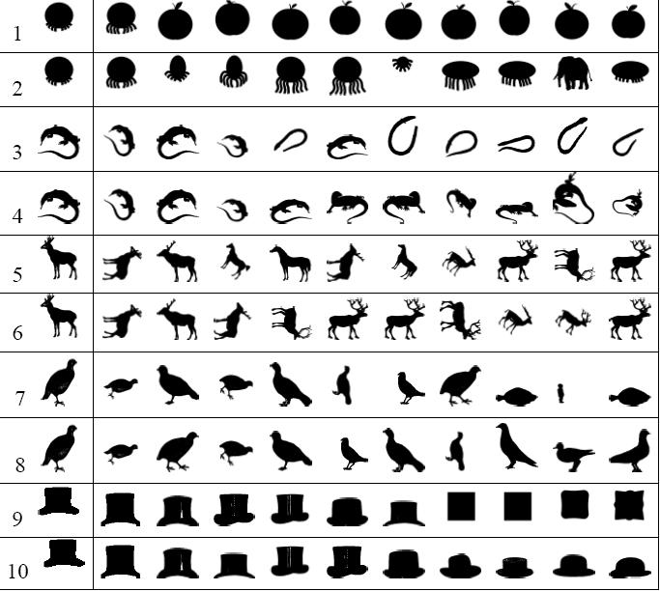
The first column shows the query shape. The remaining 10 columns show the most similar shapes retrieved by IDSC (odd row numbers) and by my method after graph transduction. (even row numbers)

Slide 5
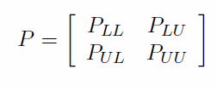
Evaluators’ job
Generate 5 sets of the test data using gentestdata.m
Normalize matrix A to a stochastic matrix P, i.e., sum of each row of P is one.
Generate matrix P_{LL} of size l x l, where l = 70, by taking 1 random shape from each of the 70 shape classes. Hence there is u=1330 unlabeled points.
Divide the matrix P of size 1400 x 1400 into the following
3. Save matrices PLL, PLU, PUL, PUU, vector y= True_LL with class labels of size l x 1 corresponding to the labeled points, and vector True_UU of size u x 1 with labels of unlabeled points.
Perform evaluation using testssl.m:
For each of the 5 test datasets do
1. Call your function ssl.m to predict the class labels of shapes l+1 to l+u in matrix P.
Input: matrices PLL, PLU, PUL, PUU and vector y with class labels.
Output: vector z of predicted class labels of size u x 1.
2. Compare vector z to vector True_LL and compute the
classification accuracy = (# of correct labels in z vector) / (length of z vector).
Then average classification accuracy over the 5 tests and save it.

Slide 6
Your job
Write a Matlab function called ssl.m:
Input: matrices PLL, PLU, PUL, PUU and vector True_LL with class labels.
Output: vector z of class labels of the remaining elements of size u x 1.
You can assume that the matrices are obtained as describe on the previous slide.

Slide 7
Winning team
The winning team is the one with the largest classification accuracy over the 5 runs.
The run time will be used as tie-breaker.

