Slide 1
A* Project
Joseph Catrambone and Jesse Glass

Slide 2
Grading Criteria
Path Distance
Time

Slide 3
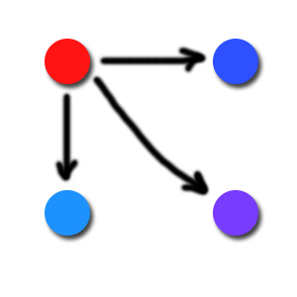
Distance

Slide 4
Interesting Results
3 Classifications
Real Distance
Constant Jump Cost
Map Cost

Slide 5
Real Distance
sqrt(dx² + dy²) + Map Cost

Slide 6
Constant Jump
All Spaces Cost 1 + Map

Slide 7
Map Cost
Purely Map Cost

Slide 8
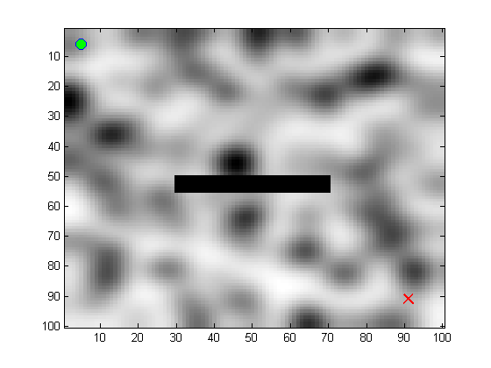
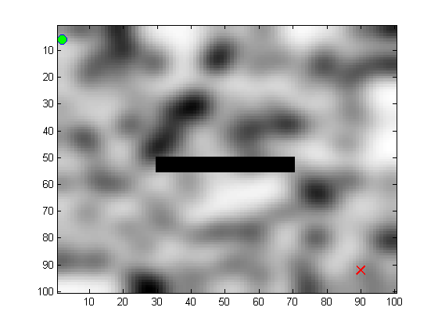
Maps 1 and 2

Slide 9
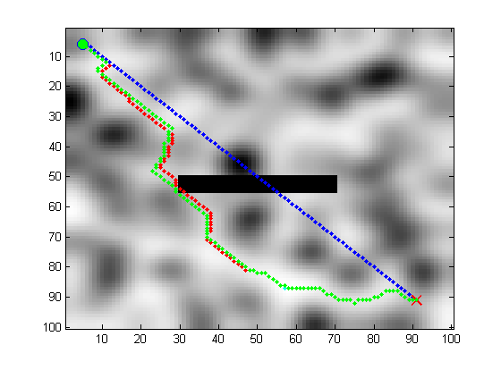
Results – Map 1

Slide 10
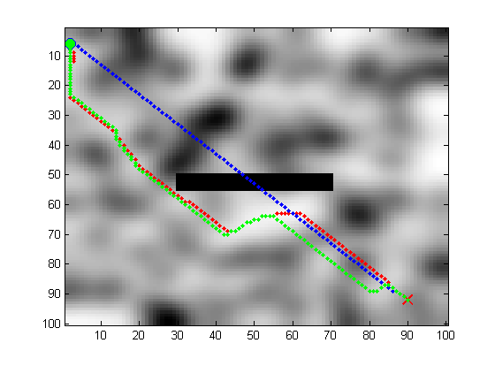
Results – Map 2

Slide 11
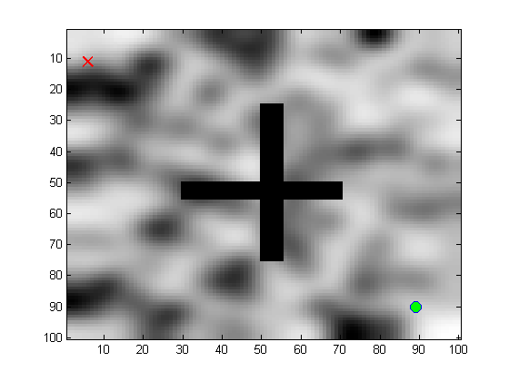
Map 3

Slide 12
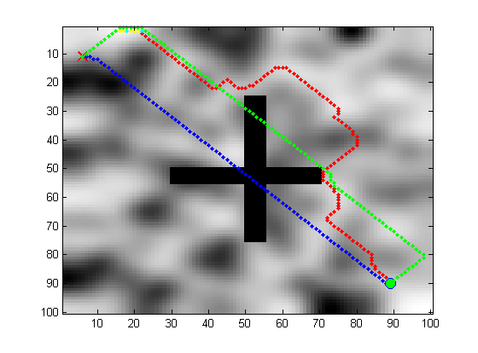
Results – Map 3

Slide 13
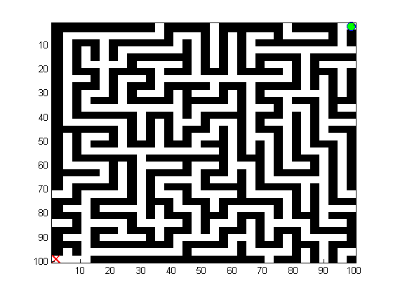
Map 4

Slide 14
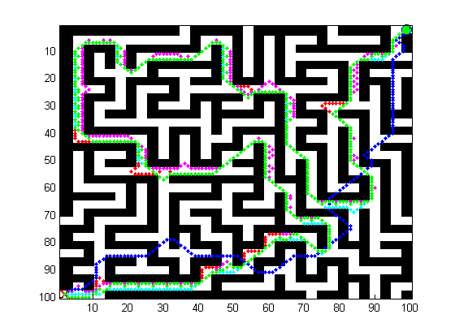
Results – Map 4

Slide 15
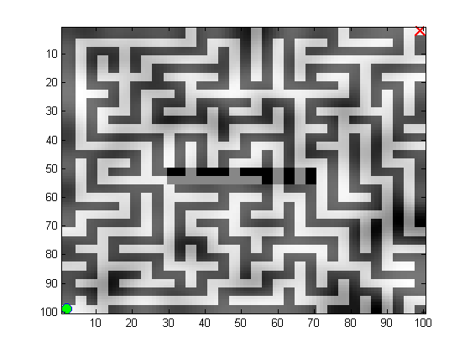
Map 5

Slide 16
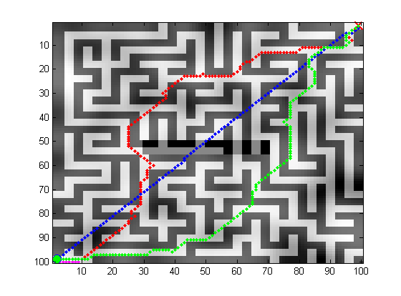
Results – Map 5

Slide 17
Wrapping Up
Well done!

