Slide 1
A* Project
Project 1
Due Sep. 26, 2012, 10pm EST
Class presentation on Oct. 1, 2012

Slide 2
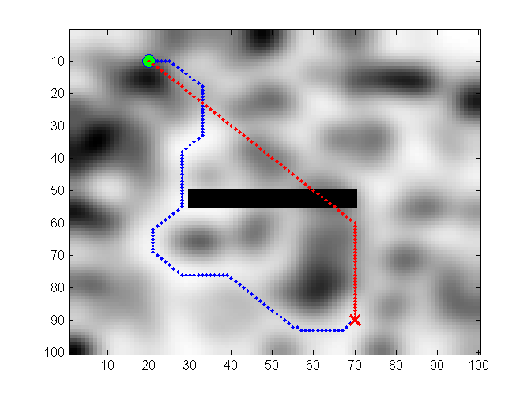
Your task
The map contains walking time for each cell (i.e. inverse of walking speed)
and the aim is to find the shortest path with respect to time.
The time is referred to as cost.
Thus the task is to find the path of minimal total cost using A* algorithm.
Gray color shows cost,
darker = higher cost.
Green circle is starting point.
Red cross is the goal point.
Red is your path.
Blue is my path.

Slide 3
Your task
Homework based on homework by Michael Otte
University of Colorado at Boulder, 2007
Updated at Massachusetts Institute of Technology, 2012
Run astar_test.m to randomly generate a map and draw the resulting paths
from the A* function and the my_astar.mexw64 function.
My path is blue, yours (the astar.m path) is red.
Modify the code in astar.m to do the A* search.
I included my_astar.mexw64 so that you can have something to compare to, this is by no means the most correct path.
You can change the map attributes by tuning the parameters in astar_test.m
The cost of each cell in the map must range from 1 to max_cost >=1.
Provide your code before the deadline to the evaluation team.
Present your main steps to the class (ca. 5 minutes)

Slide 4
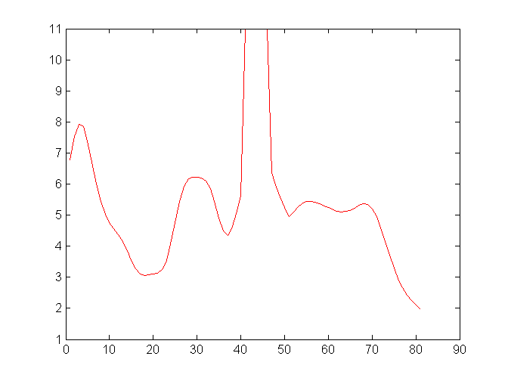
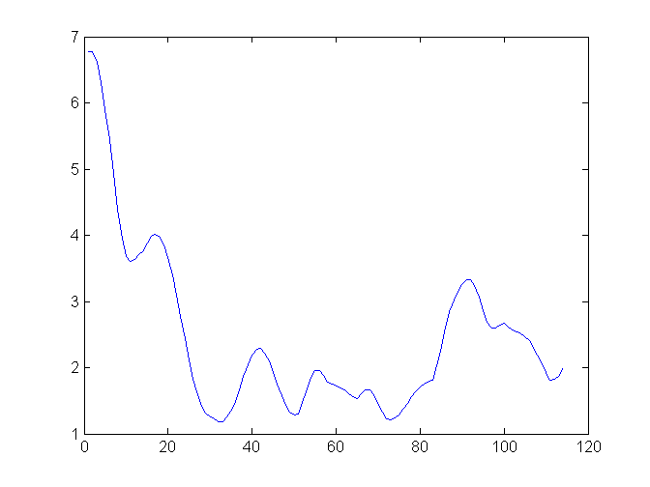
Example run
>> [my_pathcost, your_pathcost] = astar_test()
my_pathcost = 279.9270
your_pathcost = 431.9550

Slide 5
Task of the evaluation team
Generate 5 different test maps by changing the map attributes by tuning the parameters in astar_test.m
Obtain the Matlab function astar.m from each team.
Run it on each of the 5 test maps, and report the average path cost.
Report any problems with any code, e.g., did not run on map2.
Announce the winning team and present the 5 maps used for the evaluation (ca. 5 min.)

Slide 6
astar_test.m
This is the main file to run. It creates random velocity map using random_map.m, and then adds a wall in the center using fill_map.m. Note: the wall is still walkable, but with very high cost.
astar.m
This file generates dummy solution using horizontal, vertical and diagonal lines. You must replace this with their own solution.
draw_path.m
This function is used internally to draw the path.
random_map.m
This function generates random cost map for tests.
map_blur.m, fill_map.m, normalise.m
These functions are used internally for cost map generation.

