Slide 1
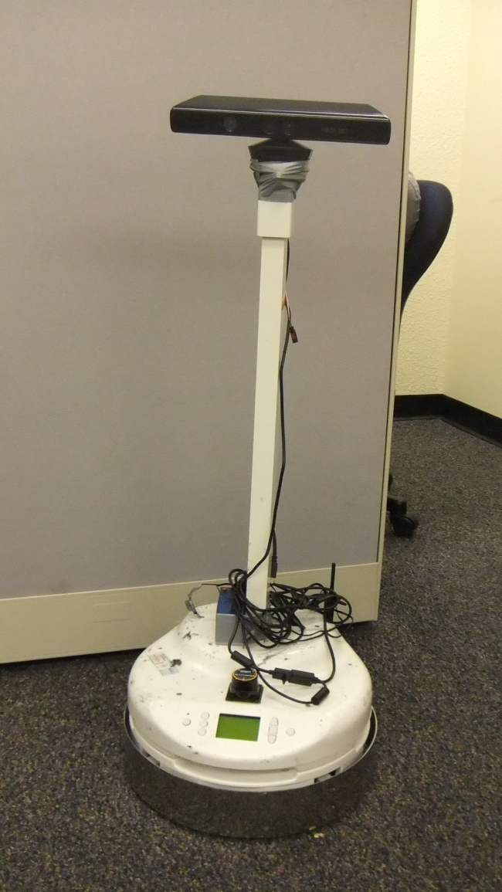
3D perception and autonomous navigation
Longin Jan Latecki Zygmunt Pizlo
Yunfeng Li
Temple University Purdue University
Project Members at Temple University:
Yinfei Yang, Matt Munin,
Kaif Brown, Meng Yi, Wenjing Qi
Robot: Pekee II with the Kinect Sensor

Slide 2
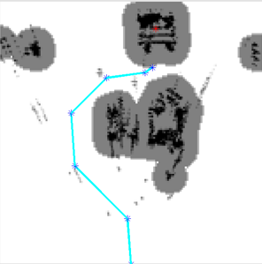
Robot’s Task
Given a target object (blue box), reach the target object by itself (autonomously).
The obstacles and the target object can move!

Slide 3
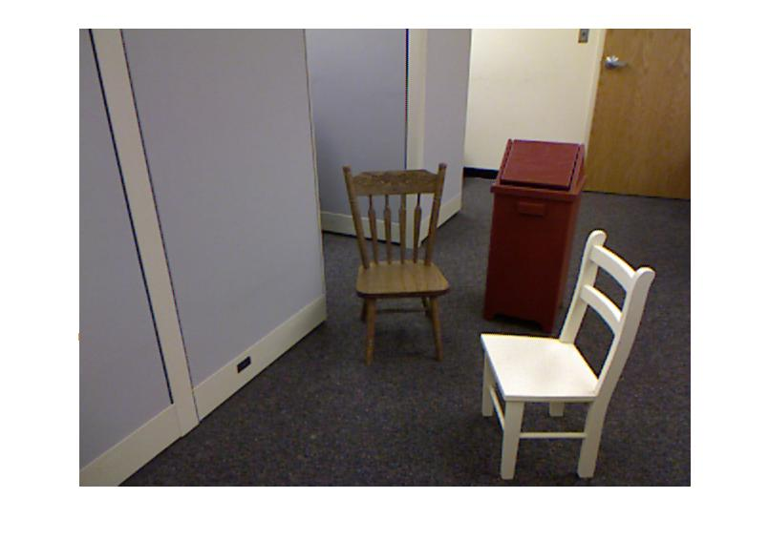
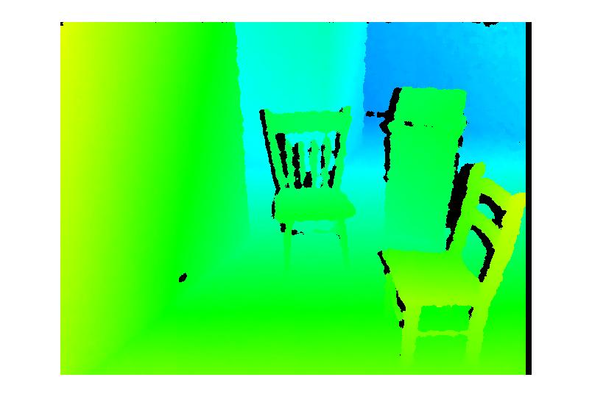
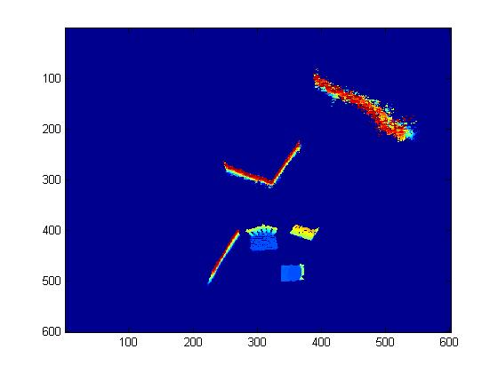
Perception-action cycle
Real world
Action
Perception
Top view world model
Main tasks: Build word model and perform path planning

Slide 4
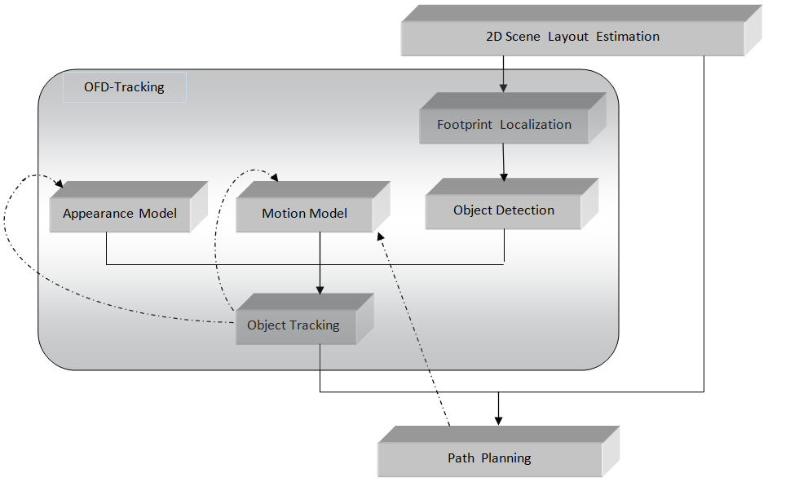
Main tasks: Build word model and perform path planning
Building word model

Slide 5
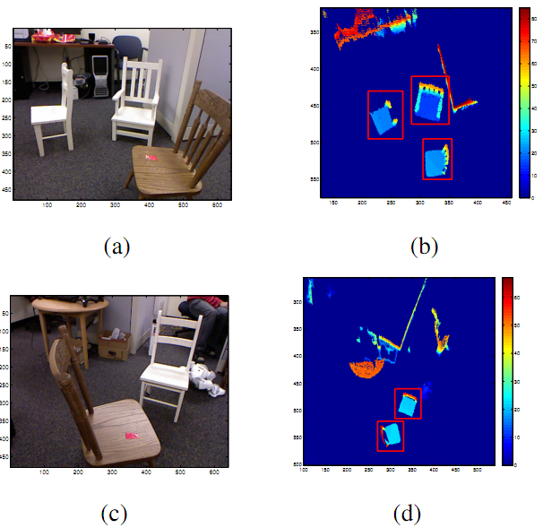
Building word model
Top View Image (Ground Plane Projection)
Depth Map
3D Points Cloud
Ground Plane
Project Objects to Ground Plane (obstacles and free space detection)
Detect the Target Object

Slide 6
Goal: Visual navigation to a target
Order of Steps:
Get Kinect data (sense)
Find ground plane
Generate Ground Plane Projection (GPP)
Perform Footprint Detection
Detect the target object
Plan the motion path to the target (plan)
Execute part of the path (act)
goto 1)
A word model is built in 2)-5)

Slide 7
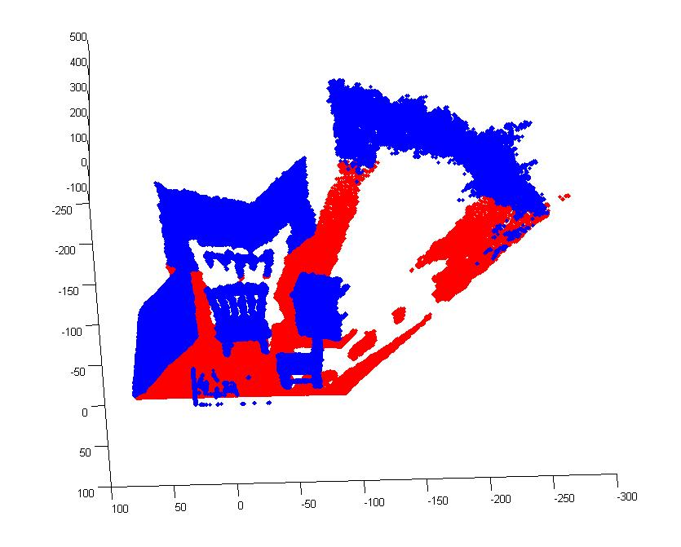
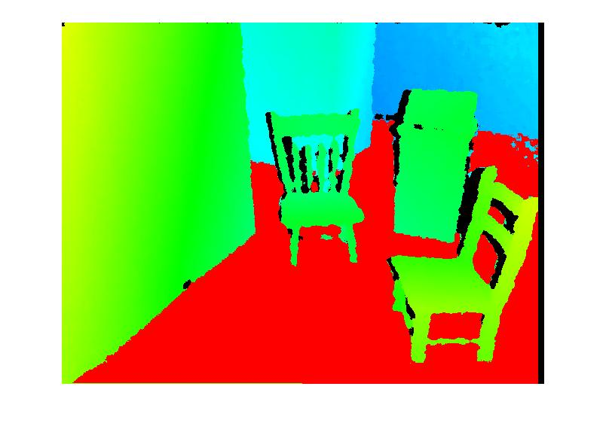
Ground Plane (GP) Detection
Input from Kinect
GP is detected in 3D points by plane fitting with RANSAC.
The depth map and depth map with the GP points marked in red.

Slide 8
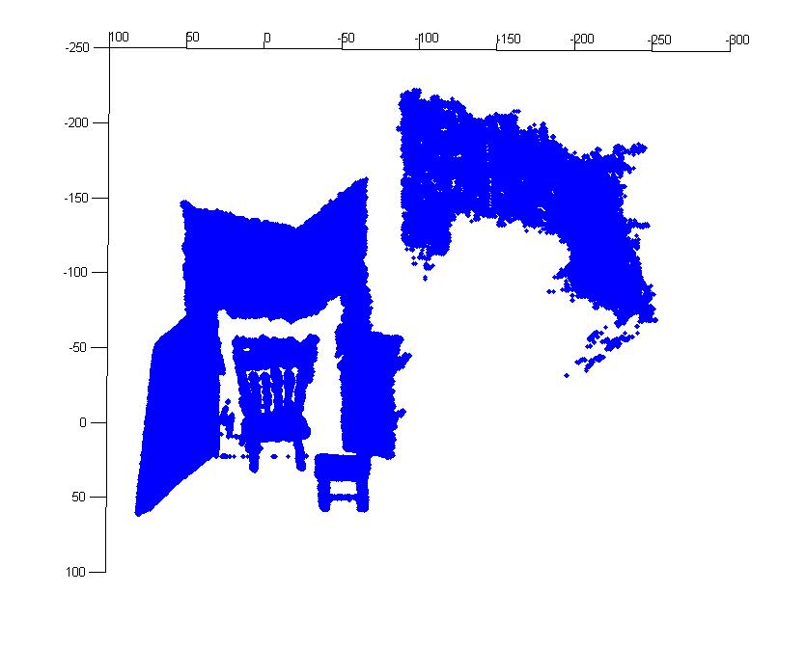
Ground Plane Projection (GPP)
The GP points (red) are removed and the remaining points are projected to GP.
We obtain a binary 2D image representing plan view or top view. We observe that it is easy to segment the footprints of objects there as connected components.

Slide 9
GPP with Height Information
The color GPP gives us additional height information about each object. It is the max height of 3D points projecting to a given pixel.

Slide 10
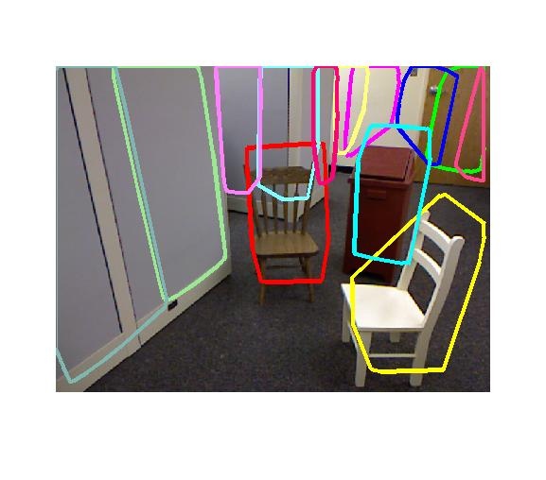
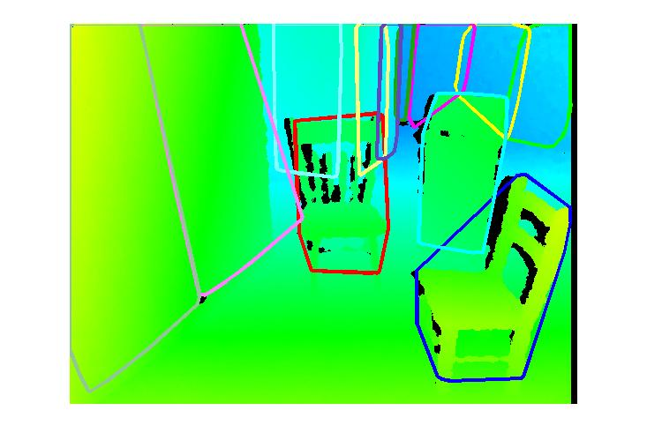
Object detection in gpp

Slide 11
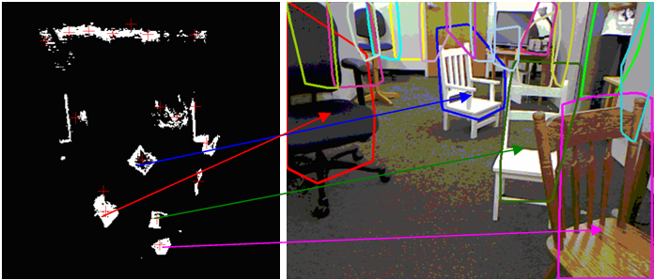
Footprint Segmentation As Robust object detector in The Original RGB images
The arrows connect the footprints detected in GPP to corresponding objects in the color image.
For a detected footprint in GPP, we know the 3D points that project to it. For the 3D points we know the pixels in the side view.
Thus, we can easily transfer the detected footprint to pixels in the side view.
We show in colors convex hulls of pixels corresponding to different footprints.

Slide 12
Separating object Detection from Recognition
We first answer the “where” question = object detection (without any appearance learning)
Then we answer the “what” question = object recognition
Opposed to the current state-of-the-art, in our approach object detection does not depend on the object recognition!
The focus on view invariant object recognition.

Slide 13
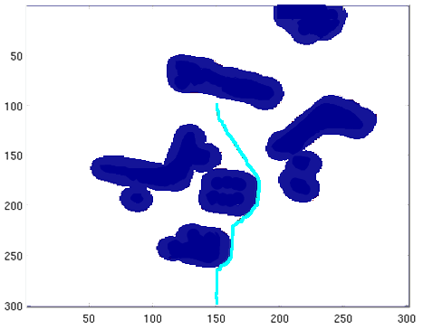
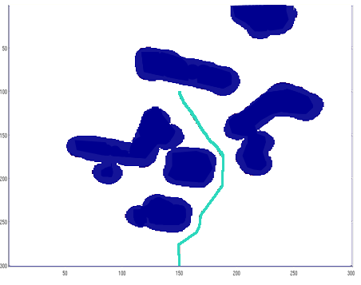
Path planning in GPP
We use the classic A* algorithm with an added weight function that penalizes paths that approach obstacles. It allows Pekee to avoid bumping into obstacles.
A* path A* path with the weight function

Slide 14
Pekee’s Perception-action cycle
In between each step, Pekee takes a new image allowing it to verify the target and path in a dynamic environment. The white chair was moved in between steps 2 & 3, so path is updated to adjust.

Slide 15
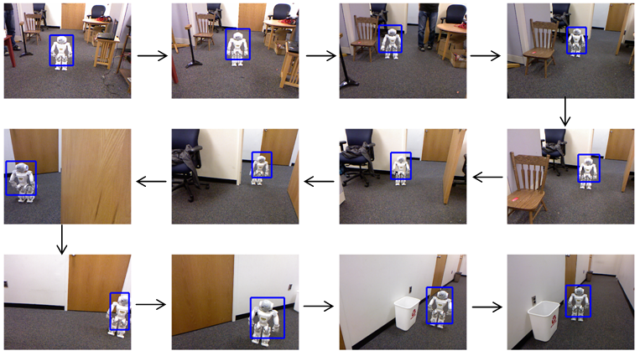
Pekee following a moving target, a humanoid robot Nao,
From the point of view of Pekee!

