Slide 1
Probabilistic Inference Unit 4, Introduction to Artificial Intelligence, Stanford online course
Made by: Maor Levy, Temple University 2012

Slide 2
Inference in Bayes Nets
What is the probability of getting a strong letter?
We want to compute the probability of a set of query variables X (= the letter) given an event e (= being intelligent)
An event = an assignment of values to a set of evidence variables E (= intelligence)

Slide 3
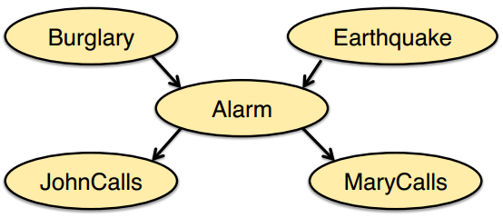
The Burglary example
The alarm can go off if there is a burglary or if there is an earthquake.
If the alarm goes off, John might call.
If the alarm goes off, Mary might call.

Slide 4
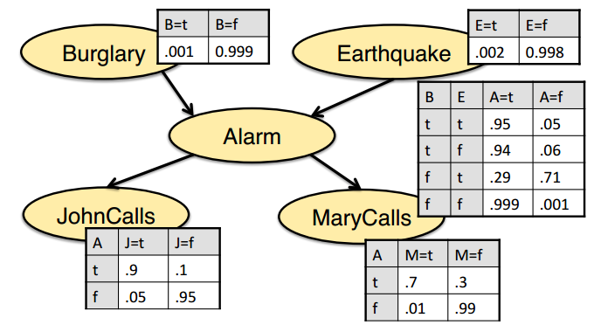
The Burglary example
What is the probability of a burglary if John and Mary call?

Slide 5
The Burglary example
Inference by enumeration
What is the probability of a burglary if John and Mary call?
What is the joint probability P(b,j,m)?

Slide 6
The Burglary example
Inference by enumeration
What is the joint probability P(b,j,m,e,a)?
So,

Slide 7
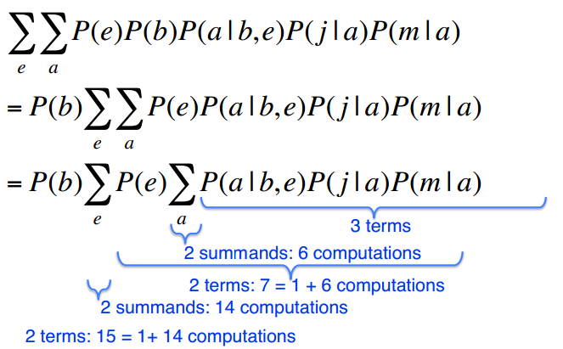
The Burglary example
Inference by enumeration

Slide 8
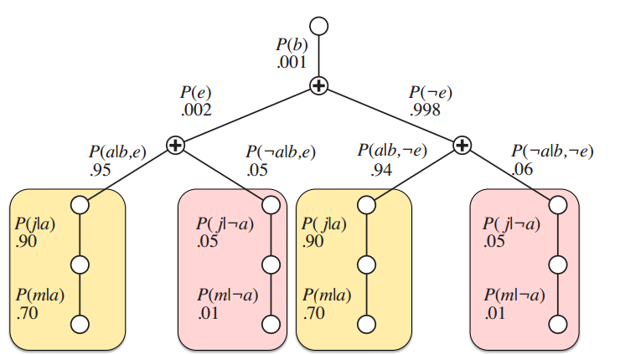
The Burglary example
Inference by enumeration (visually)

Slide 9
Enumeration is inefﬁcient…
It repeatedly evaluates the same sub expressions.
Time complexity for n Boolean variables: O($2^{n}$)
Insights:
It's better to evaluate each sub expression only once and save the result.
Often, the number of sub expressions will be relatively small.

Slide 10
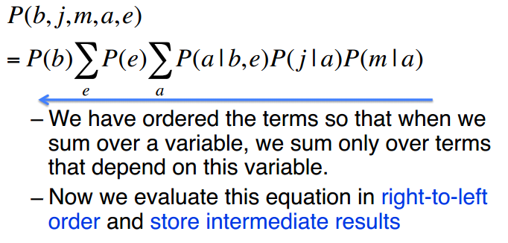
Variable elimination
We want to compute

Slide 11
Three main approaches to determine posterior distributions in belief networks:
Exploiting the structure of the network to eliminate (sum out) the non-observed, non-query variables one at a time.
Search-based approaches that enumerate some of the possible worlds, and estimate posterior probabilities from the worlds generated.
Stochastic simulation where random cases are generated according to the probability distributions.

Slide 12
A factor is a representation of a function from a tuple of random variables into a number.
We will write factor f on variables X1,..., Xj as f (X1,...,Xj).
We can assign some or all of the variables of a factor:
f (X1 = v1; X2,...,Xj), where v1 2 dom(X1), is a factor on X2,...,Xj
f (X1 = v1; X2 = v2,...,Xj = vj) is a number that is the value of f when each Xi has value vi.
The former is also written as f (X1; X2,...,Xj)X1 = v1, etc.

Slide 13
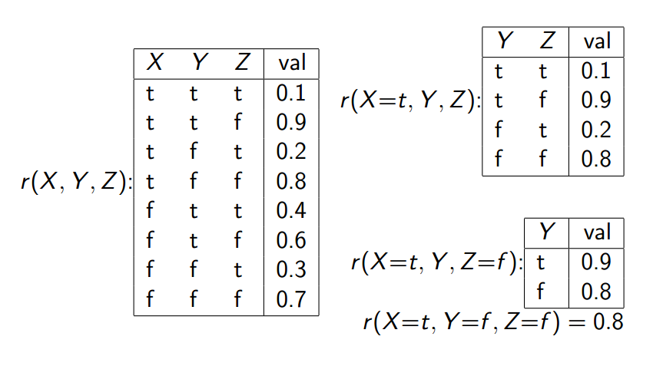
Example factors:

Slide 14
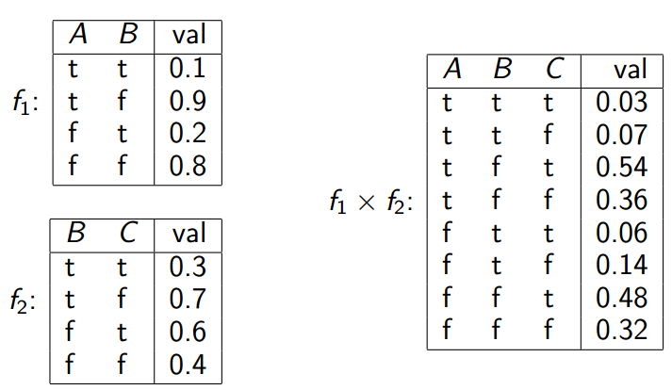
.
Multiplying factors example:

Slide 15
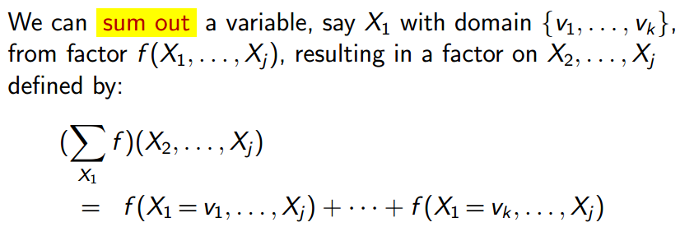
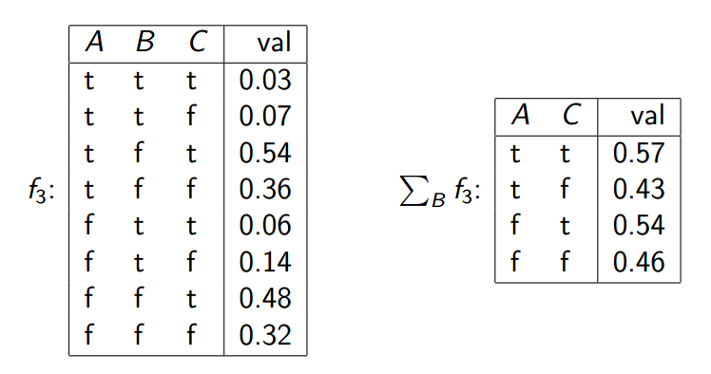
Summing out variables:
Summing out a variable example:

Slide 16
Evidence
.

Slide 17
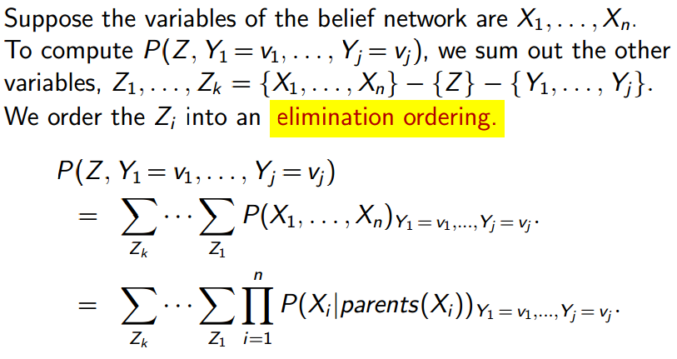
Probability of a conjunction
.

Slide 18
Computing sums of products
Computation in belief networks reduces to computing the sums of products.
How can we compute ab + ac efficiently?
Distribute out the a giving a(b + c)
How can we compute efficiently?
Distribute out those factors that don't involve Z1.

Slide 19
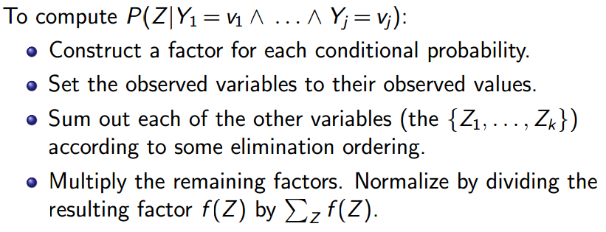
Variable elimination algorithm

Slide 20
Summing out a variable

Slide 21
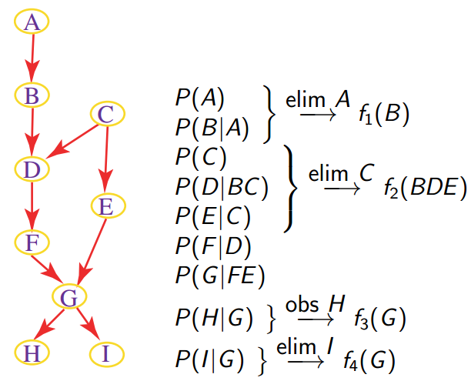
Variable elimination example

Slide 22
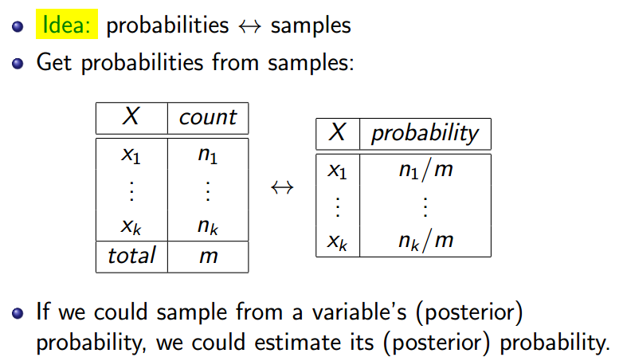
Stochastic Simulation

Slide 23
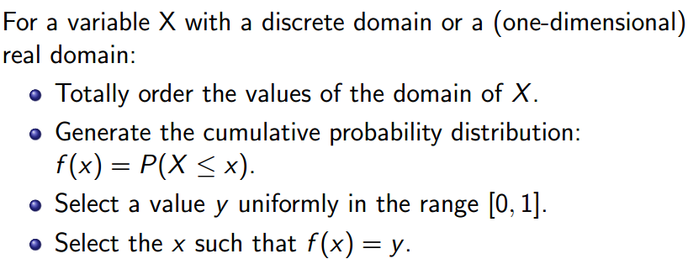
Generating samples from a distribution

Slide 24
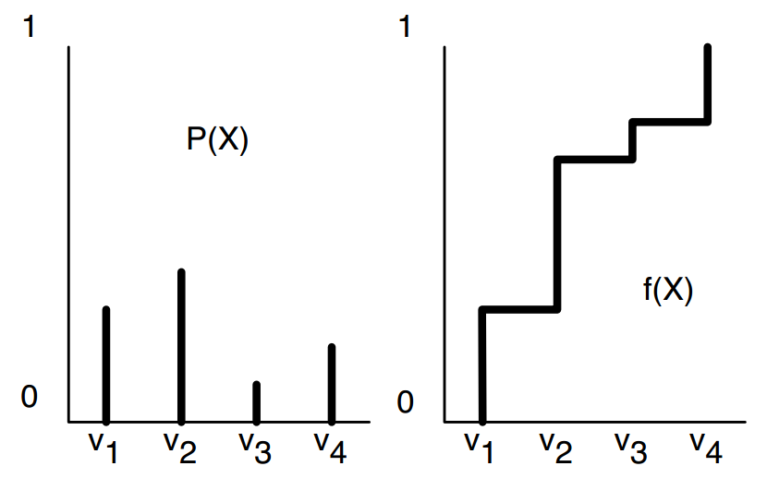
Cumulative Distribution

Slide 25
Forward sampling in a belief network
Sample the variables one at a time; sample parents of X before you sample X.
Given values for the parents of X, sample from the probability of X given its parents.
Rejection Sampling

Slide 26
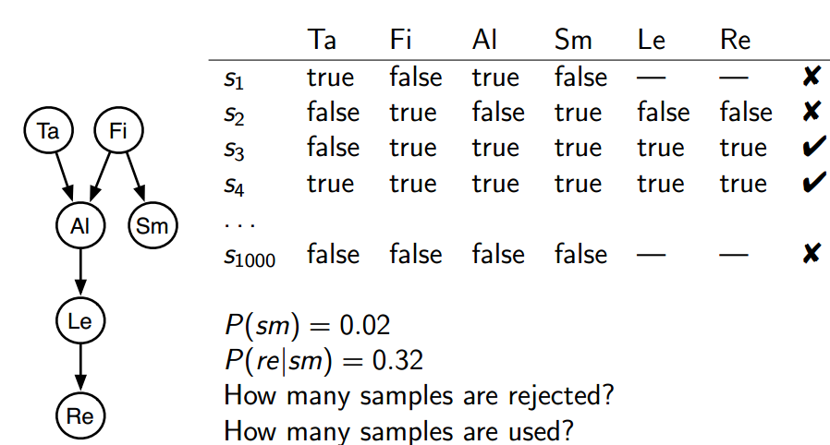
Rejection Sampling Example: P(tajsm; re)

Slide 27
Importance Sampling
Samples have weights: a real number associated with each sample that takes the evidence into account.
Probability of a proposition is weighted average of samples:
If we can compute P(evidence|sample) we can weight the (partial) sample by this value.
Mix exact inference with sampling: don't sample all of the variables, but weight each sample appropriately.
Sample according to a proposal distribution, as long as the samples are weighted appropriately

Slide 28
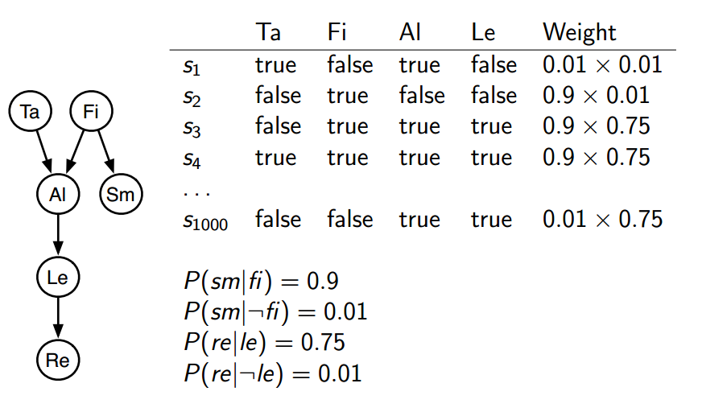
Importance Sampling Example: P(tajsm; re)

Slide 29
References:
Inference in Bayes Nets examples, Prof. Julia Hockenmaier, University of Illinois.

