Slide 1
States and Searching based on Chapter 3. Poole & Mackworth, Artificial Intelligence. Foundations of Computational Agents. Cambridge University Press 2010 Wikipedia: http://en.wikipedia.org/wiki/A_star S. Dasgupta, C.H. Papadimitriou, and U.V. Vazirani. Algorithms. http://www.cs.berkeley.edu/~vazirani/algorithms.html Andrew Moore, CMU B&B animation, John W. Chinneck, Carleton University http://www.sce.carleton.ca/faculty/chinneck/po.html Greg Grudic, University of Colorado at Boulder http://www.cs.colorado.edu/~grudic/ Charles R. Dyer, University of Wisconsin-Madison

Slide 2
The idea of search: the agent constructs a set of potential partial solutions to a problem that can be checked to see if they truly are solutions or if they could lead to solutions.
When an agent is given a problem, it is usually given only a description that lets it recognize a solution, not an algorithm to solve it.
Heuristic knowledge, in contrast to factual knowledge, the less rigorous, more experiential, more judgmental knowledge of performance.

Slide 3
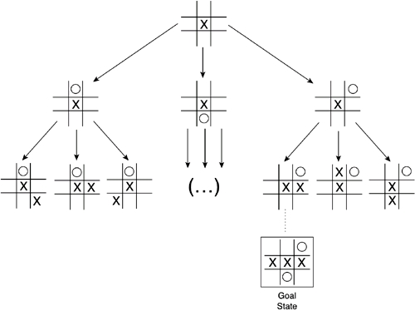
A state contains all of the information necessary to predict the effects of an action and to determine if it is a goal state.
State space is the group consisting of all the attainable states of a problem. It is usually shown by a directed graph with nodes as states and arcs as operators, which change one state into another.
How many states for tic-tac-toe?
State-space tree for tic-tac-toe (subset).

Slide 4
State-space searching assumes that:
The agent has perfect knowledge of the state space and can observe what state it is in (i.e., there is full observability).
The agent has a set of actions that have known deterministic effects.
Some states are goal states, the agent wants to reach one of these goal states, and the agent can recognize a goal state.
A solution is a sequence of actions that will get the agent from its current state to a goal state.

Slide 5
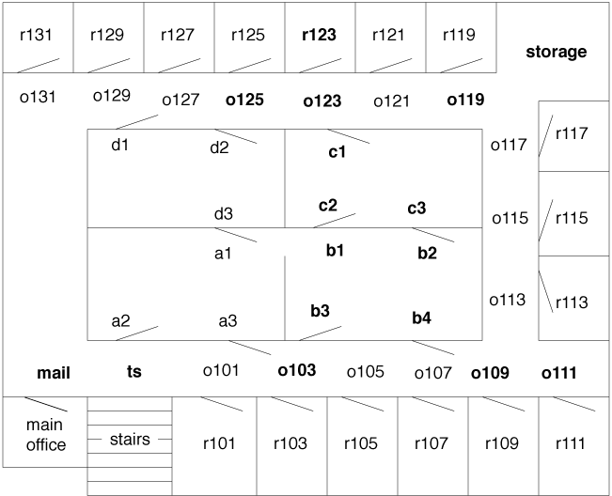
Consider the robot delivery domain and the task of finding a path from one location to another.
This can be modeled as a state-space search problem, where the states are locations.
Assume that the agent can use a lower-level controller to carry out the high-level action of getting from one location to a neighboring location.
Thus, at this level of abstraction, the actions can involve deterministic traveling between neighboring locations.
An example problem is where the robot is outside room r103, at position o103, and the goal is to get to room r123. A solution is a sequence of actions that will get the robot to room r123.

Slide 6
A state-space problem consists of:
A set of states.
A distinguished set of states called the start states.
A set of actions available to the agent in each state.
An action function that, given a state and an action, returns a new state.
A set of goal states, often specified as a Boolean function, goal(s), that is true when s is a goal state.
A criterion that specifies the quality of an acceptable solution. For example, any sequence of actions that gets the agent to the goal state may be acceptable, or there may be costs associated with actions and the agent may be required to find a sequence that has minimal total cost. This is called an optimal solution. Alternatively, it may be satisfied with any solution that is within 10% of optimal.

Slide 7
To solve a problem, first define the underlying search space and then apply a search algorithm to that search space.
Many problem-solving tasks can be transformed into the problem of finding a path in a graph.
A directed graph consists of a set of nodes and a set of directed arcs between nodes. The idea is to find a path along these arcs from a start node to a goal node.

Slide 8
To encode problems as graphs, one set of nodes is referred to as the start nodes and another set is called the goal nodes.
A solution is a path from a start node to a goal node.
Sometimes there is a cost associated with arcs.
An optimal solution is one of the least-cost solutions. In other words, it is a path from a start node to a goal node such that there is no other path from a start node to a goal node where the cost is less.

Slide 9
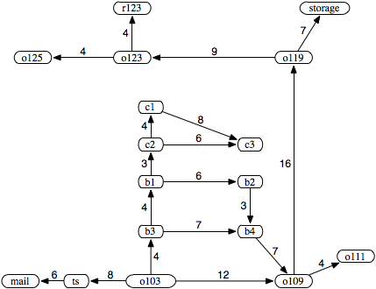
Consider the problem of the delivery robot finding a path from location o103 to location r123.
There are three paths from o103 to r123:
⟨o103, o109, o119, o123, r123⟩
⟨o103, b3, b4, o109, o119, o123, r123⟩
⟨o103, b3, b1, b2, b4, o109, o119, o123, r123⟩
If o103 were a start node and r123 were a goal node, each of these three paths would be a solution to the graph-searching problem.
First path is the optimal solution.

Slide 10
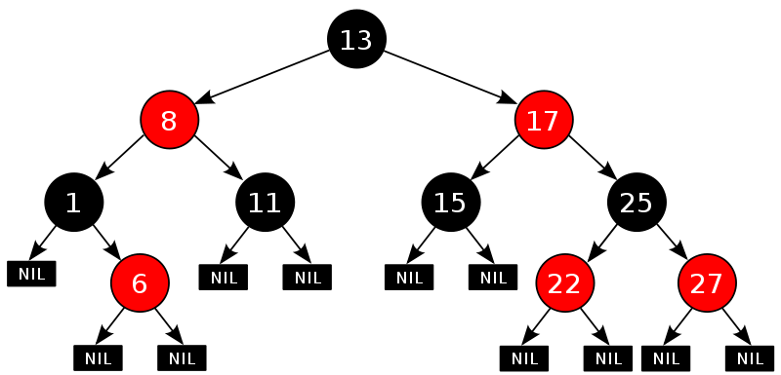
The forward branching factor of a node is the number of arcs leaving the node.
The backward branching factor of a node is the number of arcs entering the node.
The branching factor is important because it is a key component in the size of the graph.
If the forward branching factor for each node is b, and the graph is a tree, there are $b^{n}$ nodes that are n arcs away from any node.

Slide 11
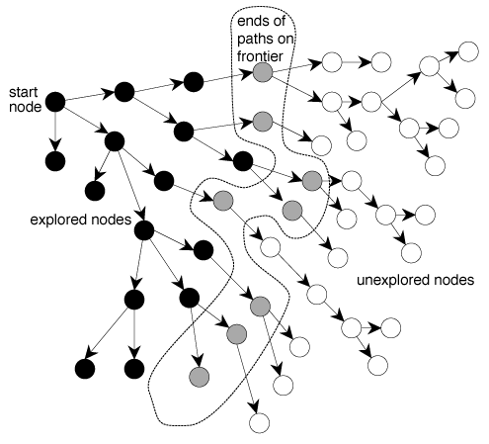
A Generic Searching Algorithm is an independent algorithm of any particular search strategy and any particular graph.
Given a graph, a set of start nodes, and a set of goal nodes, is to incrementally explore paths from the start nodes.
This is done by maintaining a frontier (or fringe) of paths from the start node that have been explored.

Slide 12
The frontier contains all of the paths that could form initial segments of paths from a start node to a goal node.
Initially, the frontier contains trivial paths containing no arcs from the start nodes.
As the search proceeds, the frontier expands into the unexplored nodes until a goal node is encountered.

Slide 13
Generic graph searching algorithm
Procedure Search(G,S,goal)
Inputs
G: graph with nodes N and arcs A
S: set of start nodes
goal: Boolean function of states
Output
path from a member of S to a node for which goal is true
or ⊥ if there are no solution paths
Local
Frontier: set of paths
Frontier ←{⟨s⟩: s∈S}
while (Frontier ≠{})
select and remove ⟨s0,...,sk⟩ from Frontier
if ( goal(sk)) then
return ⟨s0,...,sk⟩
Frontier ←Frontier ∪{⟨s0,...,sk,s⟩: ⟨sk,s⟩∈A}
return ⊥

Slide 14
Uninformed search strategies that do not take into account the location of the goal:
Depth-First Search
Breadth-First Search
Lowest-Cost-First Search
Algorithms (including search algorithms) can be compared on:
The time taken.
The space used.
The quality or accuracy of the results.

Slide 15
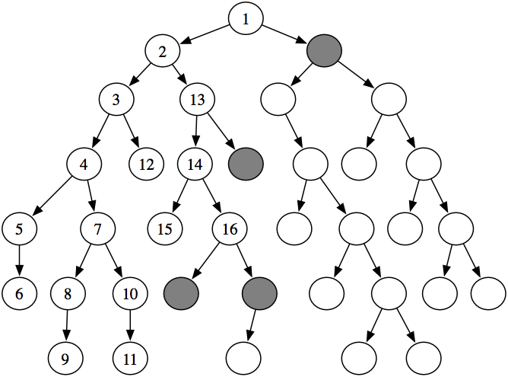
In depth-first search, the frontier acts like a last-in first-out stack.
This method is said to involve backtracking: The algorithm selects a first alternative at each node, and it backtracks to the next alternative when it has pursued all of the paths from the first selection.

Slide 44
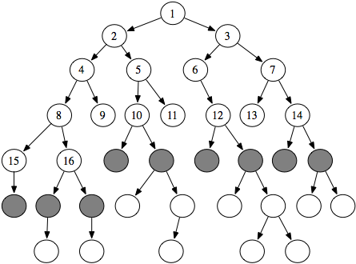
In breadth-first search the frontier is implemented as a FIFO (first-in, first-out) queue.
The path that is selected from the frontier is the one that was added earliest.
In breadth-first search, as in depth-first search, the order in which the nodes are expanded does not depend on the location of the goal.

Slide 45
Breadth-first search is useful when:
Space is not a problem.
You want to find the solution containing the fewest arcs.
Few solutions may exist, and at least one has a short path length.
Infinite paths may exist, because it explores all of the search space, even with infinite paths.
It is a poor method when all solutions have a long path length or there is some heuristic knowledge available.
Breadth-first search is not used very often because of its space complexity.

Slide 62
When a non-unit cost is associated with arcs, we often want to find the solution that minimizes the total cost of the path.
The simplest search method that is guaranteed to find a minimum cost path is similar to breadth-first search.
Instead of expanding a path with the fewest number of arcs, it selects a path with the minimum cost.

Slide 63
This is implemented by treating the frontier as a priority queue ordered by the cost function.
Like breadth-first search, lowest-cost-first search is typically exponential in both space and time. It generates all paths from the start that have a cost less than the cost of the solution.

Slide 64
Dijkstra's Algorithm (least-cost-first)

Slide 84
One form of heuristic information about which nodes seem the most promising is a heuristic function.
Heuristic search is a technique that employs heuristic for its moves. Heuristic is a rule of thumb that probably leads to a solution.
Heuristics play a major role in search strategies because of exponential nature of the most problems.
Heuristics help to reduce the number of alternatives from an exponential number to a polynomial number.

Slide 85
In AI, heuristic search has a general meaning, and a more specialized technical meaning.
In a general sense, the term heuristic is used for any advice that is often effective, but is not guaranteed to work in every case.
Within the heuristic search architecture, however, the term heuristic usually refers to the special case of a heuristic evaluation function.
The heuristic function is a way to inform the search about the direction to a goal.
It provides an informed way to guess which neighbor of a node will lead to a goal.

Slide 86
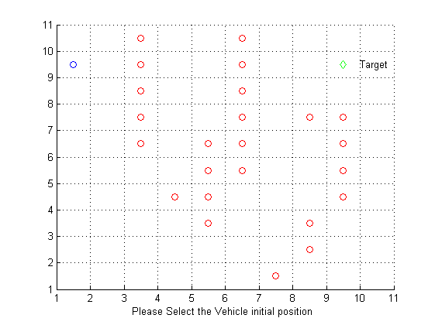
A* search for path planning
Grid points represent real locations
Allowed moves to the neighbor points

Slide 87
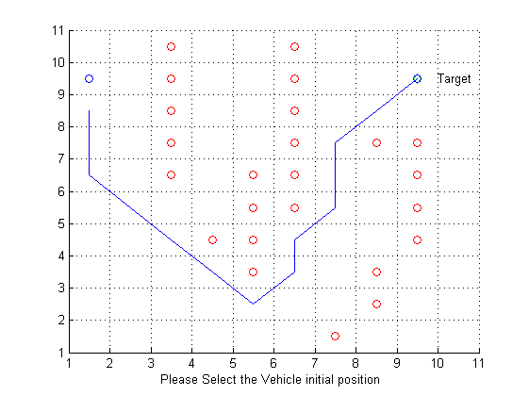
What is A* search algorithm
Output:

Slide 88
A* Search is one of the many search algorithms that takes an input, evaluates a number of possible paths and returns a solution.
In each step expand a node that have the lowest value of
function f(n) = g(n) + h(n)
actual estimate
start ---------> n -----------> goal
g(n) h(n)
-------------------------> f(n)
g(n) = path cost from node START to node n
h(n) = heuristic function that is used to approximate distance from the current location to the goal state. If h(n) = 0 this reduces to Dijkstra's shortest path
Function h is distinct because it is a mere estimation rather than an exact value.
As the heuristic function more accurate, the better and faster the goal state is reach and with much more accuracy.

Slide 89
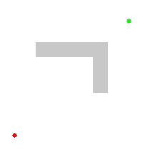
If there is solution A* will find it, which makes this search algorithm complete.
As A* traverses the graph, it follows a path of the lowest known heuristic cost, keeping a sorted priority queue of alternate path segments along the way.
Illustration of A* search:
The empty circles represent the nodes in the open set (those that remain to be explored).
The filled ones are in the closed set.
Color on each closed node indicates the distance from the start: the greener, the further.
One can firstly see the A* moving in a straight line in the direction of the goal.
When hitting the obstacle, it explores alternative routes through the nodes from the open set.

Slide 90
When starting at the initial node this search keeps track of the nodes to be traversed.
This is known as the open set and it keeps track of nodes in order of the lowest f(x) to the highest f(x).
In order of priority each node is removed from the queue and then the values for f(x) and h(x) neighboring nodes around the removed node are updated.
The search continues until it reaches the node with the lowest f(x) value (goal node).
h(x) at the goal is zero.

Slide 92
Algorithm A*
1 Put the start node S on the nodes list, called OPEN
2 If OPEN is empty, exit with failure
3 Select node in OPEN with minimal f(n) and place on CLOSED
4 If n is a goal node, collect path back to start and stop
5 Expand n, generating all its successors and attach to them pointers back to n. For each successor n' of n
1 If n' is not already on OPEN or CLOSED
put n ' on OPEN
compute h(n'), g(n')=g(n)+ c(n,n'), f(n')=g(n')+h(n')
2 If n' is already on OPEN or CLOSED and if g(n') is lower for the new version of n', then:
Redirect pointers backward from n' along path yielding lower g(n').
Put n' on OPEN.

Slide 93
Some observations on A*
Perfect heuristic: If h(n) = h*(n) for all n, then only the nodes on the optimal solution path will be expanded. So, no extra work will be performed
Null heuristic: If h(n) = 0 for all n, then this is an admissible heuristic and A* acts like uniform-cost search and A* becomes Dijkstra’s shortest path
Better heuristic: If h1(n) < h2(n) <= h*(n) for all non-goal nodes, then h2 is a better heuristic than h1
If A1* uses h1, and A2* uses h2, then every node expanded by A2* is also expanded by A1*
i.e., A1 expands at least as many nodes as A2*
We say that A2* is better informed than A1*
The closer h is to h*, the fewer extra nodes that will be expanded

Slide 95
The robot is outside room r103, at position o103, and the goal is to get to room r123.
Frontier
Start at [o103₂₁] with f(o103)=21, since h(o103)=21 and g(o103)=0)
[b3₂₁, ts₃₁,o109₃₆]
[b1₂₁, b4₂₉, ts₃₁, o109₃₆]
[c2₂₁, b4₂₉, b2₂₉, ts₃₁, o109₃₆]
[c1₂₁, b4₂₉, b2₂₉, c3₂₉, ts₃₁, o109₃₆]
[b4₂₉, b2₂₉, c3₂₉, ts₃₁, c3₃₅, o109₃₆]

Slide 97
The property that A* always finds an optimal path, if one exists, and that the first path found to a goal is optimal is called the admissibility of A*.
Admissibility means that, even when the search space is infinite, if solutions exist, a solution will be found and the first path found will be an optimal solution.

Slide 98
Proposition. (A* admissibility): If there is a solution, A* always finds a solution, and the first solution found is an optimal solution, if
the branching factor is finite (each node has only a finite number of neighbors).
arc costs are greater than some ε>0.
h(n) is a lower bound on the actual minimum cost of the lowest-cost path from n to a goal node.
Proof Part A:
A solution will be found. If the arc costs are all greater than some ε> 0, eventually, for all paths p in the frontier, cost f(p) will exceed any finite number and, thus, will exceed a solution cost if one exists (at depth in the search tree no greater than m/ε, where m is the solution cost). Because the branching factor is finite, only a finite number of nodes must be expanded before the search tree could get to this size, but the A* search would have found a solution by then.
Proof Part B:
The first path to a goal selected is an optimal path. The f-value for any node on an optimal solution path is less than or equal to the f-value of an optimal solution. This is because h is an underestimate of the actual cost from a node to a goal. Thus, the f-value of a node on an optimal solution path is less than the f-value for any non-optimal solution. Thus, a non-optimal solution can never be chosen while a node exists on the frontier that leads to an optimal solution (because an element with minimum f-value is chosen at each step). So, before it can select a non-optimal solution, it will have to pick all of the nodes on an optimal path, including each of the optimal solutions.

Slide 100
Summary of A* properties
Described by Hart and Nilsson in 1968
h*(n) = true cost of the minimal cost path from n to a goal
A* is complete whenever the branching factor is finite, and every operator has a fixed positive cost
A* is admissible if h(n) <= h*(n) holds, meaning that h is admissible.
Using an admissible heuristic guarantees that the first solution found will be an optimal one
Hart, P. E.; Nilsson, N. J.; Raphael, B. (1968). "A Formal Basis for the Heuristic Determination of Minimum Cost Paths". IEEE Transactions on Systems Science and Cybernetics SSC4 4 (2): 100–107.

Slide 101
Solving 8-Puzzle with A*
How to represent the sates?
What are neighbor states?
What is h*(n)?
What is f(n)?
Examples of h(n)?
3
2
8
Current State
4
5
6
?
7
1
1
2
3
Goal State
4
5
6
7
8

Slide 102
Heuristics for 8-puzzle
1
2
3
Current State
4
5
6
7
8
1
2
3
The number of misplaced tiles (not including the blank)
1
2
3
4
5
6
4
5
6
1
2
3
7
8
Goal State
7
8
4
5
6
7
8
N
N
N
In this case, only “8” is misplaced, so the heuristic function evaluates to 1.
In other words, the heuristic is telling us, that it thinks a solution might be available in just 1 more move.
N
N
N
N
Y

Slide 103
Heuristics for 8-puzzle
3
2
8
3
3
Manhattan Distance (not including the blank)
Current State
4
5
6
2 spaces
7
1
8
1
2
3
Goal State
3 spaces
4
5
6
8
7
8
1
In this case, only the “3”, “8” and “1” tiles are misplaced, by 2, 3, and 3 squares respectively, so the heuristic function evaluates to 8.
In other words, the heuristic is telling us, that it thinks a solution is available in just 8 more moves.
The misplaced heuristic’s value is 3.
3 spaces
1
Total 8

Slide 104
Solving 8-Puzzle with A* Example
Current State n0 State n1 State n2 State n3 = goal
1
3
1
2
3
1
2
3
1
2
3
4
2
6
4
6
4
5
6
4
5
6
7
5
8
7
5
8
7
8
7
8
h*(n0) = 3
h1 - misplaced tiles, h2 – sum of Manhattan distances
h1(n0) = 3 h2(n0)=3

Slide 105
Depth-first branch and bound (B&B) search is a way to combine the space saving of depth-first search with heuristic information.
B&B is a systematic method for solving optimization problems.
B&B is a rather general optimization technique that applies where the greedy method and dynamic programming fail.

Slide 106
A company is assembling a team to carry out a series of operations.
There are four members of the team: A, B, C and D, and four operations to be carried out.
Each team member can carry out exactly one operation.
All four operations must be carried out successfully for the overall project to succeed, however the probability of a particular team member succeeding in a particular operation varies, as shown in the table below.
For example, if the team members were assigned to operations in the order ABCD, then the overall probability of successful completion of the project is (0.9)(0.6)(0.85)(0.7) = 0.3213.

Slide 107
If there is any possible way that the team can be arranged such that the overall probability of success exceeds 45%, then the manager will approve the project.
Will the manager approve the project?
If yes, what is the arrangement of the team that gives the highest probability of success?

Slide 108
At the root node, no decisions have been made. We will simply choose the best person for each of the jobs.
In this case, person A has the best probability of success for each of the 4 operations.
This gives a bounding value of: (0.9)*(0.8)*(0.9)*(0.85)= 0.5508
We will label the root node with this solution and the bounding function value.
Root
A
B
C
D
B
C
D
B
C
A
C
D
A
B
D
A
B
A
B
C
B
C

Slide 109
Now, we will expand this node by branching on the first operation.
Each node is labeled with the person who is assigned to operation 1 at that node.
We will now evaluate the bounding function at each of these nodes.
Root
A
B
C
D
B
C
D
B
C
A
C
D
A
B
D
A
B
A
B
C
B
C
AAAA
0.5508

Slide 110
At this node, the decision has been made that person A will perform operation 1. we will indicate this by coloring A in green.
Person A cannot be selected to perform any other operation because it has already been chosen.
Root
A
B
C
D
B
C
D
B
C
A
C
D
A
B
D
A
B
A
B
C
B
C
AAAA
0.5508
110

Slide 111
The remaining people will be assigned to the remaining jobs.
This is done in the same way that we have done it before. The person with the best probability for success will be chosen for the job.
In the case of a tie, choose one arbitrarily.
This assignment gives a bounding function value of: (0.9)*(0.7)*(0.85)*(0.8)=0.4284
Root
A
B
C
D
B
C
D
B
C
A
C
D
A
B
D
A
B
A
B
C
B
C
ADCC
AAAA
0.5508
111
111

Slide 112
We will now move on to the next nodes.
Root
A
B
C
D
B
C
D
B
C
A
C
D
A
B
D
A
B
A
B
C
B
C
ADCC
0.4284
BAAA
0.4284
AAAA
0.5508

Slide 113
We will now move on to the next nodes.
Root
A
B
C
D
B
C
D
B
C
A
C
D
A
B
D
A
B
A
B
C
B
C
ADCC
0.4284
BAAA
0.4284
AAAA
0.5508
CAAA
0.5202
113

Slide 114
We will now move on to the next nodes.
We will now expand one of the nodes.
The node that we choose to expand is the node that is the most promising to provide the optimal solution.
This node is the one with the greatest bounding function value.
Root
A
B
C
D
B
C
D
B
C
A
C
D
A
B
D
A
B
A
B
C
B
C
ADCC
0.4284
BAAA
0.4284
AAAA
0.5508
CAAA
0.5202
DAAA
0.4590
114

Slide 115
We will be branching on operation 2.
There are only 3 nodes, because person C is already locked into performing operation 1.
Root
A
B
C
D
B
C
D
B
C
A
C
D
A
B
D
A
B
A
B
C
B
C
ADCC
0.4284
BAAA
0.4284
AAAA
0.5508
CAAA
0.5202
DAAA
0.4590

Slide 116
At this node, the person for operation 1 and 2 has ben decided.
A and C cannot be reassigned to other operations.
We will assign the best remaining people to the remaining operations.
Root
A
B
C
D
B
C
D
B
C
A
C
D
A
B
D
A
B
A
B
C
B
C
ADCC
0.4284
CABD
0.3808
BAAA
0.4284
AAAA
0.5508
CAAA
0.5202
DAAA
0.4590

Slide 117
This solution assigns a different person to each job, therefore, it is a feasible solution.
This is our first feasible solution.
We will mark this node as the incumbent.
We will now evaluate the remaining nodes.
Incumbent:
CABD 0.3808
Root
A
B
C
D
B
C
D
B
C
A
C
D
A
B
D
A
B
A
B
C
B
C
ADCC
0.4284
*
CABD
0.3808
BAAA
0.4284
AAAA
0.5508
CAAA
0.5202
DAAA
0.4590

Slide 118
We will now choose the next node for expansion.
The node selection policy we have chosen is global best.
We will select the node in the decision tree that has the highest bounding function value.
Incumbent:
CABD 0.3808
Root
A
B
C
D
B
C
D
B
C
A
C
D
A
B
D
A
B
A
B
C
B
C
ADCC
0.4284
*
CABD
0.3808
BAAA
0.4284
CBAA
0.3902
AAAA
0.5508
CAAA
0.5202
CDAA
0.4552
DAAA
0.4590

Slide 119
We will expand this node, branching on operation 2.
Again, there are only 3 nodes, because person D is locked into performing operation 1.
Incumbent:
CABD 0.3808
Root
A
B
C
D
B
C
D
B
C
A
C
D
A
B
D
A
B
A
B
C
B
C
ADCC
0.4284
*
CABD
0.3808
BAAA
0.4284
CBAA
0.3902
AAAA
0.5508
CAAA
0.5202
CDAA
0.4552
DAAA
0.4590

Slide 120
We will evaluate these nodes.
Incumbent:
CABD 0.3808
Root
A
B
C
D
B
C
D
B
C
A
C
D
A
B
D
A
B
A
B
C
B
C
ADCC
0.4284
*
CABD
0.3808
BAAA
0.4284
CBAA
0.3902
AAAA
0.5508
CAAA
0.5202
DACC
0.4080
CDAA
0.4552
DAAA
0.4590
DBAA
0.3443
DCAA
0.4016

Slide 121
This node has a bounding function value that is less than the current incumbent.
This means that this node cannot produce a solution better than the current incumbent.
There is no need to expand this node.
It will be cropped.
Incumbent:
CABD 0.3808
Root
A
B
C
D
B
C
D
B
C
A
C
D
A
B
D
A
B
A
B
C
B
C
ADCC
0.4284
*
CABD
0.3808
BAAA
0.4284
CBAA
0.3902
AAAA
0.5508
CAAA
0.5202
DACC
0.4080
CDAA
0.4552
DAAA
0.4590
DBAA
0.3443
DCAA
0.4016

Slide 122
We will now choose the node with the highest bounding function value to be expanded.
Incumbent:
CABD 0.3808
Root
A
B
C
D
B
C
D
B
C
A
C
D
A
B
D
A
B
A
B
C
B
C
ADCC
0.4284
*
CABD
0.3808
BAAA
0.4284
CBAA
0.3902
AAAA
0.5508
CAAA
0.5202
DACC
0.4080
CDAA
0.4552
DAAA
0.4590
DCAA
0.4016

Slide 123
We will be branching on operation 3.
There are only 2 nodes here because C and D are locked into performing operation 1 and 2 respectively.
Evaluate these nodes.
Incumbent:
CABD 0.3808
Root
A
B
C
D
B
C
D
B
C
A
C
D
A
B
D
A
B
A
B
C
B
C
ADCC
0.4284
*
CABD
0.3808
BAAA
0.4284
CDAB
0.3749
CBAA
0.3902
AAAA
0.5508
CDBA
0.4046
CAAA
0.5202
DACC
0.4080
CDAA
0.4552
DAAA
0.4590
DCAA
0.4016

Slide 124
This node is a feasible solution.
However, the value of the objective function is less than the current incumbent.
This node will be cropped.
Incumbent:
CABD 0.3808
Root
A
B
C
D
B
C
D
B
C
A
C
D
A
B
D
A
B
A
B
C
B
C
ADCC
0.4284
*
CABD
0.3808
BAAA
0.4284
CDAB
0.3749
CBAA
0.3902
AAAA
0.5508
CDBA
0.4046
CAAA
0.5202
DACC
0.4080
CDAA
0.4552
DAAA
0.4590
DCAA
0.4016

Slide 125
This node is feasible solution and it has an objective function value greater than the current incumbent.
This node will replace the current incumbent because it is a better solution.
Incumbent:
CABD 0.3808
Root
A
B
C
D
B
C
D
B
C
A
C
D
A
B
D
A
B
A
B
C
B
C
ADCC
0.4284
*
CABD
0.3808
BAAA
0.4284
CBAA
0.3902
AAAA
0.5508
CDBA
0.4046
CAAA
0.5202
DACC
0.4080
CDAA
0.4552
DAAA
0.4590
DCAA
0.4016

Slide 126
With the new incumbent, we can crop all the live bud nodes that have a lower bounding function value than the current incumbent.
Incumbent:
CABD 0.3808
CDBA 0.4046
Root
A
B
C
D
B
C
D
B
C
A
C
D
A
B
D
A
B
A
B
C
B
C
ADCC
0.4284
CABD
0.3808
BAAA
0.4284
CBAA
0.3902
AAAA
0.5508
*
CDBA
0.4046
CAAA
0.5202
DACC
0.4080
CDAA
0.4552
DAAA
0.4590
DCAA
0.4016

Slide 127
With the new incumbent, we can crop all the live bud nodes that have a lower bounding function value than the current incumbent.
We will now choose the next node to expand.
Incumbent:
CABD 0.3808
CDBA 0.4046
Root
A
B
C
D
B
C
D
B
C
A
C
D
A
B
D
A
B
A
B
C
B
C
ADCC
0.4284
BAAA
0.4284
AAAA
0.5508
*
CDBA
0.4046
CAAA
0.5202
DACC
0.4080
CDAA
0.4552
DAAA
0.4590

Slide 128
Since we have a tie, simply choose one arbitrarily.
Incumbent:
CABD 0.3808
CDBA 0.4046
Root
A
B
C
D
B
C
D
B
C
A
C
D
A
B
D
A
B
A
B
C
B
C
ADCC
0.4284
BAAA
0.4284
AAAA
0.5508
*
CDBA
0.4046
CAAA
0.5202
DACC
0.4080
CDAA
0.4552
DAAA
0.4590

Slide 129
We will now evaluate these nodes.
Incumbent:
CABD 0.3808
CDBA 0.4046
Root
A
B
C
D
B
C
D
B
C
A
C
D
A
B
D
A
B
A
B
C
B
C
ADCC
0.4284
BAAA
0.4284
AAAA
0.5508
*
CDBA
0.4046
CAAA
0.5202
DACC
0.4080
CDAA
0.4552
DAAA
0.4590

Slide 130
The value of the bounding function of all three nodes is leower than the current incumbent.
These nodes will be cropped.
Incumbent:
CABD 0.3808
CDBA 0.4046
Root
A
B
C
D
B
C
D
B
C
A
C
D
A
B
D
A
B
A
B
C
B
C
ADCC
0.4284
BACC
0.3808
BCAA
0.3749
BAAA
0.4284
BDAA
0.3749
AAAA
0.5508
*
CDBA
0.4046
CAAA
0.5202
DACC
0.4080
CDAA
0.4552
DAAA
0.4590

Slide 131
We will now expand the next node and evaluate.
Incumbent:
CABD 0.3808
CDBA 0.4046
Root
A
B
C
D
B
C
D
B
C
A
C
D
A
B
D
A
B
A
B
C
B
C
ADCC
0.4284
AAAA
0.5508
*
CDBA
0.4046
CAAA
0.5202
DACC
0.4080
CDAA
0.4552
DAAA
0.4590

Slide 132
Cropped nodes, and expand the next node.
Incumbent:
CABD 0.3808
CDBA 0.4046
ABCC
0.3672
Root
A
B
C
D
B
C
D
B
C
A
C
D
A
B
D
A
B
A
B
C
B
C
ADCC
0.4284
ACBD
0.3528
ADCC
0.4284
AAAA
0.5508
*
CDBA
0.4046
CAAA
0.5202
DACC
0.4080
CDAA
0.4552
DAAA
0.4590

Slide 133
Cropped nodes, and expand the next node.
Incumbent:
CABD 0.3808
CDBA 0.4046
Root
A
B
C
D
B
C
D
B
C
A
C
D
A
B
D
A
B
A
B
C
B
C
ADCC
0.4284
ADBC
0.4032
ADCC
0.4284
ADCB
0.3749
AAAA
0.5508
*
CDBA
0.4046
CAAA
0.5202
DACC
0.4080
CDAA
0.4552
DAAA
0.4590

Slide 134
Cropped nodes, and expand the next node.
Incumbent:
CABD 0.3808
CDBA 0.4046
Root
A
B
C
D
B
C
D
B
C
A
C
D
A
B
D
A
B
A
B
C
B
C
AAAA
0.5508
CDBA
0.4046
CAAA
0.5202
DACC
0.4080
CDAA
0.4552
DABC
0.3840
DAAA
0.4590
DACB
0.3570

Slide 135
There are no more live buds, so we are done.
The solution is the current incumbent.
The person – operation assignment is as follows:
C – Operation 1
D – Operation 2
B – Operation 3
A – Operation 4
The probability of success of 0.4046.
Because the highest probability of success is less than 0.4500 the manager will NOT approve the project.
Incumbent:
CABD 0.3808
CDBA 0.4046
Root
A
B
C
D
B
C
D
B
C
A
C
D
A
B
D
A
B
A
B
C
B
C
AAAA
0.5508
CDBA
0.4046
CAAA
0.5202
CDAA
0.4552

Slide 136
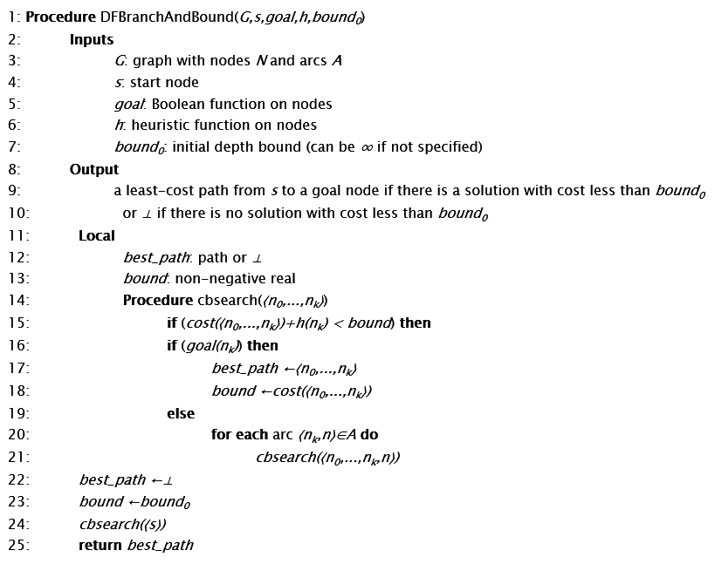
Depth-first branch-and-bound search

Slide 137
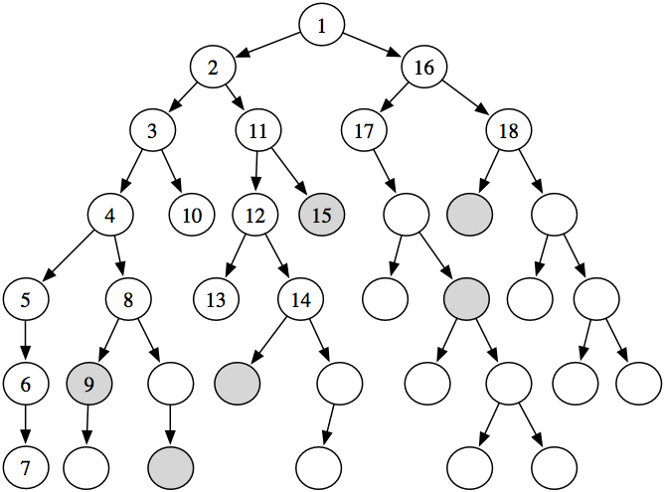
The goal nodes are shaded. Suppose that each arc has length 1, and there is no heuristic information (i.e., h(n)=0 for each node n). In the algorithm, suppose depth₀=∞ and the depth-first search always chooses the leftmost child first. This figure shows the order in which the nodes are checked to determine if they are a goal node. The nodes that are not numbered are not checked for being a goal node.

Slide 138
Dynamic Programming (DP)
DP is a general method for optimization that involves storing partial solutions to problems, so that a solution that has already been found can be retrieved rather than being recomputed.
DP algorithms are used throughout AI.
DP can be used for finding paths in graphs.
Like divide and conquer, DP solves problems by combining solutions to sub problems. However, unlike divide and conquer, sub problems are not independent.
Dynamic programming reduces computation by
Solving sub problems in a bottom-up fashion.
Storing solution to a sub problem the first time it is solved.
Looking up the solution when sub problem is encountered again.

Slide 139
Dynamic programming (DP) is useful when
The goal nodes are explicit (the previous methods only assumed a function that recognizes goal nodes).
A lowest-cost path is needed.
The graph is finite and small enough to be able to store the cost_to_goal value for each node.
cost_to_goal(n) is the actual cost of a lowest-cost path from noden to a goal
DP wokrs ifcost_to_goal(n) can be defined as
cost_to_goal(n) = 0 if is_goal(n),
min_{〈n,m〉∈A} ( cost(〈n,m〉)+cost_to_goal(m)) otherwise.

Slide 140
DP operates on a directed acyclic graphs (dags).
The special distinguishing feature of a dag is that its nodes can be linearized or topologically ordered, that is, they can be arranged on a line so that all edges go from left to right.
To see why this helps with shortest paths, suppose we want to get distances from node S to the other nodes. Let's first focus on node D. The only way to get to it is through its predecessors, B or C; so to find the shortest path to D, we need only compare these two routes:
dist(D) = min (dist(B) + 1, dist(C) + 3).
A similar relation holds for every node. If we compute these dist values in the left-to-right order, we can always be sure that by the time we get to a node v, we already have all the information we need to compute dist(v). We are therefore able to compute all distances in a single pass:

Slide 141
Notice that this algorithm is solving a collection of subproblems
{dist(u) : u in V }.
We start with the smallest of them, dist(s), since we immediately know its answer to be 0. We then proceed with progressively larger subproblems, e.g., distances to vertices that are further and further along in the linearization, Hence we are thinking of a subproblem as large if we
need to have solved a lot of other subproblems before we can get to it.

Slide 142
Edit Distance
Given two text strings A of length n and B of length m, you want to transform A into B with a minimum number of operations of the following types: delete a character from A, insert a character into A, or change some character in A into a new character. The minimal number of such operations required to transform A into B is called the edit distance between A and B.
It is also the minimal number of differences after aligning them.

Slide 143
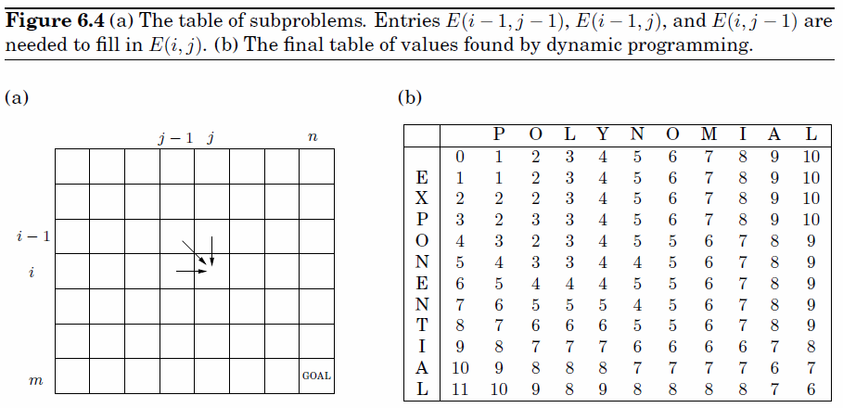

Slide 144
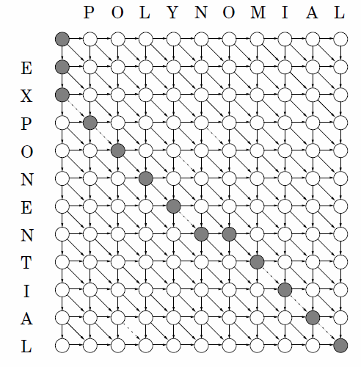
The underlying dag,
and a path of length 6.

Slide 145
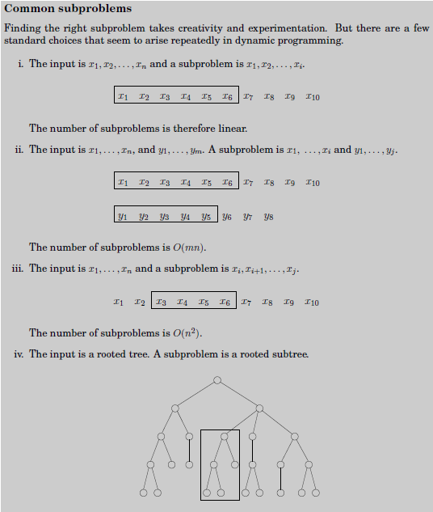

Slide 146
Overview:
Many problems can be abstracted as the problem of finding paths in graphs.
Breadth-first and depth-first searches can find paths in graphs without any extra knowledge beyond the graph.
A* search can use a heuristic function that estimates the cost from a node to a goal. If this estimate underestimates the actual cost, A* is guaranteed to find a least-cost path first. It is like breadth search with path length replaced with path cost.
Iterative deepening and depth-first branch-and-bound searches can be used to find least-cost paths with less memory than methods such as A*, which store multiple paths.
When graphs are small, dynamic programming can be used to record the actual cost of a least-cost path from each node to the goal, which can be used to find the next arc in an optimal path.

