Slide 1
Agent Architectures and Hierarchical Control
Chapter 2, Artificial Intelligence. Foundations of Computational Agents. Poole & Mackworth

Slide 2
An agent is anything that can be viewed as perceiving its environment through sensors and acting upon that environment with its effectors (also called actuators).
An agent gets percepts one at a time, and maps this percept sequence to actions
Purposive agents have preferences. They prefer some states of the world to other states, and they act to try to achieve the states they prefer most.

Slide 3
Human agent:
eyes, ears, and other organs for sensors
hands, legs, mouth, and other body parts for actuators
Robotic agent:
cameras and infrared range finders for sensors
various motors for actuators
A software agent:
Keystrokes, file contents, received network packages as sensors
Displays on the screen, files, sent network packets as actuators

Slide 4
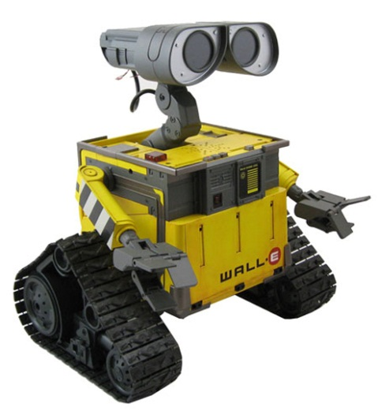
An agent system is made up of an agent and its environment. An agent is made up of a body and a controller. The controller receives percepts from the body and sends commands to the body.
An embodied agent has a physical body. A robot is an artificial purposive embodied agent.
sensors
percepts
Environment
effectors
actions

Slide 5
Examples of agents in different types of applications
Agent type
Percepts
Actions
Goals
Environment
Medical diagnosis system
Symptoms, findings, patient's answers
Questions, tests, treatments
Healthy patients, minimize costs
Patient, hospital
Satellite image analysis system
Pixels of varying intensity, color
Print a categorization of scene
Correct categorization
Images from orbiting satellite
Part-picking robot
Pixels of varying intensity
Pick up parts and sort into bins
Place parts in correct bins
Conveyor belts with parts
Refinery controller
Temperature, pressure readings
Open, close valves; adjust temperature
Maximize purity, yield, safety
Refinery
Interactive English tutor
Typed words
Print exercises, suggestions, corrections
Maximize student's score on test
Set of students

Slide 6
Percept: agent’s perceptual input at any given instant.
Percept sequence is a complete history of everything the agent has ever perceived.
An agent’s choice of action at any given instant can depend on the entire percept sequence observed to date.
An agent’s behavior is described by the agent function which maps from percept histories to actions: $[f:P^{∗}→A]$

Slide 7
The difficulty is that the agent does not know the exact state it is in. Instead, it must maintain a probability distribution, known as the belief state, over the possible states.
Example: The belief state for an agent that is following a fixed sequence of instructions may be a program counter that records its current position in the sequence.
If there exists a finite number of possible belief states, the controller is called a finite state controller or a finite state machine.

Slide 8
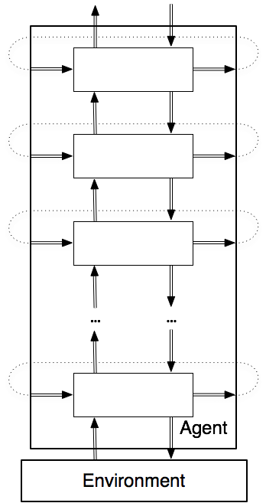
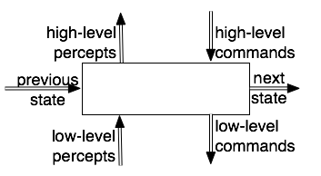
The idealized hierarchical agent system architecture is hierarchy of controllers.
The unlabeled rectangles represent layers, and the double lines represent information flow
The dotted lines show how the output at one time is the input for the next time.

Slide 9
Each layer sees the layers below it as a virtual body from which it gets percepts and to which it sends commands.
There can be multiple features passed from layer to layer and between states at different times.

Slide 10
There are three types of inputs to each layer at each time:
the features that come from the belief state.
the features representing the percepts from the layer below in the hierarchy.
the features representing the commands from the layer above in the hierarchy.
There are three types of outputs from each layer at each time:
the higher-level percepts for the layer above.
the lower-level commands for the layer below.
the next values for the belief-state features.

Slide 11
Qualitative reasoning is reasoning, often using logic, about qualitative distinctions rather than numerical values for given parameters.
Why qualitative reasoning is important?
An agent may not know what the exact values are.
The reasoning may be applicable regardless of the quantitative values.
An agent needs to do qualitative reasoning to determine which quantitative laws are applicable.

Slide 12
Qualitative reasoning uses discrete values, which can take a number of forms:
Landmarks are values that make qualitative distinctions in the individual being modeled.
Orders-of-magnitude reasoning involves approximate reasoning that ignores minor distinctions.
Qualitative derivatives indicate whether some value is increasing, decreasing, or staying the same.

Slide 13
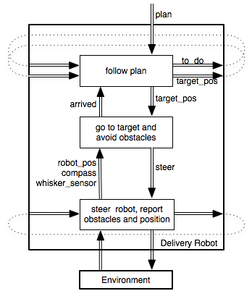
Consider a delivery robot able to carry out high-level navigation tasks while avoiding obstacles.
The delivery robot is required to visit a sequence of named locations in the environment, avoiding obstacles it may encounter.

Slide 14
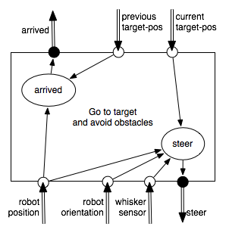
middle layer
This layer of the controller maintains no internal belief state, so the belief state transition function is vacuous.
Tries to keep traveling toward the current target position, avoiding obstacles.
The middle layer is built on a lower layer that provides a simple view of the robot.

Slide 15
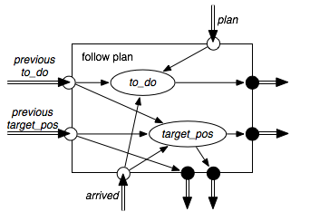
Takes in a plan to execute.
Maintains an internal belief state consisting of a list of names of locations that the robot still needs to visit and the coordinates of the current target.
top layer
The upper level knows about the names of locations, but the lower levels only know about coordinates.

Slide 16
A model of a world is a representation of the state of the world at a particular time and/or the dynamics of the world.
Dead reckoning is the process of calculating an agent's current position by using a previously determined position and advancing the position based upon known or estimated speeds over elapsed time, and course.
Perception is the use of sensing information to understand the world. Action includes the ability to negative through the world and manipulate objects.
If you want to build robots that live in the world, you must understand these processes.

Slide 17
An embedded agent is one that is run in the real world, where the actions are carried out in a real domain and where the sensing comes from a domain. Embedded mode is how the agent must run to be useful.
A simulated agent is one that is run with a simulated body and environment; that is, where a program takes in the commands and returns appropriate percepts. This is often used to debug a controller before it is deployed.

Slide 18
A agent system model is where there are models of the controller, the body, and the environment that can answer questions about how the agent will act.
Such a model can be used to prove properties of agents before they are built, or it can be used to answer hypothetical questions about an agent that may be difficult or dangerous to answer with the real agent.

Slide 19
For an intelligent agent, the belief state can be very complex, even for a single layer.
Knowledge is the information about a domain that is used for solving problems in that domain. Knowledge can include general knowledge that can be applied to particular situations.
A knowledge-based system is a system that uses knowledge about a domain to act or to solve problems.

Slide 20
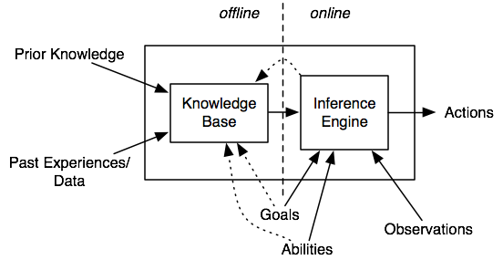
The knowledge base is its long-term memory, where it keeps the knowledge that is needed to act in the future.
The belief state is the short-term memory of the agent, which maintains the model of current environment needed between time steps.
Offline and online decomposition of an agent

Slide 21
Online, when the agent is acting, the agent uses its knowledge base, its observations of the world, and its goals and abilities to choose what to do and to update its knowledge base.
Offline, before the agent has to act, it can build the knowledge base that is useful for it to act online.
The goals and abilities are given offline, online, or both, depending on the agent.

Slide 22
Offline, there are three major roles involved with a knowledge-based system:
Software engineers build the inference engine and user interface. They typically know nothing about the contents of the knowledge base.
Domain experts are the people who have the appropriate prior knowledge about the domain. They know about the domain, but typically they know nothing about the particular case that may be under consideration.
Knowledge engineers design, build, and debug the knowledge base in consultation with domain experts. They know about the details of the system and about the domain through the domain expert.

Slide 23
Online, there are three major roles involved:
A user is a person who has a need for expertise or has information about individual cases. Users typically are not experts in the domain of the knowledge base.
Sensors provide information about the environment. For example, a thermometer is a sensor that can provide the current temperature at the location of the thermometer. Sensors come in two main varieties. A passive sensor and an active sensor.
An external knowledge source, such as a website or a database, can typically be asked questions and can provide the answer for a limited domain. An agent can ask a weather website for the temperature at a particular location.

Slide 24
Overview:
An agent system is composed of an agent and an environment.
Agents have sensors and actuators to interact with the environment.
An agent is composed of a body and interacting controllers.
Agents are situated in time and must make decisions of what to do based on their history of interaction with the environment.
An agent has direct access not to its history, but to what it has remembered (its belief state) and what it has just observed. At each point in time, an agent decides what to do and what to remember based on its belief state and its current observations.
Complex agents are built modularly in terms of interacting hierarchical layers.
An intelligent agent requires knowledge that is acquired at design time, offline or online.

