Slide 1
A* Search Algorithm
-- Yinfei Yang
What is A* Search Algorithm
How A* Algorithm works
The A* algorithm in our project

Slide 2
What is A* Search Algorithm

Slide 3
What is A* search algorithm
Description:
A* uses a best-first search and finds the least-cost path from a given initial node to one goal node (out of one or more possible goals).
Input:
Image Map
Start Position
Target Position
Output:
A path from Start Position to Target Position

Slide 4
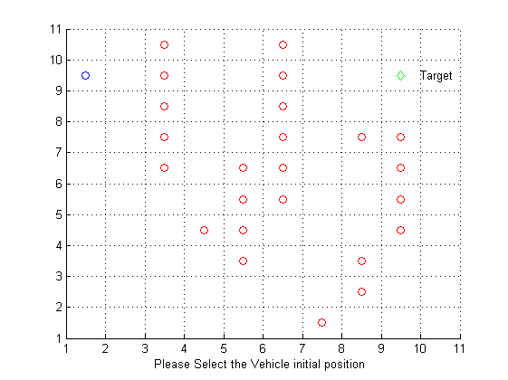
What is A* search algorithm
Input:

Slide 5
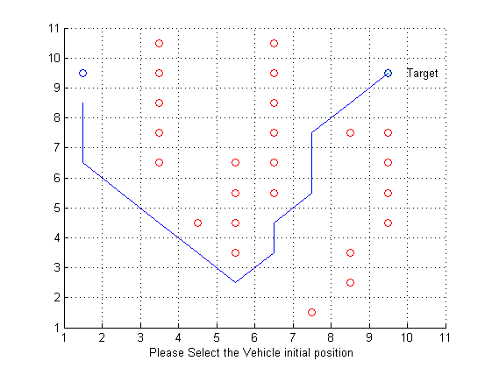
What is A* search algorithm
Output:

Slide 6
How A* Algorithm works

Slide 7
How A* algorithm works
Hints:
This is a best-first search algorithm
How to evaluate the cost of path
The cost to get from the node to the goal:
f(n) = g(n) + h(n)
g(n) gives the path cost from the start node to node n,
h(n) is the estimated cost of the cheapest path from n to the goal.

Slide 8
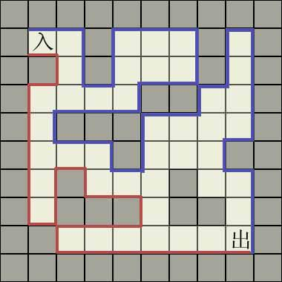
How A* algorithm works
A best-first search algorithm
A heuristic example
Notes:
A heuristic example, human walk a maze. Evaluate next step every time when he has options. Turn left or turn right, turn left or walk straight. A* algorithm also evaluate next possible step every time, which we called OPEN LIST. Choose the element with the minimize value in OPEN LIST as next step.

Slide 9
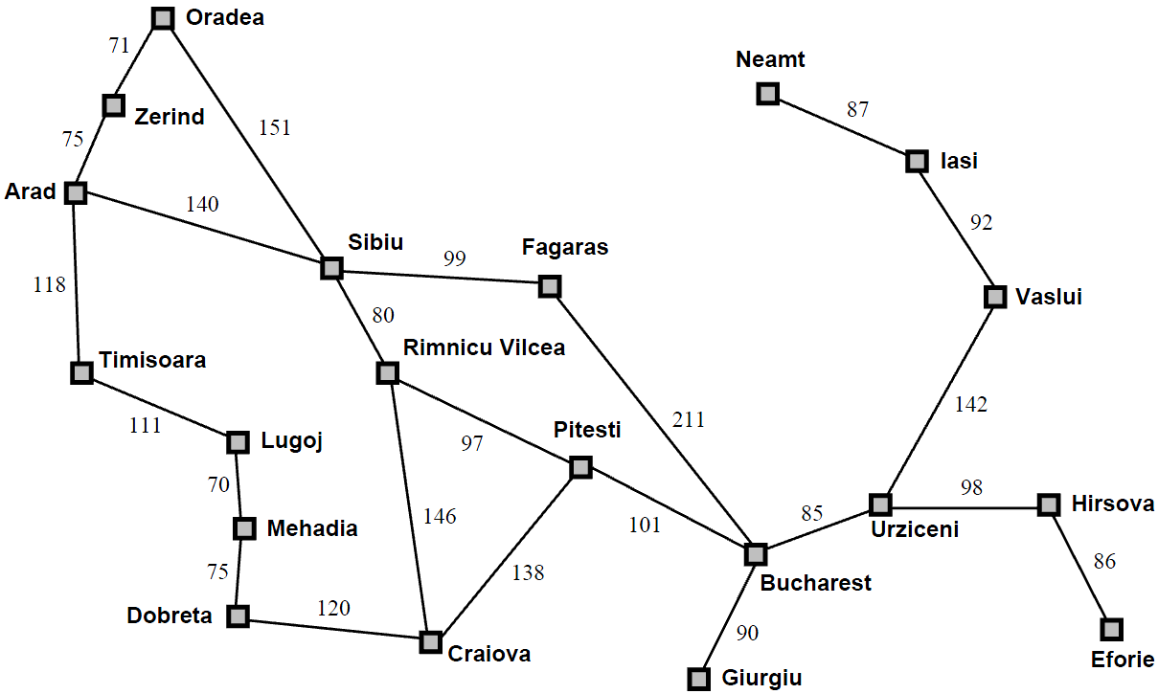
How A* algorithm works
A best-first search algorithm
A simpler example
A simplified road map of
part Romania ,
we want to find a path from Arad
to Bucharest
Notes:
Term:
OPEN LIST or SET: a priority queue of nodes to be traversed
CLOSED LIST or SET: a set of nodes have been traversed.

Slide 10
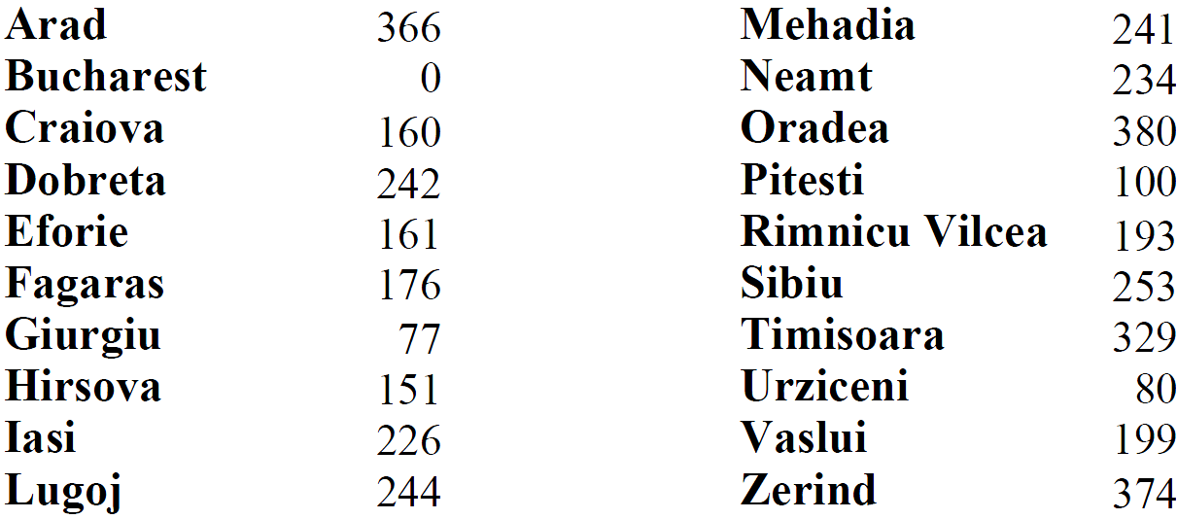
How A* algorithm works
A best-first search algorithm
A simpler example
The heuristic cost(Straight-line distances) from each node to Bucharest
Notes:
This is the h(n)

Slide 11
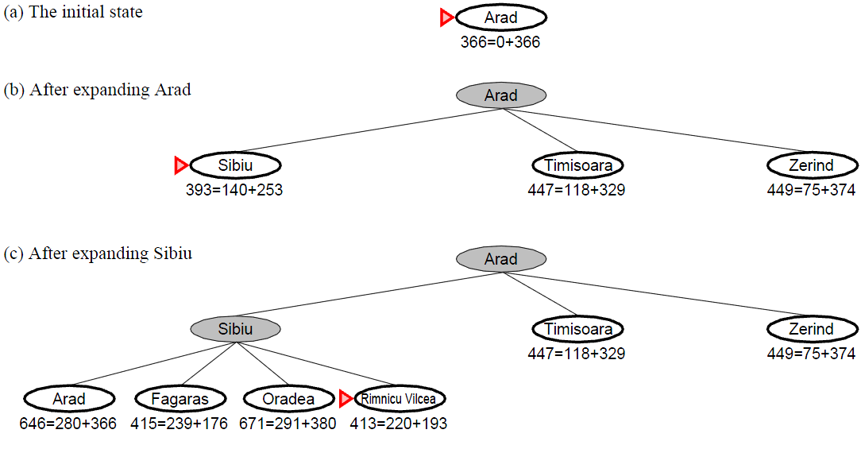
How A* algorithm works
A best-first search algorithm
A simpler example
Notes:
f(n) = g(n) + h(n)
The initial OPEN LIST is contain one node: Arad.
In Arad: the g(n) is 0, the h(n) is 366, so f(n) = 366,
after expand Arad, put Arad into CLOSED LIST, and put Sibiu Timisoara Zerind into OPEN LIST. Now, there are three nodes in OPEN LIST, choose the Sibiu since it has the minimize f(n).

Slide 12
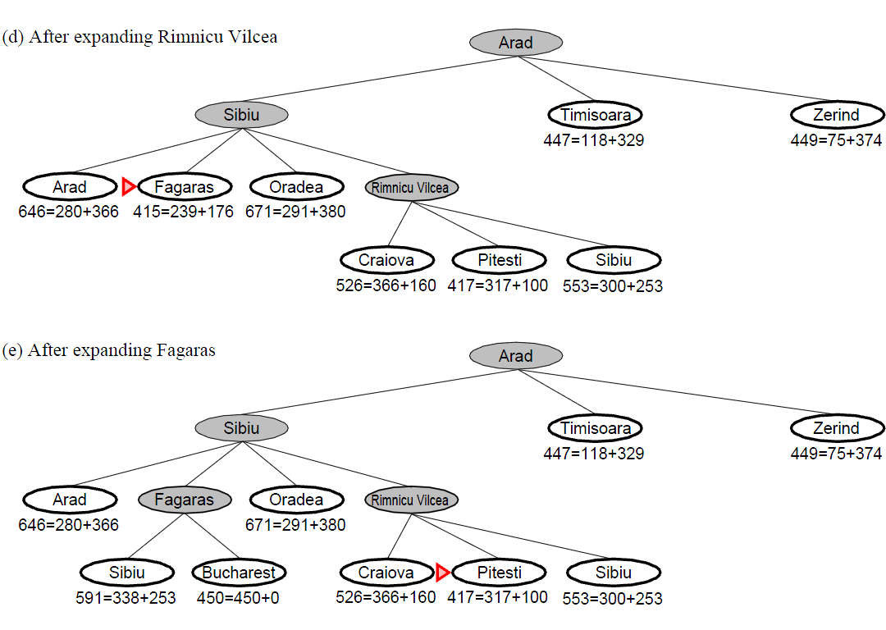
How A* algorithm works
A best-first search algorithm
A simpler example

Slide 13
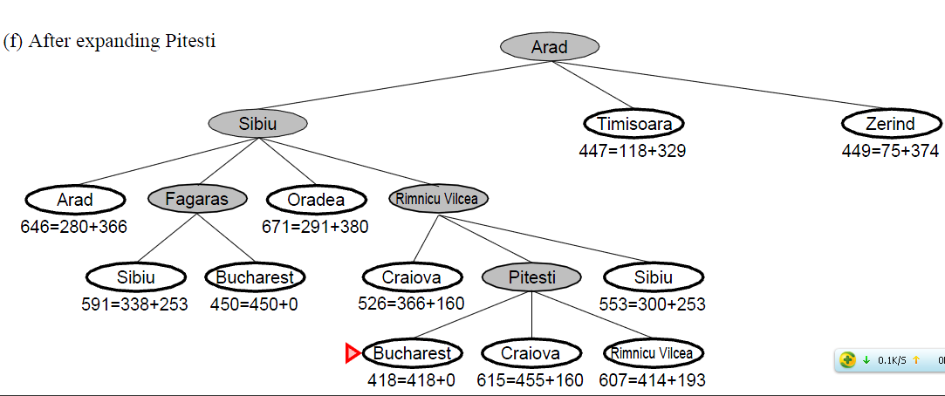
How A* algorithm works
A best-first search algorithm
A simpler example
Reached the goal node

Slide 14
How A* algorithm works
An example:
Illustration of A* search for finding path from a start node to a goal node in a robot motion planning problem.
The empty circles represent the nodes in the OPEN LIST, and the filled red/green ones are in the CLOSED LIST.
Notes:
The empty circles represent the nodes in the open set, and the filled red/green ones are in the closed set.
This is a gif image, will see the animation when run it in Slide Show mode.

Slide 15
How A* algorithm works
An example:
Weighted A* algorithm
Notes:
The empty circles represent the nodes in the open set, and the filled red/green ones are in the closed set.
They are gif images, will see the animation when run the slide in Slide Show mode.
We use f(n) = 1 x g(n) + 1.5 x h(n) in our project

Slide 16
How A* algorithm works
Is A* search optimal ?
A* is optimal if h(n) is an admissible heuristic.
Admissible heuristic, that is h(n) never overestimates the cost to reach the goal.
Notes:
Another property: A* using Graph-Search is optimal if h(n) is consistent
Theory : A heuristic h(n) is consistent if, for every node n and every successor n’ of n generated by any action a, the estimated cost of reaching the goal from n is no greater than the step cost of getting to n’ plus the estimated cost of reaching the goal from n’.
Prove: triangle inequality.
The prove of h*, if h* is consistent, then h* must be admissible.
In my prove, I assume, the h*(n',n) <= cost(n',n) if n' is the node one step far then the node n.
1. Base case:
only one node, then h*(n) = h*(g) = 0, the property is hold.
2. Step:
If the property if hold in h*(n), then h*(n) <= cost(n, g)
then consider the h*(n'), n' is the node one step far than the n,
then the h*(n) <= h*(n') + cost(n',n) <= cost(n',n)+cost(n,g) = cost(n',g)
3. Conclusion:
If h* is consistent, then h* must be admissible.

Slide 17
The A* Algorithm in our project

Slide 18
The A* Algorithm in our project
Requires:
Normal requires:
Input a map(151x151 pixel), start and target positions, output a path.
Special requires:
The path should not too close to the object (avoid bumping the object)
The path should more fit the robot motion

Slide 19
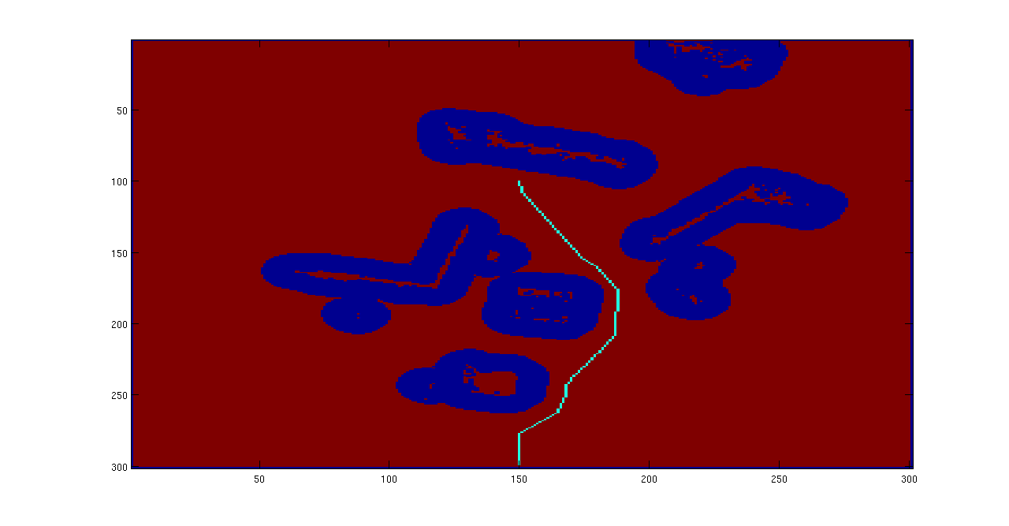
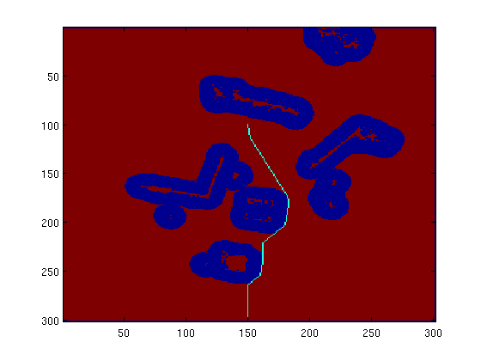
The A* Algorithm in our project
Special Requires:
Not good
Good
Notes:
Because the precise problem of Robot, too close to the object may case to bump. So we hope the Robot choose the path not too close to the object.

Slide 20
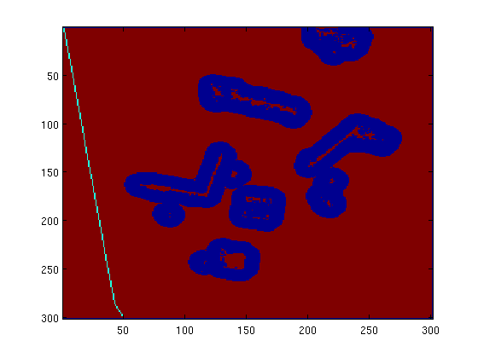
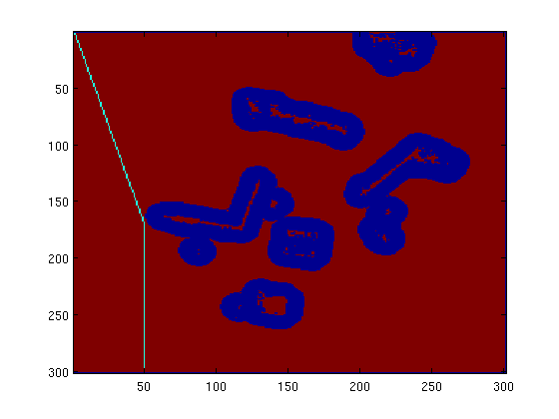
The A* Algorithm in our project
Special Requires:
Not good
Good
Notes:
The cost of paths in the two picture are the same for the A* algorithm, but the right one is more short for human eyes.

Slide 21
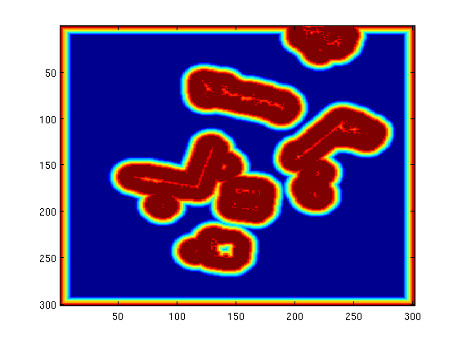
The A* Algorithm in our project
Solutions to Special Requires:
Not too close to the object
Distance transform: Calculate distance from each pixel in the map to object
We set a threshold in the project,
treat all the pixels greater or equal
the threshold are the same

Slide 22
The A* Algorithm in our project
Solutions to Special Requires:
Not too close to the object
Distance transform
Add the distance transform onto the g(n)
Why g(n) ?
Notes:
Heuristic distance h(n) influence the search order of elements in OPEN LIST, the g(n) decide the actual distance of path.
Every time we use h(n) to decide which element in OPEN LIST will be choose first, and then the algorithm drop the heuristic information. But g(n) has a accumulate property.

Slide 23
The A* Algorithm in our project
Solutions to Special Requires:
Not too close to the object
Distance transform
Add the distance transform onto the g(n)
Why g(n) ?
Path 1
Path 2
Notes:
If we add distance transform to h(n), the algorithm will pick the elements from the path 2 first, but the shortest path is path1 but not path 2. So the target position will pick the element in path 1 as parent.
Add g(n) make the cost of path 2 less than the path 1. So, in algorithm’s view, the length of path2 is shorter than the length of path1

Slide 24
The A* Algorithm in our project
Solutions to Special Requires:
Fit the robot motion
Option solution: Random to choose the direction
Has a implement problem. (Pseudo random number problem, always get the same number)
The solution we use:
Add a factor to h(n) make the cost of two paths are not equal
The factor:
If the current direction equals the previous direction
h(n) = h(n) + factor
Else
do nothing
Notes:
We choose the direction with a certain order in our implement.
Add a factor he.re to change the choose order of elements in the OPEN LIST, but not change the g(n).
This is a very trick method. And the factor depend on the gradient of the straight-line from start position to the target position. I have a view to explain how it works, but I am still not very sure.

Slide 25
The A* Algorithm in our project
Solutions to Special Requires:
Fit the robot motion
A potential better solution (We don’t implement)
Also add the factor on the g(n), make the direction information also be recorded.
Notes:
.

Slide 26
The A* Algorithm in our project
Weights:
We use
f(n) = g(n) + 1.5 * h(n) to speed up in our project
Notes:
.

Slide 27
Others:
References:
[1] Wikipedia: http://en.wikipedia.org/wiki/A_star
[2] Stuart R. & Peter N. 2003, Artificial Intelligence: A Modern Approach, Second Edition, Prentice Hall. pp. 97–104
Notes:
.

