Slide 1

Approximation Algorithms for Dependency-Aware Rule-Caching in Software-Defined Networks
Jie Wu, Yang Chen and Huanyang Zheng
Center for Networked Computing
Temple University, USA

Slide 2
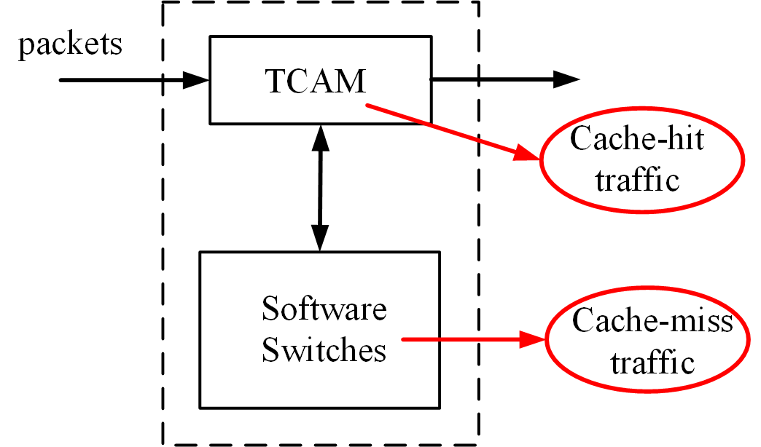
1. Introduction of Rule Caching
Rule caching
  Install packet-processing rules in switches
  Switch types
Switch types | Pros | Cons
Hardware | Fast (>400 Gbps) | Small in capacity (2K~10K)
Software | Large in capacity | Slow (40 Gbps)
  Hardware: Ternary Content Addressable Memory (TCAM)
  Software: Software-based switches

Slide 3
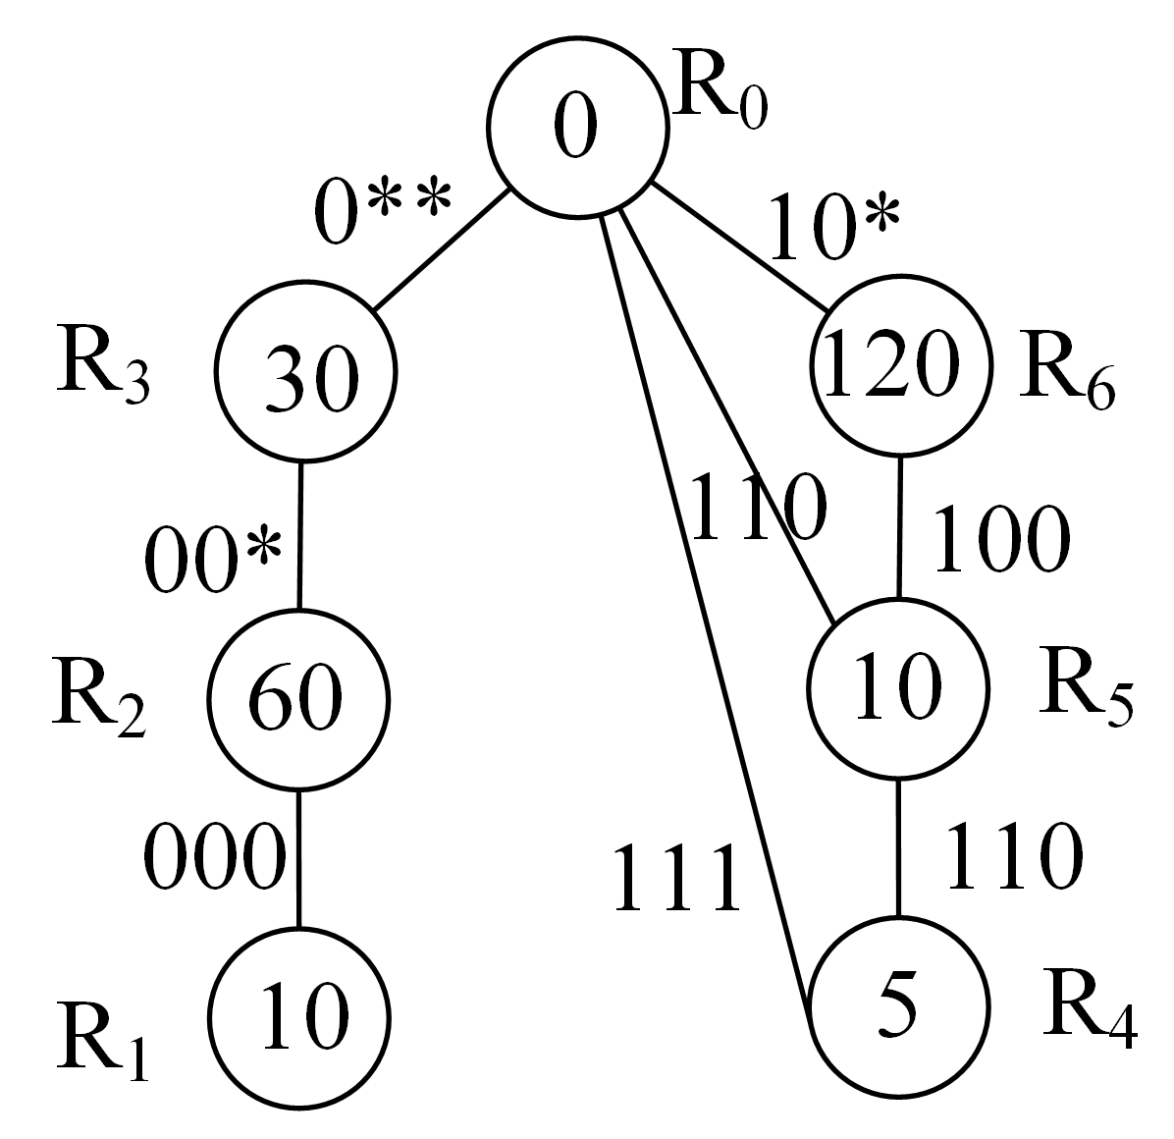
General Rule Matching Problem
Rule Table
Rule | Code | Priority | Weight
R₁ | 000 | 6 | 10
R₂ | 00* | 5 | 60
R₃ | 0** | 4 | 30
R₄ | 11* | 3 | 5
R₅ | 1*0 | 2 | 10
R₆ | 10* | 1 | 120
Rule dependency graph
  Use of wild card * to reduce rule number
  Directed acyclic graph: rule and all its decedents (to be in cache)
Maximum traffic-hit by placing no more than k rules
  NP-hard ^{[1]}
[1] Cacheflow: Dependency-aware rule-caching for software-gdefined networks (SOSR’16)

Slide 4
Efficient Rule Caching
Assumption
  Prefix coding to reduce rule number (optimal coding ^{[2]} is hard)
  All rules form a forest of trees
Constraint
  Descendant constraint
  Limited number of cached rules k
Objective
  Maximize number of rules hits
TCAM forwarding table
1100
1000
Rul e | Action
1000 | Port 1
10** | Port 2
111* | Port 3
Hit
Miss
Software switch forwarding table
[2] Explicit path control in commodity data centers: Design and applications (ToN’16)
Notes:
Disadvantage of longest prefix matching:
Fixed priority, can not changed
Form a tree instead of a DAG, can not cover the most general case of a DAG

Slide 5
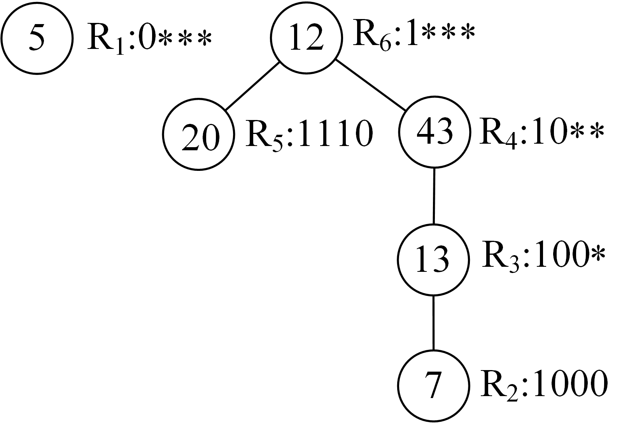
A Motivating Example
TCAM forwarding table
Rule | Action
Rule | Action
k=2
k=3
With maximum hit

Slide 6
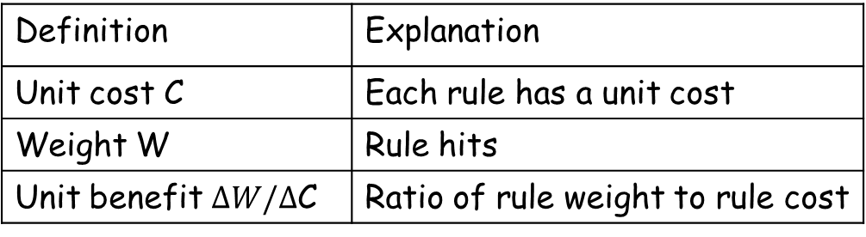
2. Solutions
Greedy Solution One (Branch)
Definition
  Branch (which includes fork)
    A rule and all its descendants
  Max branch
    If it meets either of the two conditions:
    (1) Branch size is k
    (2) If size < k, not a branch of another branch with a size of
    k or less
  Maintaining max branches will include all cacheable branches
Branch in a max branch
Definition | Explanation
Unit cost C | Each rule has a unit cost
Weight W | Rule hits
Unit benefit $ΔW/Δ$C | Ratio of rule weight to rule cost

Slide 7
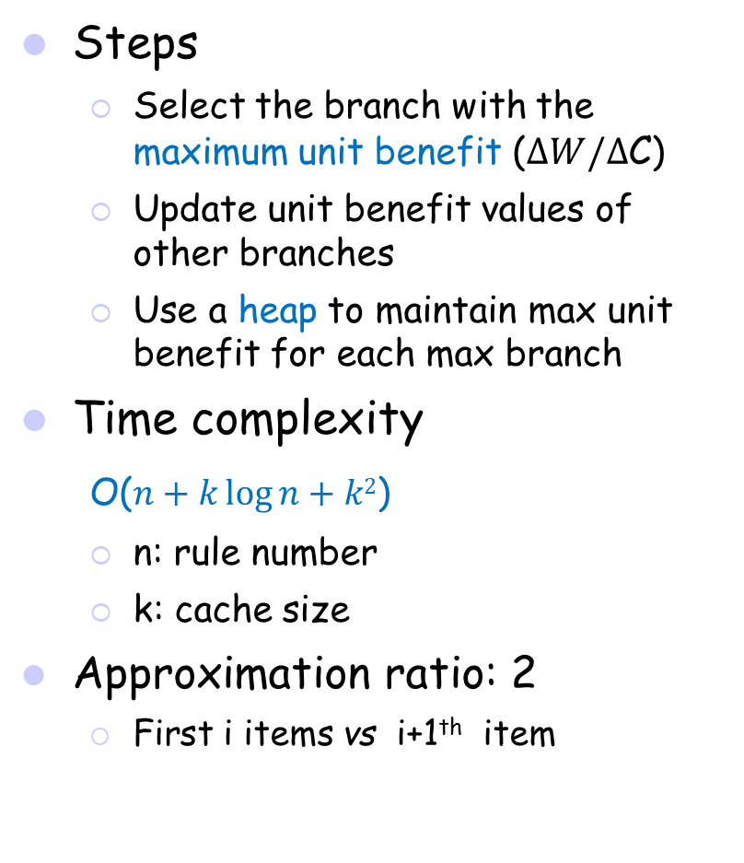
Greedy Solution One
Steps
  Select the branch with the maximum unit benefit ($ΔW/Δ$C)
  Update unit benefit values of other branches
  Use a heap to maintain max unit benefit for each max branch
Time complexity
O($n+k\log{n+k2}$)
  n: rule number
  k: cache size
Approximation ratio: 2
  First i items vs i+1th item
k=3
k=5
Optimal unit benefit (43+13+7)/3=21
Optimal unit benefit (43+13+7+12+20)/5=19

Slide 8
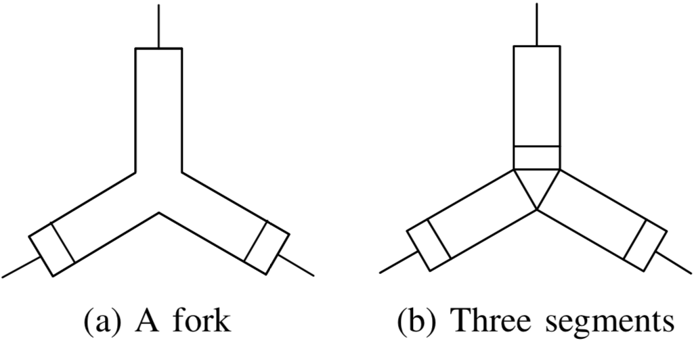
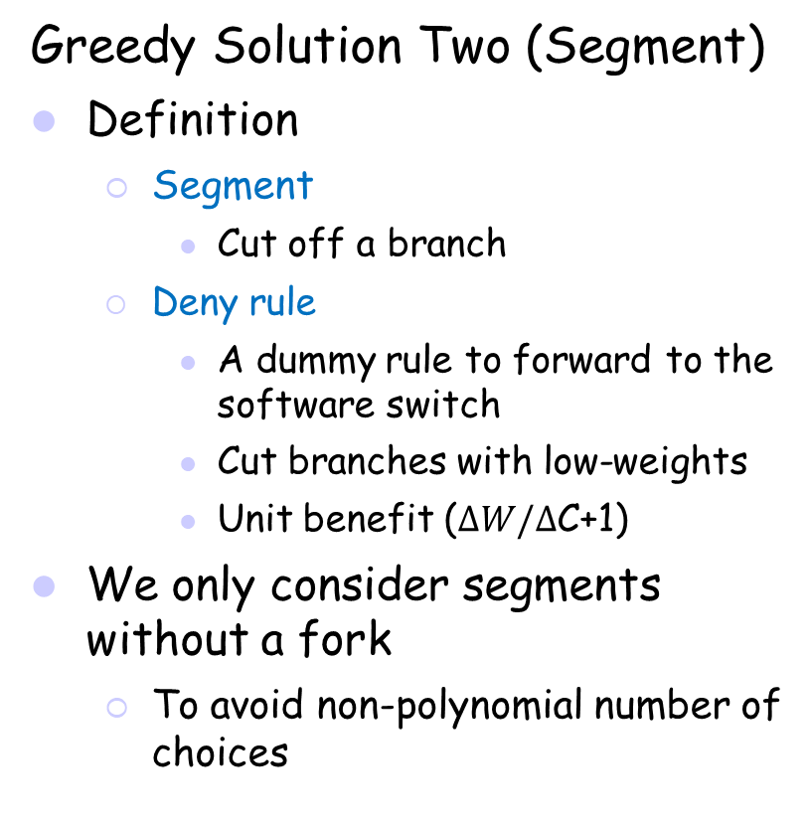
2. Solutions (cont’d)
Greedy Solution Two (Segment)
Definition
  Segment
    Cut off a branch
  Deny rule
    A dummy rule to forward to the software switch
    Cut branches with low-weights
    Unit benefit ($ΔW/Δ$C+1)
We only consider segments without a fork
  To avoid non-polynomial number of choices
Segment in a max segment
Converting a folk into
multiple segments

Slide 9
Greedy Solution Two
Steps
  Select the max segment with the maximum unit benefit
  Update unit benefit values of other segments
  Use two heaps to maintain segments
Time complexity:
  O(kn)
Constructing the global heap (g-heap) from the max heaps of local heaps (l-heaps)
1010
1110
1000
+deny rule
Rule | Action
10** | Port 1
100* | Software
k=2
Miss
Miss
Hit
Optimal unit benefit without deny rules (20+7)/2=13.5
Optimal unit benefit with deny rules 43/(1+1)=21.5
Software switch forwarding table

Slide 10
2. Solutions (cont’d)
Combined Greedy Solution
Insight
  Combine the two greedy solutions
  Use branch and segments with the same criterion
    Maximum unit benefit
    Each maintains its own heap
Time complexity
  O(kn)
Approximation ratio
  24/5
+deny rule
k=3
Optimal unit benefit with deny rules (43+20)/(2+1)=21

Slide 11
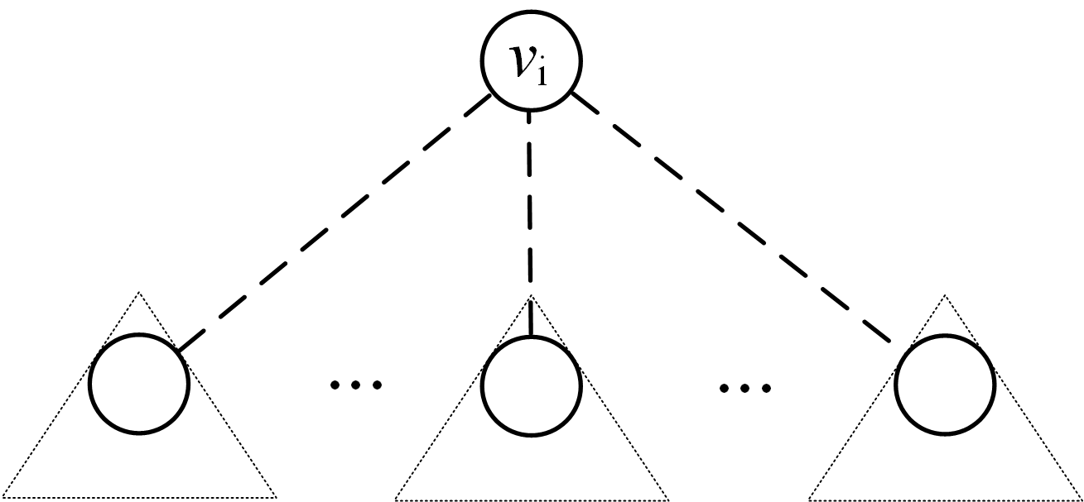
2. Solutions (cont’d)
Dynamic Programming (DP) Solution
Time complexity
  O(k²n)
m rules containing v_{i} and all its first d-1 children descendants
...
m rules containing v_{i} and all its first d children descendants
1
d
m-m’ rules containing v_{i} and all its first d- 1 children descendants
m’ rules containing v_{id} and all its children descendants

Slide 12
Dynamic Programming Solution (cont’d)
T[R,d]
  Subtree of rule R, and its first d children’s subtrees
  Depth-first-search
O[R,d,m]
  Optimal cache-hits by caching m rules in T[R,d]
  O[R₀, d(R₀),k]
  Our objective
    R₀: tree root
    d(R₀): all R₀’s children
Initialization
Formulation
  R_{id}: d-th child of R_{i}

Slide 13
7. Simulation
Comparison algorithms ^{[1]}
  Dependent
    Branch without using heap
  Cover
    Segment without using heaps
Our algorithms
  Branch
  Segment
  Combined
  DP (optimal)
Execution time
Cache
Cache-hit miss
15 min
Rule update frequency
[1] Cacheflow: Dependency-aware rule-caching for software-defined networks (SOSR’16)
Notes:
SOSR includes the algorithms: Dependent and Cover(algorithms are the same as your Greedy One and Two, but not with heaps, in other words, without considering any data structure)

Slide 14


Settings
Data sets
  CAIDA packet trace
    12,000 forwarding rules
  Stanford Backbone packet trace
    180,000 forwarding rules
Metrics
  Execution time
  Cache-hit ratio with TCAM size
  Cache-hit ratio with number of packets
Variables
  TCAM cache size: k= 63~2000
Notes:
CAIDA is a data center official website, providing the data sets
We test all the algorithms on two data set: one is from CAIDA and another is from Stanford website

Slide 15
Simulation Results
~6 min
CAIDA packet trace
DP has a much larger execution time than others
Branch is faster than Dependent because of using heaps
Our four algorithms achieve at least a 79.8% hit ratio with 2,000 cache size, which is just 1.1% of the total rule table.
DP achieves the best cache-hit ratio.

Slide 16
Simulation Results (cont’d)
~70 min
Stanford backbone trace
More rules result in a much larger execution time
Our three greedy algorithms achieve better ratios than CAIDA one with the same TCAM size because of deeper dependencies
For 30 million packets, DP’s cache-hit ratio reaches 90.2%, Combined reaches 89.4%, Segment reaches 83.7% and Branch reaches 81.9% with 2,000 cache size.

Slide 17
8. Conclusion
Hardware and software switches
Caching technology
  Wildcard (*) rule matching
  Rule dependency constraints
  Deny rule
  limited number of rules in TCAM
Objective
  Maximize cache-hit ratio
Solutions
  Three greedy algorithms with approximation ratios
  Optimal DP solution

Slide 18
Q & A

