Slide 1
RTS Assisted Mobile Localization: Mitigating Jigsaw Puzzle Problem of Fingerprint Space with Extra Mile
Chao Song ^{+*#}, Jie Wu*, Li Lu⁺, and Ming Liu^{+*#}
⁺School of Computer Science and Engineering, University of Electronic Science and Technology of China
*Department of Computer and Information Sciences, Temple University
#Big Data Research Center, University of Electronic Science and Technology of China
Oct.22, 2015

Slide 2
Outline
Motivation
RTS Assisted Mobile Localization
Building Map with Crowdsensing
Implementation and Evaluation
Conclusion

Slide 3

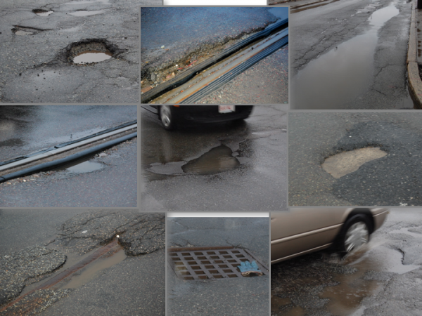
Outdoor mobile application
Waze
Pothole detection

Slide 4


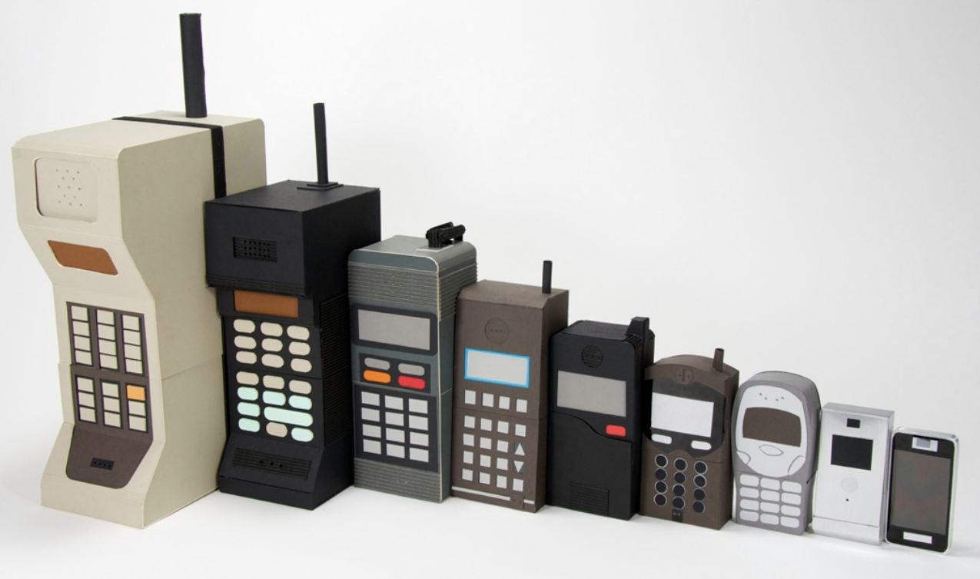
Disadvantages of localization with GPS
High energy consumption
Urban canyons
Phones without GPS

Slide 5
Signal-fingerprint
RSS fingerprints: the WiFi signal strengths from multiple access points at every location of an interested area, and accordingly build a fingerprint database (a.k.a. radio map) in which fingerprints are associated with the locations where they are recorded.
Trajectory-fingerprint-based approach: cell-ID sequence-based localization, which is recorded by changes of the IDs of the connected cell-towers by the mobile phone along the user’s trajectory.
Z. Yang, C. Wu, and Y. Liu, “Locating in fingerprint space: wireless indoor localization with little human intervention,” in Proc. of ACM MobiCom, 2012.
J. Paek, K.-H. Kim, J. P. Singh, and R. Govindan, “Energy-efficient positioning for smartphones using cell-id sequence matching,” in Proc. of ACM MobiSys, 2011.

Slide 6
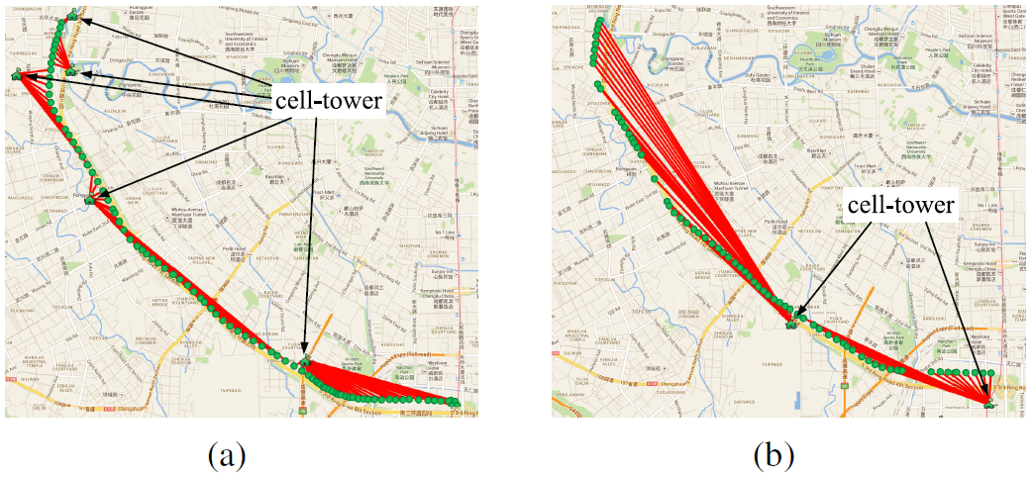
The connected cell-towers along the same route

Slide 7
Outline
Motivation
RTS Assisted Mobile Localization
Building Map with Crowdsensing
Implementation and Evaluation
Conclusion

Slide 8
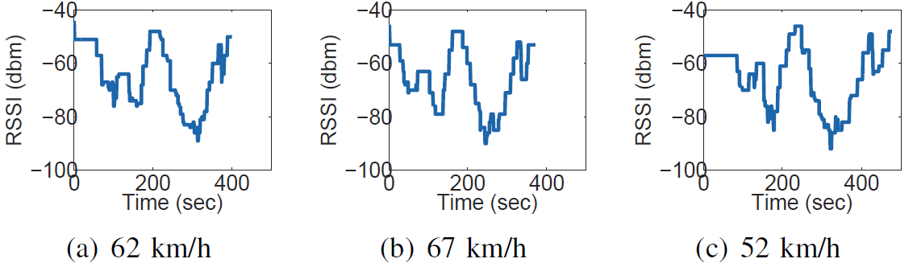
RTS-assisted mobile localization
RSSI Time Series (RTS)
Similar RTS on the same road with different average moving speeds

Slide 9
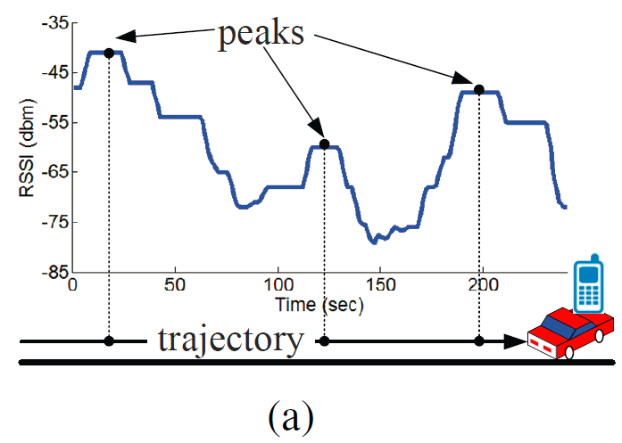
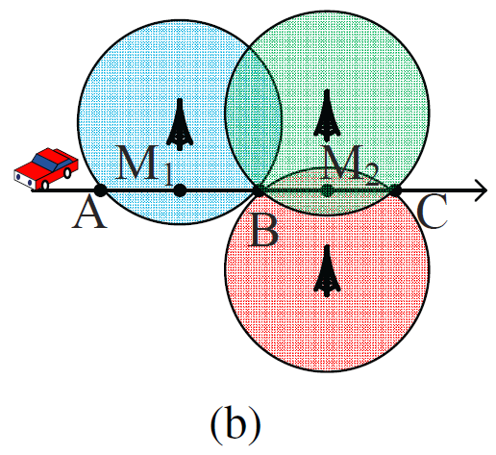
Peaks of RTS
To mitigating the RSS fluctuation problem, we investigate the peaks along the RTS from connected cell-towers for outdoor localization.

Slide 10
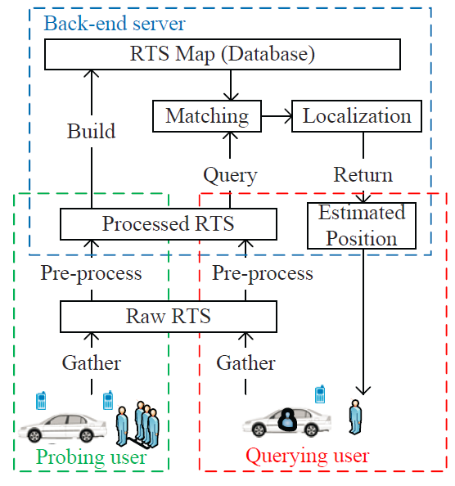
System Overview
RTS Assisted Localization System (RALS)
  Probing user, querying user, back-end server
  Training phase, locating phase

Slide 11
Matching and Localization
To track the current road where the querying user is moving, the back-end server matches the uploaded RTS from the querying user with the RTS map in the locating phase.
After matching the road where the querying user moves, RALS utilizes the travel times among the peaks of an RTS for estimating the speed and the position of the querying user on the matchable road.

Slide 12
Outline
Motivation
RTS Assisted Mobile Localization
Building Map with Crowdsensing
Implementation and Evaluation
Conclusion

Slide 13
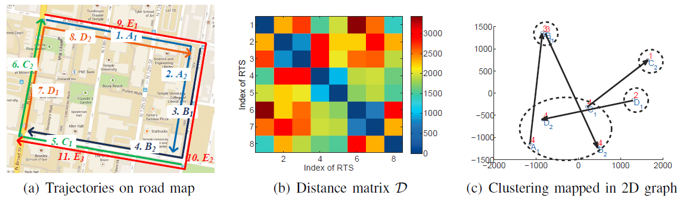
Building RTS Map without Site Survey
We term the problem of the uncertain fingerprints as the jigsaw puzzle problem, which need more RTS from the unintentional users, and slows down the map construction.

Slide 14
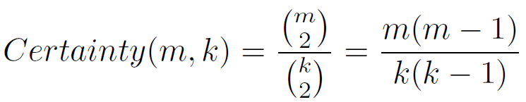
Jigsaw Puzzle Problem with Uncertain Fingerprints
We define the size of an area (k) as the number of the road segments in this area, and define the length of a trajectory (m) as the number of non-overlapped road segments covered by this trajectory.
We define the certainty as the probability of distinguishing a pair for a trajectory in the area, which can be calculated as follows:

Slide 15
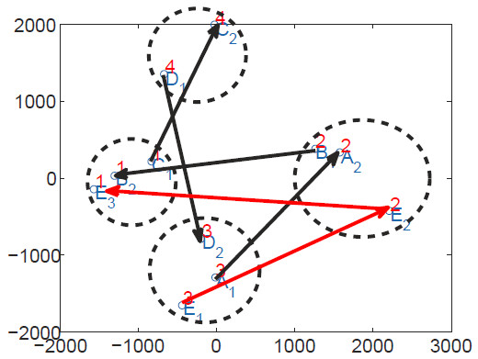
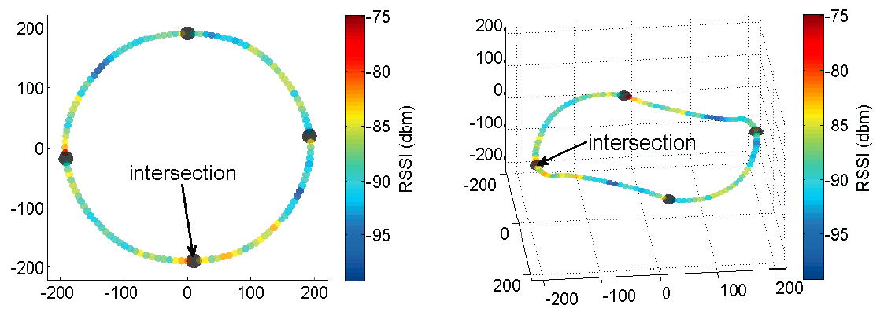
Speeding up the Map Construction
To speed up the map construction, RALS employs a small number of the intentional users with an additionally longer non-overlapped trajectory, termed as extra mile.

Slide 16
Outline
Motivation
RTS Assisted Mobile Localization
Building Map with Crowdsensing
Implementation and Evaluation
Conclusion

Slide 17
Experimental Methodology
Experimental Scenario
Mobile Phone
Back-end Server

Slide 18
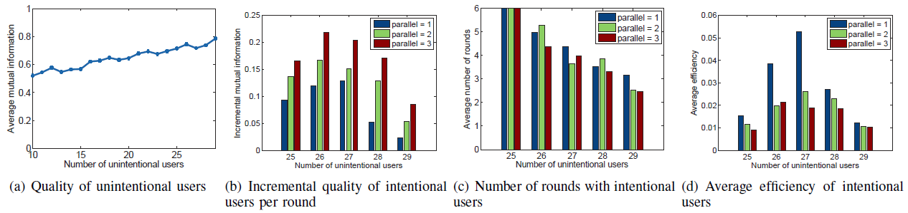
Performance of map construction with crowdsensing

Slide 19
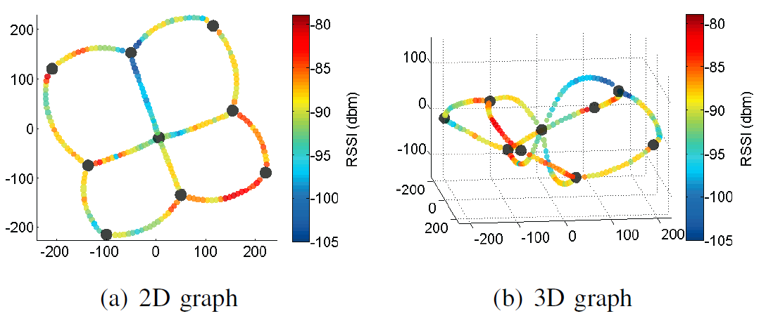
Virtual Temporal Map with Twelve Road Segments

Slide 20
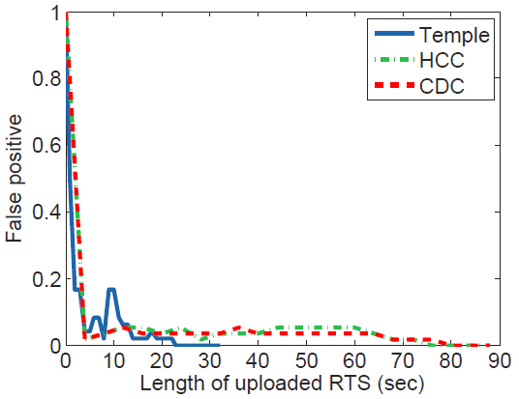
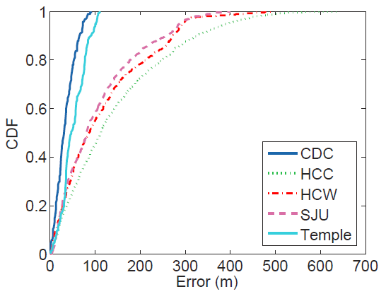
Evaluation results
Matching the roads
Error of physical distance

Slide 21
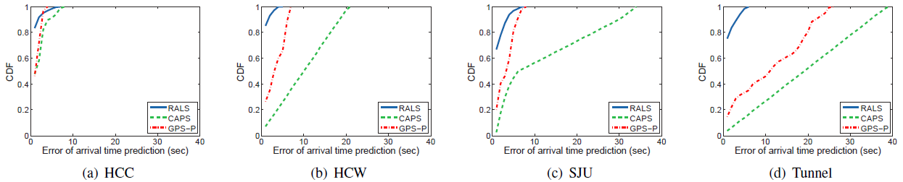
Error of Arrival Time Prediction

Slide 22
Outline
Motivation
RTS Assisted Mobile Localization
Building Map with Crowdsensing
Implementation and Evaluation
Conclusion

Slide 23
Conclusion
For an energy-efficient and accurate mobile localization, we design RALS, an RTS assisted localization system.
However, the trajectories of the regular unintentional users are often limited to being short, and the map construction with short trajectories can cause the jigsaw puzzle problem. The jigsaw puzzle problem slows down the map construction, and affects its efficiency.
RALS hires a small number of the advanced intentional users, who can move a longer distance for collecting the RTS, in order to speed up the map construction.

Slide 24


Thank you!

