Slide 1

On Balancing Middlebox Set-up Cost and Bandwidth Consumption in NFV
Jie Wu
(PhD student: Yang Chen)
Center for Networked Computing
Temple University, USA

Slide 2



1. Introduction of Middlebox
Network Function Virtualization (NFV)
  Technology of virtualizing network functions into software
  building blocks
Middlebox: software implementation of network services
  Improve the network performance:
    Web proxy and video transcoder, load balancer, …
  Enhance the security:
    Firewall, IDS/IPS, passive network monitor, …
Examples
Web Proxy
Firewall
NAT
Notes:
NFV: a network architecture concept that uses the technologies of IT virtualization to virtualize entire classes of network node functions into building blocks that may connect, or chain together, to create communication services.
a proxy :Intercepts HTTP connections and caches frequently accessed content, may also blacklist certain content.
Network Address Translator (NAT) : remapping one IP address space into another by modifying network address information in the IP header

Slide 3
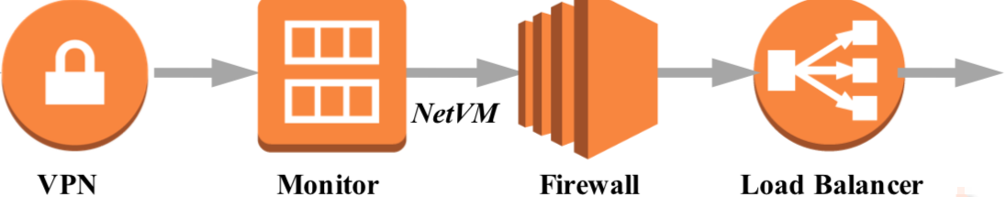
Middlebox Dependency Relations ^{[1]}
Multiple middleboxes may/may not have a serving order
  Examples
    Firewall usually before Proxy
    Virus scanner either before or after NAT gateway
Categories
  Non-ordered middlebox set
  Totally-ordered middlebox set (service chain)
  Partially-ordered middlebox set
[1] Dynamic Service Function Chaining in SDN-Enabled Networks with Middleboxes (ICNP ’16)
Notes:
Virus scanner: inspector of harmful packets
VPN (virtual private network)
Monitor: check traffic
Load Balancer: redistribute traffic

Slide 4
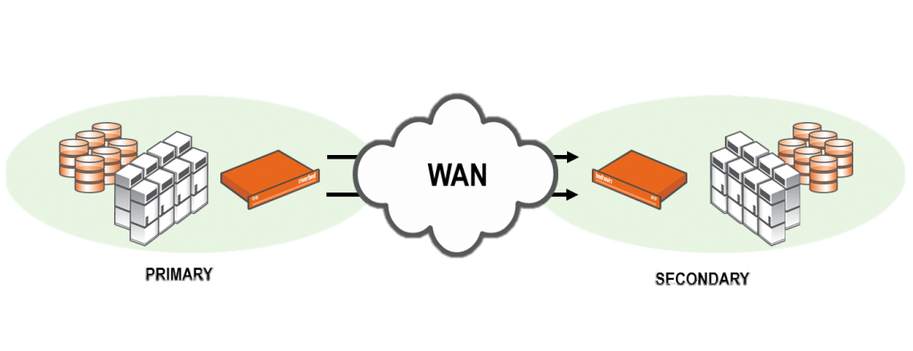
Middlebox Traffic Changing Effects ^{[2]}
Middleboxes may change flow rates in different ways
  Citrix CloudBridge WAN accelerator: 20% (diminishing)
  BCH(63,48) encoder: 130% (expanding)
Data
Checksum
1 | 0 | 1 | 1 | 1 | 0 | 1 | 0
[2] Traffic Aware Placement of Interdependent NFV Middleboxes (INFOCOM ’17)

Slide 5
Middlebox Placement Overview
Problem
  Placing middleboxes to satisfy all flows’ middlebox service requests
Objectives:
  Minimizing middlebox setup cost ^{[3]}
  Minimizing bandwidth consumption ^{[2]}
Constraints
  Dependency relations
  Traffic-changing effects
  Vertex capacity and middlebox processing volume
[2] Traffic Aware Placement of Interdependent NFV Middleboxes (INFOCOM ’17)
[3] Provably Efficient Algorithms for Joint Placement and Allocation of Virtual
Network (INFOCOM ’17)

Slide 6
A Middlebox Placement Model ^{[4]}
Setup cost
m
Cost
Objective
  Minimizing sum of middlebox setup cost and communication cost
Two special cases
  Facility location problem
    Single middlebox placement
  Generalized assignment problem
    Each middlebox has a limited processing volume
    Placing middleboxes and assigning to flows
Communication cost
f₂
f₁
[4] Near Optimal Placement of Virtual Network Functions (INFOCOM ’15)
Notes:
Facility location problem: pick a subset F of facilities to open, to minimize the sum of distances (communication cost) from each demand point to its nearest facility, plus the sum of opening costs of the facilities
Generalized assignment problem: agents to do tasks. Doing each task can earn benefit and incur some cost. Each agent has a cost budget. Maximize the total benefit when the total cost is limited to a specific value.

Slide 7
A Service Chain Model ^{[2]}
Objective
  Minimizing the total bandwidth consumption
Solutions
  Consider traffic-changing effects
  Place middleboxes for a single flow
m₁
m₂
m₃
m₁
m₂
m₃
m₁
m₂
m₃
Non-ordered
(Optimal greedy: sort
traffic-changing ratios
in increasing order)
Totally-ordered
(Optimal DP: latter
middleboxes must be
after front ones)
Partially-ordered
(NP-hard: reduced
from the Clique Problem)
[2] Traffic Aware Placement of Interdependent NFV Middleboxes (INFOCOM ’17)

Slide 8
2. Our Model
Problem
  Placing middleboxes to satisfy all flows’ network service requests
Network service requests
  Multiple middleboxes
    Middlebox set with or without dependency relations
Cost
  Middlebox setup
    Sum of middlebox setup cost
  Bandwidth consumption
    Sum of each flow’s bandwidth consumption cost on each link
Objective
  Minimizing total cost of middlebox setup and bandwidth consumption

Slide 9

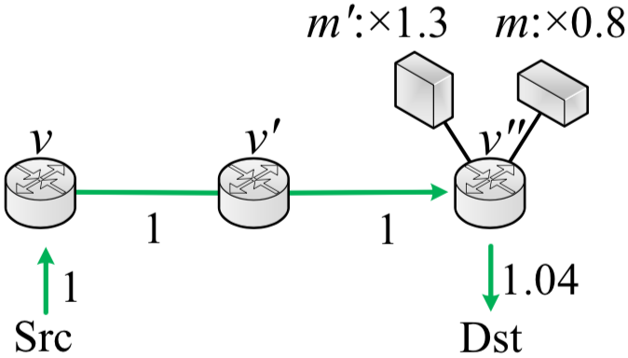
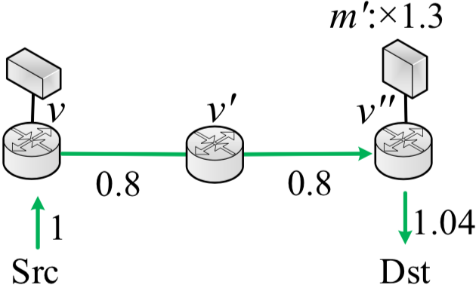
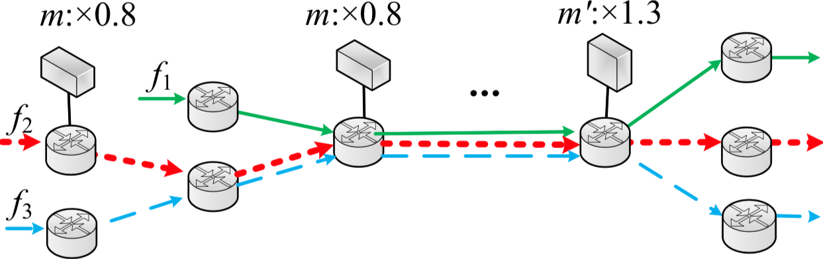
A Motivating Example
m: 0.8 (diminishing)
m’: 1.3 (expanding)
Independent middleboxes
Dependent middleboxes: m’ before m
Red flow with high rate
A flow covered by multiple middleboxes
(Multiple coverage: when additional setup cost is less
than the reduced bandwidth consumption cost)

Slide 10




3. Problem Formulation
Middlebox setup cost
    c_{m}: unit setup cost of middlebox m
Bandwidth consumption cost
    w(b_{f}^{e}): bandwidth cost function of flow f on link e
    r_{f}: initial traffic rate of flow f
    : traffic-changing ratio of middlebox m
Objective
  Minimizing c₁+c₂

Slide 11
Problem Formulation (cont’d)
Translog bandwidth cost function on each link
Reasons
  Widely used in Cisco EIGRP and OSPF protocols
  Log-linear for easy calculation
The weight of setup cost and bandwidth consumption
  Adjusting the traffic-changing ratios and unit setup costs of middleboxes

Slide 12
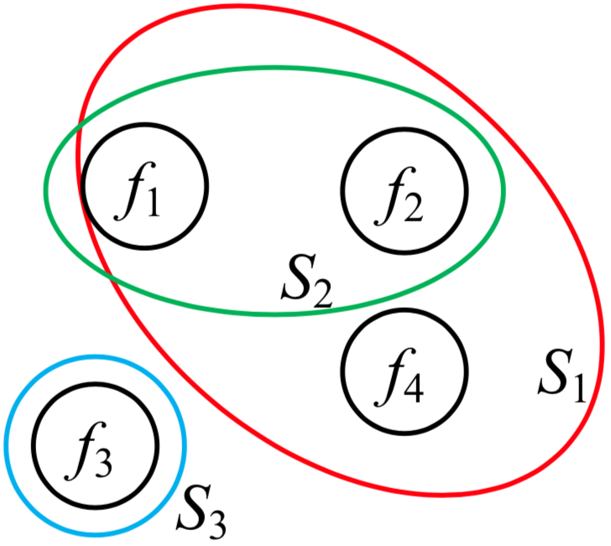
Problem Complexity
NP-hard
Even with no traffic-changing effects
Even when placing a single middlebox
Proof
Reduction from set-cover problem
Use minimum number of middleboxes to “cover” all flows
  Flows as elements: F= {f₁,f₂,…, f_{|F|}}
  Placed middleboxes as sets: {S₁, S₂,…}
  S₁={f₁, f₂, f₄}, S₂={f₁, f₂}, S₃={f₃}

Slide 13
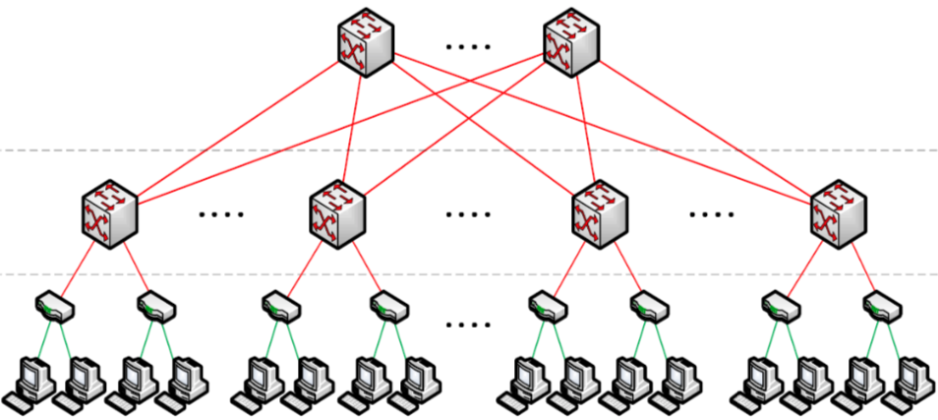
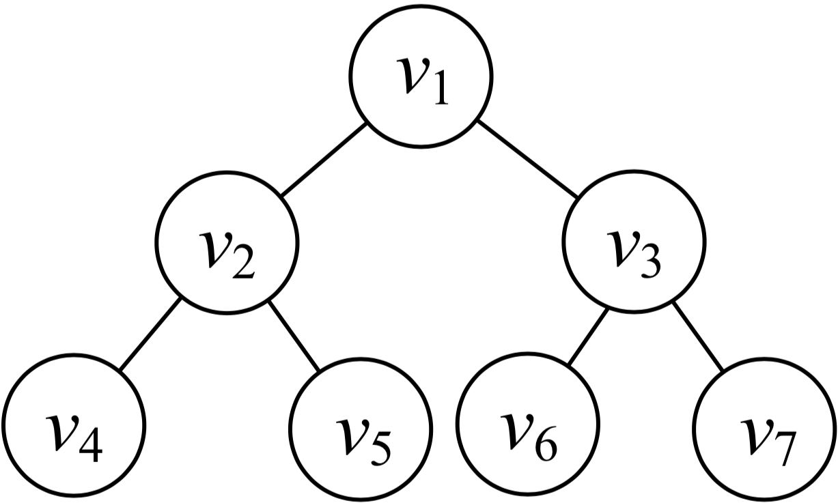
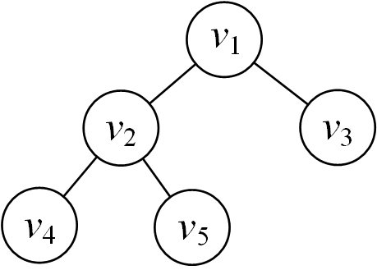
Problem Complexity (cont’d)
In this paper, we focus on tree-structured topologies
Left
Triangle
Right
Triangle
Tree-based data centers
Hierarchical data centers
Each triangle is mostly a perfect
or complete tree
Perfect tree
Complete tree

Slide 14
4. Placing a Single Middlebox
Solution
Local Greedy Algorithm (LGA)
Steps
Calculate each total cost of placing middleboxes in a whole level
Select the level with the minimum total cost
Iterative implementation
  From top level to bottom, total costs will decrease and then increase
  Select the level with the local minimum

Slide 15
4. Placing a Single Middlebox (cont’d)
Time complexity (|V|: #node)
  O(|V|)
Optimal for perfect tree topologies
  Symmetry of placement
  No multiple “coverage” situation
Also optimal for complete tree topologies
  Also multiple “coverage” situation
  The most unbalanced traffic distribution: left and right subtrees of root have a depth difference of 1

Slide 16
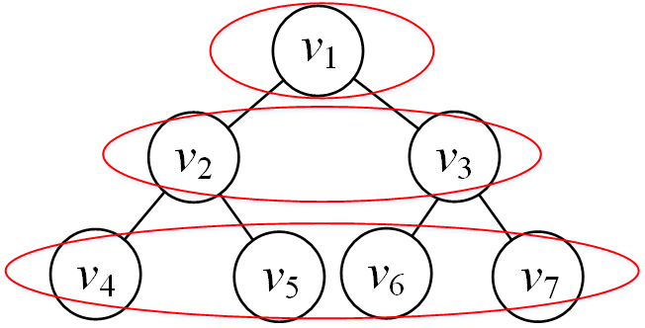
Illustration
Total cost
Optimal
Level
Calculate level by level

Slide 17
5. Placing Multiple Middleboxes
Non-ordered middlebox set placement
Solution
  Combined Local Greedy Algorithm (CLGA)
Insight
  Place each middlebox independently by applying LGA
Time complexity (|V|: #node, |M|: #middlebox)
  O(|V||M|)
Optimal for complete trees
Notes:
No vertex capacity (infinite server capacity)

Slide 18

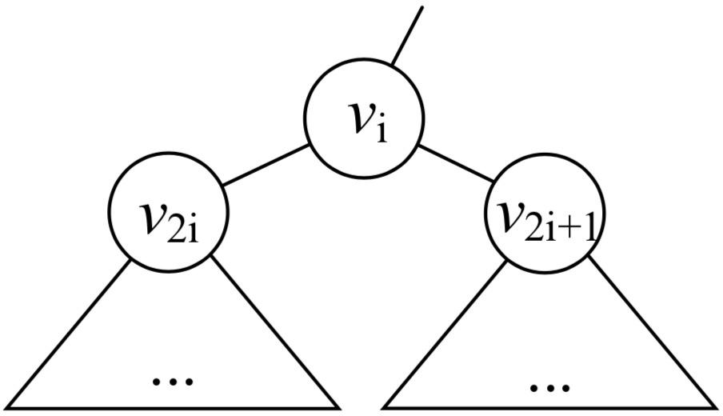
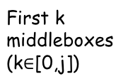
Totally-ordered Middlebox Set Placement
Solution: Dynamic Programming (DP)
Works for infinite and finite vertex capacity
OPT(i, j)
  Minimum cost of subtree with root v_{i} when placing first j middleboxes in the set
  if capacity is not enough
(k+1)_{th} to j_{th} middleboxes
First j middleboxes

Slide 19
Dynamic Programming Formulation
Left triangle
Right triangle
  Similar to the left triangle’s formulation
Left subtree
Right subtree
Bandwidth consumption
Newly placed middleboxes

Slide 20
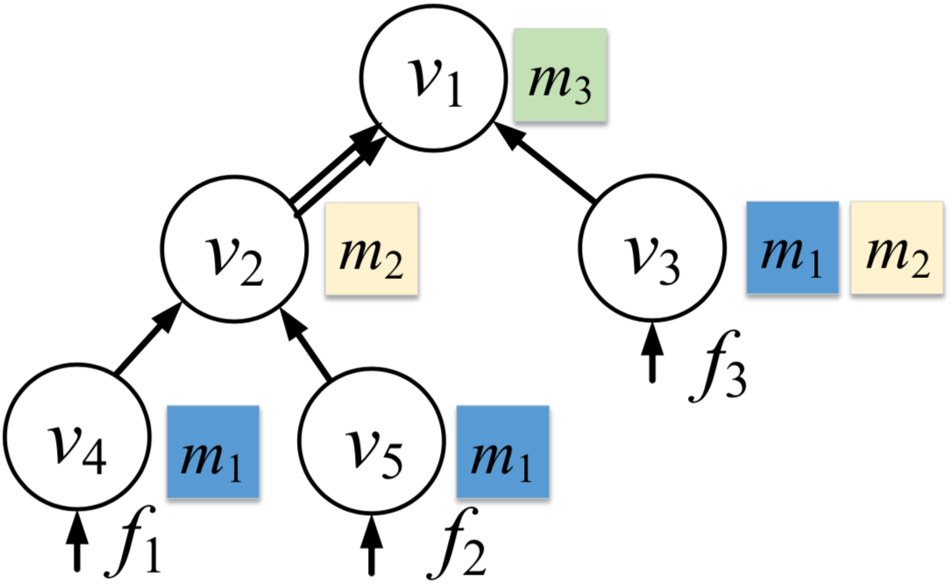
An Example
 | m₁ | m₂ | m₃
Traffic-changing ratio | 0.5 | 0.8 | 1.1
Setup cost | 0.2 | 0.4 | 0.3
Dependency relations
  m₁->m₂->m₃
Initial traffic rate
  r₁=r₂=r₃=1

Slide 21
Totally-ordered Middlebox Set Placement (cont’d)
Insights
The optimal placement with root v_{i} by placing first j and its two subtrees by placing no more than j middleboxes
Perfect tree
  Transformed to a line
  Similar to a single flow placement
Complete tree
  No multiple “coverage” situation
Time complexity (|V|: #node, |M|:#middlebox)
  O(|V||M|³)

Slide 22

Partially-ordered Middlebox Set Placement
NP-hard even for a single flow ^{[2]}
One heuristic solution
  Insight
    Transform into a totally-ordered middlebox set
  Steps ( : traffic-changing ratio)
    Treat middleboxes with dependencies as a single middlebox
    Sort middleboxes in increasing order of
  Example
    Middlebox set
    Dependency relationship：m₂ -> m_{3,} m₄ -> m₅-> m₆
 | m₁ | m₂ | m₃ | m₄ | m₅ | m₆
 | 0.7 | 1.1 | 0.8 | 1.1 | 0.5 | 1.4
m₁
m₄
m₅
m₆
m₂
m₃
0.7
1.1*0.5*1.4=0.77
1.1*0.8=0.88
[2] Traffic aware placement of interdependent NFV middleboxes (INFOCOM ’17)

Slide 23
Partially-ordered Middlebox Set Placement (cont’d)
Another heuristic solution
  Insight
    Transform into a non-ordered middlebox set
  Steps
    Treat middleboxes with dependencies as a single middlebox by a topological order
    No dependency relations among new middleboxes
  Example
    Middlebox set
    Dependency relationship：m₂ -> m_{3,} m₄ -> m₅-> m₆
 | m₁ | m₂ | m₃ | m₄ | m₅ | m₆
 | 0.7 | 1.1 | 0.8 | 1.1 | 0.5 | 1.4
m₁
m₂
m₃
m₄
m₅
m₆
0.7
1.1*0.8=0.88
1.1*0.5*1.4=0.77

Slide 24


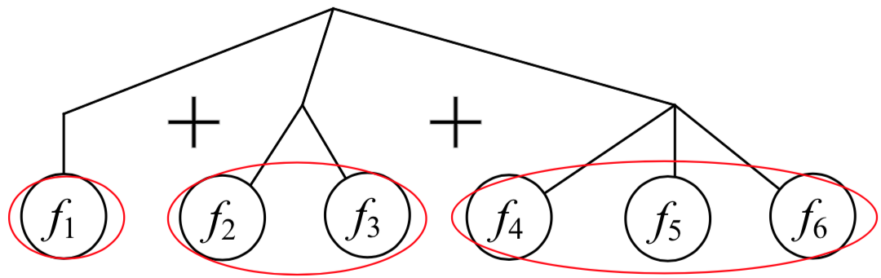
6. Handling Heterogeneous flows for Non-ordered Middlebox Set
Group Flows by Initial Bandwidths (GFIB)
  Group flows by initial traffic rates (r_{f}: f’s traffic rate)
    #group:
    The traffic rate range of the i^{th} group:
  Treat flows in each group as homogeneous
  Apply CLGA for each group
An example
Combine
max r_{f}= 7
min r_{f}= 1
Group 1: [1,2)
Group 2: [2,4)
Group 3: [4,8)
CLGA
CLGA
CLGA
r₁=1 r₂=2 r₃=3 r₄=4 r₅=6 r₆=7

Slide 25


6. Handling Heterogeneous Flows for Non-ordered Middlebox Set (cont’d)
Time complexity
Performance-guaranteed algorithm
  Approximation ratio ^{[5]}:
[5] On Optimal Scheduling of Multiple Mobile Chargers in Wireless Sensor Networks (MSCC ’14)

Slide 26
7. Simulation
Our algorithms
  LGA
    Single middlebox
    Select the level with the minimum cost
  CLGA
    Non-ordered middlebox set
    Apply LGA independently
  DP
    Totally-ordered middlebox set
    Dynamic programming
  GFIB
    Heterogeneous flows
    Group flows by initial traffic rates
    Combine placement by applying CLGA for each group

Slide 27
7. Simulation
Comparison algorithms
  Random-fit
    Randomly place middleboxes until all flows are satisfied
  NOSP ^{[2]}
    Place middleboxes in increasing order of traffic-changing effects for each flow from source to destination independently
    For single middlebox or non-ordered middlebox set
  TOSP ^{[2]}
    Dynamic programming based algorithm for each flow independently
    For totally-ordered middlebox set with or without vertex capacity
[2] Traffic aware placement of interdependent NFV middleboxes (INFOCOM ’17)

Slide 28
Settings
Topology
  Perfect 5-layer binary tree for each triangle
Facebook data center traffic trace
  Single-flow initial traffic rate: 1~6 Mb
Middlebox set
Dependency relationship
  m₂ -> m₃ -> m₁ -> m₄
 | m₁ | m₂ | m₃ | m₄
Traffic-changing ratio | 0.7 | 0.8 | 1.1 | 1.2
Setup cost | 0.4 | 0.6 | 0.2 | 0.8

Slide 29
Simulation Results
Single middlebox
Non-ordered middlebox set
Bandwidth heterogeneity
(LGA)
(CLGA)
(GFIB)
LGA costs 20.3% less than NOSP and 35.1% less than Random-fit.
CLGA performs the best even with heavy traffic.
The performance of Random-fit is not steady.
For heterogeneous flows, GFIB saves about 36.9% and 34.0% compared to NOSP and Random-fit.

Slide 30
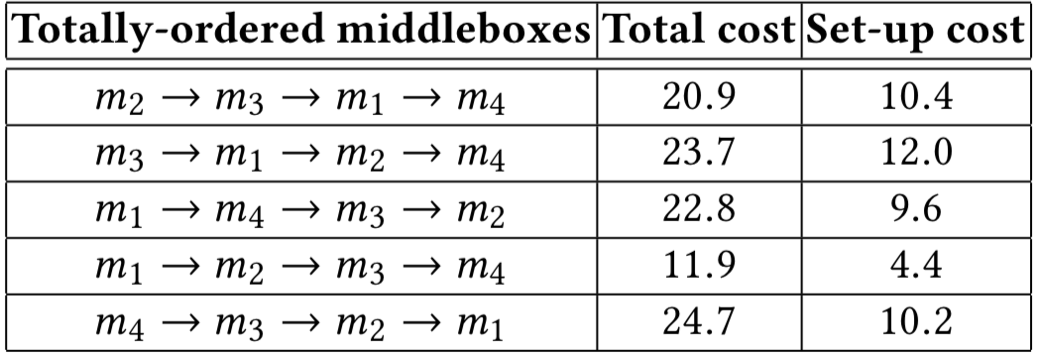
Simulation Results (cont’d)
Totally-ordered middlebox set
Without vertex capacity
With vertex capacity
Middlebox order effect at 3 Mbps (DP)
The total cost is larger than the non-ordered middlebox set.
Limited vertex capacity increases the minimum cost.
The order of a middlebox set matters not only for total cost but also for set-up cost.

Slide 31
8. Conclusion and Future Work
Middlebox constraints
  Traffic-changing effects
  Dependency relations
  Flow sharing
Middlebox placement
  Balancing middlebox set-up cost and bandwidth consumption
Tree-structured topologies
  Optimal algorithms for homogeneous flows
  Performance-guaranteed algorithm for heterogeneous flows
Future work
  General tree-structures

Slide 32
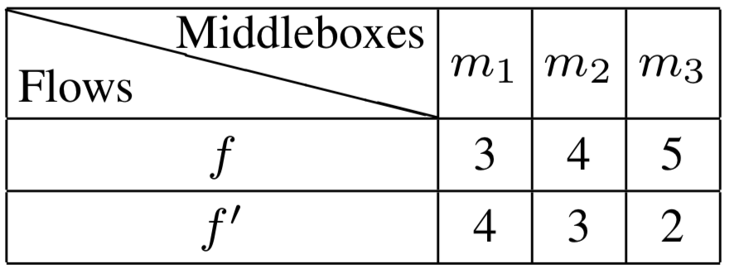
Other Service Chain Models
d₁ = 1 d₂ = 2
Processing time
prolong
f before f’
t = 10
f‘ before f
t’ = 12
Minimizing the makespan
Minimizing the average completion time
Notes:
The completion time of a flow in the current middlebox can not be more than the completion time in the last middlebox plus the transmission delay between these two middleboxes

Slide 33
Q & A

