Slide 1
Throughput and Fairness-Aware Dynamic Network Coding in Wireless Communication Networks
Pouya Ostovari
Jie Wu

Slide 2
Agenda
Introduction
Motivation and setting
Proposed methods
Dynamic network coding
Fair dynamic network coding
Simulation results
Conclusion

Slide 3
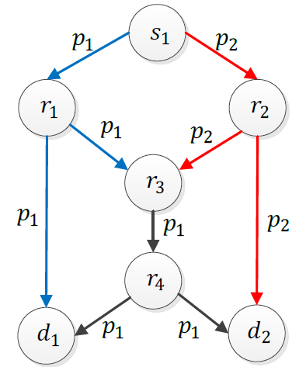
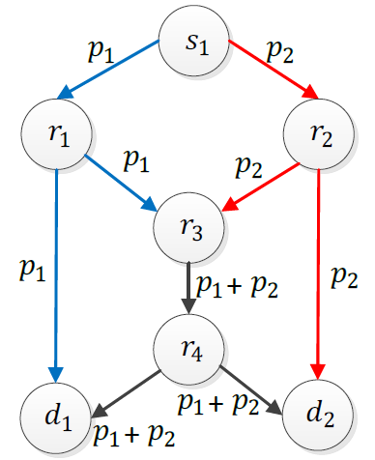
Network Coding in Wired Networks
Bottleneck problem
Without coding
With coding
Notes:
Network coding first introduced for wired networks and showed that it can solve the bottleneck problem.

Slide 4
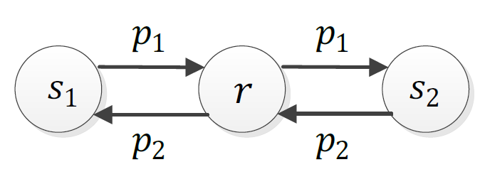
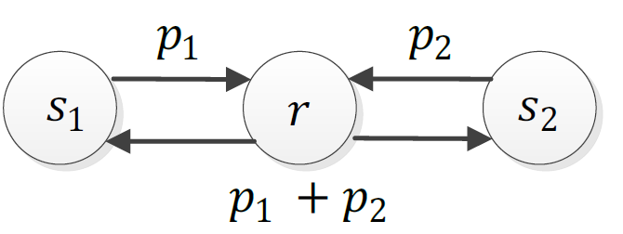
Network Coding in Wireless Networks
No coding
4 transmissions
Coding
3 transmissions
Inter-flow coding
Increases the throughput
Notes:
The wireless nature of the medium makes network coding more attractive in wireless networks.

Slide 5
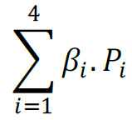
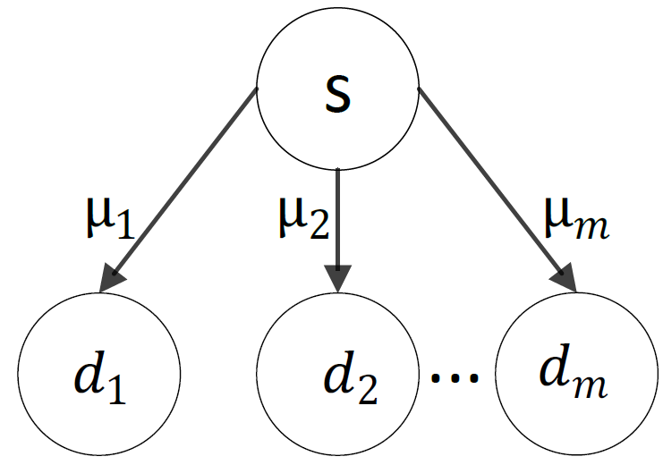
Network Coding in Wireless Networks
Intra-flow coding
Reliability
Notes:
The reliability of the link is 2/3. The source wants to transmit 2 packets to the destination node. With coding, the source on average transmits 3 coded packets and the destination receives 2 coded packets, which are sufficient for decoding. However, without coding, feedback mechanism is required to show the lost packet.

Slide 6
Setting
One source
Broadcasts a set of packets
Multiple destinations
Independent erasure channels
Equal size time slots
One packet transmission per time slot
Objective
Throughput

Slide 7
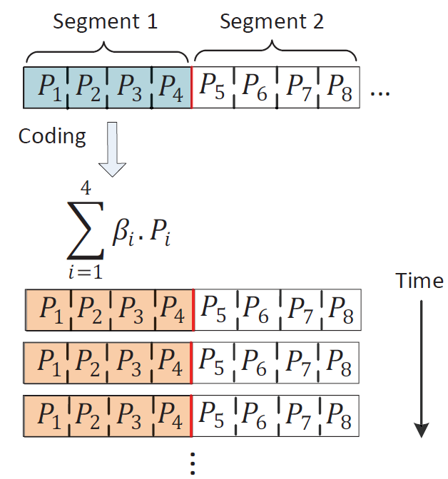
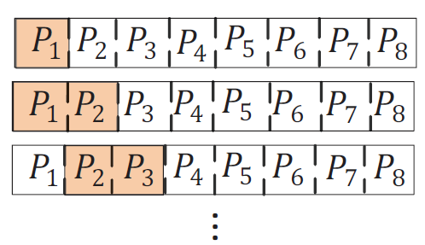
Introduction (Segment Coding)
Segment coding
Dynamic coding

Slide 8
Introduction
Seen packet (Sundararajan’08)
A node has seen a packet P if it can generate a linear combination of the form P + Q, using the received coded packets in its buffer
1
1
Seen packets can be removed from the sender’s buffer

Slide 9
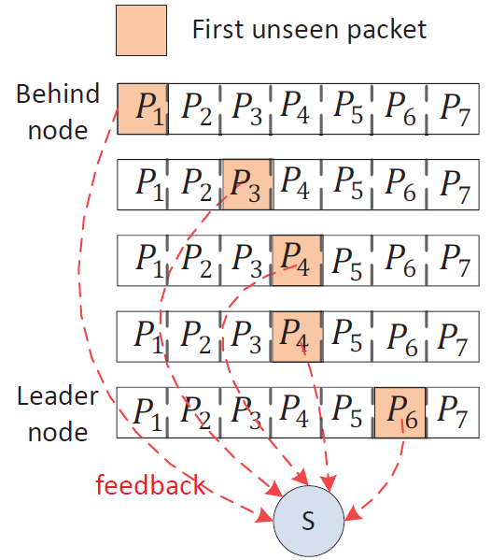
Introduction
ARQ with network coding (ANC)

Slide 10
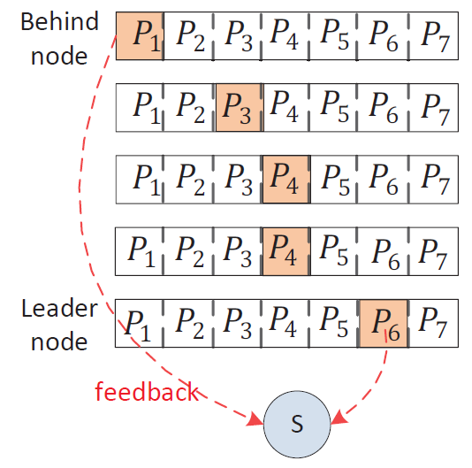
Idea
Behind and leader nodes
Code packets in the range of the first unseen packets by the leader and behind nodes

Slide 11
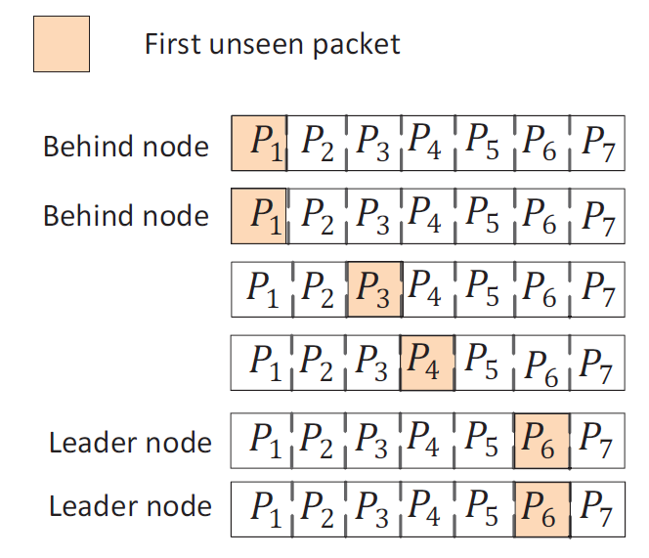
Multiple Behind and Leader Nodes
2 methods to deal with multiple behind and leader nodes

Slide 12
Dynamic NC without Overhearing
All leaders need to transmit a feedback
A receiver that missed the last transmission cannot be a leader node
If the index of the first unseen packet is equal to the largest index included in the received coded packet, then the node is a leader node
Behind nodes
If all the behind nodes receive the current transmissions, they do not send any feedback messages

Slide 13
Dynamic NC with Overhearing
Two feedbacks per time slot
Just one leader and one behind node send feedback
Set a back-off time based on the erasure rate of the nodes
The receivers listen to the channel
Leader node finishes its back-off time
Send feedback if has not overheard feedback from the other leaders

Slide 14
Dynamic NC with Overhearing
Two feedbacks per time slot
Just one leader and one behind node send feedback
The behind nodes that have received the last transmissions do not need to transmit a feedback
Only one of the nodes that was a behind node in the previous slot, and missed the current transmission should send a feedback

Slide 15
Throughput
In ANC each transmission has innovative information for all of the nodes
Achieves the maximum throughput
Proof
The same approach can be used to prove that the DNC is throughput optimal

Slide 16
Fair Dynamic NC
Unfairness of ANC and DNC
The nodes with low error rates receive more coded packets than the other nodes, and become the leaders
The nodes with higher error rates might not be able to decode the packet for a long time

Slide 17
Fair Dynamic NC
A trade-off between fairness and throughput
w : fairness factor
L : number of leaders
m : number of users
If x>0, the sender adds a new packet to the coded packet

Slide 18
Simulations (Definitions)
Decoding delay unfairness
Decoding delay fairness
Decoding unfairnes

Slide 19
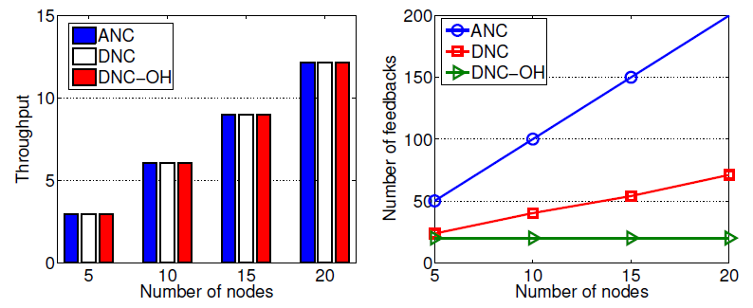
Simulations
ANC: ARQ with NC
DNC: Dynamic network coding without overhearing
DNC-OH: Dynamic network coding with overhearing

Slide 20
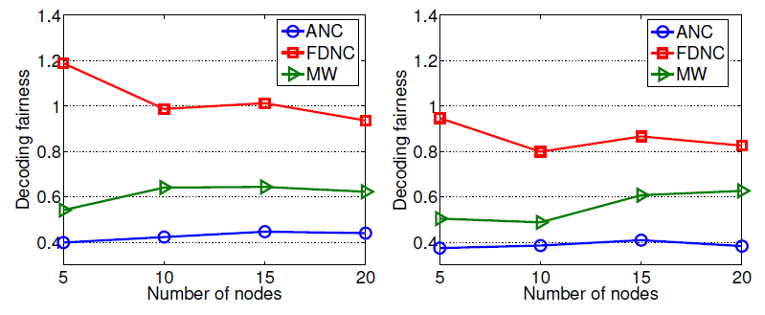
Simulations (Decoding Fairness)
ANC: ARQ with NC
FDNC: Fain dynamic network coding
MW: Moving window

Slide 21
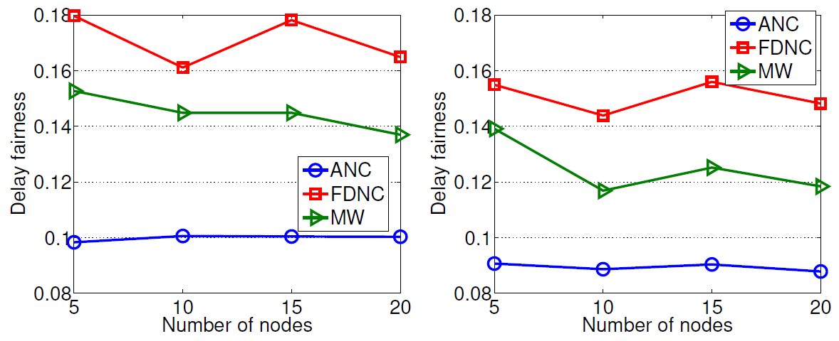
Simulations (Delay Fairness)

Slide 22
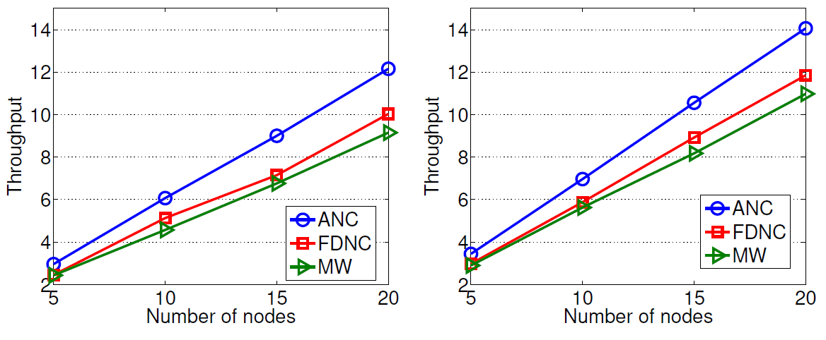
Simulations (Throughput)

Slide 23
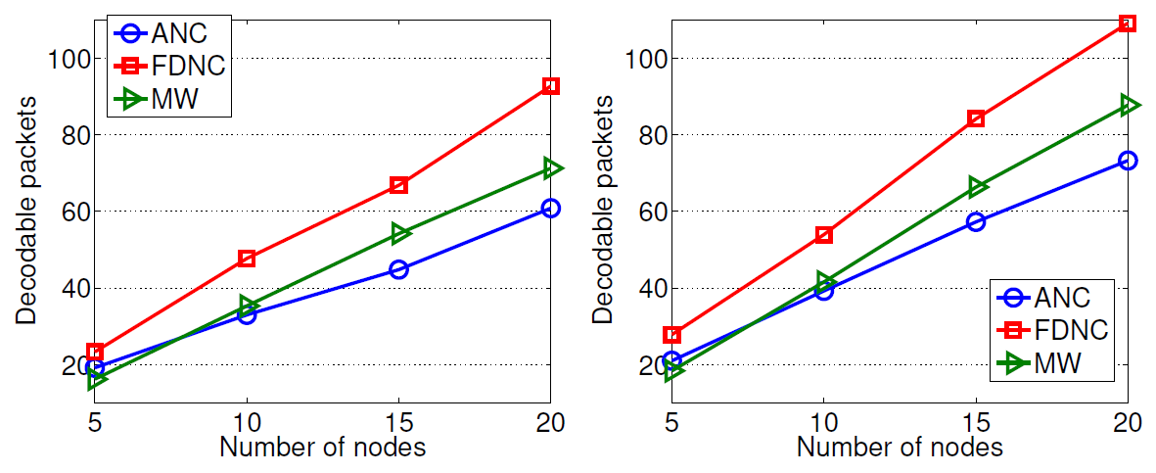
Simulations (Decodable Packets)

Slide 24
Summary
Dynamic coding increases the throughput of network coding
Too many feedback messages
We propose the DNC and DNC-OH methods to reduce the number of feedbacks
We propose the FDNC method to provide decoding and decoding delay fairness

Slide 25
Questions

