Slide 1

CausalSKyHop: Knowledge-Aware Causal Explanation of Dynamic GNNs via Higher-Order Semantic Reasoning
Jixuan Wu, Limei Lin*, Xiaoding Wang, Kunpeng Xu, Jie Wu

Slide 2
CONTENTS
1
Background & Motivation
2
CausalSkyHop Framework
3
Experiments & Results
4
Conclusion & Future Work

Slide 3
Background & Motivation
1

Slide 4
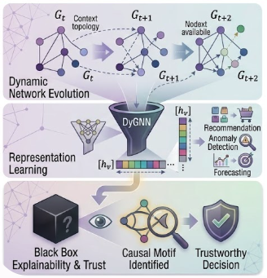
Background
Semantic-Rich Dynamic Web Graphs
Evolving graph structures with rich semantic contexts
Dynamic changes in topology and interactions
Widely used in recommendation and anomaly detection
DyGNNs for Dynamic Graph Modeling
Capturing structural and temporal dependencies
Learning highly expressive representations
Enabling diverse graph intelligence applications
Towards Trustworthy Dynamic Graph Learning
High predictive capability, yet inherently black-box
Limited transparency hinders trustworthy decisions
Faithful explanations are as crucial as accurate predictions

Slide 5
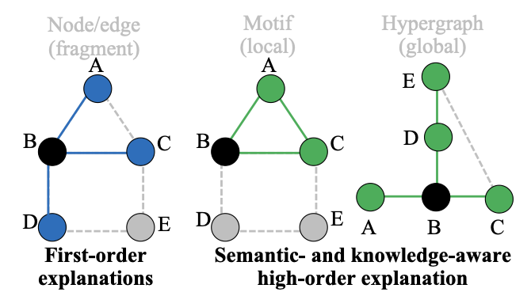
Motivation
Existing DyGNN Explanation Methods:
Mainly focus on pairwise node-edge interactions
Limited capability in capturing higher-order semantic structures
Challenges in Dynamic Graph Explanation:
Temporal graph evolution introduces complex semantic dependencies
Learned representations are often entangled with spurious correlations
Stable and faithful explanation pathways remain difficult to identify
Motivation for this Research:
There is an urgent need for an explanation framework that jointly models temporal evolution, higher-order semantics, and causal mechanisms for trustworthy dynamic graph learning.

Slide 6
key Contributions of the Paper
CausalSKyHop Framework:
A causal-aware framework for dynamic graph explanation, disentangling causal and spurious factors in evolving graphs
Higher-Order Semantic Modeling:
Capturing complex structures like motifs and hypergraphs for a richer understanding
Causal–Spurious Disentanglement:
Separates causal signals from spurious correlations, enabling more faithful explanations
Extensive Experiments:
Consistent improvements in explanation fidelity and robustness across multiple dynamic graph benchmarks

Slide 7
CausalSkyHop Framework
2

Slide 8
Overview of the CausalSkyHop Framework
Core Objective:
A semantic- and knowledge-aware framework that explains DyGNNs by uncovering causal higher-order patterns in evolving knowledge structures
Key Components:
Higher-Order Structural Causal Model (HOSCM):Captures multi-node knowledge-intensive patterns via causal reasoning
Temporal Reasoning Module:Separates persistent knowledge from evolving semantic contexts
Core Mechanism: Employs semantic backdoor adjustment to isolate genuine causal relationships from spurious ones

Slide 9
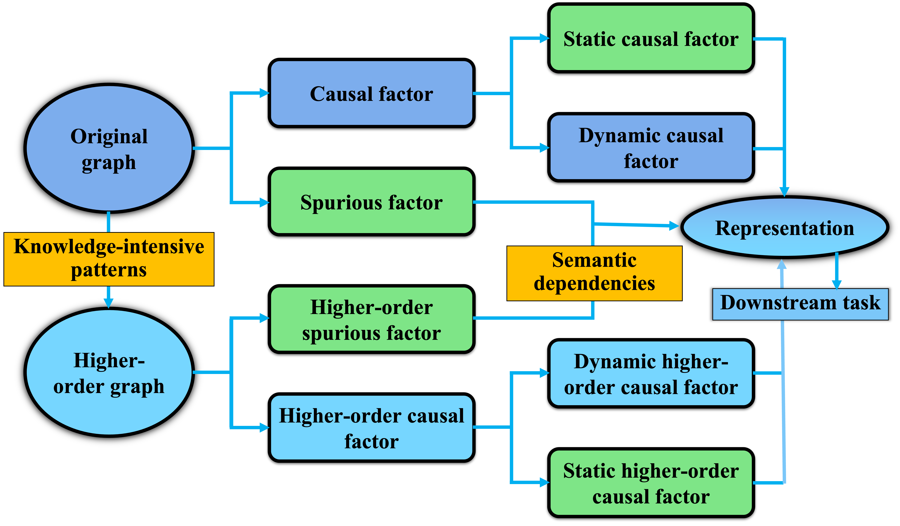
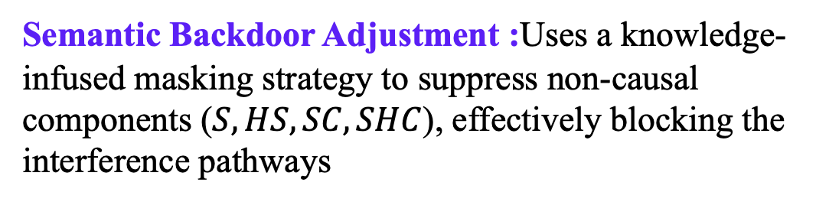
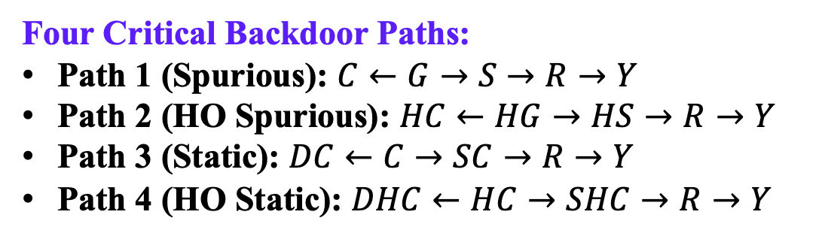
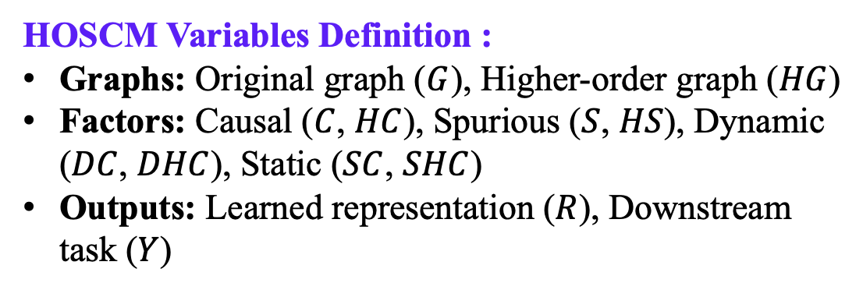
Higher-Order Structural Causal Model (HOSCM)
HOSCM Variables Definition :
Graphs: Original graph ($G$), Higher-order graph ($HG$)
Factors: Causal ($C$, $HC$), Spurious ($S$, $HS$), Dynamic ($DC$, $DHC$), Static ($SC$, $SHC$)
Outputs: Learned representation ($R$), Downstream task ($Y$)
Four Critical Backdoor Paths:
Path 1 (Spurious): $C←G→S→R→Y$
Path 2 (HO Spurious): $HC←HG→HS→R→Y$
Path 3 (Static): $DC←C→SC→R→Y$
Path 4 (HO Static): $DHC←HC→SHC→R→Y$
Semantic Backdoor Adjustment :Uses a knowledge-infused masking strategy to suppress non-causal components ($S,HS,SC,SHC$), effectively blocking the interference pathways

Slide 10
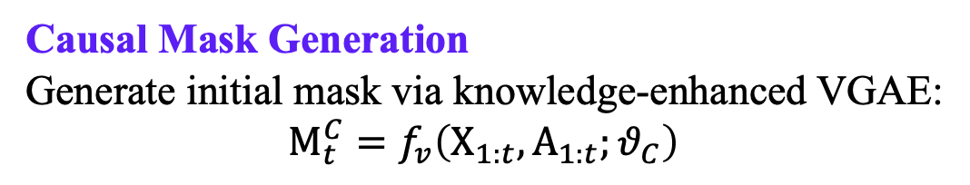
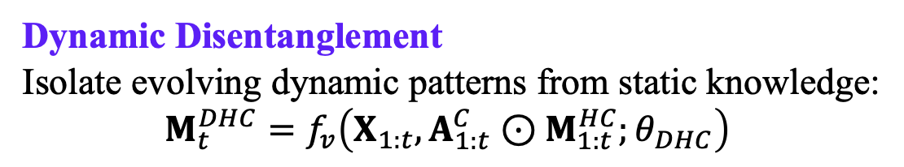
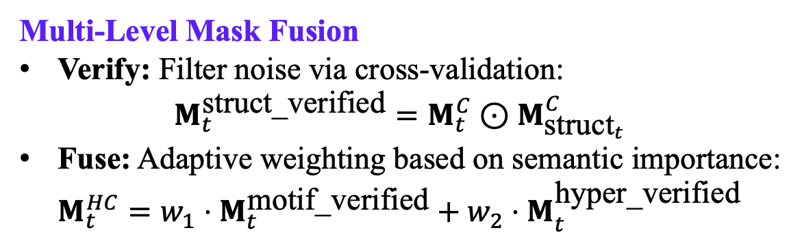
Disentangling Semantic Causal Relations
Causal Mask Generation
Generate initial mask via knowledge-enhanced VGAE:
$$M_{t}^{C}=f_{v}\left(X_{1:t},A_{1:t};θ_{C}\right)$$
Multi-Level Mask Fusion
Verify: Filter noise via cross-validation:
$$M_{t}^{\text{struct}\text{_}\text{verified}}=M_{t}^{C}⊙M_{{\text{struct}}_{t}}^{C}$$
Fuse: Adaptive weighting based on semantic importance:
$$M_{t}^{HC}=w_{1}⋅M_{t}^{\text{motif}\text{_}\text{verified}}+w_{2}⋅M_{t}^{\text{hyper}\text{_}\text{verified}}$$
Dynamic Disentanglement
Isolate evolving dynamic patterns from static knowledge:
$$M_{t}^{DHC}=f_{v}\left(X_{1:t},A_{1:t}^{C}⊙M_{1:t}^{HC};θ_{DHC}\right)$$

Slide 11
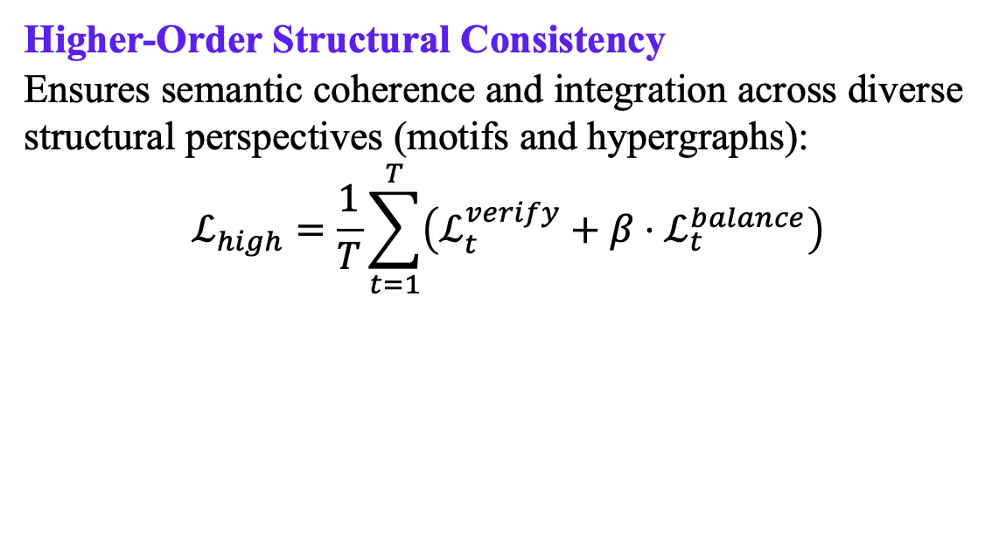
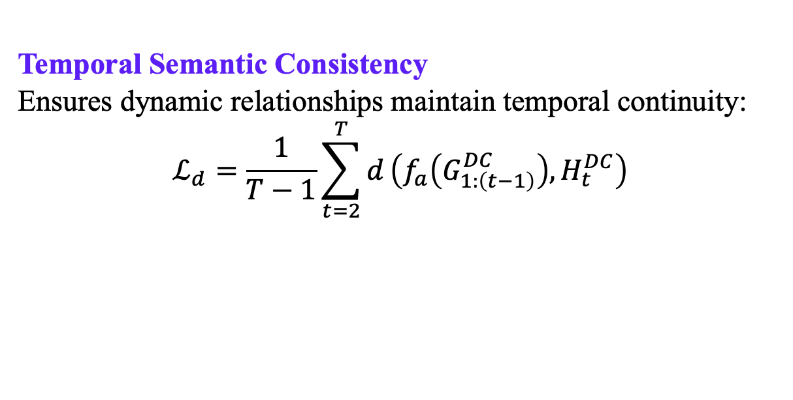
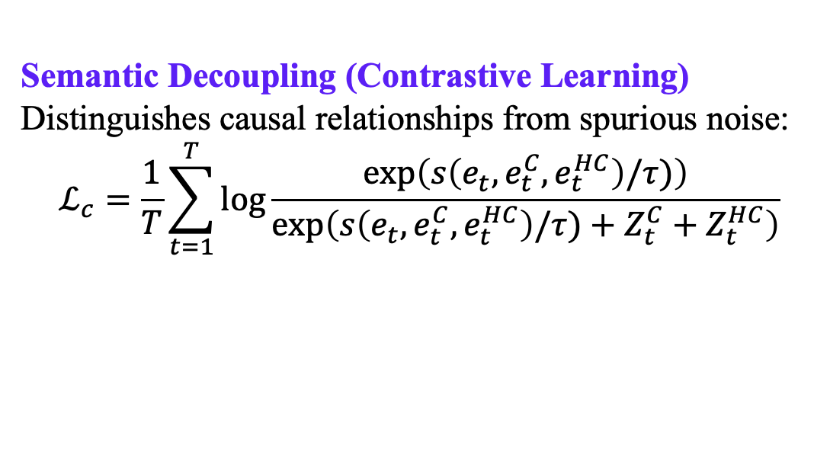
Knowledge-Grounded Optimization
Semantic Decoupling (Contrastive Learning)
Distinguishes causal relationships from spurious noise:
$$ℒ_{c}=\frac{1}{T}\sum_{t=1}^{T}{\log{\frac{\exp\left(s\left(e_{t},e_{t}^{C},e_{t}^{HC}\right)/τ)\right)}{\exp\left(s\left(e_{t},e_{t}^{C},e_{t}^{HC}\right)/τ)+Z_{t}^{C}+Z_{t}^{HC}\right)}}}$$
Temporal Semantic Consistency
Ensures dynamic relationships maintain temporal continuity:
$$ℒ_{d}=\frac{1}{T−1}\sum_{t=2}^{T}{d}\left(f_{a}\left(G_{1:\left(t−1\right)}^{DC}\right),H_{t}^{DC}\right)$$
Higher-Order Structural Consistency
Ensures semantic coherence and integration across diverse structural perspectives (motifs and hypergraphs):
$$ℒ_{high}=\frac{1}{T}\sum_{t=1}^{T}{\left(ℒ_{t}^{verify}+β⋅ℒ_{t}^{balance}\right)}$$

Slide 12
Experiments & Results
3

Slide 13
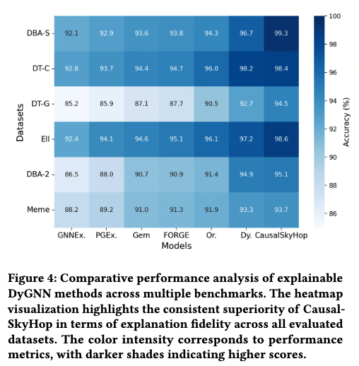
Main Results
Explanation Fidelity (Heatmap): Significant improvements in explanation accuracy and faithfulness
Prediction Accuracy (Bar Chart): Maintains or boosts downstream task performance

Slide 14
Ablation studies
Optimization Losses (Radar Chart): Confirms the effectiveness of the joint objective, especially contrastive semantic decoupling
Higher-Order Structures (Bar Chart): Demonstrates the necessity of incorporating motifs and hypergraphs for stable causal reasoning

Slide 15
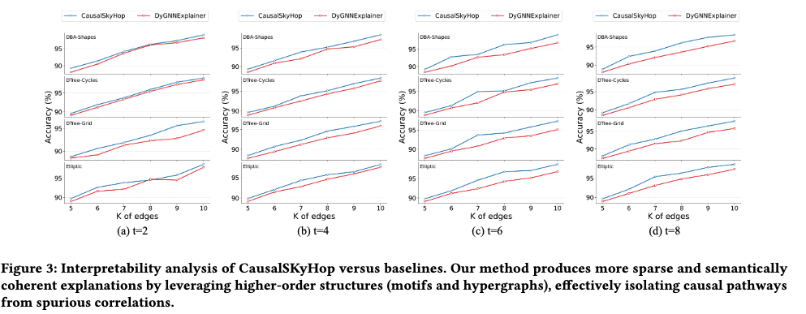
Interpretability & Sparsity
Advantage in Sparsity(Line Chart): Achieves comparable or better accuracy using fewer, more focused edges
Qualitative Interpretability(Case Study): Consistently identifies the complete, semantically meaningful 'fish' motif across all time steps

Slide 16
Conclusion & Future work
4

Slide 17
Summary
Framework Design: Introduced CausalSKyHop to explore higher-order semantic causal relations in dynamic graphs.
Mechanism: Provided a mechanism to decouple structural semantics (motifs and hypergraphs) from spurious correlations via temporal and structural constraints.
Empirical Findings: Experimental evaluations demonstrate consistent improvements in both prediction accuracy and explanation fidelity across benchmarks.
Future Work
Efficiency: Improve the computational efficiency of higher-order structure extraction for larger-scale continuous dynamic networks.
Generalization: Extend the framework to handle more complex temporal shifts and unseen node types in open-world scenarios.

Slide 18
Thanks!
Notes:
Thank you very much for your attention

