Slide 1

gShare: Efficient GPU Sharing with Aggressive
Scheduling in Multi-tenant FaaS platform
Yanan Yang¹ Zhengxiong Jiang² Meiqi Zhu²
Hongqiang Xu² Yujun Wang² Liang Li¹
Jiansong Zhang¹ Jie Wu¹
China Telecom Cloud Computing Research Institute¹
China Telecom Cloud Technology Co. Ltd.²
Presented at: ASPLOS 2026, USA.
23 March, 2026
Notes:
Hello, everyone. I am Yanan Yang from China Telecom., I am going to introduce our work “gShare: Efficient GPU Sharing with Aggressive Scheduling in Multi-tenant FaaS platform”.

Slide 2
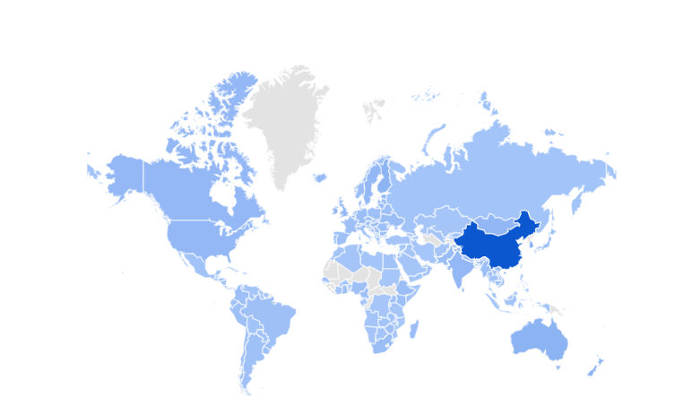
Serverless computing is acceleratedly arising
  The first commercial platform AWS Lambda in 2014
  More and more cloud services are using FaaS (Function-as-a-service) paradigm
Cloud service in the world
100
A Berkeley View on Serverless Computing
50
0
# updated in 2026/3
Notes:
In this work, we focus on the GPU functions in today's serverless platforms, which have been successful in a wide variety of workloads due to their ease of use and pay-as-you-go advantages

Slide 3

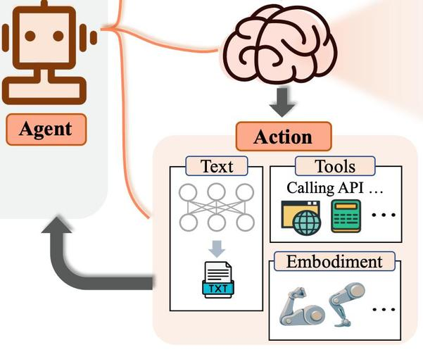
We live in the age of
Artificial Intelligence
  Smart city/transport, LLMs, AI agent, etc.
Robotics
ML serving/inference:
a critical part of our daily life.
Notes:
Today, with the growing adoption of machine learning (ML) applications, ML serving/inference has been a critical part of our daily life. Such as the smart city, chat robots and different kinds of AI agents

Slide 4
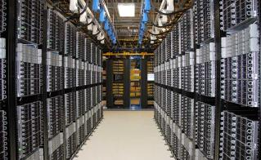
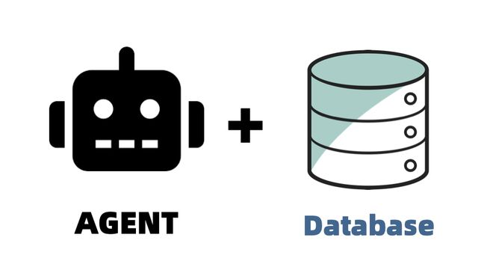

A Common Case:
  Serving ML model with FaaS Functions
    Resource management free
    Auto-scaling in/out
    Pay-as-you-go
upload
code
FaaS platform
Cloud Infra.
service
Middleware
shield the cloud details
GPU has been supported in current FaaS platforms:
Azure Container Apps, Alibaba Cloud Functions, etc.
Notes:
Serving ML models with FaaS functions has also become increasingly popular recently.
Major FaaS providers like AWS Lambda, Microsoft Azure Functions, and Alibaba Cloud Functions all report that serverless model serving has been a common use case,
and offer GPU support to meet the growing demand from inference services.

Slide 5
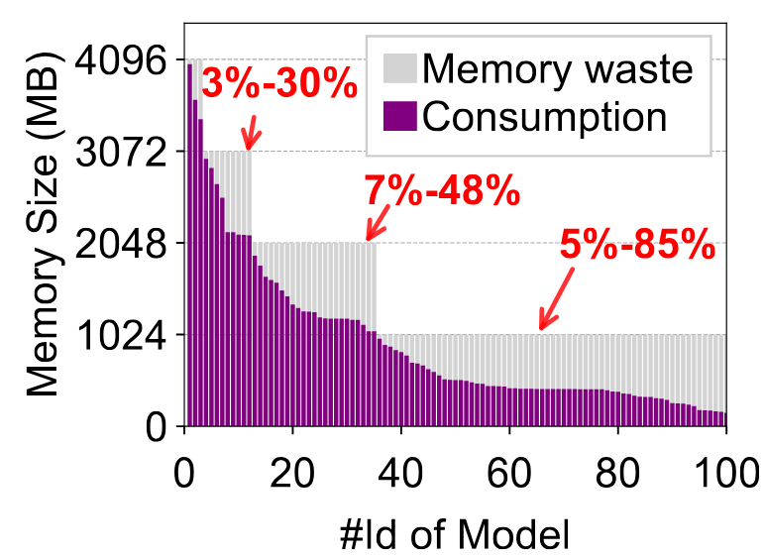
The Problem
  Coarse-grained GPU functions lacks efficiency
  Resource over-provisioning leads to high user cost
20%
Proportional
/fixed rate
computing
resource
Small models still take a considerable proportion
10%
1GB
2GB
Memory
Notes:
Unfortunately, we find that the existing GPU function management in FaaS platforms performs inefficiently, leading to high operating costs.
On the one hand, coarse-grained GPU provisioning in current FaaS platforms does not meet the needs of many small models, leading to significant resource waste and GPU underutilization.
For instance, Azure Container Apps provides NVIDIA A100 GPUs for serverless model training and inference in some regions [9], and Alibaba Cloud Function supports configuring NVIDIA V100
GPUs for functions in units of 1GB of device memory. We analyze the top 3,000 most downloaded models on TensorFlow Hub [38] and Hugging Face [24 ] (see § A) and estimate their memory footprint based on precision and pa-
rameter size. We find they exhibit a wide distribution of model sizes. More specifically, 78% of models are less than 4GB, while 66% are less than 1GB. We deploy several of them and present 100 model samples with memory consumption ranging from 128MB to 4GB. It can be seen that even using the smallest GPU function (1GB of device memory), there are about 60 functions that will suffer from a vast resource waste (with an average of 55% and a maximum of 85%). Similarly, about 20 models require at least 2GB of GPU memory for deployment, which can also lead to 7%-48% of GPU memory over-provisioning. This indicates that existing coarse-grained GPU functions may not precisely match user needs. Although GPU vendors such as NVIDIA offer proprietary virtualization solutions for VMs, the lack of flexibility and generality makes them unsuitable for dynamic serverless environments.

Slide 6
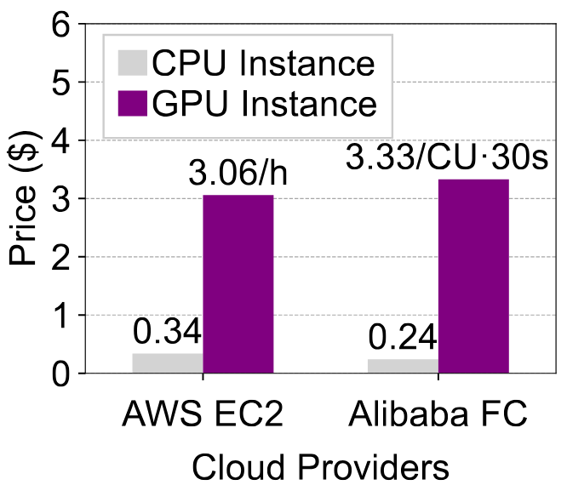
The Problem
  Coupled GPU cannot be flexibly reclamated
  GPU function idling exacerbates resource waste
# GPU are much more expensive than CPUs
# 10× higher keepalive cost v.s. CPU functions
Notes:
On the other hand, unlike CPUs that can be recycled in idle function instances, GPUs are coupled with function memory management and
cannot be flexibly offloaded for reclamation, exacerbating resource inefficiency. Cold-start is a major bottleneck in FaaS platforms. Starting a new function instance usually takes hundreds of milliseconds and hurts performance. For GPU functions, cold-start latency is even longer—often several seconds—because models, GPU drivers, and ML frameworks must be initialized, which can take longer than actual serving.
To avoid cold starts, FaaS platforms use function caching: they keep instances alive for a period (e.g., up to 15 minutes in AWS Lambda) so later requests can reuse them.
However, caching GPU functions is very expensive. Unlike CPUs, which can be reclaimed by pausing idle instances, GPU resources are tied to memory and can only be freed when the function terminates. GPU instances also cost far more: AWS P3 instances cost about $3.06/h, 9× higher than standard CPU instances, and GPU functions on Alibaba Cloud are about 14× more expensive than CPU ones.
In production, workloads can fluctuate by up to 33,000× in one minute. Even with multi-concurrency optimizations, fixed GPU allocation causes low resource utilization after traffic bursts. Due to high cost and poor efficiency, traditional keep-alive caching is not suitable for GPU functions in FaaS platforms.

Slide 7
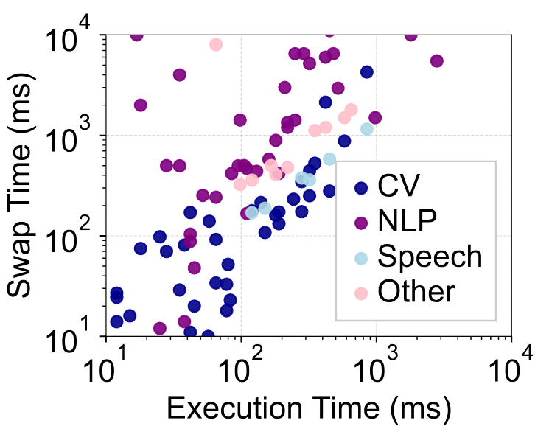
Inefficiency of Existing Methods
  Inflexible and heavy model swapping
  SLO-Oblivious scheduling decisions
100s-1000s ms
cudaMemcpyH2D
cudaMemcpyD2H
Exec
Exec
10x lat. Incre.
Exec
10s of ms
# Model swapping may experience long latency
# Simple heuristic scheduling results in either
low GPU utilization or SLO violations
Notes:
To improve GPU cost efficiency, some FaaS platforms now offer cheaper billing for idle GPU functions. They let providers swap ML models from GPU memory to host memory during keep-alive, so GPUs can be reused by others. Previous systems use a GPU proxy on each node to manage GPUs as a pool. It runs an executor on each GPU to handle CUDA calls, model swapping, and memory management. When a request comes, the function uses a CPU client to talk to this executor.
However, this model‑swapping method is not efficient. The GPU proxy works with the FaaS control plane to forward requests, swap memory, and process kernels. This two‑layer design adds overhead and makes performance less predictable. Although swapping is faster than cold start, it still causes noticeable delay—copying 1GB with cudaMemcpy() takes about 1 second. In addition, models have unstable swap and runtime speeds. Existing systems only swap based on function popularity. This often ignores how swapping affects latency, leading to frequent SLO misses. If they over‑protect against swapping, resource usage becomes low and efficiency drops.

Slide 8
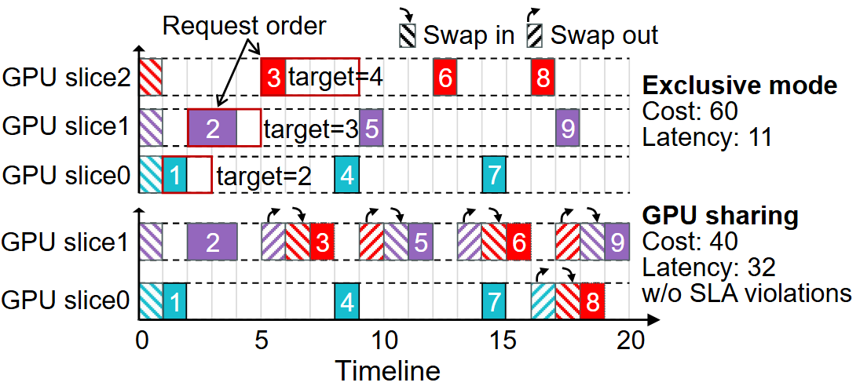
Motivations
  Fine-grained GPU allocation (time-slicing with vGPU)
  Resource decoupling & Flexible sharing
  Efficient GPU overselling
Goal: Cost-efficient GPU-enabled Muti-tenant FaaS platform
principle
Low efficiency
High efficiency
Notes:
In this paper, we argue for a domain-specific GPU function management policy to address this problem: Firstly, GPU resources should be provided in a fine-grained manner,
thereby precisely matching users' requirements and minimizing resource waste.
Second, GPUs should be decoupled from the existing function resource management scheme to support flexible recycling and sharing,
which can provide FaaS providers with an opportunity to reduce resource costs through sharing.
Moreover, some serving functions may have smaller model sizes and more lenient latency tolerances,
which can be exploited to explore more aggressive GPU sharing policies, thereby improving cost efficiency in FaaS platforms without hurting users’ function performance

Slide 9
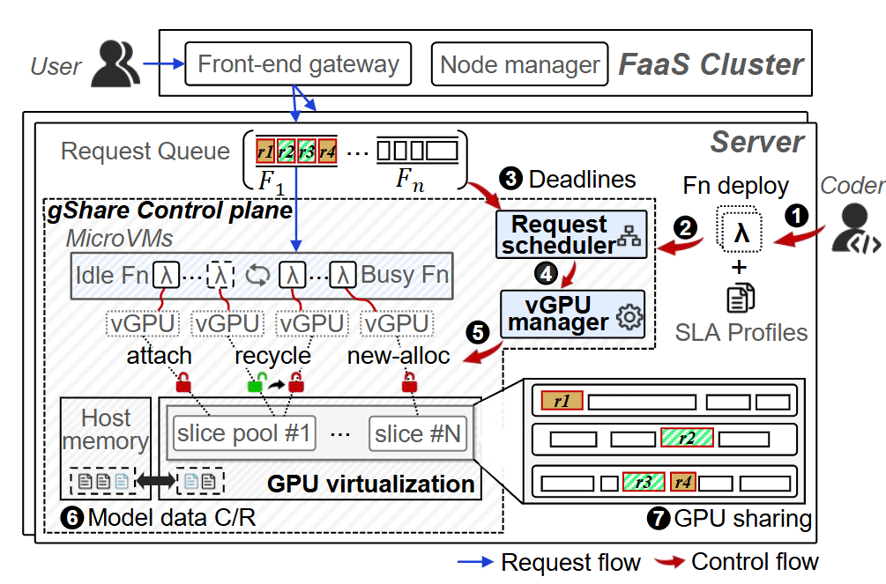
Design of gShare
  Designed for Muti-tenant FaaS platform
  GPU sharing with GPU virtualization technology
  Discounted billing model for over-selling
#1 Fine-grained GPU allocation (e.g., minimum 1%vGPU)
#2 Decoupled and flexible GPU recycling with vGPU hot-plugging and fast model swapping
#3 Profiling-based SLO-aware GPU shceduling & sharing
Domain-specific GPU function management policy
Notes:
Here, we present our system,gShare, which is designed for multi-tenant FaaS platforms and aims to provide cost-efficient GPU functions to cloud users. We summarize it as three features:

Slide 10
Design of gShare
  Designed for Muti-tenant FaaS platform
  GPU sharing with GPU virtualization technology
  Discounted billing model for over-selling
#1 Fine-grained GPU allocation (e.g., minimum 1%vGPU)
#2 Decoupled and flexible GPU recycling with vGPU hot-plugging and fast model swapping
#3 Profiling-based SLO-aware GPU shceduling & sharing
Domain-specific GPU function management policy
Notes:
The first one, Fine-grained GPU allocation

Slide 11
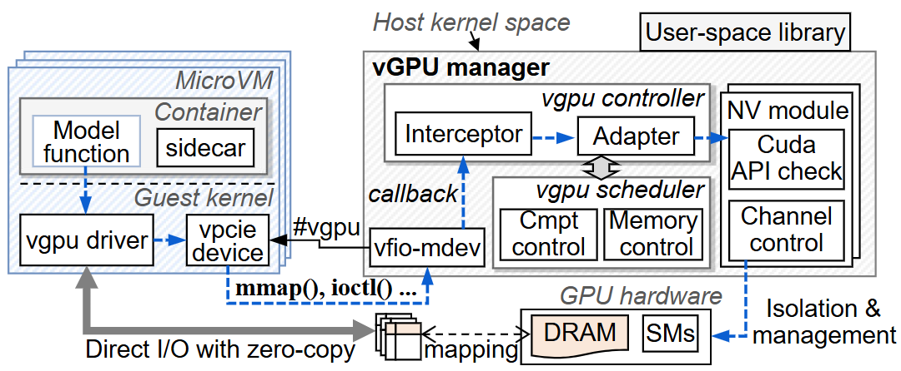
Challenge #1
  MPS can not be used in multi-tenant VM env.
  GPU virtualization is rarely studied before
  Nivida’s roprietary solution lacks flexibility
Our Solution:
# Better compatibility than user-space API
interception
# Natively direct I/O access reduces overhead
# Arbitrary device memory and time slicing allocation
A complete vGPU implementation based on driver interception
Notes:
gShare partitions the GPU hardware into a set of GPU slices of different sizes and allocates them to user functions via the vGPU abstraction.
The user can configure functions with a minimum of 128 mega bytes of device memory and is encouraged to release GPU resources to receive discounts.

Slide 12
Design of gShare
  Designed for Muti-tenant FaaS platform
  GPU sharing with GPU virtualization technology
  Discounted billing model for over-selling
#1 Fine-grained GPU allocation (e.g., minimum 1%vGPU)
#2 Decoupled and flexible GPU recycling with vGPU hot-plugging and fast model swapping
#3 Profiling-based SLO-aware GPU shceduling & sharing
Domain-specific GPU function management policy
Notes:
The second one, Decoupled and flexible GPU recycling

Slide 13
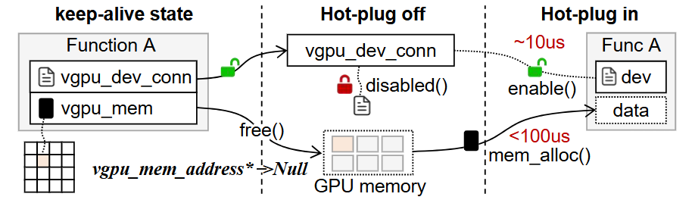
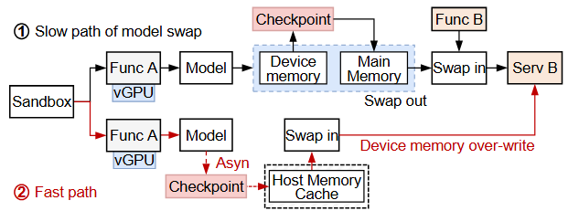
Challenge #2
  GPU recycling and data recovery incur extra lantecy
  Proxy-based GPU manager design is not necessary
  Limited memory bandwidth between host and device
Our Solution:
# vGPU Hot-Plugging mechanism
# Direct model data management inside function sidecar
# Fast model sawp with checkpoint cache
vGPU Hot-Plugging and fast model swap
Notes:
With a vGPU Hot-Plugging mechanism and a fast model swap design, an idle vGPU instance can be dynamically mapped to another tenant function VM on the host server, enabling us to flexibly allocate or recycle GPU resources to save costs.

Slide 14
Design of gShare
  Designed for Muti-tenant FaaS platform
  GPU sharing with GPU virtualization technology
  Discounted billing model for over-selling
#1 Fine-grained GPU allocation (e.g., minimum 1%vGPU)
#2 Decoupled and flexible GPU recycling with vGPU hot-plugging and fast model swapping
#3 Profiling-based SLO-aware GPU shceduling & sharing
Domain-specific GPU function management policy
Notes:
The third one, Profiling-based SLO-aware GPU scheduling & sharing

Slide 15
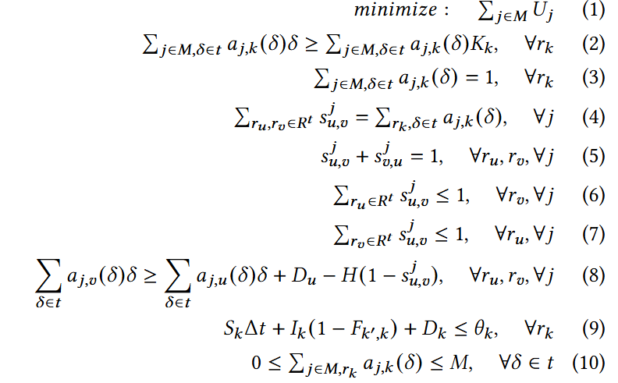

Challenge #3
  Different user latency SLOs
  Diverse workload patterns and latency requirement
  The Optimal GPU allocation and request scheduling
Problem Formulation:
E.g., f1, f2 on GPU_0
f1(20% time slicing),f2(40% TS)
ordered by
creation time
$$sched_period （20ms）$$
f1
f2
40% unused
f1
f2
40% unused
f1
f2
40% unused
timeline
0
20ms
40ms
60ms
$$slice=func_mem/dev_cap∗sched_period$$
(1) Given a request queue and time slot of each model function
(2) Decide which GPU, which slot to execute request
(3) When f1 is idle, f3 can replace it to reduce cost
or creating f4(<60%) on GPU_0 after f2
Notes:
We also proposed an SLO-aware request scheduling algorithm that enables the GPU hardware to be fully utilized by different vGPU functions in a time-sharing manner, thereby achieving high cost efficiency.
Here, we give an example of the scheduling model and the Problem Formulation.
Suppose there are two functions, f1 and f2, deployed on GPU0. f1 requests 20% of the device memory and thus gets 20% of the time slice. f2 requests 40% of the device memory and thus gets 40% of the time slice. We define the scheduling period as 20ms. In each scheduling period, f1 and f2 will exclusively occupy the GPU in a round-robin manner to execute their requests. If the requests are not completed, they will continue to execute in the next scheduling period. Therefore, when f1 or f2 is idle, the corresponding time slice, i.e., unused, will be wasted. At this point, if the requests of f3 and f4 arrive, we can choose to replace f1 with f3 or allocate the unassigned time slice to f4. This decision needs to consider how to minimize the time slice allocation while meeting the request delay SLO of all.

Slide 16
Our Solution
  A hybrid scheduling policy (cacheQueue+slackQueue)
  Deadline-driven GPU allocation & request scheduling
Greedy Algorithm:
Pick request with
smallest slack
deadline-driven
scheduling
meet
SLO?
shareQueue
Functions
can
share?
cacheQueue
cache
hit?
allocate
new slice
reuse slice with
max ddl_left
Execute
Notes:
Since it's difficult to solve this MINLP problem quickly, we resort to a fast algorithm for efficient scheduling in practice. Given a little bit of model profiles on swap and execution time, gShare adopts a hybrid vGPU provisioning policy with SLO-aware lazy scheduling to orchestrate vGPU allocation and request execution, which can minimize the GPU usage without violating users’ latency SLOs
We maintain two request queues. If the user disables the GPU sharing mechanism or the function model is too large, we use keepalive to cache the model. If the user allows sharing, it will enter the sharing queue. The scheduler selects the requests that are about to violate the SLO for scheduling each time. For specific details, please refer to the algorithm section of our paper.

Slide 17
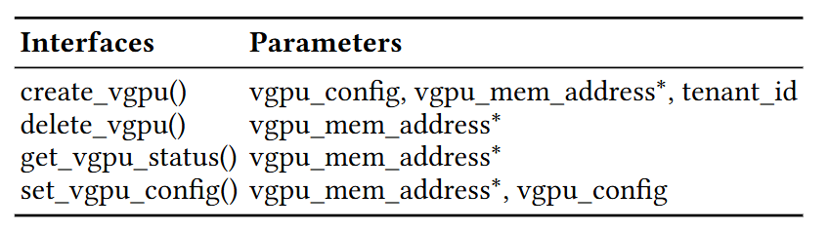
Implementation
  Kata-containers + NVIDIA GPU
  60,000 lines of C code on vGPU design
  Rewritten a total of 57 ioctl interfaces (17 NV_ESC APIs and 40 UVM_APIs)
  Adaptation for AMD ROCm are in progress
A subset of the vGPU user-space library
Notes:
In the following sections, we will introduce the Implementation and evaluation results of gShare.

Slide 18
Evaluation
  A testbed comprising 20 physical servers
  NVIDIA A100 GPUs (9 GPU vGPU types ranging from 128MB-40 GB)
  MLPerf following 3 traces from three production clusters
  Latency target is defined as 1.5× of p90 execution time
Compared systems:
  Keeaplive policy (15-minute timeout setting in AWS Lambda)
  FaasCache[ASPLOS’21] (priority-based swap policy)
  FaaSwap[] (state-of-the-art method in GPU sharing)
  NoCache (aggressive scheduling strategy)
  FIFO (a homogeneous version of gShare)
Notes:
We integrate gShare into a microVM-based FaaS platform equipped with NVIDIA GPUs, where GPU functions are encapsulated within Kata Containers [ 69 ] running on bare-metal servers.
We compare gShare against five related systems: Keepalive, FaasCache, FaaSwap, NoCache, and FIFO. The workload is generated using MLPerf [70] with real-world traces from three of our production clusters.

Slide 19
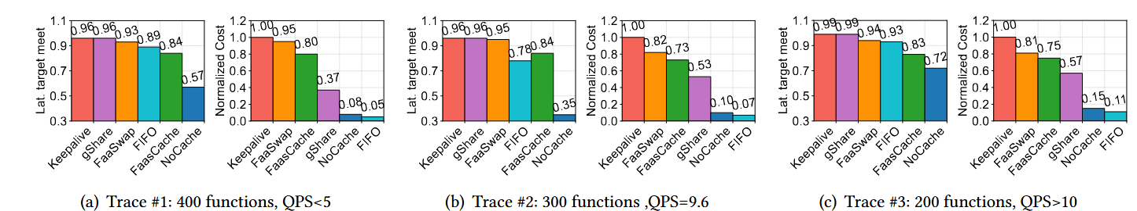
Evaluation
  Q-1: Can gShare achieve better cost-efficiency under different workloads?
gShare reduces GPU usage by 43%–63% while maintaining function performance comparable to baseline
gShare delivers consistent performance improvements across diverse workload scenarios
Notes:
We define a function’s latency target as 1.5 × its 90th percentile (i.e., 𝑝90) execution time. The evaluation results show that gShare reduces GPU usage by 43%–63% while maintaining function performance comparable to baseline.
Its workload-agnostic design is also demonstrated across different traces.

Slide 20
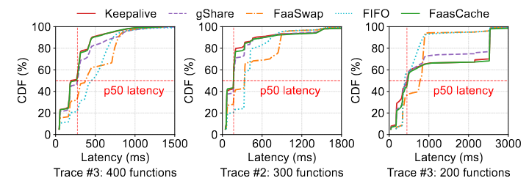
Evaluation
  Q-2: How does gShare’s GPU sharing mechanism affect request latency?
The lazy scheduling mechanism in gShare may increase request waiting time, but only results in a 15% increase in p95 latency, with negligible degradation in p50 latency
Notes:
We further analyze the Latency Impact of gShare’s GPU sharing. As shown in the figure, the lazy scheduling mechanism in gShare may increase request waiting time but results in only a 15% increase in p95 latency, with negligible degradation in p50 latency.

Slide 21
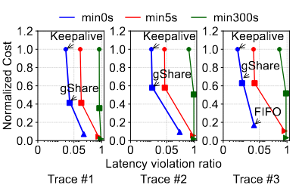
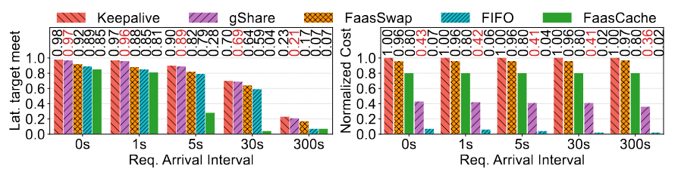
Evaluation
  Q-3: How does gShare perform under various function concurrency and latency constraints?
gShare achieves Pareto optimality on cost-efficiency under different workload settings
gShare performs best under sparse workloads with lenient latency targets
Notes:
We evaluate gShare under 20 different combinations of function concurrency and latency target. The results show it outperforms FaaSwap and FaasCache in most cases and achieves Pareto optimality among Keepalive, FIFO, and NoCache.

Slide 22
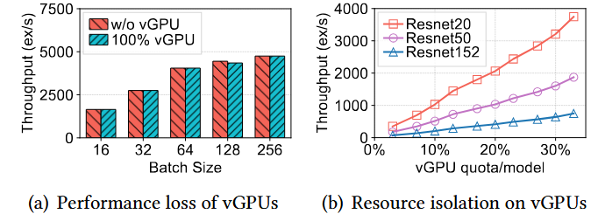
Evaluation
  Q-4: What is the system overhead of gShare on vGPU allocation and reclamation?
Share’s vGPU incurs negligible performance degradation for microVM-based functions
gShare ensures strong resource isolation across multiple tenant functions sharing the same GPU device
Notes:
We also evaluate the performance overhead introduced by virtualization as well as the cost-benefit.

Slide 23
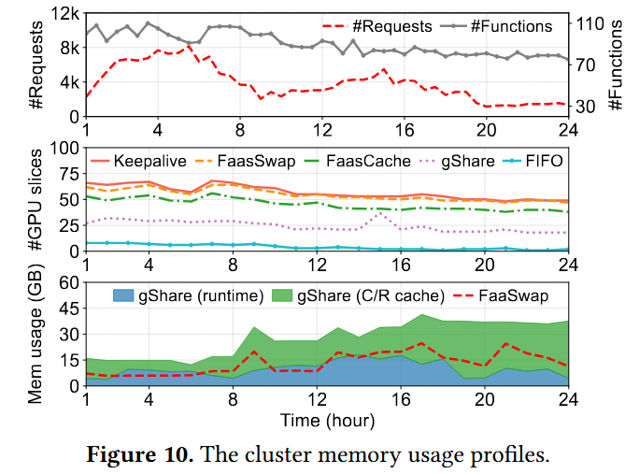
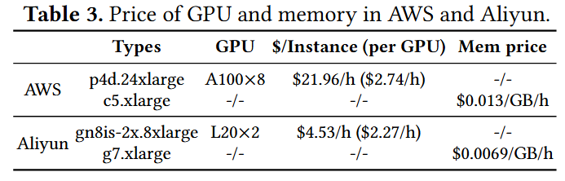
Evaluation
  Q-5: how much economic benefit can gShare bring?
gShare achieves 75% of the optimal cost-efficiency but being 100× faster in practice
gShare can help reduce GPU resource cost by hundreds of thousands of dollars every year in a typical FaaS cluster, benefiting both cloud provider and users
Notes:
Although gshare requires a large amount of memory to store model data, compared with expensive GPU devices, the memory architecture is insignificant. According to estimates, gShare can help reduce GPU resource cost by hundreds of thousands of dollars every year in a typical FaaS cluster, benefiting both the cloud provider and users

Slide 24
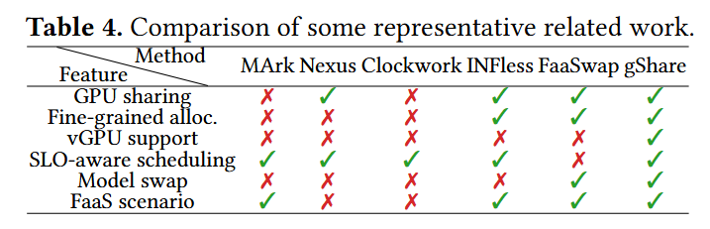
  Conclusion
We reveal the inefficiency of existing serverless GPU functions and argue the decoupled GPU management design
Small models are still important today!
We explore the optimum design space for GPU sharing and present its benefits
Any Question can contact us
yangyn11@chinatelecom.cn
Notes:
Due to time constraints, we are unable to present more details and experimental results. Here, we briefly summarize the contributions of gShare.
First, we reveale the inefficiency of existing Coarse-grained GPU functions as our motivation. Even in the age of large language models, small models still deserve attention.
Based on the findings, we argue for decoupling GPU management from FaaS functions and present user-transparent vGPU switching and sharing techniques from practice.
Finally, we also explore the optimum design space for GPU sharing and discussed its benefits.
I'm very sorry that I can't attend the conference due to visa issues. If you have any questions, please contact us via email.

Slide 25
Thanks for listening!
Notes:
Due to time constraints, we are unable to present more details and experimental results. Here, we briefly summarize the contributions of gShare.
First, we reveale the inefficiency of existing Coarse-grained GPU functions as our motivation. Even in the age of large language models, small models still deserve attention.
Based on the findings, we argue for decoupling GPU management from FaaS functions and present user-transparent vGPU switching and sharing techniques from practice.
Finally, we also explore the optimum design space for GPU sharing and discussed its benefits.
I'm very sorry that I can't attend the conference due to visa issues. If you have any questions, please contact us via email.

