Slide 1
On Effective CS Education in the Era of Information Technology
Jie Wu
Dept. of Computer and Info. Sciences
Temple University
Notes:
1

Slide 2
Roadmap
STEM Education
CS Enrollment
Several Initiatives
NSF: BPC-A and CE21 and ACM: CSTA
CS Curricula
ACM Curriculum and Competing Fields
On Creativity
Different Methodologies
Chinese vs. U.S. Ed. Systems
Final Thoughts

Slide 3
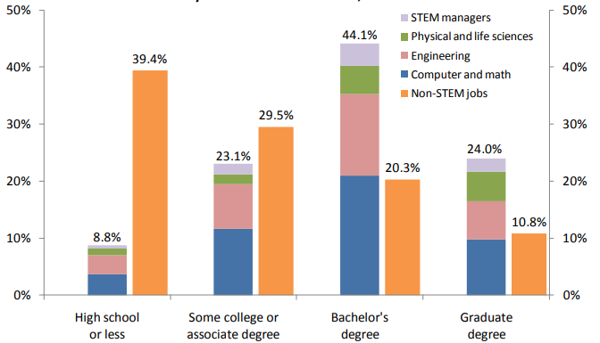
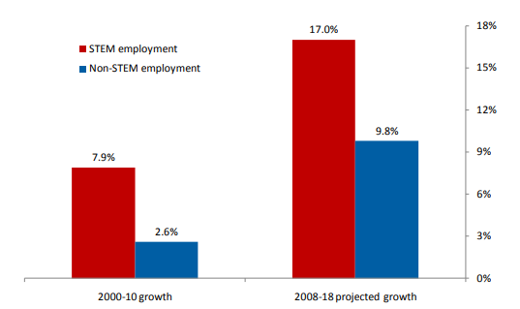
1. STEM Education
STEM: Science, Technology, Engineering, and Math
Notes:
Delay between graduation and enrollment.

Slide 4
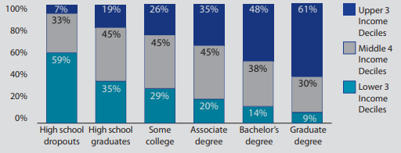
Education Level and Income Deciles ^{[1]}
[1] A. P. Carnevale (2010) “Help Wanted: Projection of Jobs and Education Requirement through 2018,” Georgetown University.
Notes:
Delay between graduation and enrollment.

Slide 5
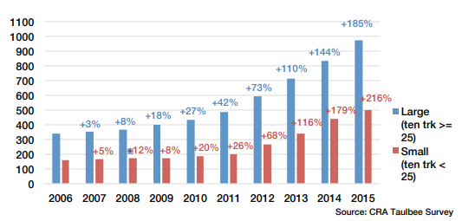
Computer Science: Majors and Jobs
Physical
Sciences
7%
Computer Support
7%
Database Admin.
2%
Computing
71%
Software
Engineering
27%
Systems Analysis
10%
Traditional
Engineering
16%
Computer
Networking
21%
CS/IS
1%
Mathematics
2%
Other Computing
3%
Life Sciences
4%
Percentage of New STEM Jobs

Slide 6
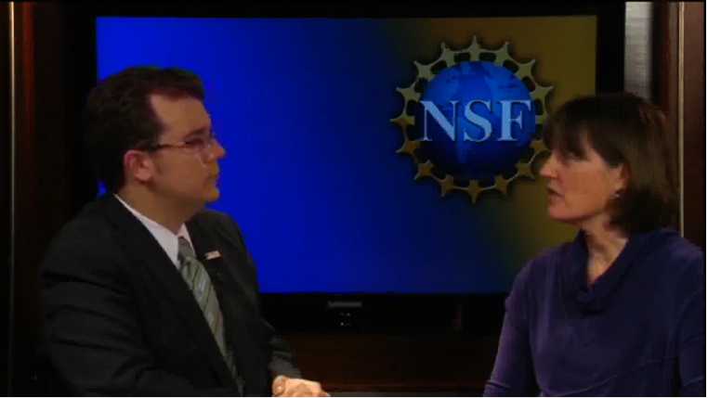
2. Several Initiatives
Broadening Participation in Computing Alliance (BPC-A)
BPC-A addresses issues across K-16
Computing Education for the 21st Century (CE21)
Effective teaching and learning in computing
NSF-initiated CS 10K project: 10,000 high school teachers to teach AP exam in CS
Cyberlearning: Transforming Education (CTE)
Notes:
Increase women’s enrollment in CS. 100,000 in total STEM
Train high school computer science teachers
Computer (Oct. 201): developing CS teacher identity, teaching teachers on-line.

Slide 7
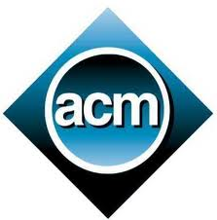
ACM: CSTA
Computer Science Teachers Association (CSTA)
Evolved from ACM’s K-12 task force
Working on revising the model curriculum
Computing education for students ages 5-18 (K-12)
Learn from the successful stories of
National Science Teachers Association (NSTA)
National Council for Teachers of Mathematics (NCTM)
Notes:
Steve Cooper (Stanford) is leading the effort.

Slide 8
Challenges (1):
Perception of CS as a service discipline
Branding CS discipline in the era of big data
Attaching more participants in CS STEM
Notes:
How to attract students to CS.
The impact of computing will go deeper into the sciences and
engineering and will become more pervasive throughout society.

Slide 9
3. CS Curricula
Diversification of CS education
Past foundation
mathematical logic
mathematical engineering (M. Snir)
Current foundation
mathematics, statistics, cognitive sciences,
social sciences, physical sciences, etc.
New fields and cross-disciplinary programs
Cybersecurity, data analytics, AI, and IoT
Double major, CS-major X-minor, and X-major CS-minor

Slide 10
ACM (AIS and IEEE) Curricula
Curriculum 65
Prelim. recommendation
Curriculum 68
Algorithmic thinking
Curriculum 78
Programming skills
Curriculum 91
Multiple core
Curriculum 01
Multiple tracks
Curriculum 13
Outward looking
ACM Curriculum
Computer Engineering
Computer Science
Information Systems
Information Technology
Software Engineering
Multiple Introductory Seq.
Imperative-first
Object-first
Functional-first
Algorithm-first
Hardware-first
Notes:
Andrew McGettrick: Greater emphasis on concurrency, assurance, systems.

Slide 11
Sample Curricula: IST
Notes:
Education-related conferences and journals.

Slide 12
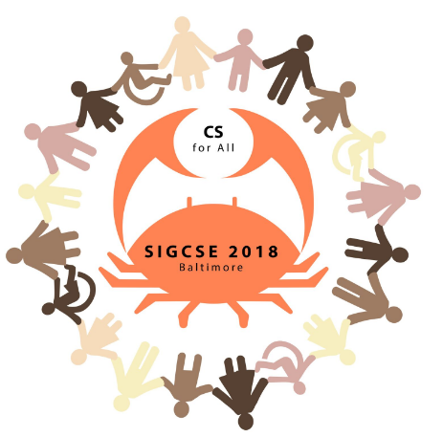
CS Education Matters
ACM Symp. on CS Education (SIGCSE 2018)
Keynote:
The Evolution Before the Revolution
Teaching CS in a Time of Opportunities and Challenges
Panel:
Team-Teaching with Humanities; Rising CS Enrolments
Writing in CS: Why and How? Best Practices to Remedy Gender Bias
Special Sessions:
Studying K-12 Computing Education
Evaluating CS4All Initiatives – Challenges and Opportunities
ACM Student Research Competition
BOF Flock: CSTA: Connecting Colleges and K-12 CS Teachers
Technical Papers, Exhibits, Posters, Demos, and NSF Showcases
ACM Journal of Educational Resources in Computing
ACM Transactions on Computer Education
Notes:
Education-related conferences and journals.

Slide 13
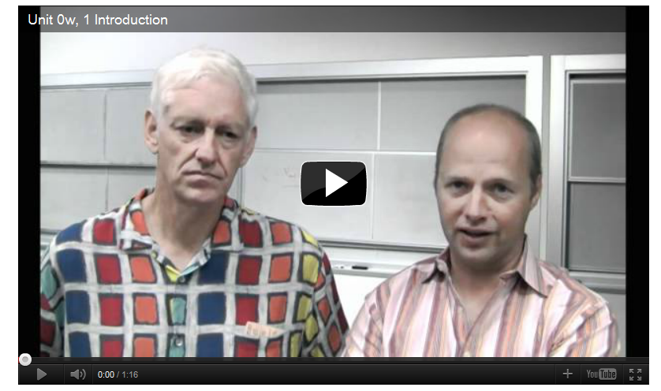
Distributed Ed: Stanford “Intro to AI”
S. Thrun (Stanford) and P. Norvig (Google)
Free and online worldwide
Delivering lectures on youtube
Earning class certificate once passing
Notes:
Temple is also participating in this class (a course taught by Longin)

Slide 14
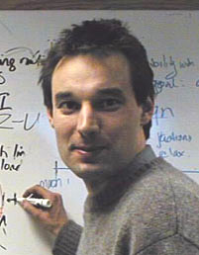
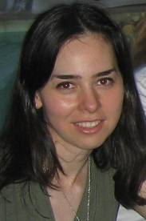
Multi-subject: MIT “Computer Sys. Eng.”
Intro & complexity
Tech trends
Naming
Enforcing modularity
Operating systems
Concurrency
Threads
Performance
Networks
Layers
Routing
End-to-end
Sharing networks
Distributed naming
Fault tolerance
Atomicity
Recovery
Isolation
Multi-site atomicity
Consistency and replication
Security
Message authentication
User authentication
Certification
F. Kaashoek
(lecturer)
D. Katabi
(recitation)
Notes:
D. Katabi (the world renowned researcher in wireless networks) is doing recitation!
This course only applies to excellent students already exposed to system issues.

Slide 15
Diversity
CMU Ph.D. Programs
Computation, Organizations and Society
Computational Biology
Computer Science
Human-Computer Interaction
Language and Information Technologies
Machine Learning
Machine Learning and Public Policy
Machine Learning and Statistics
Robotics
Software Engineering
CMU (School of Computer Science): Department, Institute, and Center
Computer Science Dept.
Human-Computer Interaction Institute
Institute for Software Research
Language Technologies Institute
Lane Center for Computational Biology
Machine Learning Department
Robotics Institute
Notes:
Structure and programs in school of computer science at CMU.

Slide 16
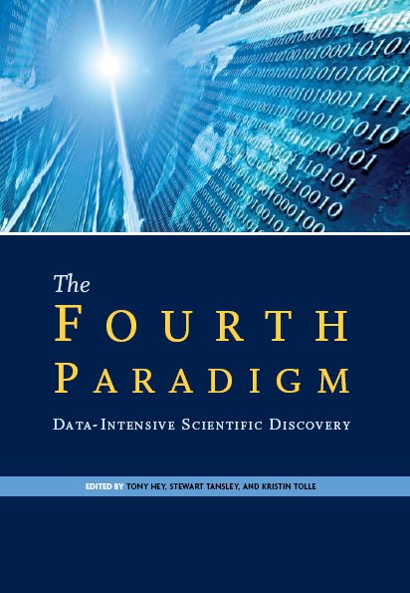
The Bigger Picture
CS role in four scientific paradigms
Theory: The primary scientific paradigm
Experimentation: The use of apparatus, artifacts, and observation to test theories and construct models
Computation (1980s): A specialization of experimentation with tools focused around numerical techniques afforded by computers
Data-driven (2010s): data and the computational systems needed to manipulate, visualize, and manage large amounts of scientific data
Notes:
CS is involved in the third paradigm, but the filed is dominated by computation scientists in the other field.
The explosive growth of scientific and social data, wireless connectivity
at broadband speeds for billions of endpoints – which are both people and
environmental sensors
Computing research and education has the potential to form a
pervasive intellectual fabric that connects a wide range of
disciplines
Data-driven as the fourth paradigm, was done by the effort by Jim Gray at MS.
Computational Science is scientific investigation through modeling and simulation of physical processes on computers. Importance of experimentation to validate their hypotheses.

Slide 17
Challenges (2):
Expanding C&I curricula while maintaining
its core
Utilizing IT technology for effective teaching and learning
Educating CS students in ways of thinking and problem solving, which characterizes CS
Notes:
How to educate our CS students. NSF new program CTE: Cyberlearning: transforming education

Slide 18
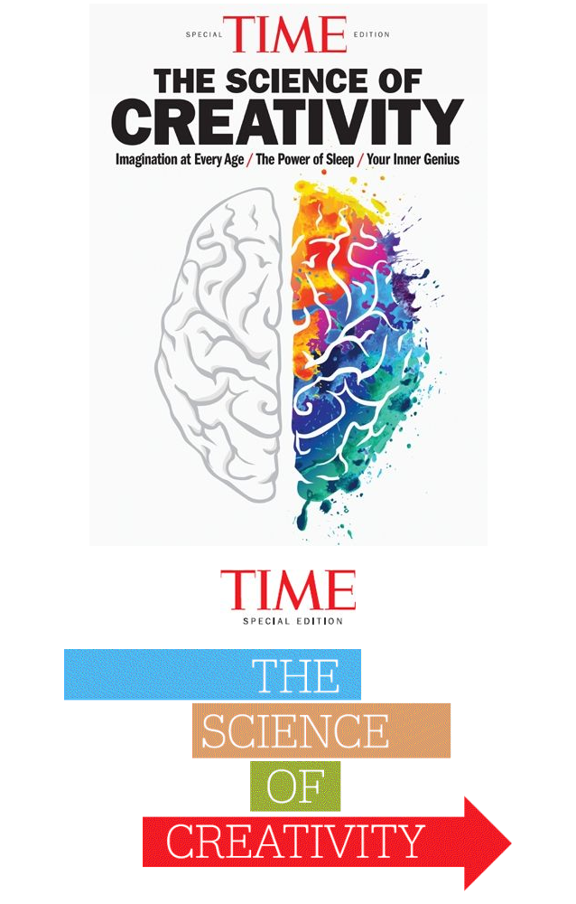
3. On Creativity
Transformative research
A culture of creativity ^{[2]}
The science of creativity ^{[3]}
Research institutions
Communication
Cooperation
Courage
[2] Alexander Von Humboldt Foundation, Cultures of Creativity
[3] Time, Special Issue on The Science of Creativity

Slide 19
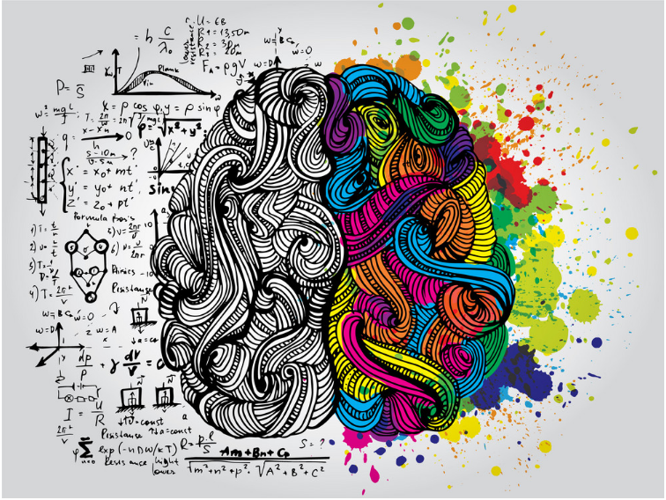
Human Brain
Left brain
Logic
Analysis
Right brain
Creativity
Imagination

Slide 20
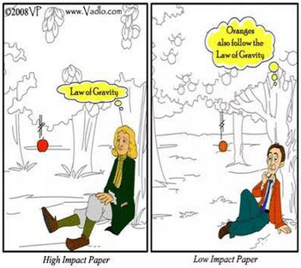
Quality
Originality
Reading literature
Writing own paper(s)
Learn from artists
Abstraction
Imagination
Georgia O’keeffe

Slide 21
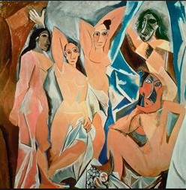
Why Picasso is Great
Know how to make appropriate abstraction – very important in CS!
Many CS students use excessive amounts of math to explain simple things!
Les Demoiselles
Notes:
K. Batcher , Cray award winner, attended ICPP every year, until the conf. was moved around. He refused to miss any class.
S. Sahni , CS chair at UF, drove to Boca Raton early morning (staring at 5 am) as he did not want to miss a class the day before.

Slide 22
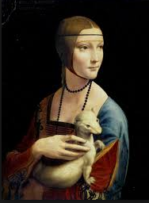
Learning From Leonardo
Overemphasis on utility can be the enemy of creativity
Be curious, relentlessly curious
Indulge fantasy
Create for yourself
Let your reach exceed your grasp
Lady with an Ermine
Notes:
K. Batcher , Cray award winner, attended ICPP every year, until the conf. was moved around. He refused to miss any class.
S. Sahni , CS chair at UF, drove to Boca Raton early morning (staring at 5 am) as he did not want to miss a class the day before.

Slide 23
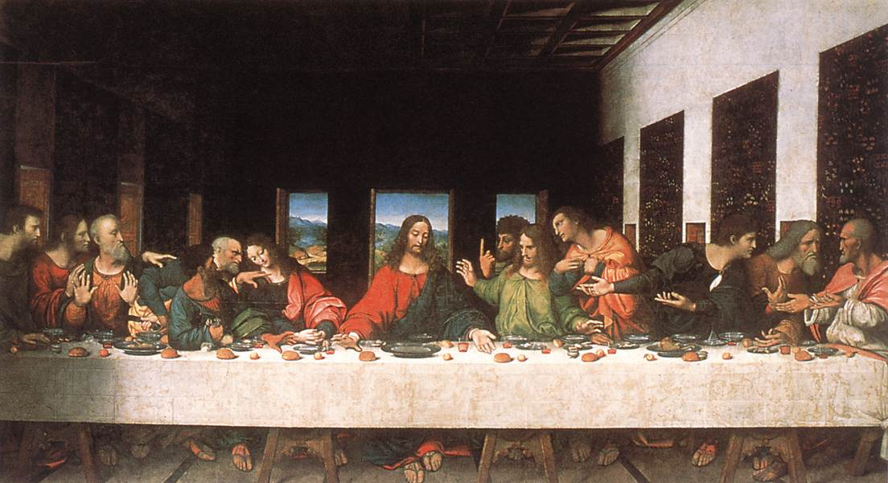
Imagination
Extended Fibonacci seq. (F_{i} = F_{i-1} + F_{i-2}, 1, 2, 3, 5, 8, 13,…)
2, 4, 6, 10, 16, 26, 42,…
4, 8, 12, 20, 32, 54, 86,…
8, 16, 24, 40, 64, 104, 168, …
Fibonacci seq. in The Last Supper: 1, 2, 3, 5, …

Slide 24
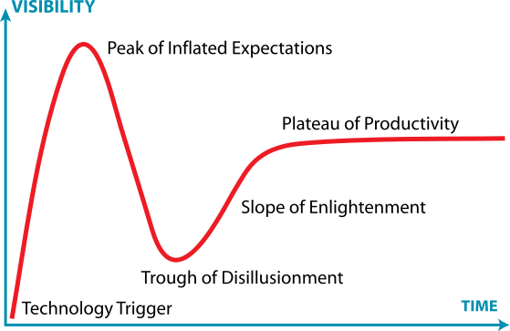
MOOC
MOOC: massive open online course
Coursera, Udacity, and edX
MOOC hype
The New York Times: 2012 became “the year of the MOOC”
Expectations undergoing a wild swing
General distance/online courses
Flipped classroom
Watching online outside classrooms
Q & A inside classrooms

Slide 25
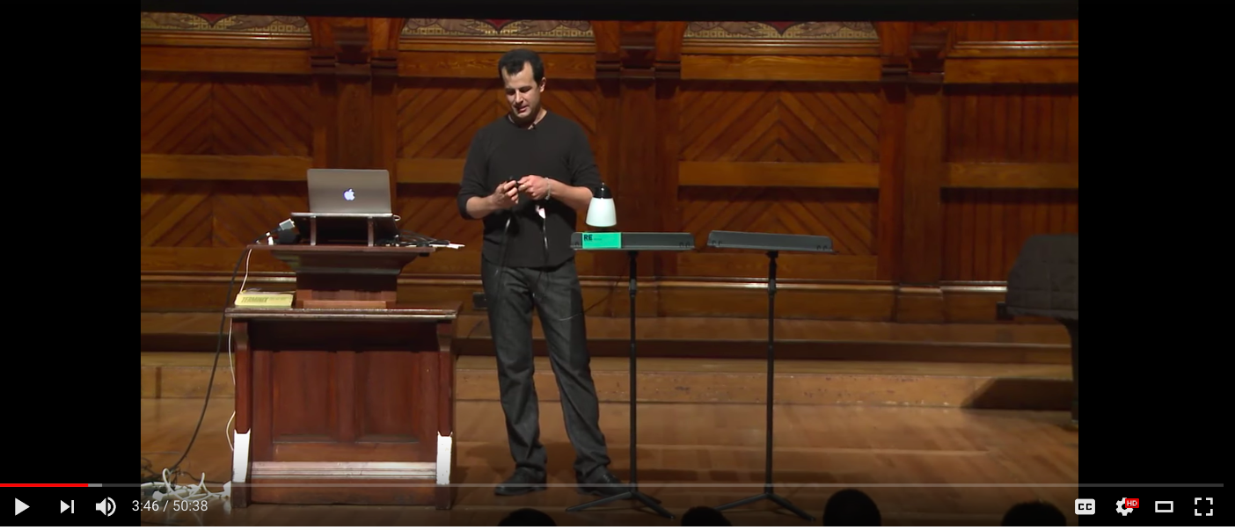
General Distance/Online Courses
Features
Lecture capture
Interactive pen display
Products
Zoom Video Communication
Panopto, Camtasia Studio, etc
According to a 2015 survey among American students ^{[4]}
+ 45% take more than one online course
+ 9% take all of the courses online
+ 36% take non-credit courses for personal learning
[4] Babson College Survey in 2011

Slide 26
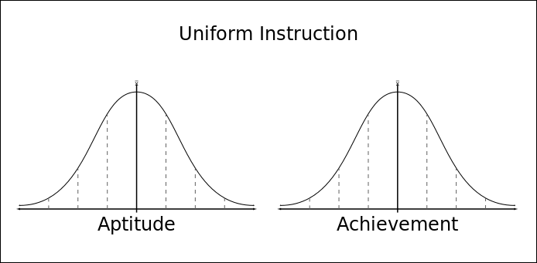
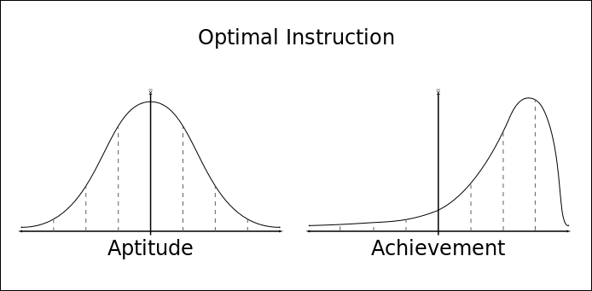
Mastery Learning ^{[5]}
Students must achieve a level of mastery
(e.g., 90% on a knowledge test) before moving forward to learn subsequent information
[5] B. S. Bloom (1981). All Out Children Learning – A Primer for Parents, Teachers, and Other Educators. McGraw-Hill.

Slide 27
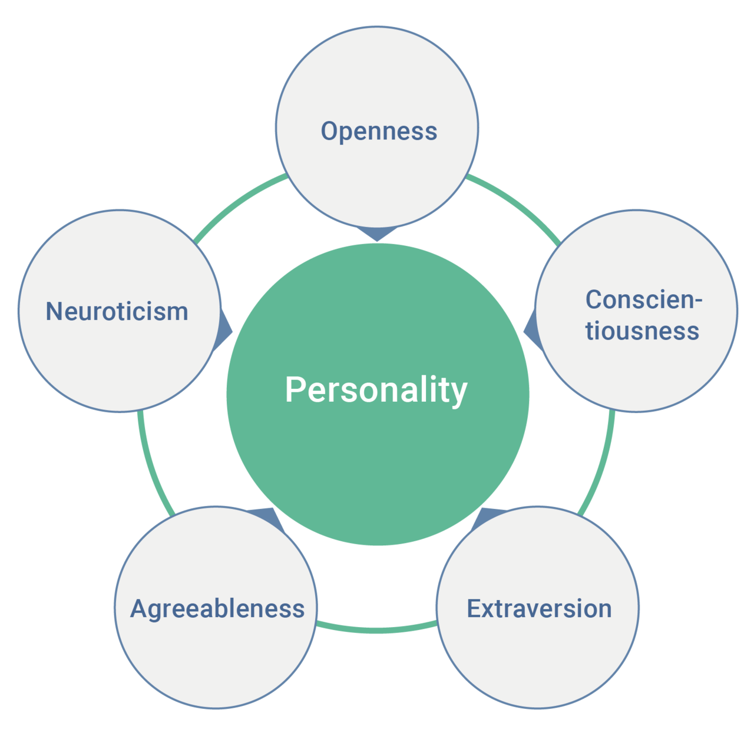
Big Five Personality Traits
Openness to experience
Inventive/curious vs. consistent/cautious
Conscientiousness
Efficient/organized vs. easy-going/careless
Extraversion
Outgoing/energetic vs. solitary/reserved
Agreeableness
Friendly/compassionate vs. challenging/detached
Neuroticism
Sensitive/nervous vs. secure/confident

Slide 28
Grit
IQ
Ability alone does not bring
about success in any field
High Achievers
Ability combined with zeal and with
capacity for hard labor
Grit
Perseverance and passion
Development of the grit scale[6]
[6] M. D. Matthews (2007), Grit: Perseverance and Passion for Long-Term Goals, Journal of Personality and Social Psychology.

Slide 29
Role of Library
Library
Means both “book” and “free”
Social infrastructure
Shape the way people interact
For all groups of people
Small kids
Teenagers
College students
Adults
Senior citizens
[

Slide 30
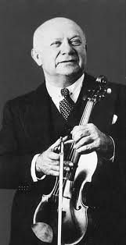
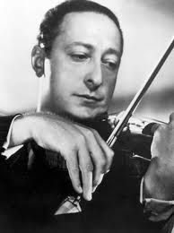
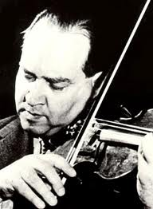
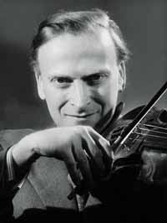
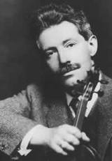
Education for Building Character!
Learning the lesson from the classical music world
Musicianship with character
Violinists
Past generation: Heifetz, Oistrakh, Menuhin, Kreisler, Elman…
Current generation: Perlman, Mutter, Vengerov, Bell, Chang…
Notes:
Current violinists tend to be “perfect” but without character. Character, not just test scores, are predictors of success. Learning Is not only the 3 Rs (reading, writing, arithmetic). It is also socialization, team sports, music, manual workshops.

Slide 31
5. Chinese vs. U.S. Ed. Systems
ACM International Collegiate Programming Contest (ICPC)
Shanghai Jiaotong University (3 time winners, tied 1st overall)
Zhejiang University (2011 winner)
D. A. Patterson (CACM, 2005): Reflections on a Programming Olympiad
Putin met with the 2004 winner team
U.S. president met with football champions
Notes:
US dominated early competitions, but more recently by China and Russian.

Slide 32
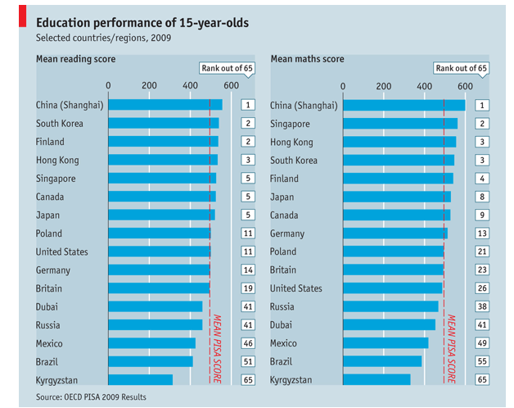
Shanghai Kids First class city, first class education
Notes:
Writing, reading, and math. Shanghai is no. 1 for all.
Mobility is at the heart of personal communcations.
People trasmit and receive information wherever they are and whenever they choose.

Slide 33
Amy Chua’s “Tiger Moms”
Time Magazine, Jan. 2011
Is tough parenting really an answer?
NY Times, Jan. 15, 2011
Chinese children typically start their formal education at age two
The Chinese tend to favour the U.S. education system for trying to make learning exciting and not just a chore
NY Times, Nov. 3, 2011
The China Conundrum
It is difficult to identify good
Chinese students from applications
Notes:
The author is a Yale law professor. “Why Chinese Moms are Superior” Wall Street Journal
Nov. 3, 2011, 90% false recommndation, 70% personal essay written by someone else, 50% forged high school transcript.

Slide 34
Elite to Mass to Universal
Almost all schools follow similar curricula
Almost every child in China learns one classical musical instrument
... but, there are only 2 or 3 thousand die-hard classical music fans in Beijing!
Notes:
The author is a Yale law professor. “Why Chinese Moms are Superior” Wall Street Journal

Slide 35
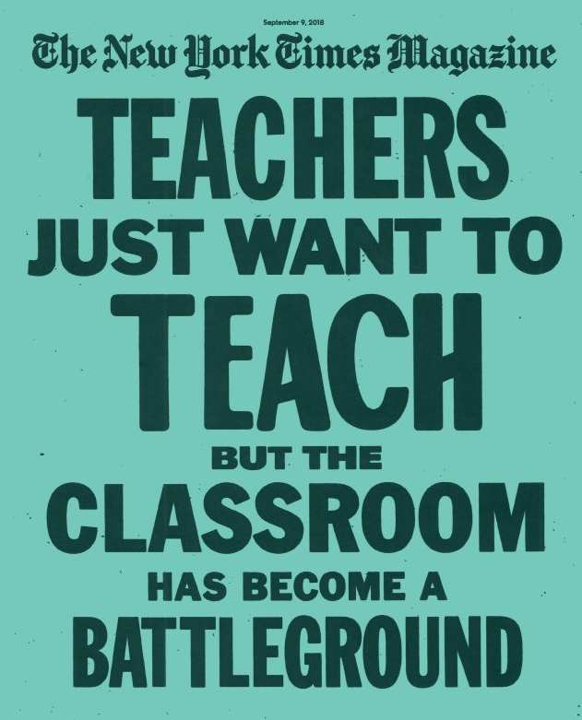
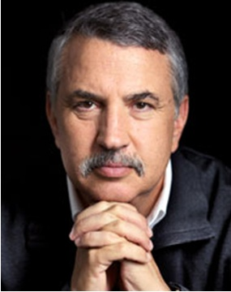
Conflicting Views on Education in U.S.
Thomas L. Friedman: Five Pillars of Prosperities
Public education, modernization infrastructure, open immigration policy, basic R&D, and regulation of private economic activity
(Three-time Pulitzer winner)
Notes:
He wrote this book after a recent visit to Tianjing. He was so impressed with Chinese speed in construction.

Slide 36
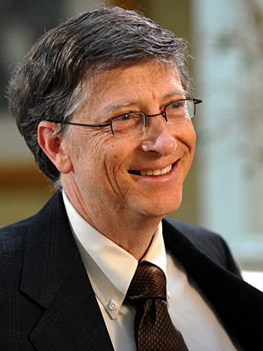
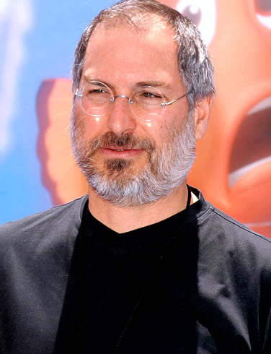
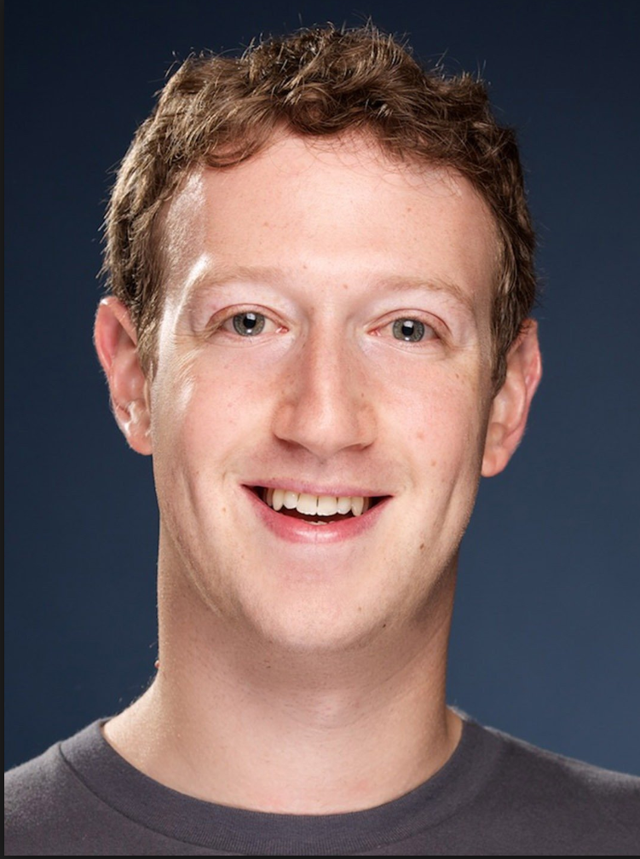
Conflicting Views on Education in U.S.
The debate on “the need for higher education”
Bill Gates, Steve Jobs, and Mark Zuckerberg never completed their college study
Notes:
Visionary vs. technical background. Gates and Dell, the type of supports they received early on.
Jobs, talent of his friend, Wozniak.

Slide 37
Things Students Learn at College
50% of the learning materials for a student’s career future is outside the classroom
45% show no significant gains in critical thinking, analytical reasoning, and written communication during the first 2 years
BUT
Learn how to learn
Learn how to think
Learn self-discipline
Learn how to communicate effectively
Notes:
College life is more than just knowledge.

Slide 38
U.S. Ed. System
National priority
Public safety, transportation, energy, education, health, advanced manufacturing
Admission criteria
Standardized test, GPA/HPA, extra-curricular activities, etc.
Different types
Vocational technical institutions, community colleges, universities, and professional schools
Notes:
Chinese system uses only standardized test for college admission. Also, US has many community college.

Slide 39
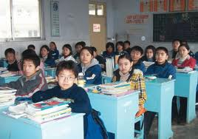
Chinese System vs. U.S. System
Chinese system
Highly structured, disciplined learning
U.S. system
Critical thinking and student-centered learning
China and the U.S. should learn from one another and adopt what the other does best!
Notes:
Two complement systems.

Slide 40
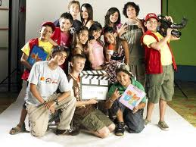
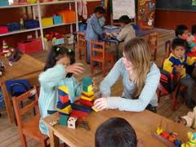
Merits of U.S. Ed. System
U.S. system
Flexibility of educational system
Importance of extra-curricular activities
Club activities
Sports
Volunteering
Five pillars of learning
Learning to know
Learning to do
Learning to live together
Learning to be
Learning to transform oneself and society
Notes:
How to become a team player. Openness of the education system in U.S.

Slide 41
Challenges (3):
Developing general education to produce well-rounded citizens
Fulfilling individual potential AND
Contributing to social transformation
Notes:
A well-rounded person with character. For CS, to develop competent, technical, entrepreneurial leaders, not only the competent.
Exceptional C&I education occurs in a wider context: K-12, development of teachers, interaction with business and industry, pragmatics and experimentation, not just axims and deduction. Individuals with social not just personal aspirations.

Slide 42
Final Thoughts
Education ecosystem: government, industry, academia, and professional societies
Government
Professional
Societies
Academia
Industry
Problems/Funds/Solutions
Notes:
Professional societies with members coming from government, industry, and academia.
Public private partnerships

Slide 43
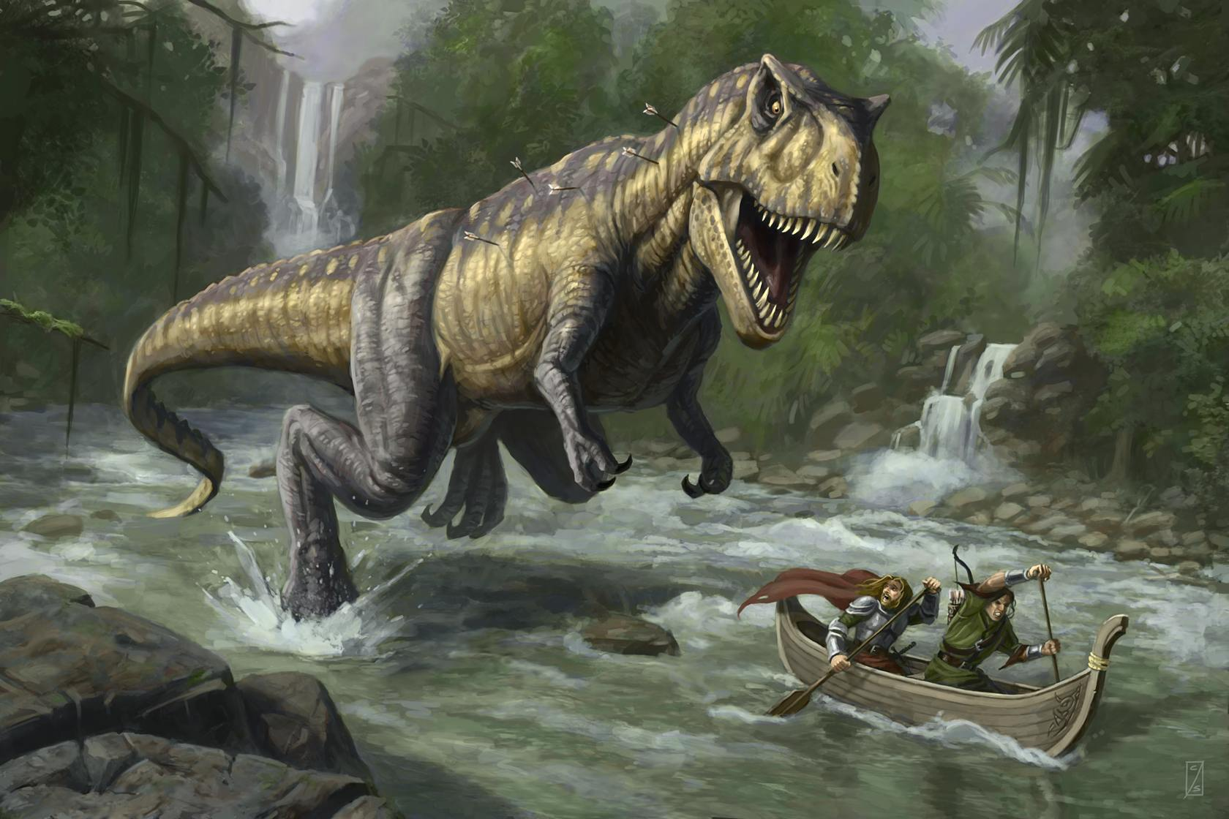
Charles Darwin (Origin of Species)
“It’s not the strongest of the species that survives, not the most intelligent, but the one most responsive to change.”
Notes:
CS is still relatively new and our community should be responsive to the change of the outside world.
The real question is whether academic computer science will adapt to the demands for a profession.

Slide 44
Notes:
K. Batcher , Cray award winner, attended ICPP every year, until the conf. was moved around. He refused to miss any class.
S. Sahni , CS chair at UF, drove to Boca Raton early morning (staring at 5 am) as he did not want to miss a class the day before.

