Slide 1

Multi-hop Coflow Routing and Scheduling in Data Centers
Yang Chen and Jie Wu
Center for Networked Computing
Temple University, USA

Slide 2

Road Map
  Introduction
  A Motivation Example
  Proposed Solution
  Experiments
  Conclusions

Slide 3
1. Introduction
Coflow
  A collection of parallel flows with a common performance goal
  All flows within a coflow are generated at the same time
Coflow completion time (CCT)
  The finishing time of the last flow
coflow a (blue)
coflow b (red)
coflow c (yellow)
Notes:
all flows within a coflow are generated at the same time
Every single flow can be routed towards only one path to avoid packet reorder costs.

Slide 4
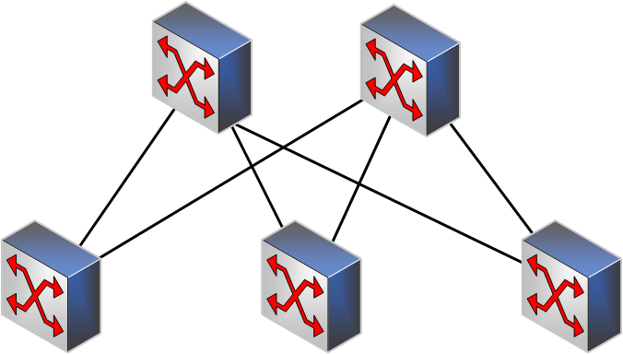
Objective and Setting
Objective
  Minimize the average coflow completion time (CCT)
Data center topology
  Leaf-spine
Online and preemptive
Scheduling point:
  New coflow arrives
  Completion of current coflow
Spine
Leaf

Slide 5
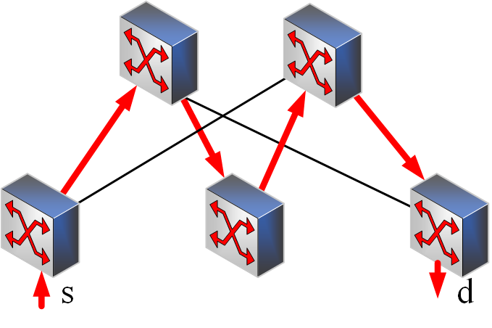
Solutions
Baseline^{[1]}
The coflow with the minimum remaining time first
Large individual flows for idle bandwidth
Observation
One-hop path is not enough
  #one-hop path: m
Two-hop path (red) helps
  #two-hop path: m(m-1)(n-2)
m: number of spine switches n: number of leaf switches
Spine
Leaf
[1] RAPIER: Integrating Routing and Scheduling for Coflow-aware Data Center Networks (INFOCOM ’15)
Notes:
Inter-coflow scheduling should apply the minimum remaining time first strategy.

Slide 6

2. A Motivating Example
6.25
0.25
0.75
0.25
1
The bandwidth of each link is 1 Mbps.
Average CCT:4.75s
0.25
1

Slide 7
A Motivating Example (cont’d)
4.75
0.25
0.75
0.75
1
The bandwidth of each link is 1 Mbps.
Average CCT:4.25s
1
0.75

Slide 8
3. Proposed Solution
Single coflow completion time
  Path selection
  Bandwidth allocation
  Solution: Linear programming and rounding
Coflow selection
  Minimum remaining time first
Idle bandwidth allocation
  Using additional individual flows
Spine
Leaf

Slide 9
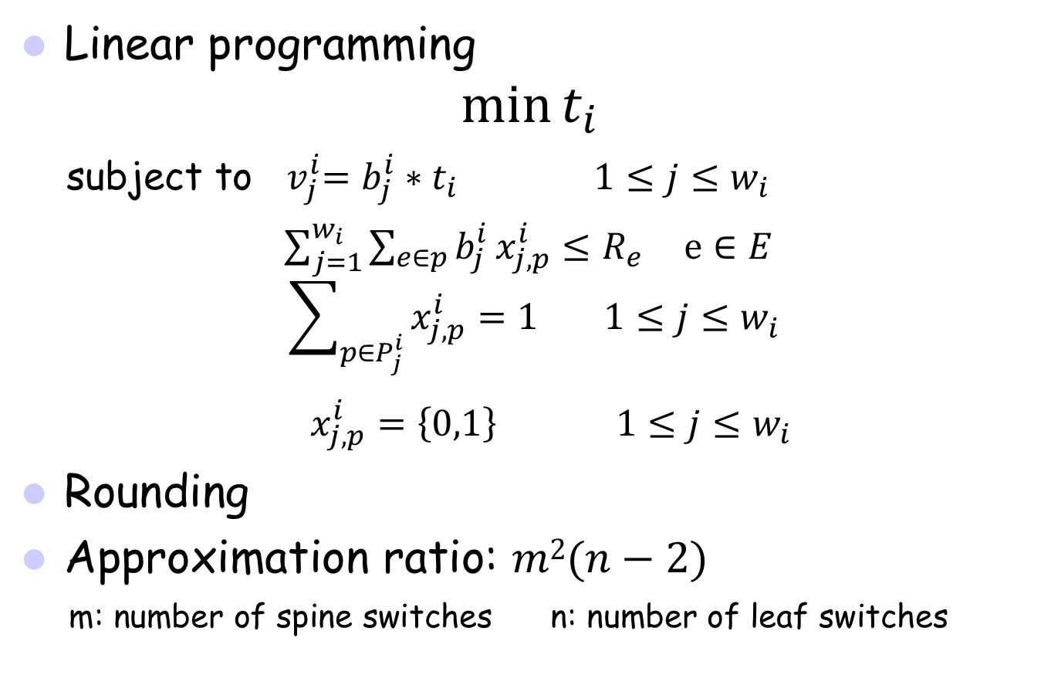
Single Coflow Completion Time
Linear programming
$$\min{t_{i}}$$
subject to${ v}_{j}^{i}=$ $b_{j}^{i}∗t_{i} 1≤j≤w_{i}$
$\sum_{j=1}^{w_{i}}{\sum_{e∈p}{b_{j}^{i}}x_{j,p}^{i}≤R_{e}} e∈E$
$$\sum_{p∈P_{j}^{i}}{x_{j,p}^{i}=1} 1≤j≤w_{i}$$
$x_{j,p}^{i}=\left\{0,1\right\}$ $1≤j≤w_{i}$
Rounding
Approximation ratio: $m2(n−2)$
m: number of spine switches n: number of leaf switches
Minimize CCT
Flow volume
Link capacity
Path selection
Flow unsplitable
Notes:
t_i: the completion time of coflow i
v_j^i: the volume of flow j in coflow i
b_j^i: the bandwidth of flow j in coflow i
w_i: the number of flows in coflow i
x_{j,p}^i: whether the flow j in coflow I select the path p
P_j^i: the path set (one-hop and two-hop paths) of flow j in coflow i

Slide 10
Coflow Selection and Idle Bandwidth
Minimum remaining time first algorithm
  Coflow with the minimum completion time t
  Approximation ratio: m²(n-2)(c+1)/2, c: #coflows
Large workload v for idle bandwidth

Slide 11
4. Simulations
Four comparison algorithms
  MCRS: Multiple Coflow Routing and Scheduling (our method)
  Scheduling-only: MCRS with only one-hop paths (baseline)
  Routing-only*: All flows routed by ECMP (coflow non-awareness)
  Heuristic*: All coflows equally share links, and bandwidth saving through alignment with the maximum time^{[2]} (* non-preemptive)
Routing-only
Heuristic
[2] Barrier-Aware Max-Min Fair Bandwidth Sharing and Path Selection in Datacenter Networks (IC2E ’16)
Notes:
Equal-cost multi-path routing (ECMP)

Slide 12
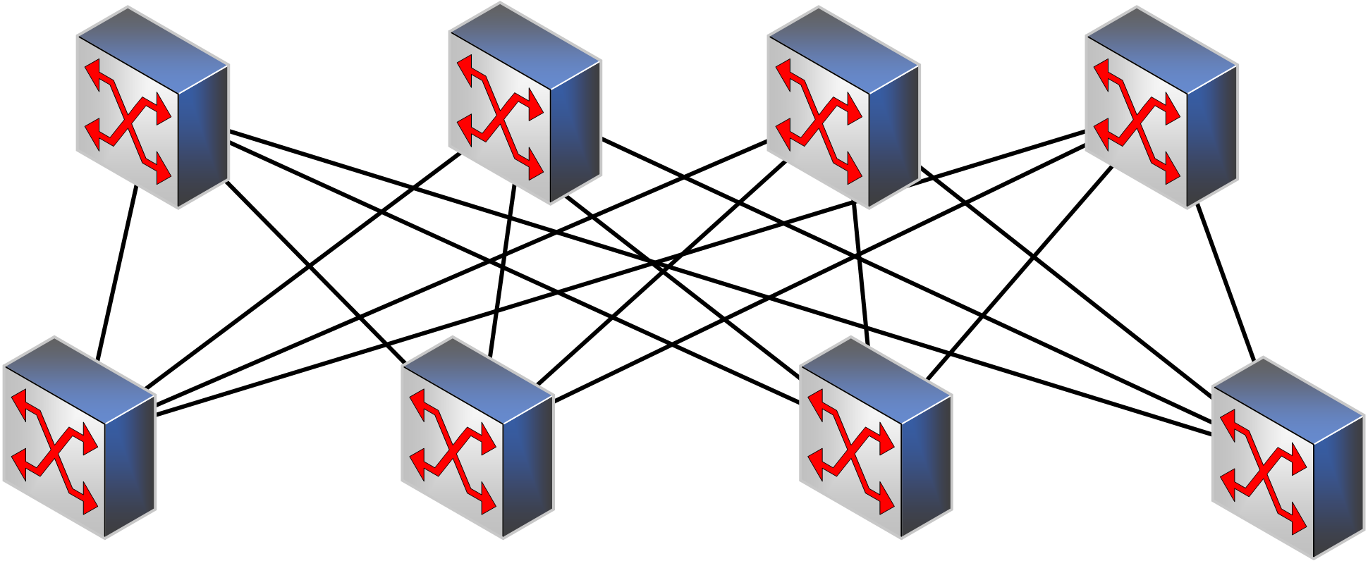
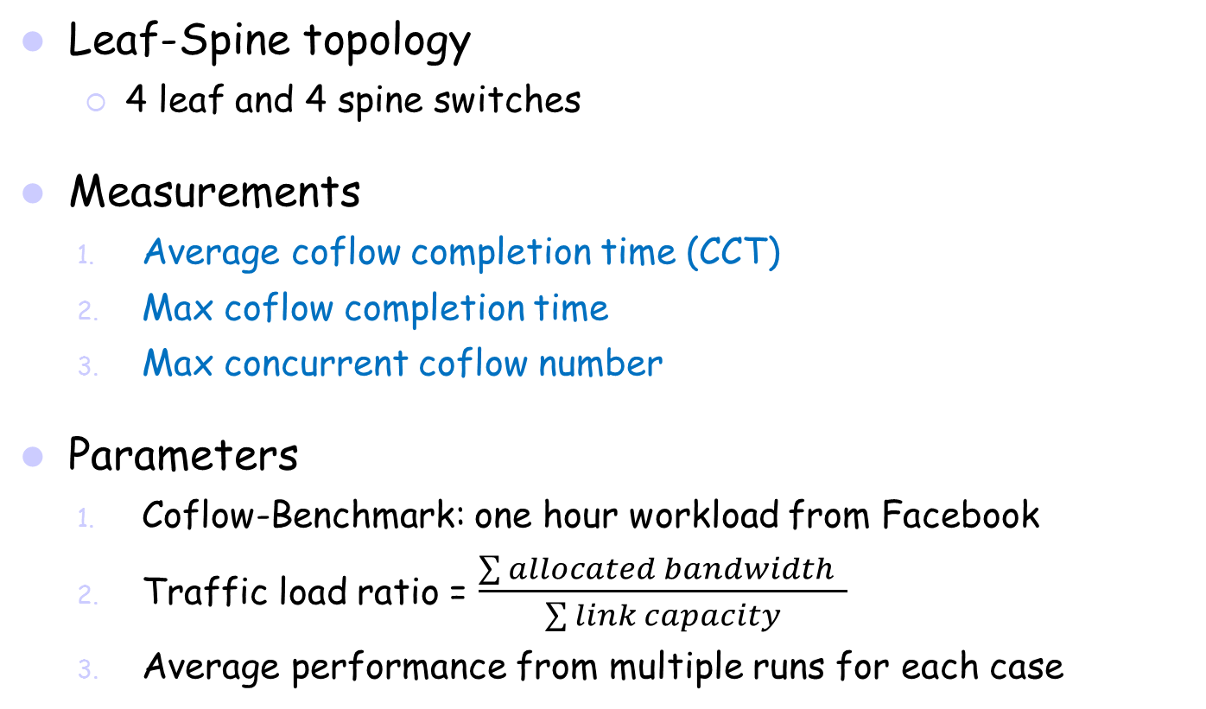
Settings
Leaf-Spine topology
  4 leaf and 4 spine switches
Measurements
  Average coflow completion time (CCT)
  Max coflow completion time
  Max concurrent coflow number
Parameters
  Coflow-Benchmark: one hour workload from Facebook
  Traffic load ratio = $\frac{\sum{allocated bandwidth} }{\sum{link capacity}}$
  Average performance from multiple runs for each case

Slide 13
Simulation Results
Average CCT
  MCRS reduces by up to 31.7% compared to Scheduling-only.
  Scheduling-only reduces by up to 27.9% compared to Routing-only.
Max CCT
  MCRS has the smallest, while Scheduling-only has the largest.
Concurrent coflows
  Both MCRS and Scheduling-only have a small number.

Slide 14
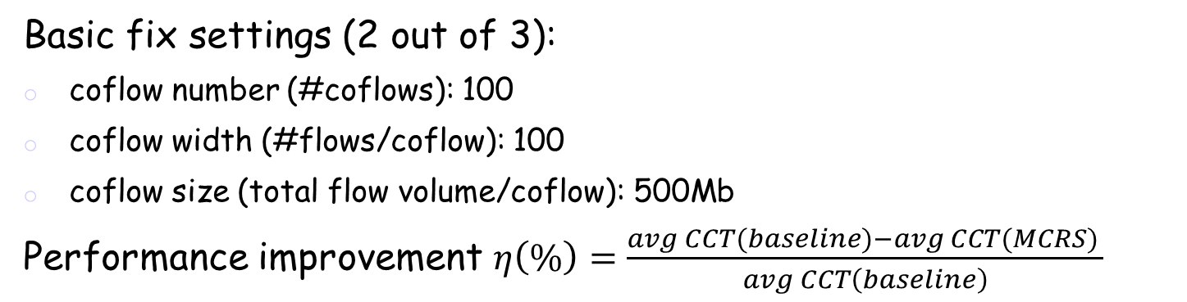
Simulation Results (cont’d)
Basic fix settings (2 out of 3):
coflow number (#coflows): 100
coflow width (#flows/coflow): 100
coflow size (total flow volume/coflow): 500Mb
Performance improvement $η\left(\%\right)=\frac{avg CCT(baseline)−avg CCT(MCRS) }{avg CCT\left(baseline\right)}$
MCRS has the performance improvement at least 41.8% for low traffic loads.
Coflow size improves performance least while coflow width improves most.

Slide 15
5. Conclusions
Routing and scheduling coflows in leaf-spine topology
  Coflow selection: Path selection and bandwidth allocation
  Idle bandwidth allocation
Combined one-hop and two-hop in path selection
Performance evaluation
Spine
Leaf

Slide 16
Q & A

