Slide 1
Max Progressive Network Update
Yang Chen and Jie Wu
Temple University, USA

Slide 2
SDN Network Update
Network update
  Can adapt to frequent traffic changes for high network utilization.
Challenges
  Rule updates from the controller to the individual switches traverse an asynchronous network and may arrive out-of-order.
Objectives
  Optimality, consistency, and swiftness
Basic update methods
  Ordering update protocols
  Two-phase update protocols
In our paper
  We use switch buffer to assist the update in order to migrate flows consistently.
Notes:
Causes of network update：(1) changes in security policies (2) traffic engineering in the network (3) network maintenance work (4) reaction to link
Yet despite the logically centralized perspective offered, an SDN still needs to be considered a distributed system. Then there are problems during the update

Slide 3
Motivation
f₂
A
B
A
B
Consistency
  Loop-free
  Drop-free
  Congestion-free
f₃
f₁
f₂
D
C
D
C
f₃
f₁
Notes:
The left graph is the initial state and the right is the final state. Each link capacity is 1. The bandwidth of f1 is o.7, f2 is 0.8, f3 is 1. Flows are not splittable. So none of the flows can migrate to their final paths because of the link congestion.

Slide 4
A
B
Switch buffer (for swiftness)
f₁
A
B
f₂
D
C
f₁
f₃
f₂
f₂
A
B
f₃
buffer
D
C
f₃
D
f₁
C
Notes:
But with the assistance of switch buffer, we can migrate flows consistently. For example, we buffer f1 in its source switch. The update procedure is shown in this slide.

Slide 5
Problem Formulation
Problem
  Given the initial and final network states, we need to find a feasible solution to consistently migrate flows.
(Finding the optimal update schedule is NP-hard with the constraint of link capacity.)¹
Objective
  Find the quickest update schedule with the help of switch buffer: balance between updating time and buffer size
Definitions:
  Dependency graph
  In degree and out degree of a flow node
  Necessary condition for deadlocks: cycles among flows and link resources
¹: “Dynamic Scheduling of Network Updates”, SIGCOMM14
Notes:
Dependency graph is a directed graph. There are two kinds of nodes: flow node and link node. The value of the flow nodes is its bandwidth and the link node is its current remaining capacity. The directed link from the flow node to the link node means that the flow is occupying this link. It shows that the link is in the flow’s initial path.
The directed link from the link node to the flow node means that the flow is requesting this link. It shows that the link is in the flow’s final path.
In degree: the number of the flow node’s in links
Out degree: the number of the flow node’s out links

Slide 6
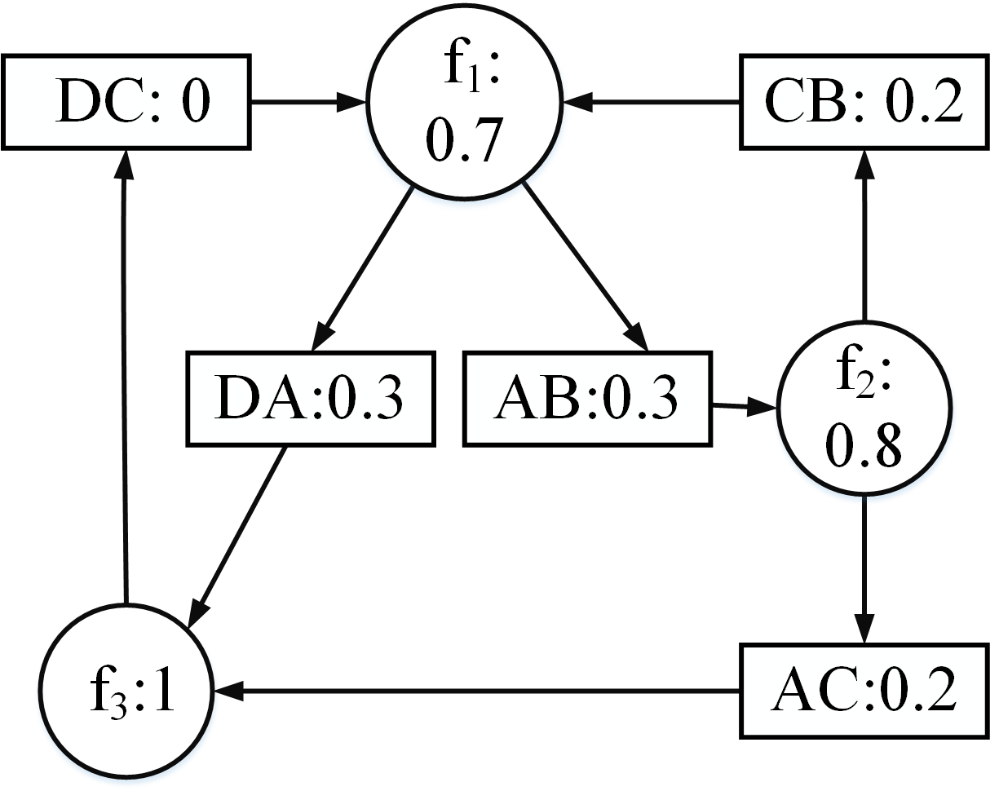
Max Progressive Updating Method (MAPUM)
f₂
A
B
A
B
f₃
f₁
f₂
D
C
D
C
f₃
f₁
Link’s capacity: 1; Flow demand: f₁=0.7; f₂ =0.8; f₃=1
Dependency graph
If the dependency graph is a DAG, then there are no deadlocks; otherwise, limit flows to break all elementary cycles.
D. B. Johnson, “Finding all the elementary circuits of a directed graph,” SIAM 2006 Journal on Computing.
Notes:
The right graph is the dependency graph of our example in the left. (The same as in the motivation part)

Slide 7
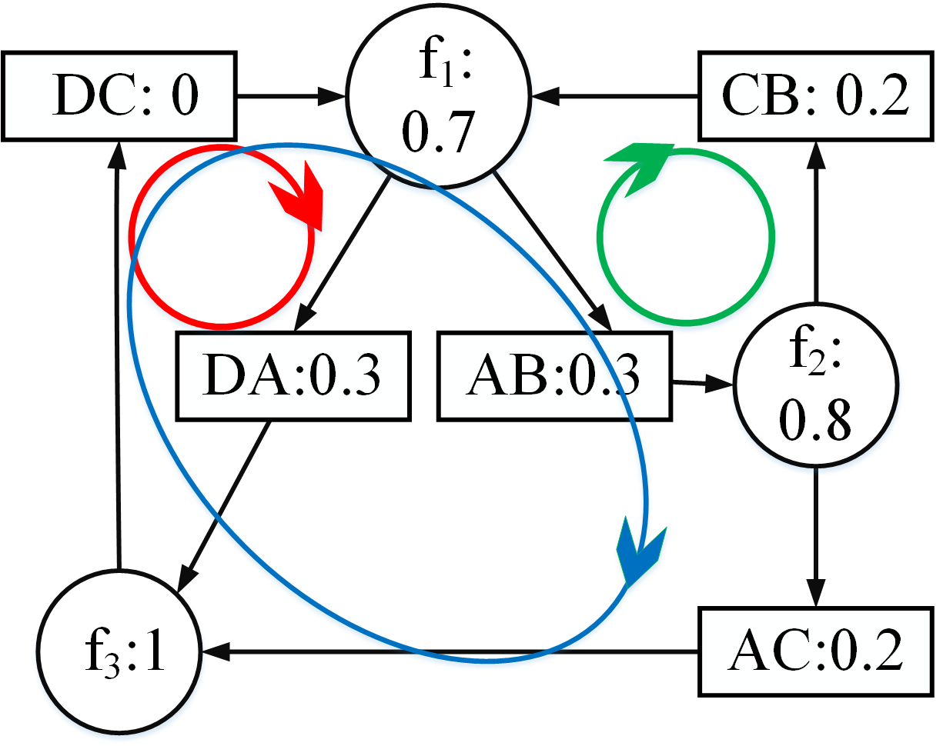
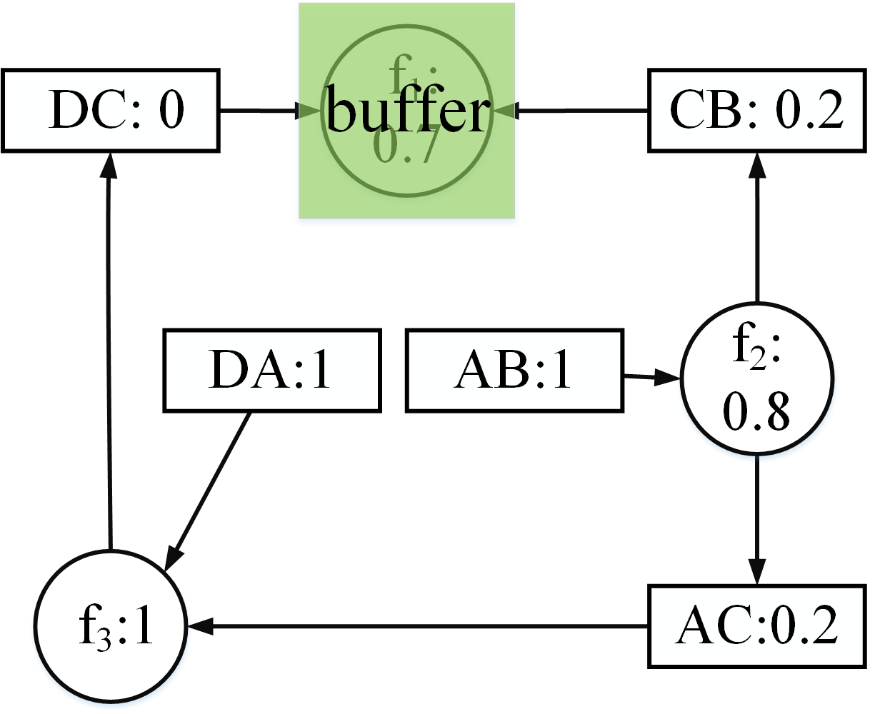
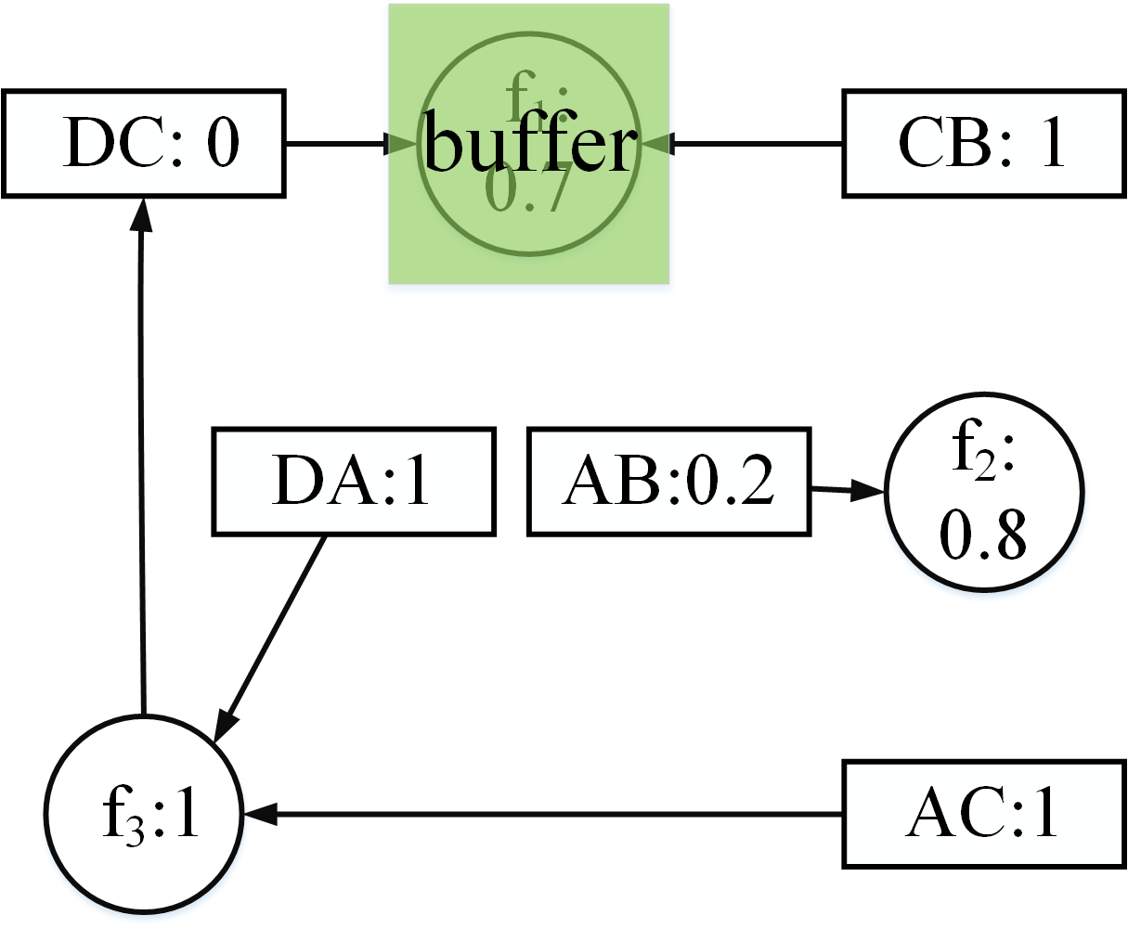
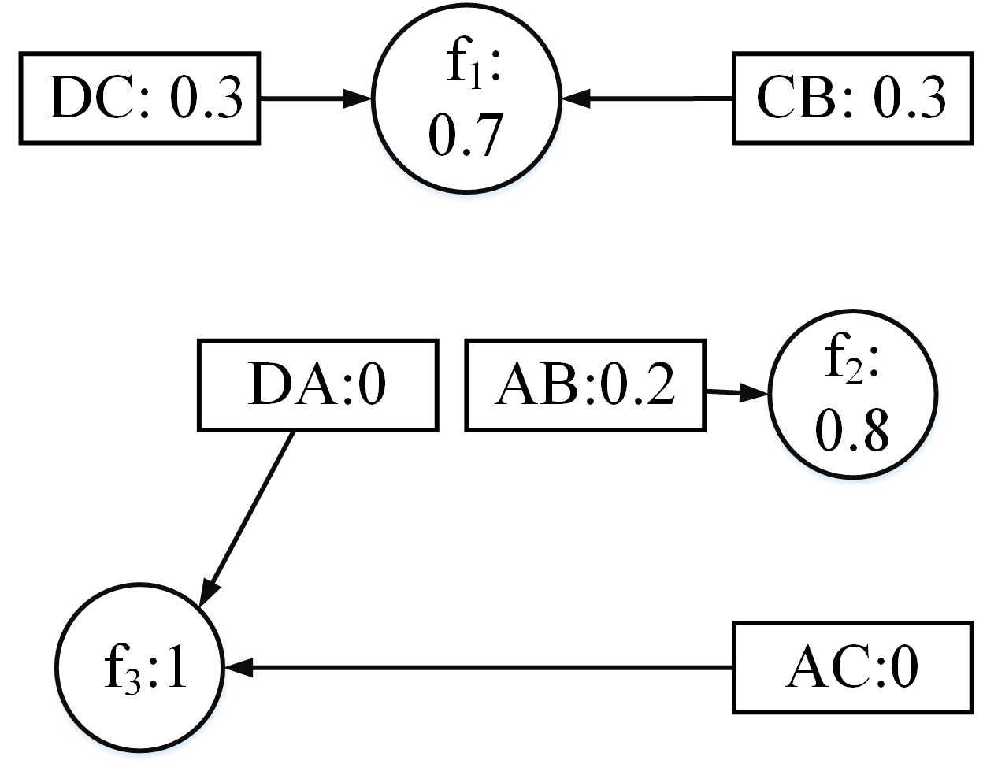
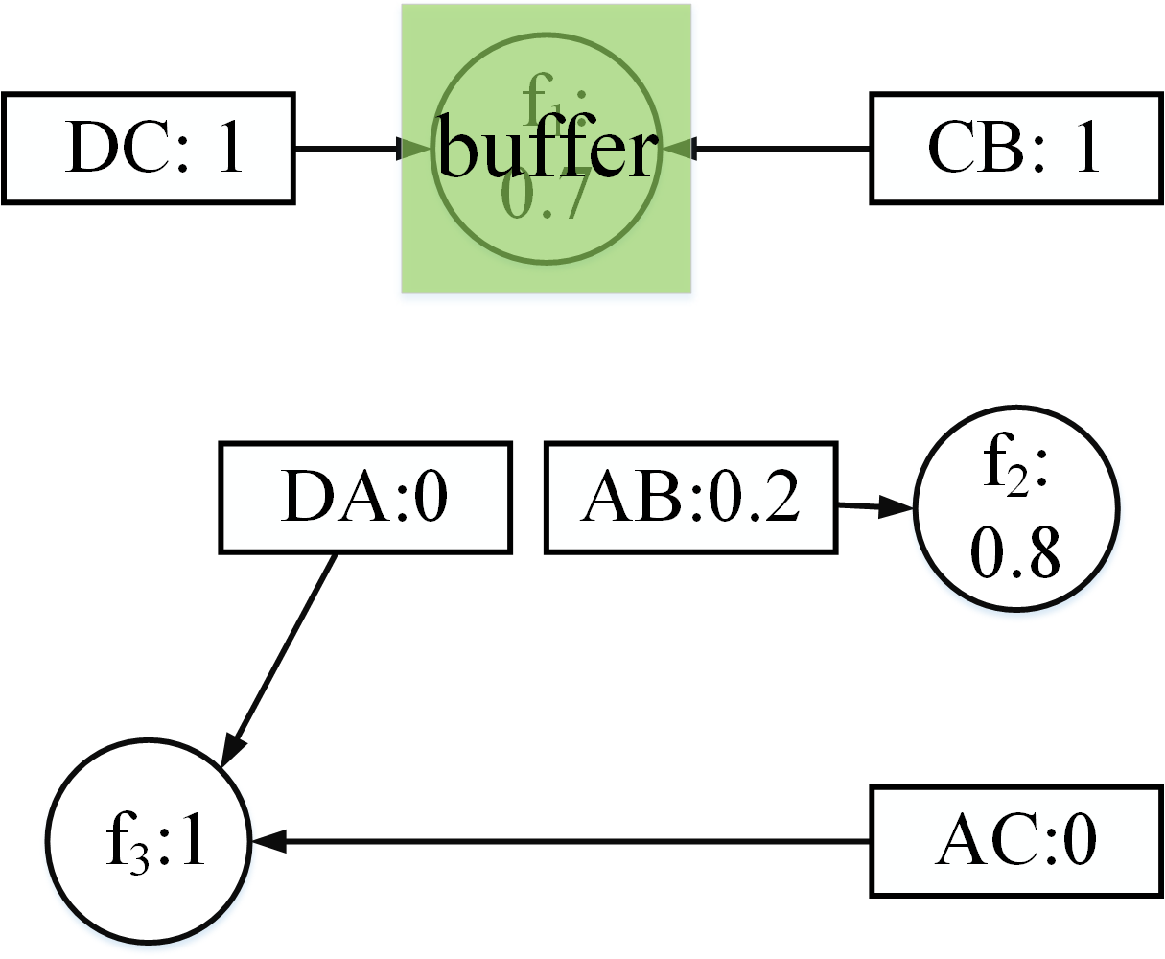
buffer f₁
Release buffer
3 elementary circuits
Done
Notes:
This is the detailed dependency graph update steps.

Slide 8
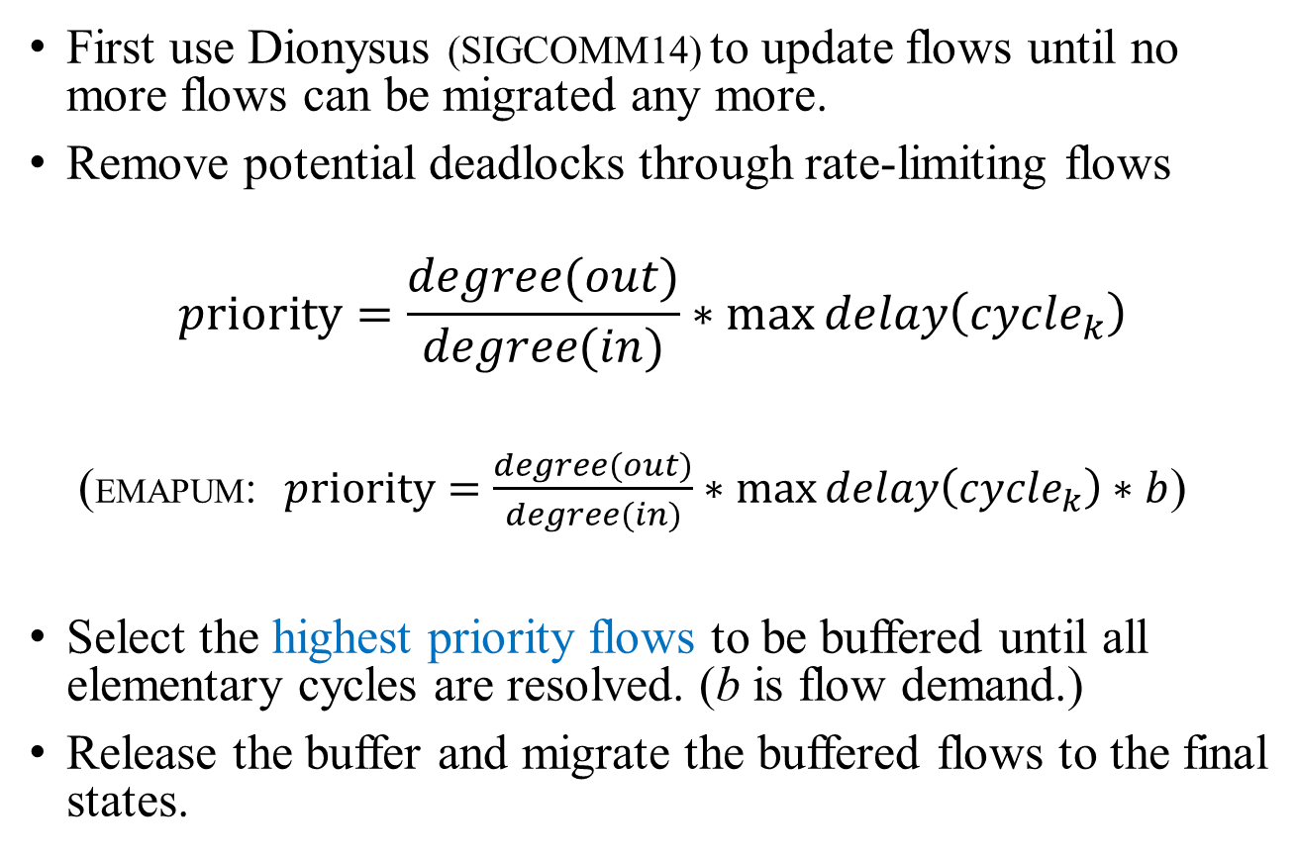
Max Progressive Updating Method (MAPUM)
First use Dionysus (SIGCOMM14) to update flows until no more flows can be migrated any more.
Remove potential deadlocks through rate-limiting flows
$$priority=\frac{degree(out)}{degree(in)}∗\max{delay\left({cycle}_{k}\right)}$$
(EMAPUM: $priority=\frac{degree(out)}{degree(in)}∗\max{delay\left({cycle}_{k}\right)∗b}$)
Select the highest priority flows to be buffered until all elementary cycles are resolved. (b is flow demand.)
Release the buffer and migrate the buffered flows to the final states.
Deadlocks in the dependency graph
(shown as three colored cycles)
Notes:
This is the algorithm MAPUM and EMAPUM.

Slide 9
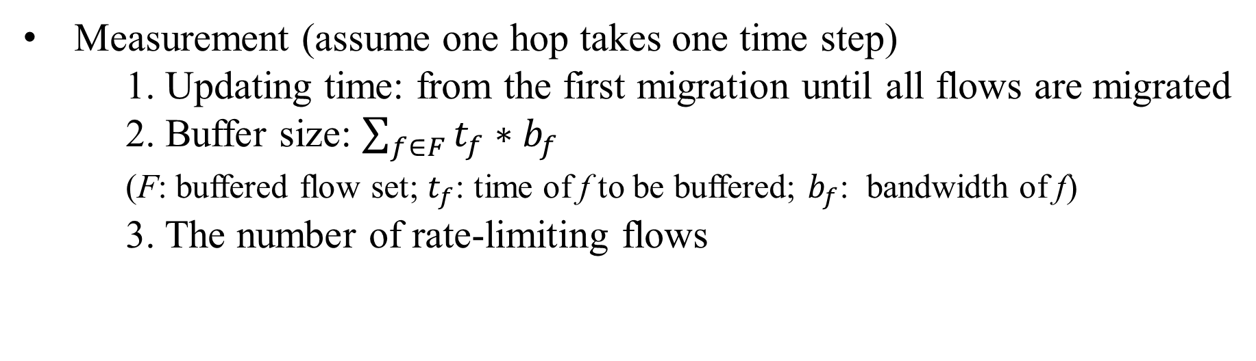
Evaluation
We compare our MAPUM and EMAPUM with three schemes
1. RS (random selection);
2. DELS (delay-consideration);
3. DEGS (degree-consideration).
Measurement (assume one hop takes one time step)
1. Updating time: from the first migration until all flows are migrated
2. Buffer size: $\sum_{f∈F}{t_{f}∗b_{f}}$
(F: buffered flow set; $t_{f}$: time of f to be buffered; $b_{f}$: bandwidth of f)
3. The number of rate-limiting flows

Slide 10
Evaluation Results
Compared with RS, MAPUM and EMAPUM can reduce the updating time by 41% and 53%, respectively.
In terms of buffer size usage, MAPUM and EMAPUM save over 37% and 42% buffer compared to RS.
For ratio between rate-limiting and total flows, MAPUM and EMPUM are only 72% and 67% compared to RS.
Notes:
Random Selection (RS)
For the third graph, on average, 60% used link capacity has 5212 flows, 70% has 6139 flows, 80% has 7098 flows, 90% has 8132 flows.

Slide 11
Q & A

