Slide 1






Joint Mobile Edge Caching and Pricing:
A Mean-Field Game Approach
Yin Xu¹, Xichong Zhang¹ , Mingjun Xiao¹, Jie Wu²,
An Liu³, and Sheng Zhang⁴
¹University of Science and Technology of China
²Temple University ³Soochow University ⁴Nanjing University
Notes:
Hello, everyone. My name is XuYin. I’m from University of Science and Technology of China. Today I will give you a report of my work--- Joint Mobile Edge Caching and Pricing: A Mean-Field Game Approach.

Slide 2
Outline
Background & Motivation
Related Work & Problem Formulation
Basic Idea & Solution
Evaluation & Conclusion
Notes:
Here is the outline of my presentation. First, I will simply introduce the background and our motivation.

Slide 3
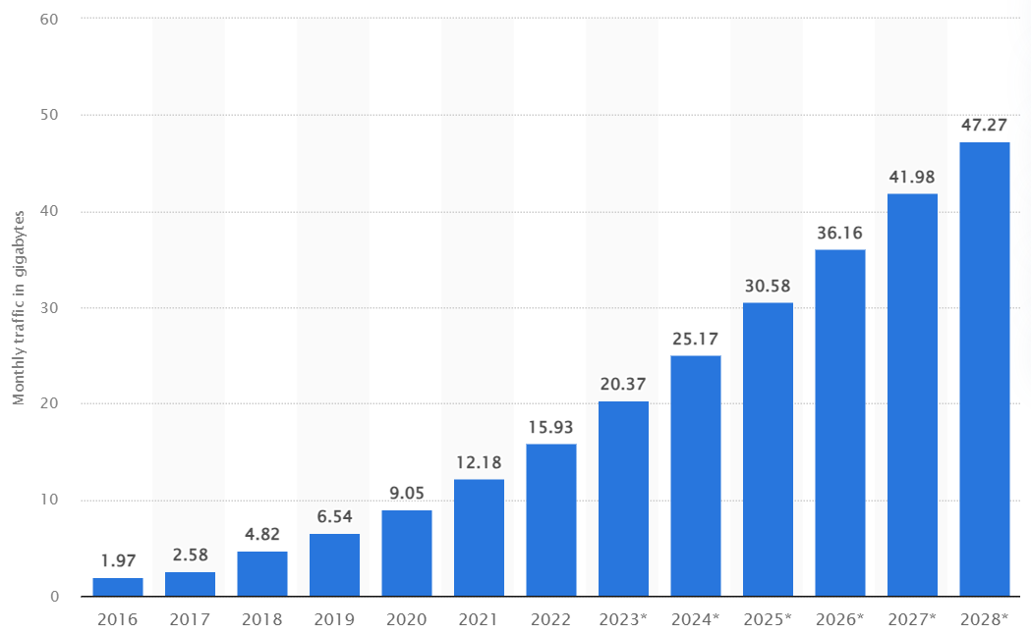
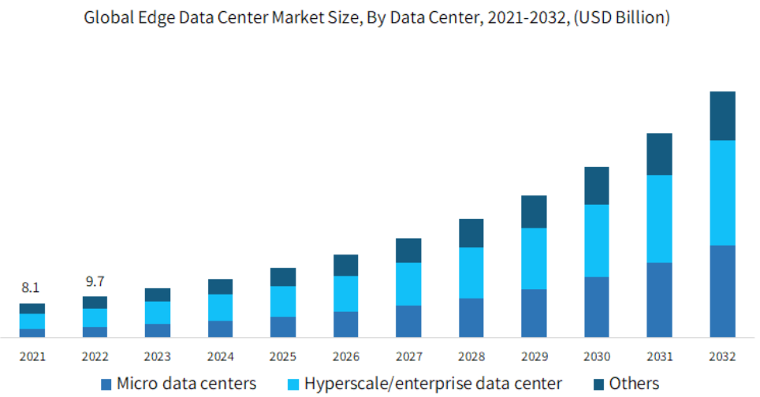
Background
Explosive growth of mobile data traffic
Content caching and trading in the edge
Fast deployment of edge devices
10x increase from 2016 to 2023
Significant stress on back-haul links
By 2032, the market size of edge data centers is expected to exceed $50 billion
Enhance Quality of Experience (QoE)
3
Notes:
With the explosive /ɪkˈsploʊsɪv/ spread of devices and services, Mobile Edge Caching (MEC) has become an attractive paradigm /ˈpærədaɪm/ for handling the growth of mobile data traffic. Due to its ability to enhance Quality of Experience /ɪkˈspɪriəns/ for requesters and reduce bandwidth ˈbændwɪtθ/ consumption, content caching and trading has gained much attention.

Slide 4
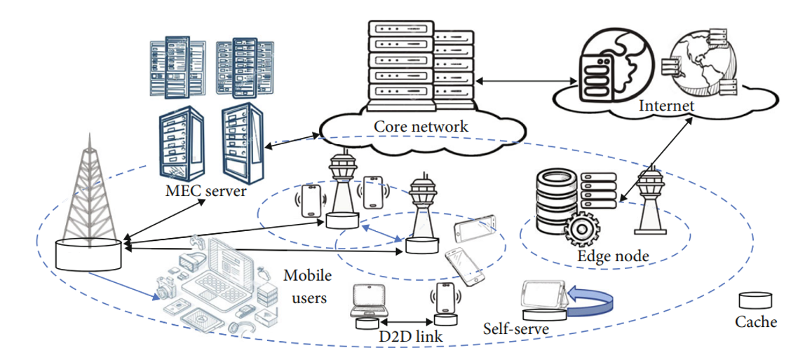
Background
Edge Data Providers
EDP
EDP
EDP
General architecture of Mobile Edge Caching systems
4
Notes:
A typical Mobile Edge Caching system consists of many Edge Data Providers, such as small-cell base stations, and a group of content requesters, such as mobile users. Here, Edge Data Providers can cache suitable contents and then trade with requesters at a suitable price.

Slide 5













Motivation
Example
Key Challenges
Complicated interplay:
competitive content placement
Bob
Alice
Caching Strategy
Sharing Strategy
Trading Strategy
$$v_{1}$$
$$v_{2}$$
Popularity: $v_{1}$> $v_{2}$
Real-time decision-making:
Both cache $v_{1}$→ A competition
→ Attract more requesters by sequentially
lowering their trading prices
→ Low utilities or even negative utilities
→ Caching $v_{2}$may be better
Peer content sharing
→ Improve the caching efficiency
Dynamic network conditions
Time-varying content service requests
→ popularity & timeliness demands
Large-scale best response:
Non-cooperative game
Distributed decisions
Heavy overhead
Economic effect of caching & sharing
5
Notes:
In this paper, we focus on the competitive /kəmˈpetətɪv/ content placement issue, where each EDP not only needs to place proper contents but also needs a pricing policy for content trading. However, this issue has many challenges. Firstly, there is complicated interplay between caching, pricing, and sharing. For example, there are two edge video providers (Alice and Bob), they offer video services to requesters. Under the supply-demand principle, caching strategies can impact the trading price, and the rewards of content trading conversely affect the caching decisions. Meanwhile, each EDP may share contents with others, which will make the interplay more challenging. Second, the network conditions and service requests are dynamic. Thus, it is difficult to make the optimal caching decision. Finally, there is a complex non-cooperative /kəʊˈɒpərətɪv/ game among EDPs. When the number of EDPs is large, we need heavy overhead to estimate other EDPs’ information.

Slide 6
Outline
Background & Motivation
Related Work & Game Formulation
Basic Idea & Solution
Evaluation & Conclusion
Notes:
Next, we review some related works and formulate our problem.

Slide 7

Related Work
Goal: edge caching optimization while considering pricing and content sharing
Mean-Field Game
Mobile Edge Caching
[5] D. Narasimha, et al., “Age-dependent distributed MAC for ultra-dense wireless networks,” IEEE INFOCOM2021
[6] H. Feng, et al, “Mean-field game theory based optimal caching control in mobile edge computing,” IEEE TMC2022.
[1] H. Sun, et al, “ A proactive on-demand content placement strategy in edge intelligent gateways,” TPDS2023.
[2] T. Zong, et al, “ Cocktail edge caching: Ride dynamic trends of content popularity with ensemble learning ,”
IEEE/ACM ToN2023.
4
1
Edge caching and pricing
3
2
Content Trading
[4] J. Zou, et al, “ Joint pricing
and cache placement for video caching: A game theoretic approach,” IEEE JSAC2019.
[3] Y. Huang, et al, “ Profit sharing for data producer and intermediate parties in data trading over pervasive edge computing environments,” IEEE TMC2023.
7
Notes:
So far, mobile edge caching and content sharing have been studied separately. Only a few studies have considered caching optimization with pricing. However, these works ignore the strategic behaviors and economic game among EDPs. In short, these solutions cannot deal with the above challenges.

Slide 8
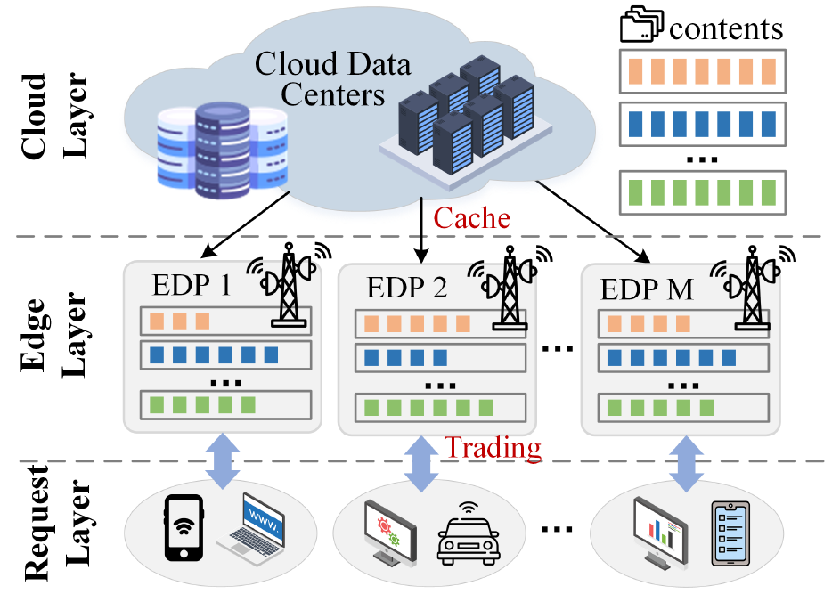

System Model
System Model
Edge Data Providers (EDPs) {1,…,i,...,M}: cache certain contents in advance and are allowed to share the cached contents with each other.
Content requesters {1,…,j,...,J}: buy desired contents from EDPs and pay a suitable trading price.
Contents {1,…,k,...,K}: the data size of content $k$ is denoted by $Q_{k}$.
Caching strategy vector of EDP $i$: $x_{i}(t)=[x_{i,1}(t),⋯,x_{i,K}(t)]$ → the instantaneous caching rate of contents
Remaining Storage capacity of $i$: $q_{i}(t)=[q_{i,1}(t),⋯,q_{i,K}(t)]$
8
Notes:
Now, we begin to formulate our problem. As shown in this Figure /ˈfɪɡjər/, EDPs need to cache some contents in advance. Also, EDPs may share their cached contents with each other. After receiving requests, EDPs can sell their cached contents with a suitable trading price. Here, the size of content k is Q_k, and the caching strategy vector of each EDP is $x_{i}(t)$, which indicates the instantaneous /ˌɪnstənˈteɪniəs/ caching rate of contents. Based on this, we use $q_{i}\left(t\right)$ to denote the remaining /rɪˈmeɪnɪŋ/space of EDP i.

Slide 9

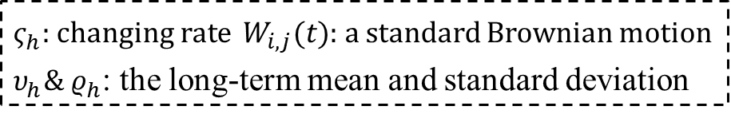
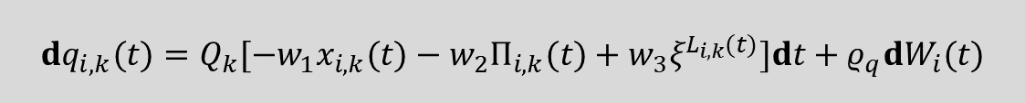
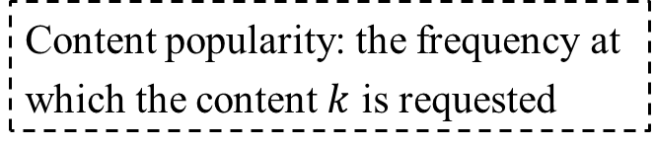
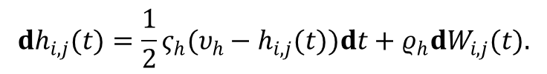
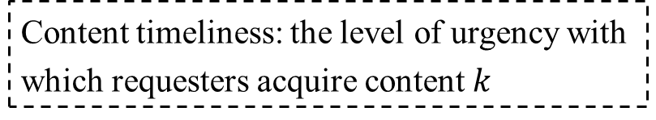
System Model
Network Model: the evolution of $h_{i,j}\left(t\right)$→ the channel fading coefficient between EDP $i$ and requester $j$
$$dh_{i,j}(t)=\frac{1}{2}ς_{h}(υ_{h}−h_{i,j}(t))dt+ρ_{h}dW_{i,j}(t).$$
$ς_{h}$: changing rate $W_{i,j}(t)$: a standard Brownian motion
$υ_{h}\& ρ_{h}$: the long-term mean and standard deviation
Edge Caching Model：Content Popularity + Timeliness → The dynamics of the caching state
$$dq_{i,k}(t)=Q_{k}[−w_{1}x_{i,k}(t)−w_{2}Π_{i,k}(t)+w_{3}ξ^{L_{i,k}(t)}]dt+ρ_{q}dW_{i}(t)$$
Content popularity: the frequency at which the content $k$ is requested
Content timeliness: the level of urgency with which requesters acquire content $k$
The fewer the requests for content $k$, the faster it is removed from the caching storage.
The more urgent the requests for content $k$, the faster it is added into the caching storage.
Trading Model：$p_{i,k}(t$)→ the unit price customized by EDP $i$for selling content $k$
Sharing price ${\overline{p}}_{k}$→ a uniform unit price for obtaining content $k$ from other peer EDPs
9
Notes:
In our system, there are two important models. The first is the network model. Due to the randomness and uncertainty of requesters’ mobility, network conditions may be unstable. Here, we use the dynamic differential equation to describe the evolution of the channel fading coefficient /ˌkoʊɪˈfɪʃ(ə)nt/. The second is the caching model. Clearly, the remaining space is controlled by the caching strategy. Meanwhile, Content Popularity and Timeliness /ˈtaɪmlinəs/ also affect the remaining space, such as the fewer the requests for content 𝑘, the faster it is removed from the caching storage. Then, we use $p_{i,k}(t$) and ${\overline{p}}_{k}$ to denote the sale /seɪl price and sharing price.

Slide 10
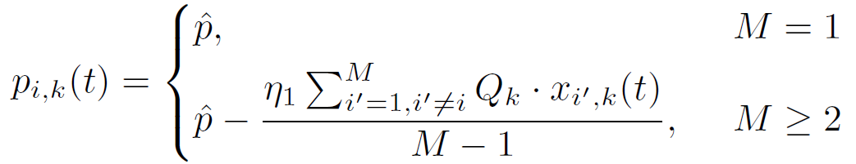
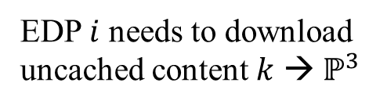
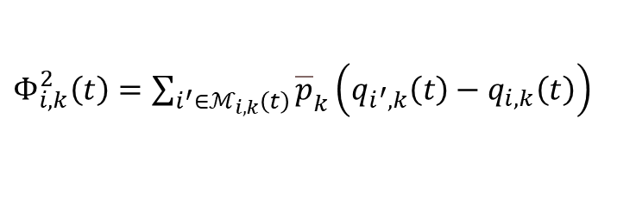
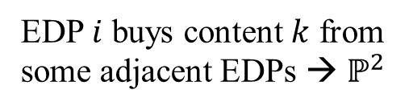
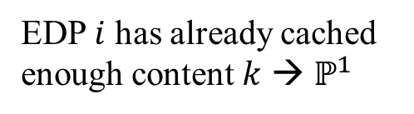
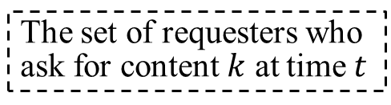
Game Formulation
Case 1
Case 2
Case 3
Three cases when trading
EDP $i$ has already cached enough content $k$ → $ℙ^{1}$
EDP $i$ buys content $k$ from some adjacent EDPs → $ℙ^{2}$
EDP $i$ needs to download uncached content $k$ → $ℙ^{3}$
Trading income: the dynamic price * the number of requesters
$$Φ_{i,k}^{1}\left(t\right)=I_{i,k}\left(t\right)p_{i,k}ℙ^{1}\left(Q_{k}−q_{i,k}\left(t\right)\right)+I_{i,k}\left(t\right)p_{i,k}ℙ^{2}\left(Q_{k}−q_{−i,k}\left(t\right)\right)+I_{i,k}\left(t\right)p_{i,k}ℙ^{3}Q_{k}$$
The set of requesters who ask for content $k$ at time $t$
The principle
of supply and demand
Sharing benefit: the monetary benefit formed when EDP $i$ shares its contents with other EDPs $ℳ_{i,k}\left(t\right)$
$Φ_{i,k}^{2}\left(t\right)=\sum_{i^{′}∈ℳ_{i,k}\left(t\right)}{{\overline{p}}_{k}\left(q_{i^{′},k}\left(t\right)−q_{i,k}\left(t\right)\right)}$
10
Notes:
Then, we need to define the utility of each EDP. Note that, each EDP will confront with three cases when trading. Case 1：EDP i has already cached enough content k for requesters. Case 2: EDP i needs to buy content $k$ from some adjacent /əˈdʒeɪs(ə)nt/ EDPs. Case 3: Both EDP i and other EDPs do not cache enough content k. So, the EDP needs to download the uncached portion from the center. Under three cases, the utility of each EDP is the incomes minus the outcomes. Here, we consider the trading income is : dynamic price multiplied by the number of requesters. Note, the dynamic price is influenced by other EDPs’ strategies. Meanwhile, each EDP can obtain some benefits by sharing contents.

Slide 11






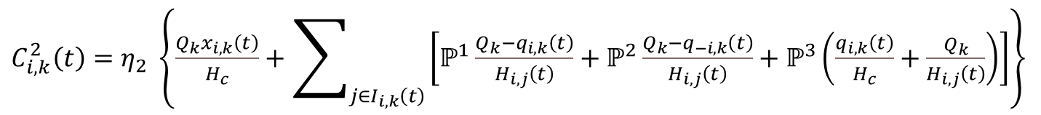
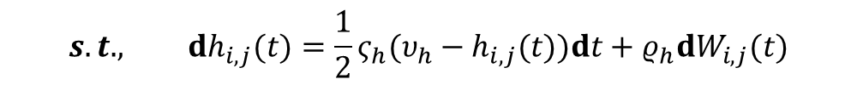

Game Formulation
Content placement cost
$$C_{i,k}^{1}\left(t\right)=w_{4}x_{i,k}\left(t\right)+w_{5}x_{i,k}^{2}\left(t\right)$$
Placing and storing cached contents
Staleness cost: a penalty function of the total request service delay
$C_{i,k}^{2}\left(t\right)=η_{2} \left\{\frac{Q_{k}x_{i,k}\left(t\right)}{H_{c}}+\sum_{j∈I_{i,k}\left(t\right)}{\left[ℙ^{1}\frac{Q_{k}−q_{i,k}\left(t\right)}{H_{i,j}\left(t\right)}+ℙ^{2}\frac{Q_{k}−q_{−i,k}\left(t\right)}{H_{i,j}\left(t\right)}+ℙ^{3}\left(\frac{q_{i,k}\left(t\right)}{H_{c}}+\frac{Q_{k}}{H_{i,j}\left(t\right)}\right)\right]}\right\}$
Sharing cost
$$C_{i,k}^{3}\left(t\right)=ℙ^{2}{\overline{p}}_{k}\left(q_{i,k}\left(t\right)−q_{−i,k}\left(t\right)\right)$$
Buy content $k$ from an adjacent EDP
$$\max_{x_{i,k}\left(t\right),t:0→T}𝒰_{i,k}\left(x_{i,k} , S_{i,k} , S_{−i,k}\right)=Φ_{i,k}^{1}(t)+Φ_{i,k}^{2}(t)−C_{i,k}^{1}(t)−C_{i,k}^{2}(t)−C_{i,k}^{3}(t)$$
Game
$$s.t. , dh_{i,j}(t)=\frac{1}{2}ς_{h}(υ_{h}−h_{i,j}(t))dt+ρ_{h}dW_{i,j}(t)$$
$$dq_{i,k}(t)=Q_{k}[−w_{1}x_{i,k}(t)−w_{2}Π_{i,k}(t)+w_{3}ξ^{L_{i,k}(t)}]dt+ρ_{q}dW_{i}(t)$$
11
Notes:
The outcomes of each EDP include three costs. Placing and storing cached contents will form placement cost. The staleness cost is defined as a penalty /ˈpenəlti/ function of the total service delay. The first term is that EDP i downloads content k from the center. When trading with requesters, the second term corresponds to case 1. The third term corresponds to case 2. The fourth term corresponds to case 3. The sharing cost means that the EDP buys content 𝑘 from an adjacent EDP. Based on the above definitions, our goal is to maximize the utility of each EDP. However, the utility of each EDP not only depends on its own strategy but also is affected by other EDPs’ strategies. Therefore, it is so difficult to make decisions if we do not know enough information.

Slide 12
Outline
Background & Motivation
Related Work & Problem Formulation
Basic Idea & Solution
Evaluation & Conclusion

Slide 13


Basic Idea
Solving a series of Hamilton-Jacobi-Bellman (HJB) equations
$$\max_{x_{i,k}\left(t\right)}\left[𝒪𝒱_{i,k}\left(t\right)+U_{i,k}\left(t\right)\right]+∂_{t}𝒱_{i,k}\left(t\right)=0$$
Partial differential operator
$$𝒱_{i,k}\left(t , S_{i,k} , S_{−i,k}\right)=\max_{x_{i,k}\left(t\right)}𝒰_{i,k}\left(x_{i,k} , S_{i,k} , S_{−i,k}\right)$$
There exists a complicated coupling of the M equations;
Unknown mutual influence: a dynamic pricing policy and a peer-to-peer sharing policy.
Approximate the collective impact of large-scale EDPs on caching, trading, and sharing, and then iteratively solve multiple coupled equations to determine the optimal caching strategy for each EDP.
The original stochastic differential game →
A Mean-Field Game by using generic-player representation
An iterative best response learning algorithm to solve the coupled equations in a distributed way
The original stochastic differential game →
A Mean-Field Game with a generic-player representation
A mean-field estimator → Estimate the unknown incomes & costs of EDPs
A generic player →
Adjust its caching strategy
Estimate
Solve
13
Notes:
In order to address the game, we can solve a series of HJB equations. Unfortunately, there exists a complex coupling /ˈkʌplɪŋ/ of the M equations, and it is hard to solve them. This is because each EDP needs the information of all other EDPs, leading to a high overhead. Moreover, the content trading process involves a dynamic pricing policy and a content sharing policy, which also results in the unknown mutual influence among EDPs’ decisions. In order to avoid these problems, we estimate the collective impact of large-scale EDPs on caching, trading, and sharing. Then, we iteratively /'itə,reitivli/ solve multiple coupled equations to determine the optimal caching strategy for each EDP. Specifically, we first transform the original game into a novel mean-field-game. Then, we design a mean-field estimator to approximate the unknown incomes / costs of EDPs, and design a generic dʒəˈnerɪk player to adjust its caching strategy. Based on this, we propose an iterative best response learning algorithm to solve the coupled equations in a distributed way.

Slide 14
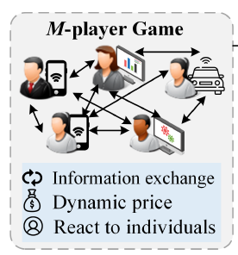
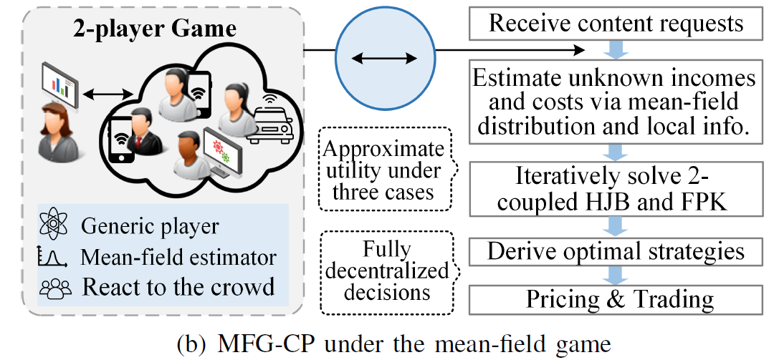
Solution
MFG-CP
The number of partial differential equations in the MFG-CP is reduced from M×K to 2×K
→ The computing time required to derive the optimal strategies will not incur excessive complexity.
The optimal caching strategy can be determined during the time horizon using only local information and a mean-field distribution.
14
Notes:
First, we transform the original game into a mean-field-game. Here is our proposed framework. The number of partial differential equations in the origin game is M×K. In contrast, the number of partial differential equations in our framework is 2×K. Therefore, the computation complexity is much lower. In this way, the optimal caching strategy can be determined by using only local information and a mean-field distribution.

Slide 15

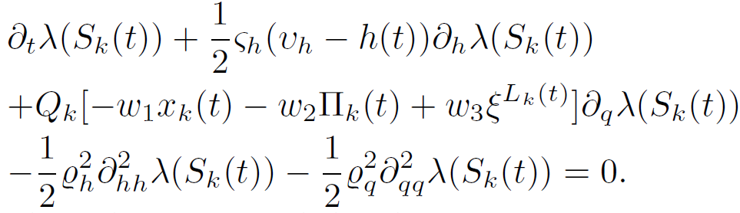
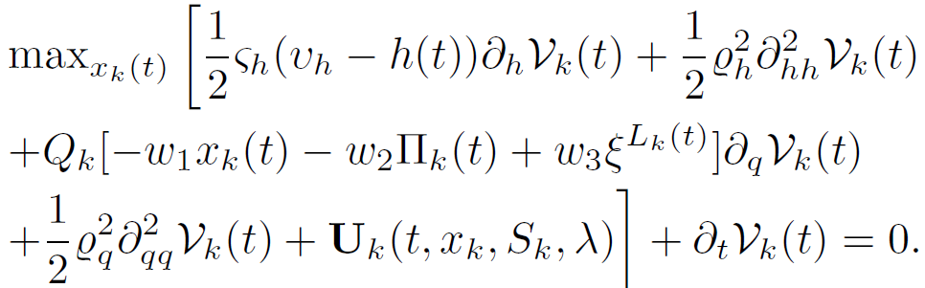
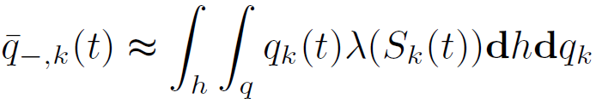
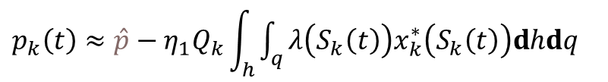





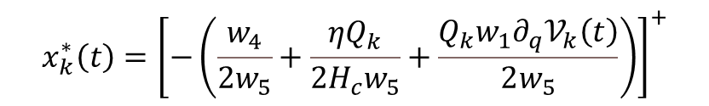
Determining the Optimal Caching Strategy
Mean-field Estimator
Generic player
Construct the Fokker-Planck-Kolmogorov (FPK) equation to estimate the statistical distribution of states $λ\left(S_{k}\left(t\right)\right)$:
Estimate the dynamic price:
Estimate the average caching state:
Estimate the average sharing benefit:
Solve the optimization problem:
Employ the mean-field estimator to quickly obtain the trading income, sharing benefit, staleness cost, and sharing cost.
Reconstruct HJB equation to determine the value function $𝒱_{i,k}\left(t\right)$:
The optimal caching strategy:
$$λ$$
$p_{k}\left(t\right)≈\hat{p}−η_{1}Q_{k}\int_{h}{\int_{q}{λ\left(S_{k}\left(t\right)\right)x_{k}^{∗}\left(S_{k}\left(t\right)\right)dhdq}}$
$$x$$
$$x_{k}^{∗}\left(t\right)={\left[−\left(\frac{w_{4}}{2w_{5}}+\frac{ηQ_{k}}{2H_{c}w_{5}}+\frac{Q_{k}w_{1}∂_{q}𝒱_{k}\left(t\right)}{2w_{5}}\right)\right]}^{+}$$
$${\overline{Φ}}_{k}^{2}\left(t\right)={\overline{p}}_{k}\overline{Δq}\left(t\right)\left(\frac{M−M_{k}^{′}\left(t\right)}{M_{k}\left(t\right)}−1\right)$$
15
Notes:
In our framework, the mean-field estimator /ˈestəˌmeɪtər/ calculates the cumulative impact of all EDPs on content caching, trading, and sharing for the generic EDP. Firstly, we construct the FPK equation to estimate /ˈestɪmət; the statistical /stəˈtɪstɪk(ə)l/ distribution of states. Then, we can determine the dynamic price, the average caching state, and the average sharing benefit with the help of the mean-field distribution. So, we can employ the mean-field estimator to quickly obtain the incomes and outcomes of each EDP. Next, the generic EDP can further optimize its utility by calling the mean-field estimator. After reconstructing HJB equation to determine the value function, the generic EDP can determine the optimal caching strategy under the current information.

Slide 16

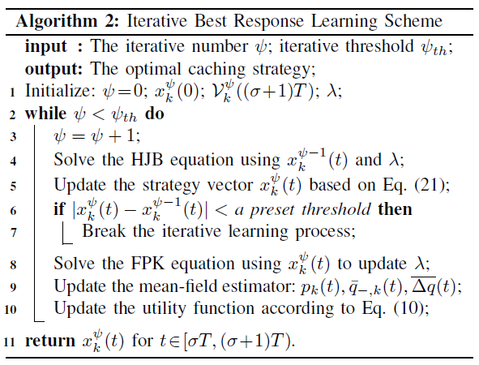
Iterative Learning
Core: iteratively solve the coupled HJB equation and FPK equation: the backward HJB models the induction process of the optimization of each individual, while the forward FPK models the evolution of the mean-field as a whole.
The solution of the HJB equation has a great impact on the FPK equation to update the mean field.
The solution of the FPK equation is also required by the HJB equation to estimate the generic player’s utility and update strategies.
16
Notes:
Based on the above designs, we propose the Iterative Best Response algorithm. The key idea is to iteratively solve the coupled HJB equation and FPK equation. The solution of the HJB equation has a great impact on the FPK equation to update the mean field. The solution of the FPK equation is also required by the HJB equation to estimate the generic player’s utility and update strategies.

Slide 17
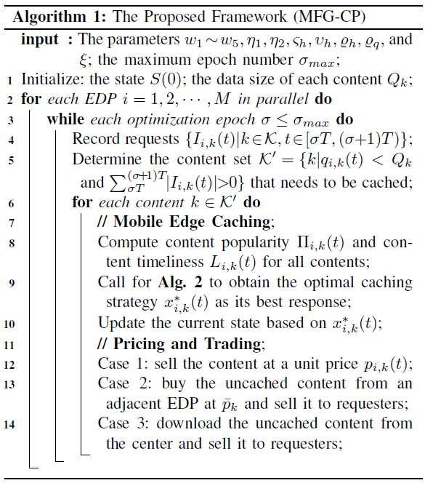
Framework Description
Core: Each EDP makes decisions in parallel
→ Mobile Edge Caching + Pricing and Trading
The change in requesters’ demands occurs at a relatively slow rate
Invokes Alg. 2 to give the best response: customizing its optimal caching strategy
The trading process between the EDP and the corresponding requesters will be carried out, where the EDP needs to take different actions under various cases
17
Notes:
Then, we present the process of the whole framework. First, each EDP determines the content set that needs to be cached. Then, each EDP conducts the edge caching and content trading. That is, we use Alg. 2 to determine the optimal caching strategy. After that, the trading process between the EDP and the corresponding requesters will be carried out.

Slide 18
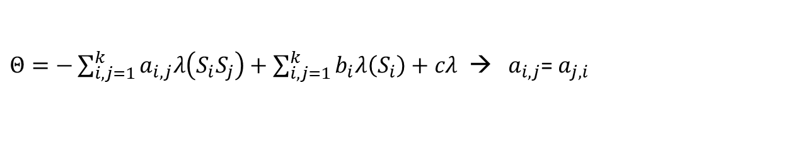

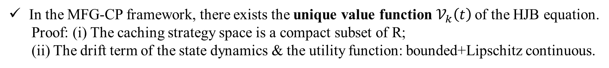
Equilibrium Analysis
Lemma
In the MFG-CP framework, there exists the unique value function $𝒱_{k}\left(t\right)$of the HJB equation.
Proof: (i) The caching strategy space is a compact subset of R;
(ii) The drift term of the state dynamics & the utility function: bounded+Lipschitz continuous.
There exists the unique mean-field distribution $λ\left(S_{k}\left(t\right)\right)$of the FPK equation.
Proof: A parabolic partial differential equation →
$$∂_{t}λ\left(S_{k}\left(t\right)\right)+Θ=d$$
$Θ=−\sum_{i,j=1}^{k}{a_{i,j}λ\left(S_{i}S_{j}\right)}+\sum_{i,j=1}^{k}{b_{i}λ\left(S_{i}\right)+cλ }$ → $a_{i,j}$= $a_{j,i}$
Theorem
In the MFG-CP framework, there exists a unique Nash equilibrium.
Proof:
Given this contraction mapping, there exists a unique fixed-point based on the fixed-point theorem
The unique solution pair
of the HJB-FPK equations
18
Notes:
Next, we analyze the game equilibrium /ˌiːkwɪˈlɪbriəm/. Since there exist the unique value function of the HJB equation and the unique mean-field distribution of the FPK equation, the optimal caching strategy determined by our mechanism forms the unique equilibrium.

Slide 19
Outline
Background & Motivation
Related Work & Problem Formulation
Basic Idea & Solution
Evaluation & Conclusion
Notes:
Finally, we introduce the performance and conclude my paper.

Slide 20
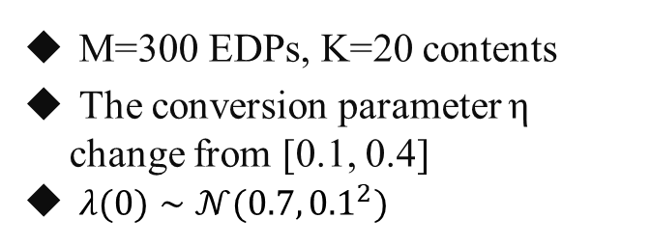
Evaluation
Real Dataset
Parameter settings
M=300 EDPs, K=20 contents
The conversion parameter η change from [0.1, 0.4]
$λ(0)∼𝒩(0.7,{0.1}^{2})$
YouTube → The number of requests for each category
→ content id, tags, views,
comment count, description.
Experimental Settings
Random Replacement (RR)
Most Popular Caching (MPC)
MFG: do not consider sharing
Ultra-Dense Caching Strategy (UDCS): consider content overlap
Mean-Field Equilibrium
Caching state & Utility
Computation time
Compared Algorithms
Evaluation Metrics
20
Notes:
There are some simulation settings. We adopt the real-world dataset and select four baselines.

Slide 21
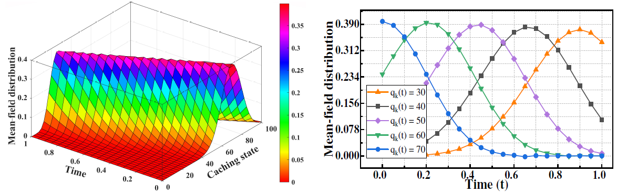
Evaluation
Evolution of the mean-field distribution at the equilibrium:
When we fix the time slot, the size of the remaining caching space will increase first and then decrease.
As the time evolves, the remaining caching space with {60MB, 70MB} will vanish due to the improvement of space utilization.
21
Notes:
We first evaluate the evolution of the mean-field distribution over time at the equilibrium. When we fix the time slot, the size of the remaining caching space will increase first and then decrease. This is because each EDP adjusts the trading price and content placement to cache more popular or urgent contents. As time goes by, due to the improvement of space utilization, the large remaining caching space will vanish.

Slide 22
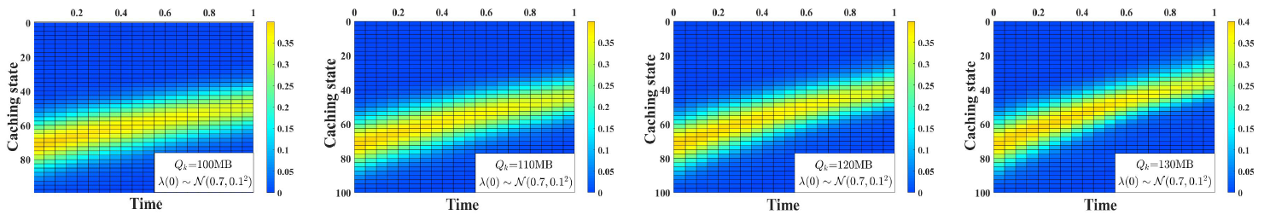
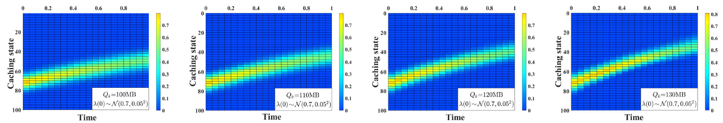
Evaluation
A heat map description of the mean-field distribution under different $Q_{k}$:
The caching space will gradually reach saturation with the increase of $Q_{k}$.
When decreasing the variance values, the heat map displays more concentrated results.
22
Notes:
Then, we provide the heap map description of the mean-field distribution under different Qk. When increasing Q_k, the caching space will gradually reach saturation /ˌsætʃəˈreɪʃ(ə)n/. This is because the corresponding caching strategy will grow. Meanwhile, when decreasing the variance values, the heat map displays more concentrated results.

Slide 23
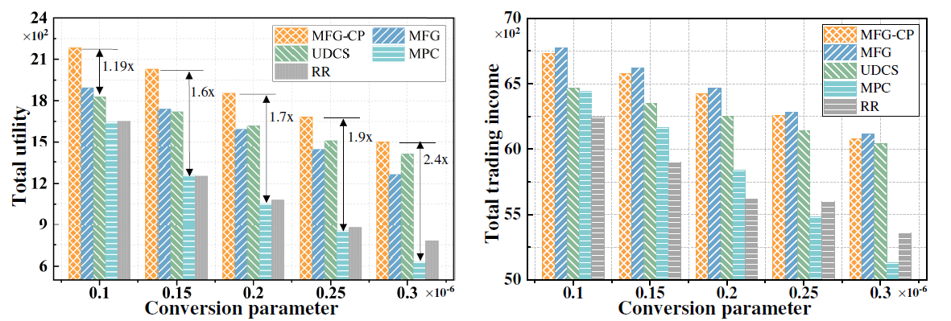
Evaluation
Comparisons under different conversion parameters:
Improving the value of the conversion parameter leads to a reduction in total utility;
The staleness cost of MFG obviously exceeds that of MFG-CP;
The behavior of content sharing is beneficial for improving the utility of each EDP;
MFG-CP enables each EDP to possess a higher utility than these compared algorithms.
23
Notes:
Next, we conduct comparisons under different parameters. We find that improving the value of the conversion parameter leads to a reduction in total utility, and the behavior of content sharing is beneficial for improving the utility of each EDP. More importantly, MFG-CP makes each EDP have a higher utility than these compared algorithms.

Slide 24
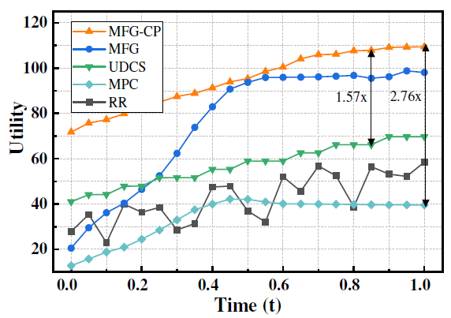
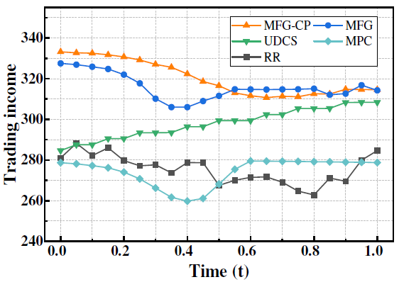
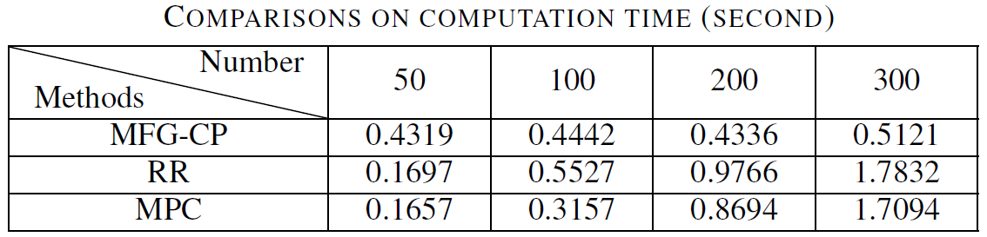
Evaluation
Comparisons on utility, trading income, and time:
The proposed framework MFG-CP offers significant advantages in maximizing the utilities of EDPs
The computational complexity
of MFG-CP does not increase with the number of EDPs
24
Notes:
Meanwhile, we also evaluate utility, trading income, and time. Similarly, we observe that although there is a small gap in the trading income between MFG-CP and MFG, the staleness cost of our algorithm is lower. Moreover, the computational complexity of MFG-CP does not increase with the number of EDPs. This observation validates the efficiency and scalability of our algorithm in large-scale mobile edge caching systems.

Slide 25
Conclusion
We study the competitive content placement issue in large-scale dynamic MEC systems.
We model the problem as a non-cooperative stochastic differential game, which considers the heterogeneous content demands, real-time trading prices, and paid content sharing.
01
02
To facilitate decentralized decision-making, we propose the MFG-CP framework for joint content caching and pricing.
03
We develop an iterative best response learning scheme to determine the optimal caching strategy for each EDP.
04
Extensive simulations on real-world traces validate its great performance.
05
25
Notes:
In summary, we study the competitive content placement issue in large-scale dynamic mobile edge caching systems. We first model the problem as a non-cooperative stochastic differential game, which considers different content demands, real-time trading prices, and paid content sharing. To achieve decentralized decision-making, we propose the MFG-CP framework for joint content caching and pricing. Meanwhile, we develop an iterative best response learning scheme to determine the optimal caching strategy for each EDP. We also prove that these optimal strategies form a unique NE. Finally, extensive experiments validate the great performance of our framework.

Slide 26



Thank you for your attention!
Question?
Yin Xu xuyin218@mail.ustc.edu.cn

