Slide 1

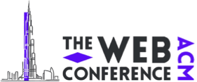
Grasp: Refining Semantic Graphs into Purified Knowledge for Cross-Modal Communication
Liang Chen, Xiaoding Wang, Limei Lin*, Dajing Wang，Zhiquan Liu, Jie Wu
The Web Conference 2026
29 June - 3 July 2026 Dubai, United Arab Emirates
Notes:
Hello everyone. It is my honor to present our paper, titled “Grasp: Refining Semantic Graphs into Purified Knowledge for Cross-Modal Communication.”
This work focuses on semantic communication in multimodal web scenarios.

Slide 2

CONTENTS
1
Background & Motivation
2
Grasp Framework Design
3
Experiments & Results
4
Conclusion & Future Work
Notes:
My presentation is divided into the following four parts.

Slide 3
Background & Motivation
1
ONE
Notes:
Let me start with the background and motivation.

Slide 4
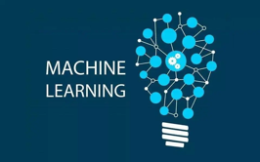
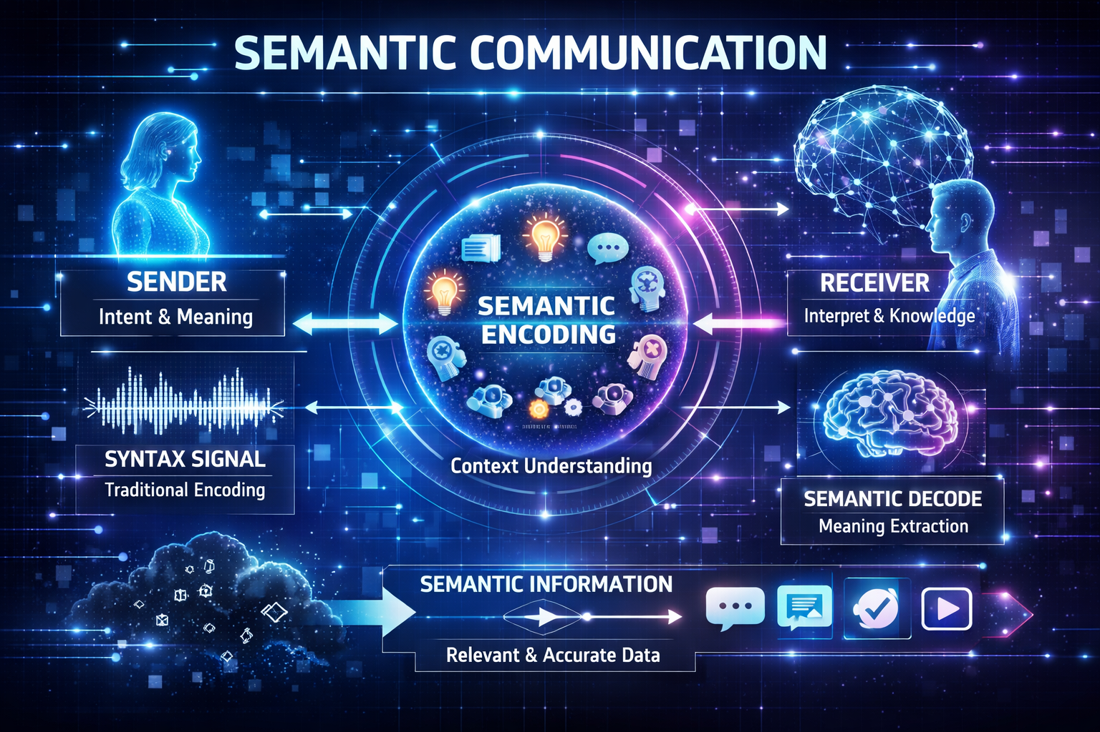


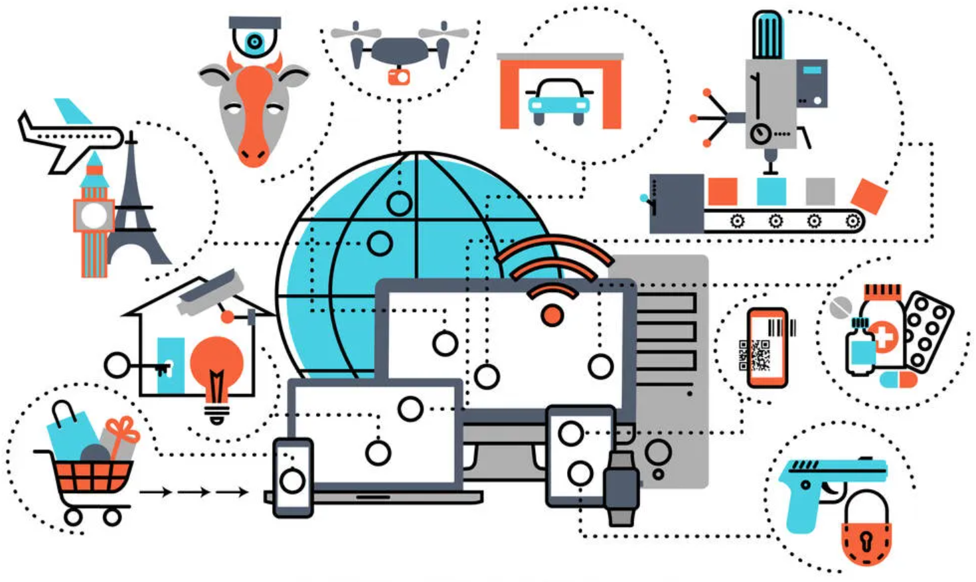

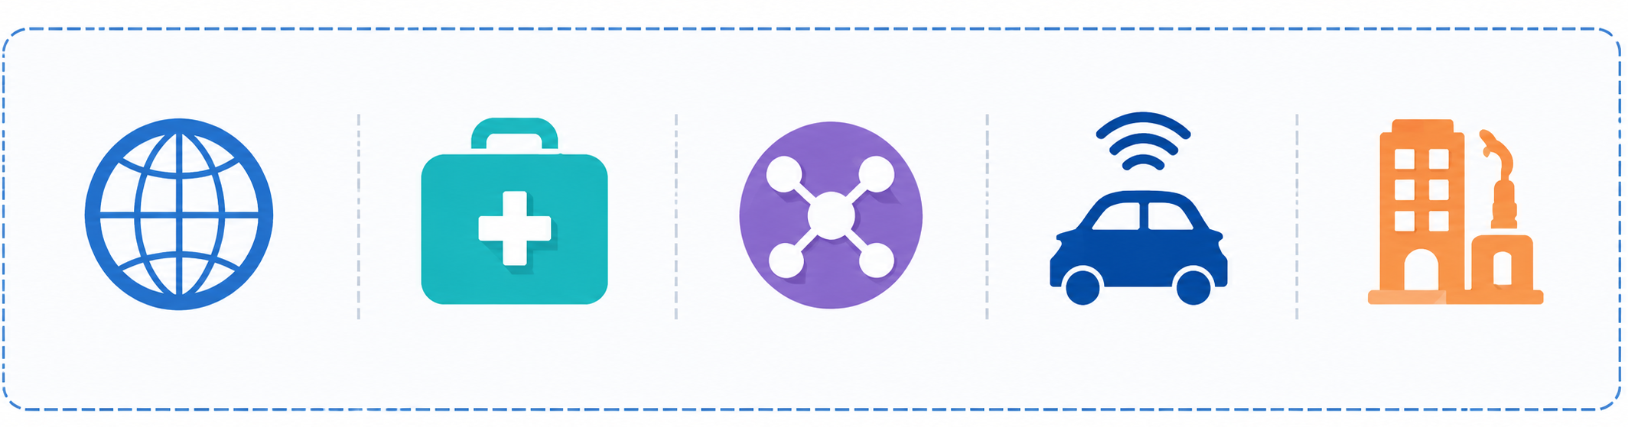
Semantic Communication: towards Knowledge-Centric Cross-Modal Communication
Communication Challenges in the Multimodal Web Era:
Explosive growth of video, audio, and text databrings high transmission cost.
Traditional communication focuses on raw bitreconstruction, causing redundancy and lowsemantic efficiency.
选题的介绍
项目团队介绍
Why Cross-Modal Communication is More Challenging:
Modalities are often asynchronous, incomplete,and affected by channel noise.
Surface-level feature transmission may failunder low SNR or missing modalities.
选题研究实施
研究目标成果
Typical Application Scenarios：
Intelligent
Web Services
Telemedicine
Internet of
Things
Vehicle-to-Everything
Digital Twins
& Smart Sensing
Notes:
In the multimodal web era, data from video, audio, and text is growing very fast. This creates high transmission cost, especially in applications such as intelligent web services, telemedicine, Internet of Things, vehicle-to-everything systems, and digital twins.
Traditional communication usually focuses on reconstructing raw bits. However, not all bits are equally important. For many tasks, what we really need is the meaning behind the data.
Cross-modal communication is more difficult because different modalities may be affected by channel noise.

Slide 5

Motivation
Challenges in Real-World Cross-Modal Communication:
Surface-level features are easily corrupted by noise,packet loss, and low SNR.
Video, audio, and text are often asynchronous,causing semantic misalignment.
Missing modalities and distribution shifts reduce semantic fidelity and robustness.
选题的介绍
项目团队介绍
Limitations of Existing Methods:
Most methods focus on feature alignment or reconstruction rather than core knowledge.
Shared semantics are entangled with modality-specific factors.
They lack structured, schedulable semantic units for efficient transmission and recovery.
选题研究实施
研究目标成果
Motivation for this research:
There is an urgent need for a knowledge-centric semantic communication framework that can organize semantics, purify modality-invariant knowledge, and support robust transmission and recovery under realistic conditions.
Notes:
There are three main challenges in real-world cross-modal communication.
First, surface-level features are easily corrupted by noise. Second, video, audio, and text are often not perfectly aligned in time, which causes semantic misalignment. Third, missing modalities and distribution shifts reduce semantic fidelity and robustness.
Existing methods often focus on feature alignment or reconstruction. But shared semantics are still mixed with modality-specific information.
So our motivation is to build a knowledge-centric framework. It should organize semantics, purify modality-invariant knowledge, and support robust transmission and recovery under realistic conditions.

Slide 6
Key Contributions of the Paper
Grasp Framework:
Grasp organizes multimodal content as semantic graphs and extracts prioritized transmissibleknowledge units.
Knowledge Purification::
A conditional mutual-information objective enables three-way disentanglement for robust
tri-modal alignment.
Unified End-to-End Pipeline:
The framework unifies semantic modeling, purification, shared knowledge coding, and
attention-based recovery.
Experimental Results:
Experiments show better semantic quality vs. bit cost, low latency, and
effective component-wise ablation results.
Notes:
We makes four main contributions.
First, we propose Grasp, which organizes multimodal content as semantic graphs and extracts knowledge units for transmission.
Second, we introduce knowledge purification. It uses a conditional mutual-information objective to separate core knowledge from modality-specific and noisy factors.
Third, Grasp provides a unified end-to-end pipeline, including semantic modeling, purification, shared knowledge coding, and recovery.
Finally, our experiments show better semantic quality with lower bit cost and clear improvements from each component.

Slide 7
Grasp Framework Design
2
TWO
Notes:
Next I will introduce the design of the Grasp framework.

Slide 8
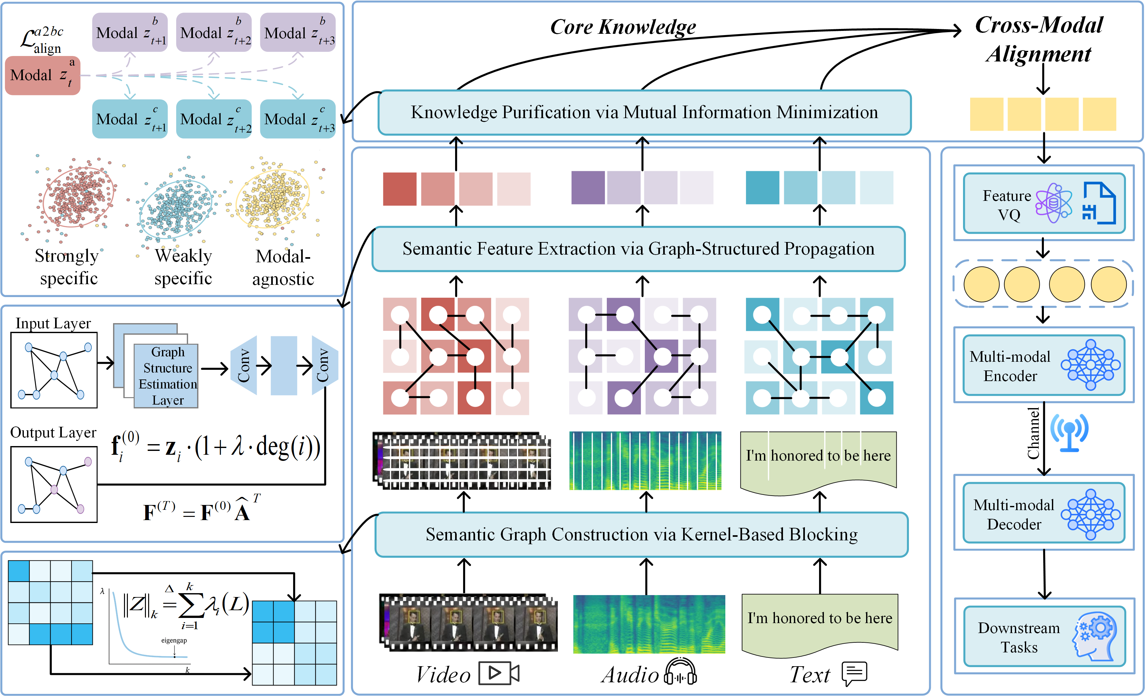
Overview of the Grasp Framework
We propose Grasp, a knowledge-centric framework for cross-modal communication that organizes multimodal inputs into semantic graphs, purifies modality-invariant knowledge, and transmits compact
semantic units efficiently.
The framework integrates semantic graph construction, graph-structured feature propagation, mutual-information-based knowledge purification, cross-modal alignment, and shared vector-quantized knowledge coding.
The figure illustrates key components: KBB, GSP, MICA, shared knowledge coding, and robust semantic recovery.
Notes:
This slide shows the overall pipeline of Grasp.
The input contains multiple modalities. First, Grasp divides the raw multimodal streams into semantic blocks. Then, it builds semantic graphs to describe the relations among these blocks.
After that, the framework purifies the knowledge.
Then, the purified knowledge is encoded for efficient transmission. At the receiver side, Grasp uses attention-based recovery to reconstruct semantic information.

Slide 9
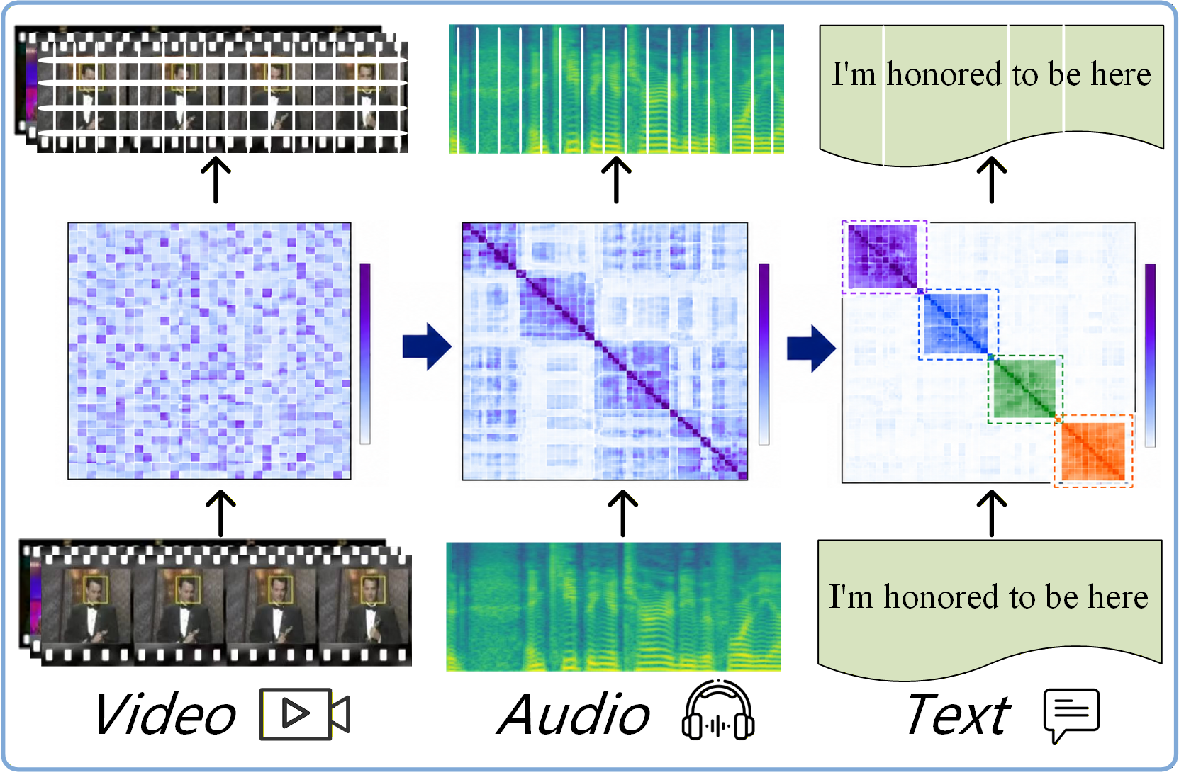
Semantic Graph Construction via Kernel-Based Blocking
KBB determines how to divide raw multimodal streams into semantic blocks.
It learns semantic relations among candidate segments through kernel self-representation.
The learned affinity gradually forms a block-diagonal structure, where each block corresponds to a coherent semantic unit.
These semantic blocks serve as the basic nodes for subsequent semantic graph construction and knowledge purification.
Key idea: KBB decides semantic blocks by discovering block-diagonal structures from kernel-space relations.
Notes:
To begin with, let us look at the first key module: Kernel-Based Blocking. It decides how to divide raw multimodal streams into semantic blocks.
The key idea is kernel self-representation. If several segments are semantically close, their relationships become stronger in the kernel space. Gradually, the learned affinity matrix forms a block-diagonal structure.
Each block corresponds to a coherent semantic unit. These blocks then become the basic nodes for the semantic graph.

Slide 10
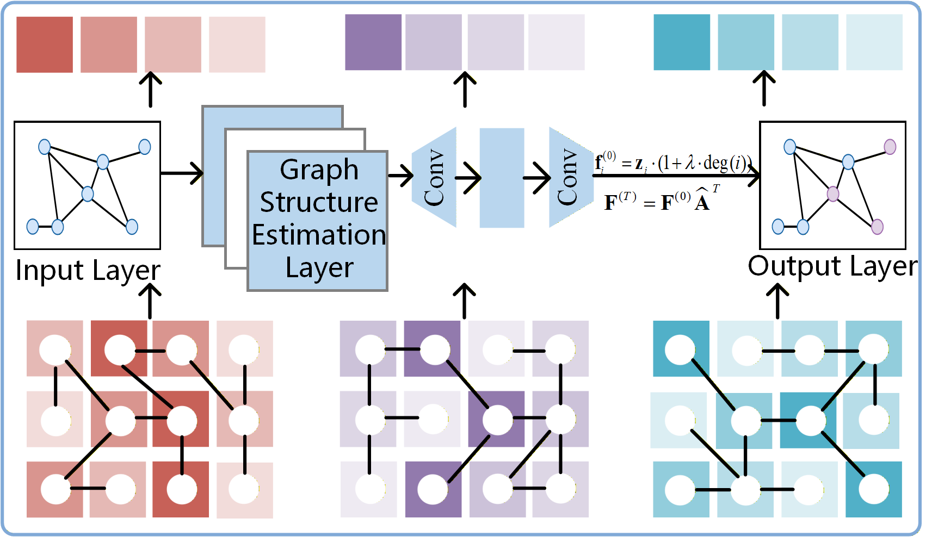
Semantic Feature Extraction via Graph-Structured Propagation
Purpose of GSP
Estimate semantic relations among blocks.
Propagate features through the semantic graph.
Enhance each block with neighborhood context.
Generate importance-aware semantic representations.
Key idea: GSP uses graph propagation to enrich semantic blocks with relational context.
Notes:
The second module is Graph-Structured Propagation.
After semantic blocks are constructed, we need to understand the relations among them. It estimates these relations and propagates features through the semantic graph.
In this way, each block is enhanced by its neighboring context.
This helps generate importance-aware semantic representations. This means the system can know which semantic units are more important for transmission.

Slide 11

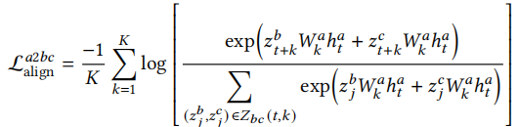
Knowledge Purification via Mutual Information Minimization
1. Component Refinement
MICA further refines the routed components into purified core, specific, and weak/noisy representations.
2. Conditional MI Minimization
Minimize conditional dependency to purify modality-invariant knowledge.
3. Temporal Cross-Modal Alignment
Align one anchor modality with the other two modalities over time.
Key idea: MICA purifies core knowledge and aligns tri-modal semantics.
Notes:
The third key module is Knowledge Purification via Mutual Information Minimization.
The purpose of this module is to separate different types of information. We want to keep strongly related, modality-invariant core knowledge. At the same time, we want to reduce modality-specific, weakly related, or noisy information.
To achieve this, we use conditional mutual information minimization. In simple words, we reduce unnecessary dependency between irrelevant components, so the transmitted representation becomes cleaner.
What's more, this module also performs temporal cross-modal alignment. It aligns one modality with the other two modalities over time.

Slide 12
Experiments & Results
3
FOUR
Notes:
Next, I will present the experimental results.

Slide 13
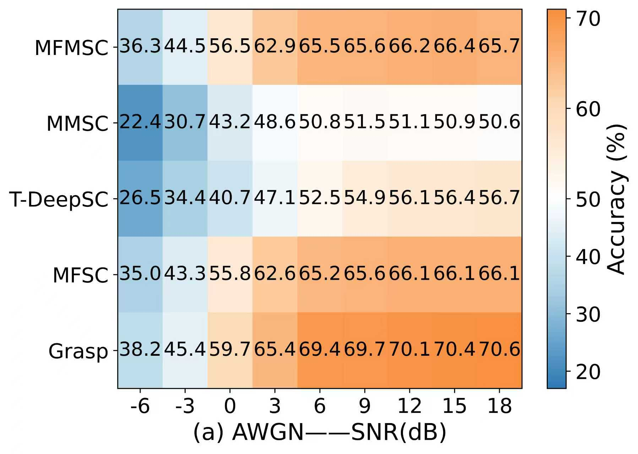
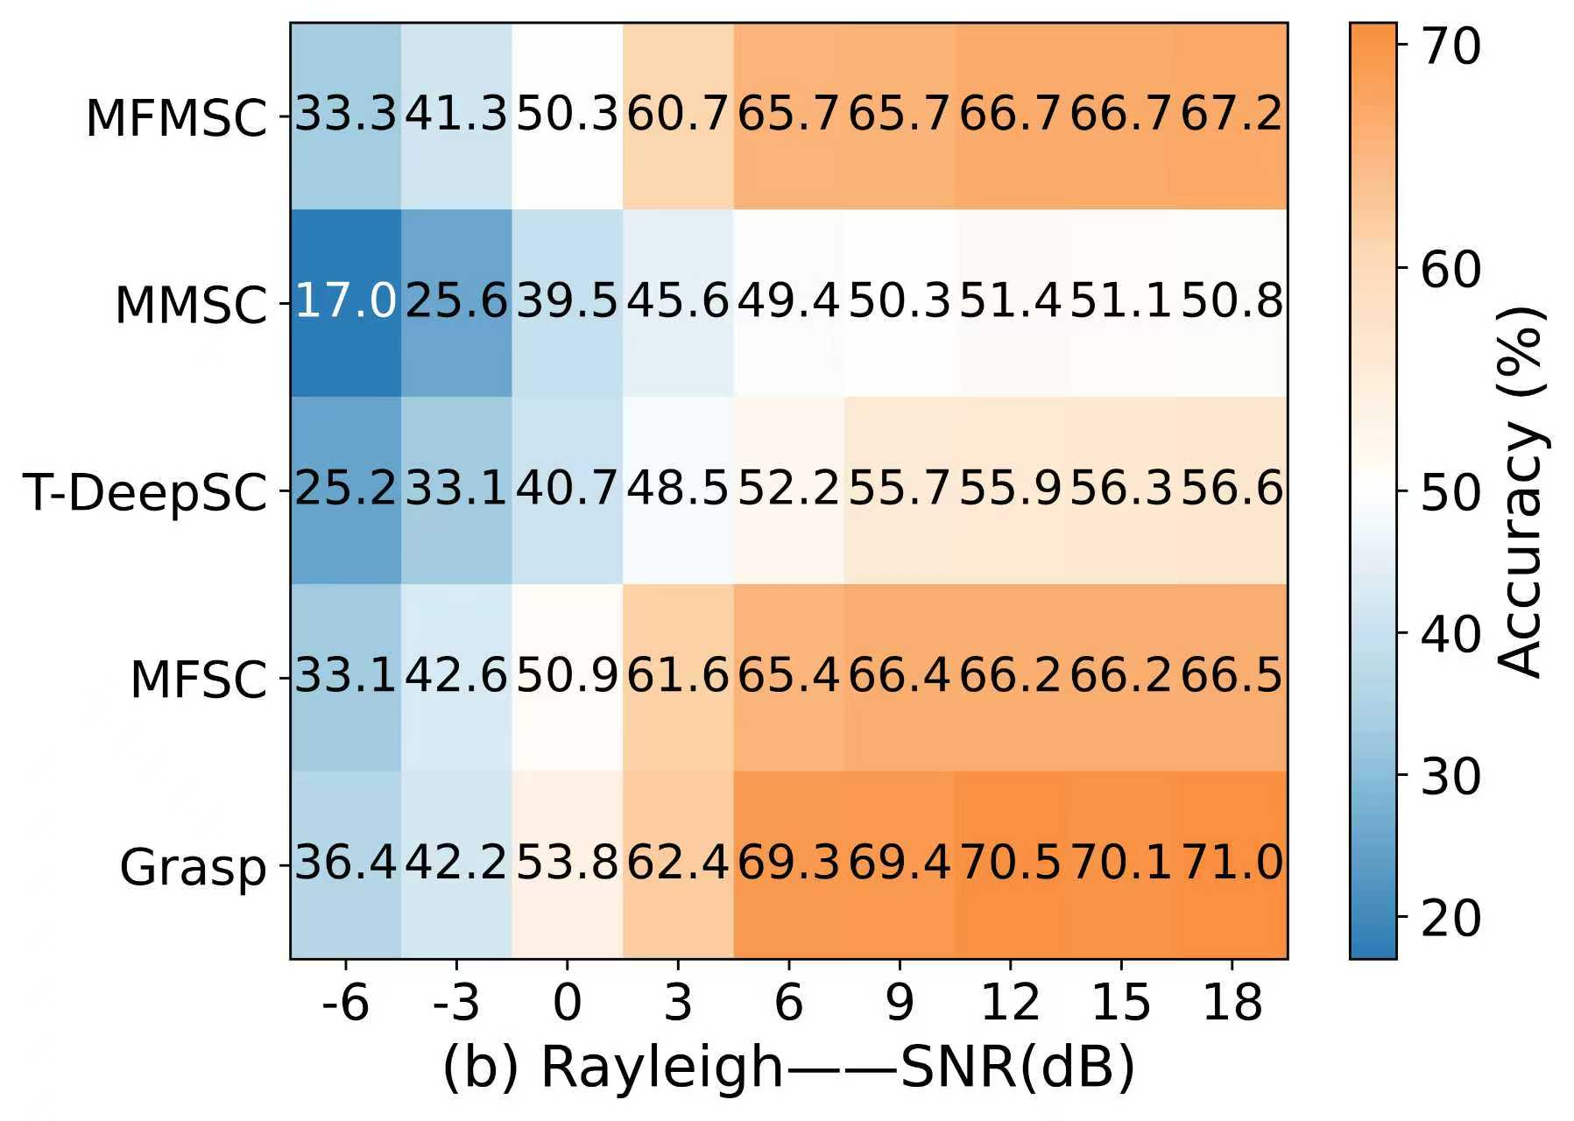
Experiments & Results
Notes:
We evaluate Grasp under different channel conditions, including AWGN and Rayleigh fading channels, and different SNR levels.
From the curves, we can see that Grasp consistently performs better than other methods as SNR changes. Especially under low SNR, the performance gap is clear. This means Grasp is more robust when the communication channel is noisy.
The heatmaps and 3D bar charts show similar trends across different datasets and tasks.
The radar charts show the ablation study.
Overall, the results confirm that structured semantic graphs, graph propagation, and knowledge purification work together to improve robust cross-modal communication.

Slide 14
Conclusion & Future Work
4
FIVE

Slide 15
Conclusion
We propose Grasp structures tri-modal inputs as semantic graphs and transmits purified, modality-invariant knowledge.
It disentangles strongly related, weakly related, and irrelevant components for robust tri-modal alignment.
Experiments show consistent improvements in fidelity, robustness, and downstream performance.
选题的景
选题的背景
请替换输入您的正式研究选题文字内容，也可以直接复制您的文字内容到此，根据需要调整文字的大小。
请替换输入您的正式研究选题文字内容，也可以直接复制您的文字内容到此，根据需要调整文字的大小。
选题的背景
Future Work
请替换输入您的正式研究选题文字内容，也可以直接复制您的文字内容到此，根据需要调整文字的大小。
Extend to richer modalities such as depth, LiDAR, and physiological signals.
Enhance robustness and security under adversarial and real-world deployment settings.
Notes:
In conclusion, we propose Grasp, a knowledge-centric framework for multimodal semantic communication. Grasp structures video, audio, and text inputs as semantic graphs. It then transmits purified, modality-invariant knowledge instead of raw data or surface-level features. The framework disentangles strongly related, weakly related, and irrelevant components. This helps improve multimodal alignment and makes the system more robust.
In future work, we will extend it to more modalities and improve its security in real-world settings.

Slide 16
Thanks!
The Web Conference 2026
29 June - 3 July 2026 Dubai, United Arab Emirates
Notes:
That is all for my presentation. Thank you very much for your attention.

