Slide 1
On Authenticated Query Processing via Untrusted Service Providers
Jie Wu
Department of Computer and Information Sciences
Temple University

Slide 2
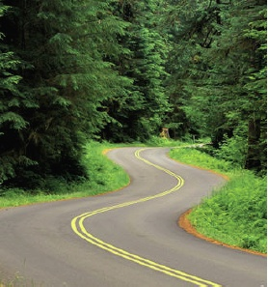
Road Map
1. Era of Big Data
    Trusting vs. suspicious
2. Search Privacy
    Individual search using homomorphic encryption
    Collaborative search using trusted third party
3. Function Query
    Function query based on ranks
    Verification object (VO)
4. Conclusions
5. Sample On-going Projects

Slide 3
1. Era of Big Data
90% of world’s data was generated over last two years!
More and more personal data is stored in the cloud
  Do you trust CSP?
    Yes: selected a trusted CSP
    No: Apply searchable encryption at CSP
Cloud Security problems are coming from :
  Loss of control
  Lack of trust (mechanisms)
  Multi-tenancy
Notes:
Data Security: Only the authorized data users can access the data stored in the cloud
Revocation: Effectively revoke a data user’s access right
Retrieval Privacy: User privacy while retrieving data from the cloud

Slide 4
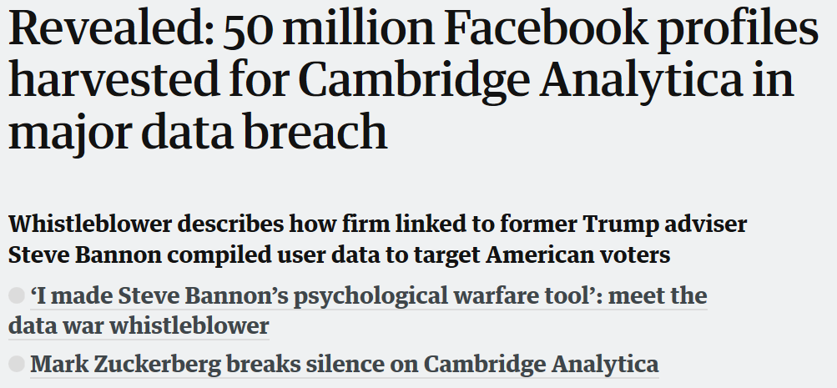
Trusting vs. Suspicious
Facebook process 500 terabytes (10¹²) of data daily, yet…
Cloud Security problems are coming from :
  Loss of control
  Lack of trust (mechanisms)
  Multi-tenancy
To be trusting is to be fooled from time to time.
To be suspicious is to live in torment.
Notes:
Data Security: Only the authorized data users can access the data stored in the cloud
Revocation: Effectively revoke a data user’s access right
Retrieval Privacy: User privacy while retrieving data from the cloud

Slide 5
Trusting: Trust (vs. Reputation)
Reputation (objective)
  What is generally said or believed about somebody (say B)
Trust (subjective: judgment + opinion)
  Trust is the subjective probability by which A expects that another B performs a given action
Trust in multiple disciplines [Computing Survey’16]
  Economics, sociology, psychology, biology, political science, computer science, social networks …
  Computational (e.g. reliability model) vs. non-computational

Slide 6
How to Build Trust?
First-hand (direct) and second-hand (recommendation)
E.g. New department chair’s trust management
direct
A
s
d
B
indirect
D
A
direct
direct
s
d
d
B
recommendation

Slide 7
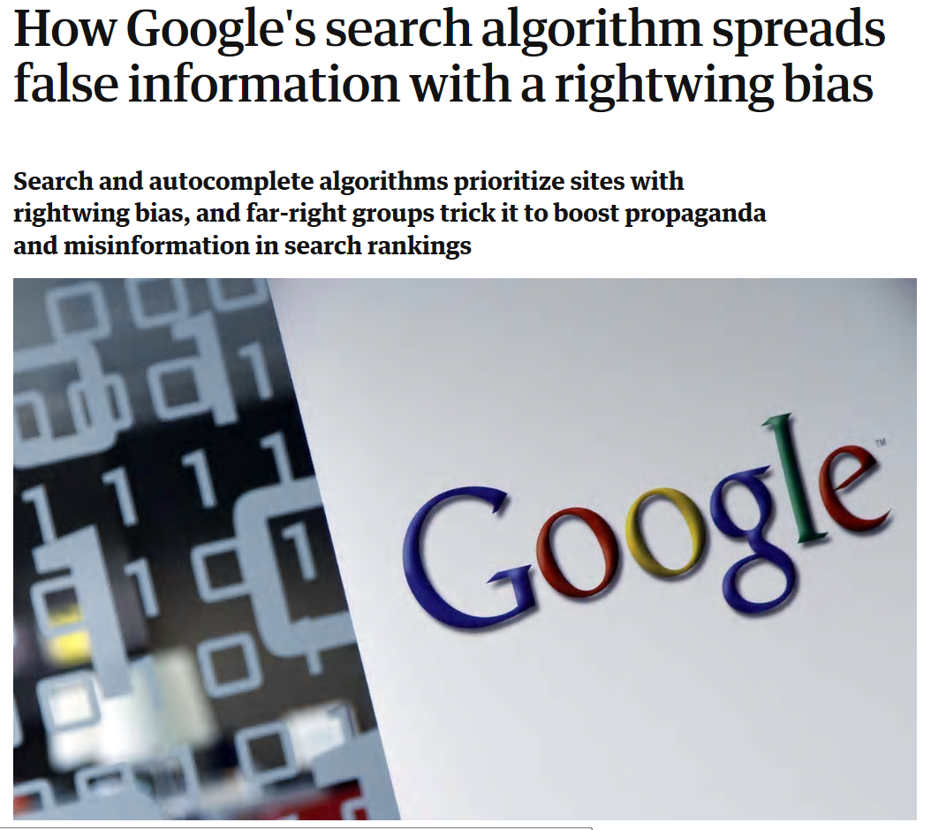
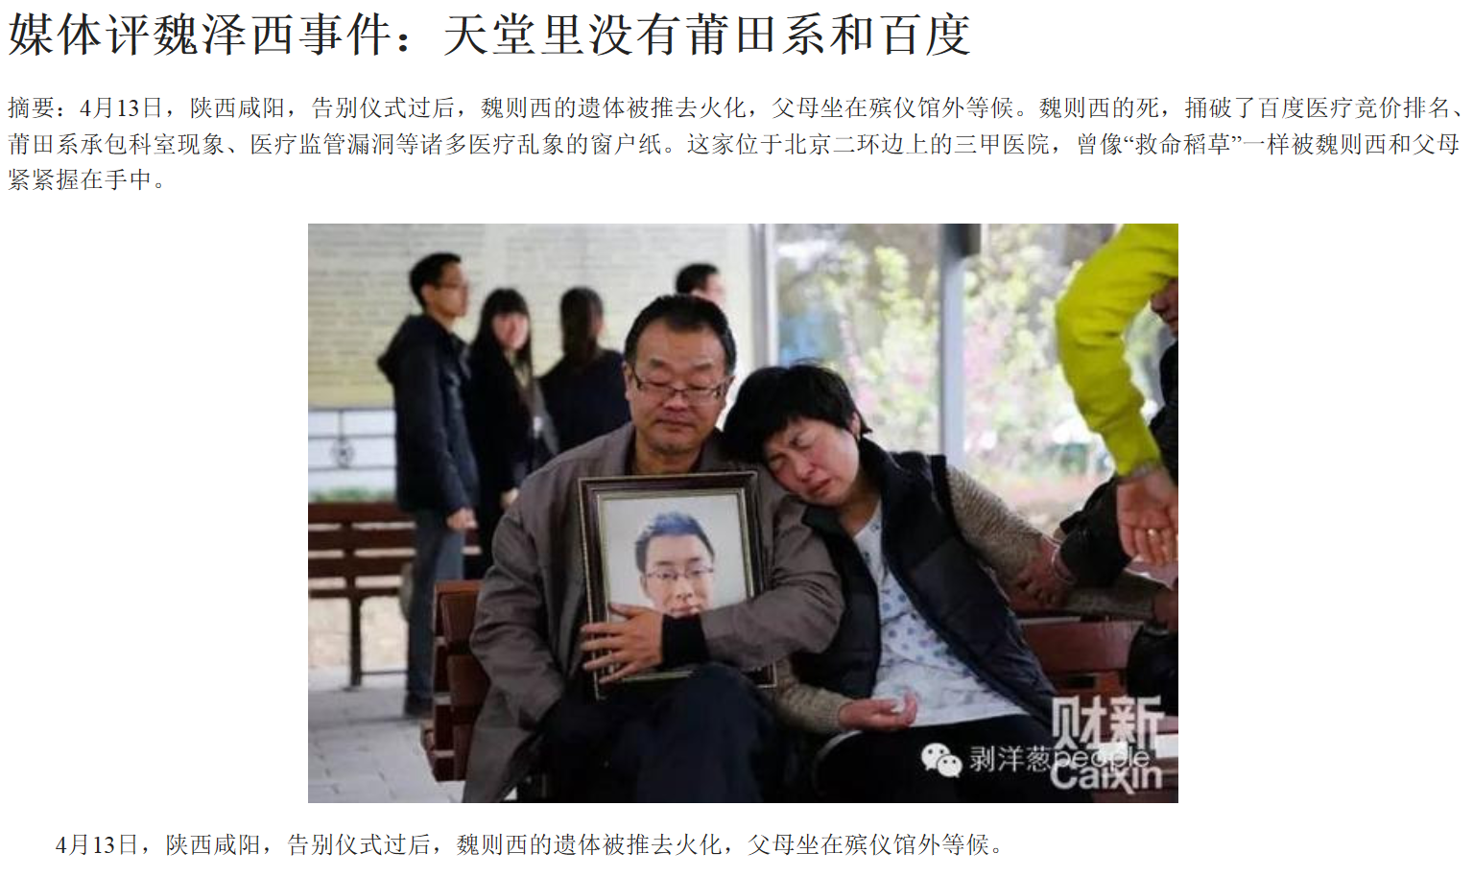
Suspicious: Search Neutrality
Search engines: no editorial policies other than that their results be comprehensive, impartial and based solely on relevance.
A fake ranking of a hospital unit under Baidu costed life and money of a patient in China

Slide 8
Security and Privacy
Data security
  Tampered data, data loss or replacement, data leakage, …
Query authentication
  Sound and complete
How to protect user privacy ....
  defending against data privacy and search privacy.
... while ensuring good system performance.
  conserving bandwidth, reducing energy through minimizing computation and communication.

Slide 9
2. Search Privacy
Users querying the cloud (forward index file: key list)
Alice
A, B
F1 : A, B
F1
Cloud Service
Provider (CSP)
F2 : C, D
F3 : E, F
C, F
Bob
F2, F3
Cloud learns Alice’s and Bob’s queries and responses.

Slide 10
Search Privacy
Cloud neither learns what the user is searching
for, nor which files are returned to a user.
Cloud: semi-trusted (i.e., honest but curious).
It will obey general rules, but still wants to know
some additional information.

Slide 11
Searchable Encryption
A user builds index (forward/inverted) for a collection of files.
A user utilizes symmetric/asymmetric key encryption and searchable encryption (SE) to encrypt file contents and indexes, respectively.
Later, a user generates a trapdoor (an encrypted query with SE) to retrieve all the files containing keyword w and performs decryption locally.

Slide 12
Prior Solution [CRYPTO’05]
1, 1, 0, 0, 0, 0
F1 : A, B
Alice
CSP
F2 : C, D
A, B, C, D, E, F
1, 1, 0, 0, 0, 0
F3 : E, F
Alice issues a special query
1, 1, 0, 0, 0, 0
with a dictionary encrypted using homomorphic encryption
Cloud compares all files and returns all.

Slide 13
Prior Solution (cont’d)
F1 : A, B
Alice
F1, F2,F3
CSP
F2 : C, D
Decrypts and only gets back F1.
F3 : E, F
Cloud computes and returns to Alice
F1, F2,F3
F1, F2,F3
is a compressed version of F1,F2,F3.
Cloud does not know what files are returned.

Slide 14
Brief Background
Homomorphic encryption allows us to perform some operations on encrypted data without decryption.
Let E() be encryption.
  E(x)*E(y) = E(x+y) where E(x) = f(g^{x}) (Paillier system)
  E(X)^{Y} = E(X * Y)
  key trick: map unwanted file F to 0
  E(0)^{|F|}=E(0*|F|) = E(0)
  Users encrypt interests in E(0) or E(1)
Returned files can be easily compressed without conflict, as all unwanted files are now E(0)

Slide 15
Looking Forward…
Full homomorphic encryption has perfect security, but too expensive
More efficient solutions leak some information (e.g., search pattern, access pattern, …)
Security and efficiency trade-offs (e.g., collaborative search)
Query expressiveness (e.g., function query)
Untrusted CSP (i.e., malicious)
Notes:
Next we introduce our solution in detail, for example, there are three records r1, r2 and r3 in the server, each record has two attribute values x and y, such as r1’s x and y attribute values are 3 and 9. Alice issues a top-1 query and the ranking function is x+y, the query result is r1. While bob issues a top-2 query and the ranking function is x2+3y, the query result are r3 and r1. The untrusted server may tamper or omit the result.

Slide 16
Collaborative Search [JPDC’12]
Prior research solves the privacy problem.
But the overhead is high
  High bandwidth and computation costs
  A lightweight SE used that reveals access pattern
1, 1, 1, 0, 0, 1
Alice
1, 1, 0, 0, 0, 0
CSP
Bob
0, 0, 1, 0, 0, 1
We can combine queries
Efficiency: 1 computation for n users
Privacy: Hide access pattern from CSP

Slide 17
Trusted Third Party (TTP)
Alice
Bob
Trusted Third
Party (TTP)
CSP
Charlie
Deploy a Trusted Third Party (TTP)
Users forward their queries to TTP and TTP to CSP as one single query.

Slide 18
Extensions [JCST’17]
Multiple TTPs: resolve bottleneck at TTP
Alice
Bob
TTP
CSP
TTP
Charlie
Cost Efficiency: For a given group #, group users with overlapping keywords to minimize # of 1s in each group.
Load Balancing: For a given U, create a minimum # of groups such that 1s in each group are bounded by U.
Robustness: For a given K, use one of the grouping criteria in such a way that each query appears in at least K different groups.

Slide 19
Grouping Example
10 files before grouping and 6 files after grouping

Slide 20
Problem Formulation
Classifying n users into k groups of equal size, so that the number of keywords in k combined queries, i.e., the total number of 1s, is minimized.
Basic idea: K-Mean-based Dynamic Grouping
Choose k queries as the seeds, and classify the queries that are closest to the seeds.

Slide 21
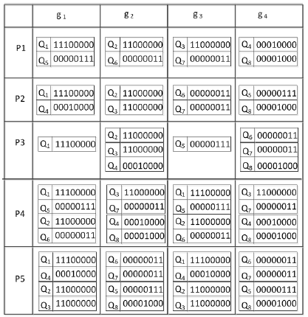
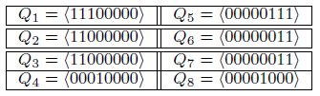
K-Mean-based Dynamic Grouping
P1: Random
P4: Random Robust
KMDG: P2
Balance group size
KMDG2: P3
Balance # of 1s
KMDG Robust: P5
Duplication

Slide 22
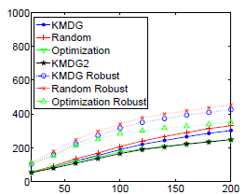
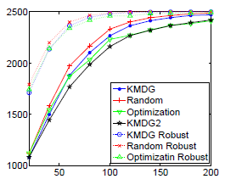
Experiment Results
The total number of 1 Bandwidth (MB)
X axis: number of users
K=5 and dictionary size 100

Slide 23
3. Function Query
Users querying the CSP through a function query
  But the CSP is untrusted (i.e., malicious)
top-1, x+y
r1 (3,9)
Alice
r1
CSP
r2 (4,5)
top-2, x²+3y
r3 (5,6)
Bob
r3,r1
Notes:
Next we introduce our solution in detail, for example, there are three records r1, r2 and r3 in the server, each record has two attribute values x and y, such as r1’s x and y attribute values are 3 and 9. Alice issues a top-1 query and the ranking function is x+y, the query result is r1. While bob issues a top-2 query and the ranking function is x2+3y, the query result are r3 and r1. The untrusted server may tamper or omit the result.

Slide 24
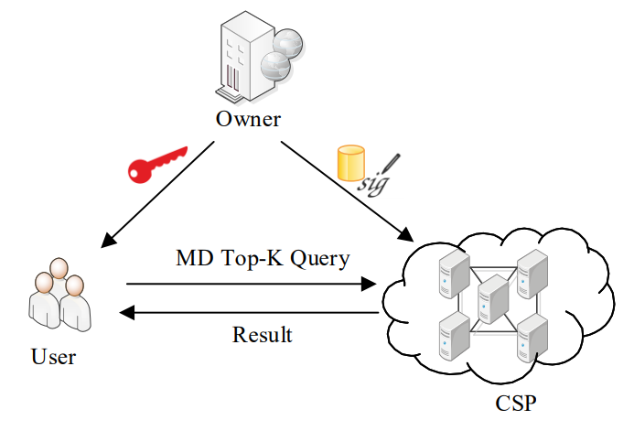
Basic Techniques
Query authentication
  Soundness (signature (r, Sig(r)): no tamper
  Completeness (signature chain): no omit or replace
Verification object (VO) for auditability
  Generated by the server, VO provides an independent means of verifying correctness
Notes:
The basic techniques include the signature chain. In our paper, we use signature chain. As we mentioned, our security goals include soundness and completeness, the soundness can be accomplished by signature and the completeness can be accomplished by hash chain.

Slide 25
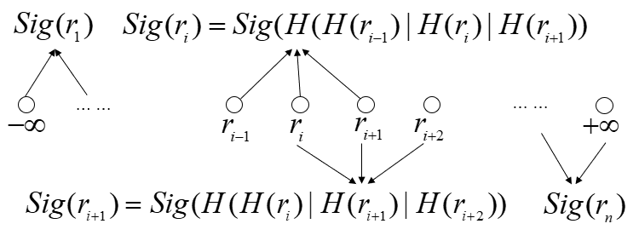
VO basic: Signature Chain
Basic idea
  Bind “neighbors” in a given “ranking” function
Signature chain
  Each record is chained with its left and right neighbors
  H(∙): one-way hash function
Notes:
Now we introduce the basic technique which we use in our paper, signature chain.
The idea is to sort the data items and then create a signature for each record in the database.
The signature for a record ri is computed based on the digest of itself and the digests of its two immediate left and right neighbors.
For example, Sig(ri) = Sig(H(H(ri−1)|H(ri)|H(ri+1))).
The query result is accompanied with verification object that contains the signatures of all data in results.
This chain serves as the proof that for any two consecutive data ri and ri+1 in results, no data is between ri and ri+1.
The chain also allows the user to verify if all data in the query range is returned by checking the two boundary records.

Slide 26
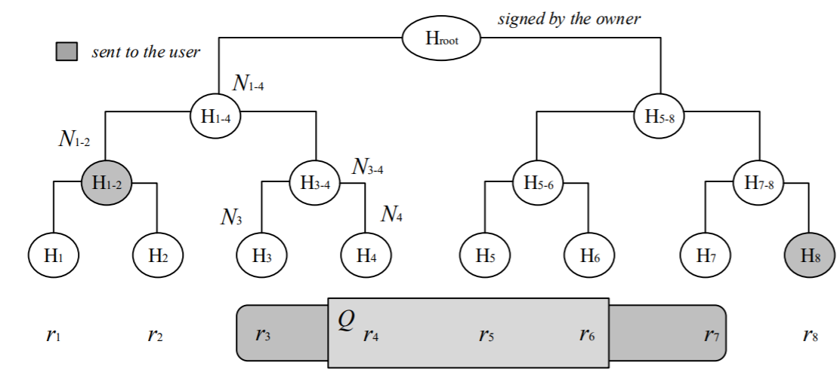
Merkle Hash Tree
Merkle hash tree
  Each internal node is a hash result of two children nodes
  If the range query result is {r₄, r₅, r₆}, the VO is {H_{root}, r₃, r₇, H₁₋₂, H₈}

Slide 27
Function Query [ICDE’16]
Function Query (FQ): map records into functions
  Univariate Linear Function r1(3,9) f1=3a+9
  Multivariate Linear Function r1(3,9) f1=3a+9b
  Multivariate High Degree Function r1(3,9) f1=3a+9b²
FQ type
  Range FQ: retrieve 10 < f(a,b) < 20
  Top-K FQ: retrieve top-3 f(a,b)
  KNN FQ : retrieve 3 nearest neighbors of f(a,b)

Slide 28
Interval Priority Order [ICDE’16]
a are b are weights in the ranking
The size of the signatures is bounded by O(n²)
Owner
f1=3a+9b r1(3,9)
f2=4a+5b r2(4,5)
f3=5a+3b r3(5,3)
top-1, (a=1,b=1)
Alice
Server
r1
Interval | List
a<2b | f1>f2>f3
2b<a<3b | f1>f3>f2
3b<a<4b | f3>f1>f2
a>4b | f3>f2>f1
Notes:
Most recently, ICDE16 proposed a solution to solve the similar problem, we first introduce their solution briefly. In ICDE 16, the owner defines the ranking function, the user can only determine the weights of the ranking function, which limits user’s query preference. For example, the owner first preprocesses the records and map them into functions, such as r1(3,9) is mapped into f1=3a+9b. The range of the user input is segmented into many intervals, the functions are sorted by the calculation results, and the signature chain technique is applied for every interval. Alice issues a top-1 query and gets result r1.
Check the interval:
Check the signature: consecutive
Check the boundary:
n2,加图

Slide 29
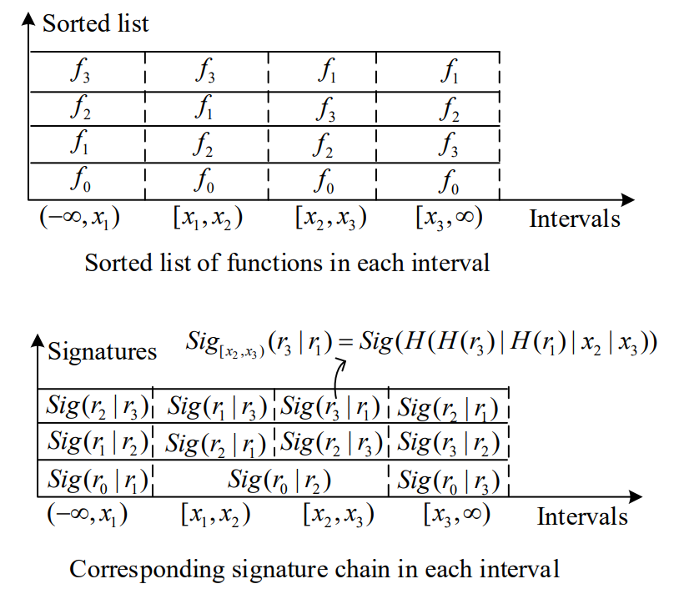
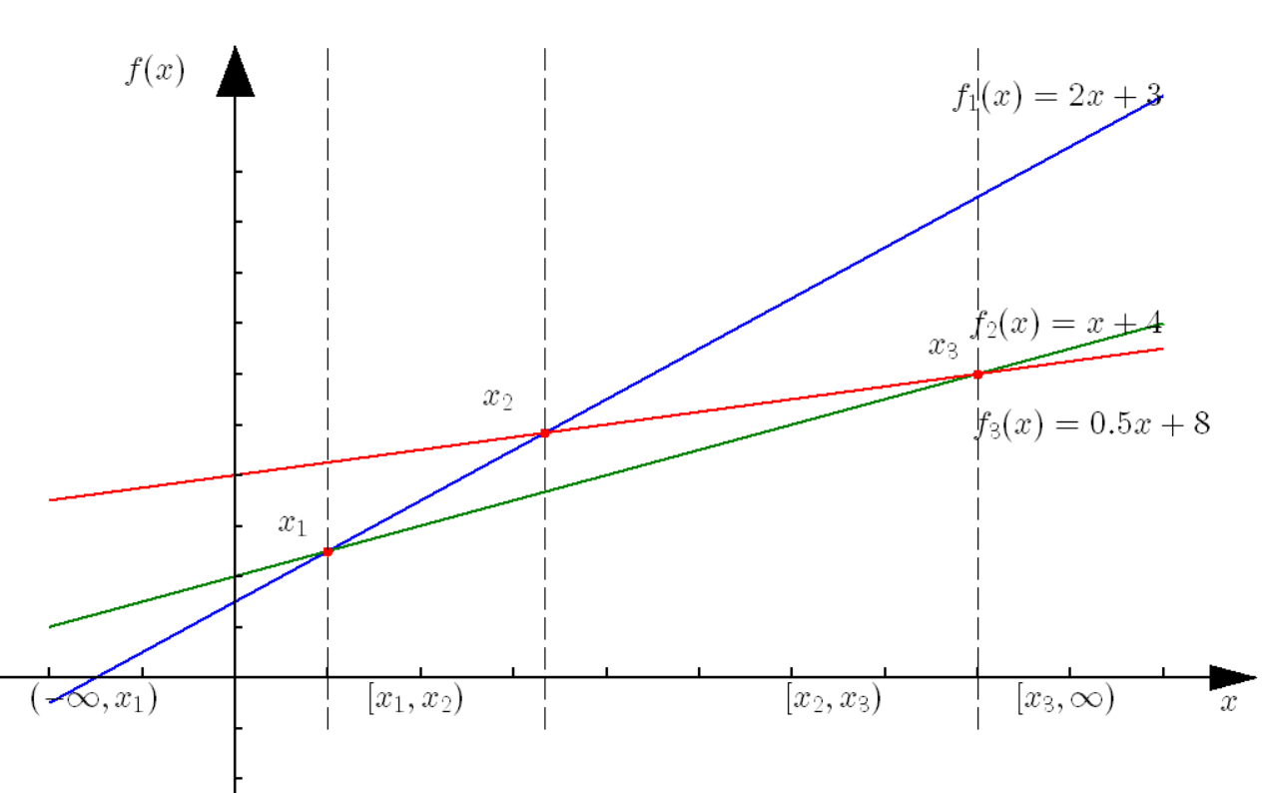
Univariate Linear Function

Slide 30
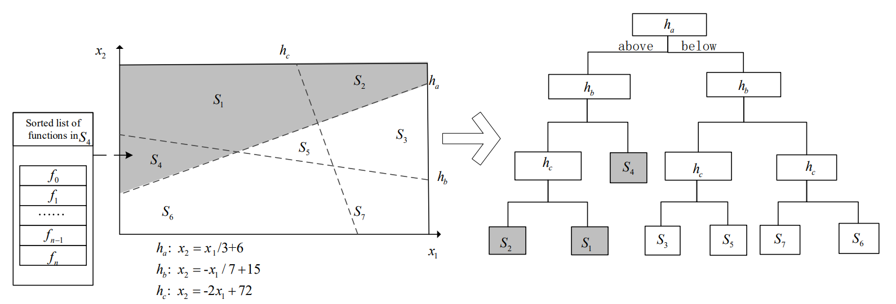
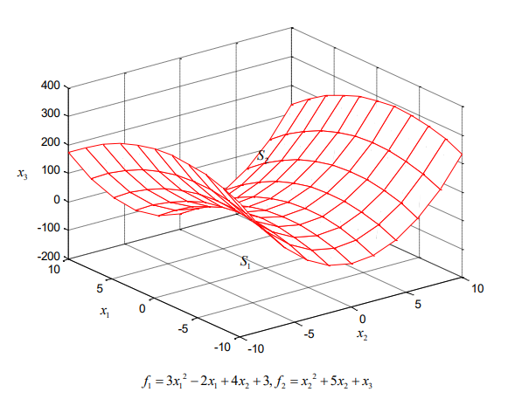
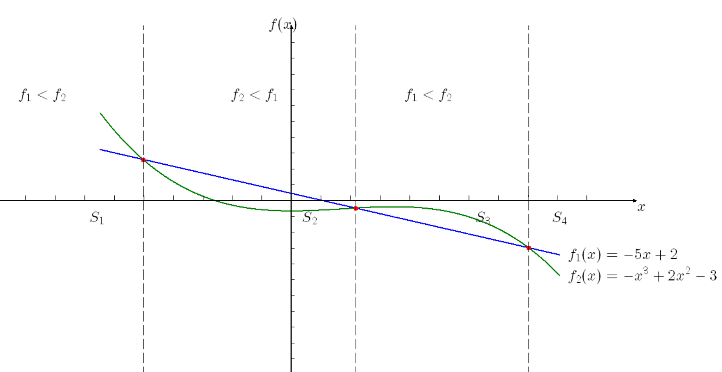
Multivariate Linear Function
Multivariate High Degree Function

Slide 31
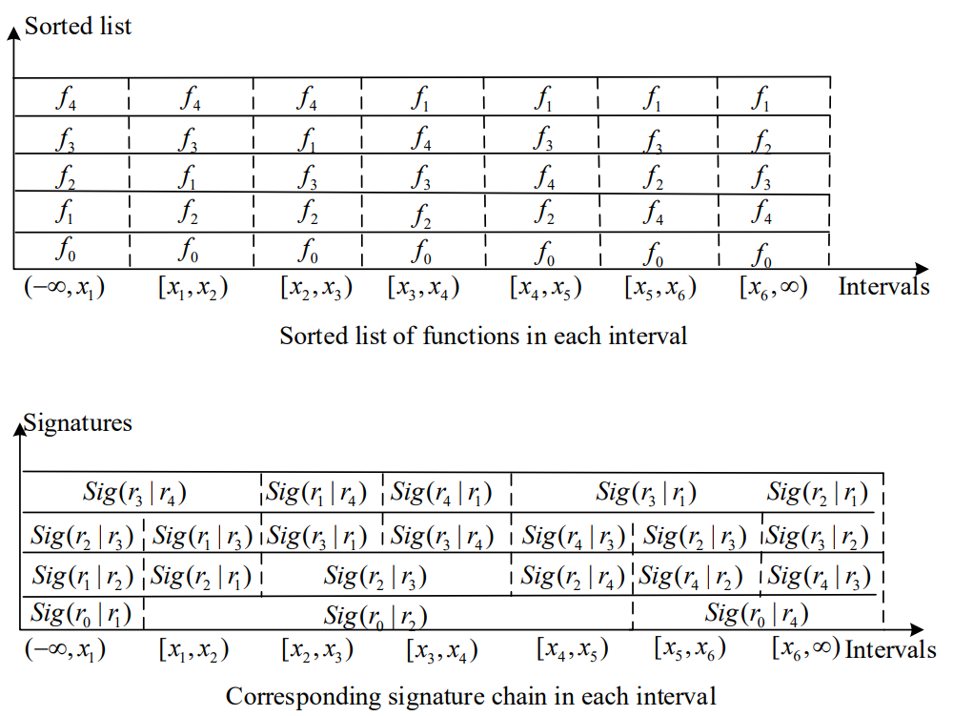
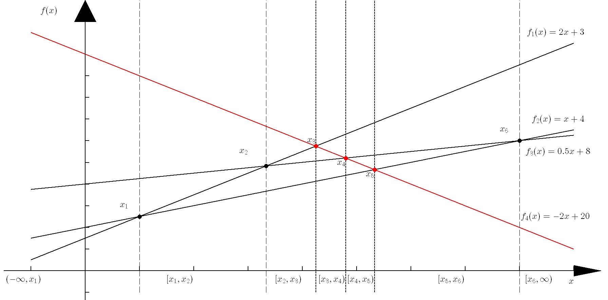
Data Update
Add a new function f₄, compute new intersections x₃,x₄,x_{5.}

Slide 32


Dimension Decomposition [IWQoS’18]
Deploy multiple signature chains on multiple dimensions
  Assuming each term in a polynomial function is positive
Each data chained with its neighbor in each dimension
  r11 is chained with its neighbor r21 and r12 in x and y dimensions
O($n$) signatures for n records, rather than O(n²)
Notes:
Firstly, we introduce our brief idea, each record is chained with its next neighbor in each dimension. there are 16 records, from r11 to r44, for example, r11 is chained with its neighbor r21 in x dimension and neighbor r12 in y dimension.
By checking the signature of r11, we ensure that no record is between r11 and r21 in x dimension, and no record is between r11 and r12 in y dimension.
By checking the boundary records, we ensure that all data satisfying the condition are included in results

Slide 33
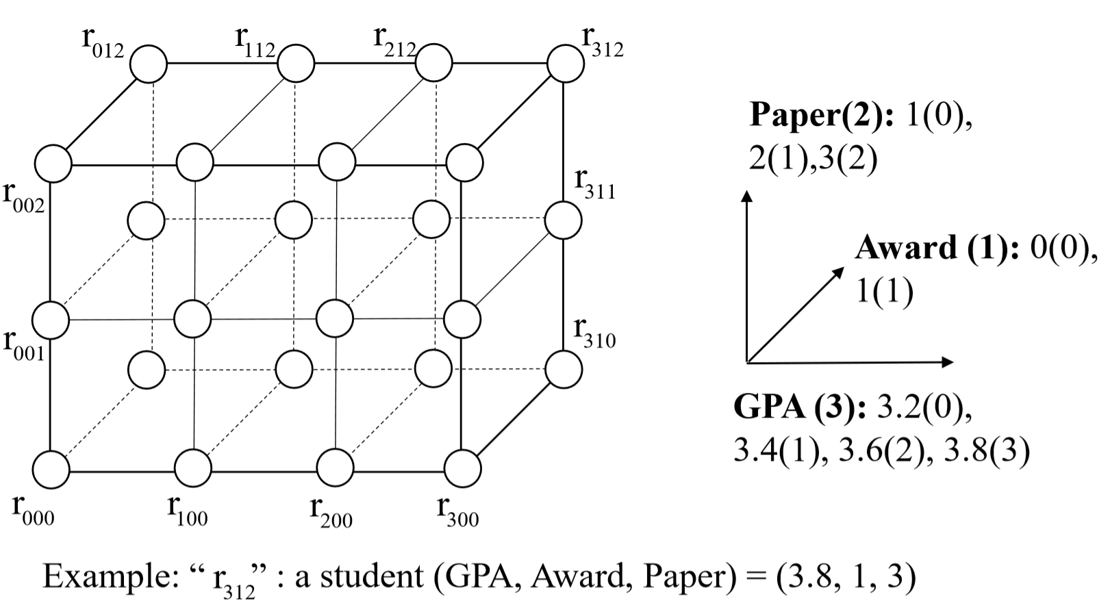
Example of MD Top-K Query
Find top-3 student ranking by Score= 5GPA+3Award+2Paper²
Notes:
Assume there is a three-dimensional dataset Student(GPA, Award, Paper); a user may want to retrieve the students whose rank scores are among the top k. For example, a student r312 is denoted as (3.8,1,3). The user may submit such a ranking function Score = 5GPA + 3Award + 2square Paper, where GPA, Award, Paper are the Student’s corresponding attribute values, (5, 3, 2) are the weights for (GPA, Award, Paper) respectively, and Paper has a degree up to 2.

Slide 34
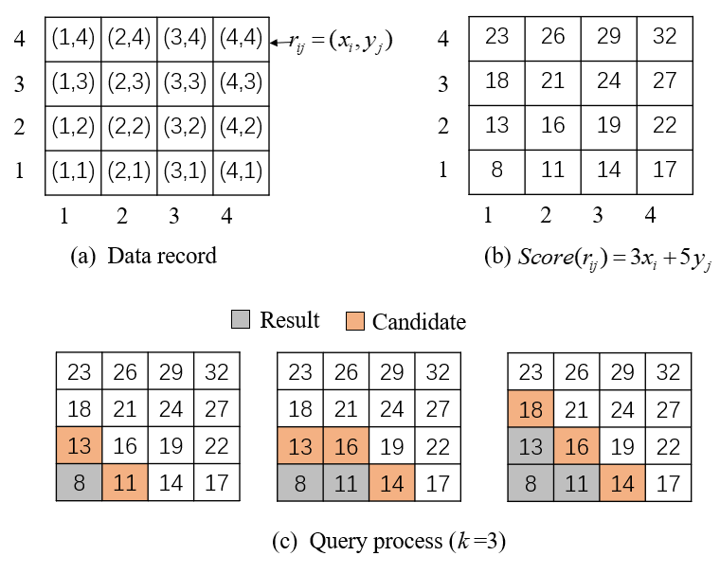
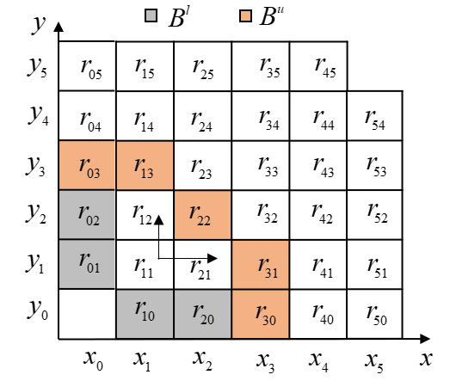
Query and VO
Notes:
The user submits a two-dimensional top-k query to the server, then the server outputs the query results. The server finds one result in each round, the results should be got in k rounds.
The data record is showed in Figure (a); each record is represented as rij = {xi , yj}, Figure (b) shows each record’s score using the ranking function Score(rij ) = 3xi + 5yj . Figure (c) shows the query process to find the top 3 smallest records. The server first sets r11 as the first result, then continues to find the smaller one r21 as the next result from r21 and r12, finally the server finds the query results R = {r11, r21, r12}.
查询

Slide 35
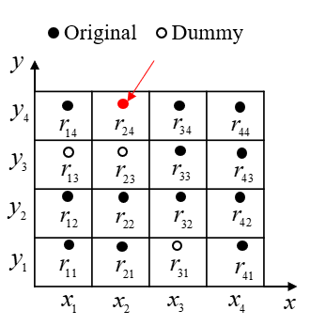
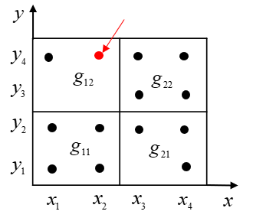
Data Insert
Sparse: dummy data in a grid
Dense: multiple data in a grid
Notes:
We now consider to partition the data space into larger grids. The partition contains two requirements: 1) each grid should have more than one data record. 2) the grid size is partitioned into equal sizes for simplicity. The Figure shows an example of partitioning the data records into larger grids, and the records are partitioned into four grids {g11, g12, g21, g22}, each grid may contain multiple records.

Slide 36

Data Update
If the owner wants to add a new record r_{a}, it should construct O($\sqrt[d]{n}$) new signatures.
r_{a}
Notes:
The data owner first finds the data record’s predecessors in each dimension, then generates a new signature for these predecessors.
For example, if the owner wants to modify r22, she first finds r22’s predecessors r12 and r21, then she generates signatures for {r22, r12, r21}.

Slide 37
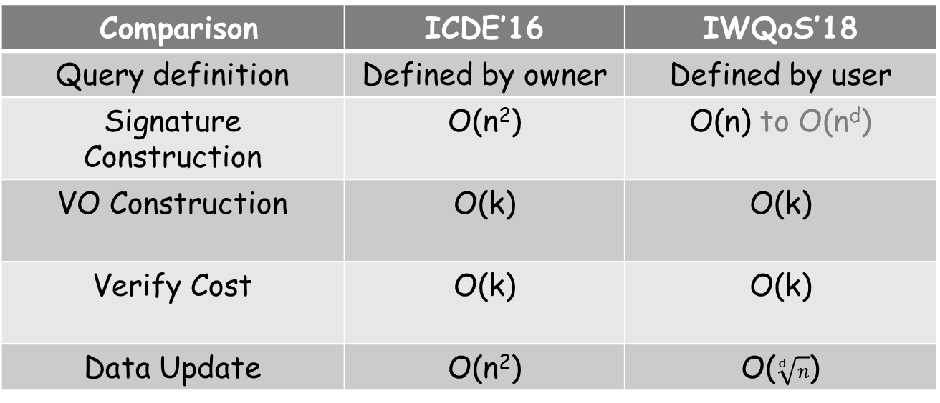
Analytical Study
n: number of records, k: number of query results
d: number of dimensions
Comparison | ICDE’16 | IWQoS’18
Query definition | Defined by owner | Defined by user
Signature Construction | O(n²) | O(n) to O(n^{d})
VO Construction | O(k) | O(k)
Verify Cost | O(k) | O(k)
Data Update | O(n²) | O($\sqrt[d]{n}$)
Notes:
We now give the performance analysis of our small grid solution with previous ICDE method from five aspect.
Firstly, our method’s query definition is defined by user, while ICDE is defined by owner, our method gives user more query preference. The cost at owner side of ICDE is O(square n), ours is O(n) to (the dth power of n), where n is the number of records. the cost at server and user side are O(k), where k is the number of results. The cost of data update is decreased from O(square n) to O(1).

Slide 38
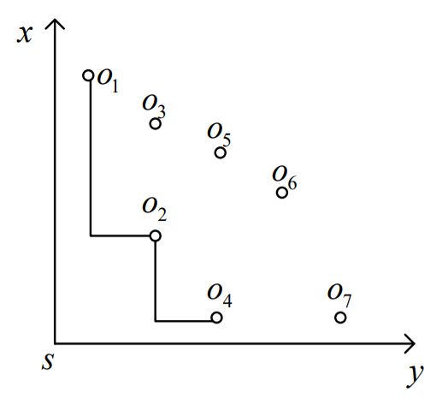
Skyline Query
(x, y) = (distance, price)
A skyline query retrieves all dominating nodes.
A point o_{i} dominates o_{j} if coordinate of o_{i} on each dimension is no larger than that of o_{j}.
Bind point with its skyline neighbors for different locations of s.
Notes:
Bind skyline with neighbors for different locations of s
Bind skyline point with its neighbors and different locations of s.
Bind point with its skyline neighbors for different locations of s.

Slide 39
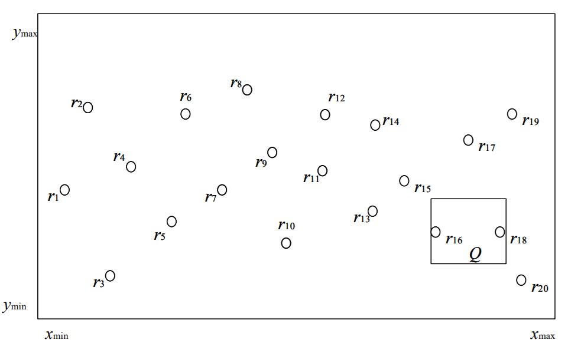
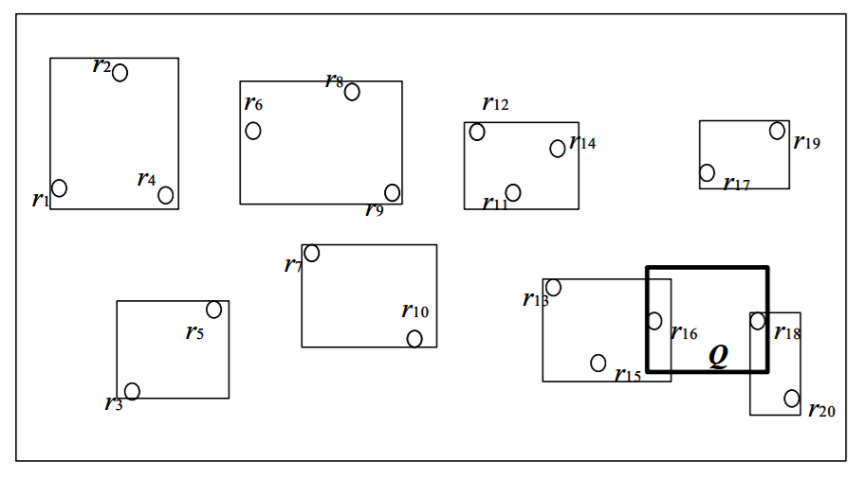
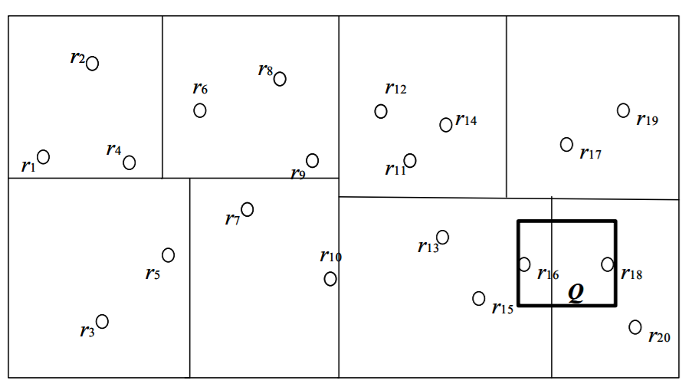
Spatial Query and Partition
KNN in 2-D
Partition
  Cluster
  Grid

Slide 40
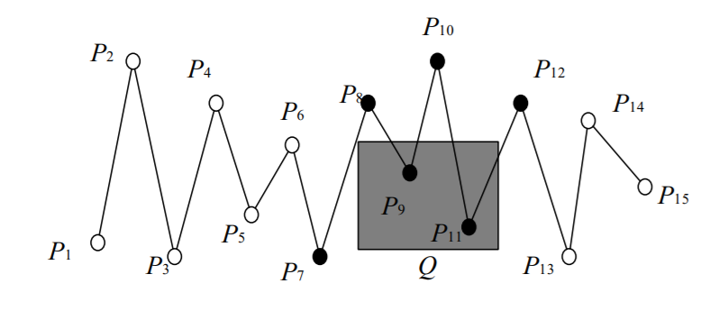
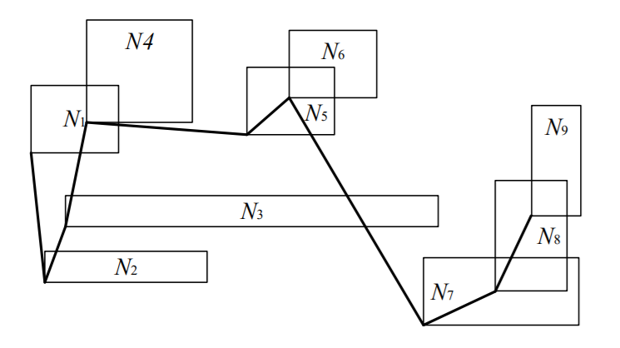
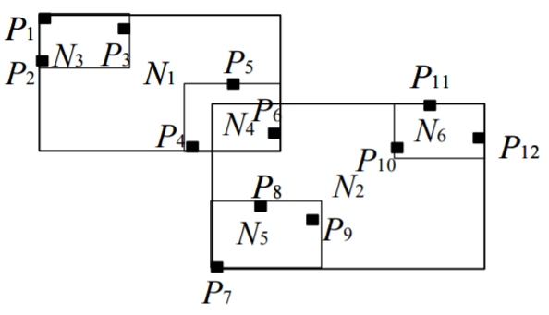
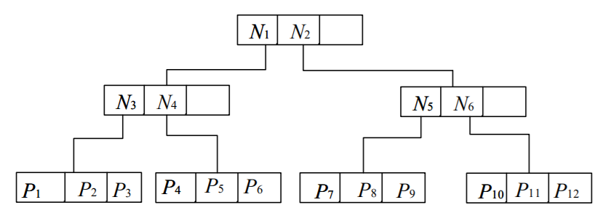
Different Bindings
Line of points and line of blocks (rectangles)
Hierarchical: blocks of blocks

Slide 41
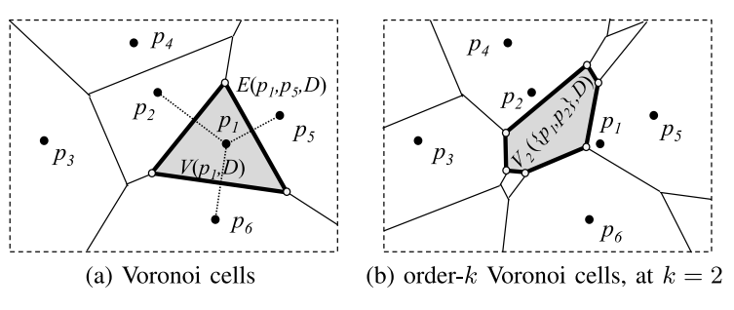
Moving KNN and Safe Region
The generator of V (p₁,D) is {p₂, p₅, p₆}.
The generator of V ({p₁, p₂}, D) is {p₃, p₄, p₅, p₆}.

Slide 42
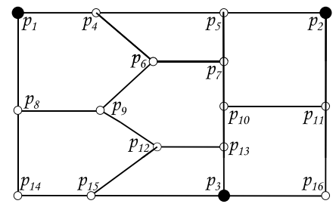
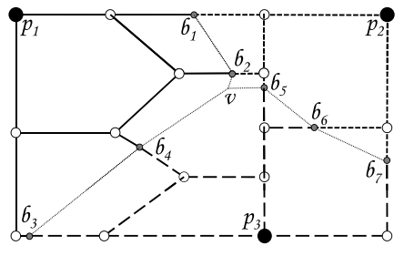
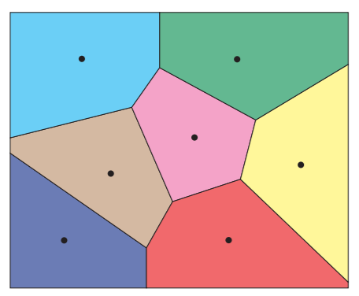
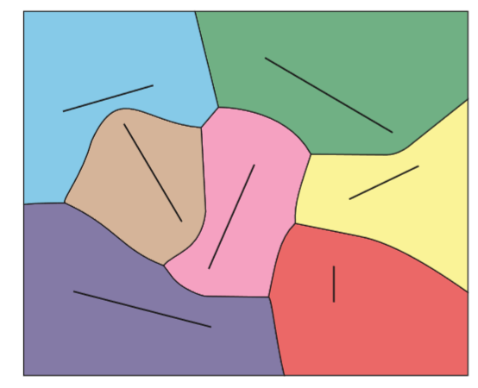
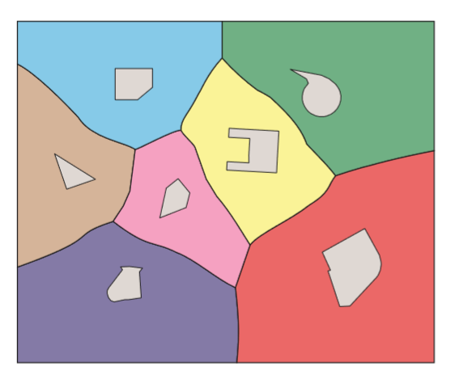
Looking Forward…
Voronoi diagrams for road networks
(a) Road network
(b) Network Voronoi diagram
A driver may issue a moving kNN query to obtain k nearest expressways or shopping mall

Slide 43
4. Conclusions
Cloud Service Provider (CSP)
  Trust: direct and indirect trust
  Suspicious: cryptography
    semi-trusted: searchable encryption
    untrusted: function queries in n-D space
On-going Projects
  Ambient key generation
  Moving target defense and intractability
  Security-performance trade-off

Slide 44

Future…
Fully secure, but probably too expensive
  Differential privacy
  Full homomorphic encryption
Decentralized trust
  Blockchain: each node is equally untrusted
  Idea: Index table stored in distributed ledger
  Extension: node’s trust score based on behavior
Science of Security (S & P 2017)

Slide 45
References
[Computing Survey’17] W. Jiang, G. Wang, M. Z. Alam Bhuiyan, and J. Wu, " Understanding Graph-based Trust Evaluation in Online Social Networks: Methodologies and Challenges," ACM Computing Surveys, Vol. 49, No. 1, 2016.
[CRYPTO’05] R. Ostrovsky and W. Skeith III, “Private Searching on Streaming Data,” Proc. of CRYPTO, 2005.
[JPDC’12] Q. Liu, C. C. Tan, J. Wu, and G. Wang, “Cooperative Private Searching in Clouds," Journal of Parallel and Distributed Computing, Vol. 72, No. 8, 2012, 1019-1031.
[JCST’17] Q. Liu, Y. Guo, J. Wu, and G. Wang," Effective Query Grouping Strategy in Clouds," Journal of Computer Science and Technology , Vol. 32, No. 3, 2017, 1231 - 1249.
[ICDE’16] G. Yang, Y. Cai, and Z. Hum, “Authentication of Function Queries,” Proc. of ICDE, 2916.
[IWQoS’18] X. Zhu, J. Wu, W. Chang, G. Wang, and Q. Liu," Authentication of Multi-dimensional Top-K Query on Untrusted Server," Proc. of IEEE/ACM IWQoS, 2018.

Slide 46
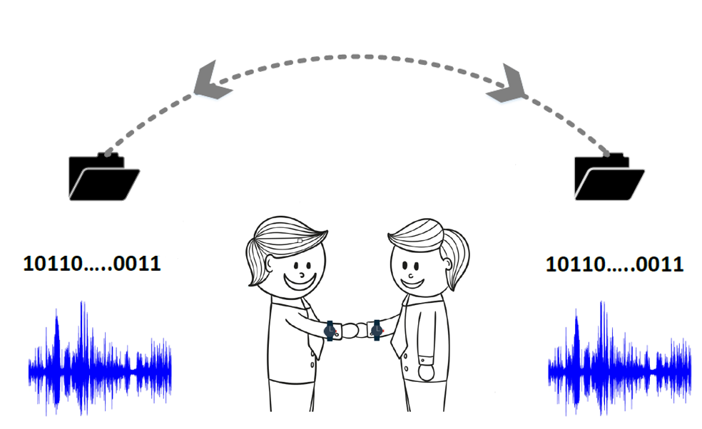
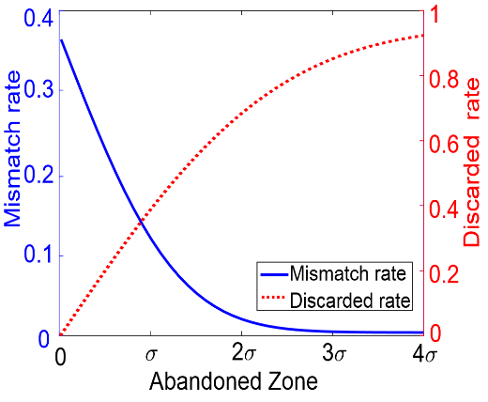
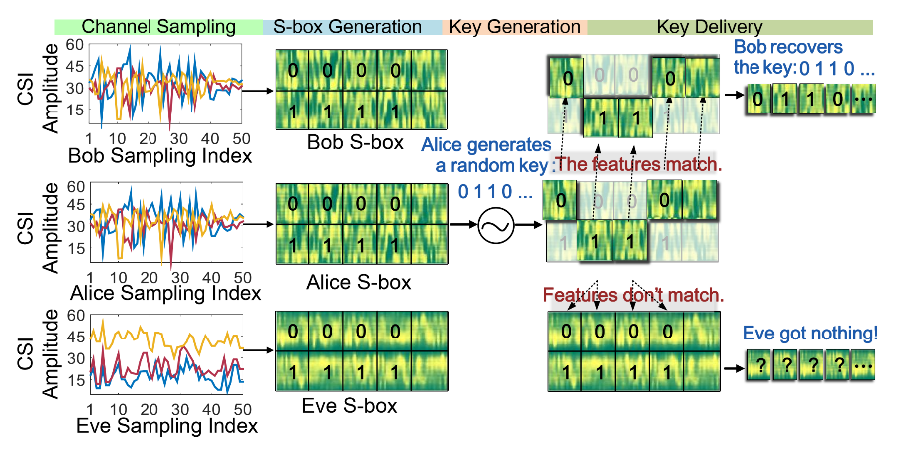
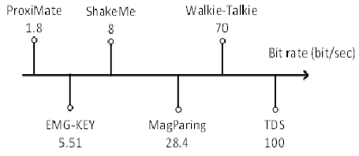
5. Samples: Ambient Key Generation
Random signals (which signal?)
  Shaking trajectory (ShakeMe, IUCC 2015)
  Gait (Walkie-Talkie, IPSN 2016)
  Magnetic signals (MagParing, TIFS 2016)
  Electromyography (EMG-KEY, Sensys 2016)
  Ambient wireless signals (ProxiMate, Mobisys 2011)
  Channel state information (TDS, CCS 2016)
Quantization
  Performance and security trade-offs
  Usability
Notes:
ShakeMe: acceleration; Shaking two devices together
Walkie-Talkie: acceleration; Two devices on the same person should have high correlation
MagParing: Two devices should receive similar magnetic signals.
EMG-KEY: Two devices touch the user’s arm should observe Electromyography signals.
ProxiMate uses television broadcast band between 512 and 608 MHz. Two devices close to each other should receive the same signal
TDS uses channel state information (CSI) provided by Wi-Fi signals. Two devices close to each other should receive the same signal

Slide 47
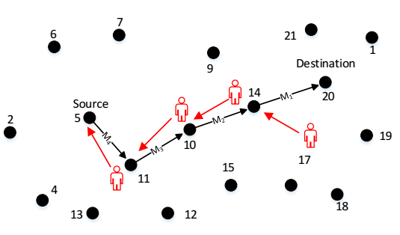
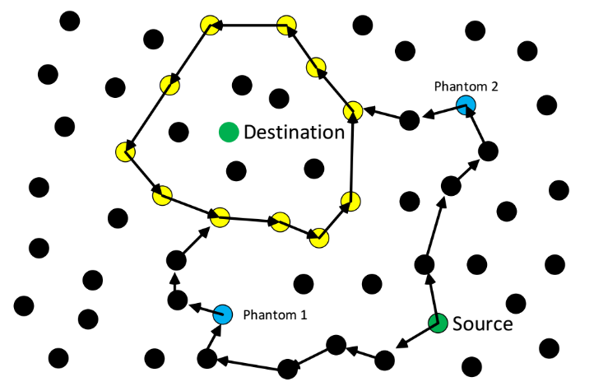
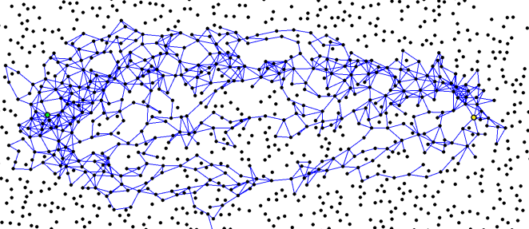
Moving Target Defense
Source and destination location privacy
(Panda-hunter game)
Phantom and Probabilistic Routing

Slide 48
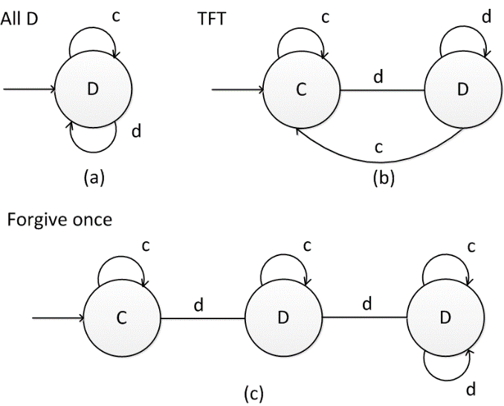
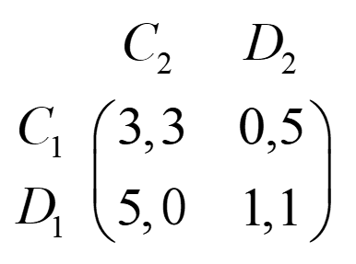
Intractability: Adversarial Model
It is unclear how smart an adversary can be
  Deep learning vs. maintaining security and privacy
  An adversary can use a sophisticated ML method
Repeated prisoner’s dilemma
  Cooperate (C) or Defect (D)
  Payoff metrics
Genetic algorithm: mutation and crossover
  148 bits with 16 recent states: chromosomes

Slide 49
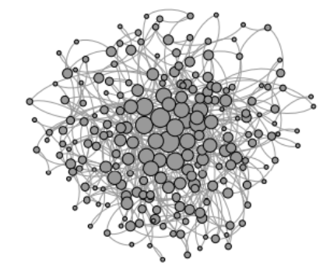

Self-Organizing Solutions
Hierarchical military command chains
Dynamic connected dominating set (CDS) rotation

Slide 50


Performance-Security Tradeoff
Dependability includes security
  Mean time between security incidents (MTBSI)
  Mean time to incident discovery (MTTID)
  Mean time to incident recovery (MTTIR)
Performability: work completed before the next security breach
Degradation
  B₁: Level 1 breach, 1,000 hrs
  B₂: Level 4 breach, 5 hrs

Slide 51

Questions
www.cis.temple.edu/~wu

