Slide 1
STPer: Task Scheduling and Traffic Routing with Spatiotemporal Dynamic Perception in Green CPNs
Authors: Xiaoyao Huang, Remington R. Liu, Jie Wu
Affiliation: China Telecom
Presented by Xiaoyao Huang

Slide 2
Motivation: Why Computing Power Networks Need New Scheduling?
Compute-intensive Workloads Rapidly Increase
AI models, video rendering, and other compute-intensive applications are growing exponentially, creating unprecedented demand for efficient resource allocation.
CPN Integrates Cloud-Edge-Device Resources
Computing Power Networks unify cloud, edge, and device computing into a single network, enabling seamless resource sharing across distributed environments.
Green CPN Reduces Cost via Hydropower Nodes
Green CPN leverages hydropower to provide cost-effective and eco-friendly computing, significantly reducing operational costs and carbon footprint.
✨Key Challenge: Dual Spatiotemporal Dynamics
Task arrival variation (work–rest cycles)
Energy price & green power fluctuation
>>>Traditional optimization cannot handle real-time, large-scale dynamic systems.

Slide 3



Problem Definition
✨Goal : Maximize Platform Profit Under Dynamic Conditions
Profit = task revenue − energy & computation cost. The goal is to optimize this balance while meeting service quality requirements.
Joint Decision: Scheduling & Routing
Task scheduling → select computing node
Traffic routing → select network path
Formulated as NP-hard INLP
The problem is modeled as an Integer Nonlinear Programming (INLP) problem with constraints on throughput, delay, and routing validity, which is computationally intractable for large-scale systems.

Slide 4
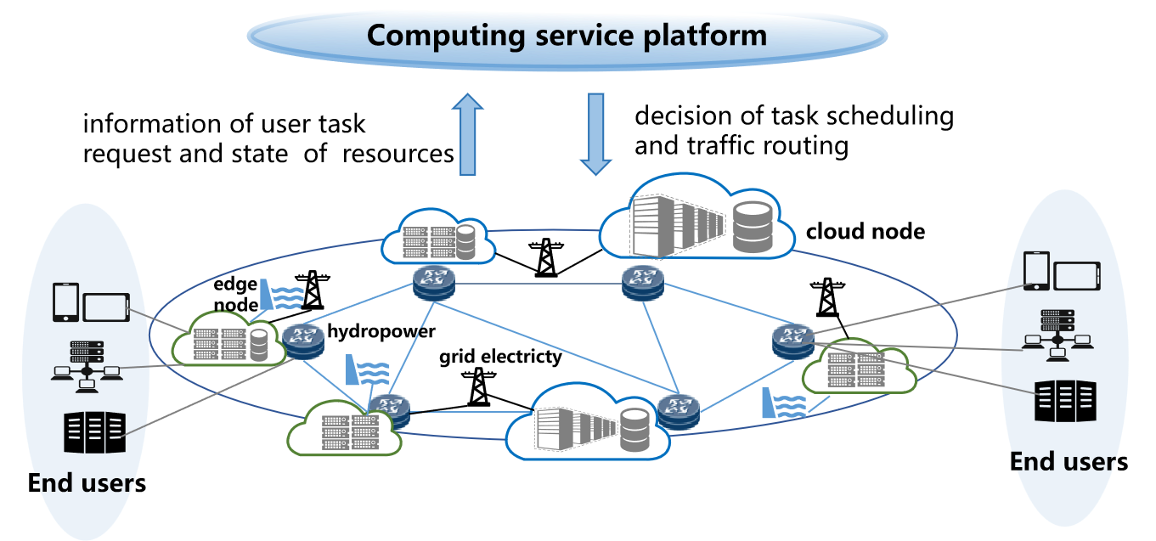
System Architecture
Heterogeneous nodes: cloud & edge, with different computing power.
Green energy (hydropower) provides dynamic price discounts.
Users submit tasks with latency constraints.
Green Computing Power Network Architecture
Dual spatiotemporal dynamics shown across nodes & workloads.

Slide 5
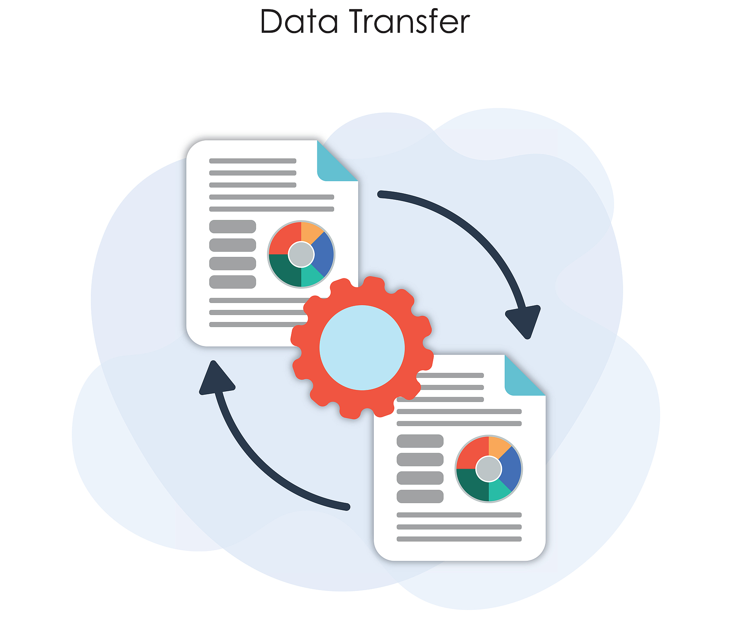

Task & Delay Model
Delay Components in Task Completion
Transmission delay: sum of link transmission + switching delay.
Dispatching offset: avoid link conflicts by scheduling later slots.
Computation delay: workload / node computing power.
Revenue Decreases with Longer Delay
Task revenue follows an exponential decay function as delay increases beyond user-specified thresholds, creating a direct incentive for minimizing latency.

Slide 6
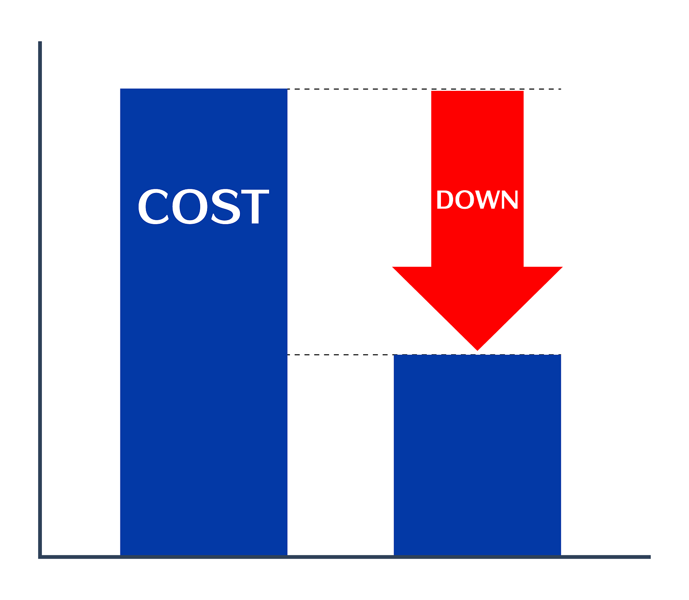

Energy Cost Model
Dynamic Energy Cost Structure
Energy cost depends on electricity price i_{e}(t).
Hydropower discount α(t):
α=0 → full hydropower supply
α=1 → full grid electricity
Computing Cost Factors
Computing cost:
  Power consumption ∝ f²
  Time-related cost ∝ workload / f

Slide 7
Optimization Challenges
High-Dimensional Decision Space
01
Binary variables multiply across task routing, time slots, and network edges, creating an exponentially large solution space that is computationally infeasible.
Dynamic Correlations Hard to Capture
02
Static optimization methods cannot model the complex temporal dependencies between task arrival patterns and resource availability.
Need for Scalable & Adaptive Solution
03
Real-time decision-making in CPN requires a solution that can adapt to changing conditions. Deep reinforcement learning provides the necessary scalability and adaptability.

Slide 8
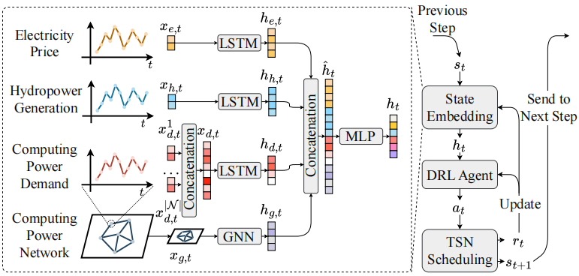
STPer Framework Overview
Graph Neural Network (GNN) Function
GNN captures spatial relationships among computing nodes.
Long Short - Term Memory (LSTM) Application
LSTM models temporal dynamics of energy & task demand.
Proximal Policy Optimization (PPO) Outcome
PPO reinforcement learning outputs task scheduling decisions.
Traffic Routing Solution
GNN + LSTM + PPO for Spatiotemporal Dynamic Perception
Traffic routing is solved by optimized mathematical module.

Slide 9
Spatial Modeling via GNN
01
Graph Structure Representation
Green CPN is abstracted as an undirected graph G=(E,N), where nodes represent computing resources/users and edges represent network links.
02
Graph Convolution Operation
GCN layers aggregate neighbor features through multiple convolutions: H(l+1)=σ(D⁻¹AD⁻¹H(l)W), capturing spatial correlations across the network.
03
Spatial Feature Output
Inputs node workload and computing power. Outputs node-level spatial embeddings hg(t) that encode resource distribution patterns and network topology.

Slide 10

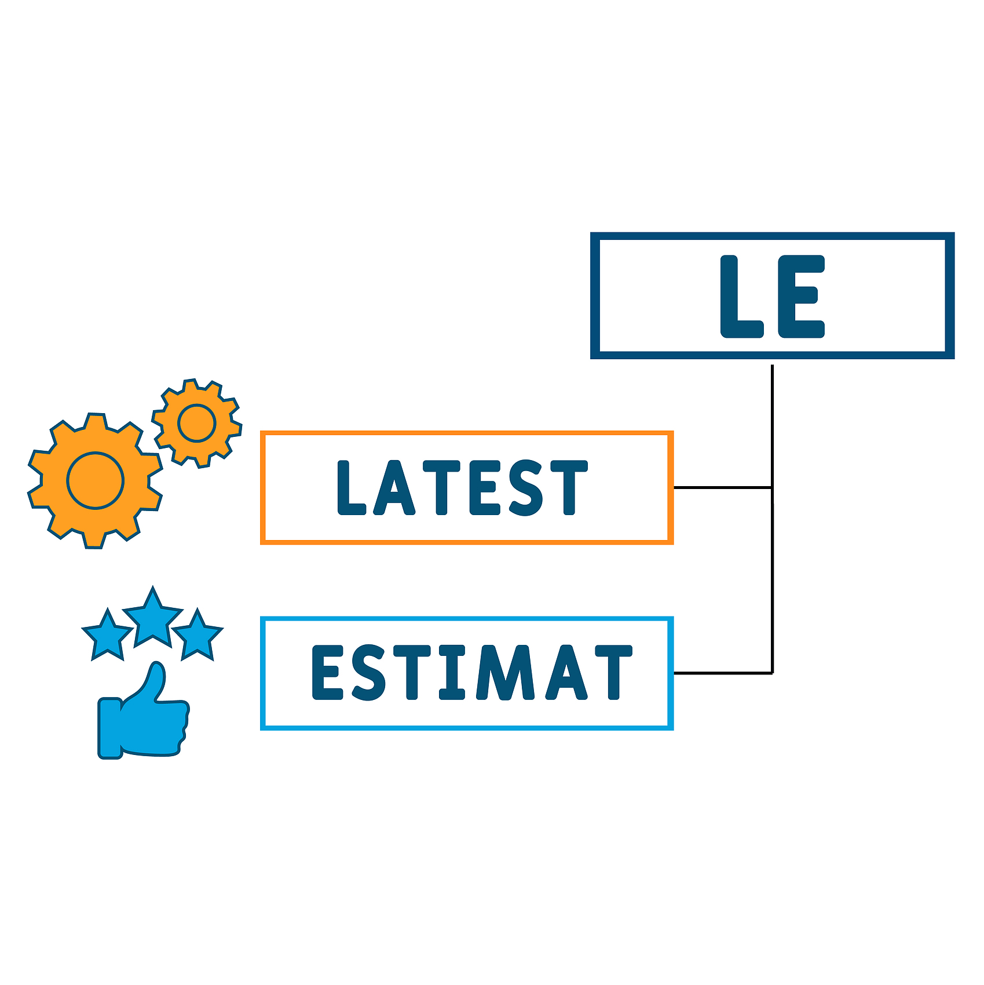

Temporal Modeling via LSTM
Time Series Inputs
Electricity price i_{e}(t), hydropower generation α(t), and task/workload sequence m(t) serve as inputs to capture temporal dynamics.
Multivariate Temporal Dependency
Three independent LSTM branches process different time series, modeling long-term dependencies of electricity prices, green energy supply, and task loads.
Temporal Feature Output
Outputs h_{i}(t), h_{α}(t), h_{r}(t) representing temporal patterns of energy prices, green power availability, and task demand respectively.

Slide 11
Feature Fusion & Policy Network
Spatiotemporal Feature Fusion
Policy Network Architecture
State Representation
Combine spatial + temporal features: h_{f}(t) = h_{g}(t) ∥ h_{i}(t) ∥ h_{α}(t) ∥ h_{r}(t). MLP transforms fused features into policy representation.
Fused features are fed into PPO's policy and value networks, which learn to map environmental states to optimal scheduling decisions.
The state vector includes node computing power, energy prices, task queue lengths, and network link status, providing a comprehensive view of the system.

Slide 12

PPO Reinforcement Learning
State Space Definition
Action Space Design
State includes spatiotemporal environment features: node status, energy prices, task queues, and network conditions.
Action = choose computing node for each task. The action space is defined as the set of all possible task-node assignments.
Reward Function Construction
PPO Advantages
Reward = task revenue − computation/energy cost. The reward function directly aligns with the platform's profit maximization goal.
Clipped policy updates ensure stability. Generalized Advantage Estimation reduces variance. Suitable for large-scale, online CPN scheduling.

Slide 13


Traffic Routing Optimization
Iterative Routing Algorithm After Scheduling
Given task → node assignment from RL.
Routing solved via fractional programming → quadratic transform.
Auxiliary variable y_{u,n} has closed form:
  y* = sqrt(benefit / delay)
Remaining routing solved via ILP (CVX).
Ensures feasible, non-loop, delay-bounded routing.

Slide 14
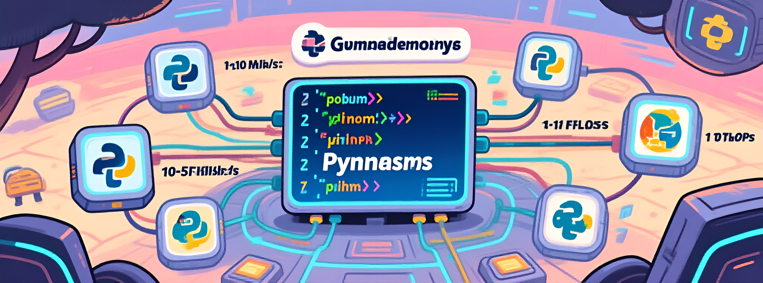
Experimental Setup
Real-world Datasets
Simulation Environment
Baseline Algorithms
Electricity market prices
Hydropower generation curves
Python-based simulation with Gymnasium for RL environment.
Node computing capacity: 1-10 TFLOPs.
Link bandwidth: 10-50 Mb/s.
STPer (full model),
STPer-L (no GNN),
STPer-M (no GNN/LSTM),
Random (random scheduling/routing)

Slide 15
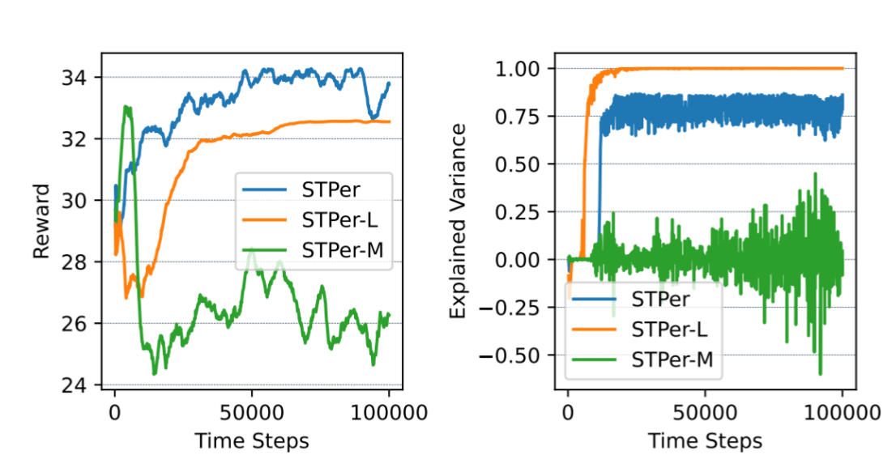
Training Performance
STPer Achieves Fast & Stable Convergence
STPer has the highest cumulative reward.
STPer-L has high explained variance (overfitting).
GNN + LSTM improves representation → better generalization.

Slide 16
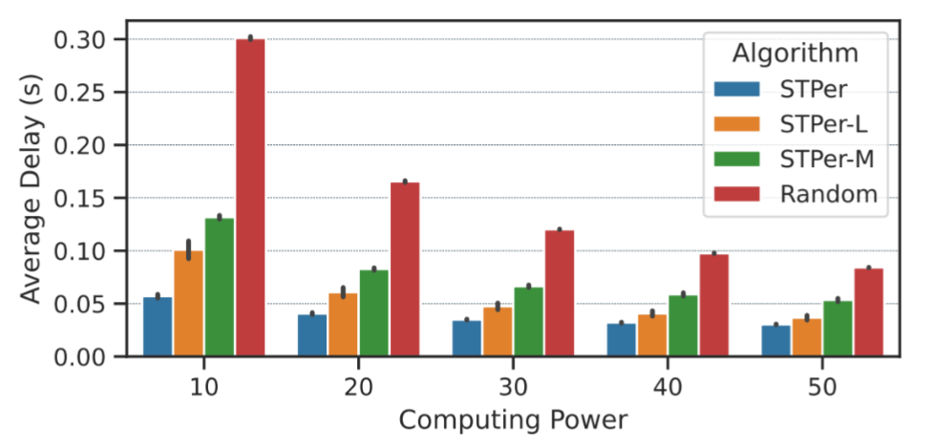
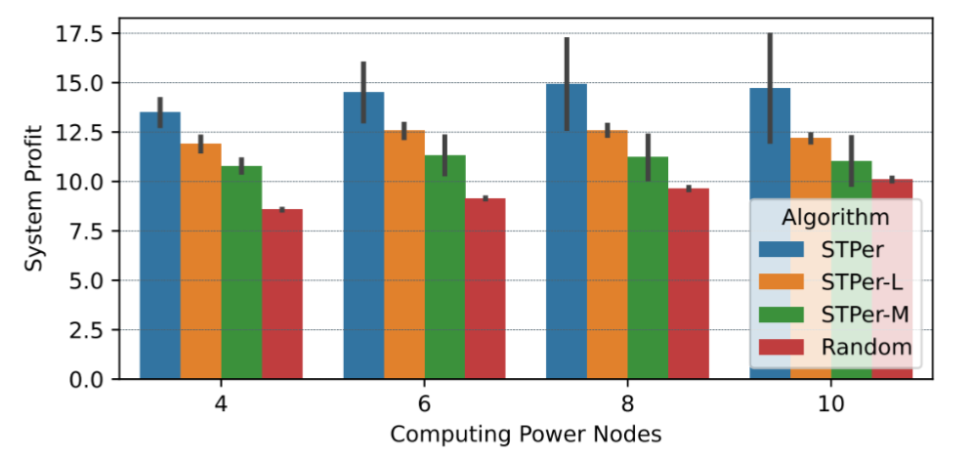
Delay & Profit vs Computing Power
Increasing Node Power Reduces Delay
All methods show decreasing delay as computing power increases.
STPer achieves the lowest average delay across all settings.
STPer-M only slightly better than random → proves spatiotemporal necessity.
STPer Maximizes Profit Across All Settings
Higher computing power → higher profit (delay ↓).
STPer consistently outperforms baselines.
Demonstrates joint scheduling-routing advantage.

Slide 17
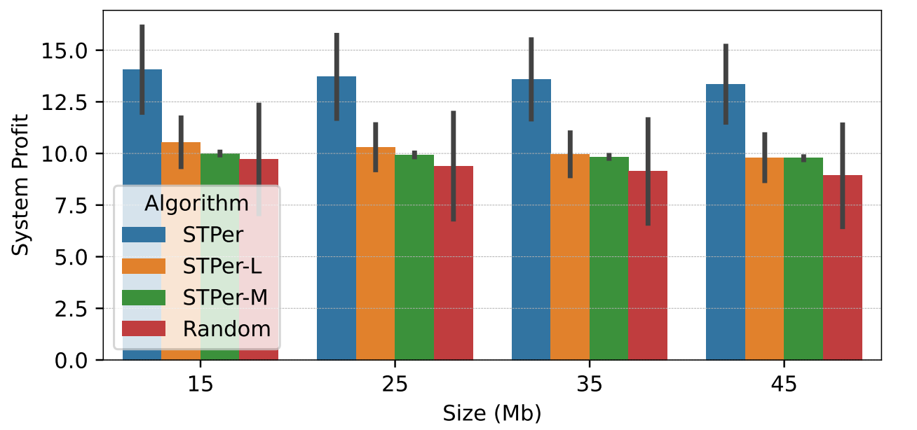
Profit vs Data Size
Profit Trend with Data Size
Larger task size increases transmission delay, leading to lower profit for all methods. The trend is consistent across data sizes from 15 to 45 Mb.
Algorithm Robustness
STPer remains most robust under heavy traffic, maintaining higher profits than baselines even with large data sizes. The spatiotemporal modeling helps adapt to varying workloads.

Slide 18
Conclusion
01
First Joint Optimization of Scheduling & Routing
STPer is the first comprehensive solution addressing dual spatiotemporal dynamics in green CPNs, integrating scheduling and routing decisions.
02
Novel STPer Framework
The framework combines GNN spatial perception, LSTM temporal modeling, and PPO reinforcement learning to handle dynamic environments effectively.
03
Significant Performance Improvements
STPer achieves substantial gains in delay reduction and profit maximization compared to state-of-the-art methods, demonstrating practical value for real-world green CPNs.

Slide 19
Q&A
Thank you—questions are welcome.

