Slide 1
Distributed Network Coding Based Opportunistic Routing for Multicast
Abdallah Khreishah, Issa Khalil, and Jie Wu

Slide 2
Enhancing the Performance of Wireless Networks
Why to study the problem?
Wireless multihop networks are becoming integral part of our lives. (Mesh networks, sensor networks, etc..)
The unique features of these networks.
Interference.
Lossy behavior.
Broadcast nature.
Correlation among the links.

Slide 3
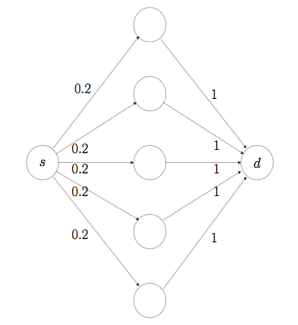
Opportunistic Routing

Slide 4
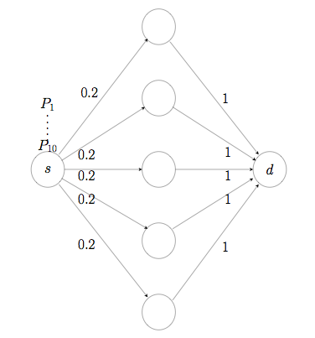
Opportunistic Routing

Slide 5
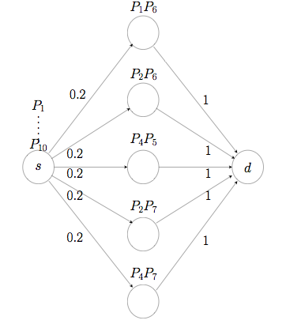
Opportunistic Routing

Slide 6
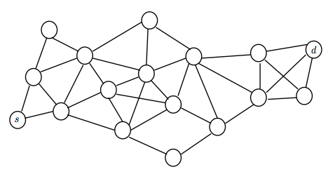
Global Scheduling

Slide 7
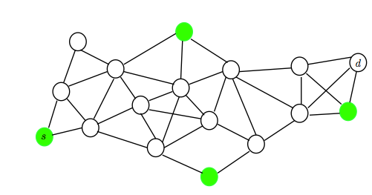
Global Scheduling

Slide 8
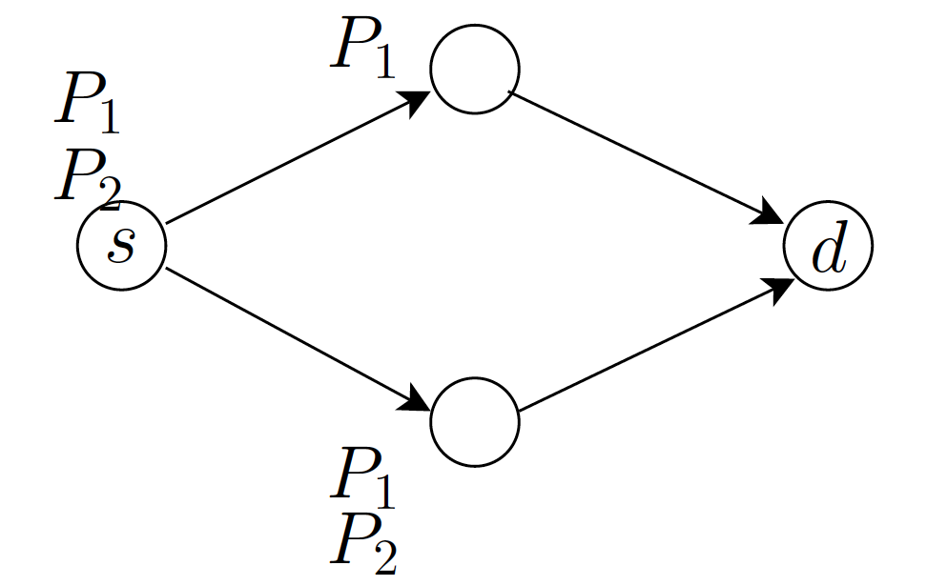
Network Coding

Slide 9
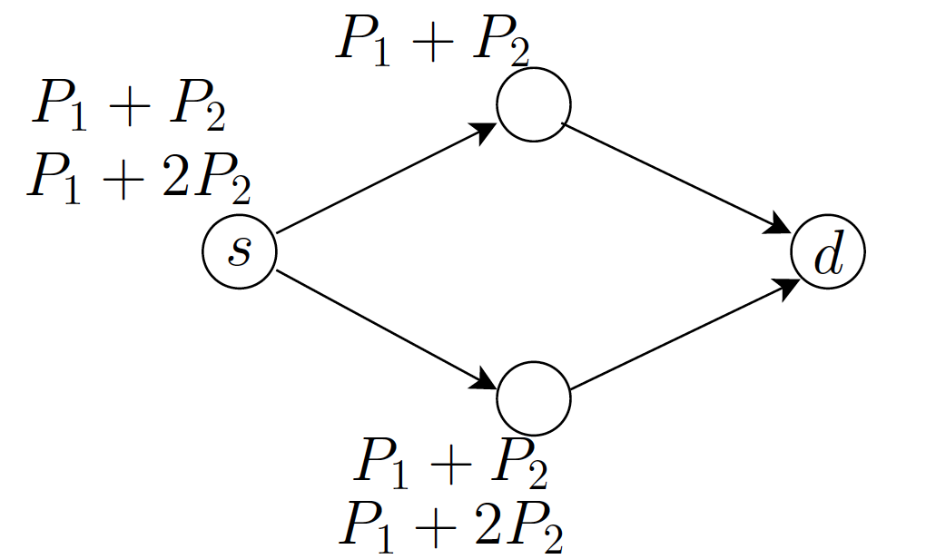
Network Coding

Slide 10
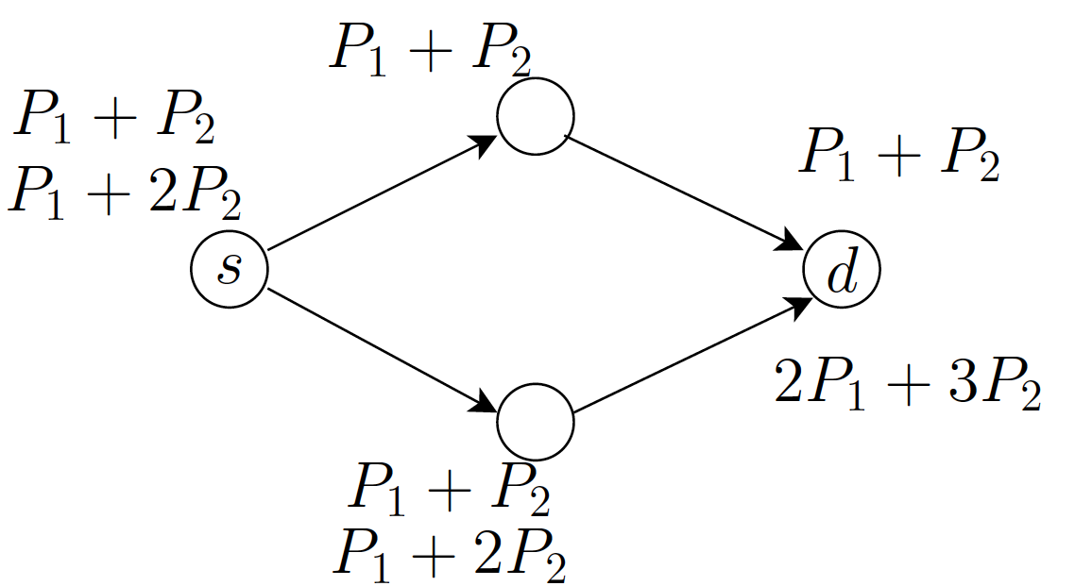
From Which & How many to How many.

Slide 11
How many packets should each node forward?
Assuming independent links: [Chachulski et al., 2007].
Depends on many factors:
The Loss rate of the links.
The fraction of time a node is scheduled.
The correlation among the links. [Srinivasan et al., 2010]

Slide 12
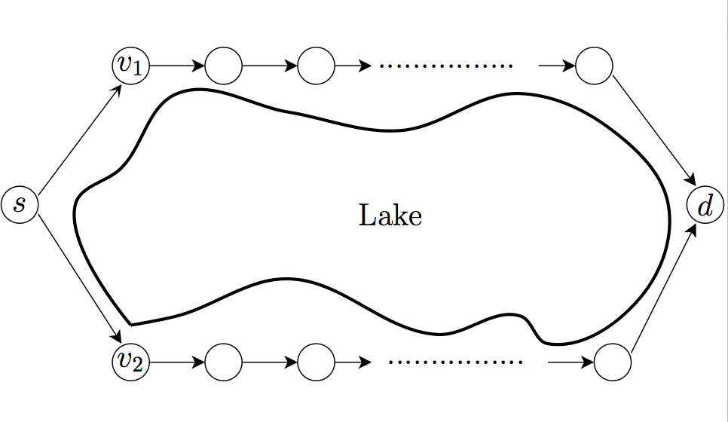
Correlation example

Slide 13
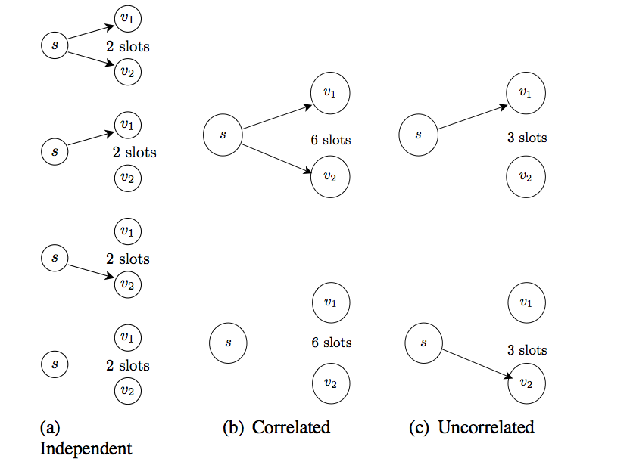
Cont.

Slide 14
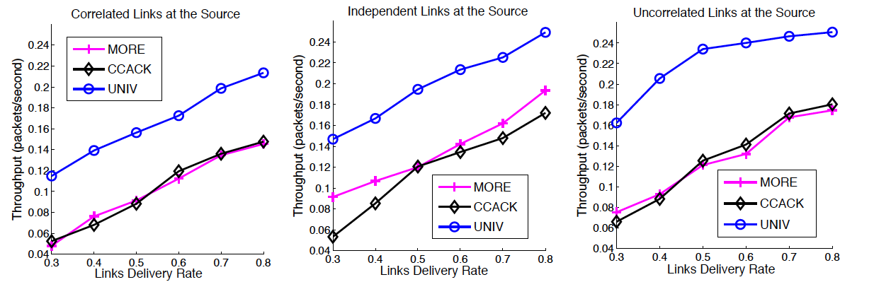
Preliminary evaluation

Slide 15
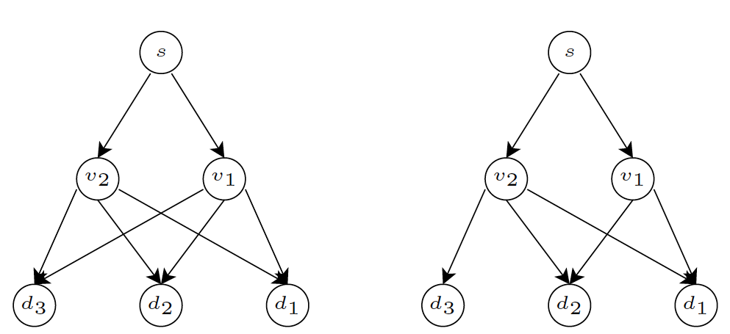
Challenges for Multicast

Slide 16
Settings

Slide 17
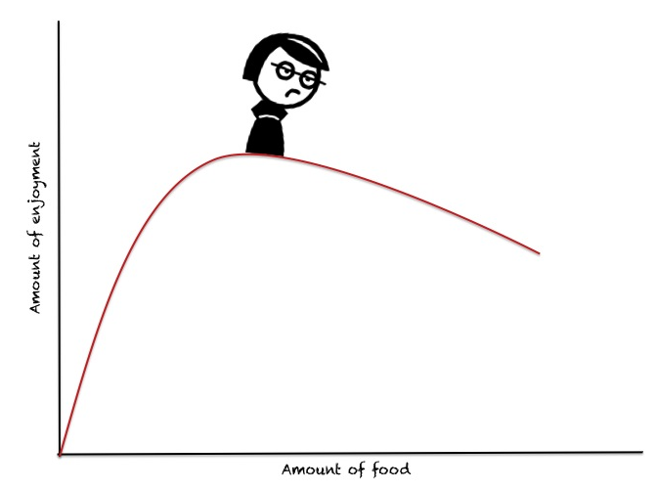
Law of Diminishing Returns

Slide 18
Formulation

Slide 19
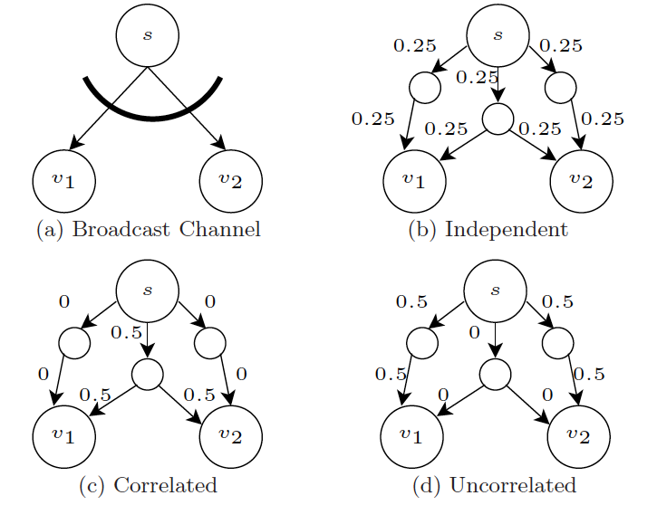
Wireless to Wireline Mapping

Slide 20
Optimality

Slide 21
The Lagrange

Slide 22
The Lagrange

Slide 23
Distributed algorithm

Slide 24
Virtual Queues Updates

Slide 25
Practical problems
If a node is scheduled to send packets, from which session it should send?
When and how to assign credits to next-hop nodes?

Slide 26
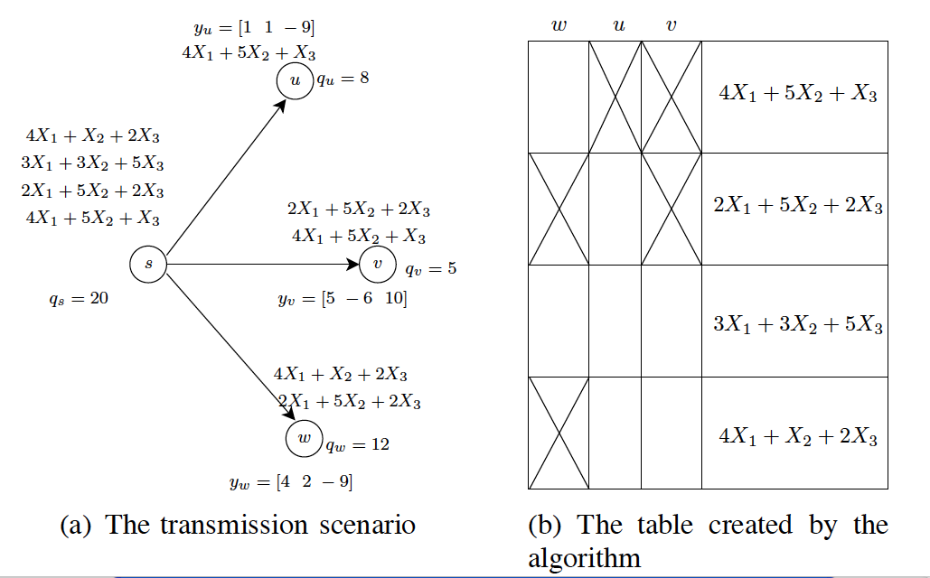
Coded-feedback

Slide 27
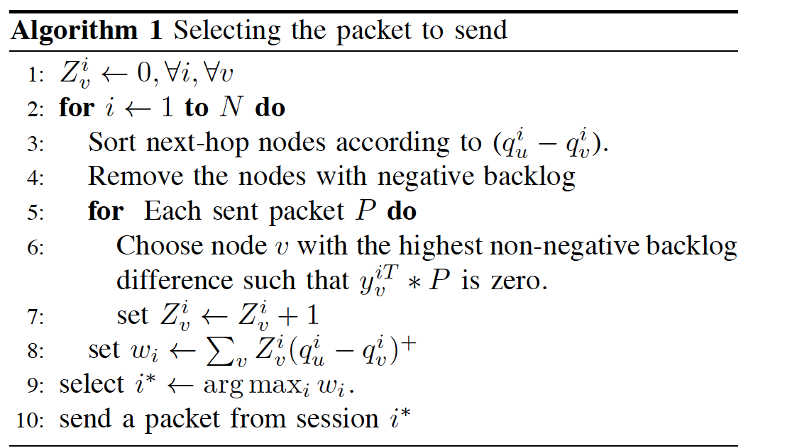
Deciding the packet to send

Slide 28
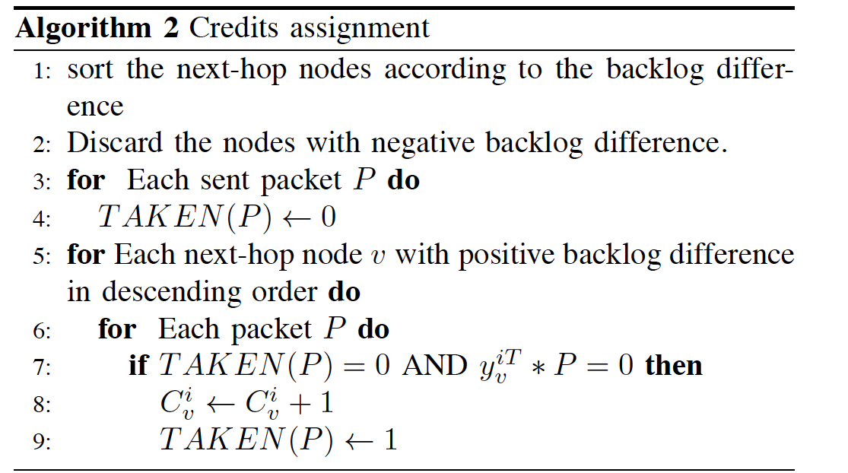
Credit assignment

Slide 29
Convergence

Slide 30
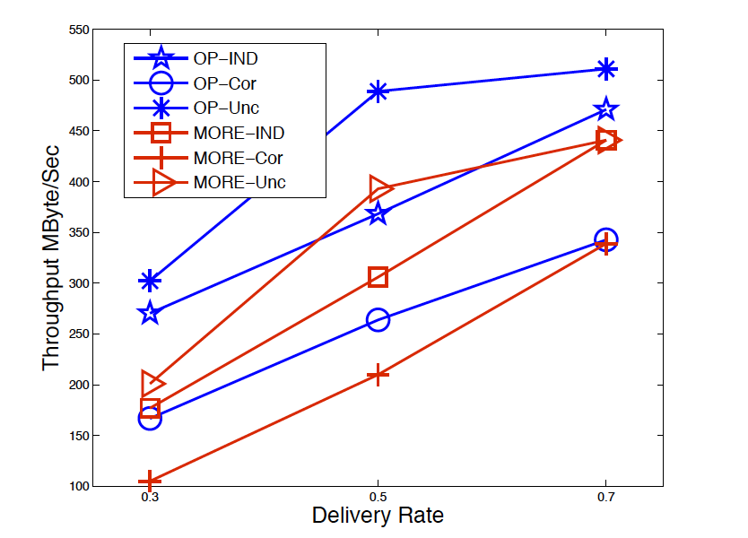

Slide 31
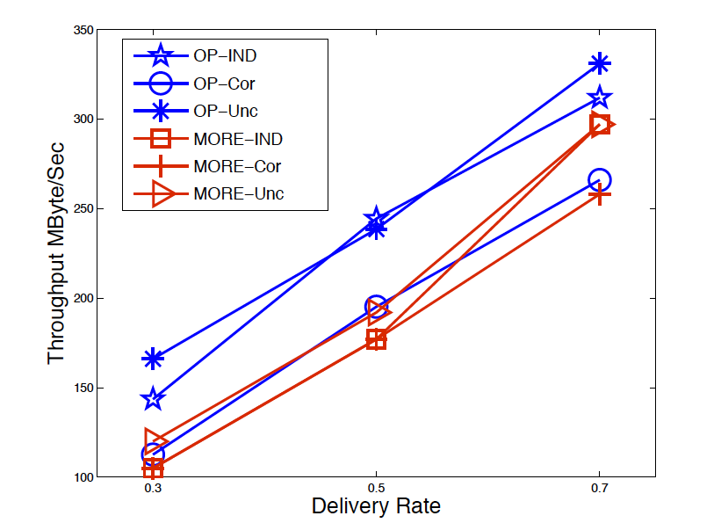

Slide 32
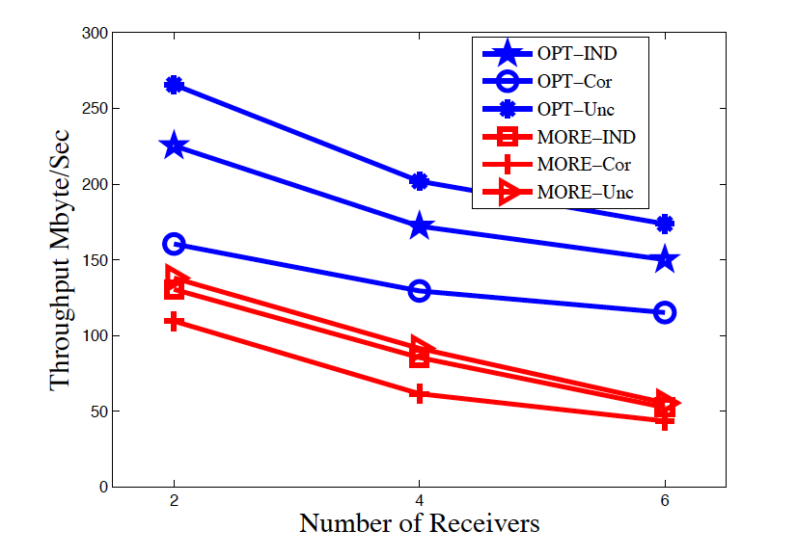
Multicast results

Slide 33
Conclusion
A simple distributed algorithm that achieves the optimal unicast rate in wireless networks.
It is a combination of:
Opportunistic routing.
Intrasession network coding.
Convex optimization.
Coded-feedback.
Arbitrary delivery rates and correlations among the links.

Slide 34
Some Future Directions
Studying Intersession Network Coding.
Studying Video Multicast with Multi-resolution Coding (MRC) or Layered Coding.
How to optimally construct the multicast tree?

Slide 35
Thanks
Questions?

