Slide 1
Boundary Helps: Efficient Routing Protocol using Directional Antennas in Cognitive Radio Networks
Ying Dai and Jie Wu
Computer and Information Sciences
^{Temple University}

Slide 2
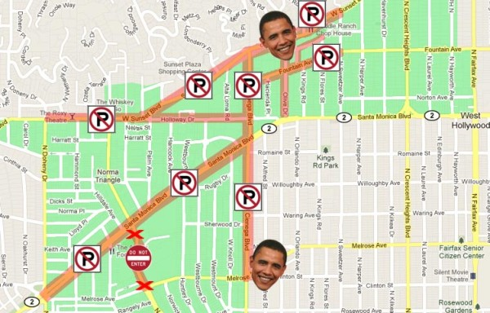
1. Introduction
A real life scenario:
Privileged User
Road blocked
Avoid in advance?

Slide 3
Cognitive Radio Networks (CRNs)
Similar situation in CRNs
_{Primary User}
_{Secondary User}
channel m
_{PU}
x
_{A}
_{B}
channel m

Slide 4
Challenges
Primary users’ (PUs’) activities are unpredictable and too costly to distribute.
Routes selected by traditional wireless protocols are unreliable in the presence of PUs.
Q: What if we can select routes that avoid those “restricted areas” in advance?
Q: What is the cost-effective way to collect such information ?

Slide 5
Simple Approach
Each node collects its own information about PUs in the neighborhood.
Each node then piggybacks PUs information during the route discovery and reply process.
Disadvantage
Burden on the common channel control for information exchange.

Slide 6
Intuition
Answer : Make use of boundary nodes.
Also, we need the help of directional antennas.
Benefits: 1) tell the direction of PUs; 2) increase the space reuse ratio.
_{Traffic} _{Blocker!}
channel m
_{PU}
_{A}

Slide 7
2. Problem Formulation
Objective: Route selection
Delay
Reliability
SINR requirements of PUs and SUs
Unpredictable PUs’ activities
No optimal solution
We propose an efficient solution, with the help of boundary nodes

Slide 8
3. Boundary Nodes
How does a node know if it is a boundary node itself?
Answer: By the variance of its sensing results in different directions!
We use USRPs to show the properties of a boundary node.
USRP: Universal Software Radio Peripheral

Slide 9
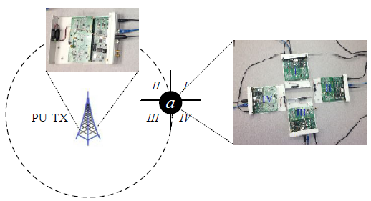
3. Boundary Nodes
5 USRP N200s
One PU; Others simulate a four-directional SU.
Central frequency: 1.3005GHz

Slide 10
3. Boundary Nodes
Sector I: -50dB; Sector II: -87dB

Slide 11
Routing Overview
Overview:
Route Discovery;
Piggyback in Route Reply;
Route Selection
_{A}
_{B}
_{S}
_{D}
_{M}
_{N}

Slide 12
4. Piggyback
Route discovery : traditional ways
Piggyback: What kind of information?
Non Boundary Node:
(IN, OUT, -, -)
Boundary Node:
(IN, OUT, m, μ)
μ = 1: ENTER
μ = -1: EXIT
_{II}
_{I}
_{data}
_{A}
channel m
_{II}
_{I}
_{III}
_{IV}
_{C}
_{PU}
_{II}
_{I}
_{data}
_{III}
_{IV}
_{B}
_{data}
_{III}
_{IV}
A: (I, III, -, -)
C: (IV, II, m, -1)
B: (I, II, m, 1)

Slide 13
Link Information
Based on piggyback information, for a link, we can know:
If the link is inside or outside a PU area;
How many PU areas the link is located inside.
Then, we define the link length based on the above information.
A larger value for link length will show that the link is within more PU areas.

Slide 14
Four Cases
Four cases to identify if a link (AB) is within a PU area, given the piggyback information:
Case1: Neither A nor B is a boundary node, but the closest boundary node on the route indicates the entering into a PU area.
C: (I, III, m, 1)
A: (I, II, -, -)
B: (IV, II, -, -)
channel m
_{data}
_{PU}
_{II}
_{I}
_{II}
_{I}
_{C}
_{B}
_{II}
_{I}
_{III}
_{IV}
_{III}
_{IV}
_{A}
_{III}
_{IV}

Slide 15
Four Cases (Cont’d)
Case2: A is a boundary node and B is not. In addition, A indicates the entering into a PU area.
A: (I, II, m, 1)
B: (IV, II, -, -)
channel m
_{PU}
_{data}
_{II}
_{I}
_{B}
_{II}
_{I}
_{III}
_{IV}
_{A}
_{III}
_{IV}

Slide 16
Four Cases (Cont’d)
Case3: B is a boundary node and A is not. In addition, B indicates the exiting from a PU area.
A: (I, II, -, -)
B: (IV, II, m, -1)
channel m
_{PU}
_{data}
_{II}
_{I}
_{B}
_{II}
_{I}
_{III}
_{IV}
_{A}
_{III}
_{IV}

Slide 17
Four Cases (Cont’d)
Case4: Both A and B are boundary nodes. In addition, A indicates the entering into a PU area and B indicates the exiting from the PU area.
A: (I, II, m, 1)
B: (I, III, m, -1)
channel m
_{PU}
_{data}
_{II}
_{I}
_{A}
_{II}
_{I}
_{B}
_{III}
_{IV}
_{III}
_{IV}

Slide 18
Special Case
Special case: if a link is within multiple PU areas, we can still detect it.
M: (IV, II, m₂, 1)
N: (IV, II, m₁, 1)
A: (IV, II, -, -)
B: (IV, III, -, -)
channel m₁
PU
_{II}
_{I}
B
_{II}
_{I}
_{III}
_{IV}
A
_{III}
_{IV}
_{II}
_{I}
N
_{III}
_{IV}
The previous boundary nodes both have μ = 1.
Link AB are in two PU areas, occupying m₁ and m₂ when active.
_{II}
_{I}
channel m₂
M
PU
_{III}
_{IV}
data

Slide 19
5. Route Selection
Intuitively, we can select the route:
with less links that pass through a PU area;
with less links that are within multiple PU areas.
We need to define the route length

Slide 20
Link Length
First, we define the length of link AB, denoted as (L_{AB}):
L_{AB} = 1, if link AB is not in any of the PUs’ areas;
L_{AB} = |M|/(|M| - C(m)), if AB is within the PUs’ areas.
|M| is the total number of channels in the network;
C(m) is the counter of how many PU areas AB is in.

Slide 21
Route Length
The route length is defined as the sum of the link length on the route: Σ(L_{AB})
The route with more links in a PU area will have a larger value of route length.
The route that passes through more PU areas will have a larger value for route length.

Slide 22
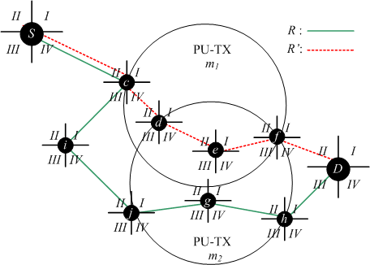
An Example
Route R’ has more links in the PU area.
Some links of R’ are in multiple PU areas.
These properties can be shown by the value of route length.

Slide 23
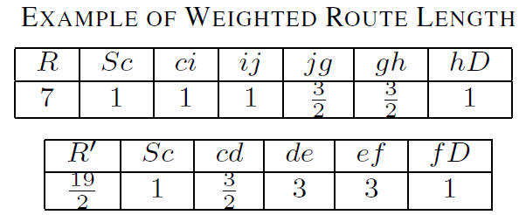
Route Length
Calculate route length:
The route with smaller route length will be chosen.
In this example, R will be chosen since 7< 19/2.

Slide 24
Supplementary Information
Our route length calculation is based on the simplified SINR model:
It aims at showing the influence of PU areas;
It can also be easily extended to other routing protocols using real SINR models.
Our model also assumes the accuracy of boundary node detections:
It can be extended to consider the misdetection of boundary nodes.

Slide 25
6. Simulation
Simulation Settings
Network area: 2,000 X 2,000
Number of nodes: [100, 300]; TX power: 23 dBm; Noise power: 98 dBm; SINR threshold: 10 dB
Number of channels:[10, 25]
Number of PUs: [10, 50]; Operation range of each PU: [300, 500];
Number of sectors: 4; Delay for one channel switch: 0.1s.

Slide 26
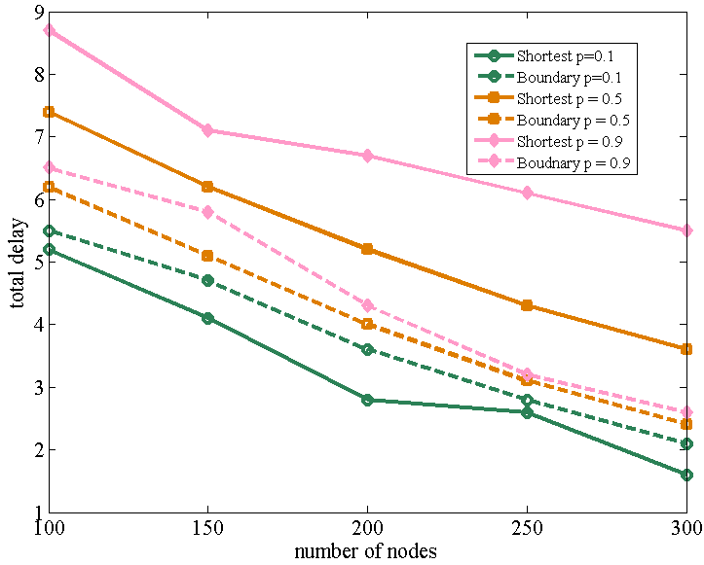
PU Active Probability
Total Delay:
Transmission Delay (based on SINR) + Channel Switch Delay
Vary the PU active probabilities, p
Our model is better when p = 0.5 and 0.9. Shortest path is better when p = 0.1.
Select 0.5 for the remaining simulation.

Slide 27
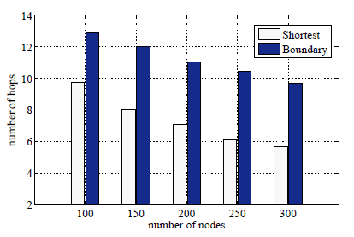
Hop and Length
Number of hops
Average route length

Slide 28
Channel Switches
Number of channel switches:
It happens when PUs become active

Slide 29
Total Delay
Transmission Delay (based on SINR) + Channel Switch Delay

Slide 30
7. Extensions
Missing boundary node
Neither A nor B is a boundary node.
channel m
_{PU}
However, by the sensing result variance, we can detect the entering of the PU area.
_{II}
_{I}
_{data}
_{B}
_{II}
_{I}
_{III}
_{IV}
_{V}
_{A}
Like a virtual boundary node.
_{III}
_{IV}

Slide 31
Extensions (Cont’d)
Imperfect information
Link AB located at the boundary area.
_{data}
channel m
_{PU}
_{II}
_{I}
_{A}
Whether to count link AB as in the PU area is decided by a predefined threshold.
_{III}
_{IV}
_{II}
_{I}
_{B}
_{III}
_{IV}

Slide 32
Extensions (Cont’d)
Threshold-based Boundary Nodes
based on active PU probability
Reporting boundary nodes when active level is above the threshold
More simulation
In-depth simulation analysis with traffic

Slide 33
7. Conclusion
Directional antenna + boundary nodes.
Detect if a link is outside PU areas, inside a single PU area, or inside multiple PU areas.
Define the link length and route length.
Our algorithm can be easily applied or extended in other models.

