Slide 1


Fine-grained Urban Prediction via Sparse Mobile CrowdSensing
Wenbin Liu¹, Yongjian Yang¹, En Wang¹, and Jie Wu²
¹College of Computer Science and Technology,
Jilin University, China
²Department of Computer and Information Sciences,
Temple University, Philadelphia, USA

Slide 2
Outline
Background, Motivation, and Challenges
Problem Formulation
Matrix Completion
Urban Prediction
Performance Evaluation
Conclusion

Slide 3
Outline
Background, Motivation, and Challenges
Problem Formulation
Matrix Completion
Urban Prediction
Performance Evaluation
Conclusion

Slide 4

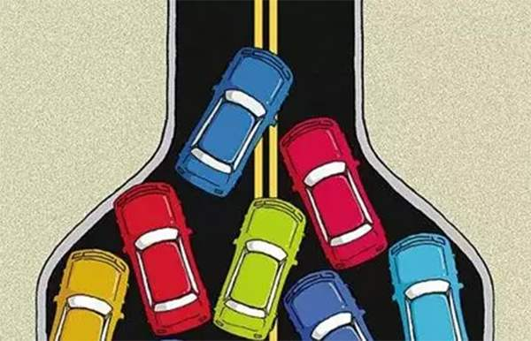





Mobile CrowdSensing (MCS)
Recruit users to collect various urban data
Traffic Monitoring
Air Quality Sensing
… …
Noise Monitoring

Slide 5

Sparse Mobile CrowdSensing
MCS: a large number of users
Sparse MCS: sense a few subareas and infer the rest ones

Slide 6
Sparse Mobile CrowdSensing
Sparse MCS provides an effective way for urban sensing
  Infer full map from sparse data
  Data inference
    Compressive Sensing
    Matrix Completion
  Subarea selection
    Active Learning
    Reinforcement Learning

Slide 7

Sparse Mobile CrowdSensing
In some cases,
  More interested in predicting the future full map
    Rather than inferring the current data
For example,
  Traffic congestion or parking capacity monitoring
    Users still need some time to drive there
    Current data are not very important

Slide 8
Urban Prediction via Sparse MCS
Infer the current → predict the future
  Based on the sparse sensed data
Two challenges:
  How to utilize the sparse sensed data
    Complete the matrix
    Preserve the temporal-spatial correlations
  How to capture the temporal-spatial correlations
    Non-linear temporal relationships (among different cycles)
    Pairwise spatial correlations (between two subareas)

Slide 9
Outline
Background, Motivation, and Challenges
Problem Formulation
Matrix Completion
Urban Prediction
Performance Evaluation
Conclusion

Slide 10
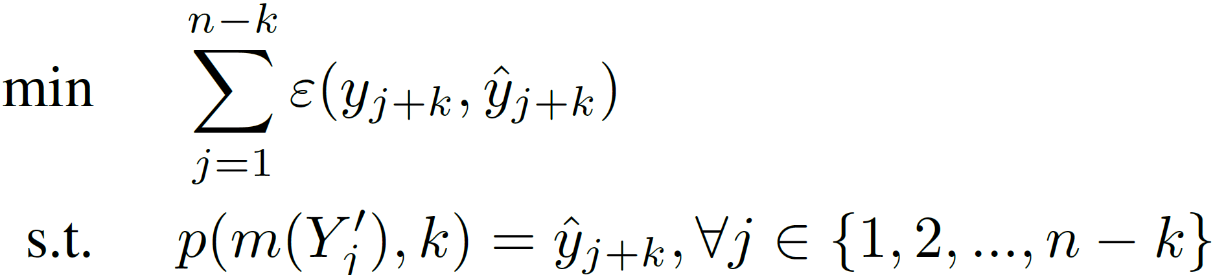
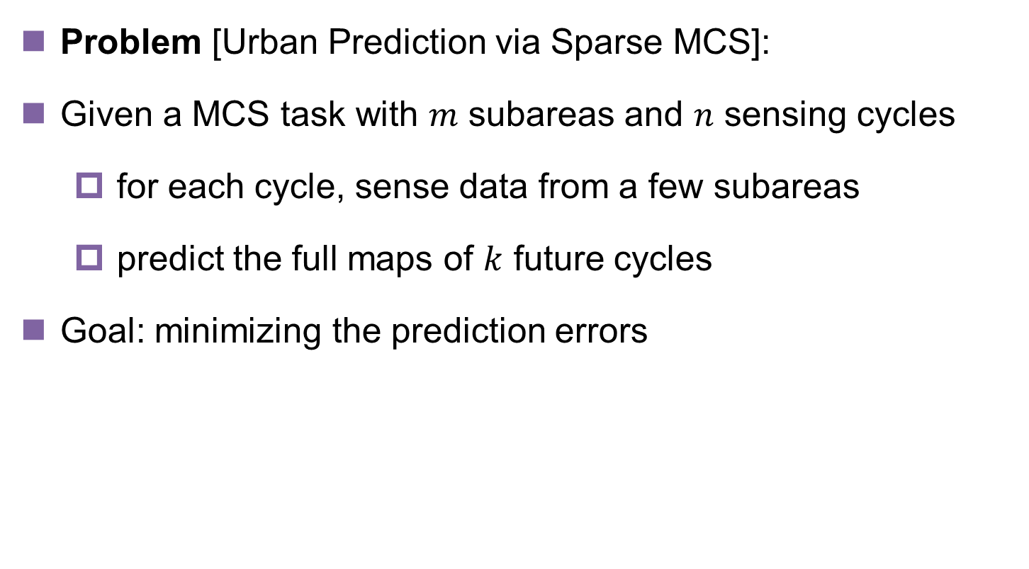
Problem Formulation
Problem [Urban Prediction via Sparse MCS]:
Given a MCS task with $m$ subareas and $n$ sensing cycles
  for each cycle, sense data from a few subareas
  predict the full maps of $k$ future cycles
Goal: minimizing the prediction errors

Slide 11
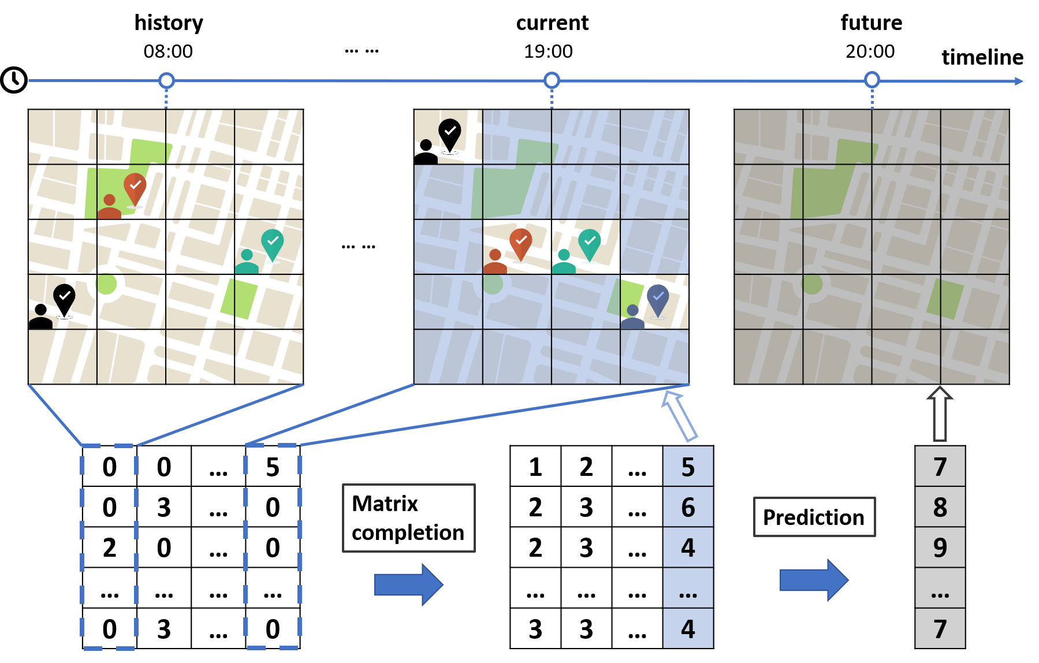
Running example
An example of urban prediction via Sparse MCS

Slide 12
Outline
Background, Motivation, and Challenges
Problem Formulation
Matrix Completion
Urban Prediction
Performance Evaluation
Conclusion

Slide 13
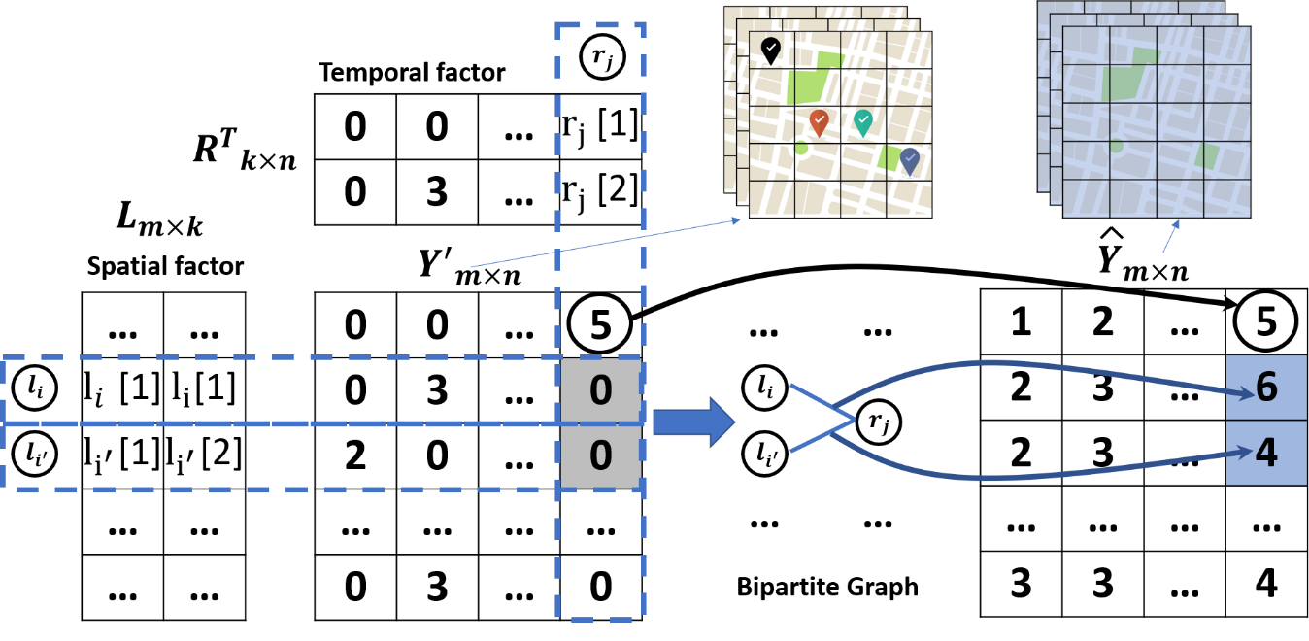

Matrix Factorization
Sensing data exhibit strong temporal-spatial correlations
  Sensing matrix $Y$ usually has the low-rank property
Given $rank(Y)=k$, we factor the inferred matrix $\hat{Y}$ into
  a spatial factor matrix $L_{m×k}$ and a temporal factor matrix $R_{n×k}$

Slide 14


Temporal-Spatial Matrix Factorization
Temporal and spatial constraint matrices, and
  Important and naturally occurring correlations
  Help data inference and preserve the correlations
constraints that two continuously sensed data from the same subarea are usually similar
constraints that the data sensed from the closer subareas usually have the similar values.

Slide 15
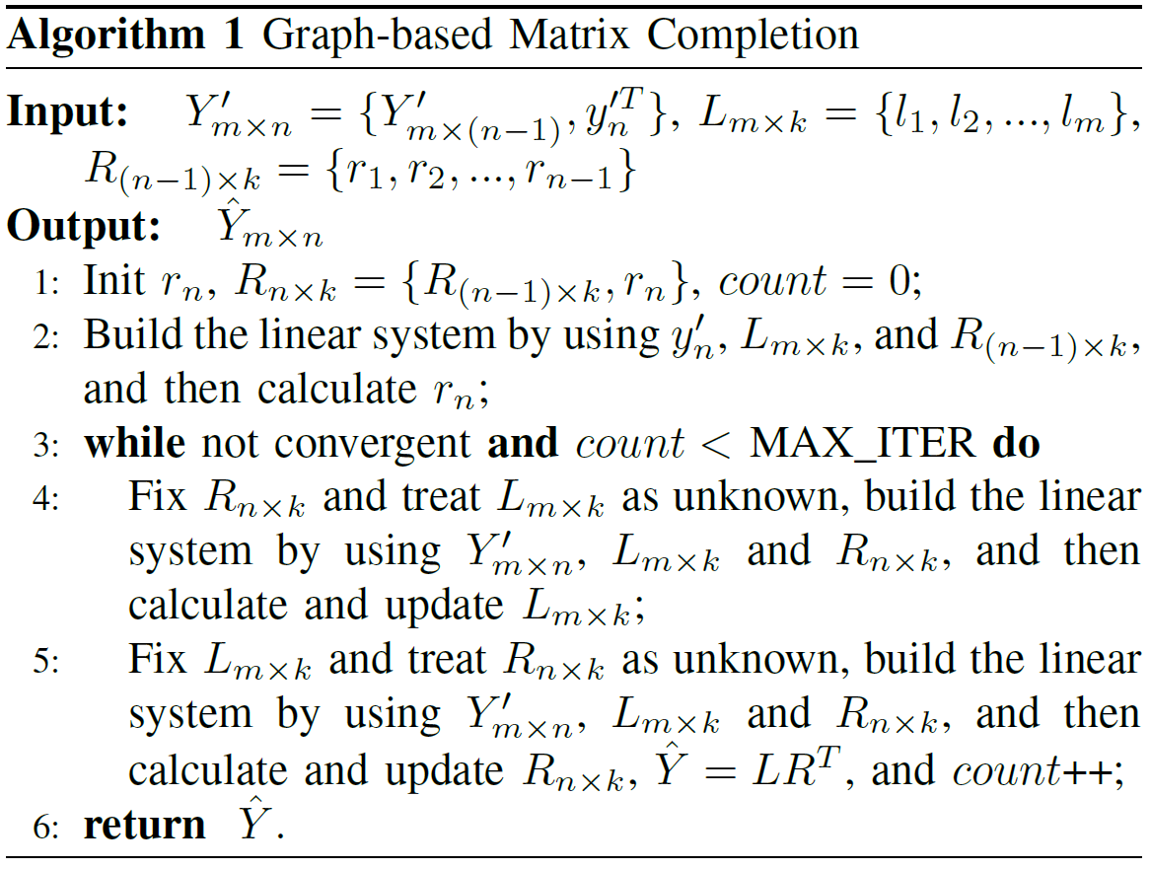
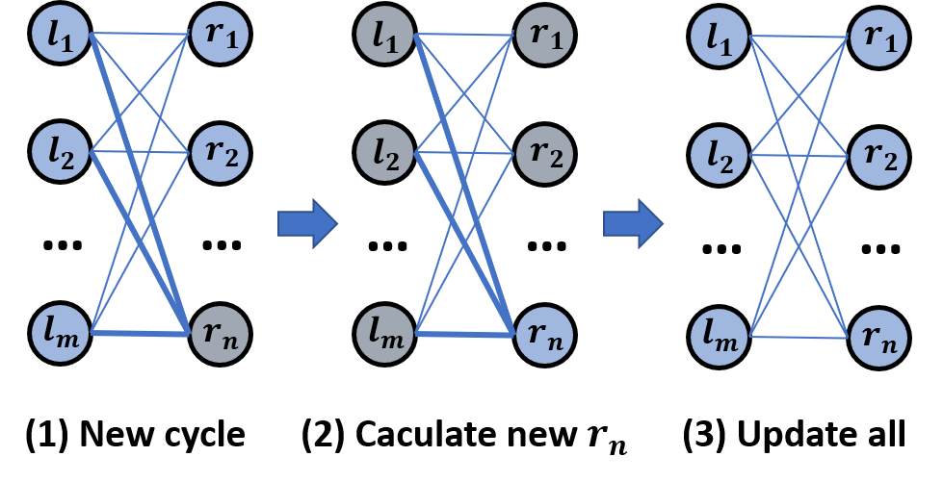

Graph-based Matrix Completion
1. With $L_{m×k}$ and $R_{(n−1)×k}$, calculate the new $r_{n}$
2. Iteratively train and update the factor $L$ and $R$

Slide 16
Outline
Background, Motivation, and Challenges
Problem Formulation
Matrix Completion
Urban Prediction
Performance Evaluation
Conclusion

Slide 17
Urban Prediction
Continuous Conditional Random Field (CCRF)
  relationships between the input and output data
    Temporal relationships among different sensing cycles
    Long Short-Term Memory (LSTM)
  correlations among the output data
    Spatial correlations between different subareas
    Stacked Denoising Auto-Encoder (SDAE)

Slide 18
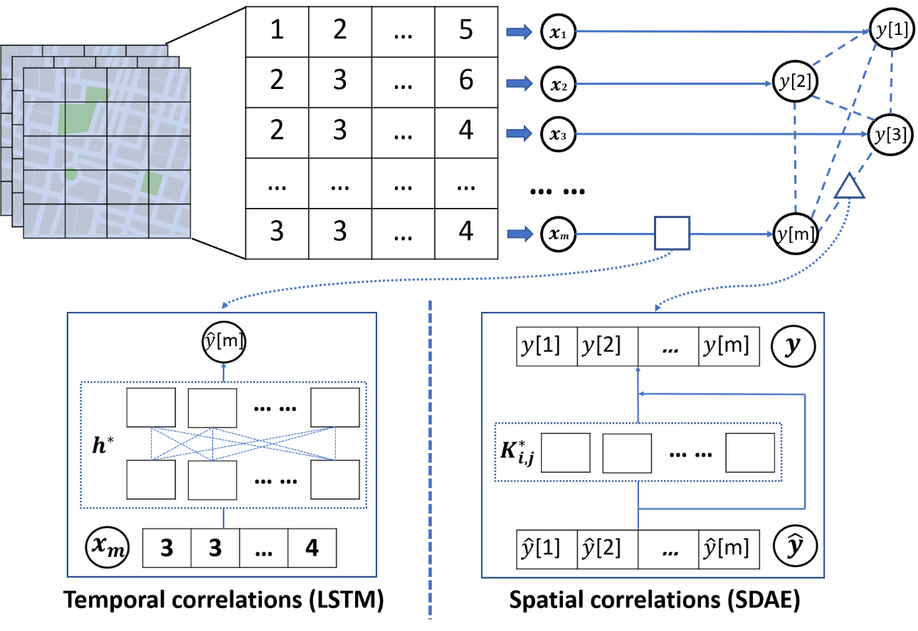
Urban Prediction
CCRF
LSTM for Temporal Relationships
SDAE for Spatial Correlations
1. Preliminary estimations
by LSTM
2. Constrain and smooth
by SDAE

Slide 19
Outline
Background, Motivation, and Challenges
Problem Formulation
Matrix Completion
Urban Prediction
Performance Evaluation
Conclusion

Slide 20
Three real-world data sets
Sensor-Scope^{[1]}, U-Air ^{[2]}, and TaxiSpeed ^{[3]}
  Five typical urban sensing tasks:
    Temperature, Humidity, PM2.5, PM10, and Traffic speed
  Collected by static sensors
    Can use mobile devices to collect the same data
[1] F. Ingelrest, G. Barrenetxea, G. Schaefer, M. Vetterli, O. Couach, and M. Parlange, “Sensorscope:application-specific sensor network for environmental monitoring,” ACM Transactions on Sensor Networks, vol. 6, no. 2, pp. 1–32, 2010.
[2] Y. Zheng, F. Liu, and H. P. Hsieh, “U-air:when urban air quality inference meets big data,” in ACM SIGKDD International Conference on Knowledge Discovery and Data Mining, 2013, pp. 1436–1444.
[3] J. Shang, Y. Zheng, W. Tong, E. Chang, and Y. Yu, “Inferring gas consumption and pollution emission of vehicles throughout a city,” in ACM SIGKDD International Conference on Knowledge Discovery and
Data Mining, 2014, pp. 1027–1036.

Slide 21
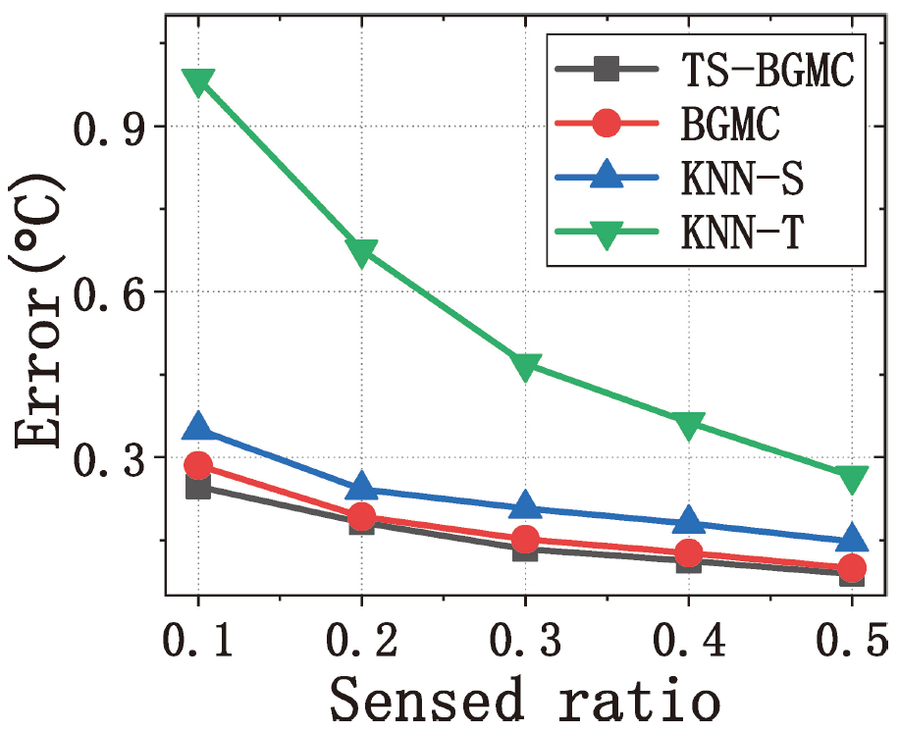
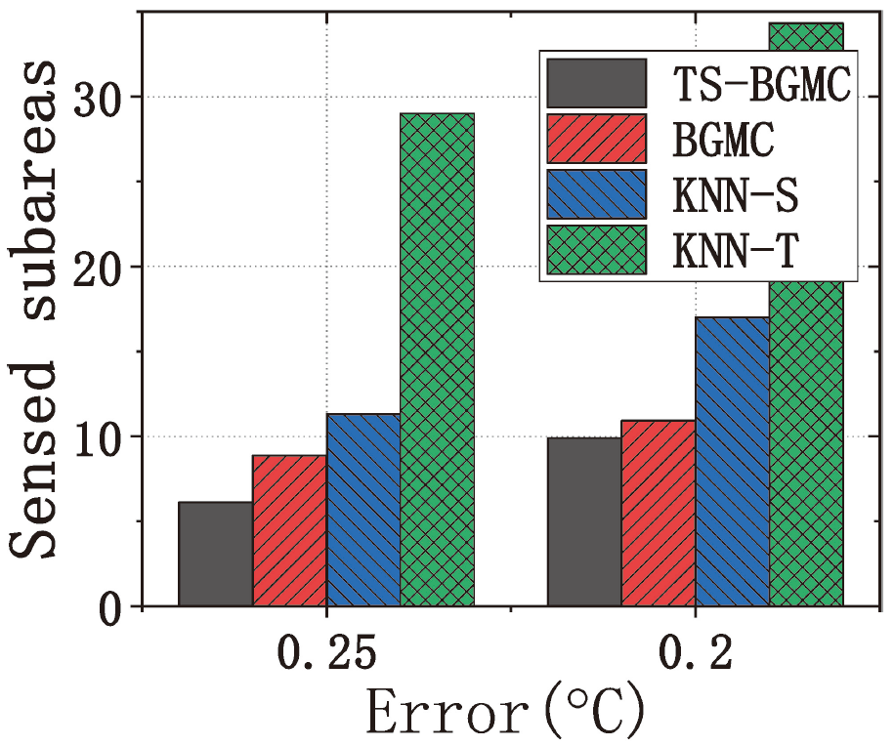
Evaluation Results
Temperature:
1) Inference accuracy; 2) Number of sensed subareas

Slide 22
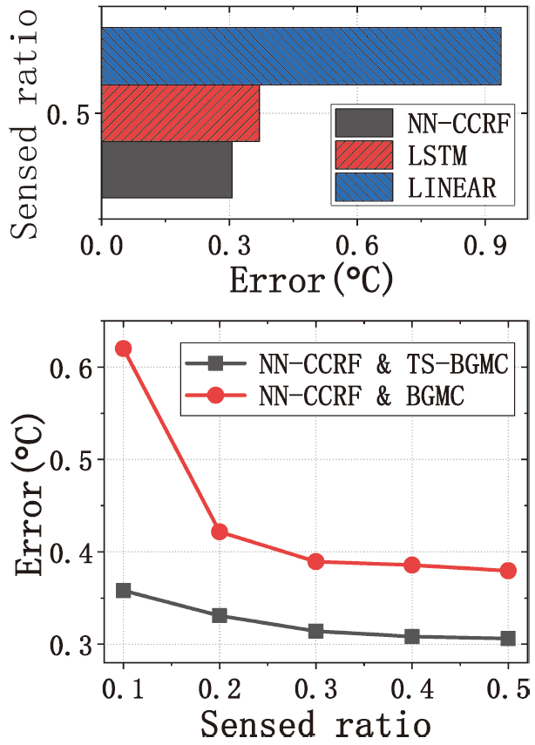
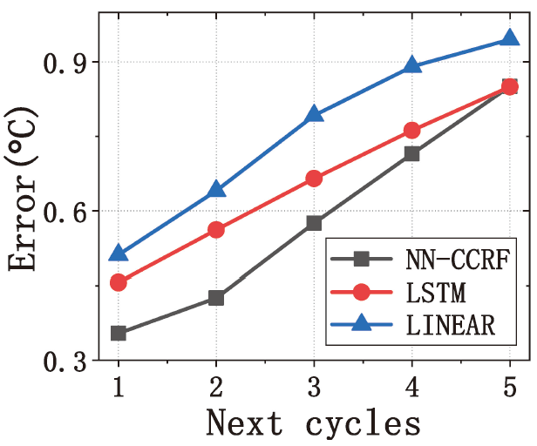
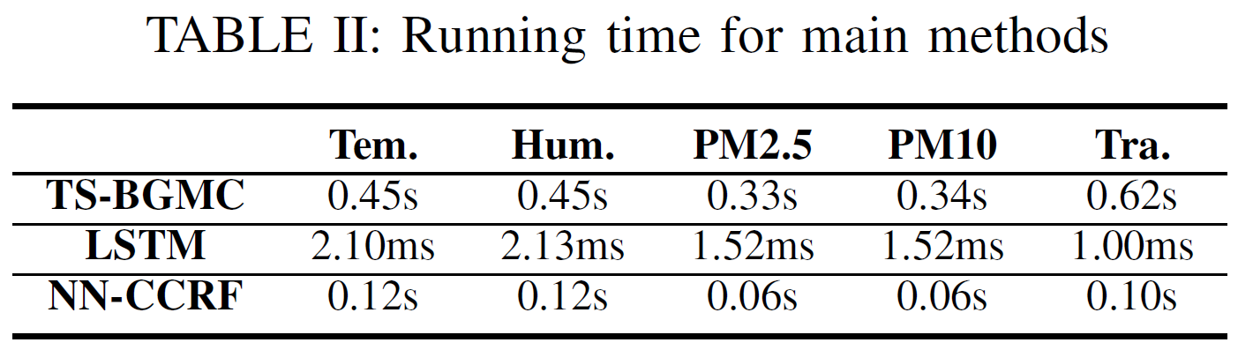
Evaluation Results
3) Sensed ratio; 4) Next cycles; 5) Running time

Slide 23
Outline
Background, Motivation, and Challenges
Problem Formulation
Matrix Completion
Urban Prediction
Performance Evaluation
Conclusion

Slide 24
Conclusion
Urban Prediction via Sparse Moblie CrowdSensing
  Predict the future full map from sparse sensed data
Matrix Completion with Temporal-Spatial constraints
  Preserve temporal-spatial correlations
Urban Prediction by Continuous Conditional Random Field
  LSTM and SDAE for temporal and spatial correlations
Extensive Evaluation
  Three real-world data sets with five typical urban sensing tasks

Slide 25

Thank you!
Q&A

