Slide 1




Towards Federated Learning on Fresh Datasets
IEEE MASS 2023
Chen Wu¹, Mingjun Xiao¹, Jie Wu²
Yin Xu¹, Jinrui Zhou¹, and He Sun¹
¹University of Science and Technology of China
²Temple University

Slide 2
Outline
Motivation & Challenges
Preliminaries & Problem Formulation
Basic Idea & Solution
Evaluation & Conclusion

Slide 3

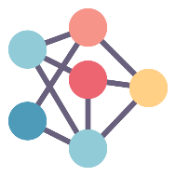
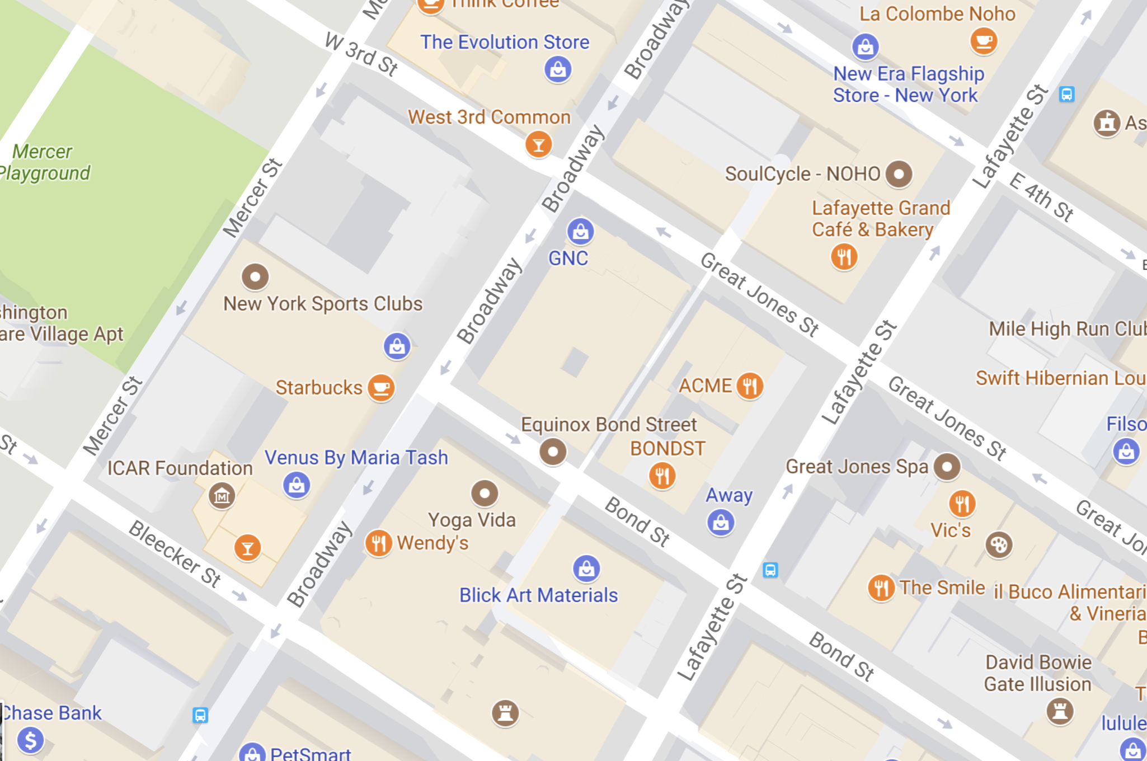




Motivation
Traditional FL
Federated Server
Global model
Invariability: clients’ local datasets are static;
Inadaptability: data in real-world are continuously generated along with the time.
Update Datasets
Train with Fresh Data
FL on Fresh Datasets
Variability: clients collect new data periodically;
Freshness of Models: fresh data can accurately characterize the model parameters;
Budget Limit: clients spend some extra costs
while the total budget is limited.
Fresh data
Stale data
Clients
Model transmission
C. Wu, M. Xiao, J. Wu, Y. Xu, J. Zhou, and H. Sun. Towards Federated Learning on Fresh Datasets
3

Slide 4
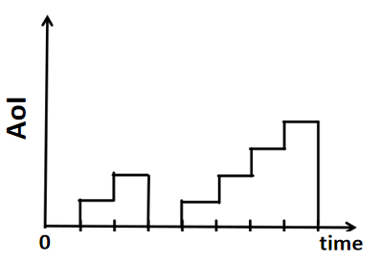
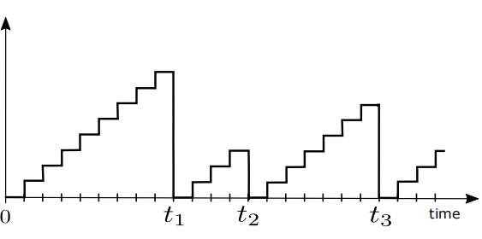
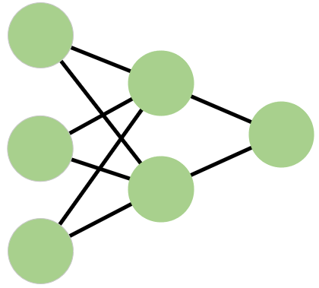
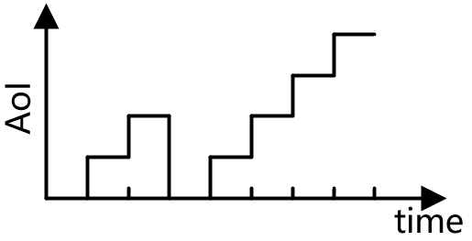
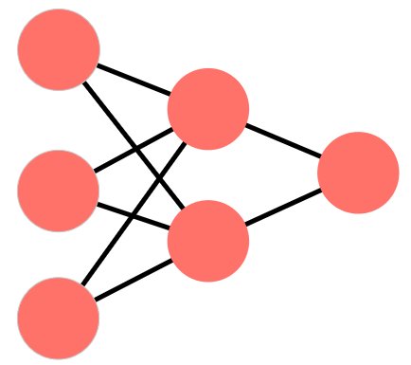
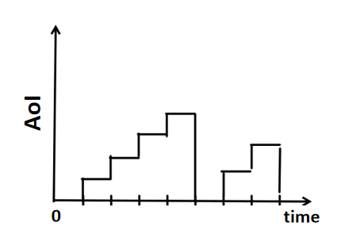
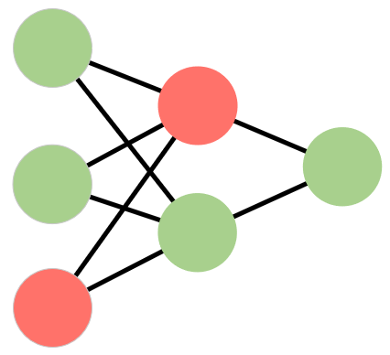

AoI: Metric for Measuring Data Freshness
Age of Information (AoI) : freshness of the local dataset --- the time elapsed from the data collection to its usage.
Example of the local dataset’s update
Clients
Fresh model
AoI
1
Time t
Server
Stale model
2
Time t
Aggregate
AoI evolution with updates at $t1, t2$, and $t3$.
3
Time t
Fresh model
C. Wu, M. Xiao, J. Wu, Y. Xu, J. Zhou, and H. Sun. Towards Federated Learning on Fresh Datasets
4

Slide 5
Challenges
Selected clients: update local datasets & reduce the AoI values
→ Quantify the impact of AoI on the model training of FL
→
Dependence: client selection and the corresponding AoI values
→
Reveal the relationship between the loss of global model and the decrease of the AoI values of clients’ datasets?
Design a client selection strategy to optimize the performance of the global model (i.e., global loss) within a budget?
C. Wu, M. Xiao, J. Wu, Y. Xu, J. Zhou, and H. Sun. Towards Federated Learning on Fresh Datasets
5

Slide 6



Related Work
Client Selection: make decisions under different optimization objectives
e.g., Huang T, Lin W, Wu W, et al. “An efficiency-boosting client selection scheme for federated learning with fairness guarantee”, in IEEE TPDS, 2020, 32(7): 1552-1564.
AoI Optimization: minimize AoI under different scenarios
e.g., Lim W Y B, et al. “When information freshness meets service latency in federated learning: A task-aware incentive scheme for smart industries”, in IEEE TII, 2020, 18(1): 457-466.
Restless MAB: all bandits might evolve stochastically
e.g., Whittle P. “Restless bandits: Activity allocation in a changing world”, in Journal of applied probability, 1988, 25(A): 287-298.
Ignore the importance of data freshness
Ignore the relationship between AoI & loss
We aim to design a clients selection mechanism for FL while considering data freshness and limited budget simultaneously.
C. Wu, M. Xiao, J. Wu, Y. Xu, J. Zhou, and H. Sun. Towards Federated Learning on Fresh Datasets
6

Slide 7
Contributions
System: Introduce a novel AoI-aware FL considering the freshness of the local datasets for client selection.
Analysis: Derive a relationship between the training loss of the global model and the AoI values of local datasets.
Algorithm: Propose the Whittle’s Index-based Client Selection (WICS) algorithm and prove its approximate optimality.
Experiments: Evaluate WICS by using real-world datasets (i.e., MNIST and FMNIST) to verify its performance.
C. Wu, M. Xiao, J. Wu, Y. Xu, J. Zhou, and H. Sun. Towards Federated Learning on Fresh Datasets
7

Slide 8
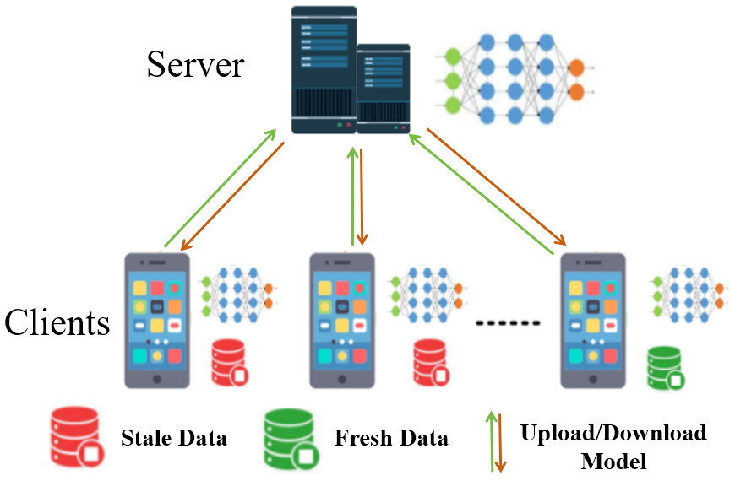



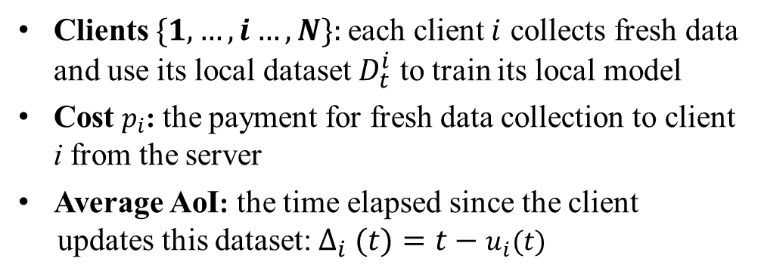
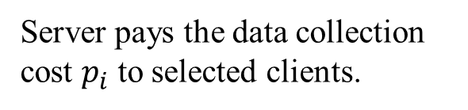
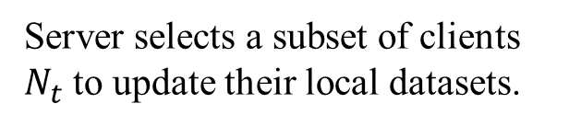
System Model
System Model
Procedure
Server selects a subset of clients $N_{t}$ to update their local datasets.
①
Client i: train its local model using local dataset and upload its model.
②
Clients $\{1,…,i…,N\}:$each client $i$ collects fresh data and use its local dataset $D_{t}^{i}$ to train its local model
Cost $p_{i}$: the payment for fresh data collection to client i from the server
Average AoI: the time elapsed since the client
updates this dataset: $Δ_{i} (t)=t−u_{i}(t)$
Server aggregrates local models to obtain the global model.
③
④
Server pays the data collection cost $p_{i}$ to selected clients.
C. Wu, M. Xiao, J. Wu, Y. Xu, J. Zhou, and H. Sun. Towards Federated Learning on Fresh Datasets
8

Slide 9
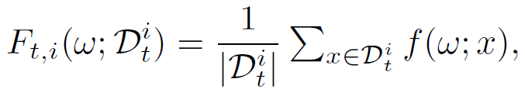

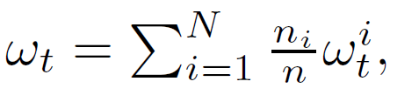


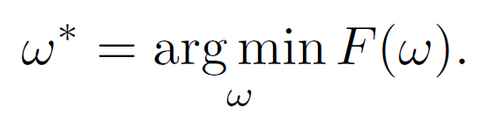
Model Training of FL
Step 1: each client $i$ conducts local training with data size $\left|D_{t}^{i}\right|=n_{i}$.
Compute Local Loss
Update Parameters
where $f(.)$is the a server-specified loss function, $η_{t}$ is the learning rate, $k=\{1,2,…,τ\}$ is the index of local iterations, and $ξ_{t}^{i,k}$ is the k-th mini-batch sampled from the dataset $D_{t}^{i}$.
Step 2: the server aggregates received local models.
Aggregate Models
where
Global Loss Function
Goal: find the optimal global model parameters
C. Wu, M. Xiao, J. Wu, Y. Xu, J. Zhou, and H. Sun. Towards Federated Learning on Fresh Datasets
9

Slide 10
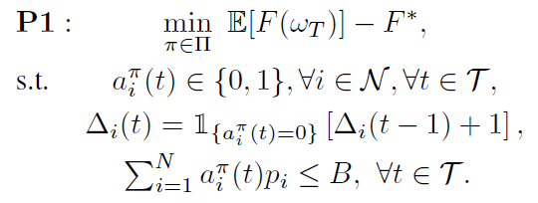

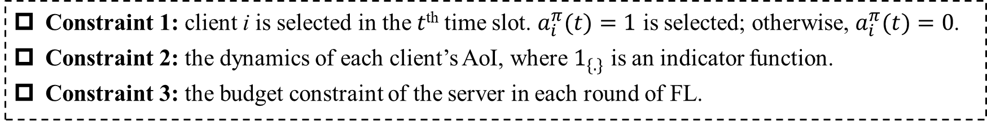
Problem Formulation
Original Optimization problem:
Goal
Optimization Objective:
Find a client selection strategy $π^{∗}$ that minimizes the gap between the expected global loss after T rounds and the optimal global loss.
Constraints
Constraint 1: client i is selected in the $t$^{th} time slot. $a_{i}^{π}(t)=1$ is selected; otherwise, $a_{i}^{π}(t)=0$.
Constraint 2: the dynamics of each client’s AoI, where $1_{\{.\}}$ is an indicator function.
Constraint 3: the budget constraint of the server in each round of FL.
C. Wu, M. Xiao, J. Wu, Y. Xu, J. Zhou, and H. Sun. Towards Federated Learning on Fresh Datasets
10

Slide 11

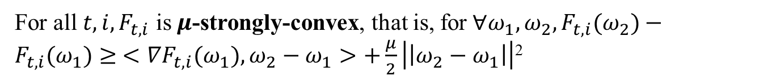


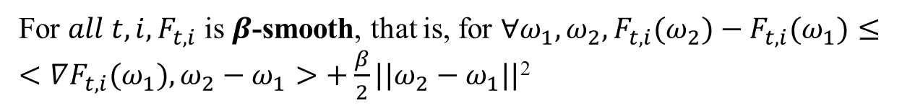
Conergence Analysis
Assumption 1
For $all t,i,F_{t,i}$ is $β$-smooth, that is, for $∀ω_{1},ω_{2}, F_{t,i}(ω_{2})−F_{t,i}(ω_{1})≤ <∇F_{t,i}(ω_{1}),ω_{2}−ω_{1}>+\frac{β}{2}||ω_{2}−ω_{1}||$²
$$.$$
For all $t,i,F_{t,i}$ is $μ$-strongly-convex, that is, for$∀ω_{1},ω_{2}, F_{t,i}(ω_{2})−F_{t,i}(ω_{1})≥ <∇F_{t,i}(ω_{1}),ω_{2}−ω_{1}>+\frac{μ}{2}\left|\left|ω_{2}−ω_{1}\right|\right|$²
Assumption 2
$$.$$
Assumption 3
For all $t,i,$the stochastic gradients of loss function is unbiased, i.e., $E_{ξ}\left[∇F_{t,i}\left(ω;ξ\right)\right]=∇F_{t,i}\left(ω\right).$
Assumption 4
For all $t,i,$ the expected squared norm of stochastic gradients is AoI-aware bounded:$E_{ξ}\left|\left|∇F_{t,i}\left(ω;ξ\right)\right|\right|≤G_{i}^{2}+Δ_{i}\left(t\right)σ_{i}^{2}.$
$Δ_{i}\left(t\right)$-- AoI; $σ_{i}^{2}$--sensitivity of client’s local data to freshness; $G_{i}^{2}$--client’s inherent bound
Note: Assumption 4 is an extension of the hypothesis in existing FL, considering the impact of data freshness on training. It is applicable to mean absolute loss, mean squared loss, and cross entropy loss.
C. Wu, M. Xiao, J. Wu, Y. Xu, J. Zhou, and H. Sun. Towards Federated Learning on Fresh Datasets
11

Slide 12
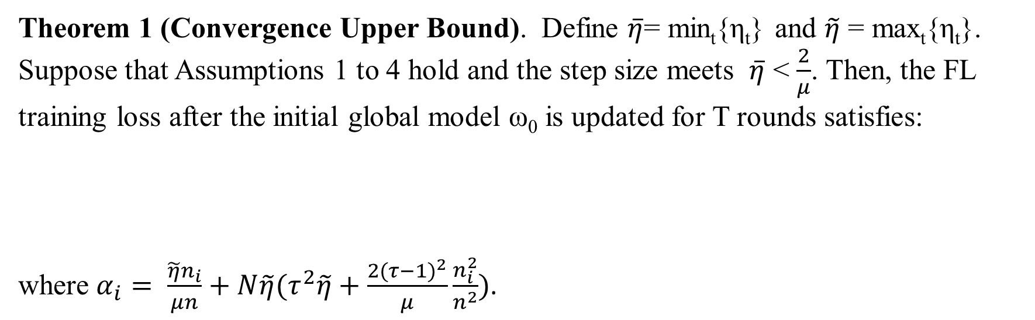
Step 1: Conergence Analysis
Theorem 1 (Convergence Upper Bound). Define $\overline{η}$= min_{t}{η_{t}} and $\tilde{η}$ = max_{t}{η_{t}}. Suppose that Assumptions 1 to 4 hold and the step size meets $\overline{η}$ < $\frac{2}{μ}$. Then, the FL training loss after the initial global model ω₀ is updated for T rounds satisfies:
where $α_{i}= \frac{\tilde{η}n_{i}}{μn}+N\tilde{η}(τ^{2}\tilde{η}+\frac{2{(τ−1)}^{2}}{μ}\frac{n_{i}^{2}}{n^{2}})$.
$E[F(ω_{T})]−F^{∗}≤\frac{β}{2}{(1−\frac{μ\overline{η}}{2})}^{2}$ + $\frac{β}{2}\sum_{t=1}^{T}{\sum_{i=1}^{N}{α_{i}[G_{i}^{2}+ ∆i(t)σ_{i}^{2}]}},$
NOTE: controlling $\sum_{t=1}^{T}{\sum_{i=1}^{N}{α_{i} ∆i(t)σ_{i}^{2}}}$ can control the convergence of the model.
C. Wu, M. Xiao, J. Wu, Y. Xu, J. Zhou, and H. Sun. Towards Federated Learning on Fresh Datasets
12

Slide 13

Restless Multi-Armed Bandit
Modeling: a Restless Multi-Armed Bandit (RMAB) --- a generalization of MAB problem
Characteristic: any number of bandits (more than 1) can be made active and all bandits might evolve stochastically.
RAMB | Our problem
Restless bandit | Each client
State | AoI value
Reward | Fresh local model
C. Wu, M. Xiao, J. Wu, Y. Xu, J. Zhou, and H. Sun. Towards Federated Learning on Fresh Datasets
13

Slide 14
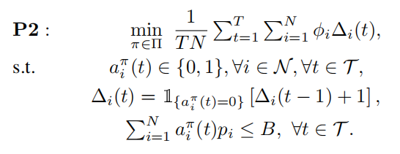
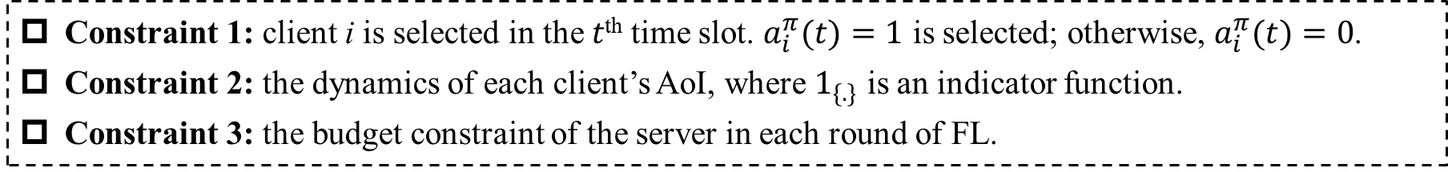
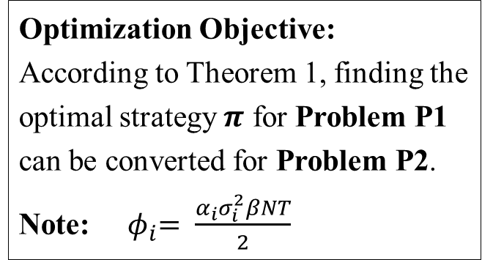
Step 2: Convert Problem
Converted Optimization problem:
Goal
Optimization Objective:
According to Theorem 1, finding the optimal strategy $π$ for Problem P1 can be converted for Problem P2.
Note: ${ φ}_{i}= \frac{α_{i}σ_{i}^{2}βNT}{2}$
Constraints
Constraint 1: client i is selected in the $t$^{th} time slot. $a_{i}^{π}(t)=1$ is selected; otherwise, $a_{i}^{π}(t)=0$.
Constraint 2: the dynamics of each client’s AoI, where $1_{\{.\}}$ is an indicator function.
Constraint 3: the budget constraint of the server in each round of FL.
C. Wu, M. Xiao, J. Wu, Y. Xu, J. Zhou, and H. Sun. Towards Federated Learning on Fresh Datasets
14

Slide 15

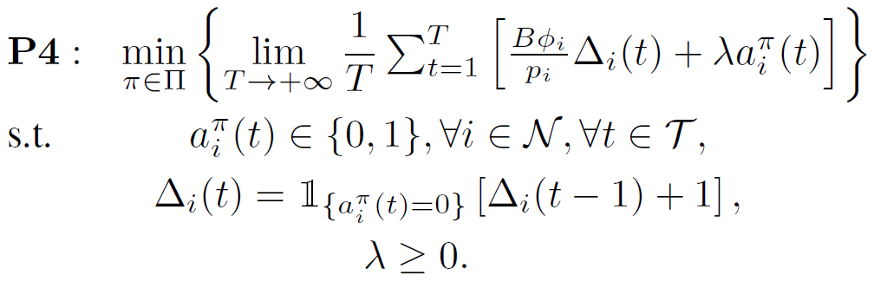
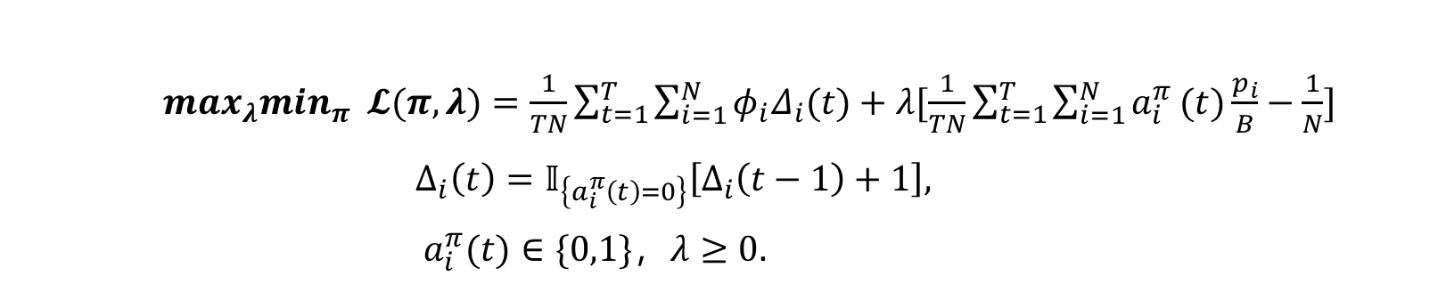
Step 3: Relaxation and Decoupling
Relax Constraint 3: $\sum_{i=1}^{N}{a_{i}^{π}}(t)p_{i}≤B$ $\frac{1}{TN}\sum_{t=1}^{T}{\sum_{i=1}^{N}{a_{i}^{π}}(t)\frac{p_{i}}{B}}≤\frac{1}{N}$
Transform Problem P2 into the Lagrangian Dual Problem P3:
$\max_{λ}\min_{π} 𝓛(π,λ)=\frac{1}{TN}\sum_{t=1}^{T}{\sum_{i=1}^{N}{φ_{i}Δ_{i}(t)}}+λ[\frac{1}{TN}\sum_{t=1}^{T}{\sum_{i=1}^{N}{a_{i}^{π}}(t)\frac{p_{i}}{B}}−\frac{1}{N}]$
$∆_{i}\left(t\right)=𝕀_{\left\{a_{i}^{π}\left(t\right)=0\right\}}\left[∆_{i}\left(t−1\right)+1\right],$
$a_{i}^{π}(t)∈\{0,1\}$，$λ≥0.$
Solve $\min_{π}𝓛(π,λ)$: finding the optimal strategy $π$ for any given $λ;$
Problem P3 can be decoupled to Problem P4:
C. Wu, M. Xiao, J. Wu, Y. Xu, J. Zhou, and H. Sun. Towards Federated Learning on Fresh Datasets
15

Slide 16
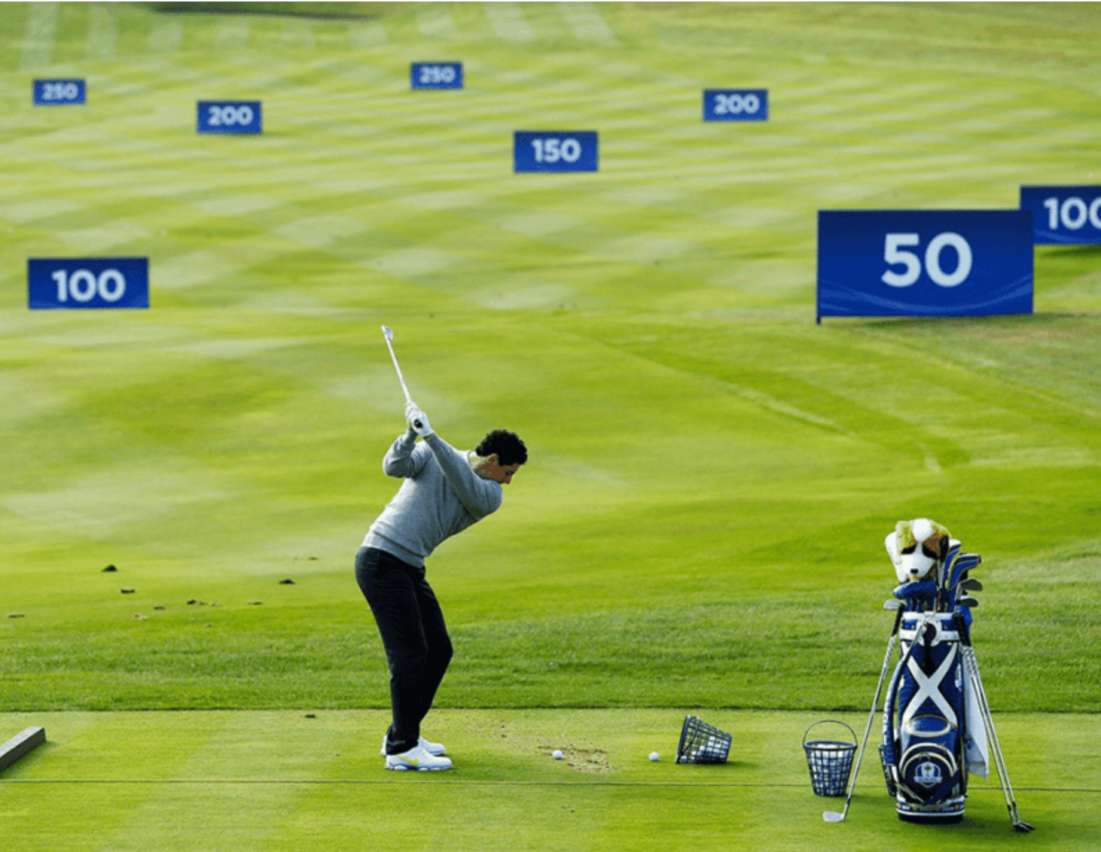
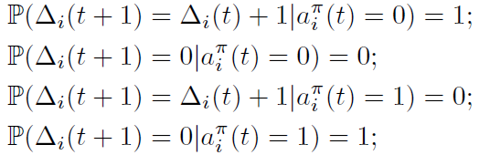
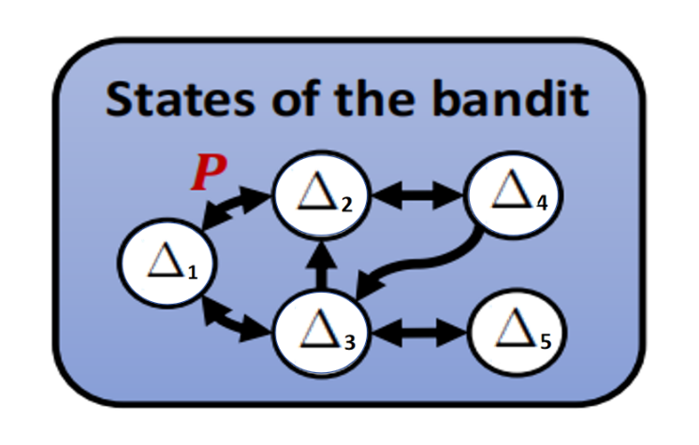

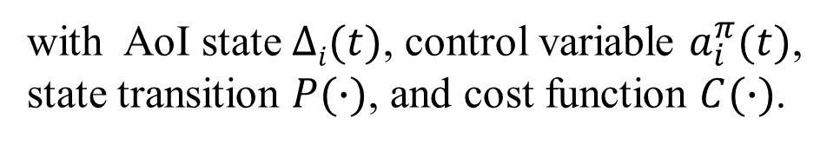
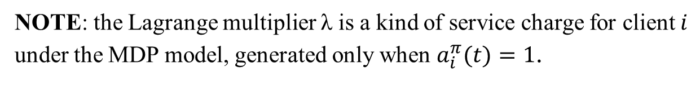
Step 4: Solving Problem P4
Formulation: The decoupled problem can be formulated as a Markov Decision Process (MDP)
with AoI state $∆i(t)$, control variable $a_{i}^{π}(t)$, state transition $P(∙)$, and cost function $C(∙)$.
State
Transition
Cost
Function
NOTE: the Lagrange multiplier λ is a kind of service charge for client $i$ under the MDP model, generated only when $a_{i}^{π}(t)=1$.
C. Wu, M. Xiao, J. Wu, Y. Xu, J. Zhou, and H. Sun. Towards Federated Learning on Fresh Datasets
16

Slide 17
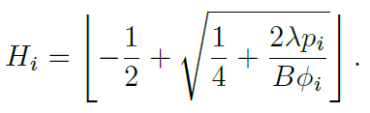


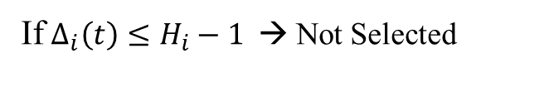



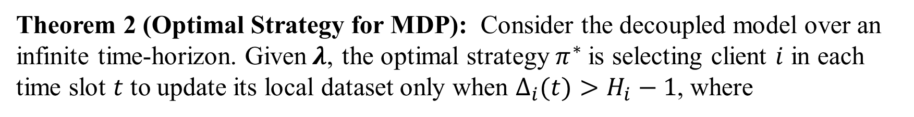
Step 4: Solving Problem P4
Solving MDP → Get the optimal strategy for the decoupled problem (P4)
Theorem 2 (Optimal Strategy for MDP): Consider the decoupled model over an infinite time-horizon. Given$λ$, the optimal strategy $π^{∗}$is selecting client $i$ in each time slot $t$ to update its local dataset only when $∆_{i}(t)>H_{i}−1$, where
If $∆_{i}(t)>H_{i}−1$ → Selected
$$π^{∗}:$$
client $i$
If $∆_{i}\left(t\right)≤H_{i}−1$ → Not Selected
C. Wu, M. Xiao, J. Wu, Y. Xu, J. Zhou, and H. Sun. Towards Federated Learning on Fresh Datasets
17

Slide 18
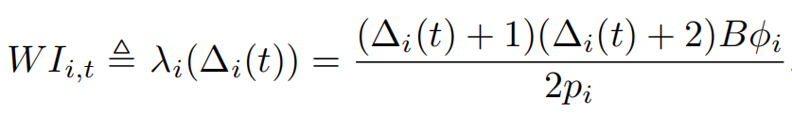


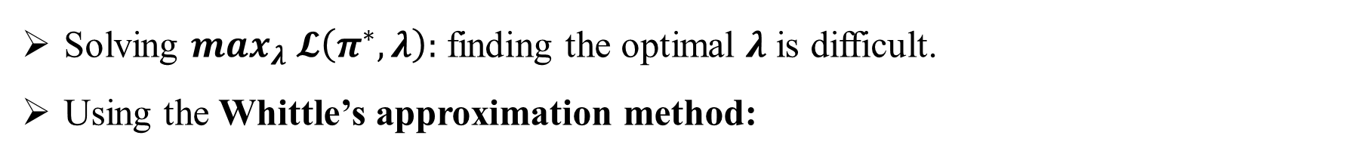
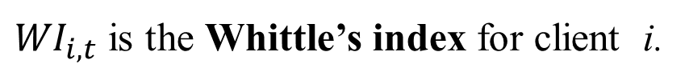
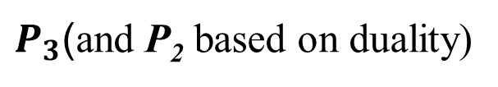
Step 5: Approximately Solve Problem P3 (and P2)
Solving $\max_{λ} 𝓛\left(π^{∗},λ\right):$ finding the optimal $λ$ is difficult.
Using the Whittle’s approximation method:
Find a $λ_{i}$ to maximize the objective function for each decoupled problem separately; Each $λ_{i}$ also follows Theorem 2;
${WI}_{i,t}$ is the Whittle’s index for client i.
Whittle’s Index-based Client Selection (WICS)
$P_{3}$(and P₂ based on duality)
Basic idea: Select the clients with higher WI values in each time slot under budget constraint $B$.
C. Wu, M. Xiao, J. Wu, Y. Xu, J. Zhou, and H. Sun. Towards Federated Learning on Fresh Datasets
18

Slide 19
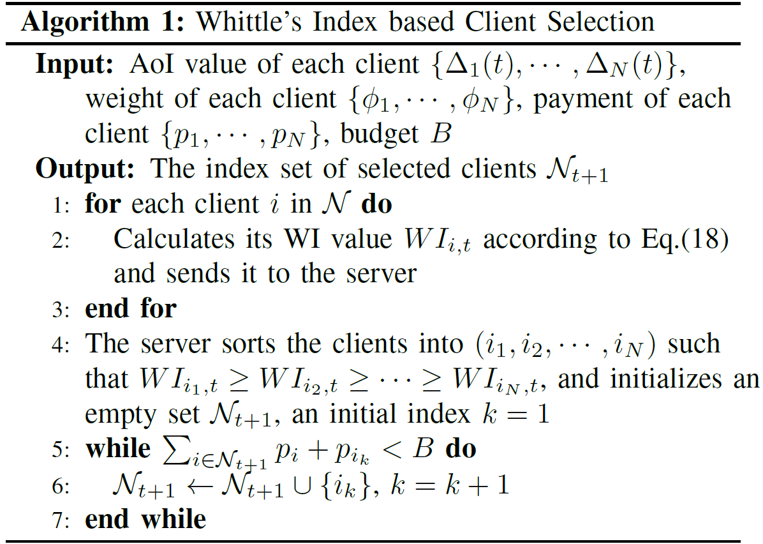































Algorithm
Budget=5 in
each round
$$φ_{i}=0.3$$
$$p_{i}=1.5$$
$$φ_{i}=0.4$$
$$p_{i}=3$$
$$φ_{i}=0.5$$
$$p_{i}=3.5$$
$$φ_{i}=0.6$$
$$p_{i}=2$$
$$φ_{i}=0.7$$
$$p_{i}=2.5$$
0
$$∆_{1}(0)=0$$
$${WI}_{1,0}=0.20$$
$$∆_{2}(0)=0$$
$${WI}_{2,0}=0.13$$
$$∆_{3}(0)=0$$
$${WI}_{3,0}=0.14$$
$$4(0)=0$$
$${WI}_{4,0}=0.30$$
$$∆_{5}(0)=0$$
$${WI}_{5,0}=0.28$$
1
$$∆_{1}(1)=1$$
$${WI}_{1,1}=1.20$$
$$∆_{2}(1)=1$$
$${WI}_{2,1}=0.80$$
$$∆_{3}(1)=1$$
$${WI}_{3,1}=0.86$$
$$∆_{4}(1)=0$$
$${WI}_{4,1}=0.30$$
$$∆_{5}(1)=0$$
$${WI}_{5,1}=0.28$$
2
$$∆_{1}(2)=0$$
$${WI}_{1,2}=0.20$$
$$∆_{2}(2)=2$$
$${WI}_{2,2}=1.50$$
$$∆_{3}(2)=0$$
$${WI}_{3,2}=0.14$$
$$∆_{4}(2)=1$$
$${WI}_{4,2}=1.80$$
$$∆_{5}(2)=1$$
$${WI}_{5,2}=1.20$$
3
$$∆_{1}(3)=1$$
$${WI}_{1,3}=1.20$$
$$∆_{2}(3)=0$$
$${WI}_{2,3}=0.13$$
$$∆_{3}(3)=1$$
$${WI}_{3,3}=0.86$$
$$∆_{4}(3)=0$$
$${WI}_{4,3}=0.30$$
$$∆_{5}(3)=2$$
$${WI}_{5,3}=3.36$$
4
$$∆_{1}(4)=0$$
$${WI}_{1,4}=0.20$$
$$∆_{2}(4)=1$$
$${WI}_{2,4}=0.80$$
$$∆_{3}(4)=2$$
$${WI}_{3,3}=1.71$$
$$∆_{4}(4)=1$$
$${WI}_{4,4}=1.80$$
$$∆_{5}(4)=0$$
$${WI}_{5,4}=0.28$$
T
C. Wu, M. Xiao, J. Wu, Y. Xu, J. Zhou, and H. Sun. Towards Federated Learning on Fresh Datasets
19

Slide 20
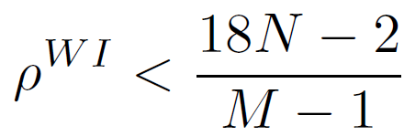
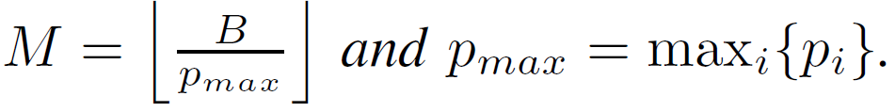
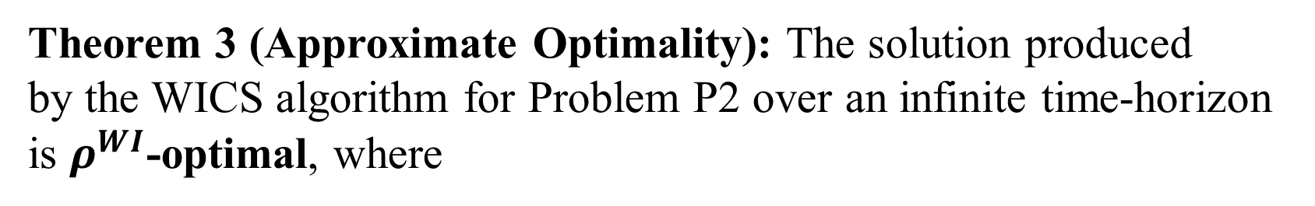
Algorithm Analysis
Theorem 3 (Approximate Optimality): The solution produced
by the WICS algorithm for Problem P2 over an infinite time-horizon is $ρ^{WI}$-optimal, where
Here,
NOTE: $ρ^{WI}$ will not be too large.
C. Wu, M. Xiao, J. Wu, Y. Xu, J. Zhou, and H. Sun. Towards Federated Learning on Fresh Datasets
20

Slide 21


Experimental Settings
Dataset and Model
Parameter settings
Dataset: MNIST and FMNIST (60,000 samples for training and 10,000 for test, IID)
Model: LR (convex) and CNN (non-convex, two $5×5$ convolution layers)
The number of clients N ranges from [10, 40]
The budget $B$ ranges from [25, 70]
The learning rate $η=$0.001
The number of time slots $T=200$
Compared Algorithms
Evaluation Metrics
WICS : our proposed algorithm
Random
MaxPack: based on AoI values
ABS: based on the time of last selection
Accuracy: the number of correct predictions
Loss: diff. between predicted and actual output
Average AoI of all clients
C. Wu, M. Xiao, J. Wu, Y. Xu, J. Zhou, and H. Sun. Towards Federated Learning on Fresh Datasets
21

Slide 22
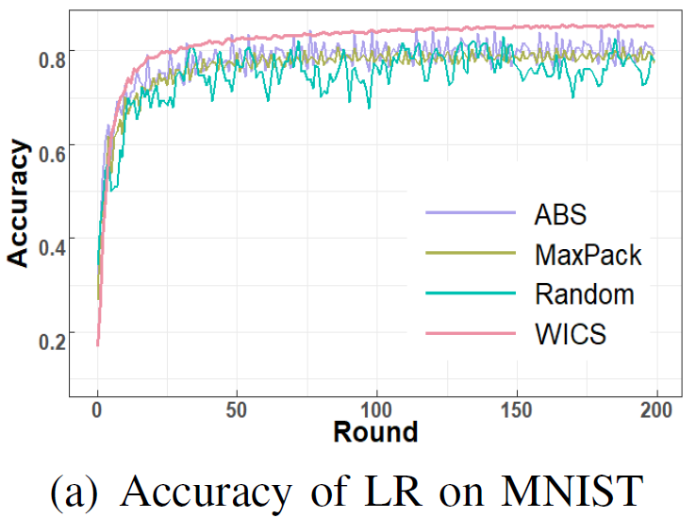
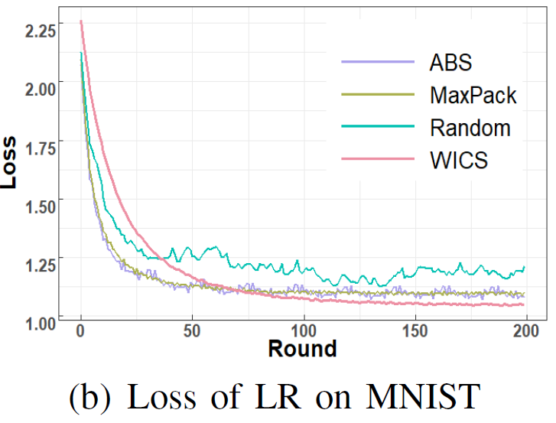
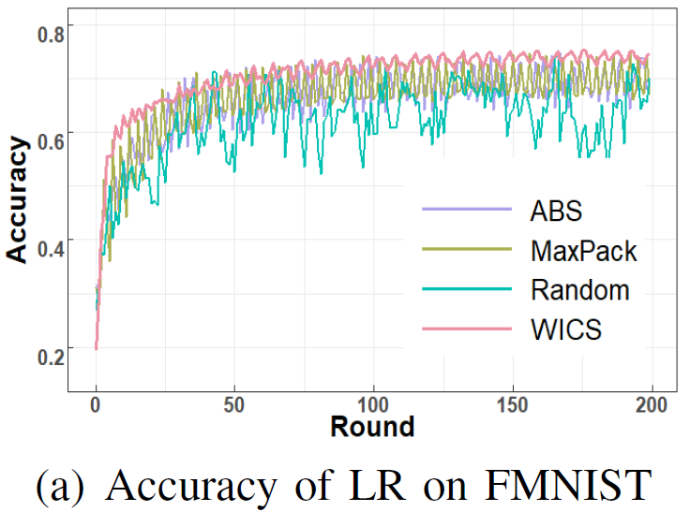
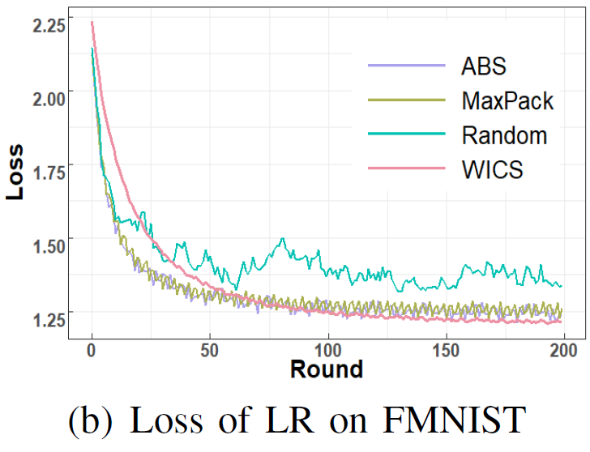
Performance of LR on MNIST and FMNIST
The accuracy of four algorithms rises along with the increase of rounds;
The loss of four algorithms descends with the increase of rounds;
WICS is better (in terms of accuracy and loss) than the three compared algorithms.
C. Wu, M. Xiao, J. Wu, Y. Xu, J. Zhou, and H. Sun. Towards Federated Learning on Fresh Datasets
22

Slide 23
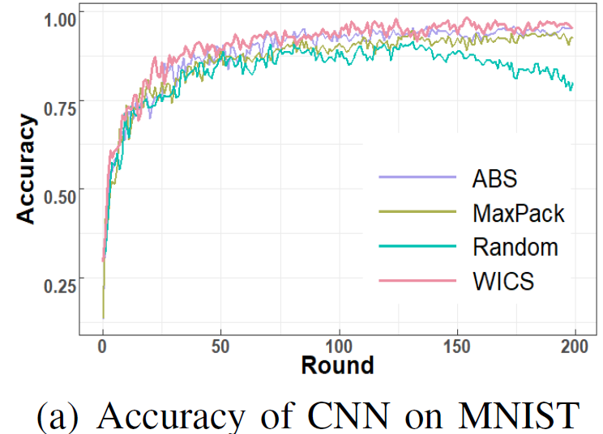



Performance of CNN on MNIST and FMNIST
When the loss function is non-convex (i.e., CNN), the performances of WICS are still better.
C. Wu, M. Xiao, J. Wu, Y. Xu, J. Zhou, and H. Sun. Towards Federated Learning on Fresh Datasets
23

Slide 24





Average AoI with Different Budget and Client Number
WICS can achieve the lowest weighted average AoI;
The weighted average AoI exhibits an uptrend with the increase of the number of clients $N$.
C. Wu, M. Xiao, J. Wu, Y. Xu, J. Zhou, and H. Sun. Towards Federated Learning on Fresh Datasets
24

Slide 25
Conclusions
Introduce a novel AoI-aware FL system, where the server tries to select suitable clients to provide fresh datasets for local model training.
Model the client selection problem as a restless multi-armed bandit, and propose the WICS algorithm by applying Whittle’s Index.
Prove the approximate optimality of WICS and evaluate the algorithm performance via simulations.
Future work:
Extend using discount factor based on time -- more weight on fresh information.
Investigate on fine-grained integration of fresh data and stale data.
C. Wu, M. Xiao, J. Wu, Y. Xu, J. Zhou, and H. Sun. Towards Federated Learning on Fresh Datasets
25

Slide 26

Q & A
C. Wu, M. Xiao, J. Wu, Y. Xu, J. Zhou, and H. Sun. Towards Federated Learning on Fresh Datasets
26

