Slide 1
Let’s Stay Together: Towards Traffic Aware Virtual Machine Placement in Data Centers
Xin Li, Jie Wu, Shaojie Tang, Sanglu Lu
Nanjing University
Temple University

Slide 2
Outline
Background and Scenario
Problem Statement
Homogeneous Case
Heterogeneous Case
Conclusion

Slide 3
Background
Virtual machine (VM) placement
Tenants submit their resource requirements to the cloud system, and the cloud decides how to implement the resource allocation.
One of the primary task in virtualization-based cloud system.
The cost is one of the major concerns for the cloud providers.
PM-cost
N-cost

Slide 4
Scenario
We use slot to represent one basic resource unit. (CPU/memory/disk)
Tenants submit their resource requirements, in terms of the number of VMs (slots).
Each slot host one VM
For one tenant, it could be one project group, and each VM can be assigned to one group member.
The VMs (group members) finish the task cooperatively.
There exists inter-VM communication.

Slide 5
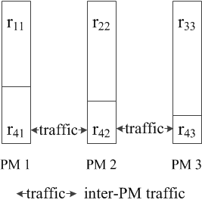
Virtual Machine Placement
Inter-PM traffic
Inter-VM traffic
The objective
Minimize the total inter-PM traffic.
How to determine the communication cost?
placement for 4 requests on 3 PMs: $r_{1}, r_{2}, r_{3}, r_{4}$.
$r_{ij}$: the VMs placed on PM $j$ of request $r_{i}$.

Slide 6
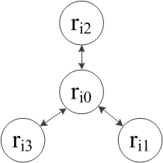
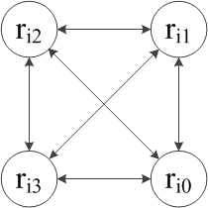
Communication Model
Two communication models
Centralized Model
Distributed Model
$r_{ij}$: the VMs placed on PM $j$ of request $r_{i}$.

Slide 7
Communication Cost
The traffics between VMs are assumed to be aware in most related works.
Here, we do NOT adopt this assumption.
We focus on network cost, measured by the number of traffic links between VMs
One request may be placed on multiple servers

Slide 8
Problem Statement
Given a set of requests $R=\{r_{i}|0≤i<n\}$, and a data center that consists of $m$ uniform PMs with $c$ slots for each. There may be traffic between VMs of the same tenant. Present a VM placement such that the overall network cost is minimized.
$φ_{i}$: the cost caused by request $i$
$r_{i}$: the requirement of request $i$
objective:
$$\min{\sum_{i=0}^{n−1}{φ_{i}^{}}}$$

Slide 9
Cost Function
Centralized Model Cost Function (CCF)
$φ_{i}^{(1)}=K_{i}$
Distributed Model Cost Function (DCF)
$φ_{i}^{(2)}=K_{i}^{2}$
Enhanced Distributed Model Cost Function (E-DCF)
$φ_{i}^{(3)}=\frac{1}{2}\sum_{κ=1}^{K_{i}}{r_{i}^{(κ)}⋅(r−r_{i}^{(κ)})}$
$K_{i}$: the number of fractions of request $i$.

Slide 10
Classification
Only N-cost is discussed, PM-cost is fixed as the minimal number of PMs that can host all of the required VMs.
Homogeneous case
$r_{i}=r_{j}=r$;
Heterogeneous case
otherwise.

Slide 11
Homogeneous Case
CCF
Recursive algorithm
Optimal solution
DCF
Algorithm based on the above recursive algorithm
Optimal solution
E-DCF
Recursive algorithm
Optimal solution

Slide 12
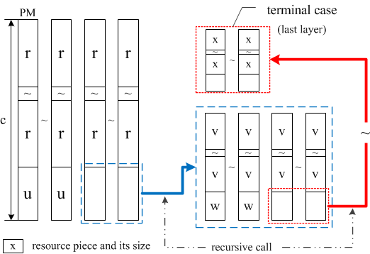
Homogeneous Case - CCF
Recursive algorithm
solution structure

Slide 13
Homogeneous Case - CCF
Basic idea
Achieve the perfect placement as many as possible, then split the unplaced requests into pieces.
Layer
Perfect placement (Stay Together)
All of the required VMs are placed on the same PM.
For each layer, the perfect placement may be different, i.e. the number of required VMs varies.
Piece
TPC: terminal-piece
CPC: continue-piece

Slide 14
Homogeneous Case - CCF
Piece
TPC, terminal piece
One piece is placed completely without split at some layer;
CPC, continue piece
Otherwise.
There is exactly one TPC for each request.
There is at most one CPC on each PM.

Slide 15
Solution Structure
$$c=α⋅r+u$$
$$r=β⋅u+v$$
TPC: r
CPC: u
$$c←u$$
$$r←v$$
TPC: v
CPC: w
recursively
solution structure
$$φ_{i}^{(1)}=K_{i}$$

Slide 16
Homogeneous Case - CCF
Swap operation
$s_{i}$: a set of pieces placed on PM $i$.
$swap(s_{i}, s_{j})$
$s_{i}=s_{j}$
$s_{i}>s_{j}$
Split $s_{i}$ into two parts, $s_{i}^{∗}$ and ${s_{i}^{}}^{Δ}$, such that $s_{i}^{∗}=s_{j}$, then swap $s_{i}^{∗}$ and $s_{j}$.
It is easy to get $s_{i}^{∗}$ by splitting ONLY one piece into two parts.
$s_{i}<s_{j}$

Slide 17
Optimality
Theorem
The recursive algorithm gives the optimal solution when $∀i, r_{i}=r≤c$, and $φ_{i}^{}=φ_{i}^{(1)}=K_{i}$, i.e., the CCF cost function.
Proof
Case $Ω$
For any PM, the sum of the sizes of the fragments is more than r.
Fragment
The piece that with the size less than $r$.

Slide 18
Proof
There is no case $Ω$ in our solution.
In the optimal solution, we can remove all of the case $Ω$.
Let $r_{ij}$ be one of the fragment, and $s_{j}$ be the union of the other fragments of PM $j$.
There must be another fragment $r_{ij′}$ on PM $j′$, and we have $s_{j}>r_{ij′}$ since $s_{j}+r_{ij}>r$.
Swap operation: $swap(s_{j},r_{ij^{′}})$.
The swap operation will not change the fact whether PM $j′$ contains case $Ω$ or not.

Slide 19
Proof (cont.)
Repeat the swap operation until there is only one piece for $r_{i}$, and the sum of the size of fragments on PM $j$ can be reduced by $r$.
There can be no case $Ω$ in the optimal solution.
Reduce the optimal solution to our solution.
There are $α$ perfect placement in the layer 0.
For the remaining pieces, we can do swap operation to gather the pieces of the same tenant as close as possible.

Slide 20
Solution Structure
$$c=α⋅r+u$$
$$r=β⋅u+v$$
TPC: r
CPC: u
$$c←u$$
$$r←v$$
TPC: v
CPC: w
recursively
solution structure
$$φ_{i}^{(1)}=K_{i}$$

Slide 21
Homogeneous Case - DCF
DCF: $φ_{i}^{(2)}=K_{i}^{2}$
CCF: the sum of the pieces is minimal.
The basic idea
To minimize the objective function, we should achieve the $K$ distribution like this: 1,1,…,1,2,…,2
Swap operation
For given number of items, to minimize the sum of the square of items, its sum should be minimized, and it achieves the minimal value when all the items are equal.

Slide 22
Homogeneous Case - Example

Slide 23
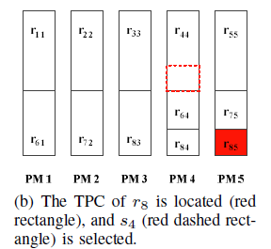
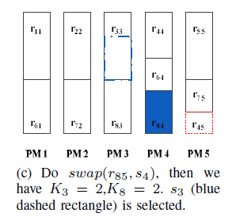
Optimality
Feasibility of the swap operation.
There must be at least 1 perfectly placed request on the PMs that contains CPC of $r_{i}$.
The perfectly placed request will provide its part to be swapped out of the PM.

Slide 24
Optimality (cont.)
Let the swap operation start from the TPC of $r_{i}$, so it is unnecessary for the PM that contains TPC of $r_{i}$.
Only one perfectly placed pieces on each PM is enough.
There is at most one CPC on each PM.
In fact, we have $α(α>1)$ perfectly placed pieces on each PM.

Slide 25
Optimality (cont.)
After the swap operations for all requests that have more than 2 pieces, their piece number becomes to 1.
For the other request that participate the swap operation (the perfectly placed request), their piece number becomes to 2.
For the other, their piece number remains unchanged.
We achieve the optimal $K$ distribution.

Slide 26
Homogeneous Case – E-DCF
The same algorithm as the case CCF.
Recursive algorithm
$φ_{i}^{(3)}=\frac{1}{2}\sum_{κ=1}^{K_{i}}{r_{i}^{(κ)}⋅(r−r_{i}^{(κ)})}$
We assume that $r_{iu},r_{iv},r_{ju}, r_{jv}$ are four pieces.
The four piece will not coexist in the optimal placement, because we can do $swap(r_{iu},r_{jv})$ or $swap(r_{iv},r_{ju})$.
If $r_{iu}≥r_{iv}$ and $r_{iu}+r_{iv}>r_{ju}$, then $r_{iu},r_{iv},r_{ju}$ will not coexist, since we can do $swap(r_{ju},r_{iv})$.

Slide 27
Optimality
From the two facts, we can construct the optimal solution from any give placement.
(1)Mark the pieces that have the size equal to $r$ as red; otherwise, black.
(2)Select the piece with largest size among the black pieces. (Assume that $r_{iu}$ is selected)
(3)Do $swap(r_{ju},r_{iv})$, as shown above, until no $r_{ju} or r_{iv}$ can be selected. Then mark the new $r_{iu}$ red.
(4)Repeat step 2 and 3, until all of the pieces are red.

Slide 28
Optimality (cont.)
The impact of the swap operation (step 3).
The piece $r_{iu}$ will be larger.
Feasibility of the swap operation.
$r_{iu}$ has the largest size among the black pieces.
When the swap operation will be terminated.
$K_{i}=1$ ($r_{iu}=r$)
The other pieces on PM $u$ are all marked as red.
If it still have black piece, the swap operation can continue.

Slide 29
Optimality (cont.)
The red piece will not participate the swap operation.
The red piece has the size equal to r; (step 1)
There are no black pieces on the PM it located.
From the construction process, there will be $α$ perfect placement on each PM, and other requests will occupy as fewer PM as possible.
The result matches the recursive solution.

Slide 30
Solution Structure
$$c=α⋅r+u$$
$$r=β⋅u+v$$
TPC: r
CPC: u
$$c←u$$
$$r←v$$
TPC: v
CPC: w
recursively
solution structure

Slide 31
Heterogeneous Case
SBP: Sorting-based Placement
Basic idea: place the requests with larger VM requirements first.
Sorting
According the number of VMs that tenants require
Ascending order
Place the first item of the sequence ($r_{0}$)
Case 1: perfect placement
Case 2: split $r_{0}$ into two pieces

Slide 32
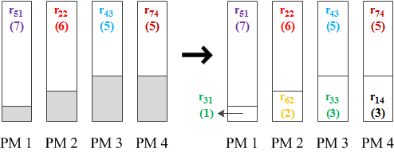
An Example
The inputs:
$r_{1}=3,r_{2}=6,r_{3}=4,r_{4}=5,r_{5}=7,r_{6}=2,r_{7}=5$
Different color
Sorting: 7，6，5，5，4，3，2

Slide 33
Greedy Algorithm
Basic idea
The basic idea of GBP is that, for each request, place the required VMs on the current PM as much as possible; when the current PM is fully loaded, then place the part that exceeds the PM capacity to the next PM. Hence, there are at most 2 pieces for each request. In fact, the total number of pieces will not exceed $m+n$, since there are at most $m$ requests that are split into two pieces.

Slide 34
Approximation Ratio of GA

Slide 35
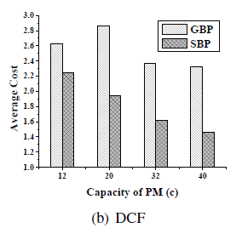
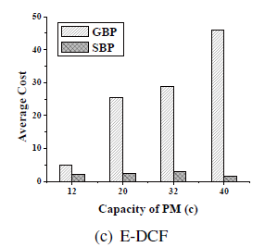
Comparison

Slide 36
Impact of Number of PMs

Slide 37
Conclusion
VM placement for network cost minimization.
Homogeneous case
Optimal solutions for 3 cost functions
CCF, DCF, E-DCF
Heterogeneous case
Approximation algorithm
2-approximation ratio for CCF.

Slide 38
Thank You!
Let’s Stay Together: Towards Traffic Aware Virtual Machine Placement in Data Centers
Xin Li
Email: lixin@dislab.nju.edu.cn

