Slide 1

Efficiently Collecting Histograms Over RFID Tags
Lei Xie, Hao Han, Qun Li, Jie Wu, and Sanglu Lu
State Key Laboratory for Novel Software Technology, Nanjing University, China
Department of Computer Science, College of William and Mary, USA
Department of Computer Information and Sciences, Temple University, USA
Presenter：Dr. Lei Xie
Associate Professor，Nanjing University, China
lxie@nju.edu.cn

Slide 2
Outline
Background and Motivation
Problem Formulation
Use Ensemble Sampling to Collect Histograms
Iceberg Query & Top-k Query
Performance Evaluation
Conclusion

Slide 3
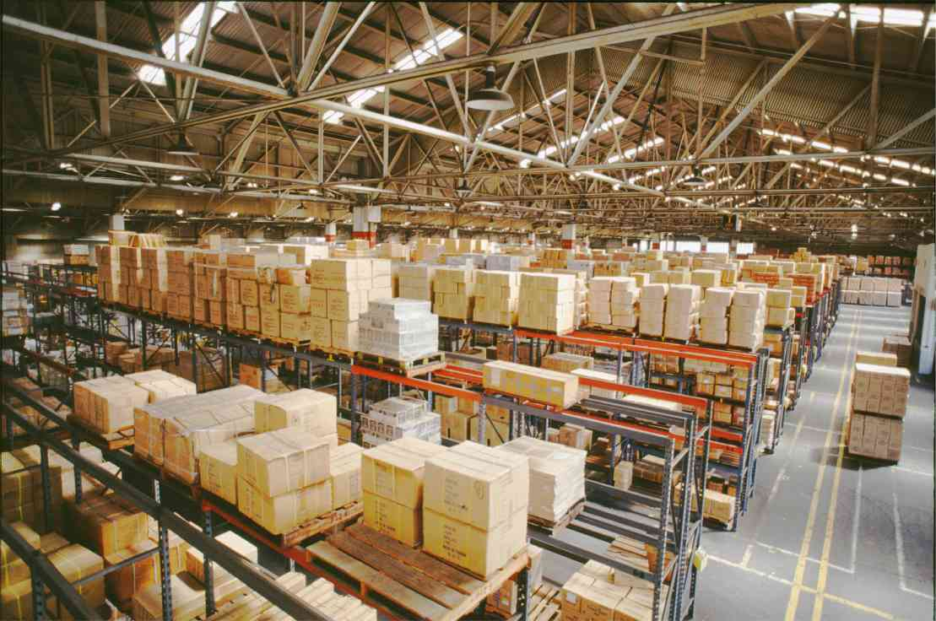


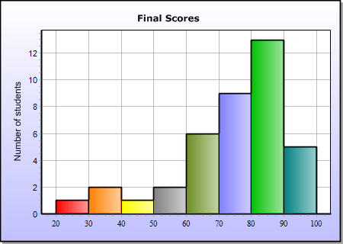
Background and Motivation
Applications with Passive RFID
Only some useful statistical information is essential to be collected:
Overall tag size
Popular categories
Histogram
RFID
Tag

Slide 4
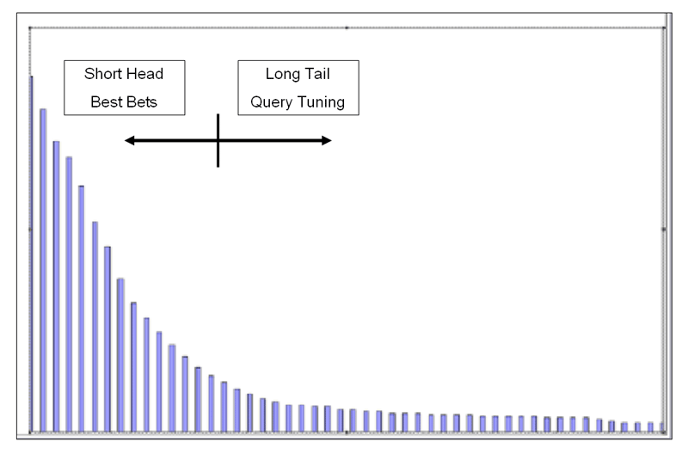
Background and Motivation
Histogram Collection
  Basic Histogram Collection
  Long Tail

Slide 5
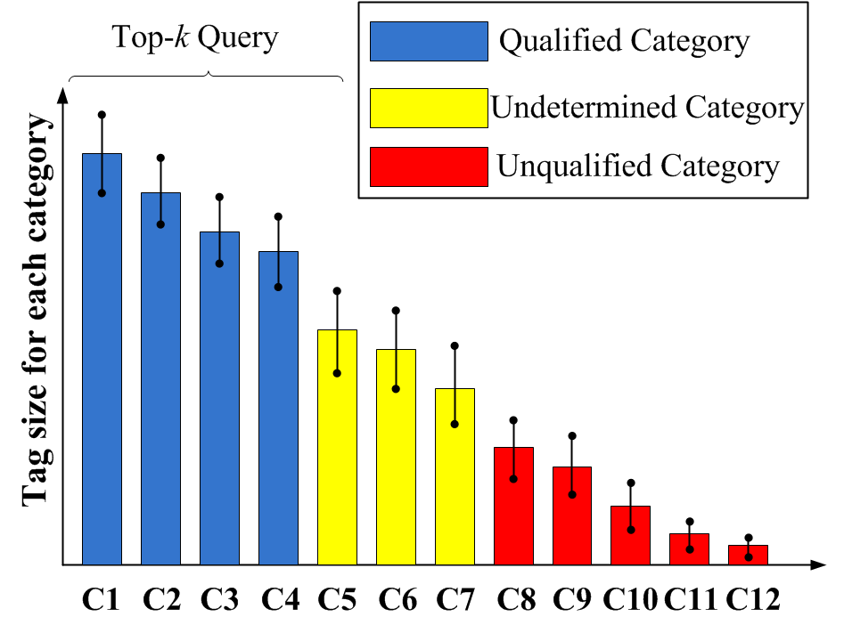
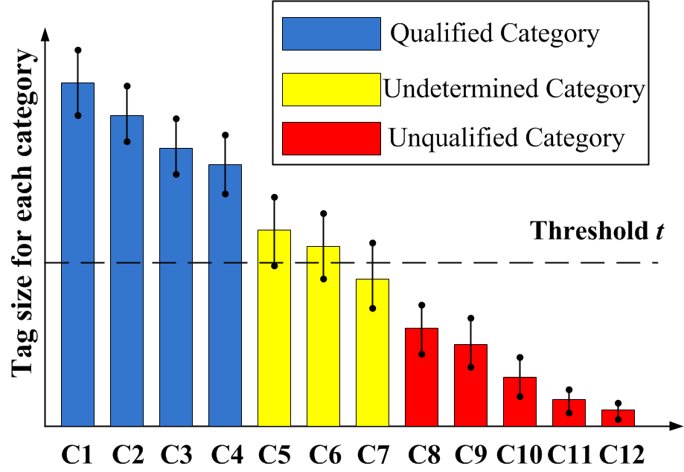
Background and Motivation
Advanced Histogram Collection
  Iceberg Query over Histogram
  Top-k Query over Histogram

Slide 6

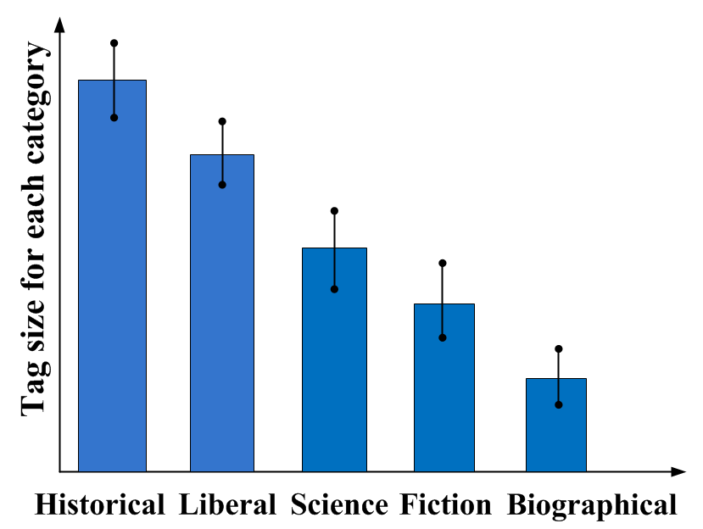
Background and Motivation
Application scenarios
  Approximately show me the number of books for each category in a large bookshelf?
Standard deviation

Slide 7
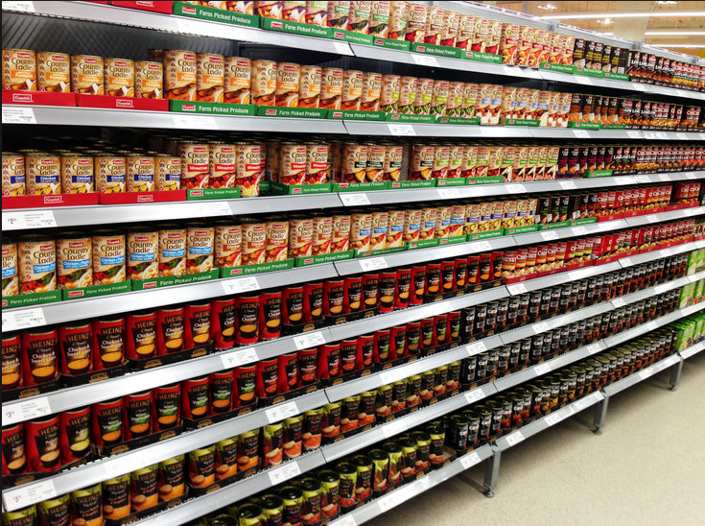
Background and Motivation
Application scenarios
  Approximately show me those categories with the quantity above 15 in supermarket shelves?
Find popular merchandise and control stock, e.g., automatically signaling when more products need to be put on the shelf.

Slide 8
Background and Motivation
Histogram Collection
  In most applications, the tags are frequently moving into and out of the effective scanning area.
  Traditional tag identification is not suitable for histogram collection
    Scanning time is proportional to the number of tags, in the order of several minutes.

Slide 9
Background and Motivation
Histogram Collection
  In order to capture the distribution statistics in time
    It is essential to sacrifice some accuracy.
    Obtain the distribution within the order of several seconds.
  Propose estimation scheme to quickly count the tag sizes of each category, while achieving the accuracy requirement.
  We aim to propose a series of novel solutions satisfying the properties:
    Time-efficient.
    Simple for the tag side in the protocol.
    Complies with the EPCglobal C1G2 standards.

Slide 10
Problem Formulation
Scenario
  A large number of tags (about 5000 tags) with a large number of categories (about 100 categories) in the effective scanning area.
  The slotted ALOHA-based anti-collision scheme is used.
  The present set of category IDs cannot be predicted in advance.
Objective
  Collect the histogram over RFID tags according to some categorized metric, e.g., the type of merchandise.
  Achieve time-efficiency while satisfying the accuracy /population constraints.

Slide 11
Basic Histogram Collection
Objective
  The RFID system needs to collect the histogram for all categories in a time-efficient approach.
Accuracy constraint
  Suppose the estimated tag size for category (1 ≤ 𝑖 ≤ 𝑚) is , then the accuracy constraint is
For example, if 𝜖 = 0.1, 𝛽 = 0.05, then for a category with tag size 𝑛𝑖 = 100, the estimated tag size should be within the range [90, 110] with a probability greater than 95%.

Slide 12
Basic Histogram Collection
Two straightforward solutions
  Basic Tag Identification
  Separate Counting
Both of the two solutions are not time-efficient.
  Basic tag identification: uniquely identifying each tag in the massive set is not scalable.
  Separate counting:
    The fixed initial frame size for each category, and the inter-cycle overhead among query cycles, make the scanning time rather large.
    The reader needs to scan each category with at least one query cycle, not necessarily addressed in the iceberg query or the top-𝑘 query.

Slide 13
Basic Histogram Collection
Ensemble sampling-based solution
  Issue a query cycle by selecting a certain number of categories.
  Obtain the empty/singleton/collision slots.
  Estimate the overall number of tags according to the observed number of empty/singleton/collision slots.
  Estimate the number of tags for each of the categories according to the sampling in the singleton slots.

Slide 14
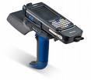

Basic Histogram Collection
Select C1, C3, C4
Estimate the overall tag size
14~17 tags
RFID Reader
RFID Tags
Ensemble sampling
C3
C4
C1
C3
0
X
1
1
X
0
1
X
0
1
0
Estimated tag size for each category:
C1: 3~5 tags
C3: 4~6 tags
C4: 5~7 tags
C1
C3
C4
C3
C4
C1
C4
C3
C4
C3
C1
C4
C1
C3
C4

Slide 15
Basic Histogram Collection
Ensemble sampling-based solution
The ensemble sampling is more preferred than the separate counting in terms of reading performance.
  More tags are involved in one query cycle-> more slots amortize the cost of inter-cycle overhead, the Select command, as well as the fixed initial frame size.
  The overall scanning time can be greatly reduced.
  In regard to iceberg query and top-k query, some optimization can be further applied with ensemble sampling to filter unqualified categories and estimate the threshold.

Slide 16
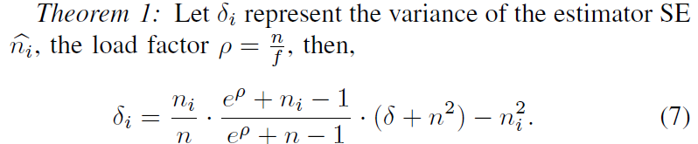
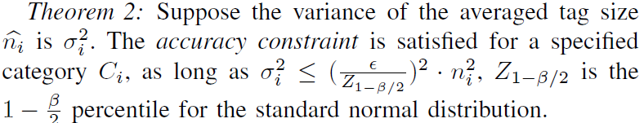
Basic Histogram Collection
Ensemble sampling-based solution
Accuracy Analysis
  The variance of the estimator
  Reduce the variance through repeated tests

Slide 17
Basic Histogram Collection
Property of the Ensemble Sampling
  During the ensemble sampling, the major categories occupy most of the singleton slots, those minor categories cannot obtain enough samplings in the singleton slots for accurate estimation of the tag size.
  Achieve the accuracy requirement for all categories -> the scanning time depends on the category with the smallest tag size, as the other categories must still be involved in the query cycle until this category achieves the accuracy requirement.
  Solution: Break the overall tags into several groups for separate ensemble sampling.

Slide 18
Basic Histogram Collection
Ensemble sampling-based solution
The optimal granularity for the group size in ensemble sampling
Each cycle of ensemble sampling should be applied over an appropriate group-> the variance of the tag sizes for the involved categories cannot be too large-> all categories in the same group achieve the accuracy requirement with very close finishing time.
Solution: dynamic programming

Slide 19

Basic Histogram Collection
Dynamic Programming-based Solution (Example)
A set of tags with 10 categories
(ranked in non-increasing order of the estimated tag size)
Category:
C1, C2, C3, C4, C5, C6, C7, C8, C9, C10
Rough tag size:
100, 80, 75, 41, 35, 30, 20, 15, 12, 8
Dynamic Programming:
We define T(i,j) as the minimum scanning time over the categories from Ci to Cj among various grouping strategies
𝑇(𝑖, 𝑗) is obtained by enumerating each possible combination of 𝑡(𝑖, 𝑘) and 𝑇(𝑘+1, 𝑗), and then getting the minimum of 𝑡(𝑖, 𝑘) + 𝑇(𝑘 + 1, 𝑗).

Slide 20
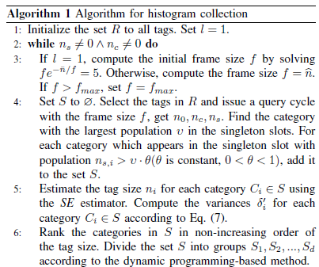
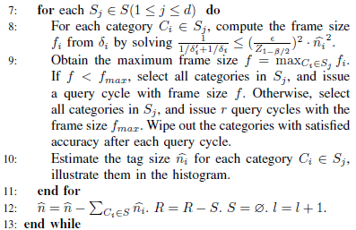
Basic Histogram Collection
Dynamic Programming-based Solution
Set an initial query round to roughly estimate the tag size.
Use dynamic programming to break the tags into smaller groups for ensemble sampling.
Ensemble sampling over each group for multiple cycles for the accuracy requirement.

Slide 21

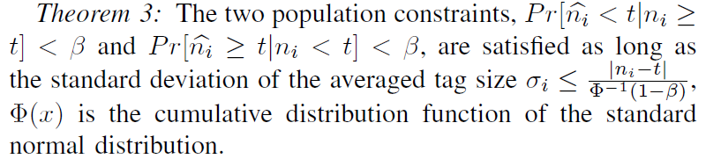
Iceberg Query Problem
Objective
  The RFID system needs to collect the histogram for those categories with tag size over a specified threshold 𝑡 in a time-efficient approach.
Accuracy constraint
Population constraint
Express population constraint in equivalent form

Slide 22
Iceberg Query Problem
Key issues in Iceberg Query Problem
  Quickly determine the qualified and unqualified categories according to the threshold.
Ensemble sampling-based solution
  As the number of repeated tests increases, the averaged variance 𝜎𝑖 for each category decreases-> the confidence interval for each category is shrinking.
  After a certain number of query cycles, all categories can be determined as qualified / unqualifed for the population constraint.

Slide 23
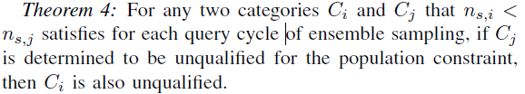
Iceberg Query Problem
Important clues to optimize the solution
  Unqualified categories: When the estimated value , the required variance in population constraint is much larger than accuracy constraint. They can be quickly identified as unqualified, wiped out immediately from ensemble sampling.
  Long tail: those categories each of which occupies a rather small percentage, but all together they occupy a substantial proportion. Quickly wipe out the categories in the long tail.

Slide 24
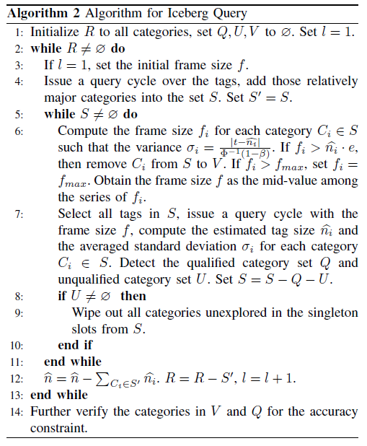
Iceberg Query Problem
Ensemble sampling based solution for Iceberg Query
  Qualified categories 𝑄
  Unqualified categories 𝑈
  Undetermined categories 𝑅
Ensemble sampling.
Wipe out unqualified categories quickly.
Wipe out unqualified categories in the “long tail”.

Slide 25

Top-k Query Problem
Objective
  The RFID system needs to collect the histogram for those categories in the top-k list in a time-efficient approach.
Accuracy constraint
Population constraint
Both Basic Tag Identification and Separate Counting are not suitable.

Slide 26
Top-k Query Problem
Important clues to optimize the solution
  As the exact value of tag size 𝑛𝑖 is unknown, in order to define 𝑃𝑟[𝐶𝑖 ∈ top-𝑘 list], it is essential to determine a threshold 𝑡 so that 𝑃𝑟[𝐶𝑖 ∈ top-𝑘 list] = 𝑃𝑟[𝑛𝑖 ≥ 𝑡].
  Ideally, 𝑡 should be the tag size of the 𝑘th largest category; however, it is difficult to compute an exact value of 𝑡 in the estimation scheme.
  If the threshold 𝑡 can be accurately estimated, then the top-𝑘 query problem is reduced to the iceberg query problem.
The key problem is to quickly determine the value of the threshold while satisfying the constraint.

Slide 27
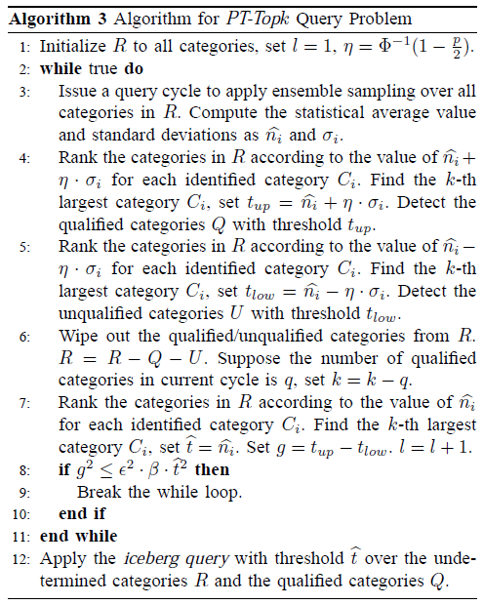
Top-k Query Problem
Ensemble sampling based solution for Top-k Query
Use ensemble sampling to estimate the threshold t:
rapidly make it converge to t.
Apply the Iceberg Query method.

Slide 28
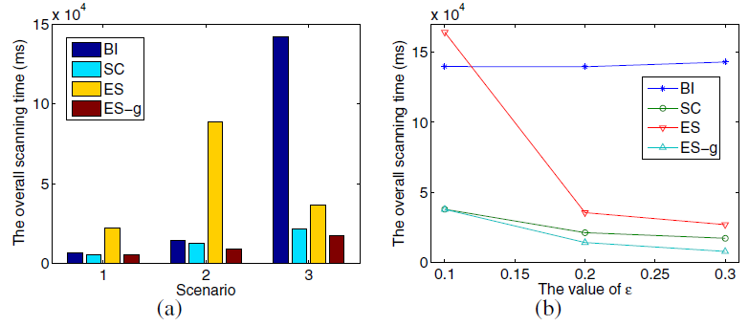
Performance Evaluation
The Performance in Basic Histogram Collection
BI: Basic Identification
SC: Separate Counting
ES: Ensemble sampling with one group
ES-g: Ensemble sampling with optimized grouping
Varying the number of categories and tag size
Varying the accuracy requirement

Slide 29
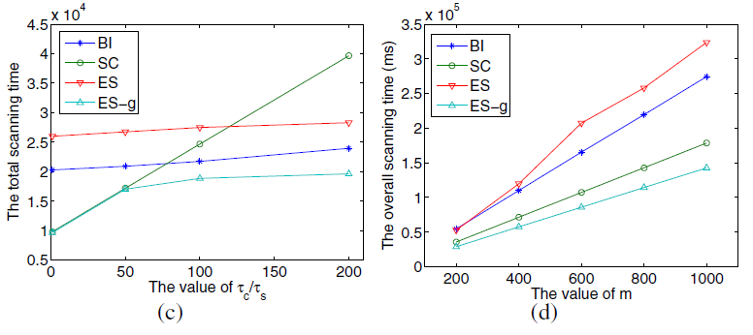
Performance Evaluation
The Performance in Basic Histogram Collection
Varying the inter-cycle overhead.
Varying the overall number of categories.

Slide 30
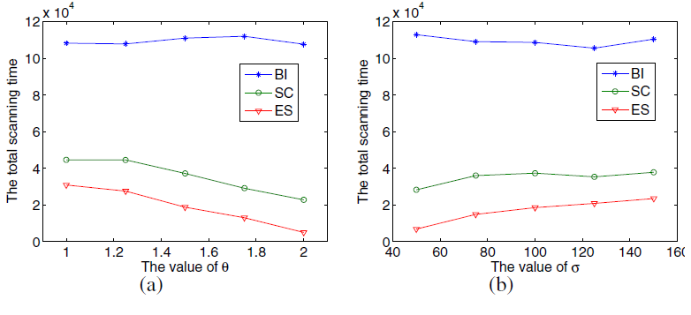
Performance Evaluation
The Performance in Advanced Histogram Collection
Varying the values of threshold ratio 𝜃 in iceberg query.
Varying the standard
deviation 𝜎 of tags size for various categories.

Slide 31
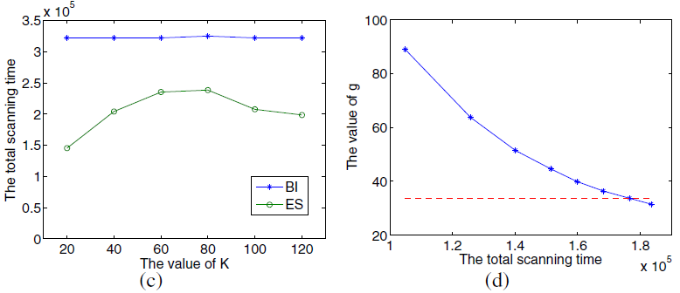
Performance Evaluation
The Performance in Advanced Histogram Collection
Varying the values of k in top-k query.
Evaluate the convergence for estimating the threshold 𝑡 in top-k query.

Slide 32
Conclusion
We propose a series of protocols to tackle the problem of efficient histogram collection
  Basic histogram collection
  Iceberg Query
  Top-k Query
To the best of our knowledge, we are the first to consider collecting histograms over RFID tags, a fundamental premise for queries and analysis in RFID applications.
We propose a novel, ensemble sampling-based method to simultaneously estimate the tag size for a number of categories.
Our solutions are completely compatible with current industry standards and do not require any modification to tags.

Slide 33
Q & A
Thanks for your attention!

