Slide 1
Dynamic Adaptation of In-Band Network Monitoring via Meta Learning
Mingyuan Zang∗, Eder Ollora Zaballa‡, Lars Dittmann‡, Jie Wu∗†
∗ China Telecom Cloud Computing Research Institute,
‡Technical University of Denmark, † Temple University
IEEE 50th Conference on Local Computer Networks (LCN)

Slide 2










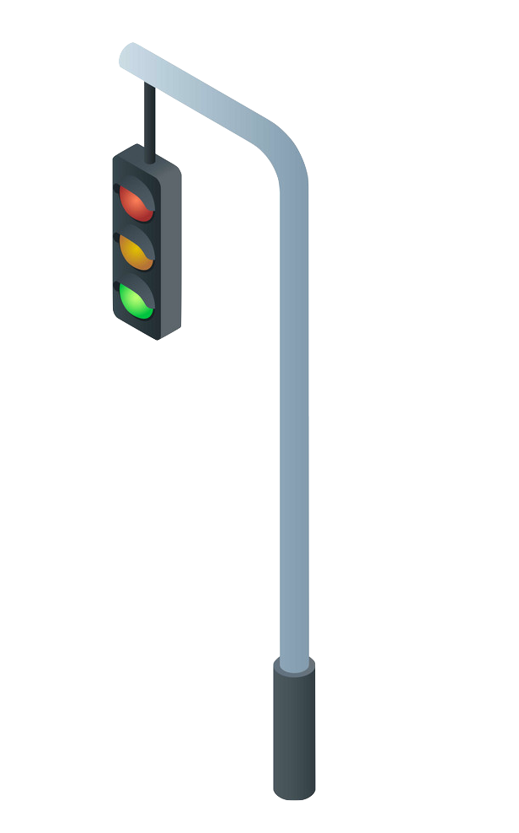
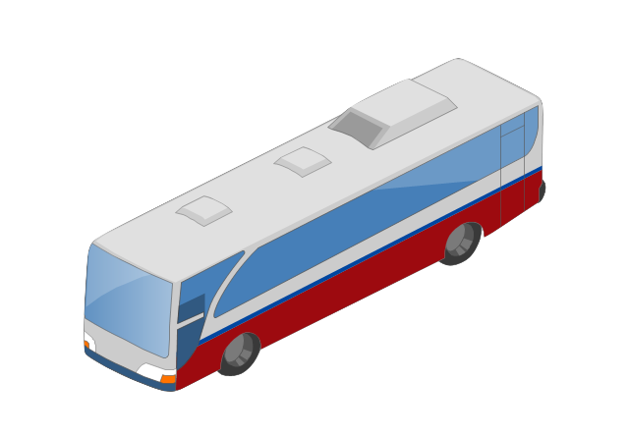
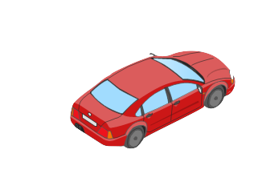
Internet of Things (IoT) Network
ML-based Analysis
Diverse use cases
Heterogeneous Access
Internet
5G/6G’s extremely low latency requirements + emerging attack variants in IoT
→ Fast spreading threats with changing patterns
IEEE 50th Conference on Local Computer Networks (LCN)

Slide 3


Internet of Things (IoT) Network
Diverse use cases
Heterogeneous Access
Internet
Programmable data planes enable flexible in-network traffic processing
IEEE 50th Conference on Local Computer Networks (LCN)
3

Slide 4


Dynamic Traffic Pattern
In-Band Feature Collection
Port Scan attack as an example:
A UDP packet sent to all ports and response from the target port
reflected by port, length distribution in packets
UDP + Port 53
UDP + Port 53 Data
UDP + Port 54
Collected Features:
Number of UDP packets
Number of unique port pairs
Max/min packet length
…
…
IEEE 50th Conference on Local Computer Networks (LCN)

Slide 5
Dynamic Traffic Pattern
In-Band Feature Collection
DDoS LOIT as an example:
Halfway handshakes triggered by numerous SYN
Reflected by the number, rate and TCP flags of packets within a time window
SYN
SYN ACK
SYN
Collected Features:
Number of TCP packets
Number of TCP SYN flags
Inter-Arrival Time (IAT)
…
SYN ACK
…
IEEE 50th Conference on Local Computer Networks (LCN)

Slide 6
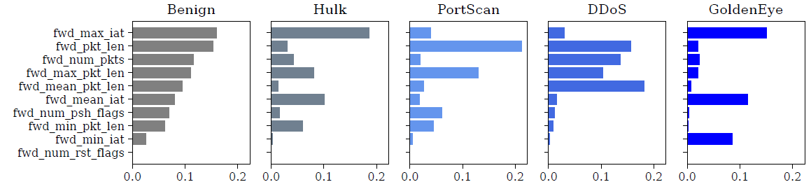
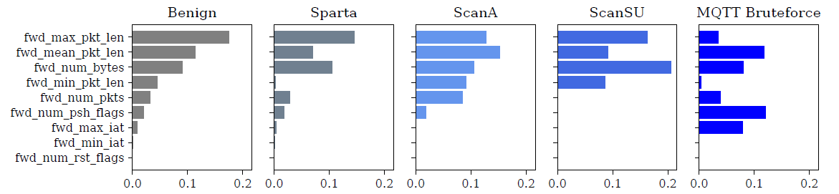
Dynamic Feature Importance
Distribution of Feature Importance
Dataset: CICIDS2017
Same group of features shows different levels of importance in attack identification
e.g. Inter-arrival time
Dataset: MQTT2020
IEEE 50th Conference on Local Computer Networks (LCN)

Slide 7
How to adaptively collect the new feature sets?

Slide 8
Programmable Data Plane
Programmable data plane with P4 language
Protocol-Independent architecture
Custom packet header & processing
More flexibility on the data plane
Feature Analysis
Control plane
Update
Incoming traffic
Forward
traffic
Feature Parse
Data plane
Design Target
Eth
IP
Custom hdr
Data
- Apply P4 for in-band feature collection
- ML algorithm for accurate & generalizable detection
IEEE 50th Conference on Local Computer Networks (LCN)

Slide 9
How to adaptively learn from new traffic patterns?

Slide 10

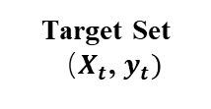
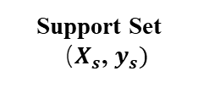

Proposed Design – Meta Learning
“Learning to learn”
Rapid adaptation to new scenarios with minimal data learned
Our work: Model-Agnostic Meta-Learning (MAML)
Optimization-based meta-learning
Inner loop (quick adaptation) + outer loop (stable convergence)
Stronger generalization
Support Set
${（X}_{s}$, $y_{s})$
Model
Support Set
Loss
Optimizer
Weight Update
Target Set
${（X}_{t}$, $y_{t})$
Inner Loop
Weight Update
Target Set
$$Σ Loss$$
Outer Loop
IEEE 50th Conference on Local Computer Networks (LCN)

Slide 11

Proposed Design – Framework
Step 1 Packet Parsing
Header fields are parsed and protocol information is extracted
Controller
Data Plane
Traffic
1
Eth
IP
UDP
Data
Switch
Cloud/Server
IEEE 50th Conference on Local Computer Networks (LCN)

Slide 12

Proposed Design – Framework
Step 2 & 3 Statistic Extraction
Stateful features are computed by hashing and updating counter registers
2
Feature
Selection
Controller
Data Plane
$f_{1}$... $f_{n}$
Traffic
Feature Extraction
1
3
Switch
Cloud/Server
IEEE 50th Conference on Local Computer Networks (LCN)

Slide 13

Proposed Design – Framework
Step 4 Report Encapsulation
When a packet arrives at the ingress port, a timestamp is recorded
Once the timestamp exceeds time window T, collected features {f1,..., fn} are read
Features are encapsulated in UDP report
2
Feature
Selection
Controller
Data Plane
$f_{1}$... $f_{n}$
UDP $f_{1}$... $f_{n}$Payload
Traffic
Feature Extraction
4
Report Encapsulation
1
3
Switch
Cloud/Server
IEEE 50th Conference on Local Computer Networks (LCN)

Slide 14
Proposed Design – Framework
Step 5 Feature Alignment
Feature alignment is performed to adapt to new feature sets
2
5
Feature Alignment
Feature
Selection
Controller
Data Plane
$f_{1}$... $f_{n}$
UDP $f_{1}$... $f_{n}$Payload
Traffic
Feature Extraction
4
Report Encapsulation
1
3
Switch
Cloud/Server
IEEE 50th Conference on Local Computer Networks (LCN)

Slide 15


Proposed Design – Framework
Step 6 Few-Shot Classification
Features are parsed and labeled by a pre-trained meta-learning model
The model is trained offline and then loaded for real-time inference on a small number of examples
2
5
6
Feature Alignment
Few-shot Classification
Feature
Selection
Controller
Data Plane
$f_{1}$... $f_{n}$
UDP $f_{1}$... $f_{n}$Payload
Traffic
Feature Extraction
4
Report Encapsulation
1
3
Switch
Cloud/Server
IEEE 50th Conference on Local Computer Networks (LCN)

Slide 16
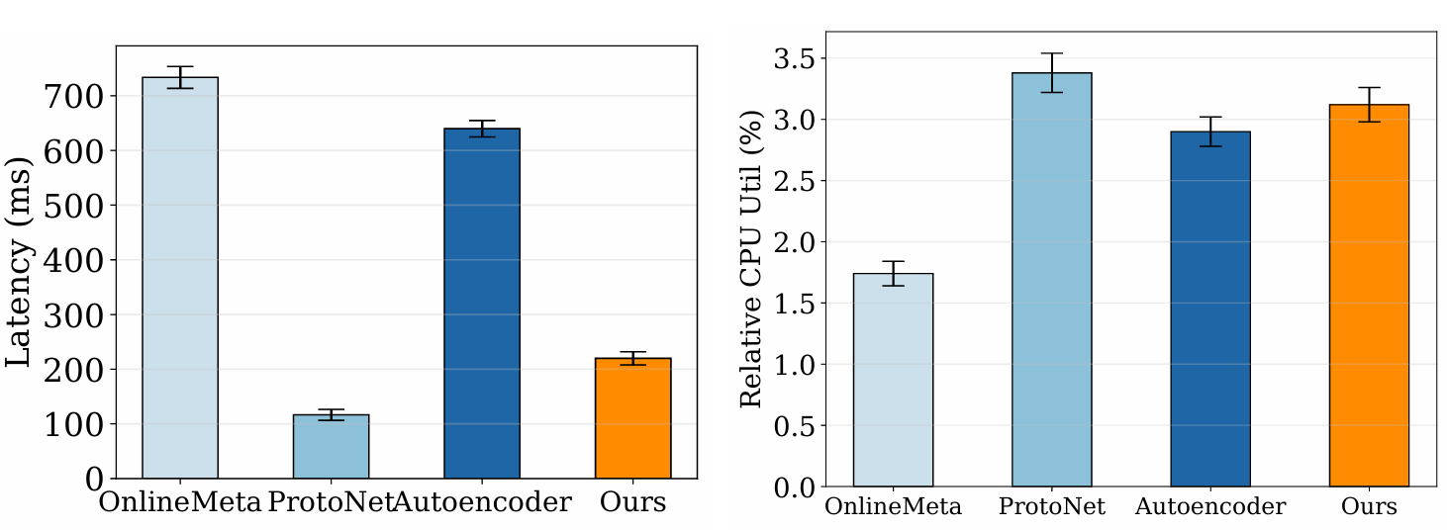
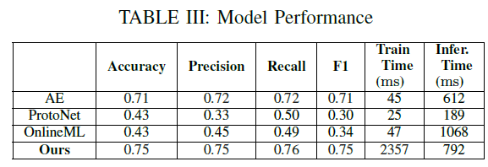
Evaluation Results
Public Dataset: public dataset CICIDS 2017, IoT Sentinel, MQTT2020
ML Baseline: Autoencoder, PotoNet, OnlineML
Prototype: BMv2 programmable switch + topology emulated in Mininet
Performance
>70% accuracy, better trade-off between accuracy/inference time, 1.5× faster latency
IEEE 50th Conference on Local Computer Networks (LCN)

Slide 17
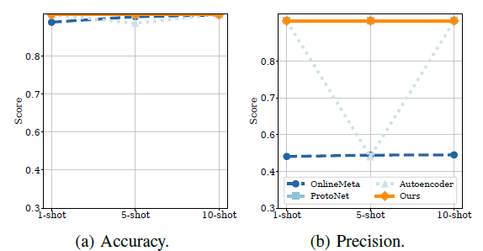
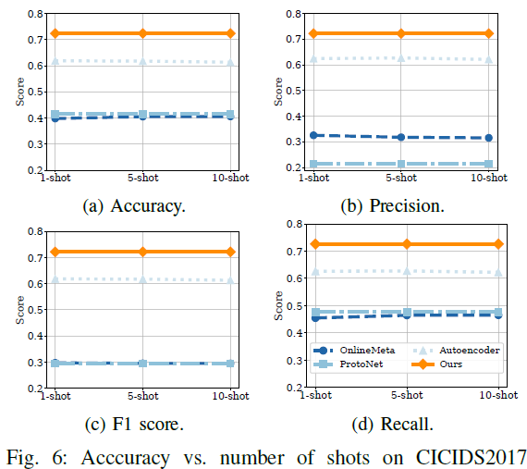
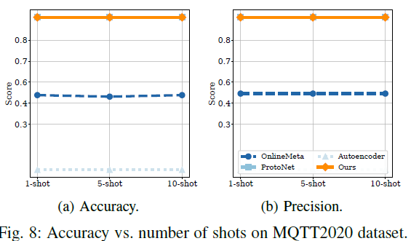
Evaluation Results
Performance
outperform baseline algorithms by 8%-17% higher accuracy across few-shot samples
Dataset: IoTSentinel
Dataset: CICIDS2017
Dataset: MQTT2020
IEEE 50th Conference on Local Computer Networks (LCN)

Slide 18
Conclusion
We present a framework to adaptively collect the new feature sets and promptly learn from them:
Accurate ML-based traffic analysis with reconfigurable feature parsing
Generalizable performance with reasonable learning time
- Lower manual recompilation overhead
Further work:
Scalable deployment scheme on hardware
Thanks! Questions?
IEEE 50th Conference on Local Computer Networks (LCN)

Slide 19

Proposed Design – Framework
Step 1 Packet Parsing
Header fields are parsed and protocol information is extracted
2
5
6
Feature Alignment
Few-shot Classification
Feature
Selection
Controller
Data Plane
Data Plane
Data Plane
$f_{1}$... $f_{n}$
UDP $f_{1}$... $f_{n}$Payload
$f_{1}$... $f_{n}$
$f_{1}$... $f_{n}$
Traffic
Feature Extraction
4
Report Encapsulation
UDP
UDP
1
3
Eth
IP
UDP
Data
Switch
Cloud/Server
IEEE 50th Conference on Local Computer Networks (LCN)

