Slide 1
Balancing Teaching, Research, Service, and Administration
Jie Wu
Dept. of Computer and Info. Sciences
Temple University
Notes:
1

Slide 2
Road Map
Introduction
Personal Experience
Teaching
Research
Service
Administration
Conclusion

Slide 3
Introduction
Teaching (T), Research (R), Service (S), and Administration (A)
What is expected of you
Reevaluate periodically (e.g., yearly)
Time allocation in career path
SIAT

Slide 4
Personal Experience
“Poor” education
3 years of middle school (1975-78)
BS/MS, Shanghai U. of Sci. & Tech. (SUST), 1982/1985
PhD, Florida Atlantic University (FAU), 1989
“Small” school experience
SUST (1985), FAU (1989), Temple U. (2009)
“First”
Programming language: Algol 60 (1976)
English book: A Discipline of Programming (1982)
Class taught: Pascal (1985)

Slide 5
Teaching
High-quality learning experience
Professor
Students
Depth and breadth
Research areas
General topics
Teaching and research relationship
Start teaching early in your career

Slide 6
Teaching Can Be Fun
Algorithm: seating problem
Several couples are seated in a round table. Each neighbor of person A should be of the same gender of A or the spouse of A.
hhhhwwww, hhwwhhww, hwwhwwhh, hwhwhwhw
Write a program that can quickly generate all “legal” streams
Results in a paper and an international research collaboration

Slide 7
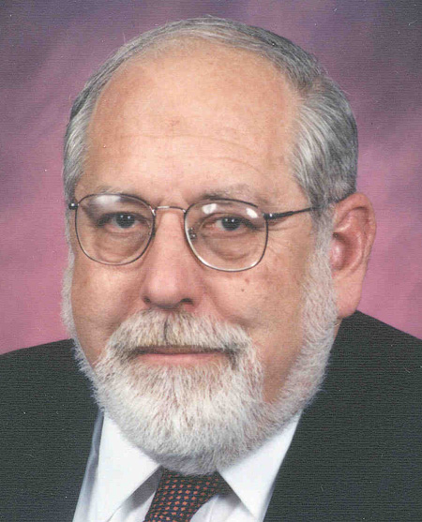
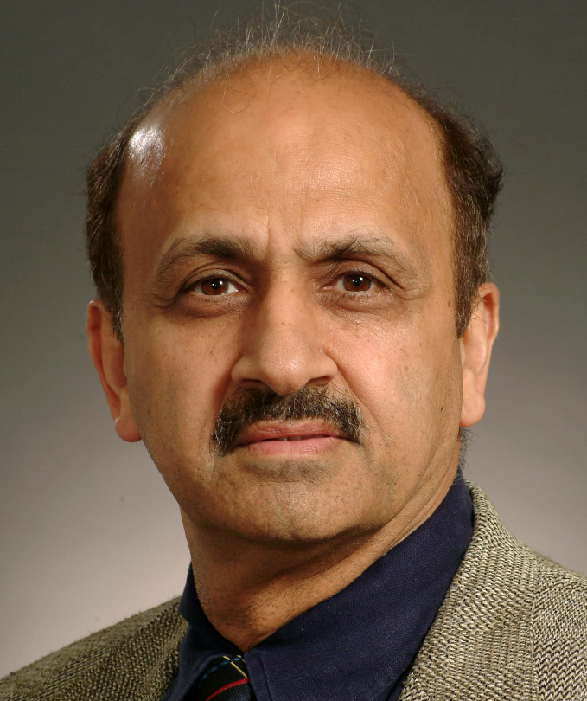
Scholar: A Serious Teacher
Ken Batcher
Sartaj Sahni

Slide 8
Research
Important decisions
Publication vs. grant
Individual research vs. collaborative research
Quantity vs. quality
CRA recommendation: quality and impact
Top 3 to 5 publications
Extended h-index?
How to measure intangible quality?
Quality comes from quantity
Analogy: leaves and flowers
Mozart and Beethoven: high quan. & high qual.
Orff (Carmina Burana) and Holst (Planets): low quan. & high qual.

Slide 9
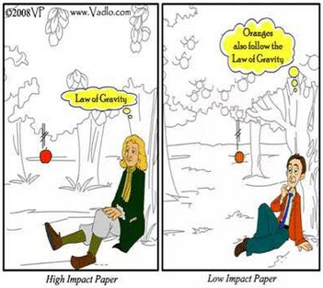
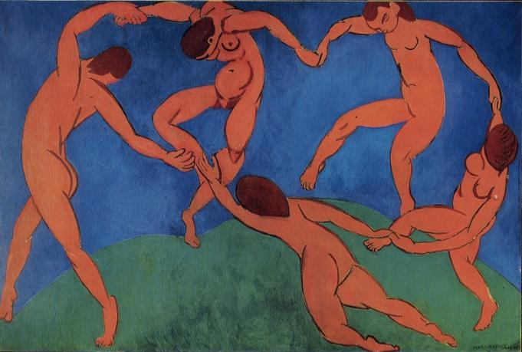
Research Quality
Originality
Balancing reading literature and writing your own paper(s)
Learn from artists
Abstraction + imagination

Slide 10
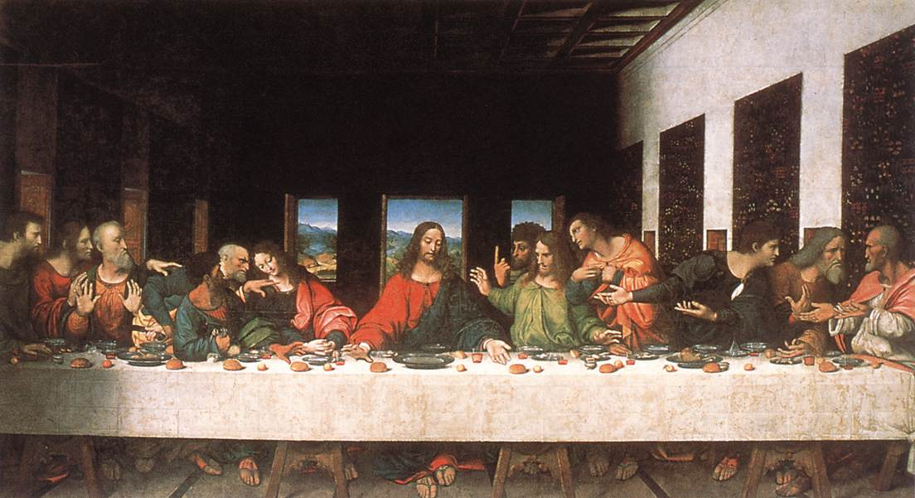
Abstraction and Imagination
Fibonacci seq. (F_{i} = F_{i-1} + F_{i-2}, 1, 2, 3, 5, 8, 13,…)
2, 4, 6, 10, 16, 26, 42,…
4, 8, 12, 20, 32, 54, 86,…
8, 16, 24, 40, 64, 104, 168, …
Fibonacci seq. in Last Supper

Slide 11
Research Can Be Fun
Mobile computing: cost optimization
Problem: The Washington, DC subway system charges fees based on travelling distance. For example, a passenger enters station A, stays there for X (say, 10) hours, and exits station B. The charge is proportional to the distance between A and B and is irrelevant to X.
What are the potential flaws? Provide possible solutions.
What happen if X is limited to 4 hours as in Nanjing, P. R. China?
A B
1, 2 (in)
2 (out)
2 (in)
1 (out)
1 (in)
2 (out)
2 (in)
1 (out)
1 (in)

Slide 12
Research Can Be Fun (con’t)
Problem: At the Shanghai int’l airport, taxi drivers have to wait for at least 4 hours. It is unfair to a driver if a passenger’s destination is the Industrial Park, which is about 20 minutes away. Others will go to downtown, which is 50 minutes away.
Find a solution so that the interests of both the drivers and the customers are protected.
Find potential flaws with the current solution at the Shanghai International Airport.

Slide 13
Service
Internal vs. external
Department, college, university
Reviewer, TPC, panelist, editor, invited speaker
External larger role
Conference GC and PC
Journal EIC
PDs in various agencies
Major roles in IEEE/ACM
How to choose?
Personal taste/judgement
General rule
Assis. professor (<35): department and limited external
Asso. professor (<40):
college and external
Full professor (>40):
university and larger role

Slide 14
Service Can Be Fun
IEEE HPCA ’99
Hotel selection
NSF NeTS PI meeting ’07
Effective program
IEEE IPDPS ’08
Keynote selection
IEEE INFOCOM ’11
Devils in details
IEEE ICDCS ’13
Dealing with the hotel
ACM MobiHoc ’14
Restaurant selection
NSF PD
Task/time management
Mobilizing the community
Teamwork
GC and TC
Optimal resource allocation
Best service with limited resources
Balancing quality (paper) and quantity (revenue)
Coordinating various chairs

Slide 15
Administration
Graduate PD
Assoc/Vice Chair
Chair
Assis/Assoc/Vice Dean
Dean
College, graduate, undergraduate, …
Assis/Assoc/Vice Provost and President
Research, Faculty Affairs, CIO, Int’l Affairs, …
Provost
President
Faculty vs. Administration
Most faculty felt that relationships are fair or poor
Less than 5% of faculty felt that they were influential
Almost no Chinese
as provost and president in Carnegie R1 universities

Slide 16
Administration (con’t)
Importance of being a chair
Shape-up department direction
General starts from a solider (e.g., chair)
Most important function of a chair
Faculty recruitment
Secure resources
Qualities
Vision
Knowledge
Commitment
Grit
Responsiveness
Fairness
Efficiency
Communication
Priority setting
Judgment
…

Slide 17
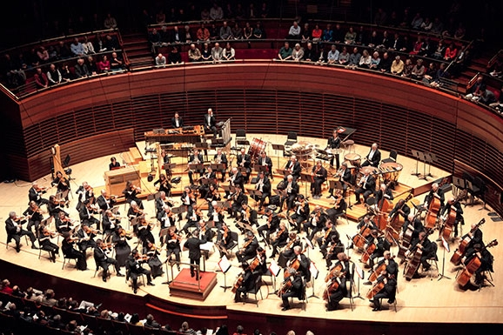
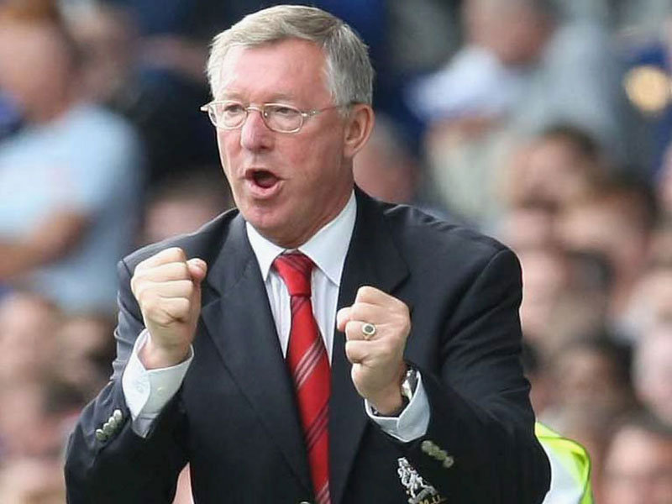
Becoming A Good Administrator
Music director in an orchestra
Sum of all its musicians
Manager of a football team
Former MU manager: Sir Alex Ferguson

Slide 18
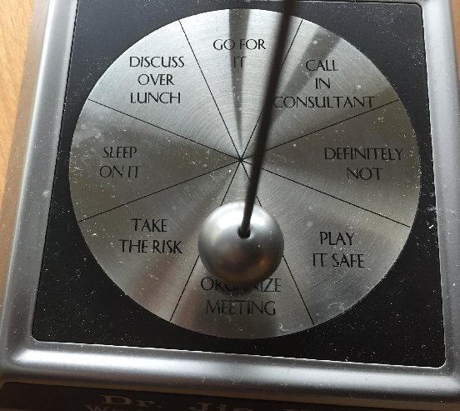
Administration Can Be Fun
Best approximation
(in impossible crises)
Judgment
Timing
Case: Trust management
Direct trust
Indirect trust
Mechanism design
Tie-in individual interests with societal (departmental) interests
Case: TA assignment
Matching with a credit system and a slide window

Slide 19
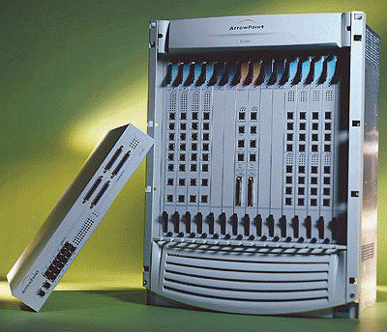
Additional Note
Nothing can replace
Hard work
Dealing with new “task/opportunity”
Prioritize tasks
Leave some room
Important vs. emergent
Optimize online/offline schedule
How to get more time
Less sleep
More exercise
Parallelism
Quick content switch

Slide 20
Balancing the Big Picture
Success
Outer achievements
Inner satisfaction/fulfillment
Science and humanism
Case: Attending a conference
Experience local culture (e.g. food) and shopping
Visit museums and attend a concert or sporting event
Case: Attending conference
Experience local culture (e.g. food) and shopping.
Visit museum and attend a concert or sport event.

Slide 21
Success vs. Happiness
Success ≠ Happiness
Meaningful work, love, and good health
Levels of happiness
Momentary (avoiding happiness dream)
Overall (be aware of expectation gap)
Spiritual (serving a purpose larger than yourself)
Case: Attending conference
Experience local culture (e.g. food) and shopping.
Visit museum and attend a concert or sport event.

Slide 22
Conclusion
Assistant professor
T + R + S
Associate professor
T + R + S
Full professor
T + R + S + A
Chair
T + R + S + A
Dean (and up)
S + A
Case: Attending conference
Experience local culture (e.g. food) and shopping.
Visit museum and attend a concert or sport event.

Slide 23
Conclusion (cont’d)
Quality, style, and taste
Show passion and enjoy what you do
Do not cut corners
“You can fool all the people some of the time; you fool some of the people all the time; but you can’t fool all the people all the time.”
Balancing the big picture
Career, family, and health

Slide 24
Future Events in Philadelphia
Case: Attending conference
Experience local culture (e.g. food) and shopping.
Visit museum and attend a concert or sport event.

