Slide 1
Backbone Discovery In Thick Wireless Linear Sensor Netorks
October 28, 2014
Imad Jawhar¹, Xin Li², Jie Wu³, and Nader Mohamed¹
¹College of Information Technology, United Arab Emirates University, Al Ain, UAE
²College of Computer Science and Technology, Nanjing University of Aeronautics and Astronautics, China
³Department of Computer and Information Sciences, Temple University, Philadelphia, PA, USA

Slide 2
Outline
Introduction: Linear Sensor Networks (LSNs). Applications and architectures
Thick LSN model and definitions
Algorithms for backbone discovery in thick LSNs
Related caching and routing strategies
Conclusions and future research

Slide 3
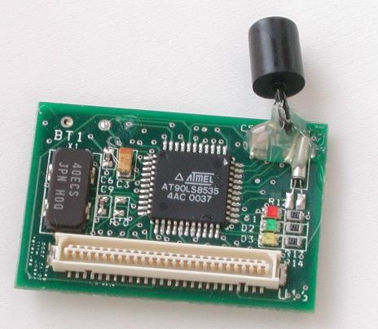
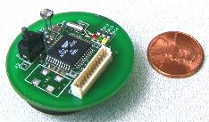
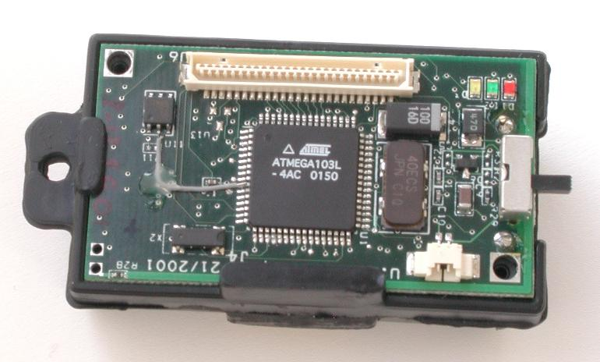
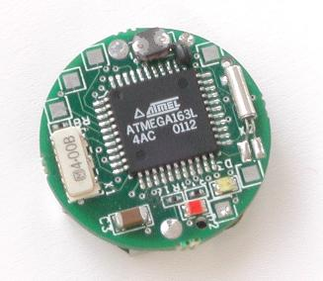
Wireless Sensor Networks
Wireless sensor networks (WSN) advancements in technology
Sensor networks application: environmental, military, agriculture, inventory control, healthcare, etc.

Slide 4
Applications of WSNs
Unusual Applications
DARPA Efforts
Defense Applications
Body Area Network
Greenhouse Monitoring
Applications of Wireless Sensor Networks
Smart Energy and Home/Office and Industrial Assembly Lines
Habitat Monitoring
Grand Duck Island Monitoring Network
Building, Bridge and Structural Monitoring
Health Care Monitoring
Notes:
4

Slide 5
Applications of WSNs
Judging by the interest shown by military, academia, and the media, innumerable applications do exist for WSNs:
  Weather monitoring
  Security and tactical surveillance
  Distributed computing
  Fault detection and diagnosis in:
    Machinery
    Large bridges
    Tall structures
  Detecting ambient conditions such as:
    Temperature
    Movement
    Sound
    Light
    Radiation
    Stress
    Vibration
    Smoke
    Gases
    impurities
  Presence of certain biological and chemical agents
Notes:
5

Slide 6
Linear Sensor Networks (LSNs)
Existing WSN research is 2-D or 3-D deployment.
Assumption that the network used for sensors does not have a predetermined structure.
Linear alignment of sensors can arise in many applications
Linear characteristic can be utilized for enhancing the routing and reliability in the such systems.
We can design adapted protocols for this special kind of sensor networks.

Slide 7



Applications of LSNs
Monitoring and protection of oil, gas, and water pipeline infrastructure using wireless sensor networks.

Slide 8

Oil, Gas, and Water Pipeline Use
UAE (2006):
  2,580 Km of gas pipelines
  2,950 Km of oil pipelines
  156 Km of refined products pipelines.
Desalinated water.
Saudi Arabia: 3,800 Km.
Use pipelines for transportation from plants to cities and populated areas.
Oil and gas industries heavily depend on pipelines for connecting shipping ports, refineries, and wells.
Types of pipelines: above ground, underground, under-water.

Slide 9
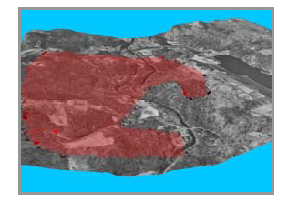
Border Monitoring
Monitoring international borders for different activities.
Illegal smuggling of goods, or drugs, unauthorized border crossings by civilian or military vehicles or persons, or any other kind of activities.
Different deployment strategies.
Deploy sensors by dropping them in a measured and controlled fashion from a low-flying airplane, installing them on a fence, etc.
Resulting topology: linear sensor network with a relatively uniform node density distribution.
Issues:
  Distance/density of different nodes
  Considering nature of the terrain.
  Available infrastructure.
  Desired level of performance and reliability

Slide 10
IVC Network
Roadside networks used to monitor vehicular activities.
Vehicle-to-Vehicle (V2V) via infrastructure.
Vehicles-to-Infrastructure (V2I) communication.
Internet access of vehicles (gateways on road side).
Alert to potential problems ahead, traffic conditions, accidents, road blockages, emergency braking, dangerous crossings, etc.
Vehicle controls can even take critical actions before the driver can respond in time.

Slide 11
Railroad/subway monitoring
Sensors to monitor fatigue-critical components in structure of a railroad bridge.
Sensors can monitor dynamic strains caused by the passing of trains.
Provide early detection of critical and dangerous cracks.
LSNs can be used to improve deployment cost, maintenance, and scalability.
Research: investigate the optimal parameters for such systems: density and distance of nodes, data rates, sensor technology.
Other applications: River, and sea cost monitoring, etc.

Slide 12
Classification of LSNs
Classification depends on deployment strategy and node types.
  Thin LSNs:
    Nodes along a line
  Thick LSNs:
    SNs scattered in 2-D random form between two parallel lines extending for long distance
    Backbone nodes have aggregation, compression, and routing responsibilities

Slide 13
Why New Protocols Needed for Thick LSNs
Speed-up route the route discovery and maintenance
Reduce control overhead and bandwidth utilization for route discovery
Increased routing fault tolerance and reliability
Reduce control overhead for route maintenance
Increased efficiency of location management

Slide 14
Why New Protocols Needed for Thick LSNs
Speed-up route the route discovery and maintenance
Reduce control overhead and bandwidth utilization for route discovery
Increased routing fault tolerance and reliability
Reduce control overhead for route maintenance
Increased efficiency of location management

Slide 15
Network Model - Area Partition
Area divided into blocks (squares): nodes located randomly in the area of [0, 0] x [10, 1].
Layer: Set of vertically aligned blocks. Considered a cluster.

Slide 16
Network Model - Area Partition
Area divided into blocks (squares): nodes located randomly in the area of [0, 0] x [10, 1].
Layer: Set of vertically aligned blocks. Considered a cluster.

Slide 17
Network Model - Received Signal Strength (RSS)

Slide 18
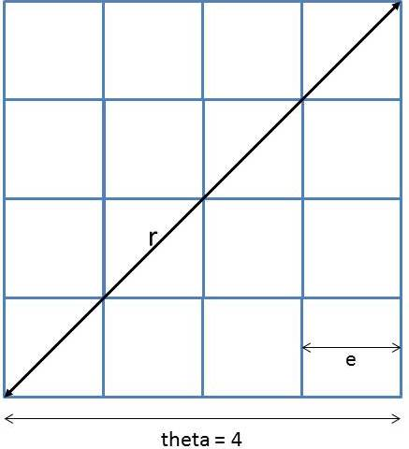
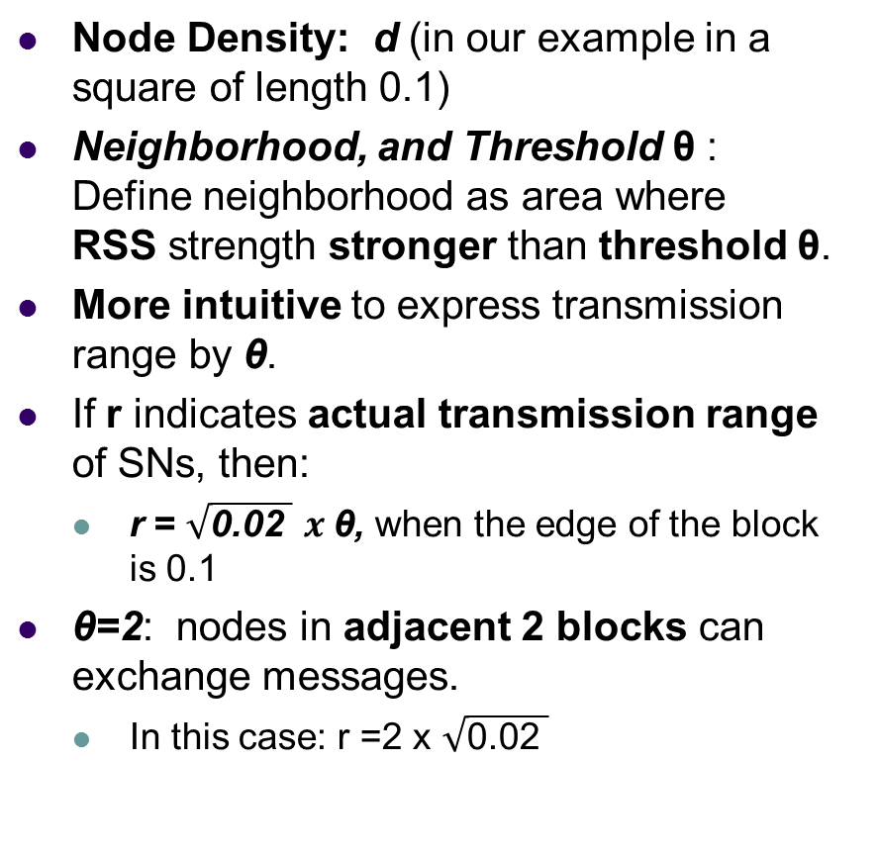
Network Model - Definitions
Node Density: d (in our example in a square of length 0.1)
Neighborhood, and Threshold θ : Define neighborhood as area where RSS strength stronger than threshold θ.
More intuitive to express transmission range by θ.
If r indicates actual transmission range of SNs, then:
  r = $\sqrt{\text{0.02 }}$ $x \text{θ}$, when the edge of the block is 0.1
θ=2: nodes in adjacent 2 blocks can exchange messages.
  In this case: r =2 x $\sqrt{\text{0.02 }}$

Slide 19
Two Backbone Discovery Strategies
Two next-hop selection strategies
  Weakest RSS (WR) Strategy.
  Strongest RSS (SR) Strategy.

Slide 20
Weakest RSS (WR) Strategy
Next hop neighbor with the weakest RSS is selected.
Leads to the selection of the neighbor that is farthest from the current node with the most progress towards the sink.
Advantage: Data can be transferred from the source node to destination node (sink) as fast as possible leading to lower end-to-end delay.
Limitations:
  Weaker link, so might have more errors at the MAC level or need to use lower data rate to avoid errors (for energy per bit)
  If we use more power in data transmission we can go to higher data rate with less errors but consume more energy.

Slide 21
Strongest RSS (SR) Strategy
Node selects neighbor with strongest RSS as next-hop node.
Leads to selection of nodes with smaller distance from transmitting node.
Advantage:
  Stronger link. With same transmission power.
  Can reduce data transmission range resulting in lower energy consumption.
Comes at the price of increased end-to-end delay.

Slide 22
Layer Information to Avoid Backward Selection
Layer is taken into account to avoid the selection of nodes in the backward direction.
  Algorithms do not select the neighbors with lower number layers as the next-hop node.
  Layer information is included in broadcasted messages.

Slide 23
Discovered Backbone Caching
Discovery Completed (DCOP) Message: When discovery reaches end node DCOMP message sent along discovered backbone.
Backbone Caching: As DCOMP message propagates nodes caches backbone node IDs.
Two strategies:
  Partial backbone caching: k neighbor in each direction.
    Less memory overhead
    Less information for routing protocol
  Full backbone caching: All backbone nodes cached.
    More memory overhead but more information for routing.
    Can help choosing direction with lower energy (smart routing)

Slide 24
Example of Routing Process and Reaction to Node Failures
Jump Always (JA) Algorithm:
  If message encounters a failed node it increases its transmission range to reach the node following current one.
  If MAX_JUMP_FACTOR is reached and message is dropped.
Redirect Always (RA) Algorithm:
  Good when no range extension is possible.
  If message reaches a failed node, it is redirected in the opposite direction. If already redirected it is dropped (redirection flag inside message is used).
Smart Redirect and Jump (SRJ) Algorithm:
  A combination of the first two algorithms JA and RA.
  Node calculates total necessary energy to reach each of the sinks on both sides and transmits in the least necessary energy direction.

Slide 25
Analysis
We analyze the algorithms from the following aspects:
  Node Selection strategy
  Total number of hops in backbone
  Transmission threshold
  Node density

Slide 26
Backbone Selection: WR Strategy (Smaller Number of Hops)

Slide 27
Weakest RSS (WR) Algorithm
WR Strategy: Neighbor longer distance is selected. Less hops to destination
Density reduced effect on minimal number of hops in backbone. Though there are more neighbors when the density is high
As threshold θ increases number of hops in the backbone decreases (inversely proportional).
But results in higher energy consumption resulting in earlier expected failure of discovered backbone.

Slide 28
Illustration of Backbone Selection with WR Strategy
With density d = 1
For red line: θ = 3 => 28 nodes in backbone.
For blue line: θ = 10 => 9 nodes in backbone.
When transmission range is large enough, path tends to be a straight line.

Slide 29
Backbone Selection: SR Strategy
(Higher Number of Hops)

Slide 30
Backbone Selection – SR Strategy
Shorter distance neighbor selected and number of hops increases.
Node transmission range θ has less effect on number of nodes in backbone.
Implies we can adjust trans. range to be shorter.
  Effective way to save energy for nodes in backbone, and reduce interference. But more end-to-end delay
When density increases, there are more nodes in area, and more nodes are selected.
  Large number of nodes in backbone unnecessary.
  Motivates us to let more nodes switch to sleep mode to save energy.

Slide 31
Backbone Selection – SR Strategy
We let d = 1 and θ = 1.2, to save energy consumption (TX power exponentially proportional to TX range).
Red-colored backbone => 195 nodes. Next-hop node is in layer more than or equal to that of sending node (can choose next-hop nodes in same layer)
Blue-colored backbone => 100 nodes. Next-hop node is in layer strictly more than that of sending node.
Strictly more than is a frequently used method to select one node from each cluster (layer in our paper).

Slide 32
More Analysis – Some Final Notes
Same algorithms work for the case of thin LSNs.
Thickness of the LSN varies according to the requirements of the corresponding application.
Energy consumption, P, is proportional to transmission range, r^{α}, where(2 ≤ α ≤ 4)
We can easily get result for how energy is consumed as transmission range r changes

Slide 33
Conclusions
Stated some of the applications for thick LSNs in order to motivate the research
Presented backbone discovery algorithms for thick LSNs.
Backbone can later be used for efficient routing of messages between nodes and sinks at either or both ends of the network.
Two different strategies for backbone discovery are presented and analyzed. Based on criteria for next-hop neighbor selection using RSS by sending node.

Slide 34
Conclusions – Cont’d
Proposed algorithms can constitute a good foundation for further future research in this area.
For long thick LSNs, which might extend for tens or hundreds of kilometers, multiple segments separated by sinks can be used to provide added efficiency, reliability, and scalability to the network and associated routing protocol.
Thick LSNs offer a good amount of issues and challenges that need further investigation.
Can work on more optimizations to enhance the routing, reliability, and energy efficiency.

Slide 35
Thank you.
Questions?

