Slide 1

Coverage and Distinguishability in Traffic Flow Monitoring
Huanyang Zheng, Wei Chang, and Jie Wu
Dept. of Computer and Info. Sciences
Temple University
Notes:
1

Slide 2

Road Map
  1. Introduction
  2. Model and Formulation
  3. Related Work
  4. Problem Analysis and Algorithms
  5. Experiments
  6. Conclusion

Slide 3
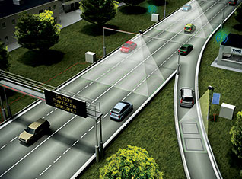
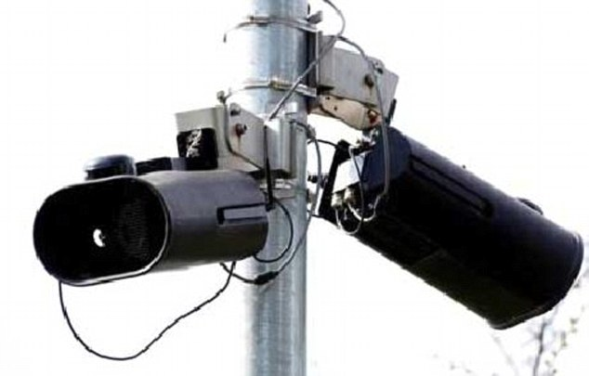

1. Introduction
  Traffic flow monitoring system
  Camera and WiFi based monitor
  Roadside Unit (RSU) deployment
  Multiple applications
  Outdoor flow rate with flow trajectory
  Indoor tracking with beacon messages
  General network (SDN) monitoring

Slide 4
RSU placement
  RSU placement problem (given traffic flows)
  Coverage
  Each traffic flow goes through at least one RSU
  Distinguishability
  The set of bypassed RSUs is unique for each flow
  Objective
  Minimize the number of placed RSUs

Slide 5
Example 1
  f₂ and f₃ are covered, but not distinguishable
  f₁ : {e₅, e₆} f₂ : {e₃, e₅} f₃ : {e₃, e₄}

Slide 6
Example 2
  f₁, f₂ and f₃ are distinguishable, but f₁ is uncovered
  f₁ : {e₅, e₆} f₂ : {e₃, e₅} f₃ : {e₃, e₄}

Slide 7
2. Model and Formulation
  Graph G = (V, E)
  V: street intersections, and E: streets
  F = {f₁, f₂, …, f_{n}} is a set of n known traffic flows on G
  S is a subset of E on which RSUs are placed
  S(f) is a subset of S that covers f

Slide 8
Another Example
  S = {e₃, e₅} with F = {f₁, f₂, f₃}
f₁: {e₅, e₆} S(f₁) = {e₅} | f₂: {e₃, e₅} S(f₂) = {e₃, e₅} | f₃: {e₃, e₄} S(f₃) = {e₃}
  All traffic flows are covered and
  distinguishable

Slide 9
Formulation
  Objective is minimizing the number of RSUs
  Coverage
  Each traffic flow goes through at least one RSU
  Distinguishability
  The set of bypassed RSUs is unique for each flow
minimize |S| (# of RSUs)
s.t. S(f) ≠ ∅ for ∀f ∈ F (coverage)
S(f) ≠ S(f′) for f ≠ f′ (distinguishability)

Slide 10
3. Related Work: Set Cover Problem
  Use minimal sets to cover all elements
  Greedy algorithm with max marginal coverage has a ratio
  of log n due to submodularity
  Complexity: O(p²q)
  p: # of sets
  q: # of elements

Slide 11
Submodularity
  N(S): # of covered (and distinguishable) flows under S
  Monotonicity: N(S) ≤ N(S’) for ∀S ⊆ S’, S’ ⊆ E
  Submodularity: N(S∪{e})−N(S) ≥ N(S’∪{e})−N(S’) for ∀e∈E
  Monotonicity enables greedy approaches
  Submodularity ensures bounds

Slide 12
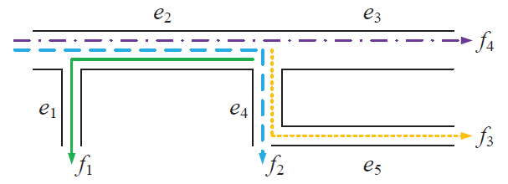
4. Problem Analysis and Algorithms
  NP-hard: reduction from the set cover problem
  Counter-example of submodularity using traditional coverage
  Existence case: S = {e₁} and S’ = {e₁, e₄}
N(S) = N(S ∪ {e₂}) = N(S’) = 1, only f₁ is covered
N(S’ ∪ {e₂}) = 4, all flows are covered/distinguishable
N(S ∪ {e₂}) − N(S) = 0 < N(S’ ∪ {e₂}) − N(S’) = 3

Slide 13
2-out-of-3 principle
  Key idea: place pairwise distinguishability in coverage
  To cover and distinguish an arbitrary pair of traffic
  flows (f and f′), two RSUs should be placed on streets
  from two different subsets of f\f′, f′\f, and f ∩ f′.

Slide 14
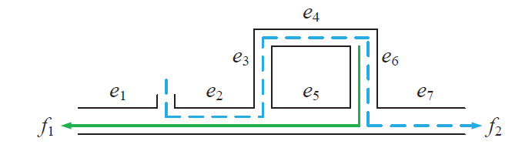
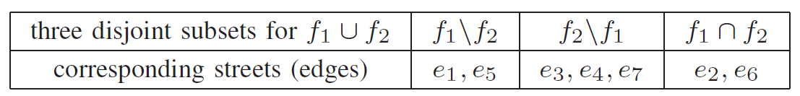
2-out-of-3 Example
  Subsets
  To satisfy S(f₁) ≠ ∅, S(f₂) ≠ ∅, and S(f₁) ≠ S(f₂)
  S can have {e₁, e₃}, {e₂, e₄}, or {e₅, e₆}
  cannot have {e₁, e₅}, {e₃, e₄}, or {e₂, e₆}

Slide 15
Simple Algorithm
  Pair-Based Greedy (PBG)
  Idea: place a pair of RSUs in each greedy iteration
  Initialize S = ∅
  while there exists a pair of traffic flows do
  Update S to place a pair of RSUs that cover and
  distinguish maximum pairs of traffic flows
  Remove corresponding pairs of traffic flows
  return S
  Element in submodular coverage: a pair of RSUs

Slide 16
PBG Performance
  Approximation ratio: n * ln [n(n-1)/2]
  n is the number of traffic flows
  Prove by converting to set cover problems
  Pair conversion brings a loss ratio of n, and set cover
  has a ratio of ln [n(n-1)/2] with n(n-1)/2 sets
  Time complexity: O(n²|E|³)
Each greedy iteration visits |E|² pairs of RSUs
for n² pairs of traffic flows, with |E| iterations.

Slide 17
3-out-of-3 Principle
To cover and distinguish an arbitrary pair of traffic
flows (f and f′), each of f, f′, and f△f′ = (f\f′)∪(f′\f)
should include a street with a placed RSU.

Slide 18
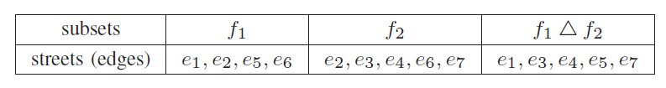
3-out-of-3 Example
Subsets
  To satisfy S(f₁) ≠ ∅, S(f₂) ≠ ∅, and S(f₁) ≠ S(f₂)
S can have {e₁, e₃}, {e₂, e₄}, or {e₅, e₆}
cannot have {e₁, e₅}, {e₃, e₄}, or {e₂, e₆}

Slide 19
Improved Algorithm
  Improved Subset-Based Greedy (ISBG)
  Idea: in each greedy iteration, place an RSU that is in
  maximal subsets of f, f′, and f △ f′
  Initialize S = ∅
  for each pair of traffic flows (say f and f’) do
  Generate subsets of f, f′, and f △ f′
  while there exists a subset do
  Update S to place an RSU that is in
  maximal subsets, remove corresponding subsets
  return S
  Elements in submodular coverage: each RSU

Slide 20
ISBG Performance
  Approximation ratio: ln [n(n+1)/2]
  n is the number of traffic flows
  Prove by converting to set cover problems
  Perfect conversion, and set cover has a ratio
  of ln [n(n+1)/2] with n(n+1)/2 sets
  Time complexity: O(n²|E|²)
Each greedy iteration visits |E| RSUs for n²
pairs of traffic flows, with |E| iterations

Slide 21
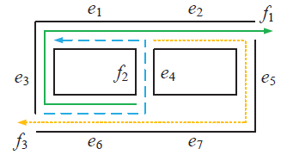
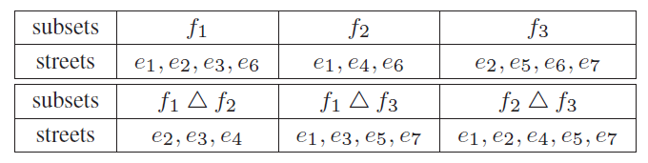
ISBG Example
  1st iteration, e₁ is added to S (appears in 4 subsets)
  2nd iteration, e₂ is added to S
  Terminate when S = {e1, e2}
  S(f₁) = {e₁, e₂}, S(f₂) = {e₁}, and S(f₃) = {e₂}

Slide 22
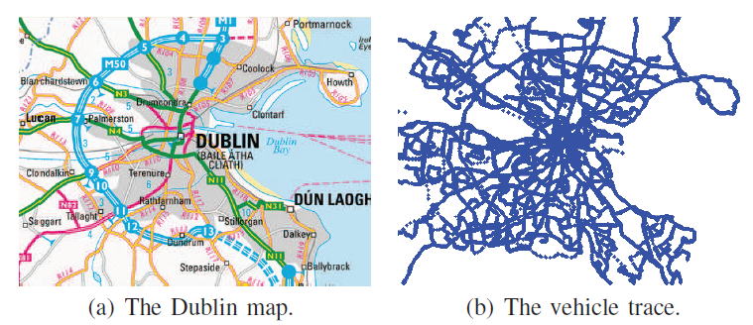
5. Experiments
  Real data-driven: Dublin
  80,000 × 80,000 square foot area
628 given traffic flows on 3,657 streets

Slide 23
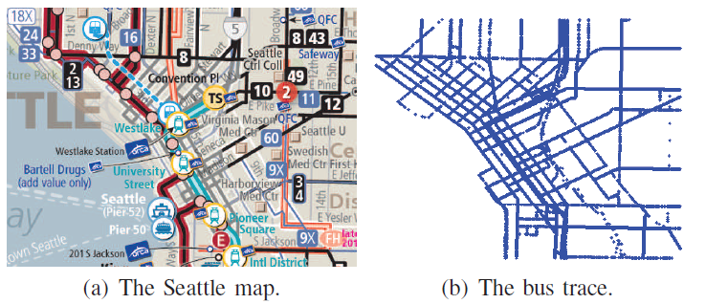
Experiments (con’t)
  Real data-driven: Seattle
  10,000 × 10,000 square foot area
135 given traffic flows on 2,283 streets

Slide 24
Comparison Algorithms
  Coverage-Oriented Greedy (COG): greedily covers all
  traffic flows, and then uniform-randomly place RSUs
  to distinguish them. O(n²|E|²)
  Two Stage Placement (TSP): greedily covers all
  traffic flows in the 1st stage, and then, greedily
  distinguishes all traffic flows in the 2nd stage. O(n²|E|²)
  Distinguishability-Oriented Greedy (DOG): greedily
  distinguishes pairs of traffic flows by placing an RSU
  at f △ f′ until all flows are distinguishable. O(n²|E|²)

Slide 25
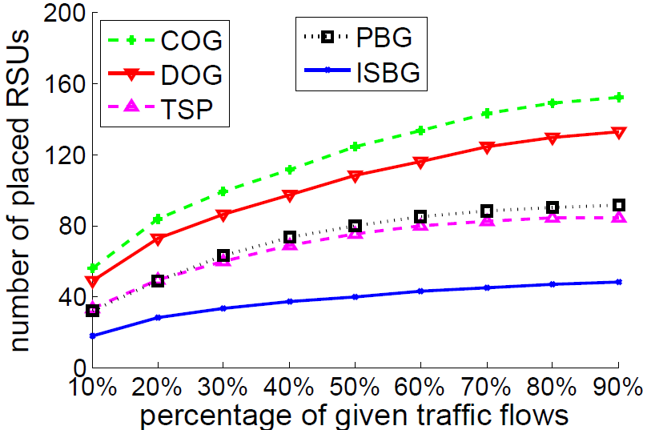
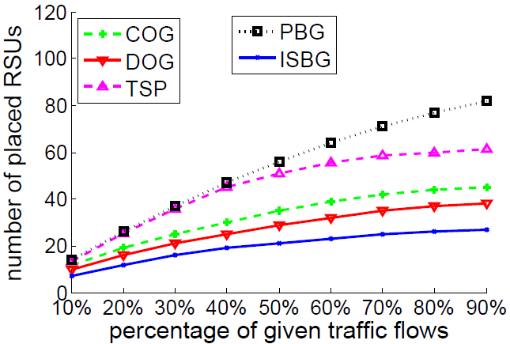
5. Experiments
  Dublin (left) and Seattle (right)
  Smaller is the better
  Different flow patterns in Dublin and Seattle

Slide 26
6. Conclusion
  Minimize the number of RSUs
  Under coverage and distinguishability requirements
  NP-hard, monotonicity, but non-submodularity
  Different from classic submodular set cover problems
  Approximation algorithms
  Different intuitions and time complexities

