Slide 1
Enhancing Scalability and Liquidation in QoS Lightning Networks
Jie Wu
Department of Computer and Information Sciences
Temple University, USA
Notes:
可扩展性,清算

Slide 2
Outline
Blockchain and Lightning Networks
QoS: Scalability and Liquidation
Supernode-based Clustering
Pooling and Pruning
Performance Evaluation
Future Work
Notes:
汇集, 修剪

Slide 3
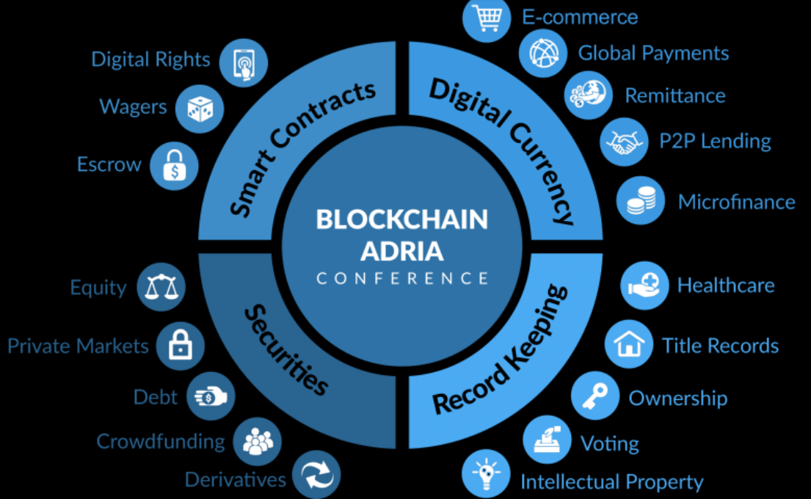
1. Blockchain and Lightning Networks
Blockchain
A system of maintaining transactions in a P2P network
Distributed ledger
Bitcoin
Bartering
Metallic money
Paper money
Cryptocurrencies
TX
Notes:
加密货币, 分布式分类帐, dis-association between gold and US dollars in 1971.

Slide 4
Blockchain Basics
Components
Transaction/block, incentive, and consensus
PoW-based blockchain mining
Mining a block: puzzle solving (Nakamoto protocol)
PoW: Prob. of solving a puzzle (computing rate)
Individual chaining of blocks
block(i-1)i+
block i
block(i+1)
...
TX
Notes:
Blocks are chained to keep the right order.
Expensive broadcast process

Slide 5
Blockchain Scalability
Scalability problem
10 minutes per block (1 MB) or ≤ 7 transactions per second
Solutions
On-chain: block-size, sharding, other consensuses (PoS/PoC)
Off-chain: SegWit, side chain, and tree chain
Payment channel network (PCN): layer 2
PCN
blockchain
TX
Notes:
A shard is a horizontal portion of a database, part of data. The scalability of sharding is achieved through the distribution of processing across multiple shards and servers in the network.
Segregated Witness: splitting the transaction into two segments. Segregate the signature part so more transactions can be placed.
10 minutes and the block size limit of 1 megabyte. 3.7 to 7 transactions per second.

Slide 6
Lightning Networks (LNs)
Micropayment channels
Quick transactions between trusted neighbors
Avoiding block confirmation via off-chain payment
Fund allocations
Allocation of node funds to channels
Bidirectional transactions
Fund balance in two directions: channel capacity
Channel balance of two sides are private
4
5
2
1
6
TX
Notes:
小额支付渠道

Slide 7
Payment Path
Indirect fund transfer
Between two untrusted neighbors
Payment path
A sequence of non-repeated trusted neighbors
Types of paths
Single-path and multi-path
e.g., transfer $4 from u to v
TX

Slide 8
2. QoS: Scalability and Liquidation
Scalability for path searching
Searching process with global information
Route validation (for channel balance check)
Liquidation for fund transfer
Success ratio for transactions
Alleviated with multi-path, but more involved
LN is dynamic: A change in topology or capacity is broadcasted
TX

Slide 9
Existing Solutions
Current scalability solution
Flare: reducing time to find a payment route
Challenges: large search space
Current liquidation solution
Revive: rebalancing cycles
Challenges: fixed channel capacity
1
a
9
5
a
5
10
3
6
8
4
e
b
e
b
2
8
6
4
4
9
2
5
6
d
c
d
c
3
10
7
6
TX

Slide 10
3. Supernode-based Clustering
A special clustering approach
Addressing both scalability and liquidation
Graph G = (E, V) partitioned into clusters locally (why?)
Supernodes S V
Each cluster is headed by a supernode
Being locally self-connected reduces update cost

Slide 11
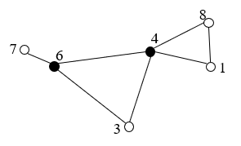
Clustering
Basic algorithm
Node v is clusterhead when v has two unconnected neighbors
Property
Clusterheads form a locally self-connected dominating set (DS)
Low-efficiency: too many clusterheads (black nodes)
4
Notes:
H depends on N and ESP capacity
簇头

Slide 12
4. Pooling and Pruning
Supernode selection (S)
Induced subgraph G[S] is connected and V-S N(S)
Fund pooling by supernodes
Pooling funds in all clusters
Redistributing funds to external channels in G[S]
Routing
Searching in a reduced space in G[S], rather than G
V-S
S
Notes:
汇集,修剪

Slide 13
Design Details
Each node
Knows its k(=2)-hop info.
Escrow Account
Each node has one escrow account for its supernode neighbor
Fund allocations of supernodes
Use escrows to allocate more funds to external channels
Implementation
Local status calculation, then status/link-state broadcasting
Notes:
代管账户

Slide 14
Self-Organizing Local Solutions
Local decisions/fixes
P2P and simple interaction (local w/o seq. propagation)
Global functionality
E.g., connectivity
Principles
P₁: Local actions w/ global properties (scalability)
P₂: Minimization of maintained state (usability)
P₃: Adaptive to changes
(self-healing)
P₄: Implicit coordination
(efficiency)
Agility
Notes:
Ants in swam intellegence

Slide 15
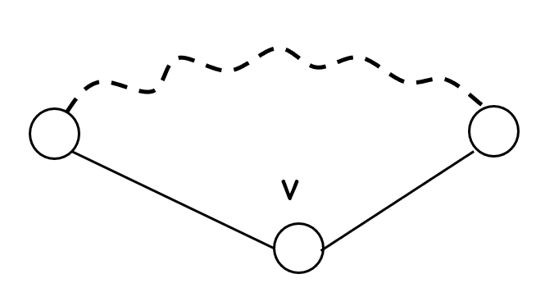
Node Pooling
Supernode selection (Wu and Dai 2004)
All nodes are initially supernodes
A supernode v becomes a non-supernode if any two neighbors
of v are connected by a path (under k-hop view, k=2) such that
for each intermediate node u in the path, Pri(u) > Pri(v)
Time complexity: O(Δ²), where Δ is max node degree
Notes:
H

Slide 16
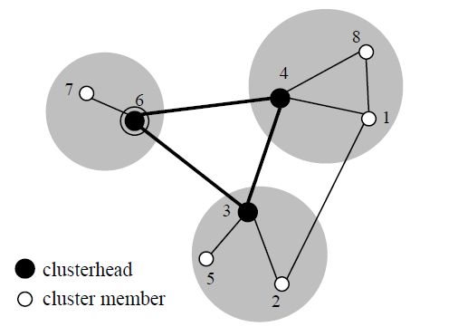
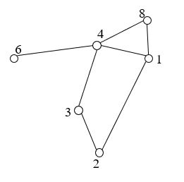
Supernode Selection
Node v
2-hop local view
A distinct priority Pri(v)
Supernode set
S = {3, 4, 6}
Node 1’s view
1-hop view
2-hop view

Slide 17
Network Dynamics
Nodes joining/leaving (channels up/down)
Local update (2-hop): no propagation
Supernode stability: graceful evolving clustering
Theorem: When a node is added to/deleted from an LN, it will only affect the status of k-hop neighborhood of the node.
4
e.g., deleting 3 changes no node & adding 9 changes 6 to a regular node
9

Slide 18
Link Pruning
Link Priority
Reserve lexicographical order for link uv
Pri(max{Pri(u), Pri(v)}, min{Pri(u), Pri(v)}), e.g., Pri(3, 2) > Pri(3, 1)
Link Pruning (Wu and Jiang 2020)
Link uv can be removed if there is a replacement path
(under k-hop view, k=2) connecting u and v: all
intermediate links have higher priorities than uv.

Slide 19
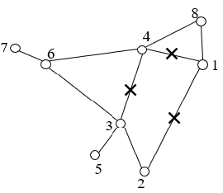
Neighbor Set Reduction
Asynchronous link pruning
Still 2-hop views from two end nodes
Replacement paths (avoiding circular replacements)
4
Replace for 12:
2341
23481
23641
236481

Slide 20
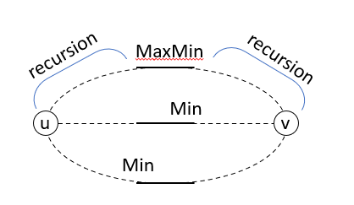
Irreplaceable Replacement Path
Irreplaceable replacement path
Min link: of a replacement path
MaxMin link: max of min links of all replacement paths
Theorem: Given a connected graph, the resultant graph after link pruning will remain connected.
236481

Slide 21
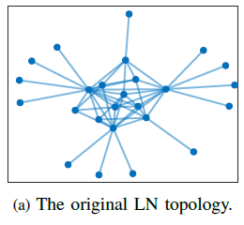
A 25-node example
Pooling or pruning only
A combination of pooling and pruning
Notes:
H depends on N and ESP capacity

Slide 22
5. Performance Evaluation
Channel capacity
Three intervals
Channel balance
Perfectly balanced
Randomly balanced
Transaction amount
Homogeneous
Heterogeneous
(micro, small, med., large)
Node/link reduction
Pooling/pruning efficiency
Success ratio (SR)
Single transaction (ST)
Transaction flow (TF)
Path length (PL)
Routing fees (not include)
Node degree (ND)

Slide 23
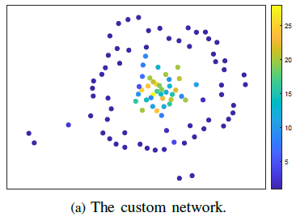
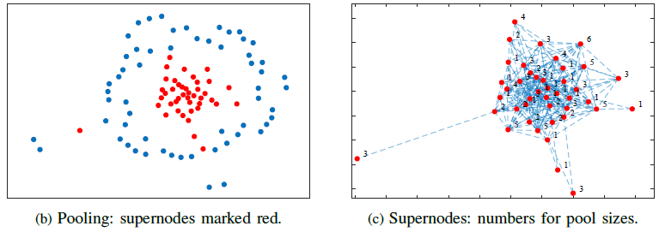
Topologies
Custom network (CN)
Power law distribution for LNs
100 nodes and 340 links
Reduction to 42 supernodes
ISP and Watts-Strogatz (WS)
ISP: power law and WS: small world
Notes:
Internet service provider: power-law, Watts-Strogatz (WS): small world
Stro’gatz

Slide 24
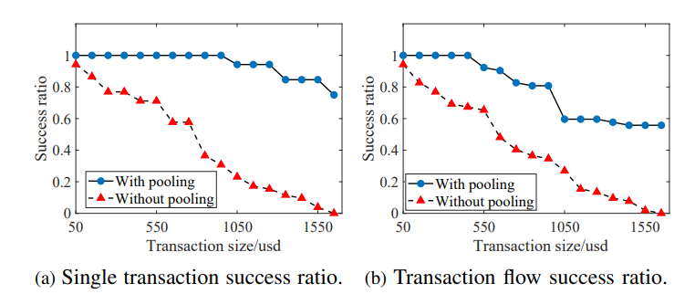
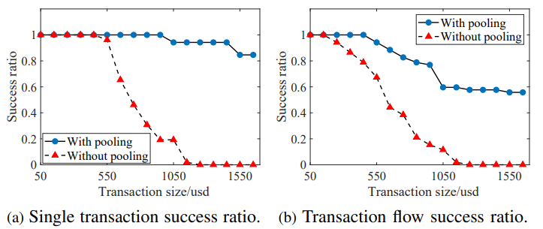
Pooling only on CN: homogenous
Randomly balanced
Perfectly balanced
Channel capacity: [1000, 1500) 50%, [1500, 2000) 35%, [2000, 2500) 15%
Notes:
Randomly balanced vs. Perfectly balanced: channel balance?
CLoTH simulator

Slide 25
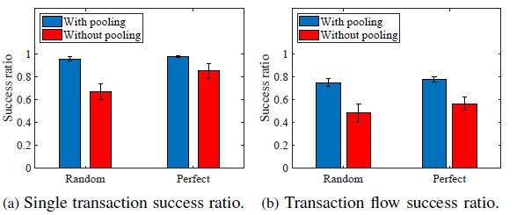
Pooling only on CN: heterogenous
Improvement is more significant in transaction flow
Transactions: micro (0, 200] 40%, small (200, 800] 30%
med. (800, 1000] 20%, large (1000, 1600] 10%

Slide 26
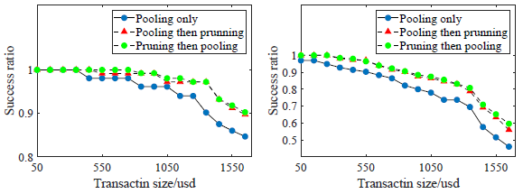
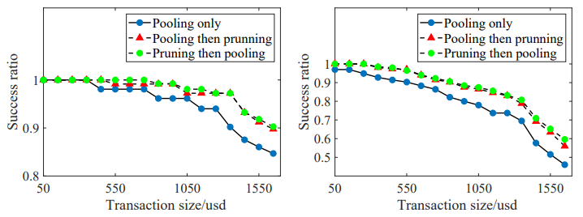
Pooling + Pruning on CN
Homogenous
Heterogenous
Notes:
Model the relation between winning probability and delay with a exponential function
Guide service providers pricing scheme
STSR (single transaction SR), TFSR (transaction flow SR), PL (path length), ND (node degree)

Slide 27
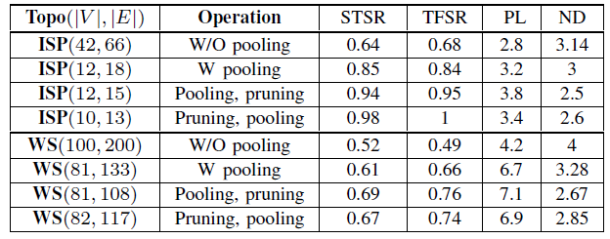
ISP and WS
Effectiveness of pooling/pruning on success ratio (SR)
Tradeoff: SR vs. path length (PL)

Slide 28
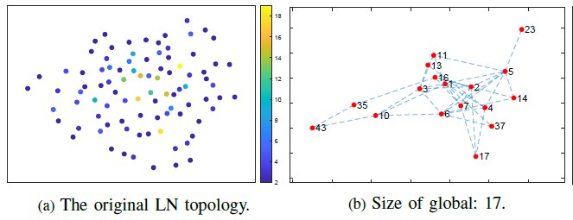
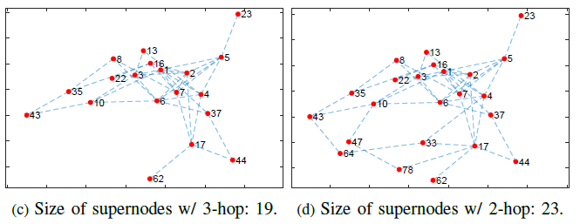
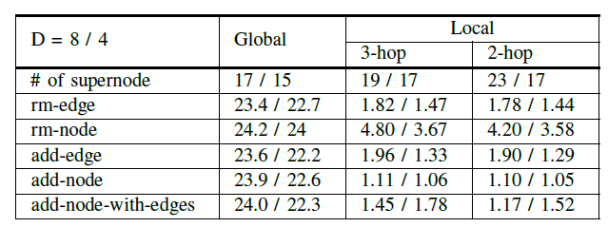
Update Cost
A sample CN:
(V, E) = (90, 199)
Diameter D=8
Another CN:
(V, E) = (70, 197)
Diameter D=4
Global CDS:
Guha/Khuller’s solution
Notes:
Model the relation between winning probability and delay with a exponential function
Guide service providers pricing scheme

Slide 29
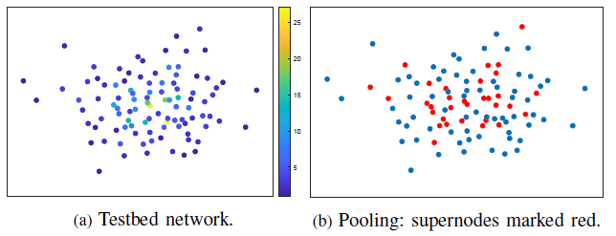
CLoTH Testbed
CLoTH: A payment network testbed, (V, E) = (100, 224)
Transaction #: 1,200 (heterogenous)
Transaction fees: 10 (per node)
Notes:
Model the relation between winning probability and delay with a exponential function
Guide service providers pricing scheme

Slide 30
6. Future Work
Hierarchical clustering
Supernodes of supernodes (e.g., node 6)
Trade-offs
Benefit (successful transactions)
Cost (various fees/updates)
Notes:
Future, CloTH simulator

Slide 31
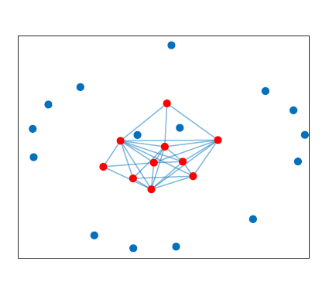
Future Work (Cont’d)
Impact of locality
Value of k on pooling efficiency and local fixes
ID rotation
E.g., ID inversion (for size reduction)
Others
Games: on topology, fund allocation, and routing fees

Slide 32
Future Trends
Future of cryptocurrency
Decentralized: Bitcoin
Centralized: Digital Currency Electronic Payment (DCEP)
In-between: Libra (Novi wallet)
Blockchain smartphones
Commercial: HTC and Samsung
Edge blockchain via offloading
Notes:
数字货币电子支付, Facebook: Libra, HTC 宏达电
Blockchain smartphones: Additional layer for security of cryptocurrency
Software Zion, enabling the secure storage of the major cryptocurrencies (Bitcoin, Litecoin, Ethereum) or tokens

Slide 33
Blockchain vs. Distributed Sys. (DS)
Past results applied in blockchain?
Latency hiding
Concurrency control
Quorum voting
Trilemma in blockchain and DS
scalability consistency
security decentralization availability partition tolerance
Notes:
三难: Brewer's theorem: CAP theorem.

Slide 34
Questions
J. Wu and F. Dai, “A Generic Distributed Broadcast Scheme in Ad Hoc Wireless Networks,” IEEE Transactions on Computers, 2004.
J. Wu and S. Jiang, “Local Pooling of Connected Supernode in Lightning Networks for Blockchains," Proc. of IEEE Blockchain, 2020.

