Slide 1





FedHAN: A Cache-Based Semi-Asynchronous Federated Learning Framework Defending Against Poisoning Attacks in Heterogeneous Clients
Xiaoding Wang¹, Bin Ye¹, Li Xu¹, Lizhao Wu¹, Sun-Yuan Hsieh², Jie Wu^{3,4}, Limei Lin^{1*}
¹Fujian Normal University
²National Cheng Kung University
³China Telecom Cloud Computing Research Institute
⁴Temple University
Notes:
Hello, I’m [xxx] from Fujian Normal University. Today I’ll present FedHAN—a cache-based semi-asynchronous federated learning framework for heterogeneous clients that defends against poisoning attacks.

Slide 2
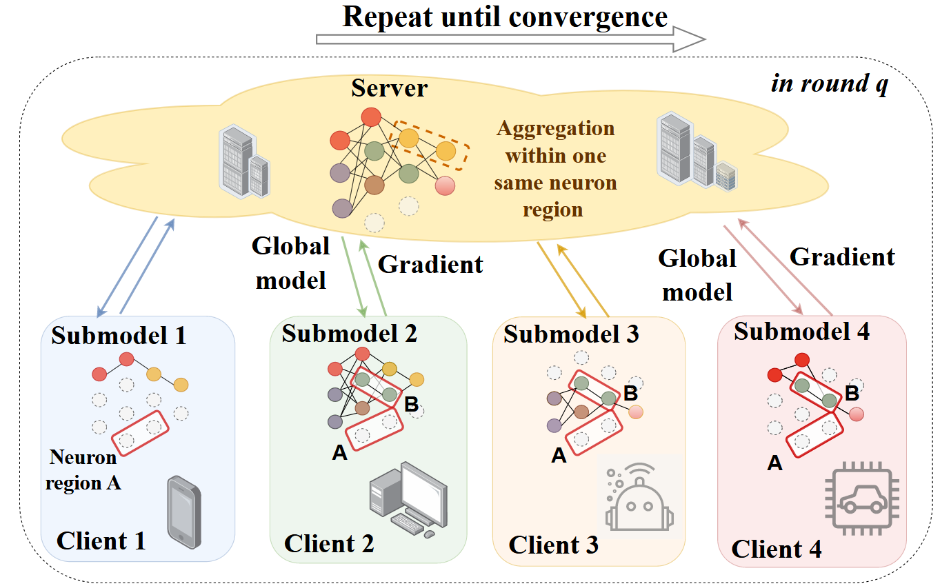
Challenges:
Non-IID data: Few/biased local samples cause overfitting and cross-client inconsistency; unstable convergence.
Semi-asynchronous participation: Only earliest K updates are aggregated; many uploads are stale → participation bias and drift.
Heterogeneous sparsity: Clients use different mask widths; sparse, shape-mismatched updates leave parameters missing and skew aggregation.
Detector-only pipelines:Identifying attackers doesn’t undo historical contamination of the global model.
Retrain-based recovery:Accurate yet communication-expensive and slow; impractical for online remediation.
Notes:
This slide summarizes five core challenges; the diagram illustrates semi-asynchronous aggregation across heterogeneous sparse submodels.
- Non-IID data: Few/biased local samples cause overfitting and cross-client inconsistency → unstable convergence.
- Semi-asynchronous participation: The server aggregates the earliest K updates while many arrivals are stale → participation bias and model drift.
- Heterogeneous sparsity: Clients use different mask widths; sparse, shape-mismatched updates leave parameters missing and skew aggregation.
- Detector-only pipelines: Identifying attackers does not undo historical contamination already embedded in the global model.
- Retrain-based recovery: Accurate yet communication-expensive and slow, impractical for online remediation.
These issues inflate bias/variance and destabilize training, motivating a cache/history-aware, staleness-weighted approach with integrated detection and recovery (FedHAN).

Slide 3
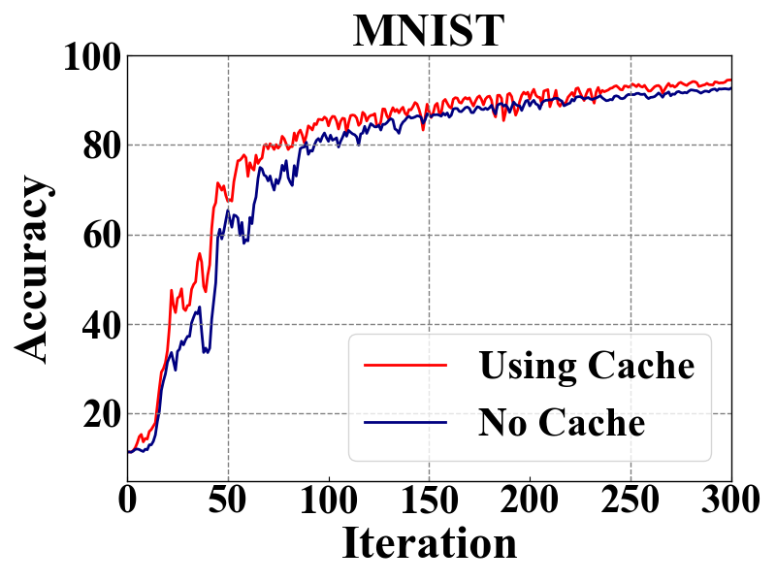
Motivation: Historical Information Forgetting
Setting: Semi-asynchronous FL with heterogeneous sparse models and Non-IID clients (N/K≪N, stale updates).Color code: yellow = received global, blue = previous local
Observation: Without cache, aggregation drifts toward currently participating clients → oscillation and slow convergence; with cache, convergence is faster and smoother.
limitation: Earliest-K aggregation ignores consistent but unreceived history; heterogeneous sparsity leaves parameters missing; uniform weighting/zero-fill inflates variance.
Need: Cache-based imputation + staleness-aware exponential weighting + cosine-similarity selection of historical updates to reduce bias/variance and stabilize convergence.
Notes:
In asynchronous FL, each training round involves only K clients, causing a ``partial client participation bias" problem. This intensifies model drift due to data heterogeneity, as the global model tends to overfit the data of the participating clients, reducing its generalization capability. To tackle this, we propose selecting some historical updates based on cosine similarity and incorporating them into the training process. Preliminary experiment results show that the red curve, which includes historical updates, exhibits reduced fluctuations and faster convergence compared to the blue curve with stale updates. This suggests that the approach can enhance model performance and training efficiency.

Slide 4
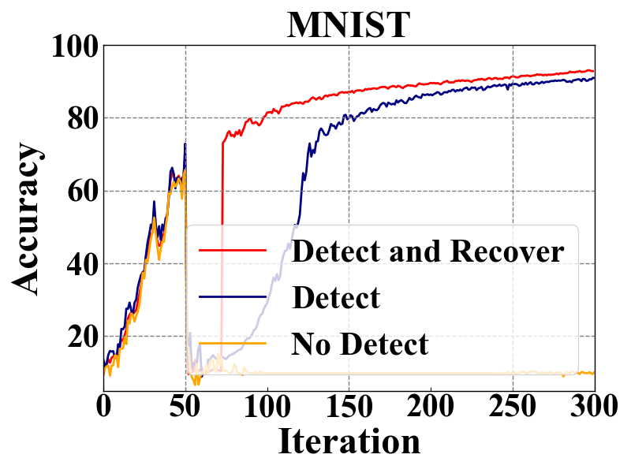
Motivation: Robust Recovery After Detection
Setup: Poisoning attacks (trim/backdoor/LF) in semi-asynchronous, heterogeneous FL; compare “No Detect” vs “Detect” vs “Detect + Recover”.
Observation: Detect + Recover reaches higher accuracy earlier and is more stable; Detect alone cannot remove historical contamination.
Limitation: Removing attackers does not undo the polluted global state; prior recovery is not integrated with detection and overlooks heterogeneity/staleness.
Need: Triggered recovery using Cauchy mean value theorem + L-BFGS to predict updates; combine precise and estimated updates to lower ASR and rapidly restore accuracy.
Notes:
Traditional defenses against poisoning attacks generally entail eliminating the identified malicious clients and proceeding with training using the remaining clients. However, this approach does not fully negate their adverse effects. To tackle this problem, we propose adding a recovery process immediately after detecting a malicious attack, aiming to reduce its effects. Preliminary experimental results confirmed that models using both detection and recovery methods outperform those relying only on detection strategies.

Slide 5
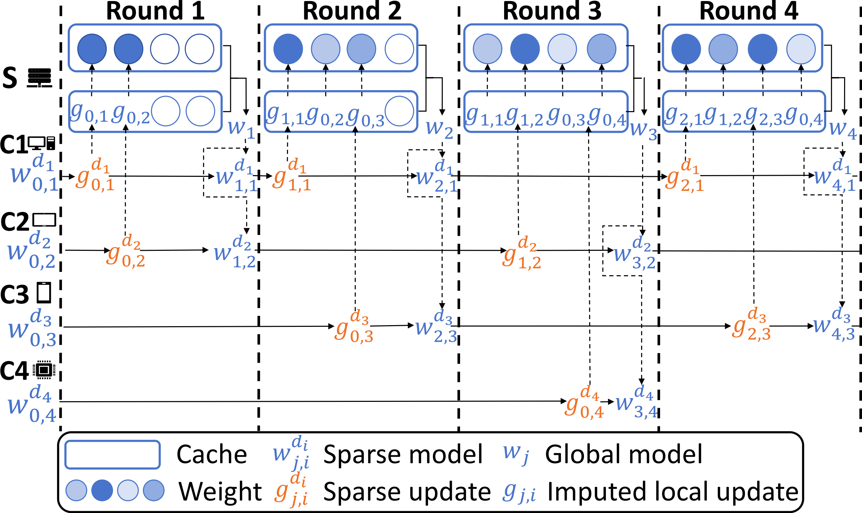
Model Update
Semi-asynchronous FL with heterogeneous, mask-based sparse models; each client uploads a sparse update plus width and staleness.
Server keeps a per-client cache of the latest imputed update and a decaying staleness weight.
Aggregate the first K arrivals, then augment with cosine-similar cached history from non-arrived clients to reduce bias/variance.
Result: faster, smoother convergence under Non-IID data and partial participation.
Notes:
Semi-asynchronous FL with heterogeneous, mask-based sparse models; each client uploads a sparse update plus width and staleness.
Server keeps a per-client cache of the latest imputed update and a decaying staleness weight.
Aggregate the first K arrivals, then augment with cosine-similar cached history from non-arrived clients to reduce bias/variance.
Result: faster, smoother convergence under Non-IID data and partial participation.

Slide 6
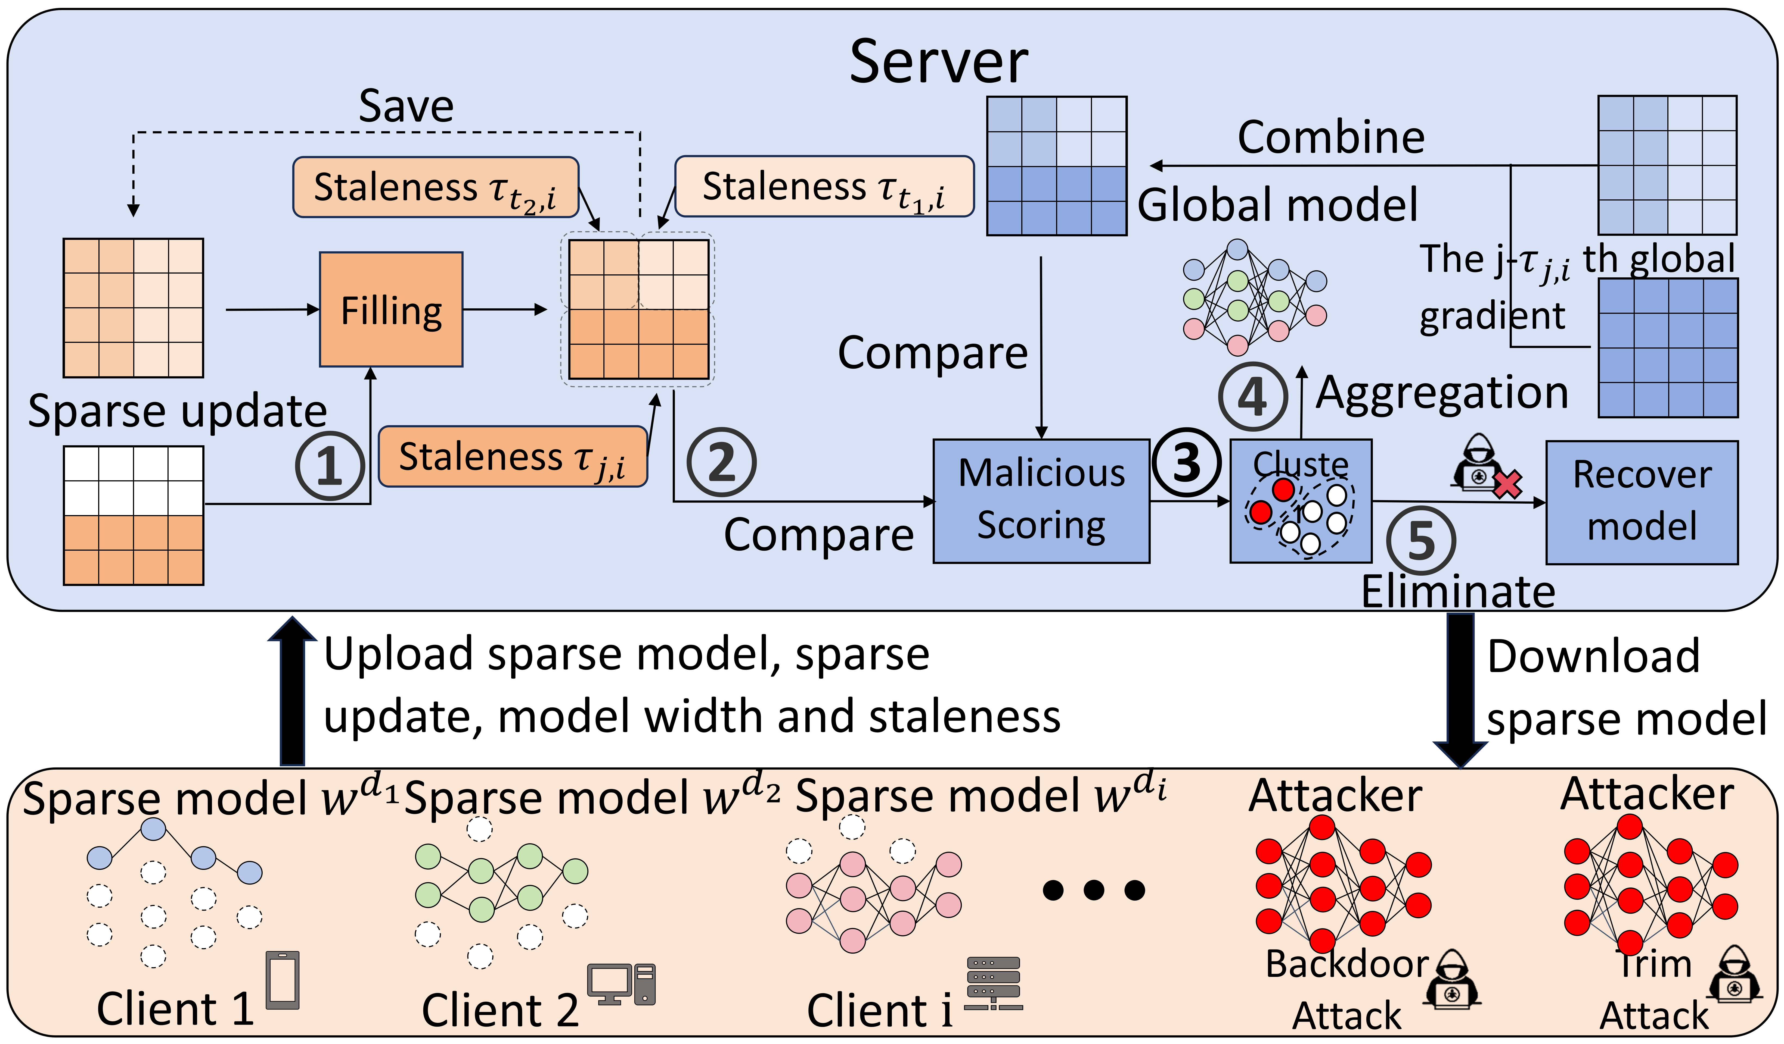



Framework Overview
① imputed local updates : $\bar{g}(w_{j,i})=g(w_{t,i}^{d_{t,i}},ξ_{t,i})∪(\bar{g}(w_{j−1,i})⊙{\tilde{m}}^{d_{t,i}})$
③ final weight $p_{j,i}^{′}=M_{j,i}(m^{d_{t,i}}∪α{\tilde{m}}^{d_{t,i}}),$
② weight of the imputed update ：$M_{j,i}=β^{τ_{j,i}}m^{d_{t,i}}∪(βM_{j−1,i}⊙{\tilde{m}}^{d_{t,i}})$
④aggregation： $\bar{g}(w_{j})=\sum_{i=1}^{K}{p_{j,i}}\bar{g}(w_{j,i})$
Complete incoming sparse updates using the cache; track staleness and maintain aligned global views per client.
Staleness-weighted aggregation of benign updates; select consistent history by cosine similarity.
Detect attacks via deviation between imputed local and global updates (DBSCAN → k-means).
On detection, roll back a few rounds and recover via Cauchy-guided, L-BFGS-based prediction mixed with periodic precise computation; continue training.
Notes:
The FedHAN system is composed of three main modules, including caching and model aggregation, attack detection, and model recovery. This modular structure allows the system to handle challenges efficiently and safely. FedHAN executes through these steps.(1) Sparse Model Customization. The server generates a client-specific mask $m^{d_{t,i}}$ based on the capacity of the client, customizes a sparse model $w^{d_{t,i}}=w⊙m^{d_{t,i}}$, and sends it to the client.(2) Local Training and Upload. Clients train their sparse models on local data and upload the sparse update $g(w_{t,i}^{d_{t,i}},ξ_{t,i})$to the server.(3) Asynchronous Reception and Update Imputation. The server collects sparse updates from the latest K clients, pads missing updates using past data to get $g(w_{j,i})$, forms a weight matrix based on update timing and client masks and updates caches.(4) Malicious Update Detection. The server identifies malicious clients by checking the Euclidean distance $s_{j,i}=||{\overline{g}(w}_{j,i})−g{{(w}_{j,i})||}_{2}$and classifies updates with DBSCAN and k-means. Malicious clients are removed if detected; otherwise, this step is skipped.(5) Global Model Recovery. Using the Cauchy median theorem, the server restores a global model, excluding malicious effects with the help of benign clients and historical data.(6) Sparse Model Imputation and Aggregate. Using the latest imputed local update to impute a spare model update, followed by aggregation to form ${g(w}_{j})$.(7) Historical Updates Select and Aggregate. The server selects some unreceived updates from the cache based on cosine similarity, followed by aggregation to form ${\tilde{g}(w}_{j})$.(8) Global Model Update. Finally, the server computes and applies the global update.

Slide 7
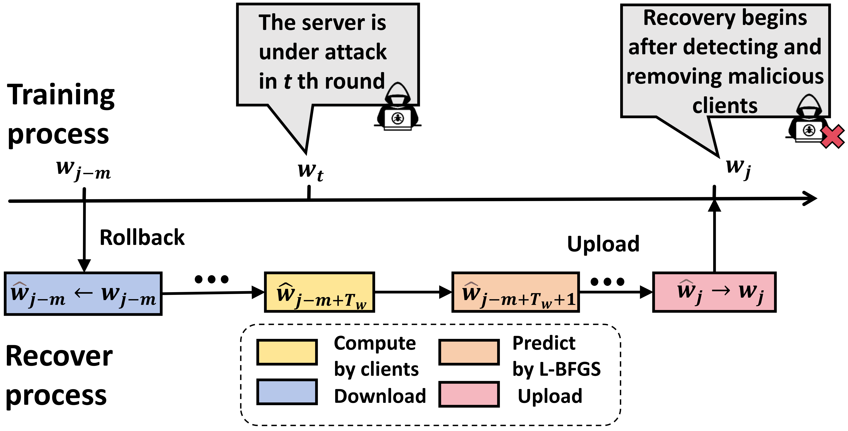

Recovery Process
the latest imputed global update $:\overset{ˇ}{g}(w_{j,i}) =\begin{matrix}g(w_{j−τ_{j,i}})⊙m^{d_{t,i}}∪\overset{ˇ}{g}(w_{j−1,i})⊙{\tilde{m}}^{d_{t,i}} & \\ & \end{matrix}$
suspicious score $:s_{j,i}=‖\overset{ˇ}{g}(w_{j,i})−\bar{g}(w_{j,i})‖_{2}$
Detect attackers, then roll back a few rounds to a clean checkpoint.
Reconstruct missing/heterogeneous sparse updates using L-BFGS guided prediction, mixed with early and periodic precise client computations.
Upload recovered updates and resume training, yielding lower ASR and faster return to pre-attack accuracy.
Notes:
In the T-th round of detection, the algorithm identified and removed all malicious clients, then rolled back m rounds to select a clean model $w_{T−m}$ as the starting point for a new training cycle, ensuring that subsequent training occurs in a reliable environment. To maintain training continuity and efficiency, the recovery algorithm combined two strategies: precise updates with benign clients following the FedHAN protocol and estimated updates using historical data from rounds T-m to T , reducing the reliance on real-time participation. To prevent error accumulation, clients performed precise calculations during the early recovery phase and at fixed intervals, promptly correcting errors and enhancing recovery quality. This innovative design balanced estimated updates and precise computations, minimizing error risks and ensuring stable and reliable global model recovery.

Slide 8
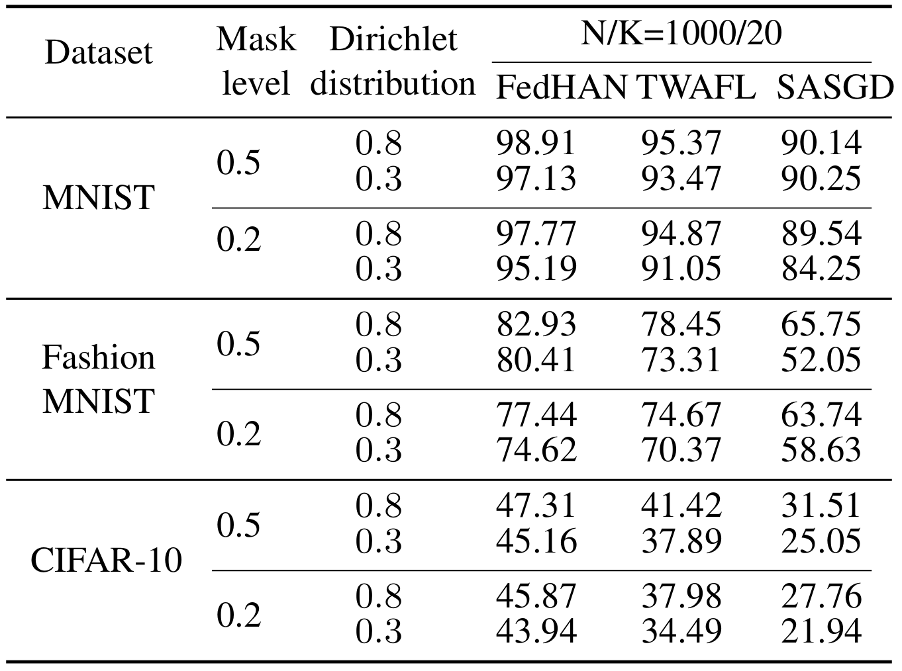
Main Results
Test accuracy: FedHAN is best and converges smoother in all settings.On MNIST, FMNIST, CIFAR-10 with N/K=1000/20 and mask 0.2/0.5, FedHAN attains the best accuracy and smoother convergence. Example (MNIST, mask 0.5, Dir=0.8): 98.91 vs 95.37 (TWAFL) vs 90.14 (SASGD)
Notes:
As shown in this table, FedHAN demonstrates superior performance over TWAFL and GASGD across MNIST, Fashion-MNIST, and CIFAR-10 datasets, achieving higher accuracy, faster convergence, and enhanced robustness. It effectively addresses system heterogeneity and Non-IID data challenges through its client selection mechanism, which mitigates staleness impacts (e.g., N/K=1000/20 ) by reducing errors from inactive clients. The table further highlights FedHAN’s stability and improved generalization, solidifying its practicality for real-world federated learning scenarios.

Slide 9
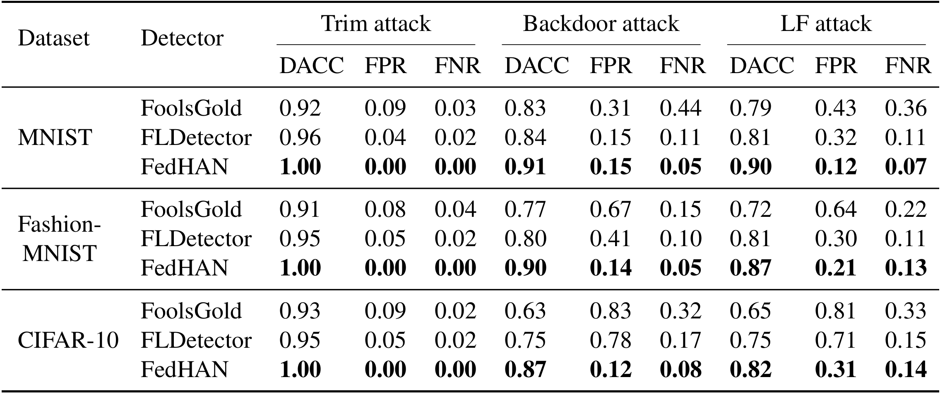
Detection Results
Under trim/backdoor/LF, FedHAN achieves high DACC with low FPR/FNR. Trim: 1.00 on all three datasets; Backdoor: 0.91/0.90/0.87 (MNIST/FMNSIT/CIFAR-10); LF: 0.90/0.87/0.82.
Notes:
This table shows that FedHAN excels over other defenses in the MNIST, Fashion-MNIST and CIFAR-10 datasets. It achieves 100% effectiveness against Trim attacks, has impressive detection rates of 91% for backdoor attacks, and 90% for label flipping attacks on MNIST, with low false negatives (15%, 12%) and false positives (5%, 7%). Although slightly less effective in CIFAR-10, FedHAN still proves to be a solid defense.

Slide 10
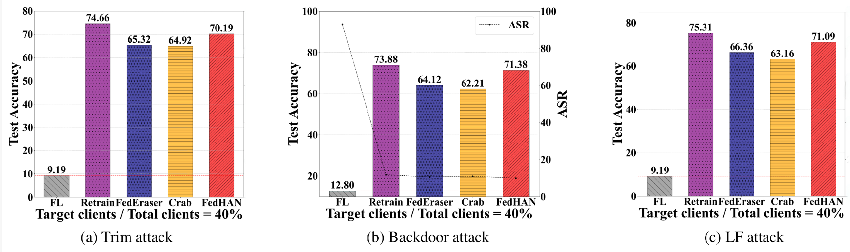
Recovery Results
Trim: FedHAN 70.2% TACC, close to Retrain 74.7%, higher than FedEraser 65.3% and Crab 64.9%; low ASR.
Backdoor: FedHAN 71.4% vs Retrain 73.9%, above FedEraser/Crab; ASR drops to near zero.
Label flipping: FedHAN 71.1% vs Retrain 75.3%, > FedEraser/Crab; low ASR.
Takeaway: FedHAN approaches retraining accuracy with far lower cost and faster recovery across attacks.
Notes:
In the study on the MNIST dataset, the FedHAN algorithm demonstrated exceptional performance in countering malicious attacks and preserving privacy: As shown in this figure, when the proportion of malicious clients reached 40%, FedHAN maintained significantly superior performance over methods like FedEraser and Crab after the 60th recovery round (with test accuracy dropping only to 12.8%), while its defense against backdoor attacks was validated by a low Attack Success Rate (ASR) of 12.7%. Further illustrated in this figure, the algorithm successfully suppressed the Membership Inference Success Rate (MISR) to 28.62%, fully proving its systemic advantages in enhancing model robustness, resisting data poisoning attacks, and safeguarding user privacy.

Slide 11
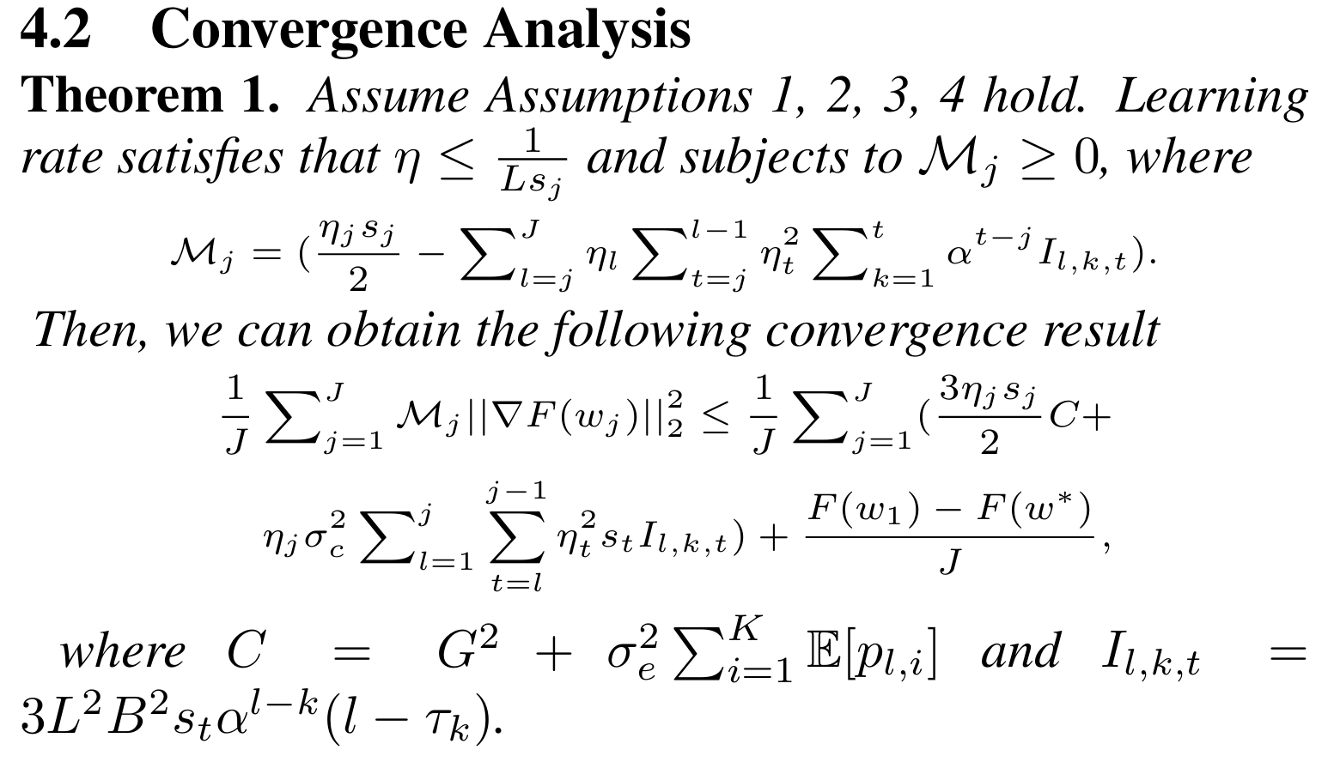
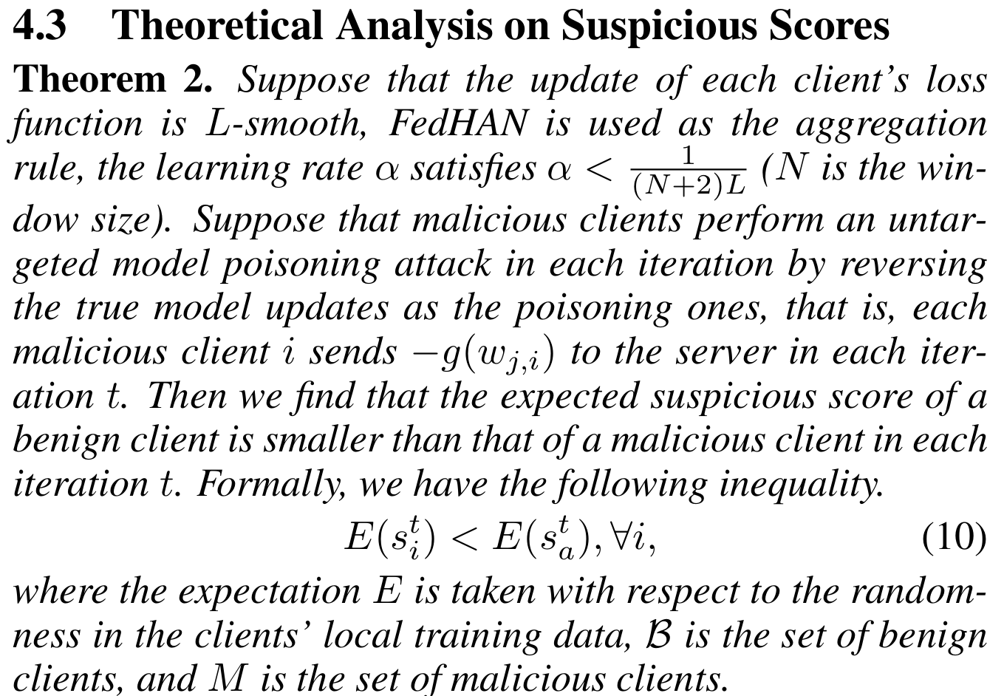
Theoretical Analysis

Slide 12
Conclusion
Conclusion:
Cache-based semi-asynchronous FL with heterogeneous sparse models.
Staleness-aware weighting and similarity-guided history stabilize training under Non-IID.
Deviation-based detection + triggered recovery (Cauchy + L-BFGS) remove historical contamination.
Results: higher accuracy, strong detection with low errors, fast recovery; robust under heterogeneity and staleness.
Notes:
Under realistic circumstances, federated learning faces significant obstacles, such as Non-IID data, asynchronicity, model heterogeneity, and poisoning attacks. We propose FedHAN, a cache-based semi-asynchronous algorithm designed to enhance robustness. FedHAN employs sparse model filling, adaptive weight distribution, and selective historical updates to handle stale updates and Non-IID data effectively. This method keeps a padded global update while incorporating client-sparse updates, aiding in the accurate identification of malicious attacks. By applying the Cauchy mean value theorem, FedHAN neutralizes the effects of such attacks, ensuring model reliability. We demonstrate FedHAN's convergence and its proficiency in detecting attacks, with experiments across three datasets confirming its superior accuracy and robustness, underscoring its practical utility.

