Slide 1
Minimizing Epidemic Viral Total Exposure under the Droplet and Aerosol Models
Abdalaziz Sawwan (Presenter) and Jie Wu.
Department of Computer and Information Sciences,
Temple University.

Slide 2
Outline
Introduction
Time-Evolving Networks
Proposed Models
The Optimal Solution of the Problem
Numerical Calculations and Simulation

Slide 3
Outline
Introduction
Time-Evolving Networks
Proposed Models
The Optimal Solution of the Problem
Numerical Calculations and Simulation

Slide 4
Introduction
The problem of minimizing the spread of viral infections in daily life has been studied widely in the recent years.
Various models have been proposed to imitate the propagation of viruses within a society.
The direct droplet infection, is the one mainly considered with little attention to the indirect contact infection that happens via aerosol spreading.

Slide 5
Introduction
The aerosol model implies that after an infected person leaves the room, it is still possible to infect another person even if they do not have contact directly.

Slide 6
Introduction

Slide 7
Outline
Introduction
Time-Evolving Networks
Proposed Models
The Optimal Solution of the Problem
Numerical Calculations and Simulation

Slide 8
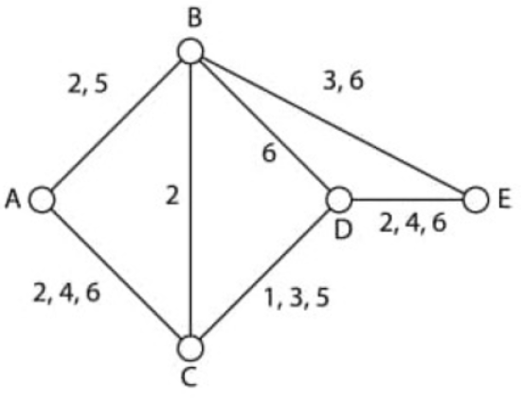
Time-Evolving Networks

Slide 9
Time-Evolving Networks

Slide 10
Outline
Introduction
Time-Evolving Networks
Proposed Models
The Optimal Solution of the Problem
Numerical Calculations and Simulation

Slide 11
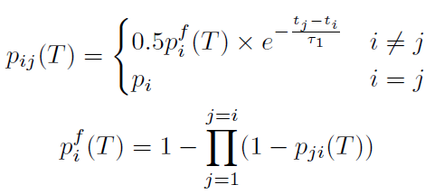
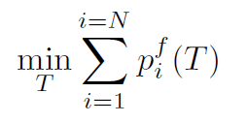
Proposed Models
1) Instant-Visiting Model

Slide 12
Proposed Models
1) Instant-Visiting Model

Slide 13
Proposed Models
2) Interval-Visiting Model

Slide 14
Proposed Models
2) Interval-Visiting Model

Slide 15
Outline
Introduction
Time-Evolving Networks
Proposed Models
The Optimal Solution of the Problem
Numerical Calculations and Simulation

Slide 16
The Optimal Solution of the Problem
First: Determining the Optimal Order of the People:
From lowest initial probability to the highest.
Proof: By contradiction.

Slide 17
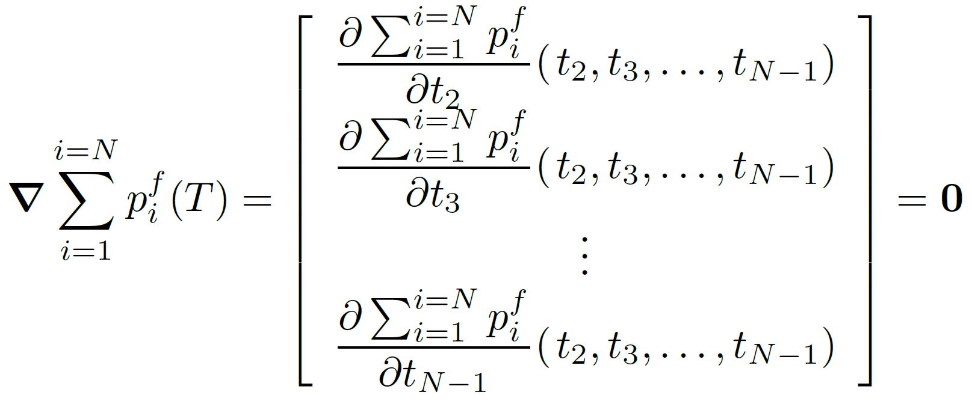
The Optimal Solution of the Problem
Second: Determining the Optimal Time Assignment of the People:

Slide 18
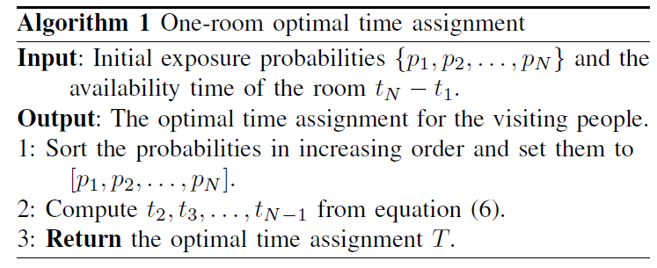
The Optimal Solution of the Problem

Slide 19
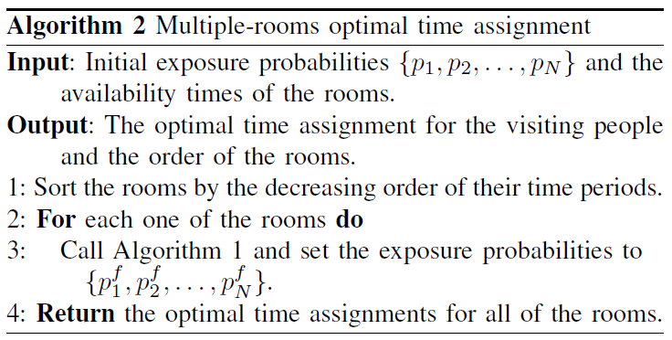
The Optimal Solution of the Problem

Slide 20
The Optimal Solution of the Problem

Slide 21
Outline
Introduction
Time-Evolving Networks
Proposed Models
The Optimal Solution of the Problem
Numerical Calculations and Simulation

Slide 22
Numerical Calculations and Simulation

Slide 23
Numerical Calculations and Simulation

Slide 24
Numerical Calculations and Simulation
Instant-Visiting Model:

Slide 25
Numerical Calculations and Simulation
Interval-Visiting Model:

