Slide 1
Energy-Aware Scheduling for Aperiodic Tasks on Multi-core Processors
Dawei Li and Jie Wu
Department of Computer and Information Sciences
Temple University, Philadelphia, USA
The 43rd International Conference on Parallel Processing

Slide 2
Agenda
Introduction
Motivational Example
System Model and Problem Definition
Preliminaries
Solution: subinterval-based scheduling
Scheduling by the Evenly Allocating Method
Scheduling by the DER-based Allocating Method
Simulation
Conclusion

Slide 3
Agenda
Introduction
Motivational Example
System Model and Problem Definition
Preliminaries
Solution: subinterval-based scheduling
Scheduling by the Evenly Allocating Method
Scheduling by the DER-based Allocating Method
Simulation
Conclusion

Slide 4
Introduction
Energy consumption of computer systems has become a critical issue.
For simple task models, namely, framed-based tasks, periodic tasks, and sporadic tasks, intensive works have been done for energy-aware scheduling on both uniprocessors and multiprocessors.
However, energy-aware scheduling for general aperiodic tasks on multiprocessors lacks extensive research endeavors.

Slide 5
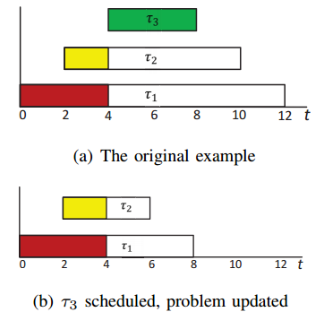
Introduction
Energy-aware scheduling for general aperiodic tasks on uniprocessors.
YDS algorithm: finds the subinterval [t1, t2] with the greatest intensity.
Simple, fast, optimal.

Slide 6
Introduction
Energy-aware scheduling for general aperiodic tasks on multi-core processors.
Existing works:
Problem is still polynomial time solvable.
However, algorithms require high complexity.
E.g.
relies on repeated maximum flow computations.
where n is the number of tasks, and f(n) is the complexity of finding a maximum flow in a graph with O(n) vertices.

Slide 7
Introduction
We consider energy-aware scheduling for general aperiodic tasks on multi-core processors.
Contributions:
Show that the energy-aware scheduling problem with the consideration of static powers is still polynomial time solvable, however, also with high complexity.
Instead of seeking optimal solutions with high complexity, we propose a lightweight algorithm suitable for real-time systems to solve the problem efficiently with good performances.
We demonstrate the practical usage of the proposed algorithms by various simulations.

Slide 8
Agenda
Introduction
Motivational Example
System Model and Problem Definition
Preliminaries
Solution: subinterval-based scheduling
Scheduling by the Evenly Allocating Method
Scheduling by the DER-based Allocating Method
Simulation
Conclusion

Slide 9
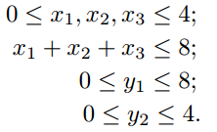
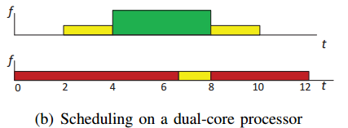
Motivational Example
Denote the time that each task occupies a core during interval [4, 8], as x1; x2; x3, respectively. Also, denote the total time that task 1 occupies a core during intervals [0, 4] and [8, 12] as y1, and the total time that task 2 occupies a core during the intervals [2, 4] and [8, 10] as y2.

Slide 10
Agenda
Introduction
Motivational Example
System Model and Problem Definition
Preliminaries
Solution: subinterval-based scheduling
Scheduling by the Evenly Allocating Method
Scheduling by the DER-based Allocating Method
Simulation
Conclusion

Slide 11
System Model and Problem Definition
We consider scheduling a set of independent aperiodic tasks
Each task
Processor power model
Problem formulation:

Slide 12
Agenda
Introduction
Motivational Example
System Model and Problem Definition
Preliminaries
Solution: subinterval-based scheduling
Scheduling by the Evenly Allocating Method
Scheduling by the DER-based Allocating Method
Simulation
Conclusion

Slide 13
Preliminaries
Characteristics of an Optimal Solution
Observation 1: in an optimal solution, no matter how many segments a task’s execution consists of, the execution frequencies for this task during all its intervals should be equal, i.e.
Applying the Lagrange Multiplier Method:

Slide 14
Preliminaries
Problem Reformulation
We sort all Ri and Di values in ascending order, and relabel the distinct values as t1, t2,…, tN , where N <= 2n is the total number of distinct Ri and Di values.
Denote x_{i,j} as the execution time of task i during the jth subinterval.

Slide 15
Preliminaries
Problem Reformulation
Theorem 1: The energy minimal scheduling of aperiodic tasks on multi-core processors with static power consumptions and migrations allowed is polynomial time solvable.
Proof from two aspects, the mathematical problem is polynomial time solvable; and based on this, tasks are schedulable.

Slide 16
Preliminaries
Problem Reformulation
Observation 2: during a subinterval [t_j, t_{j+1}], if it is a lightly overlapped subinterval, the overlapping tasks during this subinterval are valid to occupy a processing core for the whole subinterval.
The key problem lies in how to allocate available execution times to overlapping tasks during a heavily overlapped subinterval.

Slide 17
Agenda
Introduction
Motivational Example
System Model and Problem Definition
Preliminaries
Solution: Subinterval-Based Scheduling
Scheduling by the Evenly Allocating Method
Scheduling by the DER-based Allocating Method
Simulation
Conclusion

Slide 18
Solution: Subinterval-Based Scheduling
An Ideal Case, where the number of processors is unlimited.
Scheduling by the Evenly Allocating Method
the execution requirement completed in interval [tj, tj+1] is equal to the ideal optimal case.
The intermediate scheduling: allocate each task i an available execution time of during the interval [tj, tj+1].

Slide 19
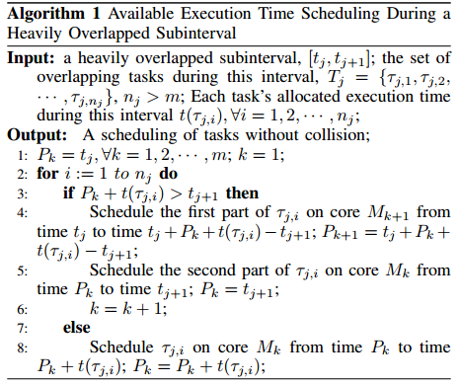
Consider the tasks one by one, and fill in the cores one by one.

Slide 20
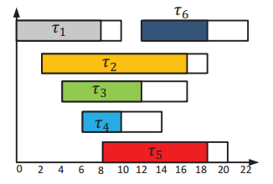
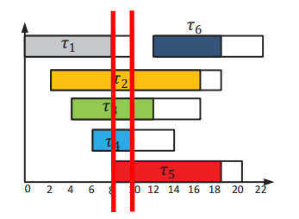
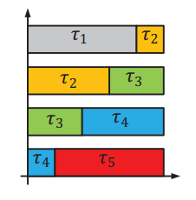
4 core

Slide 21
Solution: Subinterval-Based Scheduling
Scheduling by the Evenly Allocating Method
The final scheduling: After determining the execution time in each subinterval, we can calculate the overall available execution time.
A refined scheduling can be constructed, which can further reduce energy consumption. A_i^{F_1} is the total available execution time.
Optimal frequency setting for each task:

Slide 22
Solution: Subinterval-Based Scheduling
Scheduling by the DER-based Allocating Method
DER: Desired Execution Requirement
The intermediate scheduling: Allocate available execution time according to task’s desired execution requirement (referring to the ideal optimal case) during each subinterval.

Slide 23
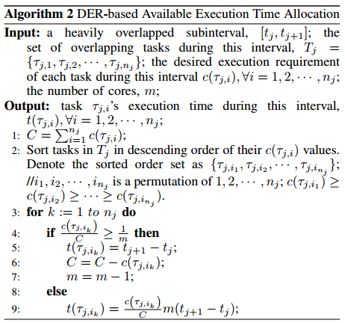

Slide 24
Solution: Subinterval-Based Scheduling
Scheduling by the DER-based Allocating Method
Final Scheduling of the DER-based Allocating Method: Refine the scheduling to further reduce energy consumption.

Slide 25
Agenda
Introduction
Motivational Example
System Model and Problem Definition
Preliminaries
Solution: Subinterval-Based Scheduling
Scheduling by the Evenly Allocating Method
Scheduling by the DER-based Allocating Method
Simulations
Conclusion

Slide 26
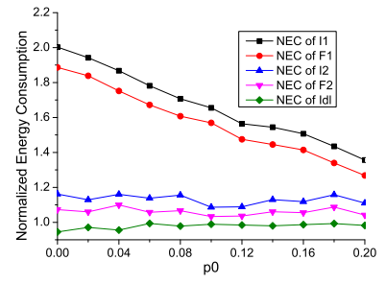
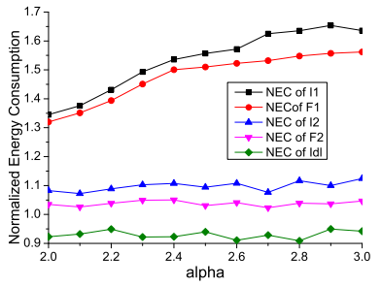
Simulations
Influence of Platform’s Characteristics

Slide 27
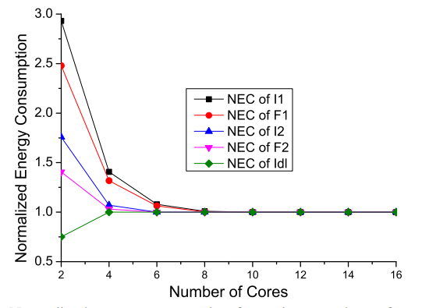
Simulations
Influence of Platform’s Characteristics

Slide 28
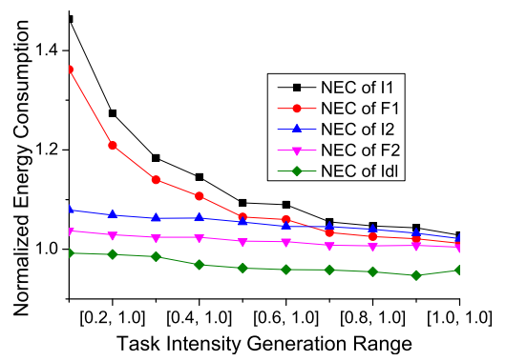
Simulations
Influence of Tasks’ Characteristics

Slide 29
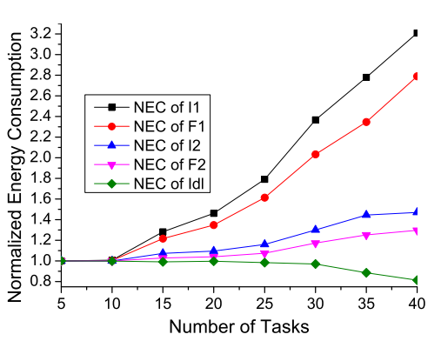
Simulations
Influence of Tasks’ Characteristics

Slide 30
Agenda
Introduction
Motivational Example
System Model and Problem Definition
Preliminaries
Solution: Subinterval-Based Scheduling
Scheduling by the Evenly Allocating Method
Scheduling by the DER-based Allocating Method
Simulation
Conclusion

Slide 31
Conclusion
The energy-aware scheduling for general aperiodic tasks on multi-core processors is addressed.
We formulate the problem on multi-core processors in a formal way, which shows that it is polynomial time solvable.
Instead of seeking optimal solutions with high complexity, we design a lightweight algorithm to solve the problem efficiently with good performances.
We demonstrate the practical usage of the proposed algorithms by various simulations

Slide 32
Additional questions can be sent to dawei.li@temple.edu
The End,
Thank you!

