Slide 1
Multi-Path-Based Avoidance Routing in Wireless Networks
Kazuya Sakai, Min-Te Sun, Wei-Shinn Ku, Jie Wu, and Ten H Lai
Tokyo Metropolitan University, National Central University, Auburn University, Temple University, The Ohio State University
ksakai@tmu.ac.jp
July 2nd, 2015

Slide 2
Outline
Introduction to avoidance routing
The Problem Formulation
Multi-Path Based Avoidance Routing (MPAR)
Performance Evaluation
Conclusions

Slide 3
1. Introduction
We are interested in designing a secure routing protocol in ad hoc networks
Cryptographic operations can protect end-to-end communications
Two issues
  Computing power are more and more accessible and inexpensive, i.e., encryption is no longer a perfect solution
  Software implementations of cryptographic protocols may be seriously flawed (e.g., generating prime numbers)
Avoidance routing
  Avoiding insecure areas is the primary countermeasure against potential adversaries

Slide 4
Avoidance and Multi-Path
What is “avoidance” in ad hoc routing?
  Motivations for non-shortest path routing
  Load balancing, energy-aware, congested links, etc.
How to utilize “multi-path”?
  Improving throughput by parallelizing message transmissions
  Fault tolerance, e.g., backup paths
Our definition
  A routing path physically avoids insecure areas
  e.g., malicious countries, compromised nodes, etc.
  We utilize the idea of multi-path with the XOR coding in a very different way

Slide 5
Avoidance Routing
The avoidance routing problem
  Avoid insecure area that adversaries can eavesdrop on communications
An insecure area
Fig. An insecure area in a graph

Slide 6
2. The Problem Formulation
Introduction to avoidance routing
The Problem Formulation
  The Adversary Model
  Our Assumptions
  The Bounded Condition
  The Safe Path Condition
Multi-Path Based Avoidance Routing (MPAR)
Performance Evaluation
Conclusions

Slide 7
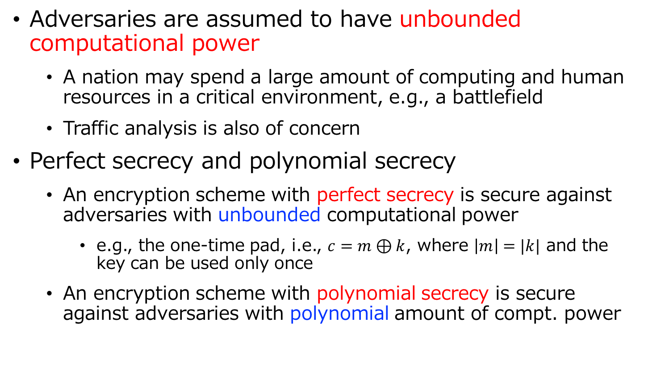
The Adversary Model
Adversaries are assumed to have unbounded computational power
  A nation may spend a large amount of computing and human resources in a critical environment, e.g., a battlefield
  Traffic analysis is also of concern
Perfect secrecy and polynomial secrecy
  An encryption scheme with perfect secrecy is secure against adversaries with unbounded computational power
    e.g., the one-time pad, i.e., $c=m⊕k$, where $\left|m\right|=|k|$ and the key can be used only once
  An encryption scheme with polynomial secrecy is secure against adversaries with polynomial amount of compt. power

Slide 8
The Adversary Model
Attack 1: eavesdropping
  Polynomial secure encryptions are assumed not to be safe
Attack 2: denying message forwarding
  Intermediate nodes can compromise encrypted data and drop packets
The protocol design goals
  A routing path should never contain adversaries
  A routing path should avoid insecure area

Slide 9
Our Assumptions
Known adversaries’ location
  Each node knows binary information (if malicious nodes are in its transmission range
Collusion attacks
  The adversaries in a connected component can collude
Fig. Connected components of adversaries
Table. Realistic scenario
 | Unknown location | Known location
Independent | likely | unlikely
Collusions | unlikely | likely

Slide 10
The Performance Bound
Condition 1: The bounded condition
  A set of adversaries does not consist of a graph cut
  This tells us the upper bound of performance
    No routing protocol can securely deliver messages if there exists a graph cut by a set of adversaries
Fig. 2. A path w/o adversaries
An ideal protocol w/ a perfectly secure encryption protects messages from eavesdropping
Fig. 1. A graph cut

Slide 11
The Existing Solutions
The existing solutions
  Avoidance routing for the internet
  Distance vector-based or beacon vector-based routing
Condition 2: The safe path condition
  There exists a path s.t. no node on the path has any adversary in its neighbors
All the existing solutions are single-path-based, and thus the safe path condition dominates the upper bound
Fig. 1. A safe path

Slide 12
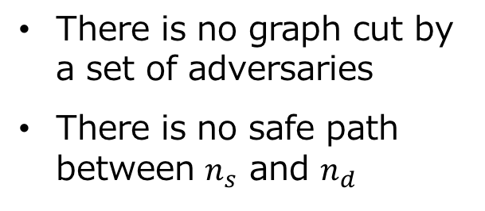
The Gap
There is a big gap between the bounded condition and the safe path condition
  Any single-path routing with a polynomial encryption scheme requires the safe path condition
There is no graph cut by a set of adversaries
There is no safe path between $n_{s}$ and $n_{d}$
Fig. A graph with no safe path

Slide 13
3. Multi-Path Avoidance Routing (MPAR)
Introduction to avoidance routing
The Problem Formulation
Multi-Path Based Avoidance Routing (MPAR)
  The Overview of MPAR and Definition
  A Framework
  The K-Path Discovery protocol
  The Performance and Security Properties
Performance Evaluation
Conclusions

Slide 14
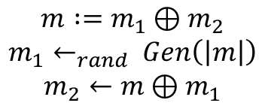
The Overview of MPAR
We propose multi-path avoidance routing (MPAR)
  An on-demand protocol
The XOR coding
  No common secret
  Perfect secrecy by a one-time pad like scheme
Multi-path
  An adversary cannot recover a message unless she wiretaps all the paths
$$m :=m_{1}⊕m_{2}$$
$$m_{1}←_{rand} Gen\left(\left|m\right|\right)$$
$$m_{2}←m⊕m_{1}$$
Fig. The idea of MPAR

Slide 15
Adversary Disjoint Paths
Definition: adversary disjoint paths
  A set of paths that have no common adversary is said to be adversary disjoint paths
Fig. 1. Adversary disjoint paths
Fig. 2. Not adversary disjoint

Slide 16
Adversary disjoint paths with collusion attacks
Adversary disjoint paths with collusion attacks
Fig. 1. Not adversary disjoint
Fig. 2. Adversary disjoint

Slide 17
The Performance Bound of MPAR
Condition 3 : the MPAR condition
  There exists at least one set of adversary disjoint paths between the source and destination
  MPAR requires condition 2 or 3
All the network graphs
Condition 1
The bounded condition
Condition 3
Adversary disjoint paths exist
Condition 2
A safe path exists

Slide 18

The MPAR Framework
MPAR ($n_{s}, n_{d}, m, k_{max}$)
Route_Discovery($n_{s}, n_{d}, k_{max}$)
if a safe path $p$ is found
$n_{s}$ sends $m$ via $p$
else if there is adversary disjoint paths $P=\{p_{1},p_{2}, …, p_{k}\}$
computes $m_{i}$ ($1≤i≤k−1$) by $Gen_{u}(\left|m\right|)$
let $m_{k}=m⊕m_{1}⊕m_{2}⊕…⊕m_{k−1}$
$n_{s}$ sends $m_{i}$ via $p_{i}$
else
routing fails
# Condition 2 is met
# The single-path mode
# Condition 3 is met
# The k-path mode
# Neither Condition 2 nor 3 are met

Slide 19
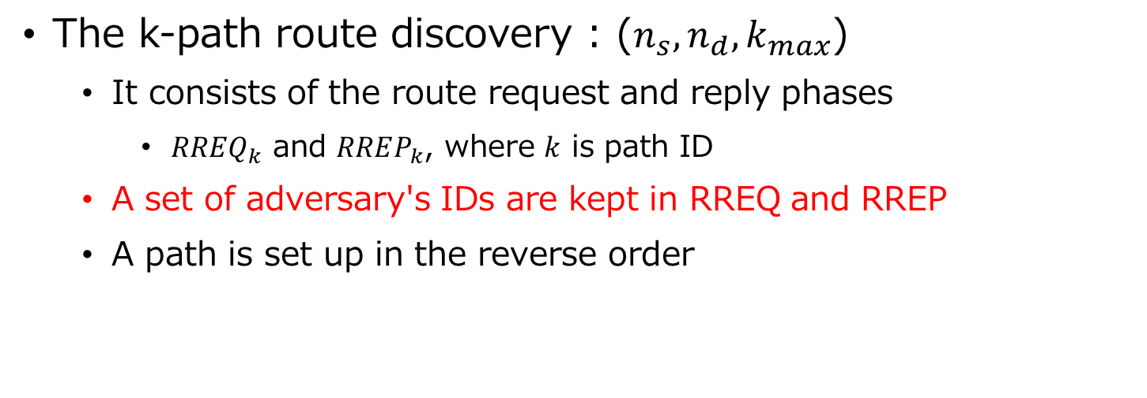
The Route Discovery
The k-path route discovery : ($n_{s}, n_{d}, k_{max}$)
  It consists of the route request and reply phases
    $RREQ_{k}$ and $RREP_{k}$, where $k$ is path ID
  A set of adversary's IDs are kept in RREQ and RREP
  A path is set up in the reverse order
Table. An entry of routing table
The path ID
The source ID
The destination ID
The predecessor ID
The descendant ID
Fig. The route discovery

Slide 20




The Route Discovery (Cont.)
Flooding is repeated until a safe path or a set of adversary disjoint paths are found, or the number of flooding exceeds $k_{max}$
RREP: $\hat{A_{1}}$
RREP: $\hat{A_{2}}$
RREP: $\hat{A_{2}}$
RREP: $\hat{A_{2}}$
Fig 1. The first RREQ
Fig 2. The second RREQ

Slide 21
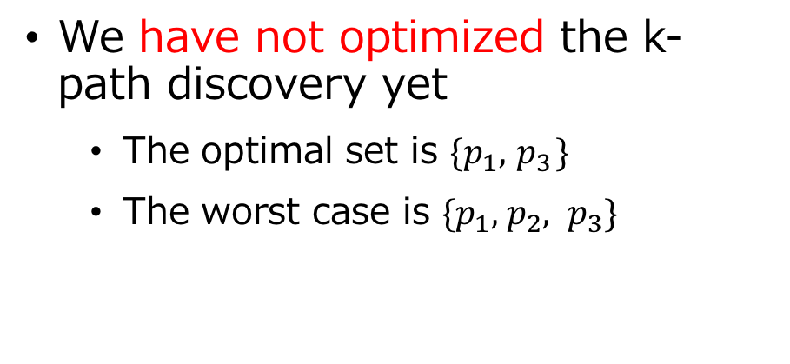
Limitations
MPAR does not work if an adversary is located in proximity of the source and destination
  Probably only the ideal routing protocol with a perfectly secure encryption scheme can handle this case
  Or cooperative jamming is required
We have not optimized the k-path discovery yet
  The optimal set is $\{p_{1}, { p}_{3}\}$
  The worst case is $\{p_{1}, { p}_{2}, p_{3}\}$
Fig. Three paths

Slide 22
The Key Properties
The cost of the k-path discovery
  MPAR introduces additional flooding cost only when a safe path is not found
The cost of the message transmission cost
  MPAR switches to the k-path routing mode, which requires k number of message transmissions, only when a safe path is not found

Slide 23
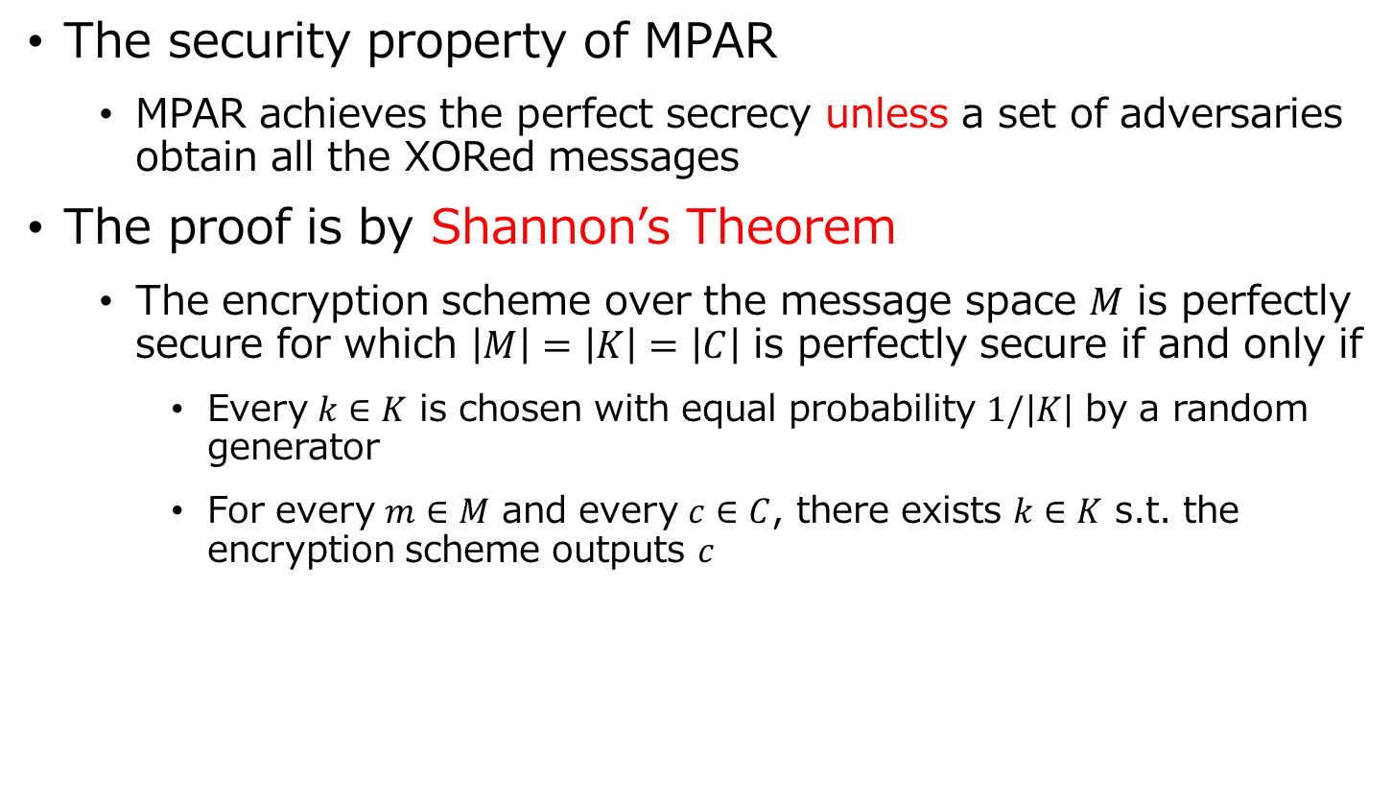
The Security Property
The security property of MPAR
  MPAR achieves the perfect secrecy unless a set of adversaries obtain all the XORed messages
The proof is by Shannon’s Theorem
  The encryption scheme over the message space $M$ is perfectly secure for which $\left|M\right|=\left|K\right|=\left|C\right|$ is perfectly secure if and only if
    Every $k∈K$ is chosen with equal probability $1/\left|K\right|$ by a random generator
    For every $m∈M$ and every $c∈C$, there exists $k∈K$ s.t. the encryption scheme outputs $c$

Slide 24
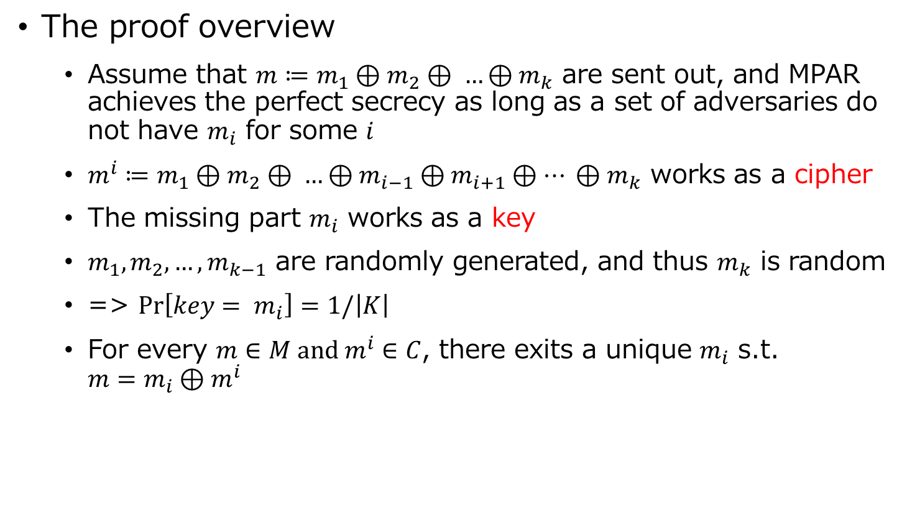
The Security Property (Cont.)
The proof overview
  Assume that $m≔m_{1}⊕m_{2}⊕ …⊕m_{k}$ are sent out, and MPAR achieves the perfect secrecy as long as a set of adversaries do not have $m_{i}$ for some $i$
  $m^{i}≔m_{1}⊕m_{2}⊕ …⊕m_{i−1}⊕m_{i+1}⊕… ⊕m_{k}$ works as a cipher
  The missing part $m_{i}$ works as a key
  $m_{1}, m_{2},…, m_{k−1}$ are randomly generated, and thus $m_{k}$ is random
  => $\operatorname{Pr}\left[{key= m}_{i}\right]=1/\left|K\right|$
  For every $m∈M and m^{i}∈C$, there exits a unique $m_{i}$ s.t. ${m=m}_{i}⊕m^{i}$

Slide 25
4. Performance Evaluation
Introduction to avoidance routing
The Problem Formulation
Multi-Path Based Avoidance Routing (MPAR)
Performance Evaluation
  Simulation Configurations
  Simulation Results
Conclusions

Slide 26
Simulation Configurations
We compared MPAR with two protocols
  The ideal protocol w/ a perfectly secure encryption scheme (The upper bound of avoidance routing performance)
  Greedy-AA (a distance vector-based protocol)
Table. Simulation parameters
Parameters | Values
Simulation area | 800 by 800
Communication range | 100
Number of nodes | 100 to 400 (4.9 ~ 19.6 neighbors / node)
Percentage of adversaries | 0 to 10 % (Adversaries are randomly deployed)

Slide 27
Independent Adversaries

Slide 28
Collusion Attacks

Slide 29
5. Conclusions
In this work,
  We study avoidance routing in ad hoc networks
  We derive the bounded condition and the safe path condition
  We propose multi-path avoidance routing (MPAR)
    The XOR cording and k-path route discovery
    The perfect secrecy
    A weaker condition than that required by the existing protocols
  We demonstrate the performance of the proposed scheme by simulations
Future works
  The optimization of a set of adversary disjoint paths and the cost of finding k-path

