Slide 1
FCell: Towards the Tradeoffs in Designing Data Center Network (DCN) Architectures
Dawei Li and Jie Wu
CIS, Temple University
ICCCN 2015

Slide 2
Agenda
Introduction
Unified Performance Model
FCell: A Novel DCN Architecture
Comparisons of DCN Architecture
Simulation
Conclusions

Slide 3
My Research on Network Connections
Interconnection Networks (1988-1998)
Direct networks (no switch)
Multistage networks (with 2X2 switches)
MANETs (1999-2005)
Topology control (to control density of neighbors)
Maintaining “long-distance” links based on small world
DTNs (2005-now)
Mobility control (for contact distribution and location)
DCNs (2010-now)
Unifying connection models using servers/switches

Slide 4
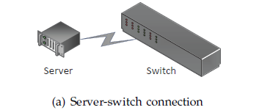
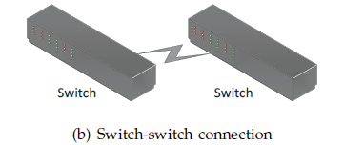
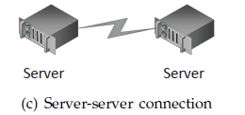
Introduction
Three types of connections:
Server-switch connection (a)
Switch-switch connection (b)
Server-server connection (c)
Two classes of DCNs :
Switch-centric
Only server-switch and switch-switch connections (a and b), no server-server.
E.g., Fat-Tree , Flattened Butterfly
Server-centric
Mostly only server-switch and server-server connections (a and c), no switch-switch.
E.g.: BCube, FiConn, DCell

Slide 5
Introduction
Switch-centric vs. Server-centric
Server-centric architectures
Enjoy the high programmability of servers, but servers usually have larger processing delays than do switches.
Switch-centric architectures
Enjoy the fast switching capability of switches, but switches are less programmable than servers.
Can we combine the advantages of both categories?

Slide 6
Introduction
Performance vs. Power Consumption
To provide low end-to-end delays and high bisection bandwidth
Large numbers of networking devices are usually used in DCNs.
E.g., Fat-Tree: three levels of switches; BCube: three or more levels & extra Network Interface Card (NIC) ports.
To achieve a low DCN power consumption
Other architectures use significantly fewer networking devices.
E.g., FiConn, Dpillar, etc.
Can we achieve high performances and low power consumption at the same time?

Slide 7
Introduction
Scalability vs. Flexibility
Scalability : networking devices, typically the switches, rely on a small amount of info., which does not increase significantly over the network size, to make efficient routing decisions.
Flexibility: expanding the network in a fine-grained fashion should not destroy the current architecture
Can we design both scalable and flexible DCN architectures?

Slide 8
Introduction
Contributions
Unified performance model
Path length (and hence, diameter)
Power consumption
A range of DCN architectures
Based on different trade-offs
A new DCN architecture: Fcell
Situated in the middle of the trade-off spectrum: dual-centric

Slide 9
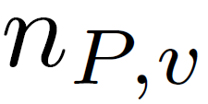
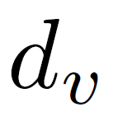
Unified Performance Model
Unified Path Length Definition:
Unified Diameter in a DCN:
: # of switches in a path
: # of servers in a path (excluding s and d)
: processing delay on a switch
: processing delay on a server
Notes:
Typical value for d_w : 2 us
Typical value for d_v: depends on how the packet forwarding engine is implemented. Can be close to 2 us if it is implemented by hardware; Can be 10 us if it is implemented by software.
Thus, d_v can be 1 to several times of d_w.

Slide 10
Unified Performance Model
DCN power consumption per server:
: power consumption of a switch
: # of switches in a DCN
: # of servers in a DCN
: average # of NIC ports each server uses
: power consumption of a NIC port
: whether the server is involved in packet relaying
: power consumption of a server’s packet forwarding
Notes:
p_w: 150 Watts
p_nic: 2 Watts
p_fwd: depends on how the forwarding engine is implemented; for software based implementation: about 2 to 5 Watts

Slide 11
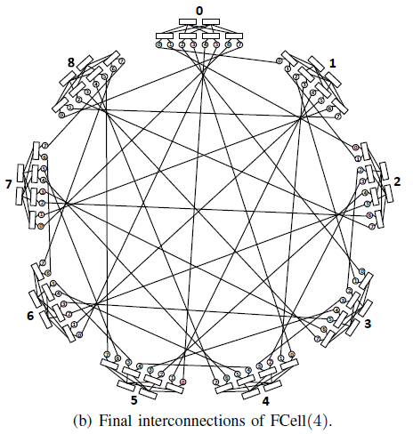
FCell: A Novel DCN Architecture
Intra-cluster
The switches and servers form a simple instance of the folded Clos topology
Inter-cluster
Each of the servers in a cluster is directly connected to another server in each of the other clusters
2 NIC ports and switches with n ports
n/2 level-2 switches and n l-1 switches
(n/2)n servers in each cluster
Total (n/2)n+1 clusters

Slide 12
FCell: A Novel DCN Architecture
FCell basic properties:

Slide 13
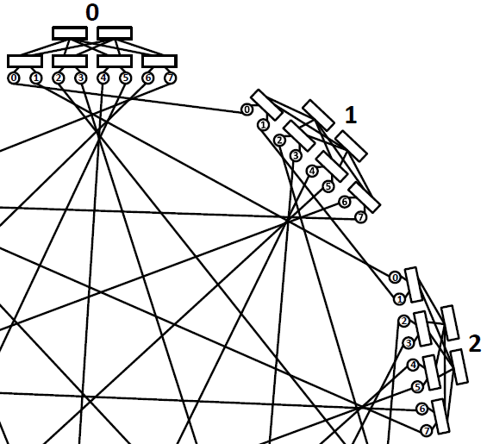
FCell: A Novel DCN Architecture
FCell routing schemes
Shortest Path Routing:
Determines the relay servers
Source to relay1 in the source cluster
Relay 1 to relay 2
Relay 2 to destination in the destination cluster
source
relay 1
relay 2
destination

Slide 14
FCell: A Novel DCN Architecture
Detour Routing:
Randomly select a relay cluster
Conduct shortest path routing from the source cluster to the relay cluster
Then, from a relay cluster to the destination cluster

Slide 15
FCell: A Novel DCN Architecture
FCell Scalability and Flexibility
FCell has good scalability due to its high degree of regularity.
Switches in FCell only need local information for packet forwarding.
Servers only need basic configuration parameters of FCell for packet forwarding.

Slide 16
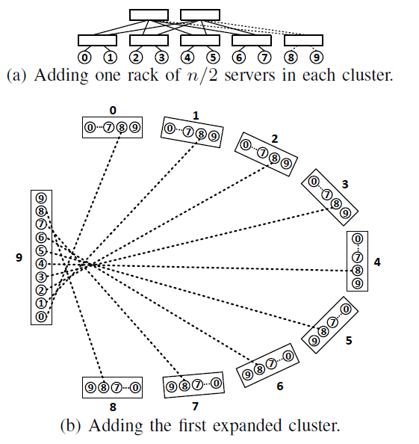
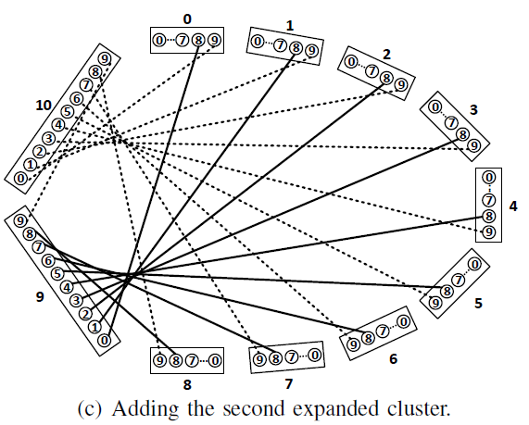
FCell: A Novel DCN Architecture
FCell supports flexibility well, i.e., it allows fine-grained and incremental growth of its network size.

Slide 17
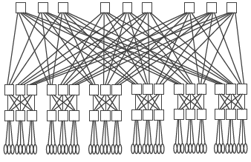
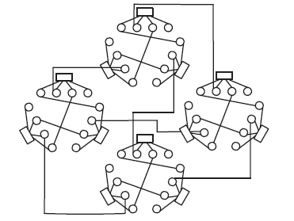
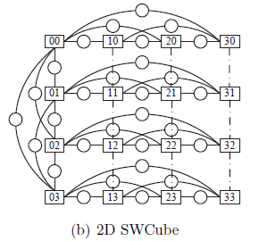
Comparisons of DCN Architectures
Some existing architectures:
Left: server-centric, Right: switch-centric
Fat-Tree:
FiConn:
SWCube:

Slide 18
Comparisons of DCN Architectures
Notes:
d_v is 1 to several (can be 5 or 10) times of d_w
From top to bottom, the diameter increases; the bisection bandwidth decreases; the power consumption decreases.

Slide 19
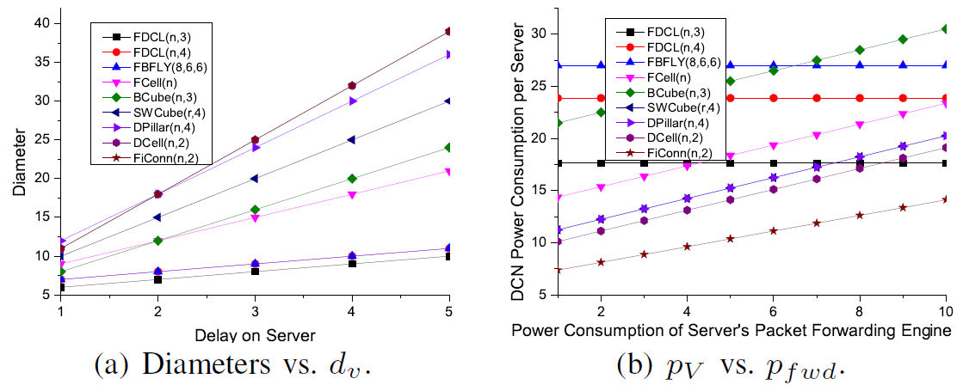
Comparisons of DCN Architectures

Slide 20
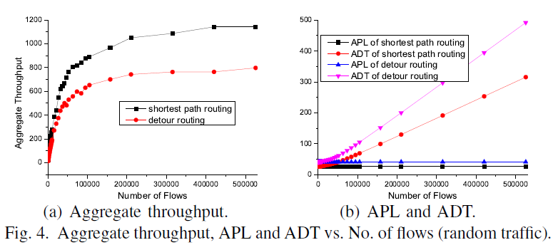
Simulation
We conduct simulations on FCell for both random traffic and bursty traffic.
Average Path Length (APL)
Average Delivery Time (ADT)
Simulations for random traffic:
Notes:
APL: Average Path Length
ADT: Average Delivery Time

Slide 21
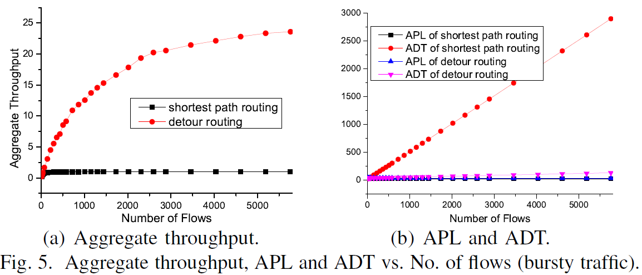
Simulation
Simulations for bursty traffic:
Notes:
APL: Average Path Length
ADT: Average Delivery Time

Slide 22
Conclusions
A unified path length definition and a unified power consumption model for general DCNs
Enabling fair and meaningful comparisons
A novel DCN architecture, FCell, which serves as a good example of a tradeoff design in three aspects
Performance and power, switch-centric and server-centric designs, and scalability and flexibility
A new class of DCNs, that can be regarded as dual-centric, with FCell as an example
Two basic routing schemes
Performance under different traffic conditions

Slide 23
Future Work
More in-depth simulation
Different flows
Different bursty modes
Simulation of some real applications
Support for overlay networks
Questions can be sent to:
dawei.li@temple.edu
jiewu@temple.edu

Slide 24
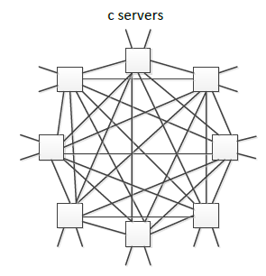
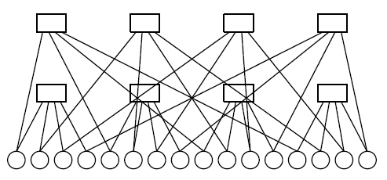
Backup slides
Flattened Butterfly (one-dimensional)
BCube (two-level):

Slide 25
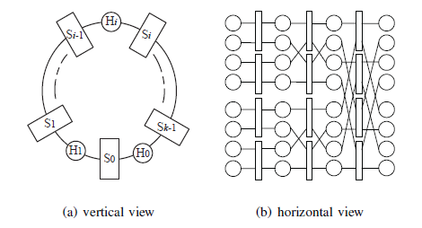
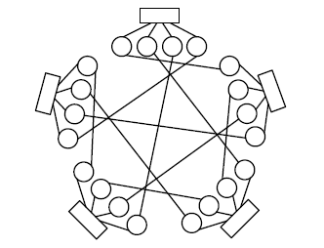
DPillar:
DCell (two-level):

