Slide 1
A Comprehensive Comparison of Two Resource
Allocation Schemes in DCNs under the Hose Model
Jie Wu*, Shuo Quan，and Xiaoyao Huang
China Telecom and *Temple University
Notes:
1

Slide 2

Unified Scheduling
The efficient integration and unified scheduling of computing and network resources.
Resource Modeling
Scheduling Optimization
Traffic Management
D(src)
s₁
D(switch)
VM
n₁
n₂
_{2/3}
_{2/2}
)一体化调度
server
switch
s₂
_{2/2}
s₃
OVS
OVS
_{2/2}
_{2/4}
_{4/4}
n₁
n₂
n₃
_{2/4}
_{2/2}
_{4/4}
DCN
D(ser)
s₃
Supersink
s₁
SDN
s₂
MAN
upstream
s₄
downstream
Spine-Leaf
short-cut
DCN
GW
DCN
DCN
n₃
n₄
D(src)
Spine-Leaf
OVS
OVS
Notes:
Unified scheduling integrates and unifies the scheduling of cloud computing resources and network resources
1. Resource modeling uses the hose model, a service interface model based on aggregated traffic
2. Scheduling optimization adopts elastic scheduling for scalability
3. Traffic management adopts a routing policy based on max-flow, introduced an efficient short-cut routing strategy

Slide 3
  2. Resource Modeling
Hose model :
Aggregated traffic demand per site B=3G multiplexing
(1,1,1), (2,1,0), (3,0,0)
Pipe model:
instead of (1, 1, 1)
Pairwise traffic demand
AWS EC2
How to allocate a slice: a chunk of compatible computing resource (VMs)
and network resource (bandwidth)?
switch
virtual switch
Instance type | vCPUs | Memory (GB) | Bandwidth (Mbps)
m7i.xlarge | 4 | 16 | 1250
m7i.2xlarge | 8 | 32 | 2500
m7i.4xlarge | 16 | 64 | 5000
bandwidth B
B
B
VM
VM
...
VM
Notes:
Smartphones, wearable devices (google glass and apple watch), cameras, vehicles_

Slide 4
Why Not Trivial?
  Given a cable connection in a graph, each household has a maximum occupancy limit and each cable section has bandwidth limit.
  Allocate a slice that contains N ppl and can support all possible simultaneous pairwise video conversations.
2
1
2
1
2
hose model

Slide 5
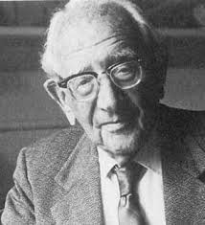
How to Solve It (Polya)
The scheduling problem is conjectured to be NP-hard for feasibility in a general network
If you can’t solve a problem, then there is an easier
problem you can solve: find it
Tree (typical DCN)
Postmortem (V. Sekar, SIGCOMM 2024)

Slide 6
DCN: Fat-Tree
Equal-cost multi-path routing (ECMP) with 4 ports
Core
40
40
40
40
10
Pods
10
20
20
20
20
20
20
20
20
5
5
5
5
5
5
5
5
5
5
5
5
5
5
5
5
5
Edge
4
6
6
4
5
6
6
4
2
5
3
4
5
6
6
4
Fat-tree structure

Slide 7
MAN: Two-level Spine-and-Leaf
Large-scale network: China Telecom MAN
Network
Cloud
ChinaNet
CN2-DCI
POP
Level 2
Backbone Network
PE
VPC
C/D
C/D
PE
PE
GW
Super Spine
Super Spine
Super Spine
Super Spine
Leaf
vDNS
Central Cloud
Egress Functional Area
CR
CR
B-Leaf
B-Leaf
Level 1
VPC
Super Spine
Super Spine
Leaf
GW
Regional Cloud
Spine
Spine
Spine
Spine
…
Spine
Spine
Spine
Spine
EPC
GW
5GC
Leaf
Leaf
Leaf
Leaf
Leaf
Leaf
…
Leaf
vBRAS
Leaf
Leaf
Leaf
Leaf
Leaf
Leaf
Leaf
Leaf
CT Cloud
OLT
A
A
OLT
A
A
OLT
A
A
OLT
A
A
MEC
A
A
A
A
UPF
Leaf
GW
CPE
eNB/gNB
CPE
eNB/gNB
VCDN
CPE
eNB/gNB
CPE
eNB/gNB
Edge Cloud
POD
POD

Slide 8



3. Scheduling Optimization
Oktopus (SIGCOMM 2011, with > 1K citations)
Problem: Given N VMs, schedule them if a solution exists in a DCN.
Solution:
  Virtual cluster with an outbound link (each VM requires B bandwidth)
  Outbound link capacity should be at least min {m, N-m} * B
$$\min\left(m,N−m\right)∗B≤L$$
$$L$$
Local: m and global: N
So inside: m and outside N-m
$$m$$
…

Slide 9


Oktopus Solution
Examine clusters from left to right, and from lower to upper layers
bandwidth
servers
Avoid fragmentation, or reduce delay (hop count) and bandwidth
v₁
When N = 8 (assuming B = 1G)
₁₁
₆
$$M_{v4}=5$$
$$M_{v5}=6$$
$$M_{v6}=6$$
$$M_{v7}=4$$
v₂
v₃
₈
₄
₇
₂
₅
₅
₆
₆
₄
$$M_{v2}=11$$
v₄
v₅
v₆
v₇

Slide 10



Oktopus Solution (Cont’d)
Different N have different schedules !
v₁
₁₂
When N = 12
₁₁
₆
$$M_{v4}=4$$
$$M_{v5}=6$$
$$M_{v6}=2$$
$$M_{v7}=4$$
v₂
₂
₁₀
v₃
₄
₇
₂
₅
$$M_{v2}=10$$
$$M_{v3}=6$$
₅
₆
₆
₄
v₄
v₅
v₆
v₇
$$M_{v1}=16$$
Issues: (1) No max load. (2) No support for traffic management. (3) Sequential process in nature

Slide 11
  Finding a Largest Slice
Maximum Admissible Load (MAL) (ICC 2018)
Problem: Given a set of VMs each requires a bidirectional link bandwidth of B, assign the maximum number of VMs in a DCN that meets the need of VM placement and their communication.
(Initially for maximum elastic computing)
v₁
switch
₁₁
₆
v₂
v₃
₄
₇
₂
₅
server
₅
₆
₆
₄
v₄
v₅
v₆
v₇
Notes:
Smartphones, wearable devices (google glass and apple watch), cameras, vehicles_

Slide 12





A Simple Solution
Simple max load: Calculate maximum load at the root of a 2-level subtree
$$min\left\{N_{l},L_{l}\right\}+min\left\{N_{r},L_{r}\right\}$$
A proper data structure
$$L_{l}$$
$$L_{r}$$
min: filtering
+: pooling
$$N_{l}$$
$$N_{r}$$
v₁
11
6
16
v₂
v₃
4
7
2
5
10+6
5
6
6
4
11
6
v₄
v₅
v₆
v₇
10
6

Slide 13
Optimal Solution
Two-phase linear solution
  Up-phase to find the max load at the root
  Down-phase to find the max load at other nodes
₆
₁₆
₁₆
₁₀
v₁
v₁
₁₁
₆
₁₁
₆
₁₀
₁₂
₁₀
₁₀
₈
₁₆
₆
₁₀
v₂
₆
₁₂
v₂
v₃
v₃
₄
₇
₂
₅
₄
₇
₂
₅
₅
₆
₆
₄
₅
₆
₆
₄
v₄
v₅
v₆
v₇
v₄
v₅
v₆
v₇
₍₉₎
₍₁₃₎
₍₈₎
₍₉₎
Up phase
Down phase

Slide 14

Scheduling N VMs
Scan from lower to upper subtree schedule
  Best fit (smallest subtree ≥ N) and simple maintenance
  N = 8
16
8
v₁
11
6
10
2
6
v₂
v₃
4
7
2
5
6
6
5
2
1
4
5
6
6
4
v₄
v₅
v₆
v₇

Slide 15
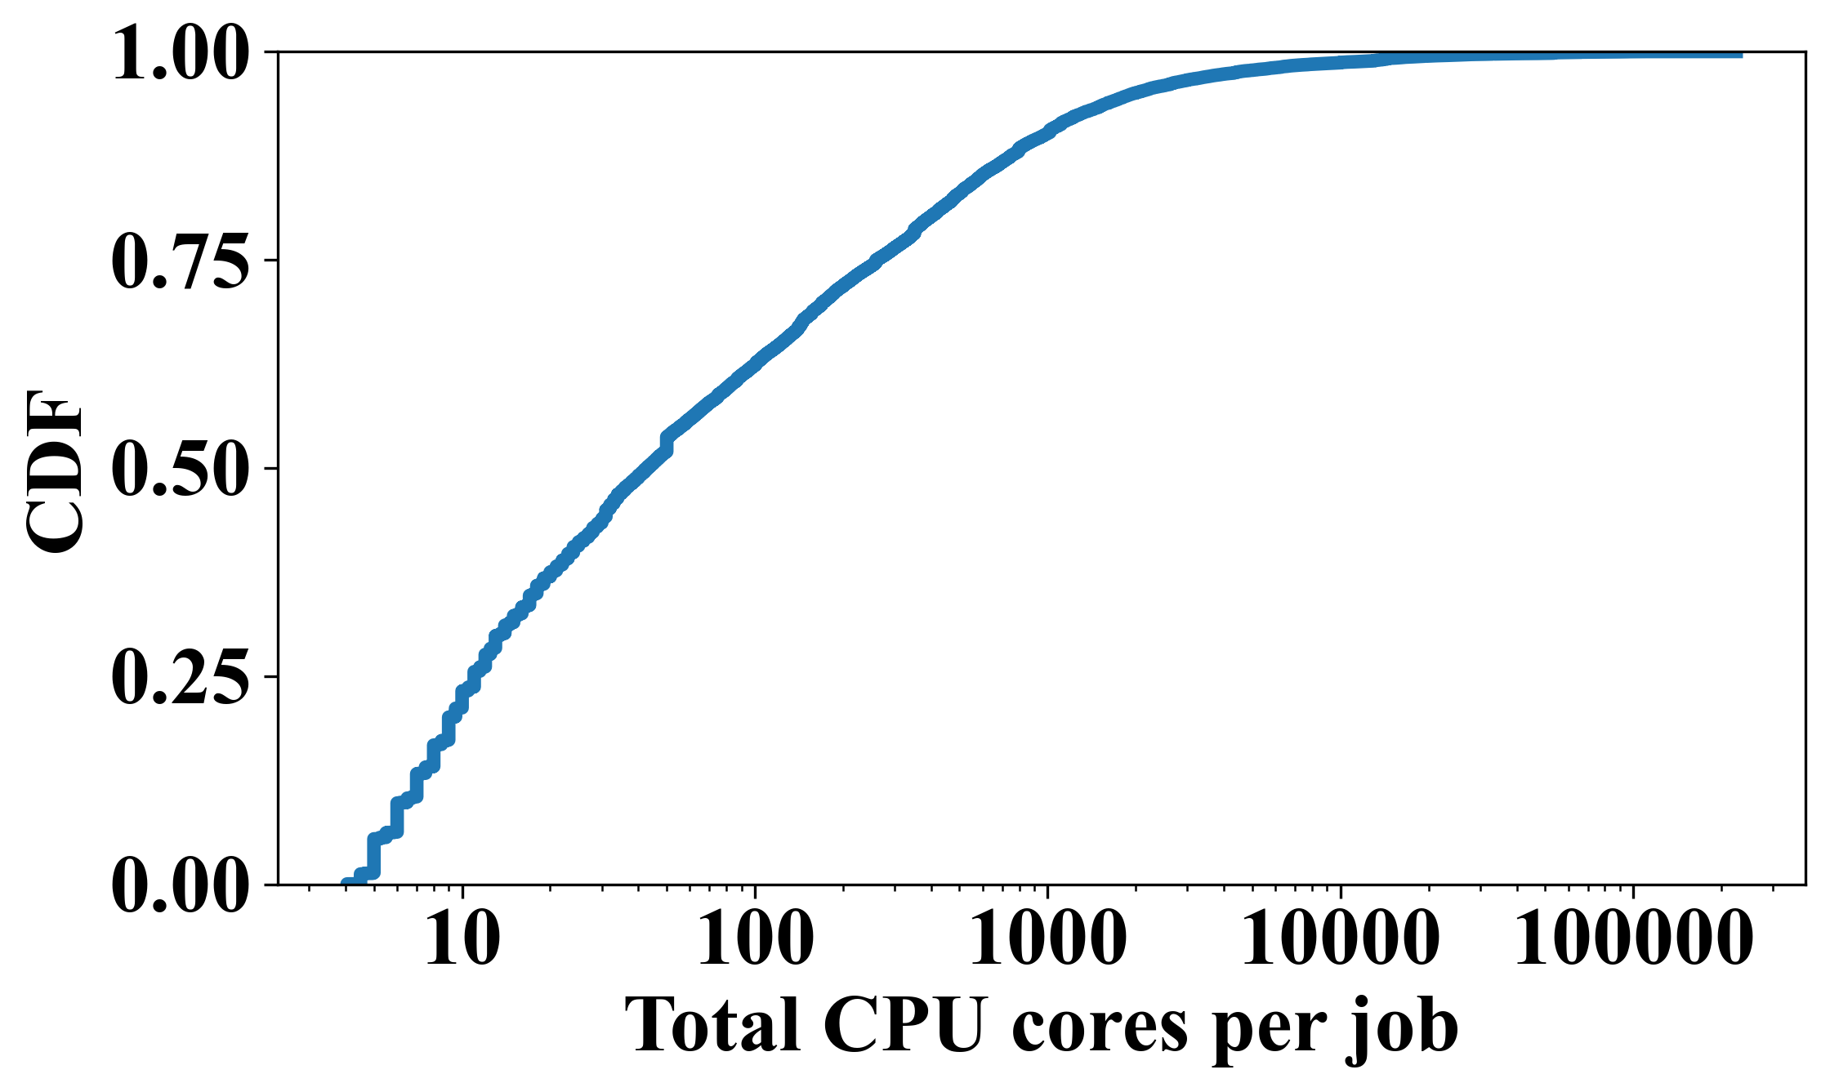
5. Simulation
512 servers: each with 32 to 64 cpu cores
VM：4 cpu cores
Small: 50%, jobs ≤ 10 VMs
Medium: 30%, 10 VMs < jobs ≤ 100 VMs
Large: 20%, 100 VMs < jobs
Alibaba clusterdata v2018 trace

Slide 16

Performance Evaluation
Speed Hop-count
Small 12.5%+3% 86.9%+3%
Medium 13.4%+7% 105%+7%
Large 48.3%+.5% 104%+0%
Mixed 13.3%+8% 101%+9%
Ratio: MAL/Oktopus, In only, dynamically drop a slice at 20-80% usage, and then garbage collection

Slide 17
Performance Evaluation (Cont’d)
Speed Hop-count
Small 18.9%+3% 84.4%+2%
Medium 23.5%+5% 108.6%+3%
Large 52.0%+1% 106%+0%
Mixed 24.4%+2% 102%+2%
Ratio: MAL/Oktopus, In/Out traffic, dynamic load at 20-80%, drop at 20% and garbage collection

Slide 18
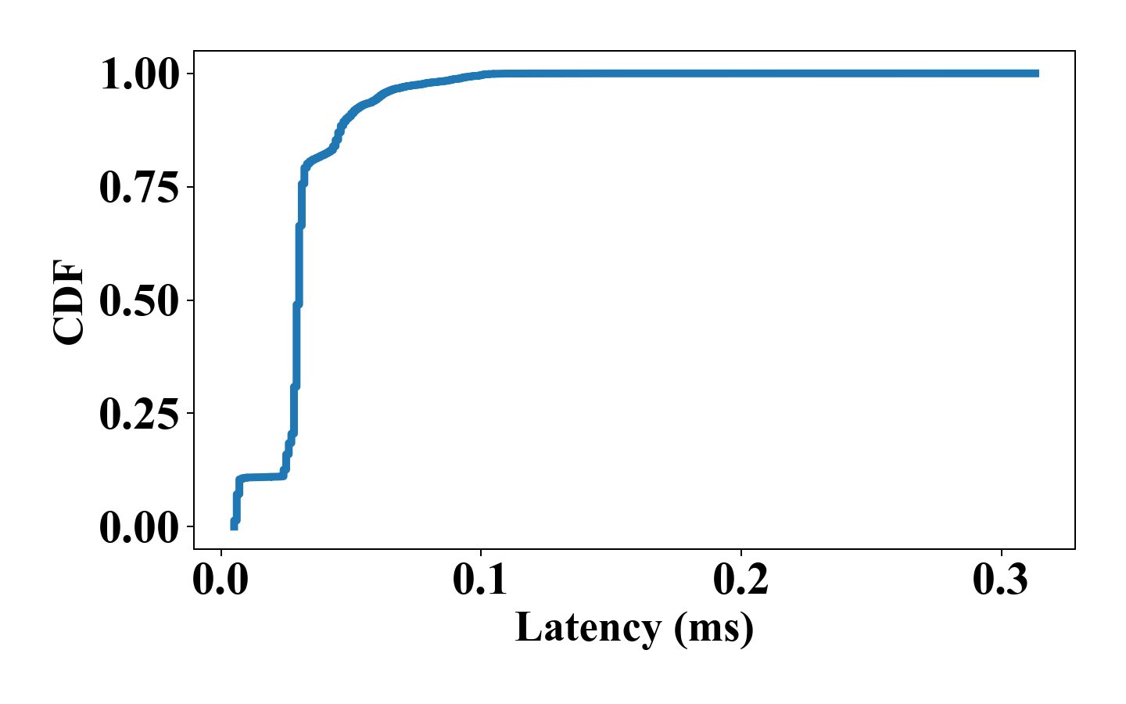
Testbed
v₁~v₂：100G switch, v₃~v₆：25G switch,
v₇~v₁₄：32-core CPU，256 GB main memory
v₁
v₂
v₃
v₄
v₅
v₆
v₇
v₈
v₉
v₁₀
v₁₁
v₁₂
v₁₃
v₁₄
Distribution of end-to-end RTT
Testbed
Method | Bandwidth | Hop Count | Scheduling Time | RTT
Tailor | 12.53 | 1.45 | 0.025 | 0.028
Oktopus | 12.4 | 1.29 | 0.062 | 0.028
Notes:
服务器：紫金DPU服务器，型号为：NF5280M6；
交换机：华为 100G 型号：CE8855-32CQ4BQ； 华为 25G 型号 CE6863E-48S6CQ；

Slide 19
Lesson Learned
Difficulty in asking the right question in CS
Importance of a proper (data) structure in design
  Programming = Data Structure + Algorithm
H. Ballani et al. Towards Predictable Datacenter Networks, SIGCOMM 2011.
J. Wu et al. On Maximum Elastic Scheduling of VMs for Cloud-based DCNs, ICC 2018.

Slide 20


