Slide 1
IEEE ICC 2026
JOINT PRICING AND SCHEDULING
FOR SLA-AWARE SERVERLESS GPU SERVICES
Xiaoyao Huang¹, Yanan Yang¹, Yujun Wang², Jie Wu^{1,3}
¹Cloud Computing Research Institute, China Telecom ²China Telecom Cloud Technology Co. Ltd ³Temple University, USA
IEEE INTERNATIONAL CONFERENCE ON COMMUNICATIONS
May 2026 | Glasgow, Scotland, UK

Slide 2
01
Introduction & Background
Serverless GPU computing landscape, key challenges, and research contributions
OUTLINE
02
System Model & Formulation
Two-timescale architecture, demand model, and Stackelberg game formulation
Presentation overview and structure of the HOPS framework
03
HOPS Framework
PBA pricing algorithm, ARMS scheduler, and bi-level optimization with convergence guarantees
04
Performance Evaluation
Trace-driven experiments on real-world workloads: profit, SLA compliance, and efficiency
05
Conclusion
Summary of contributions, related work comparison, and future research directions

Slide 3
01
Introduction & Background

Slide 4
Introduction
System Model
HOPS Framework
Evaluation
Conclusion
Background: Serverless GPU Computing
Serverless GPU services provide elastic, pay-as-you-go GPU access for AI inference, multimodal generation, and real-time analytics.
Key characteristics:
Automatic scaling — on-demand resource provisioning
Pay-per-use billing — fine-grained execution-based charging
Function-as-a-Service — no infrastructure management
GPU cloud market projected $25B by 2028, driven by GenAI adoption.
Serverless GPU Service Stack
User Applications — AI Inference, GenAI, Analytics
API Gateway — Request Routing, Load Balancing
Scheduling Layer — Job Assignment, Function Deployment
Pricing Layer — Dynamic Pricing, SLA Management
GPU Pool — vGPUs, Keep-Alive Replicas, Transient Instances
Key Observation: Demand for serverless GPU is highly bursty and time-varying, making capacity planning extremely difficult. Providers face a critical tradeoff between profitability, resource utilization, and service quality.
$25B
10-100x
<30%
ms-level
GPU Cloud Market
by 2028
Demand Burstiness
Peak-to-Average Ratio
Typical GPU Utilization
in Serverless Settings
SLA Requirements
Latency Sensitivity
4 / 20
Notes:
Looking at the service stack on the right, we have user applications at the top, going through API gateway for routing and load balancing, then the scheduling and pricing layers, and finally the GPU pool with virtual GPUs, keep-alive replicas, and transient instances.
Let me highlight a few important numbers. First, the GPU cloud market is projected to reach 25 billion dollars by 2028, largely driven by the explosive adoption of generative AI. Second, the demand in serverless settings is extremely bursty — the peak-to-average ratio can be 10 to 100 times. Third, the typical GPU utilization in serverless environments is below 30%, which means a lot of expensive resources are being wasted. And fourth, SLA requirements are at the millisecond level for latency-sensitive inference workloads.
The key observation here is: demand for serverless GPU is highly bursty and time-varying, which makes capacity planning extremely difficult. Providers face a fundamental trade-off between profitability, resource utilization, and service quality.

Slide 5
Introduction
System Model
HOPS Framework
Evaluation
Conclusion
Challenges & Research Motivation
Bursty Demand
Expensive GPUs
Highly time-varying workloads with peak-to-average ratios of 10-100x make capacity planning extremely difficult and error-prone.
Scarce GPU resources (A100/H100 cost $10-30K each) make even short under-utilization periods very costly for providers.
Stringent SLAs
Decoupled Design
Latency and reliability requirements with substantial financial penalties for violations. Cold-start delays can breach ms-level SLAs.
Existing methods decouple pricing from scheduling, leaving providers reactive rather than proactive in demand shaping.
Key Insight
There is a critical need to jointly optimize pricing and scheduling to proactively balance profitability, resource utilization, and service quality in serverless GPU platforms.
Research Gap
• Pricing work [13-16] focuses on VM-level or spot-instance markets — too coarse-grained for second-scale GPU elasticity
• Scheduling work [5-6] optimizes allocation but treats demand as exogenous — misses demand-shaping opportunity
• No existing framework jointly optimizes economic decisions (pricing) with system-level scheduling for serverless GPUs
5 / 20
Notes:
Based on this background, we identified four key challenges.
First, bursty demand. Workloads with peak-to-average ratios of 10 to 100x make capacity planning extremely difficult and error-prone. You either over-provision and waste resources, or under-provision
and violate SLAs.
Second, expensive GPUs. A single A100 or H100 GPU costs 10,000 to 30,000 dollars. Even short periods of under-utilization are very costly for providers.
Third, stringent SLAs. Latency and reliability requirements come with substantial financial penalties for violations. Cold-start delays alone can breach millisecond-level SLAs.
Fourth, and this is critical — decoupled design. Existing approaches decouple pricing from scheduling, which leaves providers in a reactive mode. They respond to demand as it comes, rather than proactively
shaping it.
This leads to our key insight: there’s a critical need to jointly optimize pricing and scheduling to proactively balance profitability, utilization, and service quality in serverless GPU platforms.
So what’s the research gap? Pricing work in the literature focuses on VM-level or spot-instance markets, which is too coarse-grained for the second-scale elasticity that serverless GPUs require. Scheduling work
optimizes allocation but treats demand as exogenous — it misses the demand-shaping opportunity entirely. No existing framework jointly optimizes economic decisions with system-level scheduling
for serverless GPUs. This is exactly where our work comes in.

Slide 6
02
System Model & Formulation
Two coupled timescales: window-level economic planning and slot-level real-time resource control

Slide 7
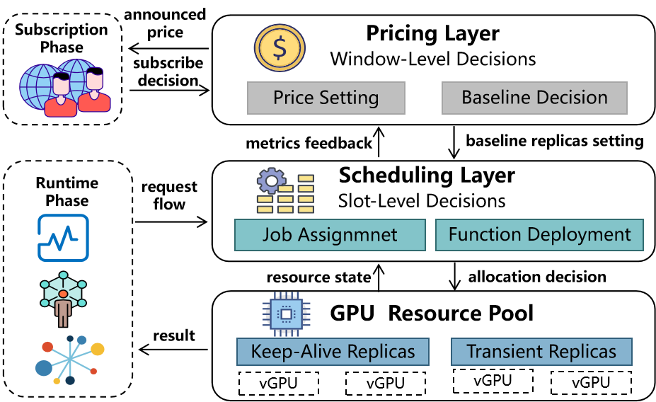
Introduction
System Model
HOPS Framework
Evaluation
Conclusion
System Overview: Two-Timescale Architecture
Window Level (t)
Slot Level (h)
Long-term economic planning
Determines per-unit vGPU price p_{m,t} for each tier m
Announces predefined SLA s_{m} and baseline n^{min}
Time scale: minutes to hours
Real-time resource control
Assigns jobs to vGPUs (x_{k,j,h})
Manages function deployment (v_{j,f,h})
Time scale: seconds
Service Tiers
Architecture Overview
Tier | Price p_{m,t} | SLA s_{m} | Baseline n^{min}
Tier 1 (Basic) | Low | Relaxed | n^{min}_{1,t}
Tier 2 (Standard) | Medium | Moderate | n^{min}_{2,t}
Tier M (Premium) | High | Strict | n^{min}_{M,t}
Coupling Mechanism: Pricing decisions (p_{t}, n^{min}_{t} ) flow downward to constrain scheduling. Scheduling costs feed back upward to inform pricing updates. This bi-level structure naturally maps to a Stackelberg game formulation.
Notation: N = total vGPUs | T = number of windows | H = slots per window | M = service tiers | F = function types
8 / 20
Notes:
The core of HOPS is a two-timescale architecture. We operate at two time granularities:
At the Window Level, which is the long-term economic planning layer, we determine the per-unit vGPU price for each service tier, and we announce the predefined SLA and the minimum baseline allocation.
This operates at the scale of minutes to hours.
At the Slot Level, which is the real-time resource control layer, we assign jobs to vGPUs and manage function deployments. This operates at the scale of seconds.
A classic three-tier service structure: Basic, Standard, and Premium, with corresponding prices, SLAs, and baseline allocations.
The coupling is important. The pricing decisions flow downward: they affect user demand and constrain the scheduler through baseline allocations. The scheduling results flow upward: the realized GPU usage,
switching overhead, and SLA penalties are fed back to the pricing layer. This closed-loop structure naturally leads to a Stackelberg game, where the pricing layer is the leader and the scheduling layer is the follower.

Slide 8
Introduction
System Model
HOPS Framework
Evaluation
Conclusion
Pricing Layer: Demand Model & Revenue
Multinomial logit (MNL) Demand Model
$$λ_{m,t}=Λ_{t}⋅\frac{e^{αs_{m}−βp_{m,t}}}{∑_{m^{′}}e^{αs_{m^{′}}−βp_{m^{′},t}}}$$
Operational Cost Components
Expected demand for tier m depends on:
α — user sensitivity to SLA quality
β — user sensitivity to price
Λ_{t} — total market demand at window t
Cost Component | Description
C_{base} | Keep-alive replica maintenance cost
C_{gpu} | Transient vGPU activation cost
C_{switch} | Function switching overhead (cold start)
b_{m}L_{m,t} | SLA penalty for tier m violations
Revenue Function
$$R_{t}=∑_{m}p_{m,t}⋅λ_{m,t}⋅g_{m,t}⋅Δ_{t}$$
Pricing Layer Objective
Maximize: Profit = Revenue − Operational Costs − SLA Penalties
Subject to: GPU capacity constraint Σ_{m} n^{min}_{m,t} ≤ N
Key Tradeoff: Higher prices → more revenue per job but lower demand. Better SLA → higher demand but more baseline cost. The pricing layer must find the optimal balance.
9 / 20
Notes:
At the pricing layer, we use the Multinomial Logit demand model. The expected demand for each tier depends on three factors: user sensitivity to SLA quality, denoted by alpha; user sensitivity to price,
denoted by beta; and the total market demand at each window, Lambda-t.
The provider’s operational cost has four components: the cost of maintaining keep-alive replicas, the cost of activating transient vGPUs, the switching overhead from cold starts, and SLA penalties for violations.
The pricing layer’s objective is to maximize profit, which equals revenue minus operational costs minus SLA penalties, subject to the GPU capacity constraint that the sum of baseline allocations across all
tiers cannot exceed the total number of vGPUs.
There’s a fundamental trade-off here: higher prices give more revenue per job but lower demand. Better SLAs drive higher demand but require more baseline cost. The pricing layer must find the optimal
balance between these competing effects.

Slide 9
Introduction
System Model
HOPS Framework
Evaluation
Conclusion
Scheduling Layer & Stackelberg Game
Slot-Level Decision Variables
Stackelberg Game Formulation
Variable | Notation | Meaning
Job Assignment | x_{k,j,h} | Job k assigned to vGPU j in slot h
Function Deploy | v_{j,f,h} | vGPU j runs function f in slot h
Switching | z_{j,h} | Function switch on vGPU j
LEADER (Pricing)
FOLLOWER (Scheduling)
Decides p_{t} and n_{min}^{t} at each window start, anticipating the Scheduling Layer's response
Solves the slot-level MILP given upper-level decisions, minimizing operational cost + SLA penalties
Bi-Level Optimization
Key Constraints
Job-function matching: each job served by vGPU running its required function
One function per vGPU per slot (no function mixing)
One job per vGPU per slot (serial execution)
Baseline replicas: active vGPUs ≥ n^{min}_{m,t}
Upper Level: max_{pt,nmin_t} Φ = Σ_{t} [R_{t} − Ψ(p_{t}, n^{min}_{t})]
where Ψ(p_{t}, n^{min}_{t}) = optimal objective of Scheduling Layer
Coupling: Ψ(·) couples economic and operational objectives — no closed form exists due to discrete scheduling decisions
10 / 20
Notes:
The scheduling layer works at the slot level. It has three main decision variables. The first is job assignment: x k j h indicates whether job k is assigned to vGPU j in slot h. The second is function deployment: v j f h
indicates whether vGPU j runs function f in slot h. The third is switching: z j h indicates whether vGPU j changes its deployed function.
The scheduler must satisfy several constraints. A job can only be served by a vGPU running the required function. Each vGPU can run at most one function in a slot. Each vGPU can process at most one job in a
slot. Also, the number of active vGPUs for each tier must not fall below the baseline selected by the pricing layer.
This gives the Stackelberg formulation. The pricing layer, as the leader, chooses prices and baselines while anticipating the scheduler's response. The scheduling layer, as the follower, minimizes operational cost and SLA penalties under those upper-level decisions. The challenge is that the lower-level scheduling problem is discrete and combinatorial, so the upper-level objective has no closed-form expression.

Slide 10
03
HOPS Framework
Hierarchical Optimization for Pricing and Scheduling — coupling stochastic optimization with adaptive scheduling

Slide 11
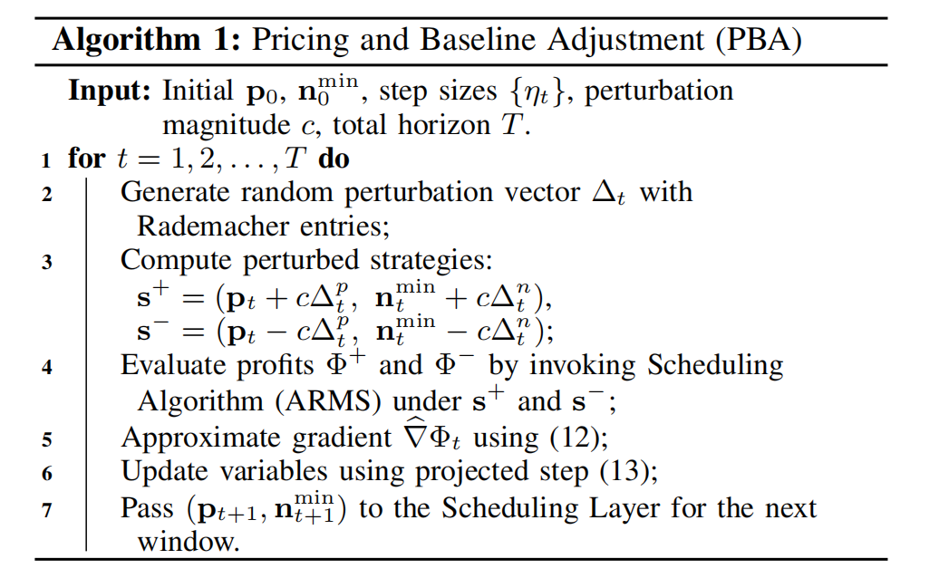
Introduction
System Model
HOPS Framework
Evaluation
Conclusion
PBA: Pricing & Baseline Adjustment
Challenge: Lower-level scheduling is discrete and non-linear — no closed-form gradient ∇Φ exists. Standard gradient descent is inapplicable.
Blockwise Two-Point Gradient Estimation
Theoretical Guarantee
Algorithm 1: PBA
Theorem 1 (PBA Convergence)
With proper step sizes η_{t} satisfying Ση_{t} = ∞ and Ση_{t}² < ∞, PBA iterates converge almost surely to a stationary point of the upper-level objective Φ.
Key Properties
Gradient-Free: Only requires function evaluations, no gradient computation
Joint Update: Optimizes prices and baseline replicas together through one projected update
Dimension-Efficient: Uses only two function evaluations per iteration, independent of decision dimension d
12 / 20
Notes:
The main challenge is that the lower-level scheduler is discrete and nonlinear. So the pricing layer cannot directly compute the gradient of the profit function. To address this, PBA uses a blockwise two-point
stochastic gradient estimation method.
At each window, PBA first generates a random perturbation direction. It then evaluates two nearby strategies: one positive perturbation and one negative perturbation. For each strategy, it invokes ARMS to
estimate the resulting profit. The difference between these two profits gives an approximate gradient direction. Finally, PBA updates the price vector and the baseline vector through a projected gradient step,
ensuring that prices remain feasible and the total baseline does not exceed the GPU capacity.
There are three useful properties. First, PBA is gradient-free, so it only needs objective evaluations from ARMS. Second, it jointly updates prices and baseline replicas. Third, it is dimension-efficient: each iteration uses only two function evaluations, independent of the decision dimension d.
In terms of theory, we establish Theorem 1: with proper step sizes satisfying the Robbins-Monro conditions, PBA iterates converge almost surely to a stationary point of the upper-level objective

Slide 12

Introduction
System Model
HOPS Framework
Evaluation
Conclusion
ARMS: Adaptive Reconfiguration & Matching
Stage 1: Reconfiguration
Stage 2: Matching
Fairness-aware reconfiguration at each slot start:
1. Estimate required replicas:
2. Compute fairness score across functions
3. Decide: switch keep-alive vGPU or activate transient vGPU based on cost comparison
Value- and fairness-aware matching:
1. Sort jobs by priority π_{k} combining:
Economic value (revenue + penalty)
SLA urgency (remaining time)
Fairness (deficit factor)
2. Assign to vGPU with min predicted completion time
Job Priority Formula
Complexity & Guarantee
$$π_{k}=w_{1}⋅{EconomicValue}_{k}+w_{2}⋅{SLAUrgency}_{k}+w_{3}⋅{FairnessDeficit}_{k}$$
Stage 1: O(|F||J|) per slot | Stage 2: O(|K_{h}| log |K_{h}|) — efficient for online operation
Theorem 2 (ARMS Approximation)
ARMS achieves a (1+ε)-approximation where ε depends on workload heterogeneity. Stage 2 achieves optimal scheduling under the priority scheme.
13 / 20
Notes:
The ARMS scheduler handles the lower-level real-time decisions in two stages.
Stage 1 is Reconfiguration. At each slot start, ARMS estimates the required number of replicas for each function, computes fairness scores across functions, and decides whether to switch an existing
keep-alive vGPU to a different function or activate a new transient vGPU, based on a cost comparison.
Stage 2 is Matching. ARMS sorts jobs by a priority score that combines three factors: economic value, which considers revenue and penalty; SLA urgency, which is the remaining time before the deadline; and
fairness, which uses a deficit factor to ensure equitable treatment across different functions. Then each job is assigned to the vGPU with the minimum predicted completion time.
The complexity is very efficient: Stage 1 is order of |F| times |J| per slot, and Stage 2 is order of |K_h| log |K_h|, which is easily suitable for online operation.
In Theorem 2, we prove that ARMS achieves a (1 plus epsilon) approximation, where epsilon depends on workload heterogeneity, and Stage 2 achieves optimal scheduling under the priority scheme

Slide 13
Introduction
System Model
HOPS Framework
Evaluation
Conclusion
Integrated Bi-Level Optimization
Closed-Loop Interaction
UPPER LEVEL (PBA)
sets
LOWER LEVEL (ARMS)
metrics
FEEDBACK LOOP
Sets (p_{t}, n_{min}^{t}) at window start to maximize cumulative profit
Operates over slots minimizing real-time operational cost
Costs fed back to PBA for strategy update
Convergence Guarantee
Theorem 3 (Bi-Level Convergence)
With PBA on a slower timescale (window-level) and ARMS providing bounded-error responses (slot-level), the joint system converges to local Stackelberg equilibria.
Theorems 1–3 jointly establish HOPS converges to a stable, near-optimal equilibrium.
Theoretical Results Summary
Theorem | Component | Result
Theorem 1 | PBA (Pricing) | Converges a.s. to stationary point of upper-level objective Φ
Theorem 2 | ARMS (Scheduling) | (1+ε)-approximation with efficient O(|Kh| log |Kh|) complexity
Theorem 3 | Joint HOPS | Converges to local Stackelberg equilibrium with near-optimal performance
14 / 20

Slide 14
04
Performance Evaluation
Trace-driven evaluation using Azure Functions trace and Alibaba GPU cluster trace

Slide 15
Introduction
System Model
HOPS Framework
Evaluation
Conclusion
Experimental Setup
System Configuration
Datasets
Parameter | Value
Number of vGPUs (N) | 64
Number of windows (T) | 40
Slots per window (H) | 60
Service tiers (M) | 3 (Basic, Standard, Premium)
Workload traces | Azure Functions + Alibaba GPU
Function types (F) | 8 diverse ML inference functions
Azure Functions Trace [Shahrad et al., ATC'20]
Real-world serverless invocation patterns with bursty demand characteristics
Alibaba GPU Cluster Trace [Wang et al., NSDI 2022]
Production GPU cluster traces with diverse ML workloads and resource demands
Baseline Methods
Baseline | Approach | Limitation
Torpor (ATC’25) | Keep-alive optimization for serverless | No pricing control; static keep-alive policies
HAS-GPU (Euro-Par’25) | Hybrid auto-scaling with GPU slicing | Reactive allocation only; no demand shaping via pricing
MQFQ-Sticky (arXiv’25) | Multi-queue fair scheduling + GPU memory management | Treats demand as exogenous; decoupled from pricing
SPSS (Ours-Abl.) | Serverless performance scaling system | No joint pricing-scheduling optimization
16 / 20

Slide 16
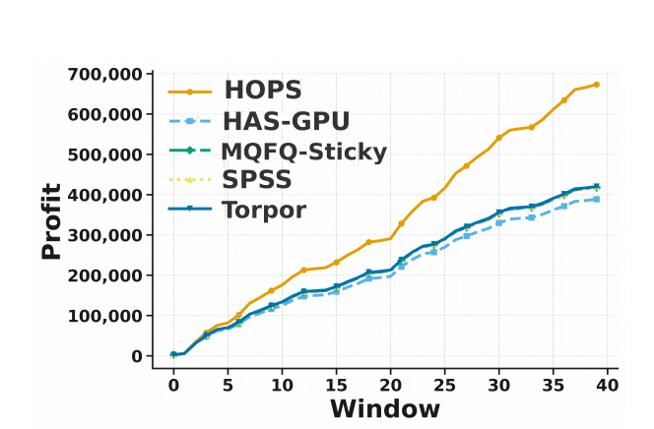
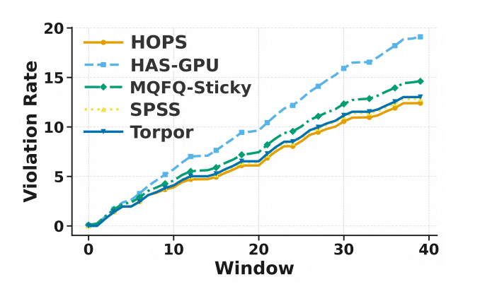
Introduction
System Model
HOPS Framework
Evaluation
Conclusion
Profitability & SLA Compliance
Key Findings
• HOPS achieves 45-55% profit improvement over HAS-GPU (best baseline) by continuously adapting prices and baseline allocations
• SLA violation rate stabilizes at ~14% vs. ~19% for HAS-GPU, demonstrating effective balance between profitability and compliance
45-55%
~14%
40 windows
4 baselines
Profit Improvement
SLA Violation Rate
Convergence Period
Compared Methods
17 / 20

Slide 17
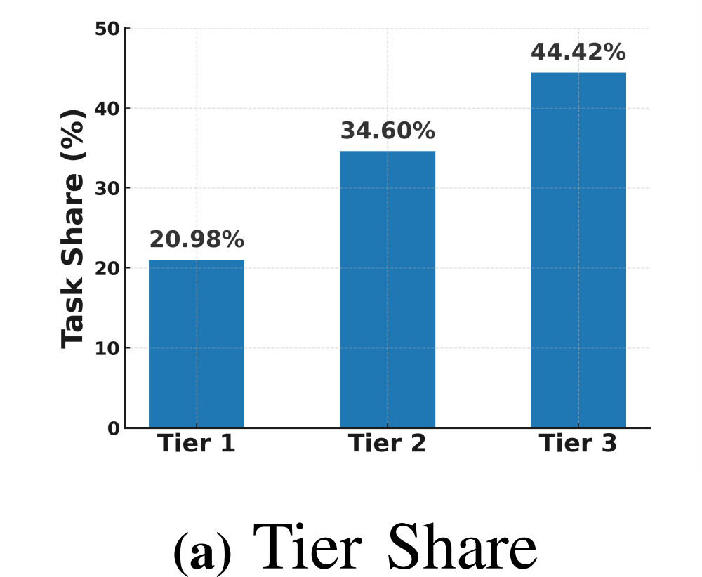
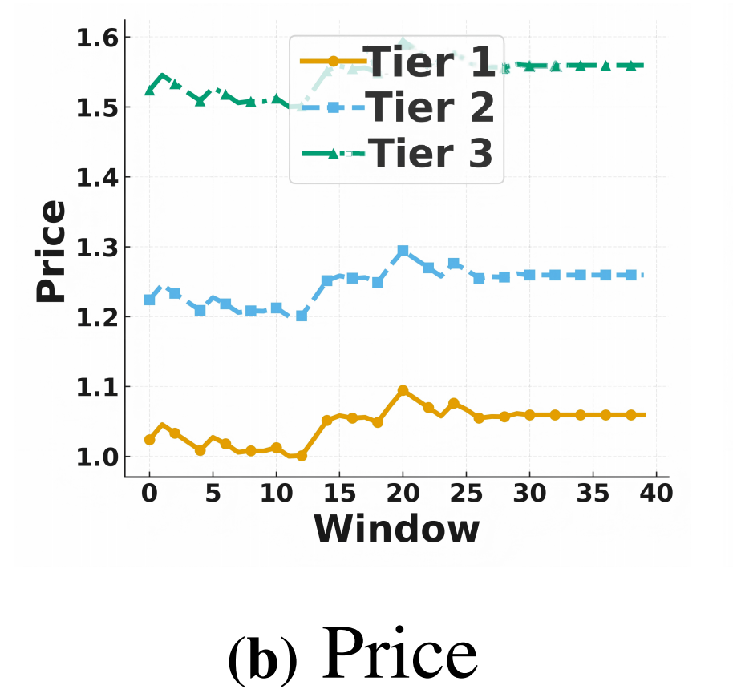
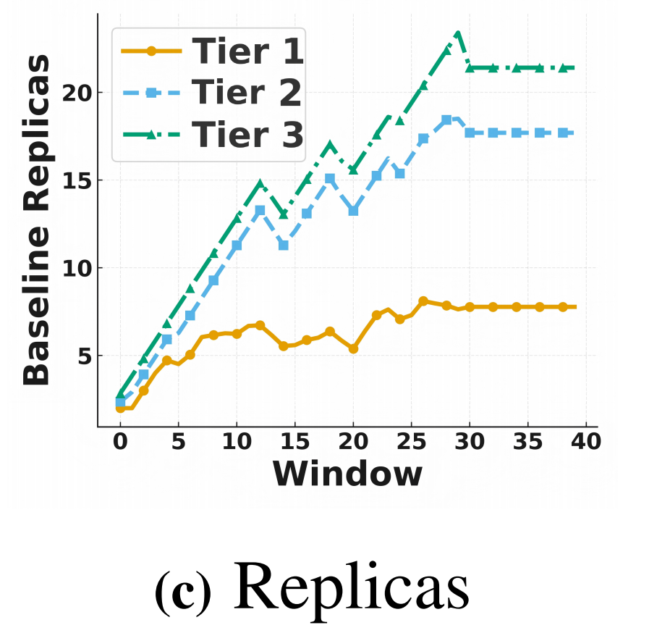
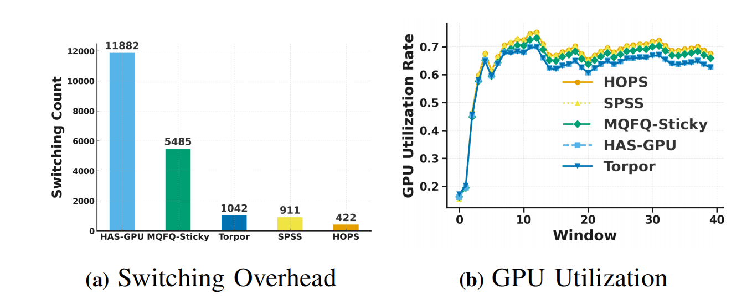
Introduction
System Model
HOPS Framework
Evaluation
Conclusion
Convergence & Resource Efficiency
Convergence of Pricing and Baseline Decisions
Switching Overhead Comparison
Key Results Summary
422 switches
≈4% of HAS-GPU (10,550), 10× lower than MQFQ
70-72% GPU utilization
Sustained without frequent reallocation
~20 windows to converge
18 / 20

Slide 18
Introduction
System Model
HOPS Framework
Evaluation
Conclusion
Conclusion & Future Work
Conclusion
HOPS jointly optimizes pricing and scheduling for SLA-aware serverless GPU services via a Stackelberg game formulation with:
3 theorems establishing convergence to near-optimal equilibrium
45-55% profit improvement over state-of-the-art baselines
Practical design with efficient O(|K_{h}| log |K_{h}|) complexity
Future Directions
Multi-Cluster Extension
Online Learning
Robustness
Extend to multi-cluster and heterogeneous GPU environments (A100, H100, edge GPUs)
Explore online learning and meta-learning for faster convergence under dynamic workloads
Enhance robustness under adversarial and non-stationary workload patterns
Takeaway: By integrating pricing and scheduling, HOPS transforms serverless GPU providers from passive resource allocators into active demand shapers, achieving superior profitability while maintaining SLA compliance.
20 / 20

Slide 19
THANK YOU
QUESTIONS & DISCUSSION
"Joint Pricing and Scheduling for SLA-aware Serverless GPU Services"
CONTACT
huangxy32@chinatelecom.cn | jiewu@temple.edu
Xiaoyao Huang, Yanan Yang, Yujun Wang, Jie Wu
IEEE ICC 2026

