Slide 1
Efficient and Robust Federated Learning via
Synergistic Aggregation on Heterogeneous Devices
Yihan Chenª, Yingchi Maoª , Haowen Xuª, Benteng Zhangª, Xiaoming He^{b}, Miao Du^{c}, and Jie Wu^{d}
ª College of Computer Science and Software Engineering, Hohai University, Nanjing, China
^{b} College of Internet of Things, Nanjing University of Posts and Telecommunications, Nanjing, China
^{c} College of Computer Science and Engineering, Southeast University, Nanjing, China
^{d} China Telecom Cloud Computing Research Institute and Temple University, Philadelphia, USA
ICC 2026
Notes:
Good afternoon, everyone. It is a great honor to present our work at ICC 2026. The title of our paper is 'Efficient and Robust Federated Learning via Synergistic Aggregation on Heterogeneous Devices'. This work was conducted by Yihan Chen and the team from Hohai University, in collaboration with researchers from Nanjing University of Posts and Telecommunications, Southeast University, and Temple University. Since my colleague, the first author, could not be here today, I will be presenting this work on their behalf.

Slide 2
Contents
1
Introduction
2
System Model
3
Approach
4
Experiment
5
Conclusion
Notes:
My presentation will follow this outline: I will start with the Introduction to explain our motivation , followed by the System Model and our proposed Approach, HFELAG. Then, I will show the Experimental results to demonstrate its effectiveness, and finally, I'll conclude with a summary and Future work.

Slide 3
Introduction
Background
Promise: FL protects privacy, and HFL relieves cloud network congestion via Edge Servers.
Pitfalls:
Frequent model exchanges cause massive device-side energy consumption.
Battery depletion forces premature ED dropouts.
Consequence: Device attrition destroys the integrity, availability, and robustness of the federated system.
Notes:
First, let’s look at the background. Hierarchical Federated Learning, or HFL, has emerged as a promising framework because it protects data privacy while relieving cloud network congestion by introducing Edge Servers for local aggregation.
However, there is a major pitfall in practice: frequent model exchanges between devices and servers lead to massive energy consumption. For many battery-constrained end devices, this burden leads to premature dropouts. The consequence is severe—device attrition destroys the integrity, availability, and robustness of the entire federated system. Therefore, reducing device-side energy consumption is not just about efficiency; it's about system survival.

Slide 4
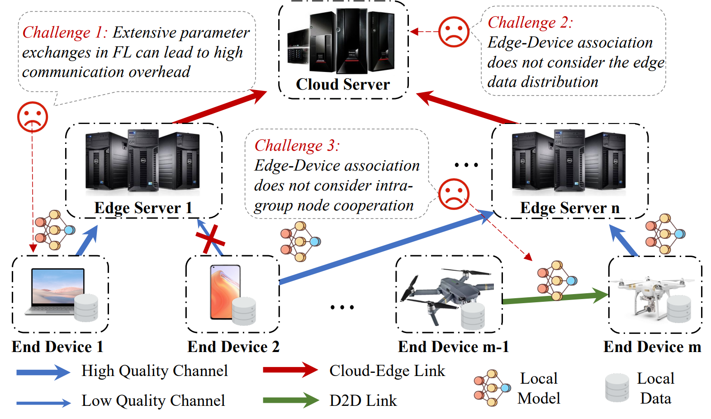
Introduction
Challenges
Notes:
So, why is it so difficult to save energy in HFL? We identify three main challenges here:
Challenge 1 is the high communication overhead caused by extensive parameter exchanges between the cloud and the massive number of devices.
Challenge 2 involves the 'Edge-Device' association. Most existing methods don't consider the edge data distribution when grouping devices. If we only group devices based on the strongest signal, we might end up with highly skewed data at certain edge servers, which ruins model accuracy.
Challenge 3 is the most critical: it's the tension between geographical proximity and channel diversity. To use D2D—or device-to-device—cooperation, nodes must be physically close. But to get high-quality channels or balanced data, we might need to associate devices that are far apart. Systematically resolving this tension remains an open problem.

Slide 5
Introduction
Existing Works
Association-based Methods (e.g., HFEL, Shape, COVG):
Fail to balance energy and data distribution simultaneously.
Rely on instantaneous rates, failing to capture time-varying network dynamics.
D2D Cooperation Methods (e.g., CE-HFL):
Cannot systematically resolve the tension between geographical proximity and channel diversity.
Notes:
Prior research has tried to tackle these issues from two angles, but with limitations:
Association-based methods, such as HFEL or Shape, often fail to balance energy and data distribution simultaneously. Moreover, they usually rely on 'instantaneous' channel rates, which means they cannot handle the time-varying dynamics of real-world networks.
D2D Cooperation methods, like CE-HFL, focus on local relaying to save energy. However, as I mentioned, they cannot systematically resolve the conflict between physical distance for D2D and the need for channel diversity in edge association.

Slide 6
Introduction
Our Method
Goal: Minimize device communication energy to enhance system availability while ensuring global model accuracy.
Solution: HFELAG
Hierarchical Federated Learning Elastic Association Aggregation.
First synergistic co-design of inter-group elastic association and intra-group hierarchical aggregation.
Notes:
To address these challenges, we propose HFELAG, which stands for Hierarchical Federated Learning Elastic Association Aggregation.
Our goal is to minimize device communication energy to enhance system availability while ensuring global model accuracy. The core innovation of HFELAG is that it is the first synergistic co-design of inter-group 'elastic' association and intra-group 'hierarchical' aggregation. In the following sections, I will explain how this multi-layer design resolves the tensions we just discussed.

Slide 7
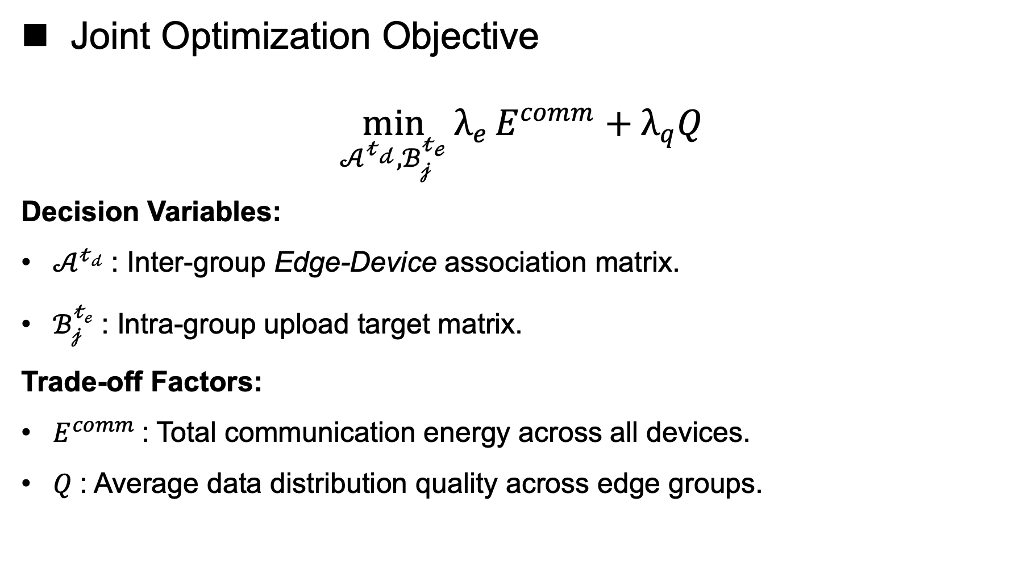
System Model
Joint Optimization Objective
$$\min_{𝒜^{𝓉_{𝒹}},ℬ_{𝒿}^{𝓉_{ℯ}}}{λ_{e}}E^{comm}+λ_{q}Q$$
Decision Variables:
$𝒜^{𝓉_{𝒹}}$: Inter-group Edge-Device association matrix.
$ℬ_{𝒿}^{𝓉_{ℯ}}$: Intra-group upload target matrix.
Trade-off Factors:
$E^{comm}$: Total communication energy across all devices.
$Q$: Average data distribution quality across edge groups.
Notes:
Moving on to the System Model. We consider a three-layer HFL system consisting of m End Devices, n Edge Servers, and a Cloud Server . Our joint optimization objective is formulated here.
We define two primary decision variables:
First, Matrix A, which is the inter-group Edge-Device association matrix.
Second, Matrix B, which represents the intra-group upload target matrix .
The goal is to minimize a weighted sum of two factors: E comm, the total communication energy across all devices, and Q, the average data distribution quality across edge groups . By adjusting the trade-off factors, we aim to achieve significant energy savings while maintaining high global model accuracy even with heterogeneous data .

Slide 8
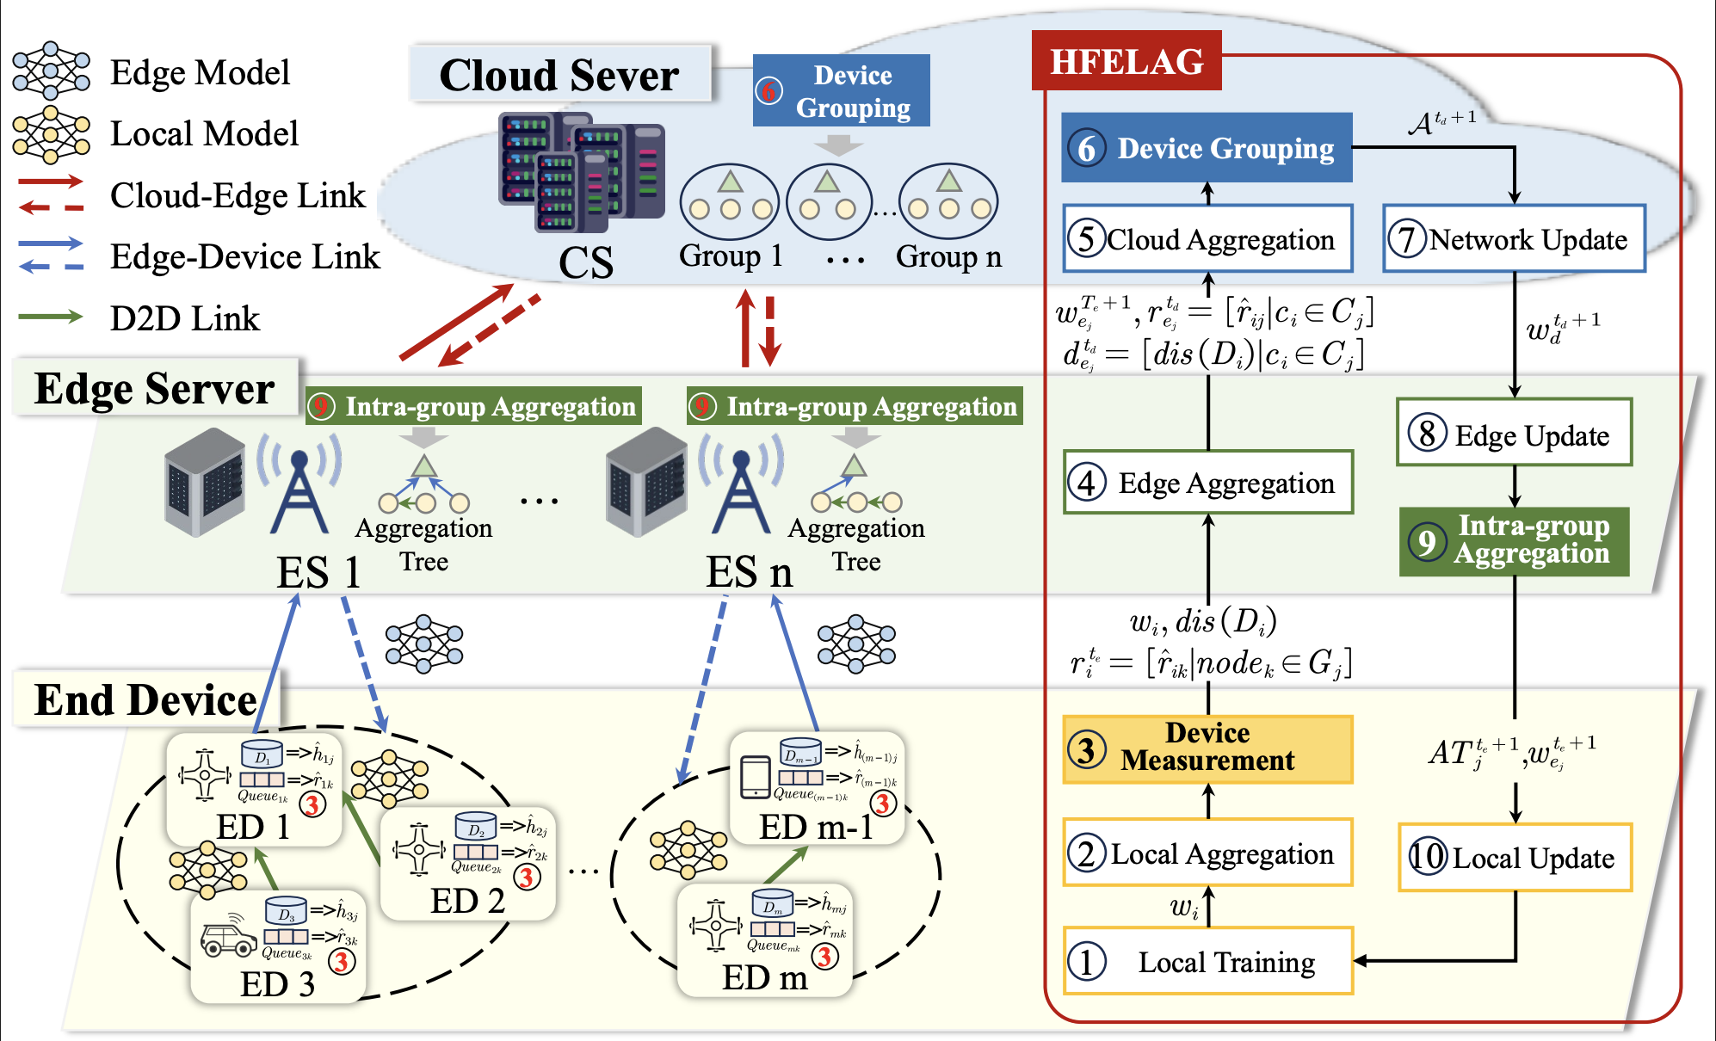
Approach: HFELAG
Mechanism 1:
Device Metric Measurement
Mechanism 2:
Cloud-level Elastic Grouping
Mechanism 3:
Edge-level
Intra-group Aggregation
Notes:
To solve the optimization problem we just defined, we designed the HFELAG framework. The diagram here illustrates the overall workflow of our system. While the process involves 10 detailed operational steps, the core logic is built upon three synergistic mechanisms:
First, the Device Metric Measurement Mechanism, which captures communication and data states.
Second, the Cloud-level Elastic Grouping Mechanism, responsible for global association optimization.
And third, the Edge-level Hierarchical Aggregation Mechanism, which achieves local energy savings through node cooperation. These three mechanisms represent the core contributions of our work. Now, let's look at how they interact.

Slide 9
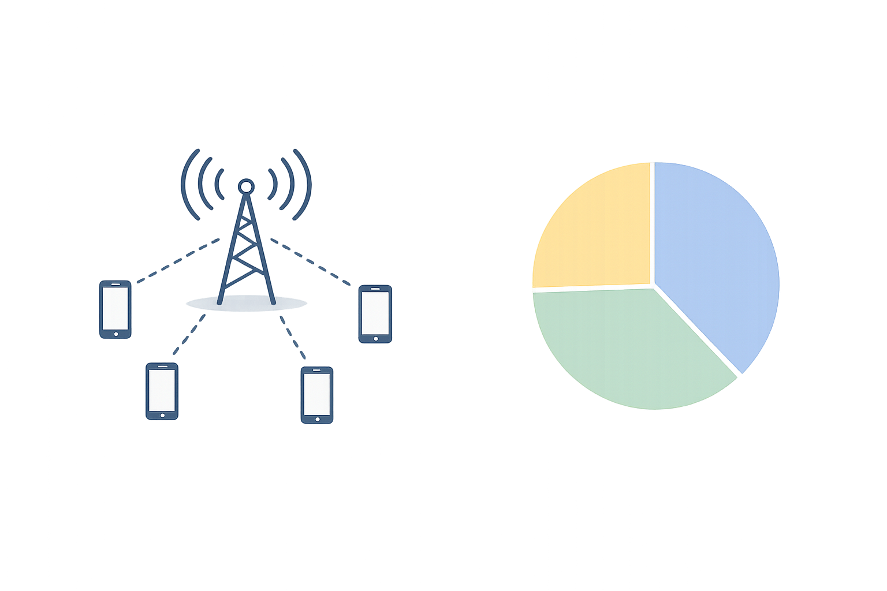
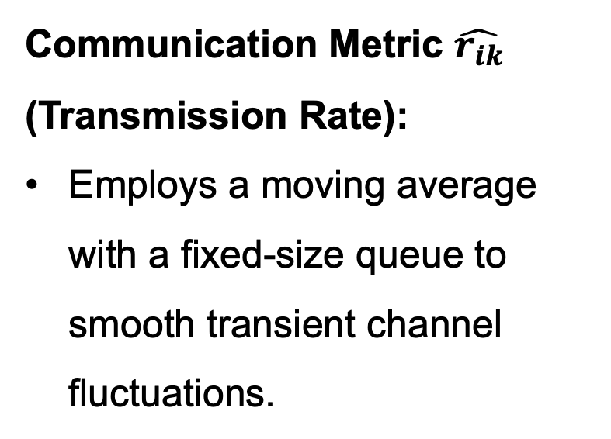
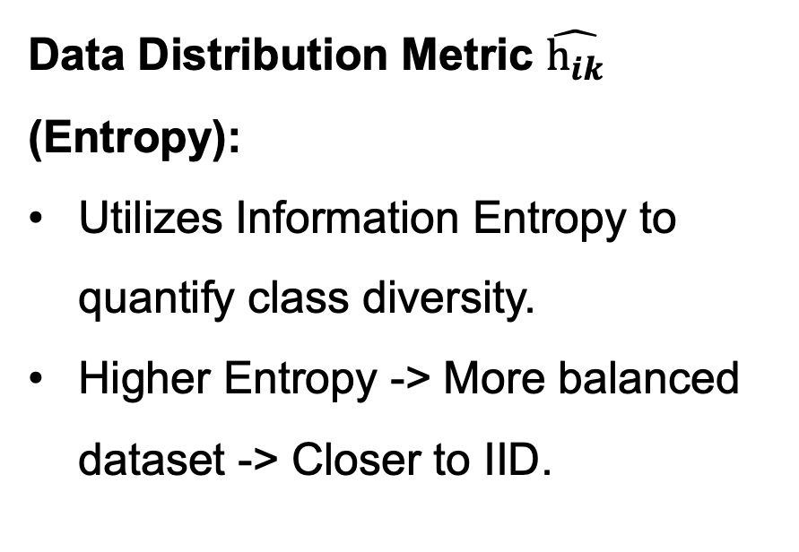
Approach: HFELAG
(1) Device Metric Measurement
Communication Metric $\hat{r_{ik}}$ (Transmission Rate):
Employs a moving average with a fixed-size queue to smooth transient channel fluctuations.
Data Distribution Metric $\hat{h_{ik}}$ (Entropy):
Utilizes Information Entropy to quantify class diversity.
Higher Entropy -> More balanced dataset -> Closer to IID.
Notes:
Now, let’s look at the first core mechanism of HFELAG: Device Metric Measurement. To achieve precise grouping and efficient aggregation, we need to dynamically capture two key dimensions from the device side.
The first is the Communication Metric, or Transmission Rate. Given the time-varying nature of wireless channels, we don't just rely on instantaneous rates. Instead, we employ a moving average mechanism with a fixed-size queue. This allows us to smooth out transient channel fluctuations and obtain a more stable and reliable assessment of communication quality .
The second is the Data Distribution Metric, based on Information Entropy. We use entropy to quantify the class diversity of the local data on each device. In federated learning, data heterogeneity—or Non-IID data—is a major challenge to model accuracy. The core logic here is simple: higher entropy signifies a more balanced dataset, which is closer to the ideal IID state .
By measuring these two metrics, we provide the necessary data foundation for the cloud to perform adaptive grouping in the next stage.

Slide 10
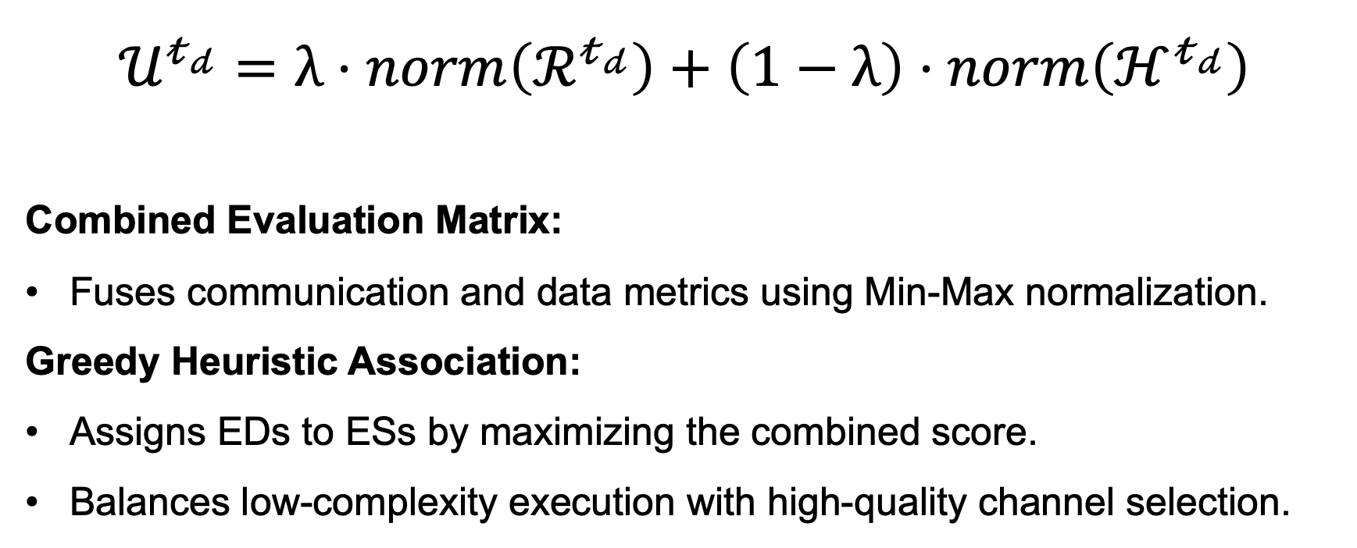
Approach: HFELAG
(2) Elastic Grouping Mechanism
$$𝒰^{𝓉_{𝒹}}=λ⋅norm\left(ℛ^{𝓉_{𝒹}}\right)+\left(1−λ\right)⋅norm\left(ℋ^{𝓉_{𝒹}}\right)$$
Combined Evaluation Matrix:
Fuses communication and data metrics using Min-Max normalization.
Greedy Heuristic Association:
Assigns EDs to ESs by maximizing the combined score.
Balances low-complexity execution with high-quality channel selection.
Notes:
The second core mechanism is the Cloud-level Elastic Grouping. Here on the screen, you can see how we calculate a combined evaluation score for each device. We fuse the communication and data metrics using Min-Max normalization. Based on this, the cloud server employs a greedy heuristic algorithm to assign end devices to edge servers by maximizing this combined score. This approach perfectly balances low-complexity execution with high-quality channel selection.

Slide 11
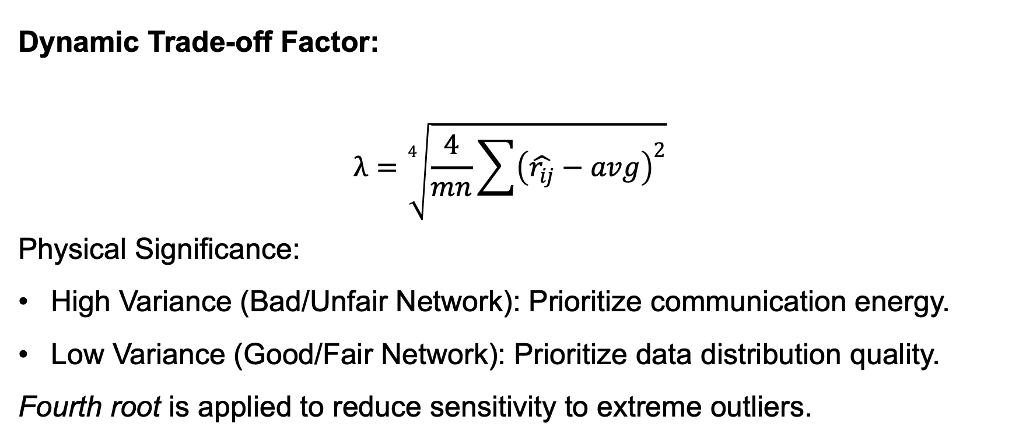
Approach: HFELAG
(2) Elastic Grouping Mechanism
Dynamic Trade-off Factor:
$$λ=\sqrt[4]{\frac{4}{mn}\sum{{\left(\hat{r_{ij}}−avg\right)}^{2}}}$$
Physical Significance:
High Variance (Bad/Unfair Network): Prioritize communication energy.
Low Variance (Good/Fair Network): Prioritize data distribution quality.
Fourth root is applied to reduce sensitivity to extreme outliers.
Notes:
To make this grouping truly adaptive, we introduce the dynamic trade-off factor, lambda, as shown here. This factor is the soul of our mechanism. Its physical significance is very straightforward: if the network has high variance—meaning conditions are bad or unfair—lambda automatically increases to prioritize communication energy. Conversely, if the network has low variance, it prioritizes data distribution quality. Additionally, we apply a fourth root to reduce the system's sensitivity to extreme outliers.

Slide 12
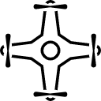
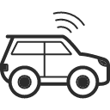
Approach: HFELAG
(3) Intra-group Hierarchical Aggregation
D2D-based Aggregation Tree: Converts long-distance ED-to-ES transmission into short-distance local relays to drastically cut the transmission power required for each device.
Leaf Nodes: Upload locally weighted models to parents.
Intermediate Nodes: Wait for children, Aggregate updates and then Upload upstream.
Root Node (ES): Final edge model aggregation.
=>
=>
3
=>
ED 1
=>
3
=>
ED 2
=>
3
ED 3
Notes:
The third core mechanism takes place within each edge group: Intra-group Hierarchical Aggregation. In traditional HFL, all end devices must transmit their models over long distances directly to the edge server, which imposes a heavy energy burden on the devices.
To address this, we build a D2D-based aggregation tree within the group . As outlined on the screen, this tree operates with three types of nodes: First, the Leaf Nodes. They only need to upload their locally weighted models to their immediate parents over a short distance . Second, the Intermediate Nodes. They wait for their children, aggregate the received updates locally, and then forward the aggregated model upstream . Finally, the Root Node, which is the Edge Server, performs the final edge model aggregation.
By utilizing this relay strategy, we successfully convert long-distance ED-to-ES transmissions into short-distance local relays, drastically cutting the transmission power required for each device.

Slide 13
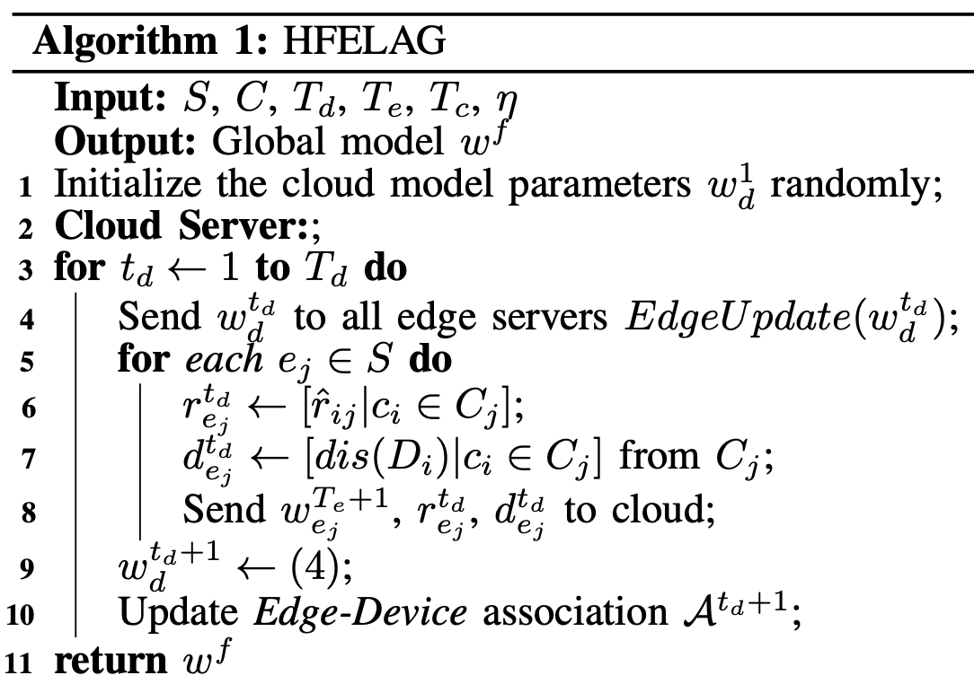
Approach: HFELAG
Global Model Distribution
Metric Collection
Cloud Aggregation
Elastic Association Update
Notes:
Here we present the formal algorithm of HFELAG. Due to time constraints, we won't go through it line by line. The colored blocks on the right perfectly summarize the core logic. This first part outlines the Cloud Server Iteration . In each cloud round, the system executes four key actions: distributing the global model , collecting metrics from edge groups , performing cloud aggregation , and most importantly, updating the elastic association for the next round.

Slide 14
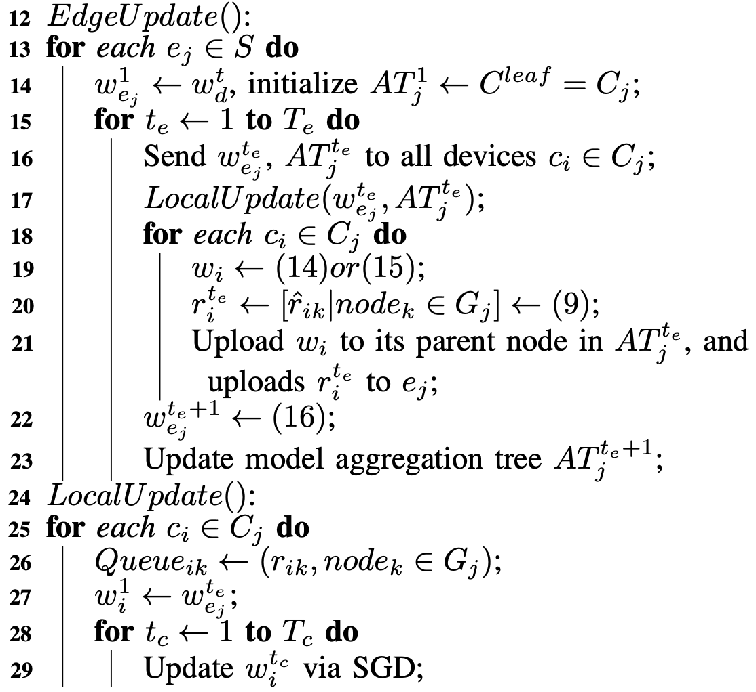
Approach: HFELAG
Privacy-Preserving Weighting
Tree-based Local Relay
Edge Model & Tree Update
Dynamic Channel Measurement
Local SGD Training
Notes:
Moving to the next part, we see the inner loops for Edge and Local Updates . This covers how devices perform local SGD training , measure dynamic channels , and utilize the tree-based local relay with privacy-preserving weighting. The most important takeaway for the algorithm is this: HFELAG focuses on optimizing the participation quality rather than altering the gradient direction. Therefore, its convergence properties completely align with standard Federated Learning schemes.

Slide 15
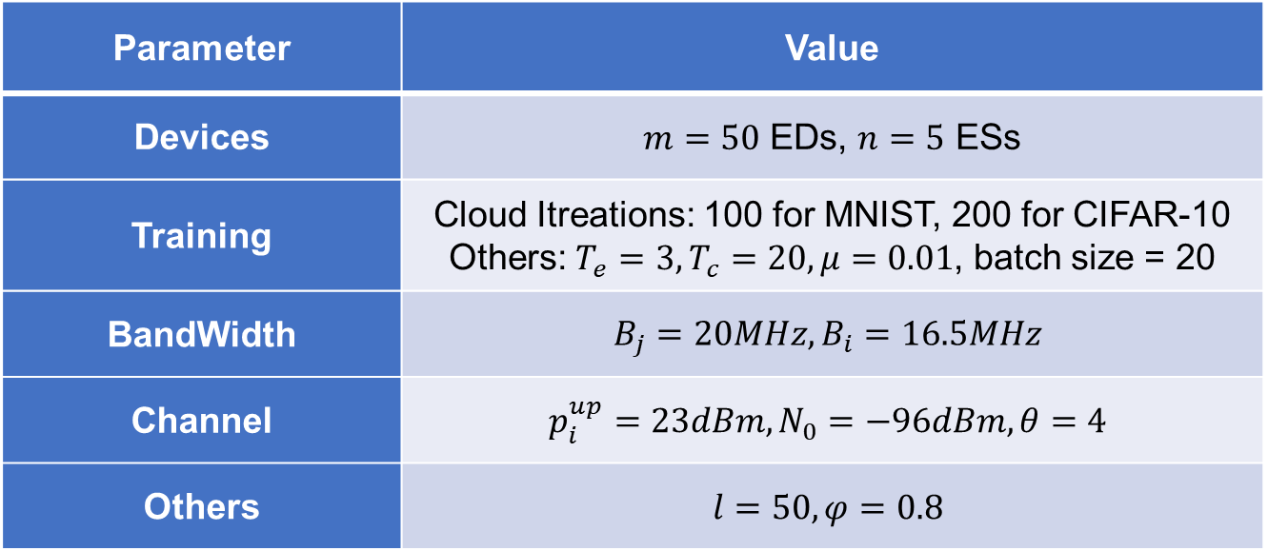
Experiment
Dataset | Target Model
MNIST | LeNet
CIFAR-10 | ResNet-18
Dataset & Model
Parameter | Value
Devices | $m=50$ EDs, $n=5$ ESs
Training | Cloud Itreations: 100 for MNIST, 200 for CIFAR-10 Others: $T_{e}=3,T_{c}=20,μ=0.01$, batch size = 20
BandWidth | $$B_{j}=20MHz, B_{i}=16.5MHz$$
Channel | $$p_{i}^{up}=23dBm, N_{0}=−96dBm, θ=4$$
Others | $$l=50,φ=0.8$$
Parameter Settings
Notes:
Now, let’s move on to the experimental section. As shown on Slide 15, we evaluated our method on two benchmark datasets: MNIST and CIFAR-10, using LeNet and ResNet-18 as our target models. Our simulation environment consists of 50 end devices and 5 edge servers.
To ensure the results are practical, we configured the communication parameters to model a typical urban network, featuring a 23 dBm upload power and a path loss exponent of 4. For the specific parameters of HFELAG, we used a queue length of 50 and a moving average coefficient of 0.8 to smooth out transient channel fluctuations while maintaining responsiveness. Other detailed parameters are available in the table for your reference.

Slide 16
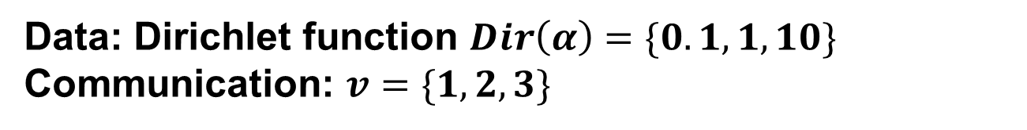
Experiment
Data: Dirichlet function $Dir\left(α\right)=\{0.1,1,10\}$
Communication: $v=\{1,2,3\}$
heterogeneity
HierAvg
HFEL
COVG
Shape
CE-HFL
Baselines
Average communication energy per round
Maximum communication energy
Global model accuracy
Metrics
Notes:
Moving on to our experimental design, we employed the Dirichlet function to simulate data heterogeneity across devices. Communication heterogeneity is modeled through three levels of variance, denoted by v.
We compared HFELAG against five strong baselines, including HierAvg、HFEL、COVG、Shape and CE-HFL. Our evaluation focuses on three key metrics: the average and maximum communication energy consumption, and the final global model accuracy.

Slide 17
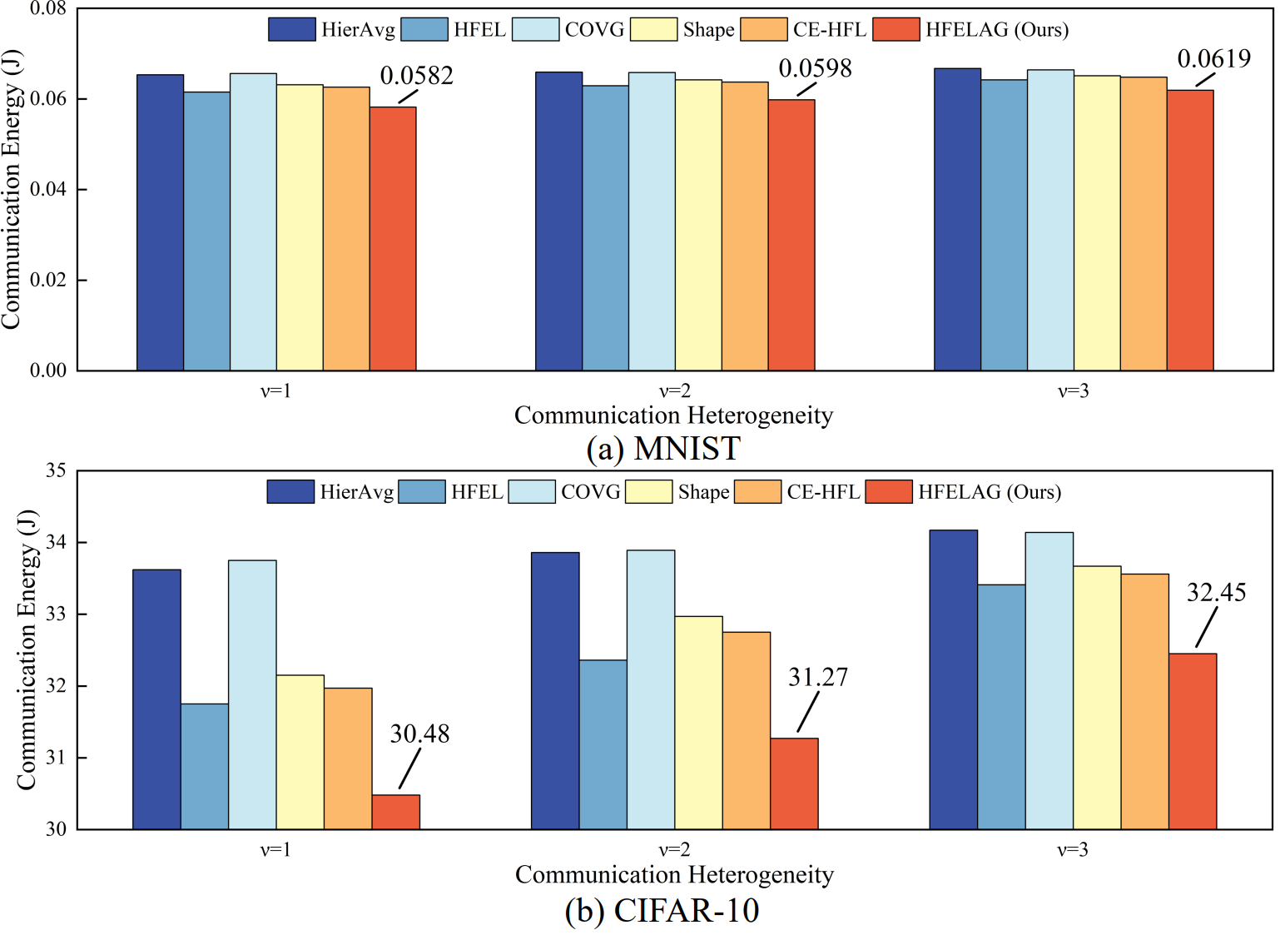
Experiment
(1) Average Communication Energy Consumption
Key Finding:
HFELAG achieves the lowest average energy, reducing it by up to 10.9% (MNIST) and 9.3% (CIFAR-10) compared to HierAvg.
Notes:
As shown in the charts, HFELAG consistently achieves the lowest average communication energy consumption across all levels of network heterogeneity. Specifically, we achieved energy reductions of up to 10.9% on MNIST and 9.3% on CIFAR-10 compared to the HierAvg baseline. This proves that our synergistic design is highly effective at saving power in practical HFL environments.

Slide 18
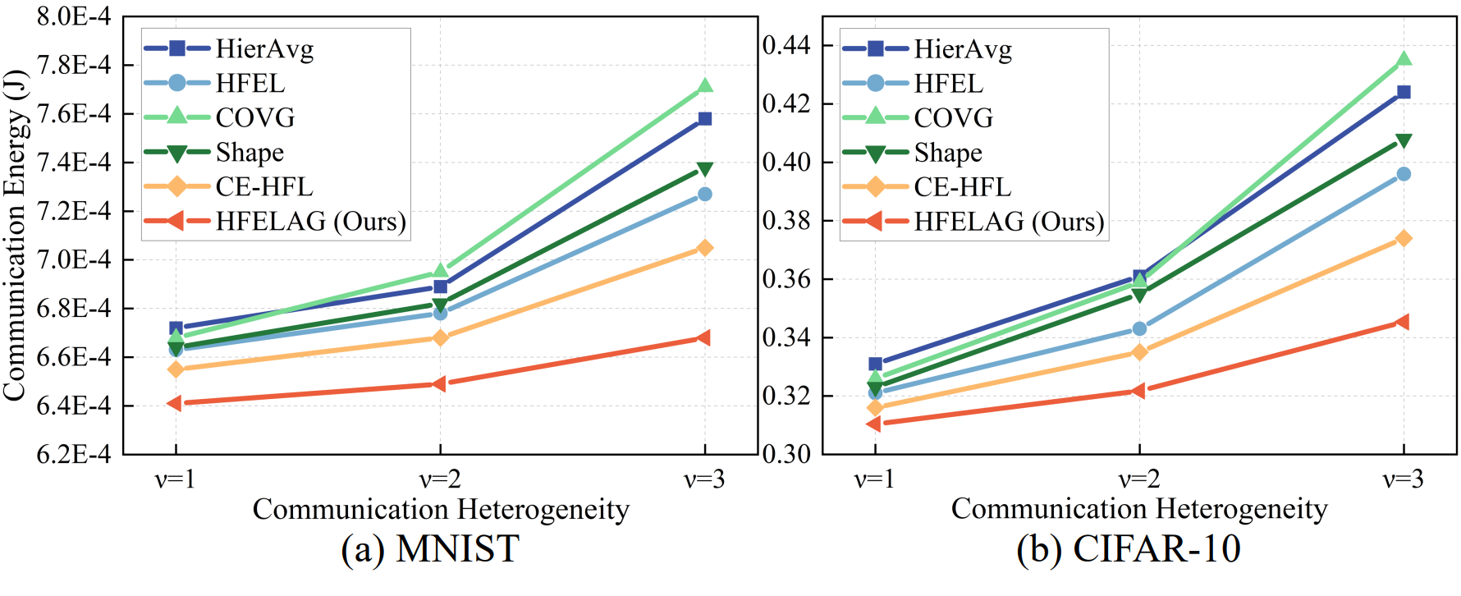
Experiment
(2) Maximum Communication Energy Consumption
Key Finding: HFELAG significantly reduces peak energy burden (up to 18.6%), demonstrating superior load-balancing and system stability.
Notes:
Moving to the peak energy consumption, HFELAG also secures the best performance. By reducing the maximum energy burden by up to 18.6%, we effectively prevent specific devices from running out of battery prematurely. This demonstrates that our method provides superior load-balancing, which is crucial for long-term system stability.

Slide 19
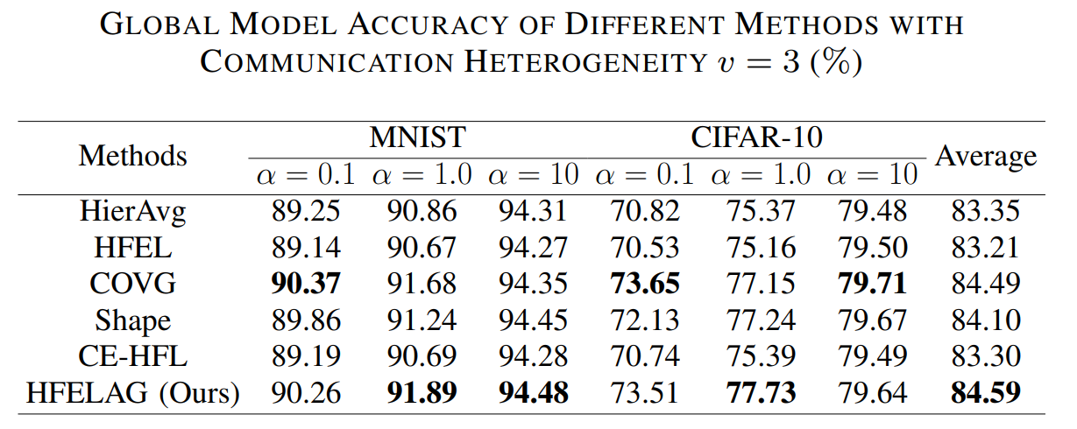
Experiment
(3) Global Model Accuracy
Key Finding: HFELAG maintains or exceeds baseline accuracy in most Non-IID scenarios, improving results by up to 2.69% over HierAvg.
Notes:
Finally, let’s look at the accuracy. The table shows that while HFELAG saves significant energy, it does not compromise model performance. In most Non-IID scenarios, we either match or exceed the baseline accuracy, with improvements of up to 2.69% over HierAvg. This confirms that our elastic grouping successfully balances communication efficiency with data distribution quality.

Slide 20
Conclusion
Conclusion
HFELAG enhances system robustness by uniting cloud-side elastic grouping with edge-side hierarchical aggregation.
HFELAG reduces energy-driven device attrition, ensuring stable participation without sacrificing global model accuracy.
HFELAG significantly lowers energy consumption and improves global model accuracy by up to 1.38% over baselines.
Future Work
Extending the framework to massive-scale IoT networks and integrating Secure Aggregation for privacy.
Notes:
To conclude our presentation, I'd like to summarize our main contributions.
First, our proposed HFELAG framework successfully ……
Second, by doing so, it effectively reduces ……
Third, our experiments demonstrate that HFELAG significantly ……
As for future work, we plan to extend the framework ……

Slide 21
At Last
Thanks for your attention!
Notes:
That brings me to the end of the presentation. Thank you very much for your time and attention!

