Slide 1

Priority Based Service Placement Strategy in
Heterogeneous Mobile Edge Computing
Authors：Meiyan Teng, Xin Li, Xiaolin Qin, and Jie Wu
Reporter：Meiyan Teng Email：myteng@nuaa.edu.cn
Nanjing University of Aeronautics and Astronautics, China

Slide 2
Ⅰ. Introduction
Ⅱ. Problem Statement
Ⅲ. Placement Strategy
Ⅳ. Performance Evaluation
Ⅴ. Conclusion
Contents

Slide 3
Ⅰ. Introduction

Slide 4
Introduction
Problem Statement
Placement Strategy
Performance Evaluation
Conclusion
1.1 Motivation
Service:
Delay sensitive;
large amount of data
Cloud:
Advantage: sufficient resources
Defect: long response time
Edge:
Advantage: short response time
Defect: limited resources
How to minimum the average response time of services?

Slide 5
Introduction
Problem Statement
Placement Strategy
Performance Evaluation
Conclusion
1.2 Related work
1. Part of the service placement strategy is investigated in the homogeneous environment (the edge node and service performance are certain);
2. Some studies do not consider the limitation of node resources;
3. Most of research do not consider the uneven distribution of service load.

Slide 6
Introduction
Problem Statement
Placement Strategy
Performance Evaluation
Conclusion
1.3 Contribution
Heterogeneity:
The node resource;
The demand of service resource;
The service load distribution.
The communication conditions between cloud and edge node;
a priority placement (2P) algorithm

Slide 7
Ⅱ. Problem Statement

Slide 8
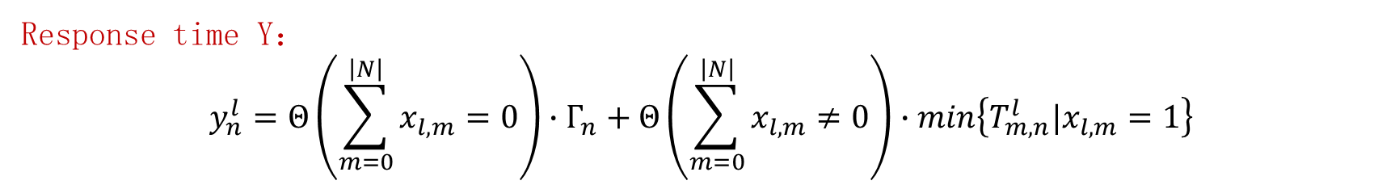

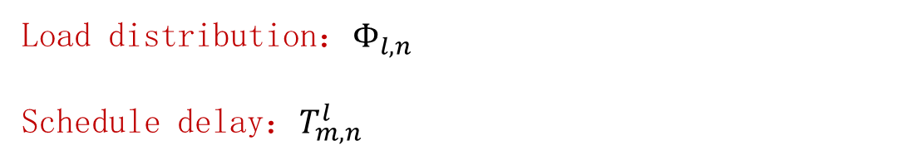
Introduction
Problem Statement
Placement Strategy
Performance Evaluation
Conclusion
2.1 Formulation
Load distribution：$Φ_{l,n}$
Schedule delay：$T_{m,n}^{l}$
Placement strategy X：
$$x_{l,n}=\{\begin{matrix}1，service l placed on the node n \\ 0， otherwise\end{matrix}$$
Response time Y：
$$y_{n}^{l}=Θ\left(\sum_{m=0}^{\left|N\right|}{x_{l,m}}=0\right)∙Γ_{n}+Θ\left(\sum_{m=0}^{\left|N\right|}{x_{l,m}}≠0\right)∙min\left\{T_{m,n}^{l}|x_{l,m}=1\right\}$$

Slide 9

Introduction
Problem Statement
Placement Strategy
Performance Evaluation
Conclusion
2.2 Aim
$$min\sum_{l=0}^{\left|S\right|}{\sum_{n=0}^{\left|N\right|}{y_{l,n}}}$$
$$s.t. \sum_{l=0}^{\left|S\right|}{{x_{l,m}∙r}_{l}}≤R_{m} ∀m∈N$$
$$x_{l,m}∈\left\{0,1\right\} ∀l∈S,∀m∈N$$
Theorem:
The service placement in a heterogeneous MEC system is NP-hard problem.

Slide 10
Ⅲ. Placement Strategy

Slide 11
Introduction
Problem Statement
Placement Strategy
Performance Evaluation
Conclusion
3.1 Idea
Why we propose 2P algorithm to minimize the response time?
Reason1:
Uneven load distribution
More loaded nodes with higher values
prioritize the high-value nodes
Reason2:
the high-value nodes' resources are tight
can not meet all requests
Prioritize services according performance

Slide 12
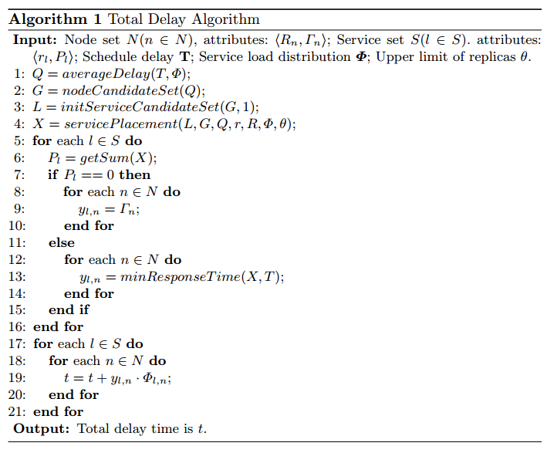
Introduction
Problem Statement
Placement Strategy
Performance Evaluation
Conclusion
Node value (priority)
？
Service placement strategy
？
Response time
Total delay time

Slide 13
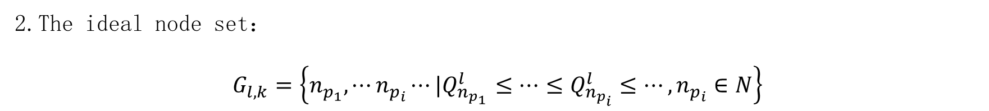
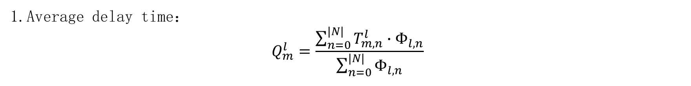

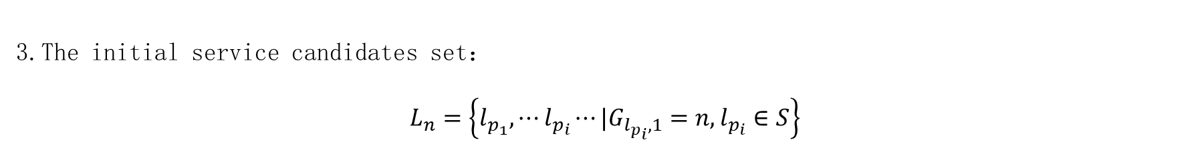
Introduction
Problem Statement
Placement Strategy
Performance Evaluation
Conclusion
3.2 Priority
1.Average delay time：
$$Q_{m}^{l}=\frac{\sum_{n=0}^{|N|}{T_{m,n}^{l}∙Φ_{l,n}}}{\sum_{n=0}^{|N|}{Φ_{l,n}}}$$
2.The ideal node set：
$$G_{l,k}=\left\{n_{p_{1}},⋯n_{p_{i}}⋯|Q_{n_{p_{1}}}^{l}≤⋯≤Q_{n_{p_{i}}}^{l}≤⋯,n_{p_{i}}∈N\right\}$$
3.The initial service candidates set：
$$L_{n}=\left\{l_{p_{1}}, ⋯l_{p_{i}}⋯|G_{l_{p_{i}},1}=n,l_{p_{i}}∈S\right\}$$
The node priority： $\left|L_{n}\right|$

Slide 14
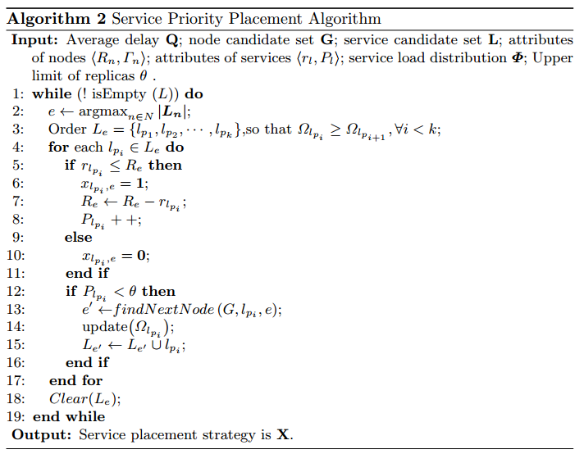
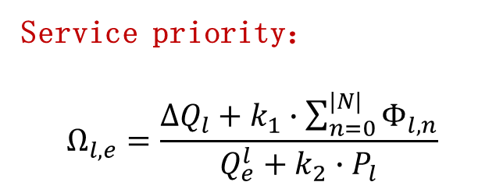
Introduction
Problem Statement
Placement Strategy
Performance Evaluation
Conclusion
3.3 strategy
Service priority：
$$Ω_{l,e}=\frac{∆Q_{l}+k_{1}∙\sum_{n=0}^{|N|}{Φ_{l,n}}}{Q_{e}^{l}+k_{2}∙P_{l}}$$

Slide 15
Ⅳ. Performance Evaluation

Slide 16
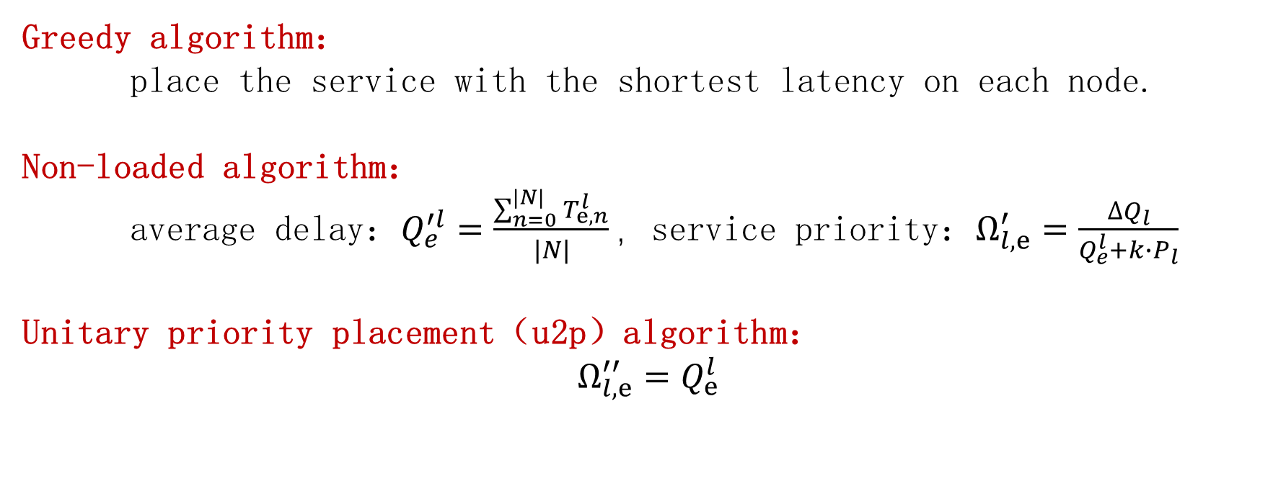
Introduction
Problem Statement
Placement Strategy
Performance Evaluation
Conclusion
4.1 Comparison
Greedy algorithm：
place the service with the shortest latency on each node.
Non-loaded algorithm：
average delay：$Q_{e}^{′l}=\frac{\sum_{n=0}^{|N|}{T_{e,n}^{l}}}{|N|}，$service priority：$Ω_{l,e}^{′}=\frac{∆Q_{l}}{Q_{e}^{l}+k∙P_{l}}$
Unitary priority placement（u2p）algorithm：
$$Ω_{l,e}^{′′}=Q_{e}^{l}$$

Slide 17
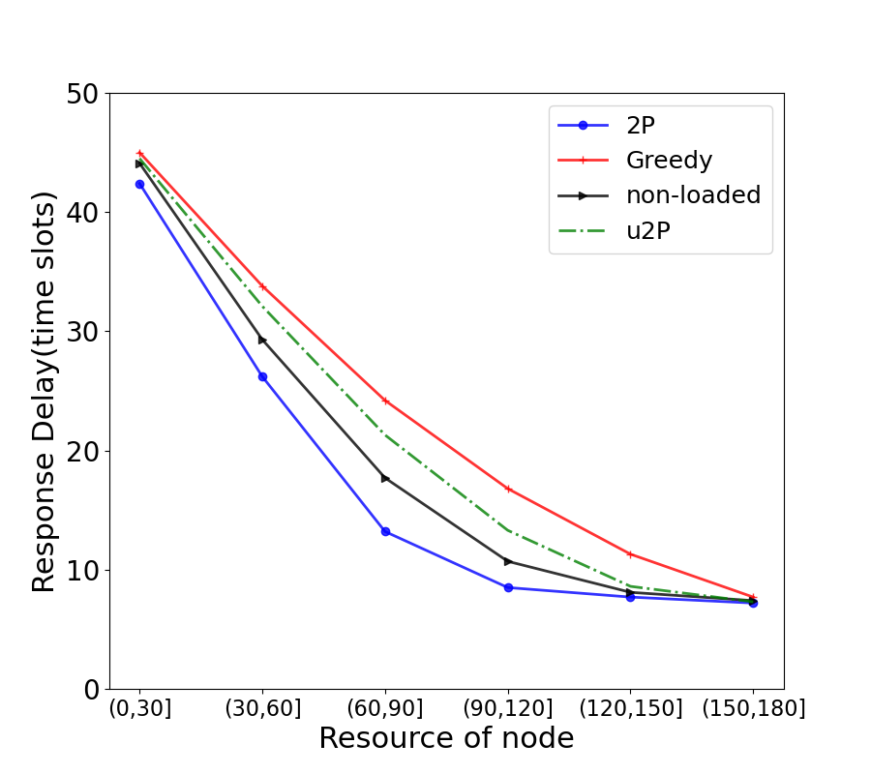
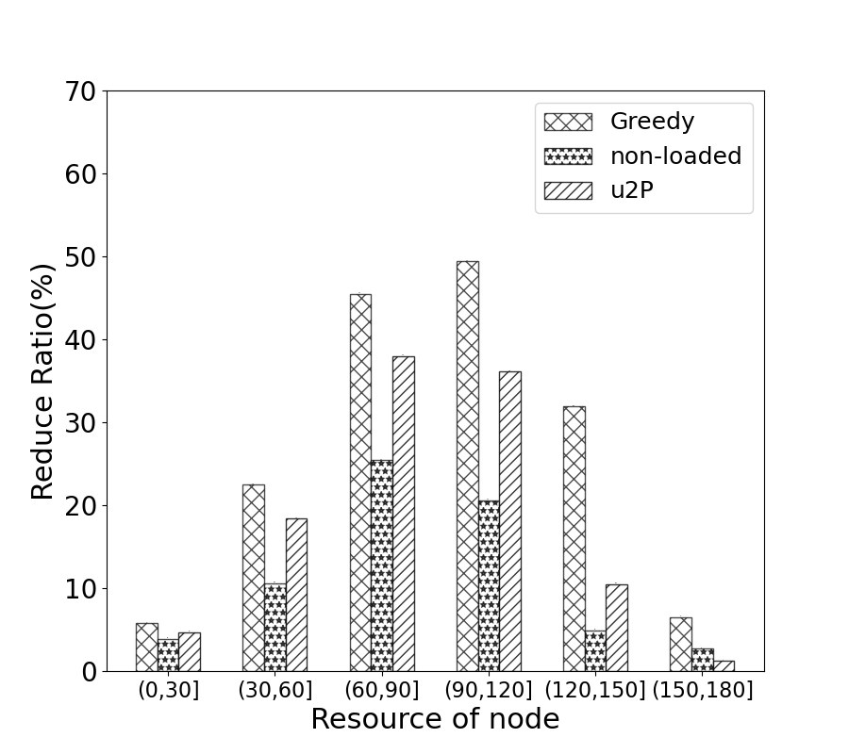
Introduction
Problem Statement
Placement Strategy
Performance Evaluation
Conclusion
4.2 Results
Test1:Change the resource of nodes $R_{n}$, where $θ=2$ and $N=9$

Slide 18
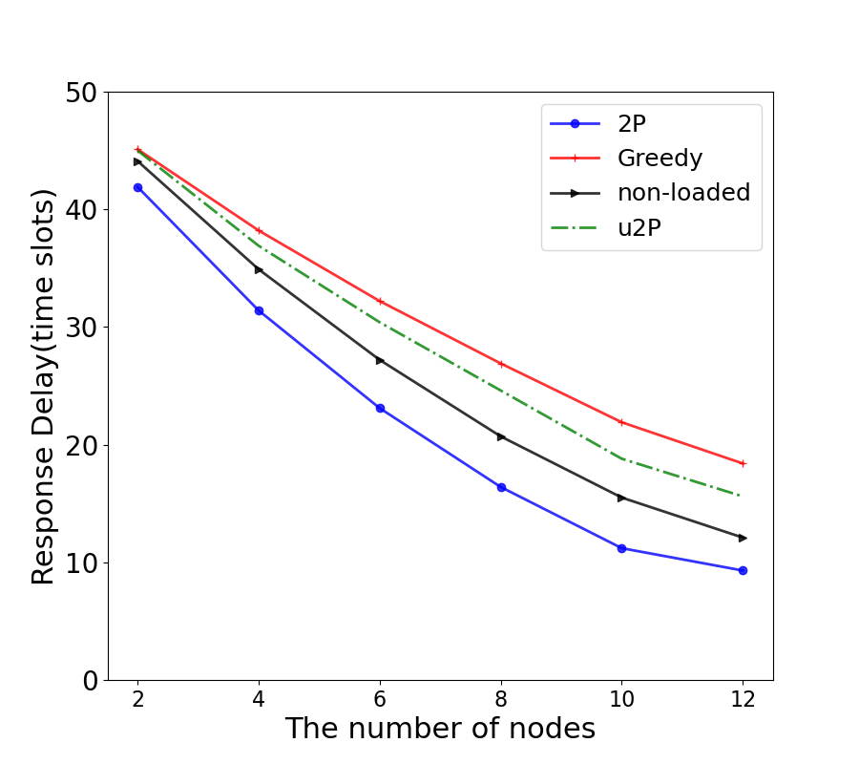
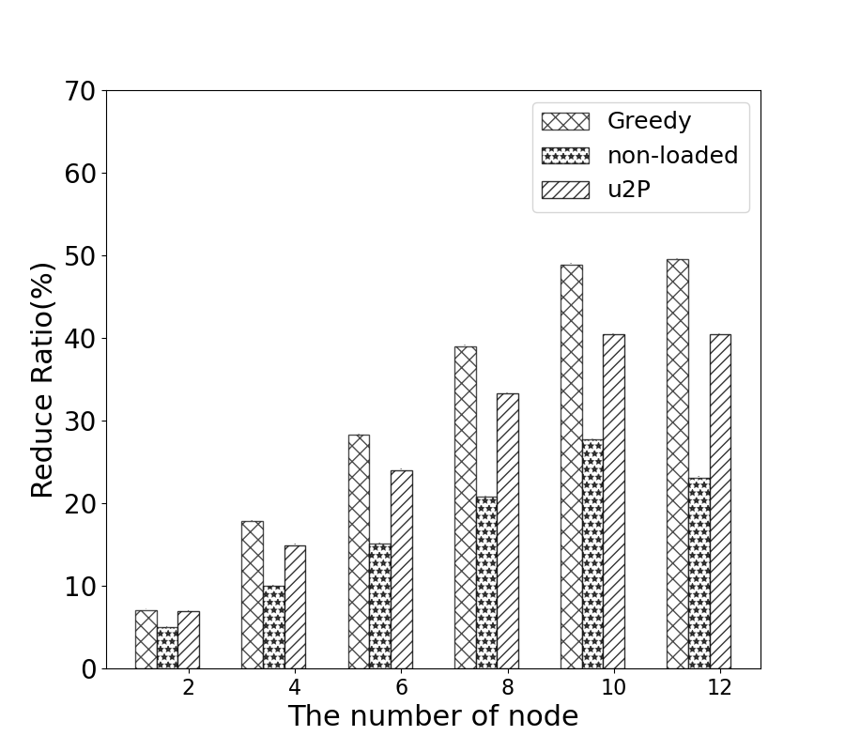
Introduction
Problem Statement
Placement Strategy
Performance Evaluation
Conclusion
4.2 Results
Test2:Change the number of nodes N, where $θ=2$ and $R_{n}∈[50,100]$

Slide 19
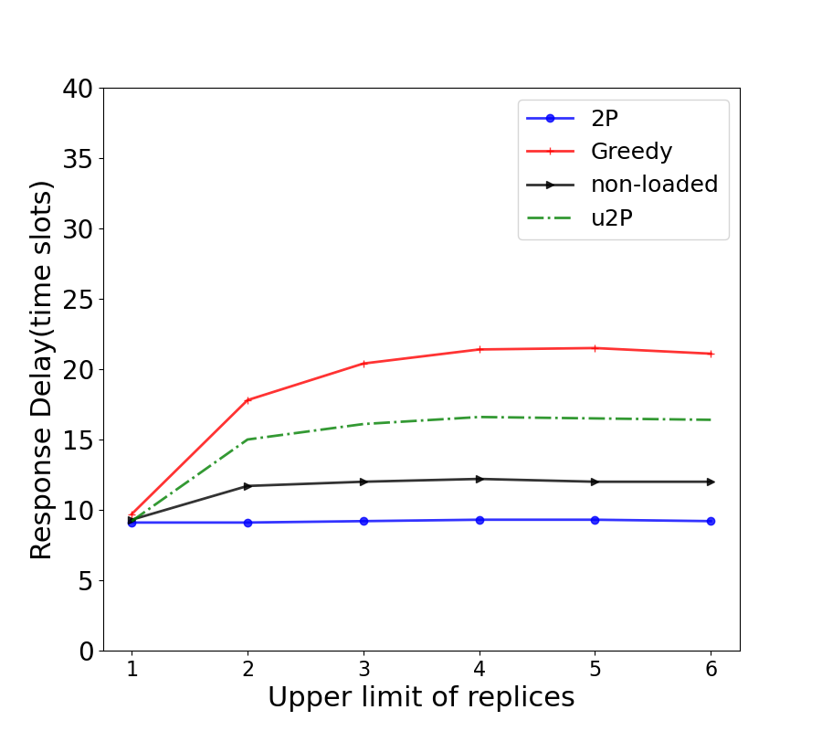
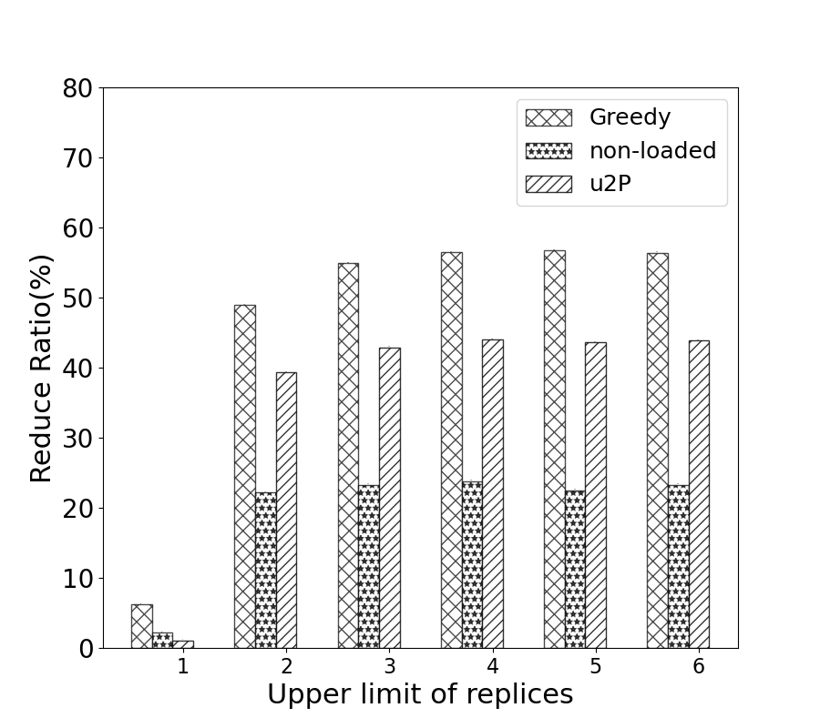
Introduction
Problem Statement
Placement Strategy
Performance Evaluation
Conclusion
4.2 Results
Test3:Change the upper limit of service replicas $θ$, where $N=12$ and $R_{n}∈[50,100]$

Slide 20
Ⅴ. Conclusion

Slide 21
Problem Statement
Placement Strategy
Performance Evaluation
Conclusion
Introduction
5. Conclusion
（1）Defined the priority of the nodes and services according to their contribution；
（2）Propose a priority placement (2P) algorithm；
（3）Conduct simulations and the results show that the 2P algorithm has better performance.

Slide 22
Thank you for listening!

