Slide 1
Optimizing MapReduce through Joint Scheduling of Overlapping Phases
Huanyang Zheng, Ziqi Wan, and Jie Wu
Dept. of Computer and Info. Sciences
Temple University
Notes:
1

Slide 2
Road Map
Introduction
Model and Formulation
Observation and Ideas
Algorithms
Experiments
Conclusion

Slide 3
1. Introduction
Map-Shuffle-Reduce
Map and Reduce: CPU-intensive
Shuffle: I/O-intensive
Merge Sort
Map: sorts local arrays
Shuffle: shuffles sorted arrays
Reduce: merges sorted arrays
map
shuffle
reduce
Local sort
Local sort
Merge
Local sort

Slide 4
Introduction
Map-Shuffle-Reduce Jobs
Reduce is not discussed (Zaharia, OSDI 2008)
Only 7% of jobs in MapReduce are reduce-heavy
Map and Shuffle
CPU-intensive and I/O-intensive (can overlap)
Centralized scheduler
Determine an execution order of jobs
on map pipeline and shuffle pipeline

Slide 5
Introduction
Dependency relationship
The map emits data at a given rate
Shuffle waits for the data emitted by map
may be delayed by the scheduling policy
Job classification
Map-heavy: map workload > shuffle workload
Balanced: map workload = shuffle workload
Shuffle-heavy: map workload < shuffle workload

Slide 6
Introduction
Impact of overlapping map and shuffle phases
map pipeline
shuffle pipeline
Word count (map-heavy)
Merge sort (shuffle-heavy)

Slide 7
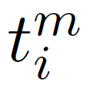
2. Model and Formulation
Jobs in Map-Shuffle-Reduce
A set of n jobs:
J = { J₁, J₂, …, J_{n} }
map workload of J_{i}
shuffle workload of J_{i}
Job classification:
Map-heavy if
Shuffle-heavy if
Balanced if

Slide 8
Model and Formulation
Schedule objective
Minimize average job completion time
includes waiting time before job start
Schedule is NP-hard
Offline scenarios
All jobs arrival at the beginning (waiting for schedule)

Slide 9
3. Observation and Ideas
When all jobs are map-heavy, balanced, or shuffle-heavy
Optimal schedule:
Sort job by dominant workload
Smaller jobs are executed earlier
map
pipeline
shuffle
pipeline

Slide 10
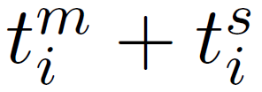
Perfect Pair
When jobs can be perfectly “paired”
Jobs J_{i} and J_{j} are paired, if
Optimal schedule:
Pair jobs (shuffle-heavy before map-heavy)
Sort job pair by total workload
Smaller pairs are executed earlier
map pipeline
shuffle pipeline

Slide 11
Theorem
Theorem: If jobs can be perfectly paired, the optimal schedule pairwisely executes jobs in a pair.
In each pair, shuffle-heavy job is executed before map-heavy job
Job pairs with smaller total workloads are executed earlier
Proof:
In each pair, shuffle-heavy job is executed before map-heavy job
Otherwise a swap leads to a better result
Job pairs with smaller total workloads are executed earlier
Otherwise a swap leads to a better result

Slide 12
Proof
Proof: jobs in a pair are executed together
Induction: shuffle-heavy J₁ and map-heavy J₂
Base case validates
Suppose the theorem validates for J
Prove validation for J₁, J₂, and J
Theorem also holds for uniform data rate

Slide 13
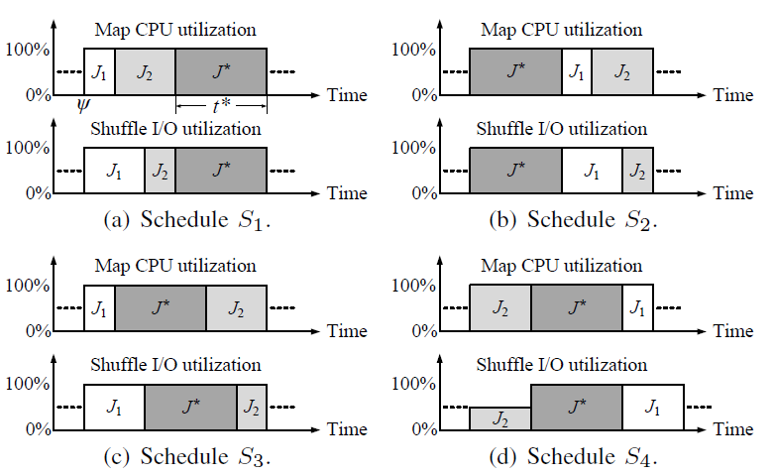
Proof
Induction validates: the best schedule is S₁ or S₂

Slide 14
Two Insights
Two scheduling factors for non-perfectly paired
Schedule smaller jobs first (dominant)
Jobs should be paired (non-dominant)

Slide 15
4. Algorithms
Two-stage scheduling algorithm
Group jobs by their workloads (first factor)
Optimally divide jobs into k groups
Criterion: minimize the sum of maximum job
workload difference within each group
Execute the group of smaller jobs earlier
Job are paired in each group (second factor)
Jobs in each group have close workloads
Pair shuffle-heaviest and map-heaviest jobs:

Slide 16
Algorithms
Example: two-stage scheduling algorithm
(order only)

Slide 17
Algorithms
Dominant workload scheduling policy (DWSP)
Group jobs by dominant workloads,
Performs well when jobs are simultaneously
map-heavy, balanced, or shuffle-heavy
Total workload scheduling policy (TWSP)
Group jobs by total workloads,
Performs well, when jobs can be perfectly paired
Weighted workload scheduling policy (WWSP)
A tradeoff between pair-based and couple-based policies
Group jobs by weighted workloads

Slide 18
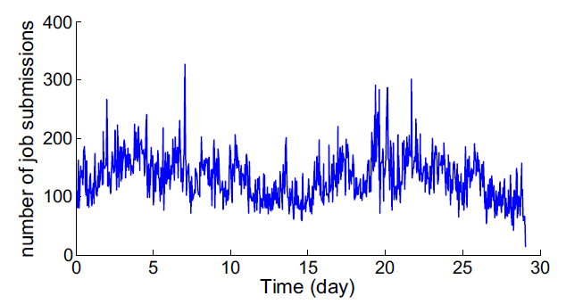
5. Experiments
Google Cluster Dataset
About 11,000 machines
96,182 jobs over 29 days in May 2011 (time collapsed)
Number of job submissions per hour (arrival rate)

Slide 19
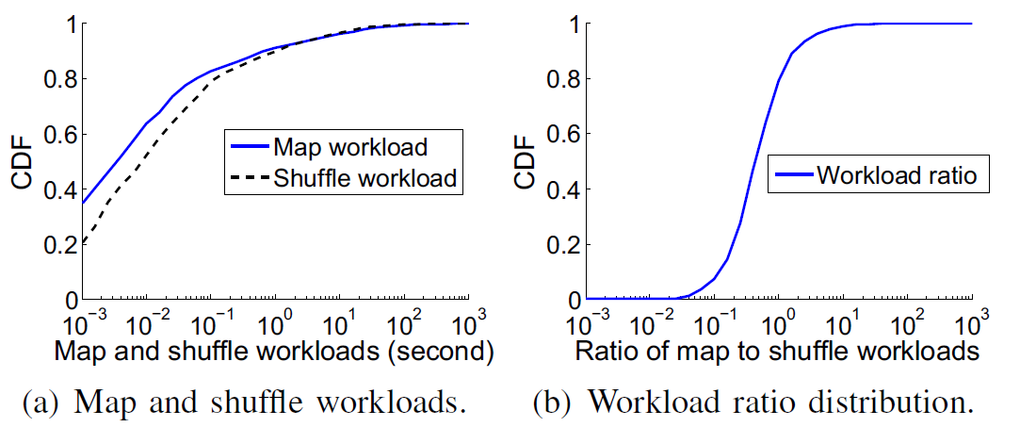
Experiments
Google Cluster Dataset
Distribution of map and shuffle time

Slide 20
Experiments
Comparison algorithms
Pairwise: has only one group, then iteratively pairs the
map-heaviest and shuffle-heaviest jobs in the group
MaxTotal: rank jobs by total workload
smaller total workload is executed earlier
MaxSRPT: rank jobs by dominant workload
smaller dominant workload is executed earlier

Slide 21
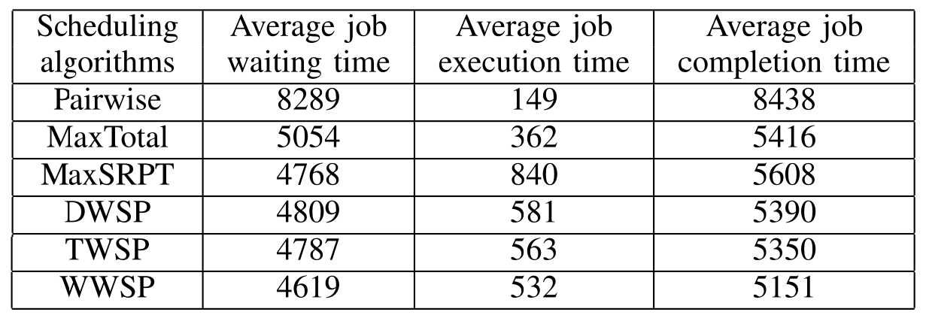
Experiments
Performance (group k = 20 and weight α = 0.5)
Improvement by considering both job workloads and pairs

Slide 22
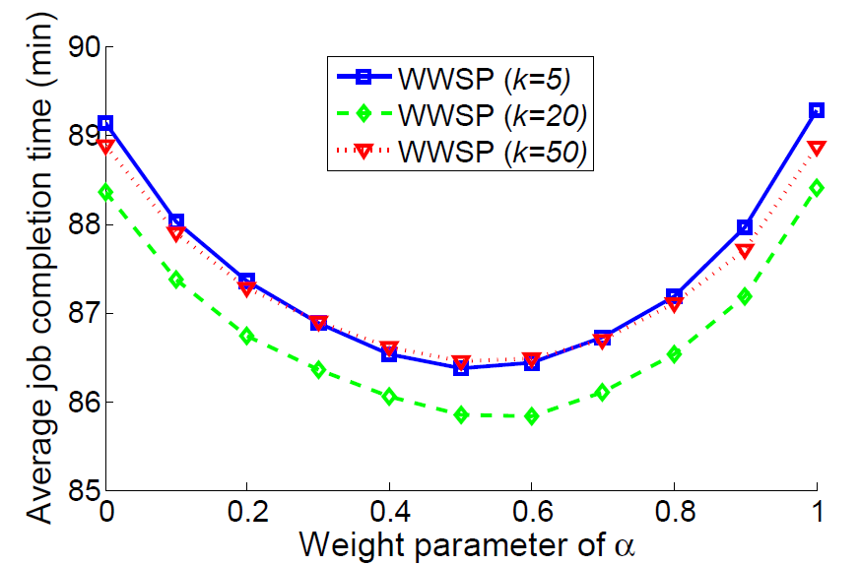
Experiments
Impact of k and α
Group-based scheduling policy with k groups
Sort jobs by
Small/Large group k
Small/large weight α
Minimized
when α = 0.57

Slide 23
Simulation Summary
Pairwise has the smallest average job execution time, but
large job waiting time, since job workloads are ignored
MaxTotal and MaxSPRT do not balance the trade-off between job size and job pair
DWSP, TWSP, and WWSP jointly consider job sizes and job pairs

Slide 24
6. Conclusion
Map and Shuffle phases can overlap
CPU and I/O resource
Objective: minimize average job completion time
Two-stage schedule
Job workloads (dominant factor)
Job pairs (avoid I/O underutilization)
Optimality under certain scenarios

