Slide 1




FaaSBoard: Efficient Graph Processing with a
Disaggregated Architecture on Serverless Services
Yushi Liu*¹, Yikang Ruan*¹, Letian Ruan¹, Zijun Li², Sen Gao³, Weihao Cui¹, Shixuan Sun¹, Quan Chen¹, Shuo Quan⁴, Jie Wu⁴, Bingsheng He³, Minyi Guo¹
Shanghai Jiao Tong University¹; Nanyang Technological University²
National University of Singapore³
China Telecom Cloud Computing Research Institute⁴
1
Notes:
Hello, everyone! This is Ruan Yikang from Shanghai Jiao Tong University. I am an undergraduate in my fourth year. Glad to be here to present our work FaaSBoard: Efficient Graph Processing with a Disaggregated Architecture on Serverless Services.

Slide 2
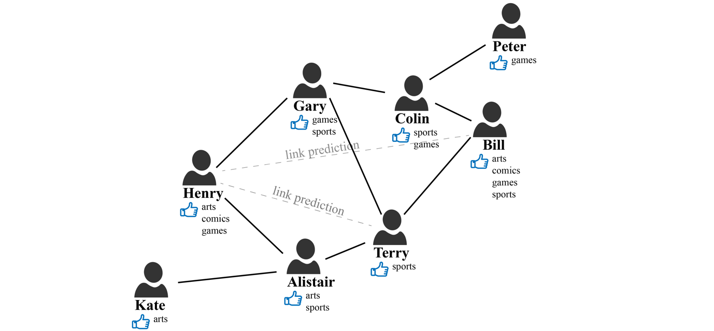
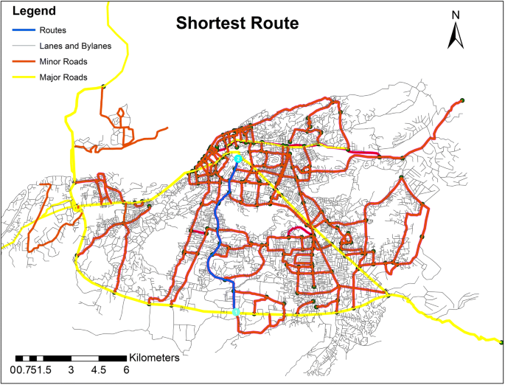






Graph Processing Stack
Apps
Framework
Resource
Social Network Mining Recommendation System Road Analysis
Shared Memory | Ligra (PPoPP’13), GridGraph (ATC’13), GraphIt (OOPSLA’18) | Distributed | Gemini (OSDI’16), Graphite (SIGMOD’20), GraphScope (VLDB’21)
Physical Servers
 | Cloud VMs (Infrastructure-as-a-Service)
2
Notes:
Here we come the Graph processing stack, as the scale of graph data grows rapidly, many specialized distributed systems are proposed to process large-scale graphs. Besides, many works provide services in the form of Infrastructure as a Service (IaaS).

Slide 3


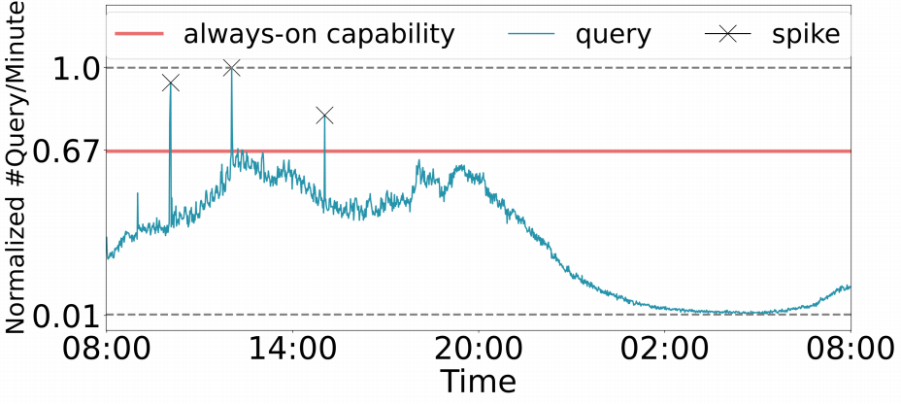
IaaS-based Graph Systems are not Elastic
Tail latency surge during query spikes.
Resource waste under low load.
Constant
Processing Capability
Query
Workload
* Real-world graph processing workload on a city road network in FaaSGraph^{[1]}
[1] Liu, Yushi, et al. "FaaSGraph: Enabling Scalable, Efficient, and Cost-Effective Graph Processing with Serverless Computing." In ASPLOS, 2024.
₃
Notes:
However, the biggest problem about IaaS-based Graph systems is elasticity. First, when query spikes, the tail latency grows rapidly. Second, during periods of low load, there is some resource waste because it is difficult to scale resources up or down in an IaaS-based system.

Slide 4



Introducing Serverless Computing
Auto-scaling
The “Unbounded Scaling” policy^{[2]} .
Pay-per-use billing
Fine-grained billing (<1ms).
Charge based on resource usage, not resource allocation.
Ease of management
Cloud manage underlying infrastructures.
Users upload only the source code and data.
[2] https://docs.aws.amazon.com/lambda/latest/dg/lambda-concurrency.html 4
Notes:
So, some works started to introduce serverless computing to graph processing. The advantages of serverless includes:
First, it is easy to control the amount of resources by increasing or decreasing the number of functions.
Second, serverless follows a pay-per-use billing model.
Third, users do not need to manage cloud infrastructures; instead, they focus on source code and data.
About auto-scaling：
When concurrent requests to a function increase, Lambda automatically scales up execution environments (up to the account concurrency limit) to handle them in parallel. When requests decline, idle execution environments are recycled.

Slide 5

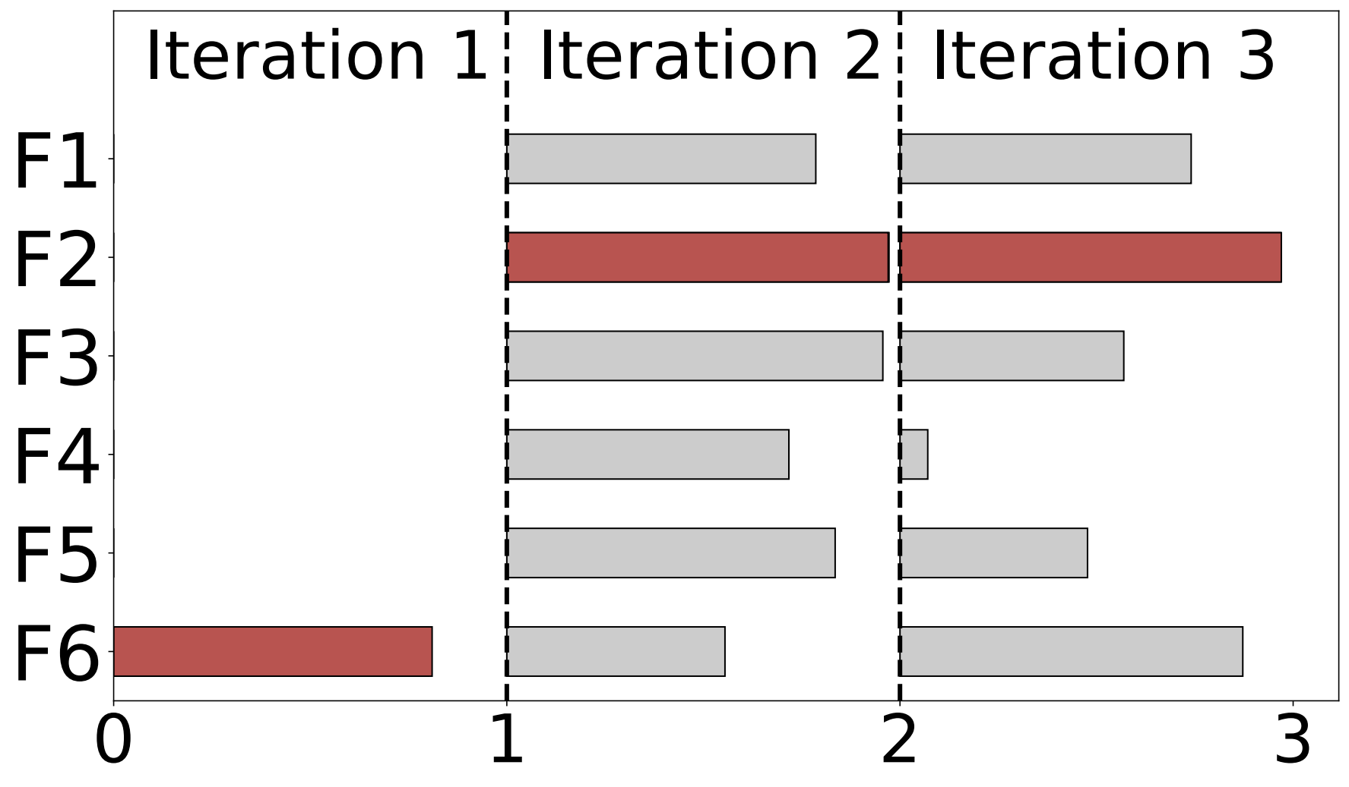
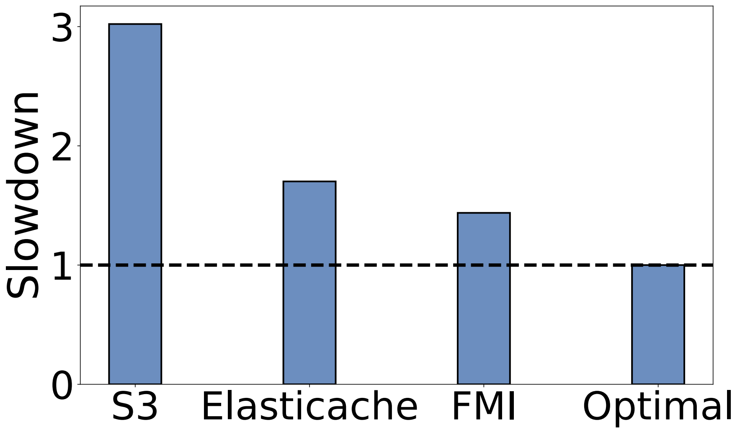
Inefficiencies
Lessons Learned from Profiling FaaSGraph
Ignoring intra-job elasticity incurs additional monetary costs.
Communication through storage or direct function links is slow.
Normalized execution time in
three consecutive iterations of tw-BFS
Performance when applying
various communication methods
5
Notes:
We profiled serverless graph processing systems represented by FaaSGraph, and we conclude that:
First, they ignored intra-job elasticity. Intra-job elasticity means that within each iteration of graph processing, there is load imbalance among functions, which leads to additional monetary costs for some functions.
Second, their communication — whether through storage or direct function links — is slow.
Graphless uses storage-based communication. The benefit of this approach is stability: when the number of functions changes, the communication topology remains unchanged.
FaaSGraph uses direct function links. It simulates a management mechanism for serverless functions and provides high communication bandwidth. The benefit is better speed, but there are two drawbacks. First, the communication topology must change when the number of functions changes. Second, in reality, the communication bandwidth of serverless functions is low — on AWS Lambda, it is only about 70–80 MB/s.

Slide 6

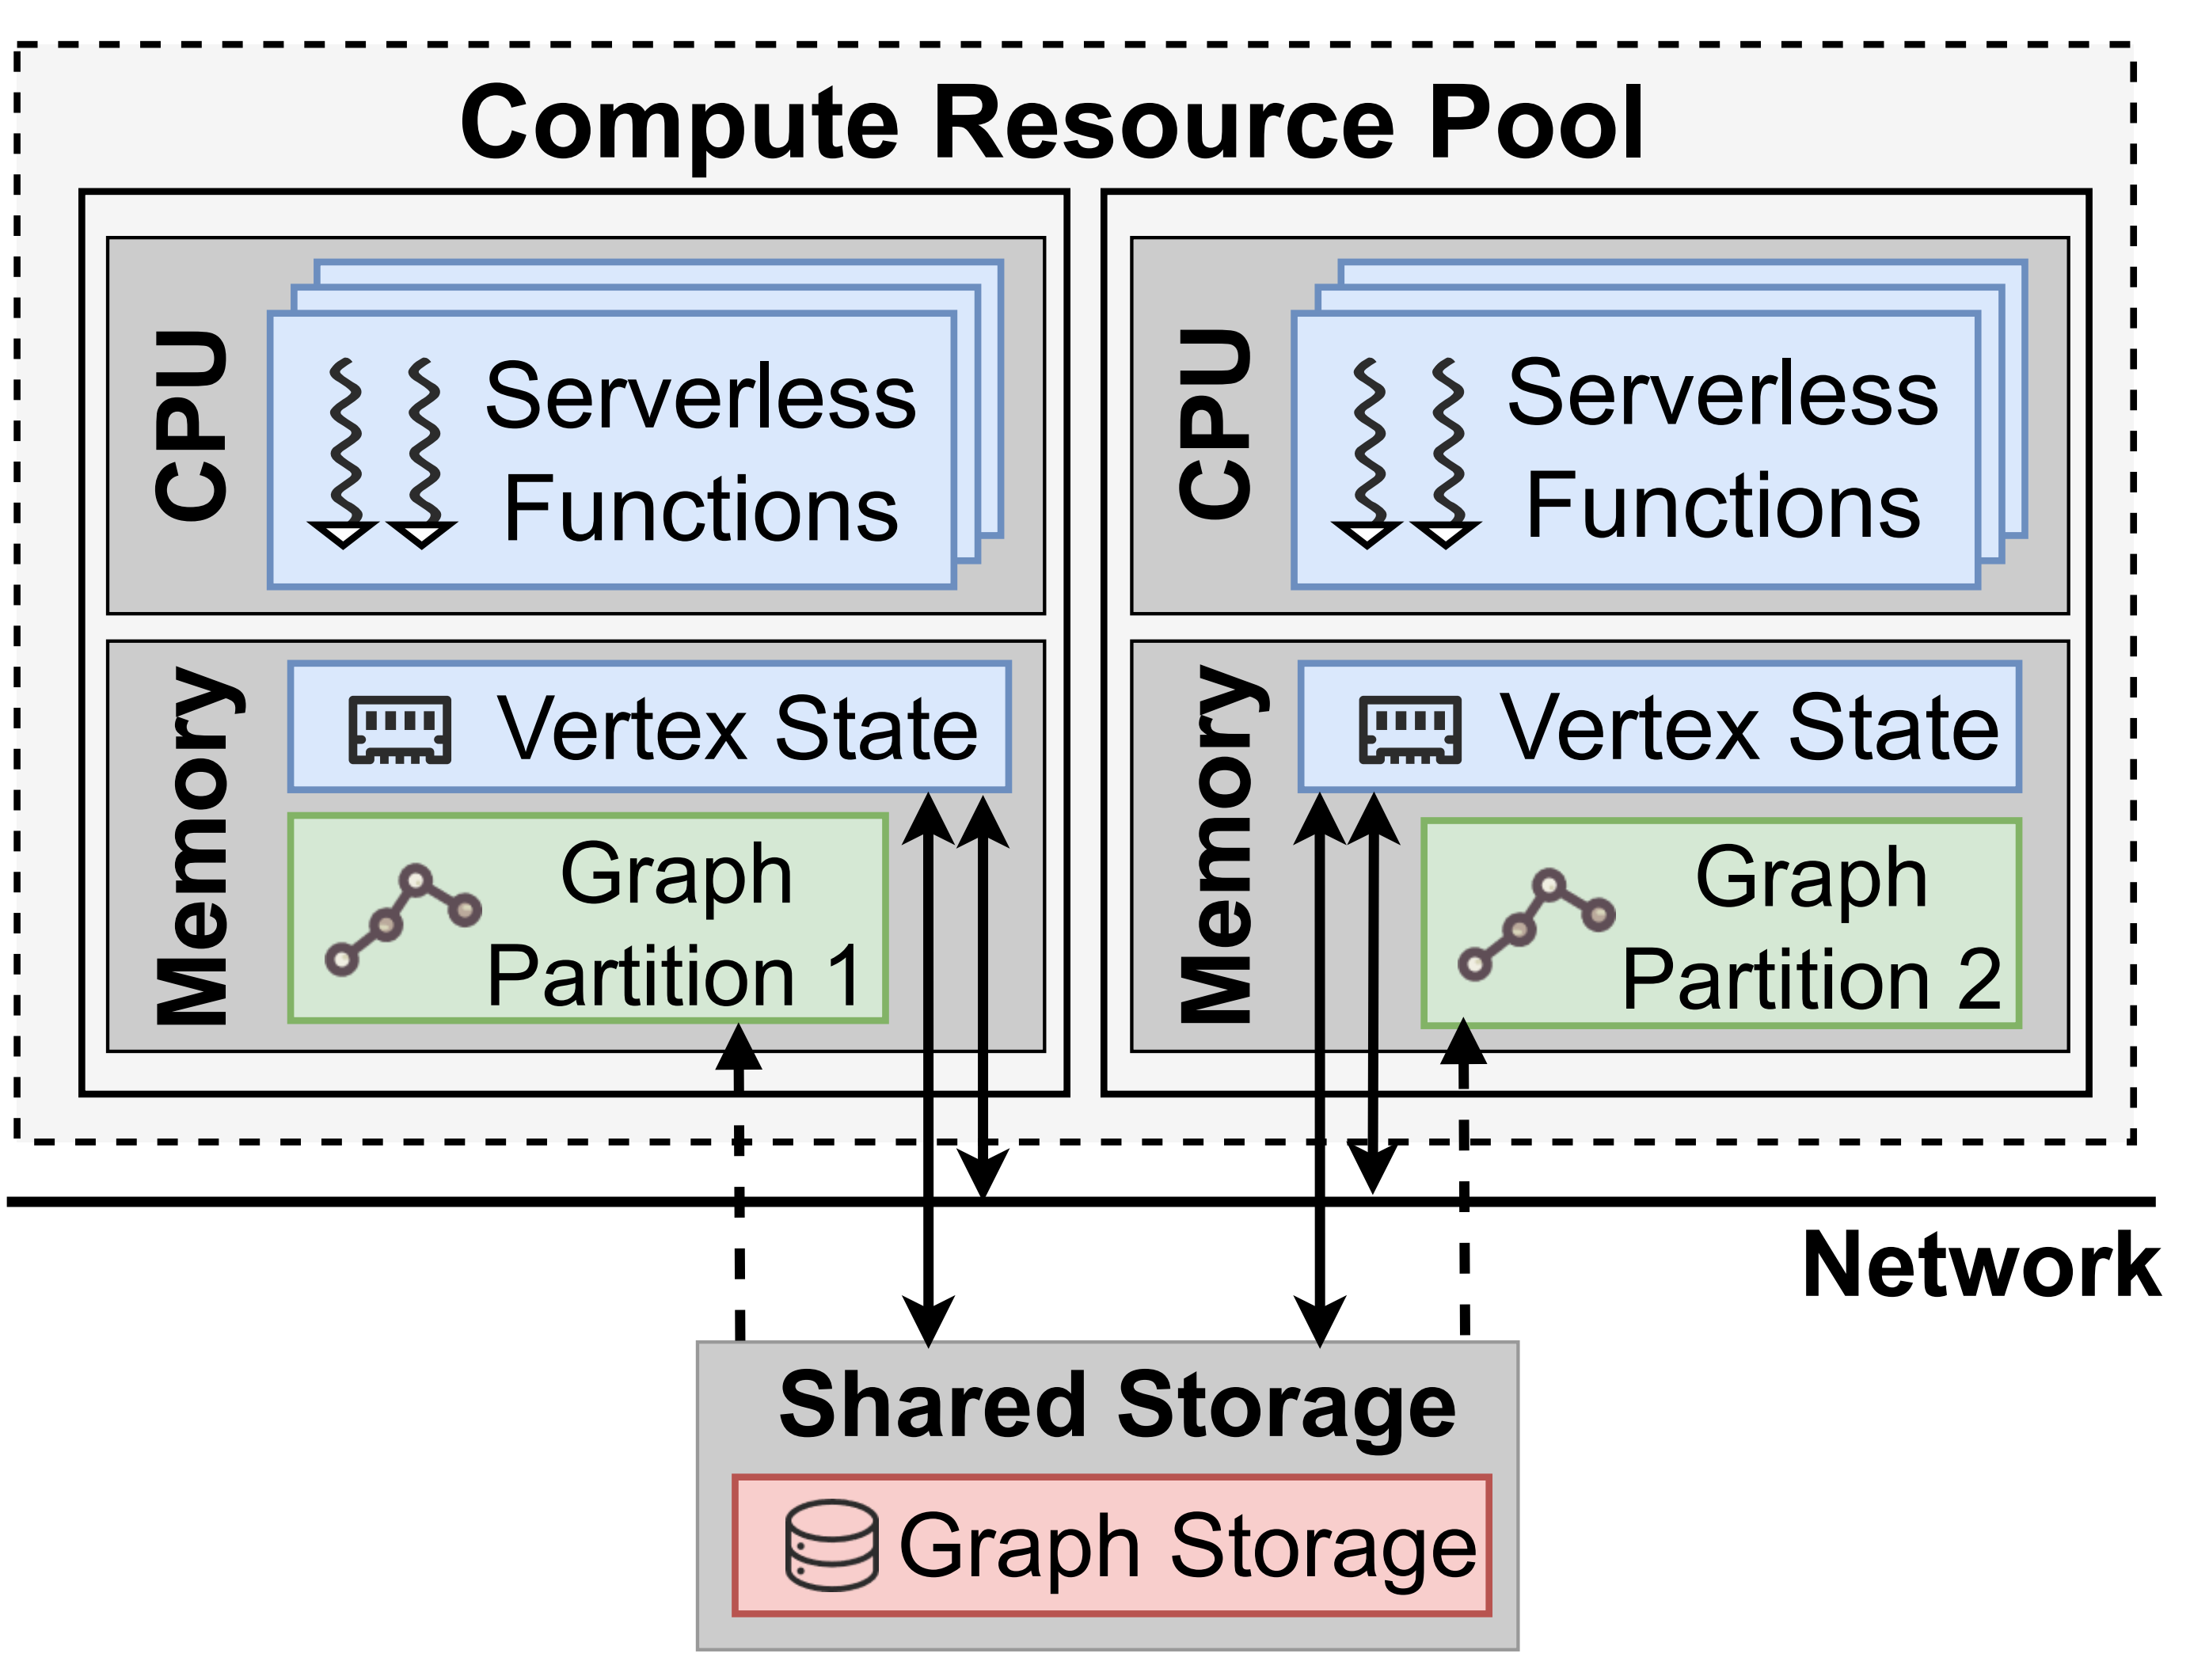
Claim
Monolithic Function Architecture adopted by existing serverless graph processing system^{[1, 3]} is the root cause, which encapsulates data loading, computation, and communication into a single function.
Monolithic Function Architecture
[1] Liu, Yushi, et al. "FaaSGraph: Enabling Scalable, Efficient, and Cost-Effective Graph Processing with Serverless Computing." In ASPLOS, 2024.
[3] Lucain, Toader, et al. “Graphless: Toward Serverless Graph Processing” In ISPDC, 2019.
6
Notes:
We conclude that, Monolithic Function Architecture adopted by existing serverless graph processing system is the root cause, which put data loading, computation, and communication into a single function.

Slide 7
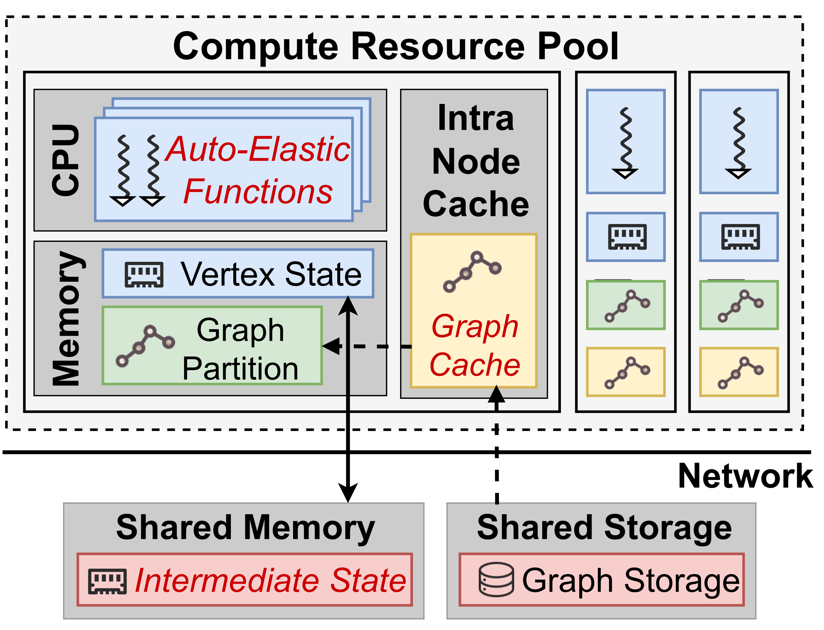
FaaSBoard: Disaggregated Serverless Architecture
We propose a Disaggregated Serverless Architecture that decouples data loading, computation, and communication.
Data Loading Decoupling
Communication Decoupling
Monolithic Function Architecture
Disaggregated Serverless Architecture
7
Notes:
So we propose a Disaggregated Serverless Architecture that decouples data loading, computation, and communication. We introduced the intra-node cache for data loading decoupling and shared memory proxy for commmunication decoupling.

Slide 8
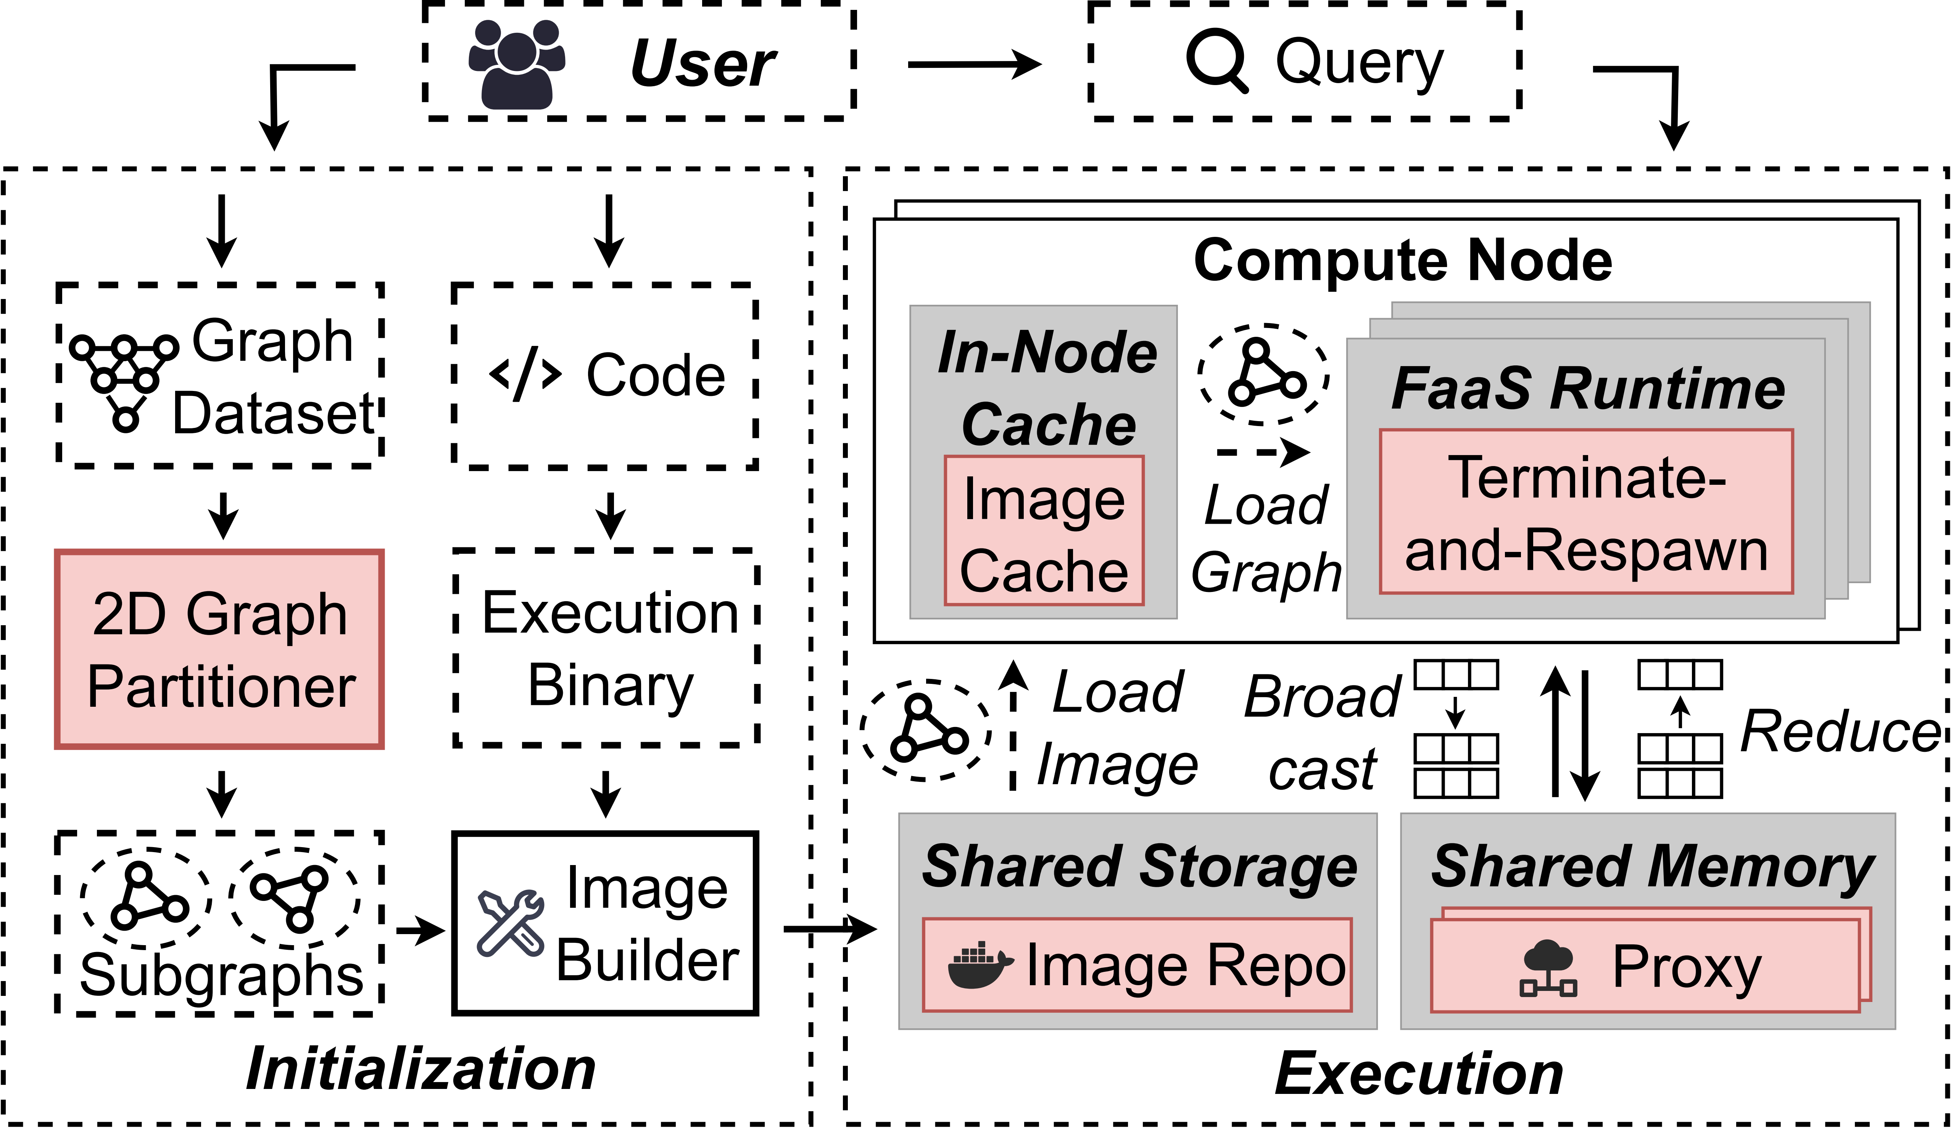
FaaSBoard Workflow
FaaSBoard is built entirely on industrial serverless services, provided by AWS.
Better Load Balance
Balanced Subgraphs
9
Notes:
We built FaaSBoard entirely on industrial serverless services provided by AWS. This is FaaSBoard workflow.
First, users need to upload their graph dataset. After being processed by our 2D Balanced Graph partitioner, balanced subgraphs are obtained.

Slide 9

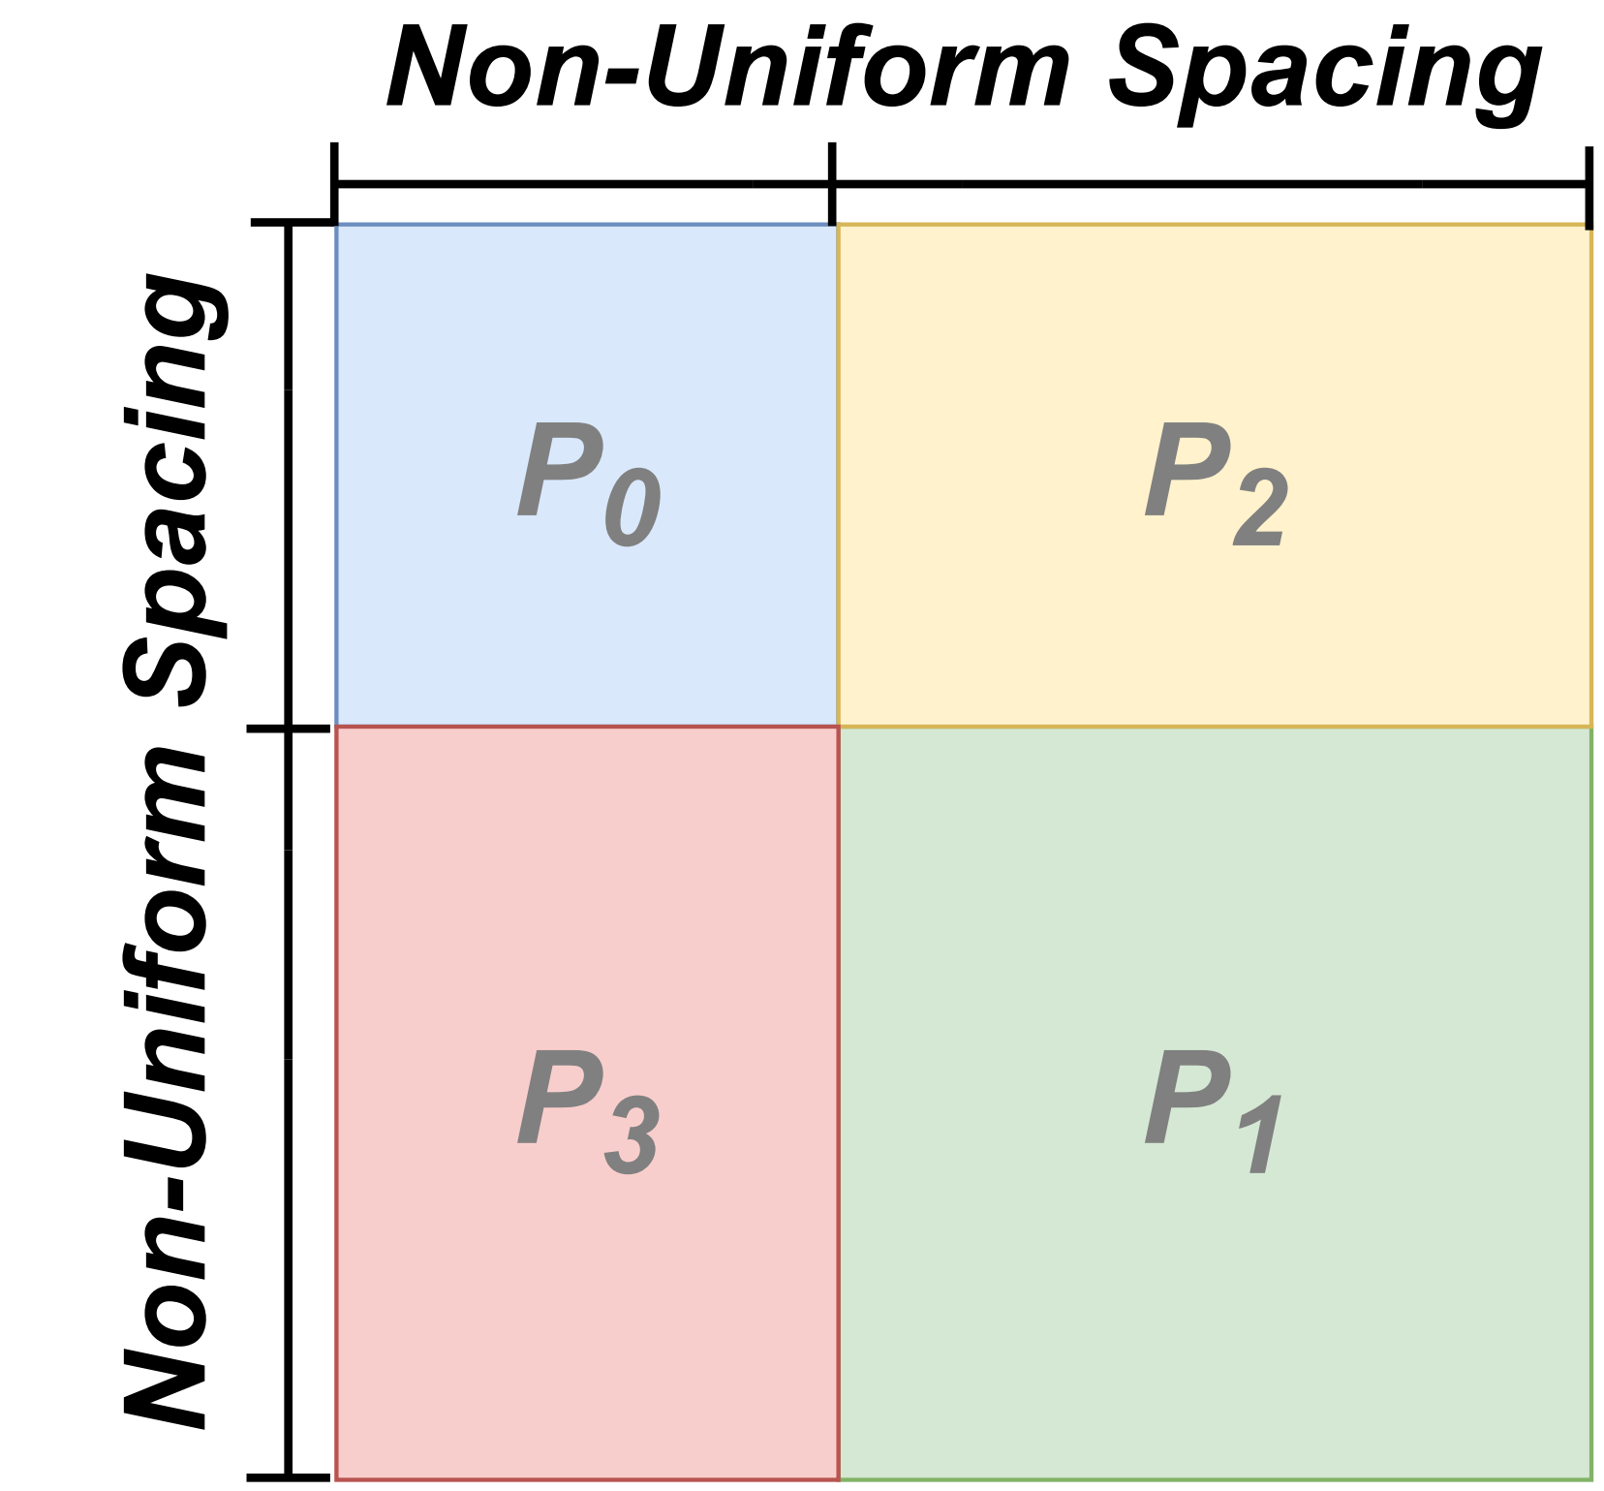
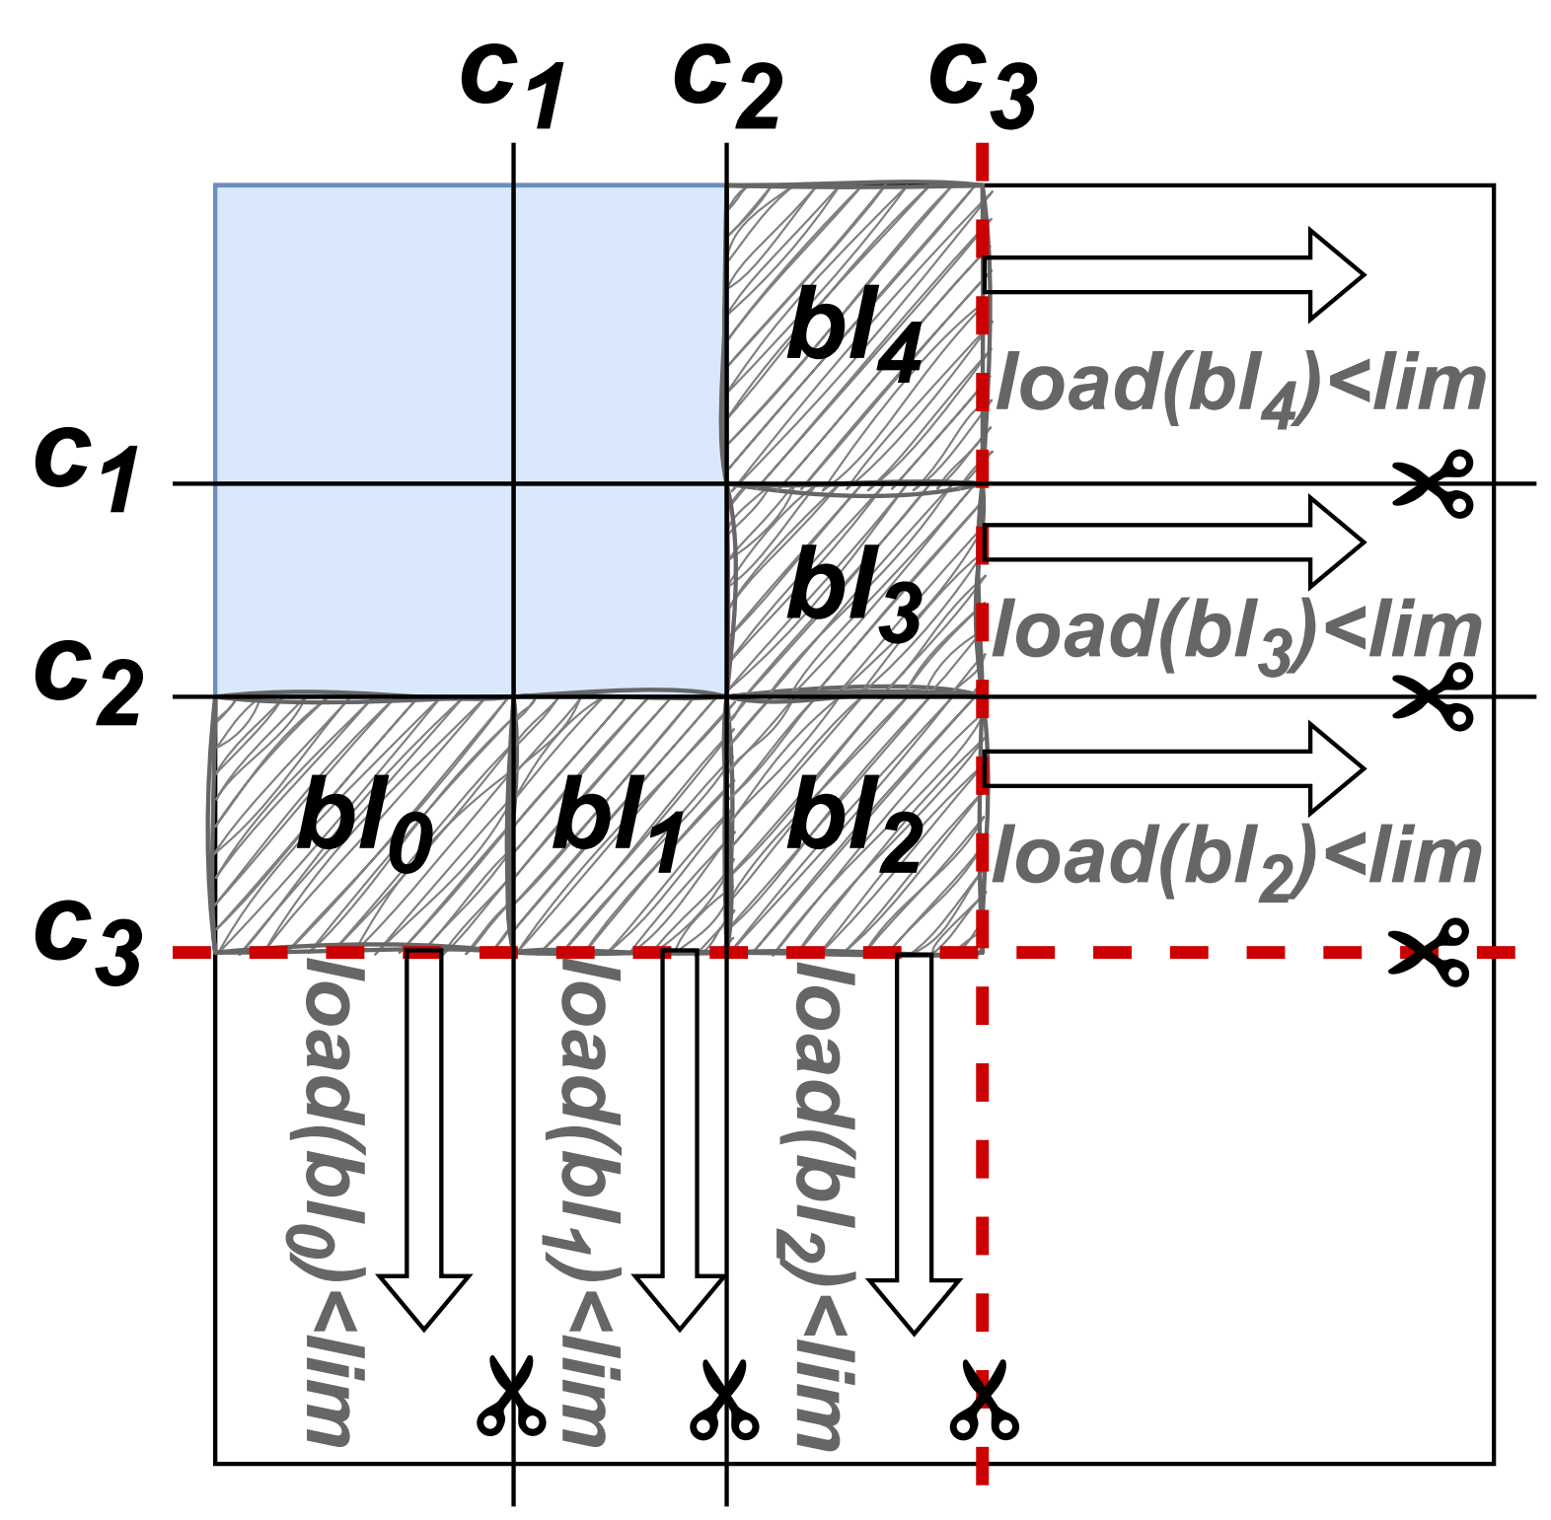
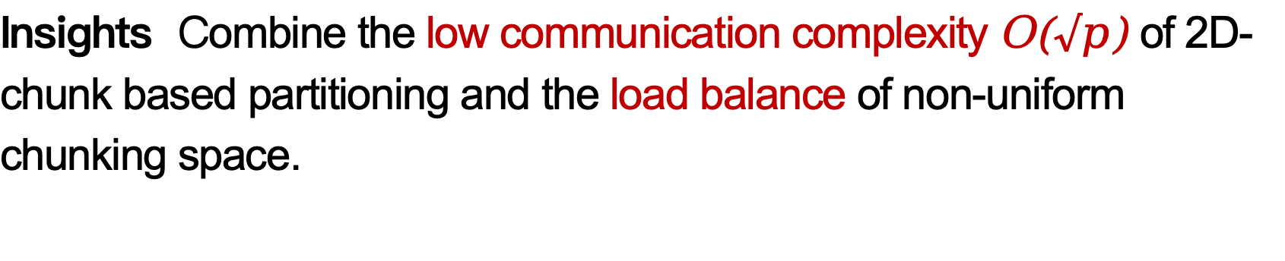
2D Balanced Graph Partitioning
Insights Combine the low communication complexity O($√p$) of 2D-chunk based partitioning and the load balance of non-uniform chunking space.
Benefits Suitable for resource-constrained serverless environments, improving computational performance while avoiding OOM.
10
Notes:
The insight of our 2D methods is that we want to combine the low communication complexit of 2D-chunk based partitioning and the load balance of non-uniform chunking space. This is particularly suitable for resource-constrained serverless environments.

Slide 10
Image-based Graph Loading
Insights Package the computation code and graph into one image.
Benefits Shorter loading path and hot data reuse.
Locality
Hotness
11
Notes:
For image-based graph loading, our insight is that we can package the source code and graph data into one image. The benefit is that, when a query comes, we load the image and launch the serverless function. Compared to the traditional approach of first launching a function and then loading graph data from remote storage, our method provides locality for graph data. Besides, we utilize the multi-level caching mechanism provided by cloud providers to cache graph data, thereby introducing the hotness.

Slide 11
Proxy-based Collective Communication
Insights Leverage the higher bandwidth of proxy compared to functions (7.0–8.5× for AWS Fargate to AWS Lambda), and utilize proxy’s computing resources for auxiliary computation.
Benefits Better communication performance.
12
Notes:
For proxy-based collective communication, we can leverage the higher bandwidth of the proxy compared to functions to change the communication topology, and utilize the proxy's computing resources for auxiliary computation.

Slide 12
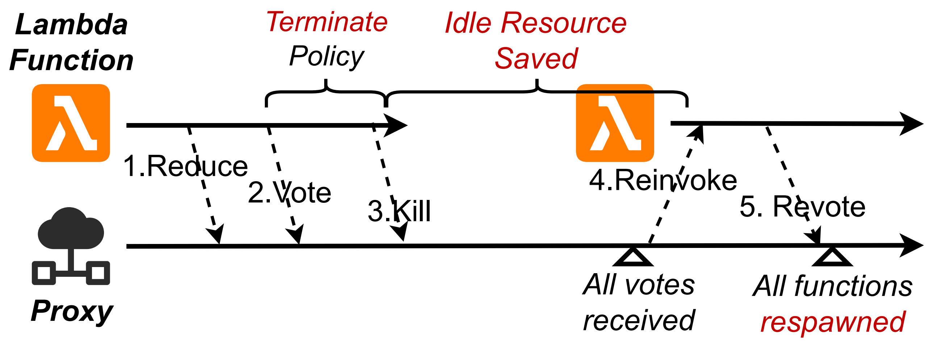
Proactive Terminate-and-Respawn
Insights Leverage intra-job elasticity of graph processing.
Benefits Less resource idling and lower monetary costs.
13
Notes:
For proactive terminate-and-respawn, our insight is to leverage intra-job elasticity of graph processing. In the right figure, when a serverless function detects that it is idle, it will proactively terminate. Then, at the end of the current graph processing iteration, the proxy will respawn this function. In this way, the previously observed idle time can be reduced, leading to lower monetary costs.

Slide 13
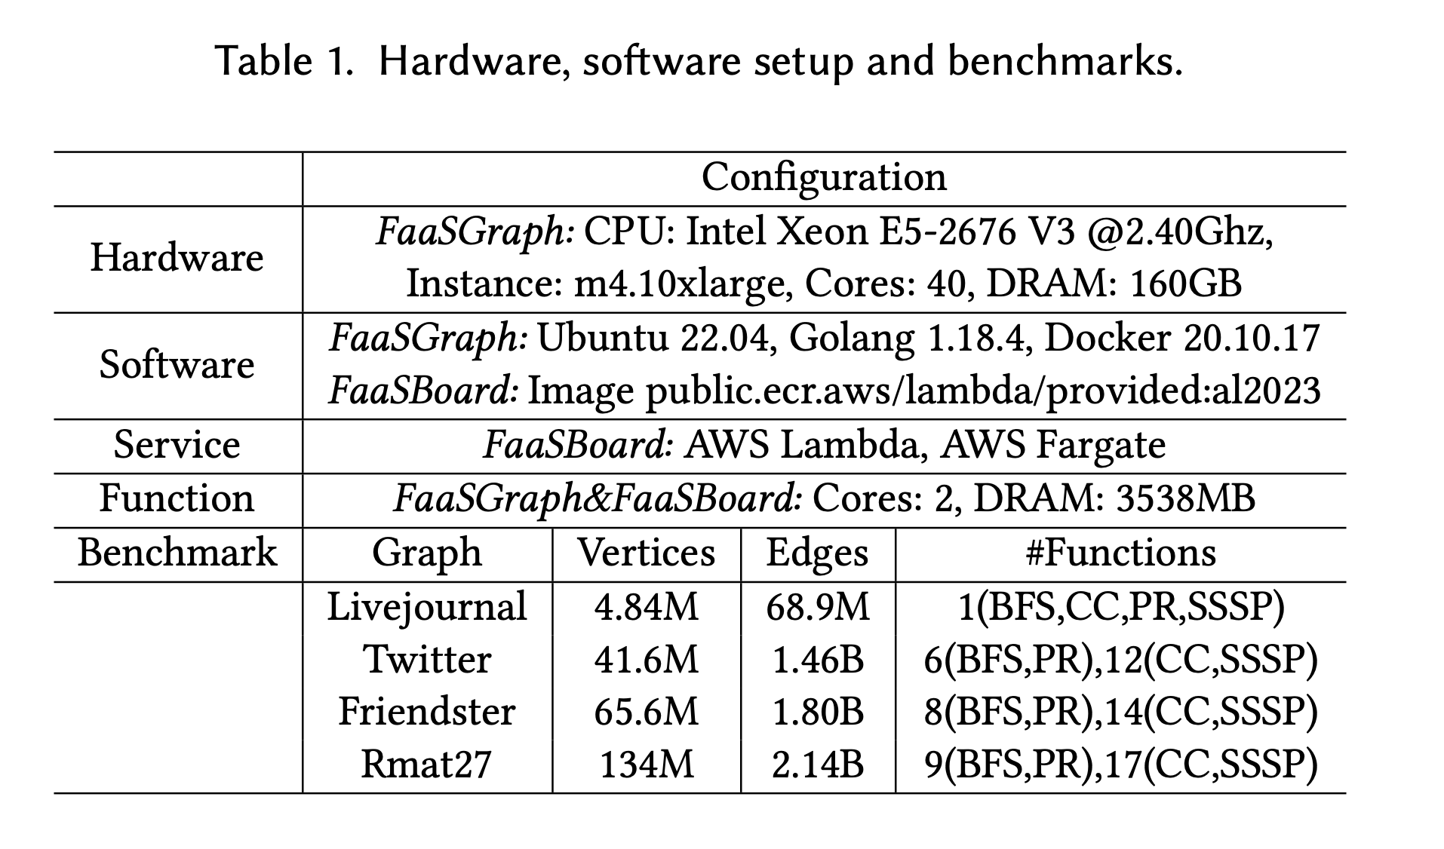
Experiment Settings
Workloads
Graphs^{[4]} : 3 SNAP datasets + RMAT-27
Apps: breadth-first-search (bfs),
connected-components (cc), pagerank (pr),
single-source-shortest-path(sssp)
Environments
Serverless function -> AWS Lambda
Proxy -> AWS Fargate
Baselines
FaaSGraph(ASPLOS’24)
[4] https://snap.stanford.edu/data
14
Notes:
We mainly compare against FaaSGraph in our experiments.

Slide 14
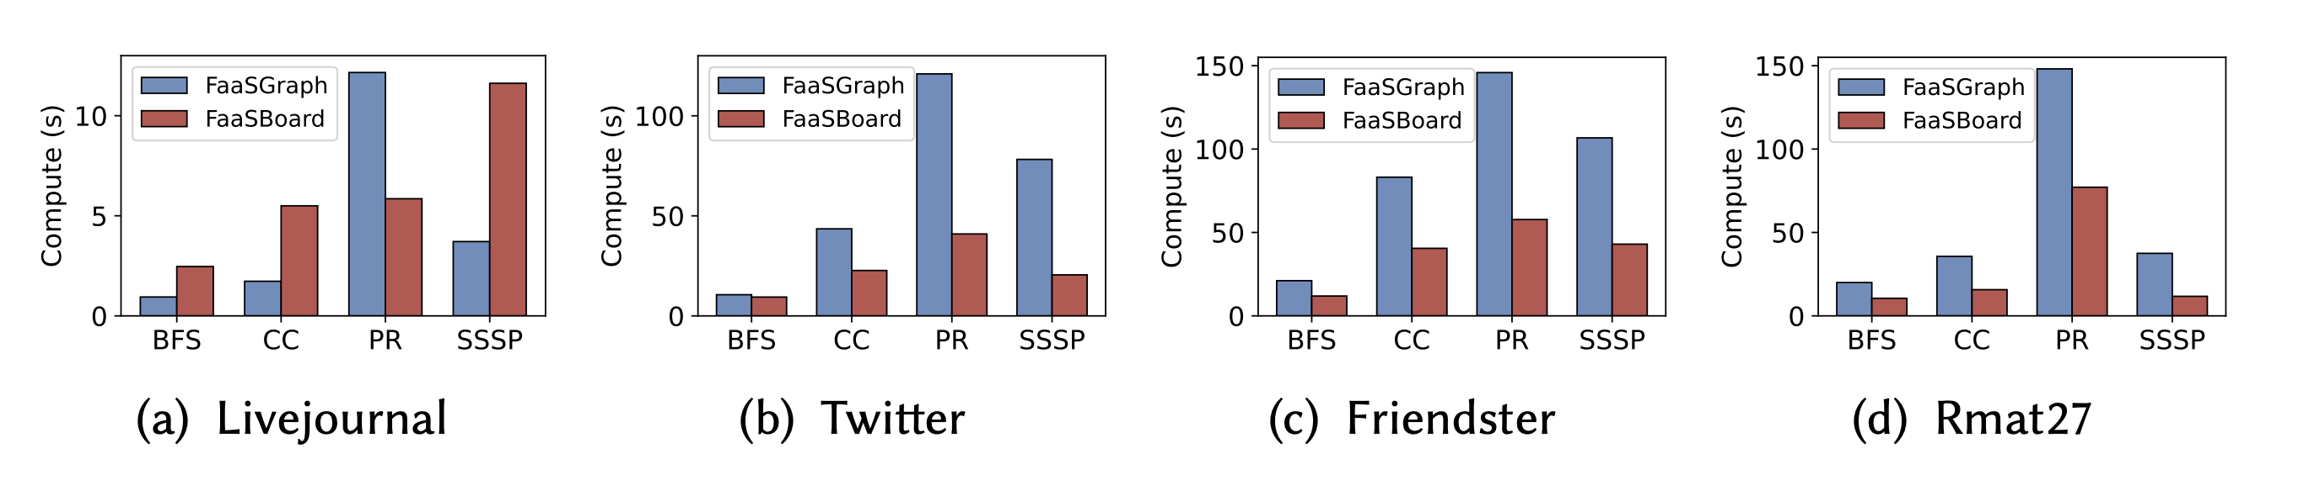
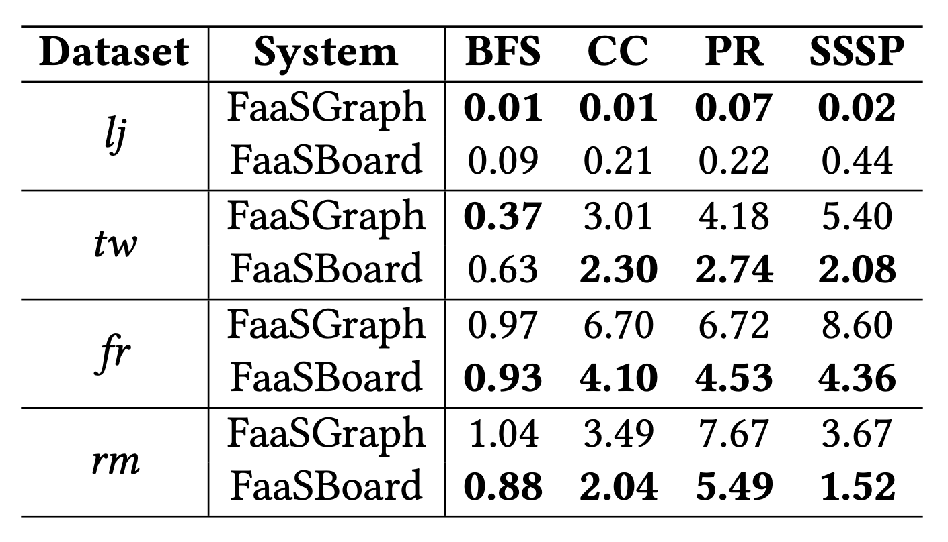
Overall Results
End-to-end Latency Speedup (FaaSBoard vs. FaaSGraph)
Max 3.8x
Speedup
Max 61.5%
Cost Savings
Monetary cost (¢) comparison (FaaSBoard vs. FaaSGraph)
15
Notes:
For overall results, we achieve up to 3.8× improvement in computational performance and up to 61.5% reduction in monetary costs.

Slide 15
Conclusion
We present FaaSBoard, a graph processing system on serverless cloud services which adopts a disaggregated serverless architectural design.
FaaSBoard achieves significant improvements in computing performance and monetary costs compared to FaaSGraph, which is the SOTA serverless graph processing system.
16
Notes:
In conclusion, We present FaaSBoard, a graph processing system on serverless cloud services which adopts a disaggregated serverless architectural design. FaaSBoard achieves significant improvements in computing performance and monetary costs compared to FaaSGraph, which is the SOTA serverless graph processing system.

Slide 16


Thanks!
Paper
Code
Source Code: https://github.com/SJTU-Liquid/FaaSBoard
17
Notes:
Welcome to our poster to discuss serverless with us.
Graphless uses storage-based communication. The benefit of this approach is stability: when the number of functions changes, the communication topology remains unchanged.
FaaSGraph uses direct function links. It simulates a management mechanism for serverless functions and provides high communication bandwidth. The benefit is better speed, but there are two drawbacks. First, the communication topology must change when the number of functions changes. Second, in reality, the communication bandwidth of serverless functions is low — on AWS Lambda, it is only about 70–80 MB/s.
About auto-scaling：
When concurrent requests to a function increase, Lambda automatically scales up execution environments (up to the account concurrency limit) to handle them in parallel. When requests decline, idle execution environments are recycled.

