Slide 1
Social-Aware Routing
in Delay Tolerant Networks
Jie Wu
Dept. of Computer and Info. Sciences
Temple University
DySON'14

Slide 2
Challenged Networks
● Assumptions in the TCP/IP model are violated
○ DTNs
● Delay-Tolerant Networks (also Disruption-Tolerant Networks)
○ Limited end-to-end connectivity
● Due to mobility, power saving, or unreliable networks
○ Activities
● IRTF’s DTRNRG (Delay Tolerant Net. Research Group)
● EU’s Haggle project
DySON'14

Slide 3
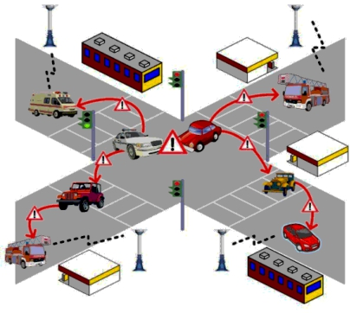
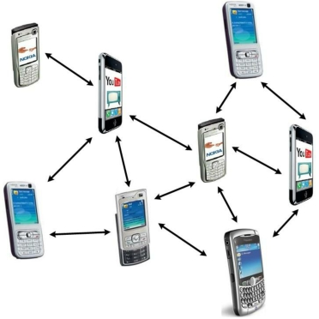
Examples of DTNs
● Vehicular communication
● Social contact networks
DySON'14

Slide 4
Store-Carry-Forward
● Movement-Assisted Routing
Views node movement as a desirable feature
○Store
○Carry
○Forward
DySON'14

Slide 5
Two Paradigms
● Random Mobility
○ E.g., epidemic routing
○ Sightseeing cars (random movement)
● Controlled Mobility
○ E.g., message ferrying
○ Taxi (destination-oriented)
○ Public transportation (fixed route)
DySON'14

Slide 6
Epidemic Routing (Vahdat & Becker ‘00)
● Nodes store data and exchange it when they meet
● Data is replicated through a random talk
DySON'14

Slide 7
Message Ferrying (Zhao & Ammar ‘03)
● Special nodes (ferries) have completely predictable routes throughout the geographic area
DySON'14

Slide 8
Key Techniques
Knowledge
• Global vs. local information (Jain et al. ‘04)
• Zero information
Replication
• Single vs. multiple copy: spray-and-wait (-focus)
• Controlled copy: delegation forwarding
Closeness (to destination)
• Location information (of contacts and dest.)
• Similarity (between intermediate nodes and dest.)
DySON'14

Slide 9
Two Fundamental Questions
● How to determine the appropriate number of copies
● How to efficiently distribute copies once determined
DySON'14

Slide 10
Delegation Forwarding (Erramilli et al. ‘08)
● The holder forwards the message to an encounter with a higher quality than those in all previous nodes seen so far
● The expected cost of the algorithms
○ Flooding: O(n)
○ Delegation forwarding: O(√n)
● Extensions
○ Probabilistic delegation forwarding (Chen, Jian, Graves & Wu ‘09)
○ Delegation forwarding in multicasting (Wang & Wu ‘10)
DySON'14

Slide 11
Spray-and-Wait (-Focus) (Spyropoulous, Psounis & Raghavendra ‘05 & ‘07)
Two phases
Sprays a number of copies into the network
Each copy waits until meeting with the destination
○ Wait : forward only to its destination
○ Focus : forward to destination or a node “closer” to the destination
● Mobility model: random walk
DySON'14

Slide 12
Key Challenges
● Existing DTN routing relies on
○ Contact history
○ Mobility pattern
● Collecting such information is costly
● Both contact and mobility are
○ Highly dynamic
○ Unstructured
DySON'14

Slide 13
Social-Aware Routing
● Based on coarse-grain social-aware approaches
○ Social features-based: semi-structured contacts (Wu & Wang ’12, INFOCOM 2012)
○ Social home-based: semi-structured mobility (Wu, Xiao & Huang ’13, INFOCOM 2013)
● Differ from fine-grain social-aware approaches
○ Community, centrality, betweenness, and strong and weak ties, …
○ …
DySON'14

Slide 14
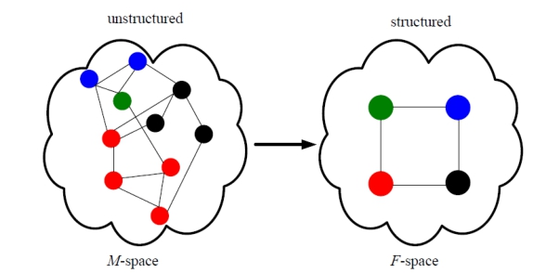
Social Feature-Based (Wu & Wang ‘12)
● Mobile & unstructured contact space (M-space) Static & structured feature space (F-space)
● Each individual with a social feature profile {F1,F2,…}
● Individuals with the same features mapped to a group
DySON'14

Slide 15
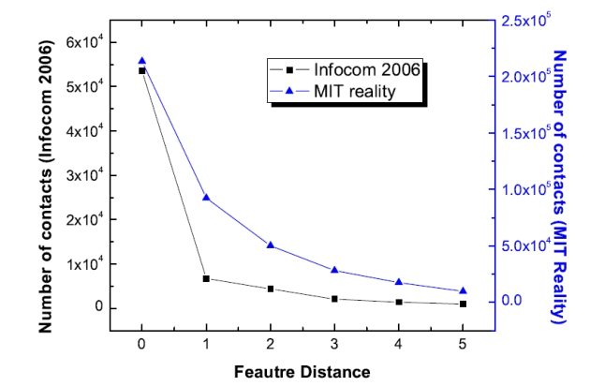
Resolve Feature Difference
● Our approach
○ Feature-based (race, gender, language, …)
○ Resolve feature difference one at a time !
● Increase delivery rate: multiple copy
○ Flooding: O(n)
○ Delegation forwarding: O(√n)
○ Our approach: logn*
○ n* is feature space size
DySON'14

Slide 16
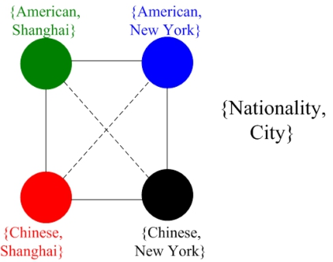
Feature-based Grouping Example
P3 P1
P2
● People come in contact with each other more frequently if they have more social features in common (P1>P3, P2>P3)
DySON'14

Slide 17
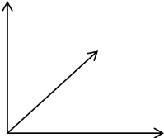
A 3-dimensional (3-D) Hypercube
021 121 221 321
Position (2): professor (0), researcher (1), student (2)
020
311
Gender (1): male (0), female (1)
010
301
City (3): New York(0), London(1), Paris (2), Shanghai (3)
000 A B 100 C 200 D 300
Example: “311”: a female researcher lives in Shanghai
DySON'14

Slide 18
Feature Extraction
● Extract mmost important features based on Shannon’s entropy
l

i 1
E
(
F
)

p(
x
i
)
log
p(
x
i
)
○E(F): entropy of feature F
○p: feature probability mass function
○{x1, x2, …, xl}: value set of feature F
DySON'14

Slide 19
Social Feature Entropy
● The entropy of each social feature (Infocom 2006 trace)
Social
Feature
Entropy
Affiliation 4.64
City 4.45
Nationality 4.11
Language 4.11
Country 3.59
Position 1.37
DySON'14

Slide 20
Property of Hypercubes
Efficient routing in an m-d binary cube (Sand D differ in kfeatures)
○kshortest paths of length k
○m−knon-shortest paths of length k+2
011 G3 111 G7 011 G3 111 G7
010 G2 110 G6 010 G2 110 G6
G1 001
G5 101
G1 001
G5 101
G0 000
G4 100
G0 000
G4 100
DySON'14

Slide 21
Hypercube Routing
● The relative address of the current group and destination group (a small string in the header)
○ calculated through XOR on S and D
○ sent, along with the packet, to the next node
● Any node in the group can forward to any node in the adjacent group
● Special treatment is needed at the destination group: spread-and-wait (-focus)
DySON'14

Slide 22
Shortcuts
● Feature matching shortcut can resolve the feature distance more than one at a time
011 G3 111 G7
G2 G6
010 110
G1 G5
001 101
G0 G4
000 100
● Shortcut reduces the number of forwardings while ensuring the path disjointness property
DySON'14

Slide 23
Simulation
● Synthetic trace
○ A node Ahas mcontact frequencies, p1,p2,...,pm, with its mneighbors in the m-D F-space.
○ 128 individuals
○ mis 4, 5, 7, 8, and 11.
● Real trace
○ Infocom 2006 trace.
○ 61 participants
○ 6 social features, mis 3, 4, 5, and 6.

Slide 24
7 routing schemes comparison
● Node-disjoint-based with wait-at-destination (ND-W)
○ Waiting for the destination after the packet enters the destination group
● Node-disjoint-based with spray-at-destination (ND- S)
○ Spraying N/(2M) copies into the destination group after the packet enters the group
● Delegation-based with wait (D-W)
● Delegation-based with spray (D-S)
○ Delegation-based: The copies of a packet is only forwarded to the individual with a smallest feature distance to the destination it has met so far
● Note: spray is needed at the destination group to increase the chances to meet the actual destination!

Slide 25
7 routing schemes comparison-cont’d
● Source spray-and-wait (S-S&W)
○ The source forwards copies to the first m distinct nodes it encounters. If the destination is not found, the copy carriers wait for the destination.
● Binary spray-and-wait (B-S&W)
○ Any node with copies will forward half of the copies to the encountered node with no copy.
● Binary spray-and-focus (B-S&F)
○ The copy carriers forward the copy to the encountered node with a smaller feature distance to the destination.

Slide 26
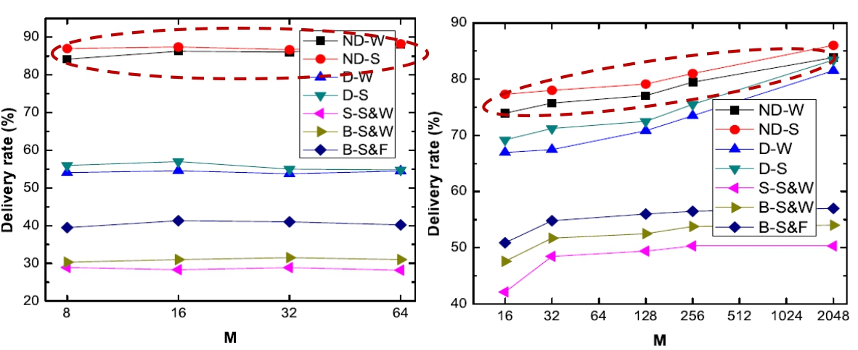
Varying node density – delivery rate
Real trace Synthetic trace

Slide 27
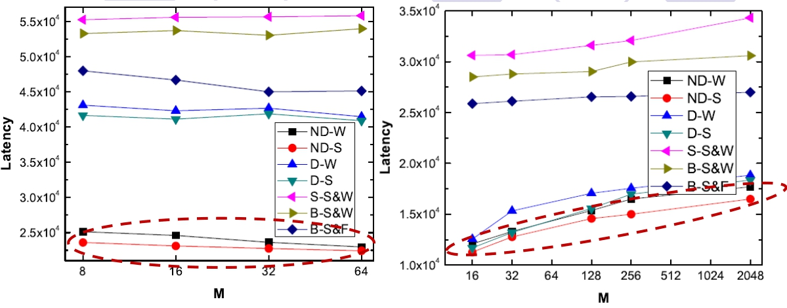
Varying node density – latency
Real trace Synthetic trace

Slide 28
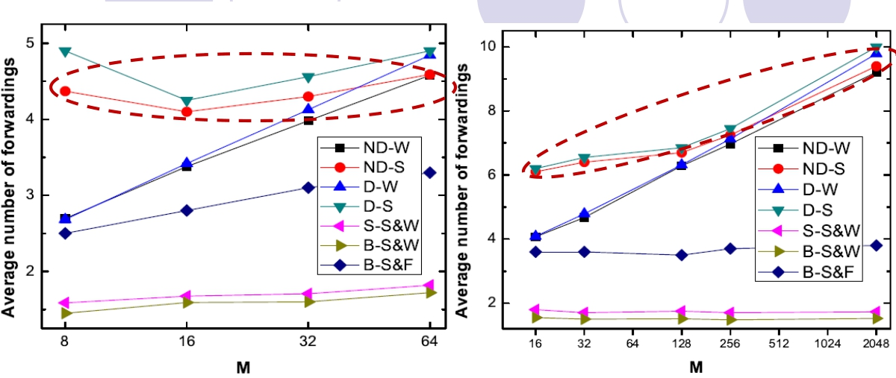
Varying node density – # of forwardings
Real trace Synthetic trace

Slide 29
Recap and Extensions
● Multi-path routing in hypercubes
○ Feature-based, efficient copy management, and node-disjoint-based
● Extensions
○ General hypercubes
(Wu & Wang 2014, IEEE TC)
○ Analytical results: delivery rate and latency
DySON'14

Slide 30
Social Home-based
(Wu, Xiao, & Huang ‘13)
○Social characteristics
Nodes visit some locations (homes) frequently, while visiting other locations less frequently
○Real or virtual “throwbox”
Each community home is equipped with a real or virtual “throwbox” so that it can store and forward messages
DySON'14

Slide 31
Problem
● Network Model
○ n mobile nodes in V
○ h homes: H = {1, 2,…, h} and other locations
home
other
location
mobile
node
Italian student: {Italian town, school, dorm}
Female student: {shopping center, school, dorm}Given a fixed numbe
message copies C DySON'14
– Minimize the exected deliver
dela

Slide 32
Solution
Homing Spread (HS)
○Homing phase
● The source sends message copies to homes quickly
○Spreading phase
● Homes with multiple copies spread them to other homes and mobile nodes
○Fetching phase
● The destination fetches the message when it meets any message holder
(Homing: meet at a home site. Roaming: at a non-home site.)
DySON'14

Slide 33
Challenges
● Given a fixed number of message copies C
○ What is the optimal way for a message holder to spread copies during homing and roaming?
○ Once a home receives some message copies, how should it further spread these copies?
○ What is a general way for a mobile destination to obtain a copy?
DySON'14

Slide 34
Homing Phase
○Binary Homing Scheme:
● Each message holder sends all of its copies to the first (visited) home.
● If the message holder meets another node before it visits a home, it binary splits the copies between them.
C/2 1 C/2
1 5
C/4 C/4 C/4 C/4
1 3 5 6
C/8 C/8 C/8 C/8
1 2 3 4
DySON'14

Slide 35
Homing Phase
○Assume
● Inter-meeting time follows the exponential distribution:  (between two mobile nodes) and ☹ (a mobile node to a home)
○Lemma 1
● The binary homing scheme can spread the C message copies to the maximum number of nodes before they reach the homes
○Analysis
● The expected delay of each message copy is always 1/h☹ no matter which splitting scheme is adopted
● The maximum number of nodes (homes) received the message copies
DySON'14

Slide 36
Spreading Phase
○1-Spreading Scheme
● Each home with more than one message copy spreads a copy to each visiting node until only one copy remains
● If a node with one copy later goes and visits a new home, the node sends the copy to that home
○Analysis
● Each home has at most one copy
● If C>h, there are C−hnodes outside the homes that have a copy
● Home is always more important than a regular node as it can spread the message faster
DySON'14

Slide 37
Spreading Phase
○1-Spreading Scheme
H+
1 1 1 1 1 1 1 1
1 1 1 1
H0
(H+: multiple copies, H1: one copy, H0: no copy)
○Lemma 2
● The 1-spreading scheme can spread copies from a home to the maximum number of nodes with the fastest speed.
DySON'14

Slide 38
Fetching Phase
○Fetching Scheme
● The destination fetches the message once it meets a message holder
d
H1
DySON'14

Slide 39
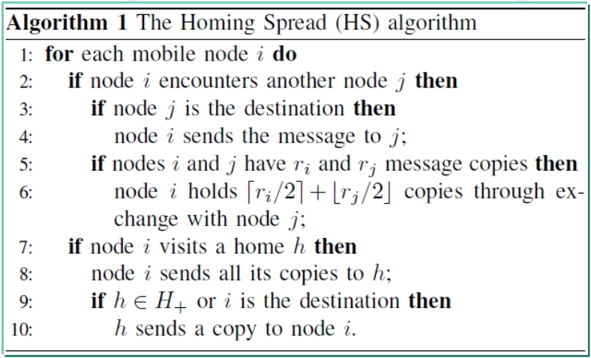
Distributed HS Algorithm
Continuous Markov Chain
● Expected delivery delay
● Number of copies needed for a given delay bound
DySON'14

Slide 40
Network State
○ State s is a vector with h+n components
s= ⟨s1, s2,…, sh, sh+1,…, sh+n⟩,
where si: copies held by i-th home (if i≤h) or (i−h)-th node (if i>h) hn
i 1 2 h h1 h 2 hn
i 1
○ For example: s= ⟨3, 0, 1, 0, 0, 0⟩
and     ☹    ☹  ( ; ) s C s s s s s s
3 0 1 0 0 0
○ Start state: st= ⟨0, 0,…, 0, C, 0,…, 0⟩
○ Optimal state: so= ⟨1, 1,…, 1, 0,…, 0⟩
DySON'14

Slide 41
Optimality of HS
○ HS follows binary homing and 1-spreading schemes
○ Lemmas 1 and 2 show that the HS is the fastest way to turn a network state into the optimal state
○ Each state transition based on binary homing and 1- spreading schemes can turn the current state into the best next state that has the minimum expected delivery delay
DySON'14

Slide 42
Expected Delivery Delay
Continuous Markov Chain
○State space s= ⟨s1, s2,…, sh, sh+1,…, sh+n⟩
○State transition graph
● Binary homing scheme and 1-spreading scheme
● A directed acyclic graph
● State transition function
❒
s,s
(t
)
'
Probability density function about the time tthat it takes for state transition from s to s′
DySON'14

Slide 43
Expected Delivery Delay
○ Derive the cumulative probability density function for the state transition from start to end state
○ Calculate the expected delivery delay
0.15e-t
st: á0, 0, 2, 0ñ
0.8e-t
s1:á0, 0, 1, 1ñ
exponential
density function
0.05e-t
0.8e-0.9t
0.45e-0.85t | s2:á1, 0, 1, 0ñ |  | 0.4e -0.85t
se 0.1e-0.9t
0.8e-0.8t s3:á1, 1, 0, 0ñ HS: 2.81
: 12.25
h=2, n=5, C=2,  = 0.005, and ☹ = 0.4
h = 2, n = 5, C = 2, ☹=0.4,DySON'14=0.05

Slide 44
Three Phases
Homing phase: average delay for the first copy reaching a home
D(1)

1
h☹
Spreading phase: average delay for each home to receive a copy
D(
2)
 2
☹
Fetching phase: average delay after the first two phases in message fetching

1
C☹
1
(C h)
,
,
C
C


h
h
D
(3)

h☹
DySON'14

Slide 45
Upper Bound
○ Define
D'

1
h☹

2
☹
homing (first term) plus spreading (second term) delay
○ The expected delay D of HS satisfies:
 D' C1☹
  1
D' h☹(C h
,
,
C
C


h
h
D

)
○Ccopies needed for a given delay bound

 1
1
☹ (
1 
D'
,
,

D' 


1 h☹

1
h☹
D'
 D'
C

D') h☹)
⋅
(

h
DySON'14

Slide 46
Simulation
Trace
○ Synthetic trace: Time-Variant Community Model
Settings
Parameter name Default value Range
Deployment area 20×20 -
Number of nodes n 200 100-400
Number of homes h 5 0-15
Homing probability per sec ☹ 0.04 0.04-0.16
Number of messages 10,000 -
Allowed message copies C 10 2-20

Slide 47
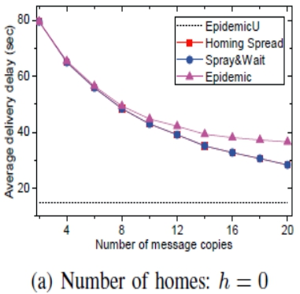
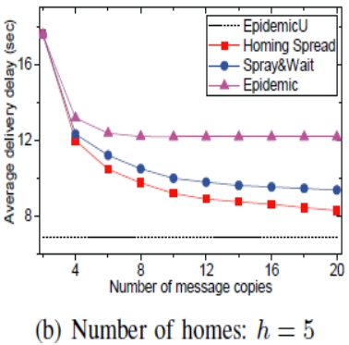
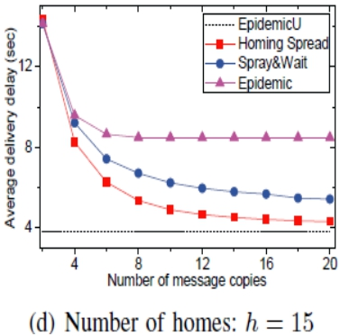
Average Delay vs. Number of Homes
○ Epidemic (C copies)
○ EpidemicU (unlimited copies)

Slide 48
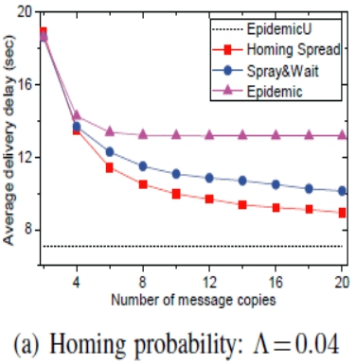
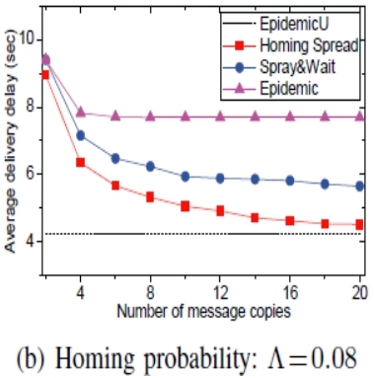
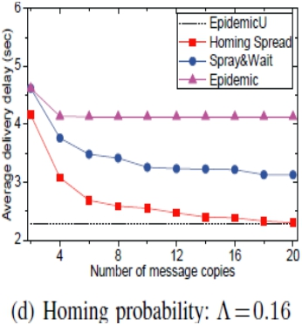
Average Delay vs. Homing Probability

Slide 49
Average Delivery Ratio vs. Number of Homes

Slide 50
Average Delivery Ratio vs. Homing Probability

Slide 51
Recap and Extensions
● Homing-spread
○ Optimal multi-copy routing in three phases: homing, spreading, and fetching
● Extensions
○ Heterogeneous homes: different homes
(Xiao, Wu & Huang ’14, IEE TPDS)
○ Heterogeneous visiting: different visit rates
DySON'14

Slide 52
Big Picture: Network Science
● How the Overall Network System will Behave
○ Static network structure
○ Dynamic networks structure (more challenging)
● Epidemic and Other Spreading Processes
○ Epidemic is well studied in static networks
● Susceptible-Infected (SI), SIR (recovered), SIS, and SIRS
○ Epidemic, especially controlled one, in dynamic networks
● More challenging and not well understood
DySON'14

Slide 53
Evolving Graphs
● Time-space view
n1 n2 n3 n4
…
t1 t2
● Social-aware contacts
t3
t4
tm
○ A special temporal-spatial link summary
● Activity level (AL)
○ AL of a node evolves based on ALs of neighbors
DySON'14

Slide 54
Collaborators
○Yunsheng Wang Kettering Univ.
○Mingjun Xiao
Univ. of Sci. & Tech. of China
DySON'14

