Slide 1

Dual-Centric Data Center Network Architectures
Jie Wu (Temple University)
PhD Candidate: Dawei Li
August 16, 2016

Slide 2
Agenda
Introduction
Unified Performance Model
Dual-Centric DCN Architectures
  FCell and FSquare
Comparisons of DCN Architectures
Simulations
Conclusion and Future Works

Slide 3





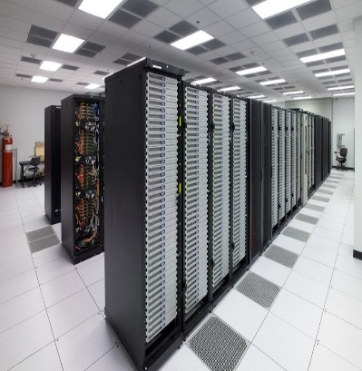







Introduction
  Data centers are important infrastructures to support various cloud computing services.
    Web search
    Email
    Video streaming
    Social networking
    Distributed file systems
    Distributed data processing
Notes:
The data center networks (DCNs) specify how servers and various other components are interconnected in data centers.
DCNs have a significant influence on the quality of data center’s services.

Slide 4
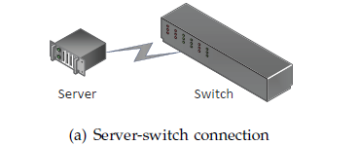
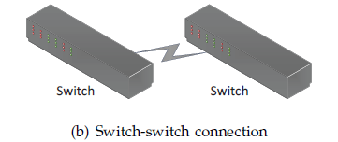
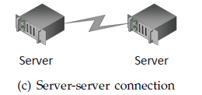
Introduction
Three types of connections:
  Server-switch connection (a)
  Switch-switch connection (b)
  Server-server connection (c)
Two classes of DCNs:
  Switch-centric
    Only server-switch and switch-switch connections (a and b), no server-server
    Eg, Fat-Tree , Flattened Butterfly
  Server-centric
    Mostly, only server-switch and server-server connections (a and c), no switch-switch
    Eg: BCube, FiConn, DCell
Notes:
Switch-centric: only server-server and switch-switch connections. Each server only use one NIC port to connect to switches.
Server-centric: only server-switch and server-server connections; no switch-switch connections.

Slide 5
Introduction
Switch-centric vs. Server-centric
  Server-centric architectures
    enjoy the high programmability of servers, but servers usually have larger processing delays than do switches.
  Switch-centric architectures
    enjoy the fast switching capability of switches, but switches are less programmable than servers.
  Can we combine the advantages of both categories?

Slide 6
Introduction
Performance vs. Power Consumption
  To provide low end-to-end delays and high bisection bandwidth
    Large numbers of networking devices are usually used in DCNs.
    E.g, Fat-Tree: three levels of switches; BCube: three or more levels & extra Network Interface Card (NIC) ports.
  To achieve a low DCN power consumption
    Other architectures use significantly fewer networking devices.
    E.g, FiConn, DPillar etc.
  Can we achieve high performances and low power consumption at the same time?

Slide 7
Introduction
  Overview
  Unified performance model
    Path length (and hence diameter)
    Power consumption
  A new category of DCN architectures: Dual-Centric
    FCell and FSquare
    Achieving tradeoffs in the design spectrum
  A range of DCN architectures
    Comparison of existing architectures under our unified performance models

Slide 8
Agenda
Introduction
Unified Performance Model
Dual-Centric DCN Architectures
  FCell and FSquare
Comparisons of DCN Architectures
Simulations
Conclusion and Future Works

Slide 9


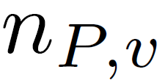

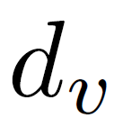

Unified Performance Model
  Unified Path Length Definition:
  Unified Diameter in a DCN:
: # of switches in a path
: # of servers in a path (excluding s and d)
: processing delay on a switch
: processing delay on a server
Notes:
Typical value for d_w : 2 us
Typical value for d_v: depands on how the packet forwarding engine is implemented. Can be close to 2 us if it is implemented by hardware; Can be 10 us or even greater if it is implemented by software.
Thus, d_v can be 1 to several times of d_w.

Slide 10







Unified Performance Model
  DCN Power Consumption per Server:
: power consumption of a switch
: # of switches in a DCN
: # of servers in a DCN
: average # of NIC ports each server uses
: power consumption of a NIC port
: whether the server is involved in packet relaying
: power consumption of a server’s packet forwarding
Notes:
Typical value for p_w: 150 Watts
Typical value for p_nic: 2 Watts
Typical value for p_fwd: depends on how the forwarding engine is implemented; for software based implementation: about 2 to 5 Watts

Slide 11
Unified Performance Model
  Bisection Bandwidth (B):
    The minimum number of links to be removed, to partition all servers in the network into two “equal” halves.
      When the total number of servers is odd, the sizes of the two halves should differ by 1.
Notes:
Actually, just partition all the servers into two halves. Do not need to partition all the switches into two halves.

Slide 12
Agenda
Introduction
Unified Performance Model
Dual-Centric DCN Architectures
  FCell and FSquare
Comparisons of DCN Architectures
Simulations
Conclusion and Future Works

Slide 13
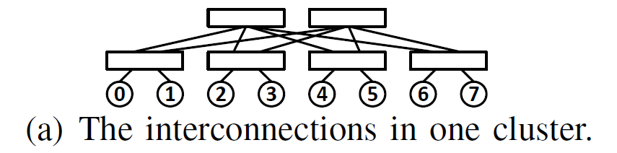
Dual-Centric DCNs: FCell
  Intra-cluster
      The switches and servers form a simple instance of the folded Clos topology. We call it a cluster.
      All switches are with n ports.
      There are n level 1 switches, and n/2 level 2 switches.
      Each level 1 switch uses n/2 ports to connect to n/2 servers, and n/2 ports to connect to n/2 level 2 switches.
(n = 4)

Slide 14
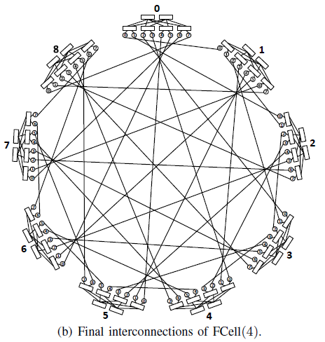
Dual-Centric DCNs: FCell
  Inter-cluster
      Each of the servers in a cluster is directly connected to another server in each of the other clusters.
  Each server has 2 NIC ports and each switch has n ports
      (n/2)n servers in each cluster.
      Total (n/2)n+1 clusters.

Slide 15
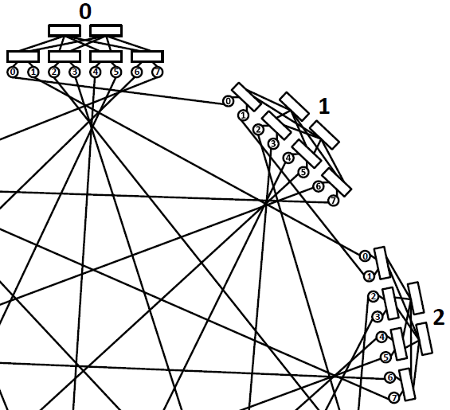
Dual-Centric DCNs: FCell
  Routing in FCell
    Shortest Path Routing:
      Determines the relay servers.
      Source to relay 1 in the source cluster.
      Relay 1 to relay 2.
      Relay 2 to destination in the destination cluster.
source
relay 1
relay 2
destination

Slide 16
Dual-Centric DCNs: FCell
    Detour Routing:
      Randomly select a relay cluster.
      Conduct shortest path routing from the source cluster to the relay cluster.
      And then, from relay cluster to destination cluster.
source
random relay cluster
destination
Notes:
We have (n^2/2 – 2) server-exclusive parallel paths for source and destination that are not in the same cluster.
Reason: we have n^2/2 clusters in total. We can choose a relay cluster from (n^2/2 – 2) clusters.

Slide 17
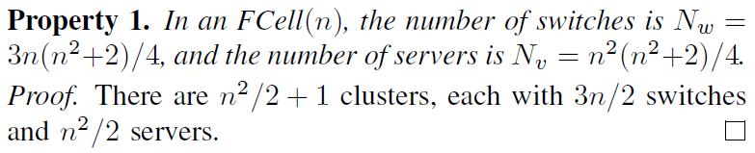

Dual-Centric DCNs: FCell
  FCell basic properties:
Notes:
Property 3: all clusters of FCell forms a complete graph. The bisection bandwidth is approximate to partition the complete graph into two halves.
Property 4: N_w / N_v = 3 / n.

Slide 18
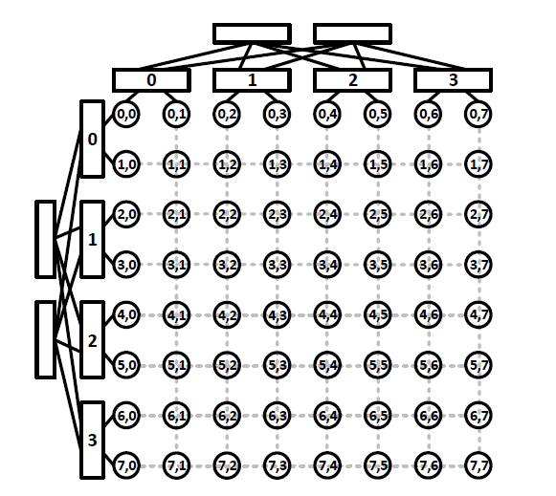
Dual-Centric DCNs: FSquare
  FSquare(n)
  Each column and each row form the same cluster as in FCell.
  i.e., in each cluster, the set of n/2 level 2 switches and the set of n level 1 switches form a complete bipartite graph.
Notes:
Folded Clos

Slide 19
Dual-Centric DCNs: FSquare
  Routing in FSquare(n):
    If source and destination are in the same row (or the same column).
    Routing only need to go through the switches in the row cluster (or the switches in the column cluster).
source
destination
destination
Notes:
After construct the Fsquare architecture, we now consider the shortest path routing in Fsquare.

Slide 20
Dual-Centric DCNs: FSquare
  Routing in FSquare(n):
If source and destination are not in the same row and not in the same column.
Row first or column first, or based on traffic condition within the row or column.
source
0
0
destination
Notes:
Both servers and switches in Fsquare have same degree of routing intelligence, so the fast switching capability of switches and the high programmability of severs can be utilized.

Slide 21



Dual-Centric DCNs: FSquare
  FSquare Basic Properties
Notes:
Property 3: Cut each row cluster into two halves is n^2/4. There are n^2/2 rows. Thus, n^2/4 * n^2/2 = n^4/8 = N_v/2.
Property 4: N_w/N_v = 6/n.

Slide 22
Agenda
Introduction
Unified Performance Model
Dual-Centric DCN Architectures
  FCell and FSquare
Comparisons of DCN Architectures
Simulations
Conclusion and Future Works

Slide 23
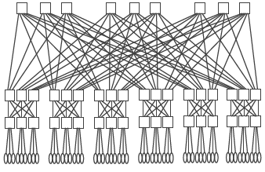
Comparisons of DCN Architectures
  Existing architectures:
    Switch-centric
      Folded Clos with k levels of n-port switches (FDCL(n, k)).
      Flattened Butterfly (FBFLY(r, k, c)): switches form a generalized hypercube; then each switch connects to c servers. r: the number of switches in each dimension; k: the number of dimensions.
FDCL(6, 3)
FBFLY(8, 1, c)
Notes:
These existing architectures can be gone through quickly.

Slide 24
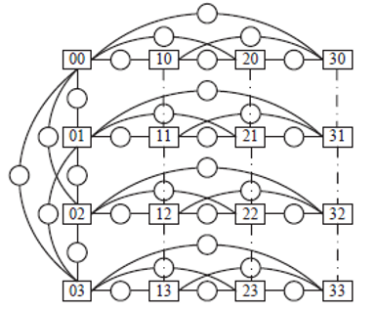
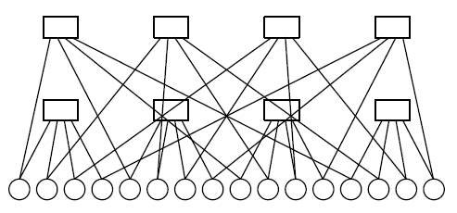
Comparisons of DCN Architectures
  Existing architectures:
    Server-centric:
      BCube(n,k): with n-port switches and k levels.
      SWCube(r, k): switches form a generalized hypercube; then, servers are inserted into the links between switches. k is the number of dimensions. Each dimension has r switches.
BCube(4,2)
SWCube(4, 2), n = 6.

Slide 25
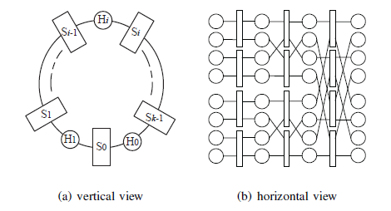
Comparisons of DCN Architectures
  Existing architectures:
    Server-centric:
      DPillar(n, k): n-port switches and k levels (k columns/pods).
DPillar(4, 3) (the first column and the last column are overlapped.)

Slide 26
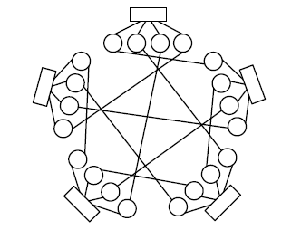
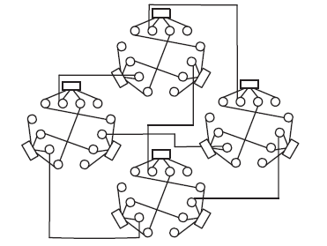
Comparisons of DCN Architectures
  Existing architectures:
    Server-centric:
      DCell(n, k): n-port switches and k levels.
      FiConn(n, k): n-port switches and k levels.
DCell(4, 2)
FiConn(4, 3)
Notes:
Multiple ports vs. 2 ports
Hiearchical (using extra port for servers for Dcell, reserve one port in dual-port FiConn)

Slide 27
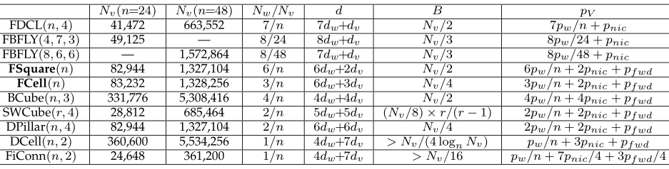
Comparisons of DCN Architectures
Notes:
d_v: processing delay on servers
d_w: processing delay on switches.
p_V: DCN power consumption per server.
d_v is 1 to several (can be 5 or 10) times of d_w
From top to bottom, in an overall trend, the diameter increases; the bisection bandwidth decreases; the power consumption decreases.

Slide 28
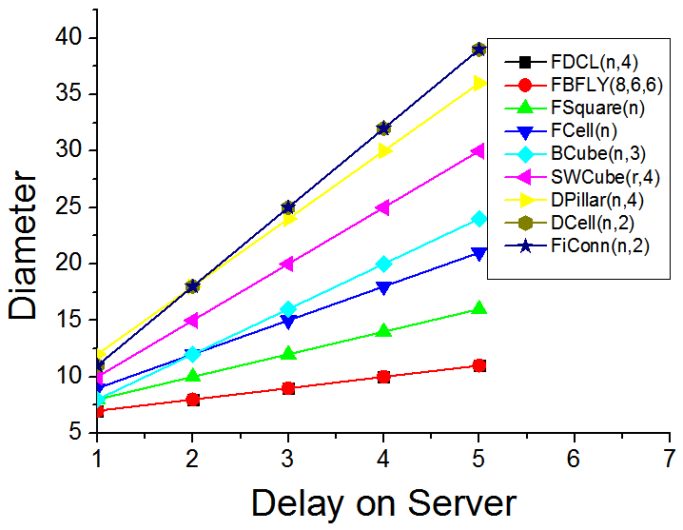
Comparisons of DCN Architectures
Notes:
We vary delay on server from 1 to 5, and compare the diameters of different architectures.
Sever-centric architectures (FiConn, DCell, DPillar, SWCube, and even BCube) usually have large diameters due to multiple servers in a path.
Switch-centric architectures (FDCL, and FBFLY) usually have low diameters because no servers are helping forward packet in the DCN.
FSquare and FCell serve as tradeoff designs in the spectrum.

Slide 29
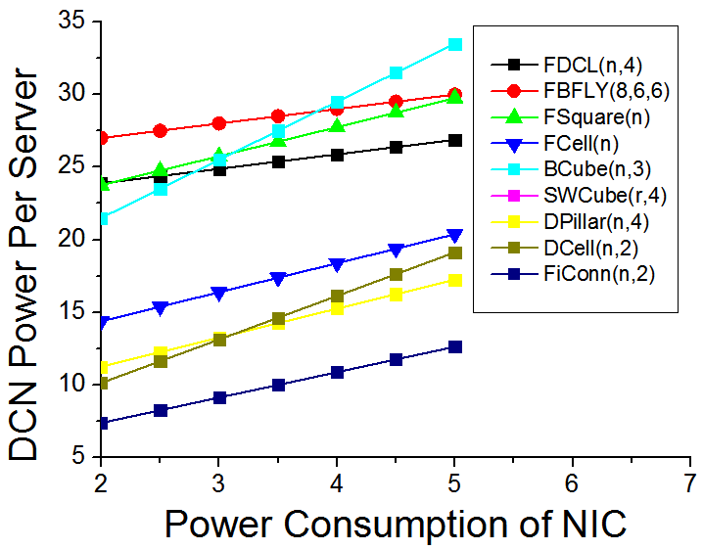
Comparisons of DCN Architectures
Notes:
We vary the power consumption of server’s NIC port from 2 to 5, and compare different architectures’
DCN power consumption per server, P_v.
Switch-centric architectures (FDCL, FBFLY) usually have high power consumption per server.
Server-centric architectures usually have low power consumption per server due to reduced number of switches.
FSquare and FCell serve as tradeoff designs in the spectrum.

Slide 30
Agenda
Introduction
Unified Performance Model
Dual-Centric DCN Architectures
  FCell and FSquare
Comparisons of DCN Architecture
Simulations
Conclusion and Future Works

Slide 31
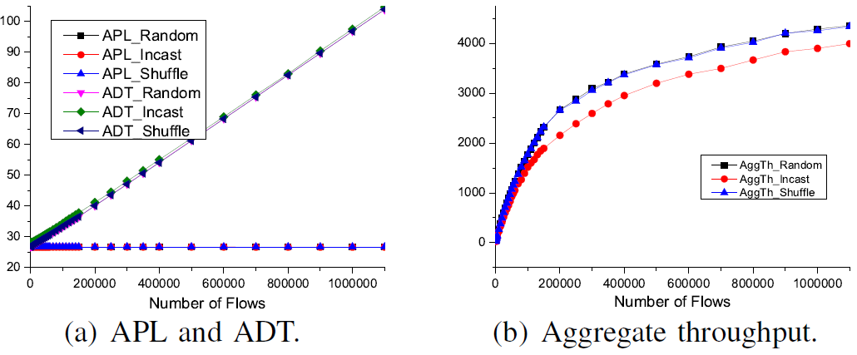
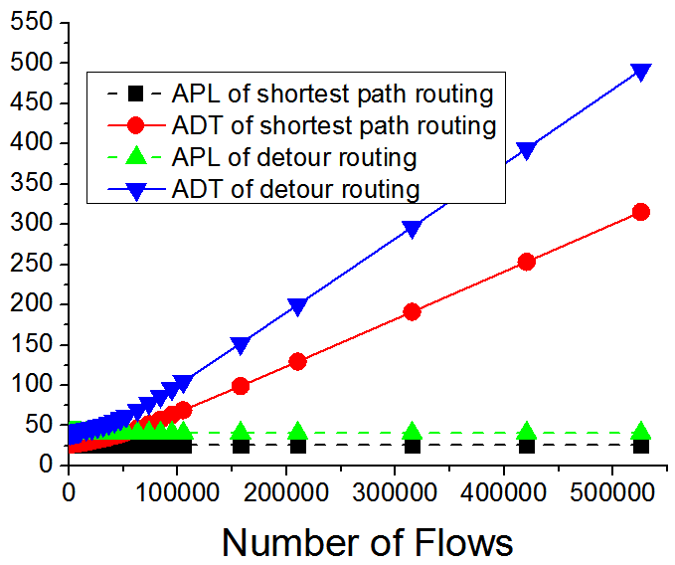
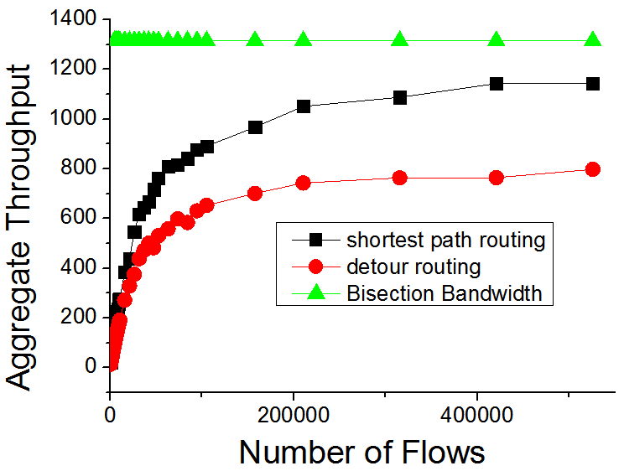
Simulations
  Simulations for FCell
    Random traffic and bursty traffic.
    Metrics: Average Path Length (APL), Average Delivery Time (ADT), and Aggregate Throughput (amount of flow delivered in a unit time).
Simulations for random traffic: the performances of shortest path routing and detour routing demonstrate graceful degradation.
ADT increases linearly with the number of flows.
Throughput tends to saturated when # of flows is large
Notes:
Upper bound of the aggregate throughput is the bisection bandwidth B = Nv/4 = 1,314.
When the number of flows is 525,600, SRouting achieves an aggregate throughput of 1,142.6, which is 87.96% of the Bisection Bandwidth.
Detour routing: 60.88%.
Simulation part can be briefly described.

Slide 32
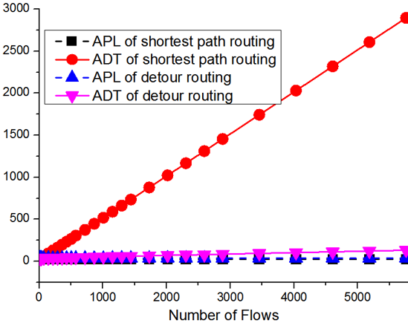
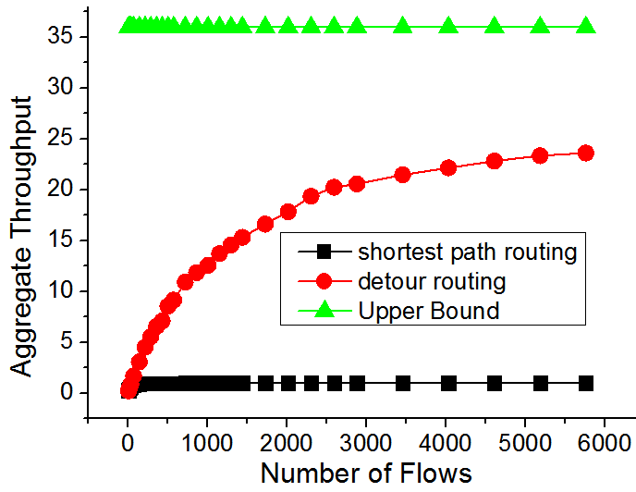
Simulations
  Simulations for FCell
Simulations for bursty traffic: the performances of shortest path routing is poor; detour routing significantly improves the performances.
ADT increases linearly with the number of flows.
Throughput is upper bounded by the servers’ sending and receiving capability.
Notes:
In the bursty traffic model. The aggregate throughput is also upper bounded by the servers’ sending and receiving rate.
If on average, only half of the servers are sending packets at each time unit, it indicates an upper bound of N_v^{cluster} / 2 = 36.
We achieve 66.67% of the upper bound.
Simulation part can be briefly described.

Slide 33
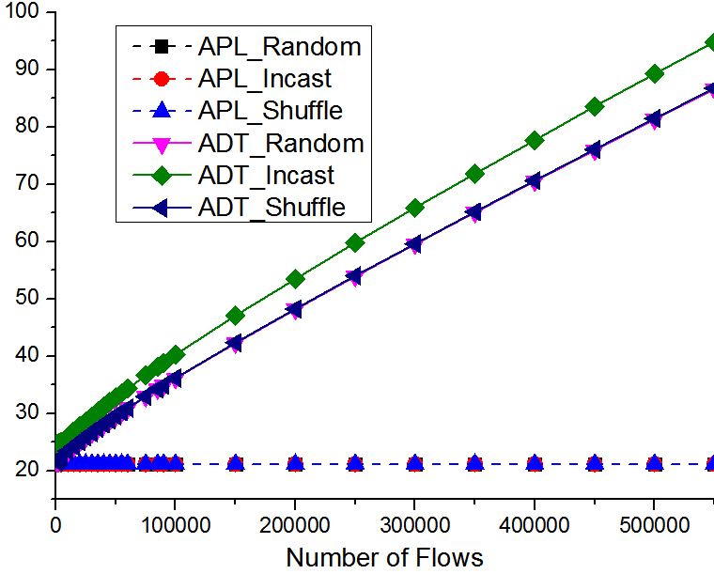
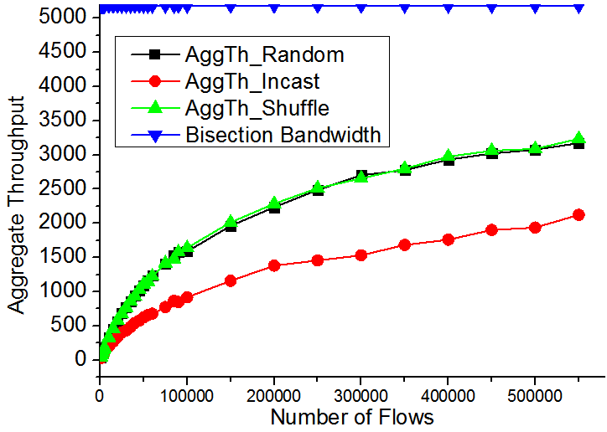
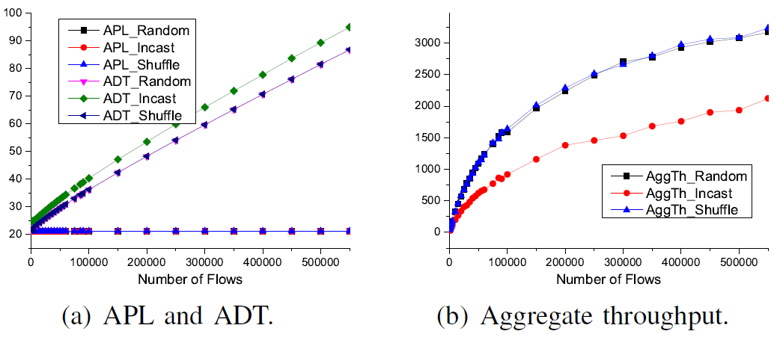
Simulations
  Simulations for FSquare
The shortest path routing demonstrates good performances under various traffic conditions.
Randon, Incast (same destination), Shuffle
ADT increases linearly with the number of flows.
Throughput tends to saturated when # of flows is large.
Incast throughput is lower because high congestion increases delivery time and thus reduces throughput.
Notes:
Random: both source and destination are randomly chosen.
Incast: A server receives traffic flows from multiple random servers in the network. (we let 10 servers sending traffic to one server)
Shuffle: Servers in a rack send traffic flows to servers in several different racks.
FSquare(12): Nv=(12^4)/4 = 5184. B = Nv/2 = 2592;
Since the links are bidirectional in our simulation, the Bisection Bandwidth is 5184.
Simulation part can be briefly described.

Slide 34
Conclusion and Future Works
Conclusion
A unified path length definition and a unified power consumption model for general DCNs
  Enabling fair and meaningful comparisons
A new class of DCNs, that can be regarded as dual-centric, with FCell and FSquare as examples.
  Basic routing schemes
  Performance under different traffic conditions
Tradeoff designs for DCN architectures
  Performance and power, switch-centric and server-centric designs

Slide 35
Conclusion and Future Works
Future Works
Designing efficient and/or adaptive routing schemes for Fcell, Fsquare, and their extensions.
Exploring other possible dual-centric architectures that also have appealing properties.
Designing dual-centric architectures where each server uses more than 2 NIC ports.
Exploring the limitations of the dual-centric design philosophy, and how to control and apply them in practical DCN designs

Slide 36
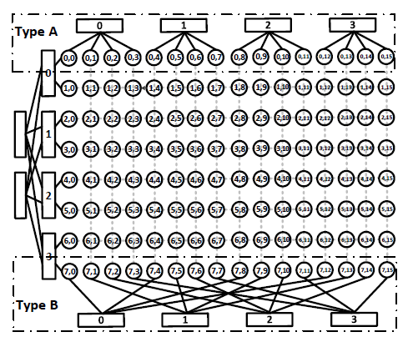
Dual-Centric DCNs: FRectangle
    Frectangle (an extension of Fsquare)
      The switches and servers in each column form the same cluster as in FCell.
      Switches and servers in each row can adopt Type A or Type B connections.

Slide 37
Dual-Centric DCNs: FRectangle
    FRectangle
      FRectangle chooses from the 2 types of interconnections in an interleaved fashion.
      Denote a_{i,j} as the server in the ith row and jth column.
      If i % 2 = 0, type A row.
      If i % 2 = 1, type B row.

Slide 38



Dual-Centric DCNs: FRectangle
    FRectangle Basic Properties

Slide 39
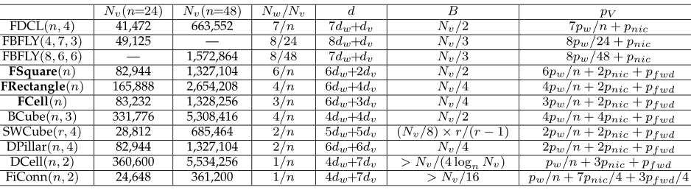
Comparison of DCNs with FRectangle
Notes:
d_v: processing delay on servers
d_w: processing delay on switches.
p_V: DCN power consumption per server.
d_v is 1 to several (can be 5 or 10) times of d_w
From top to bottom, in an overall trend, the diameter increases; the bisection bandwidth decreases; the power consumption decreases.

Slide 40
References
Dawei Li and Jie Wu, "FCell: Towards the Tradeoffs in Designing Data Center Network Architectures, " IEEE ICCCN, August 3 - August 6, 2015.
Dawei Li, Jie Wu, Zhiyong Liu and Fa Zhang, "Dual-Centric Data Center Network Architectures,” ICPP, September 1 - September 4, 2015.
Dawei Li and Jie Wu, "On the Design and Analysis of Data Center Network architectures for Interconnecting Dual-Port Servers," IEEE INFOCOM, April 27 - May 2, 2014.

Slide 41
Thank you!
Additional questions can be sent to:
jiewu@temple.edu

