Slide 1



Directional Flow Graph Framework
for Detecting Known and Unknown Malicious Traffic
DASFAA 2026
Yang Wu, Ruijia Wang, Mingyuan Zang, Jie Wu
China Telecom Cloud Computing Research Institute & Temple University

Slide 2
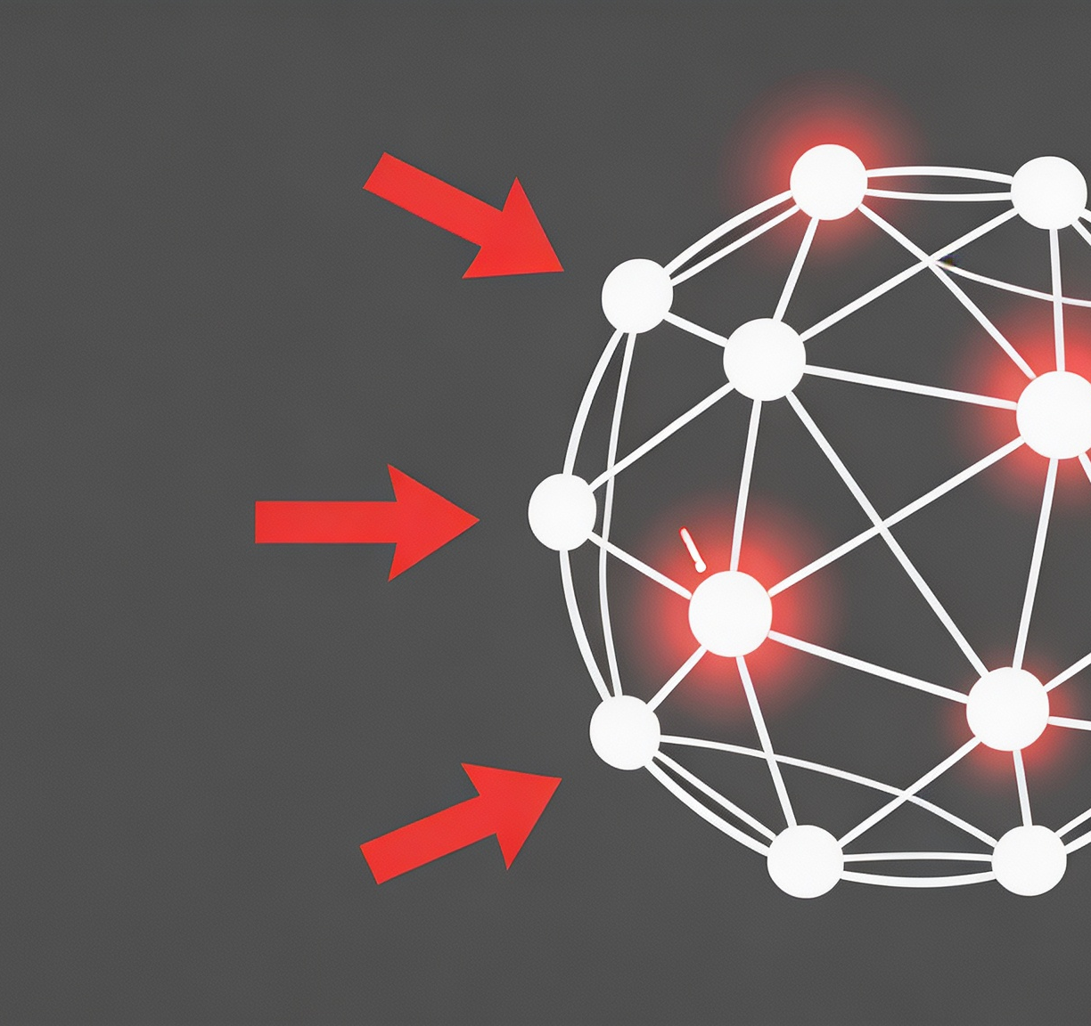
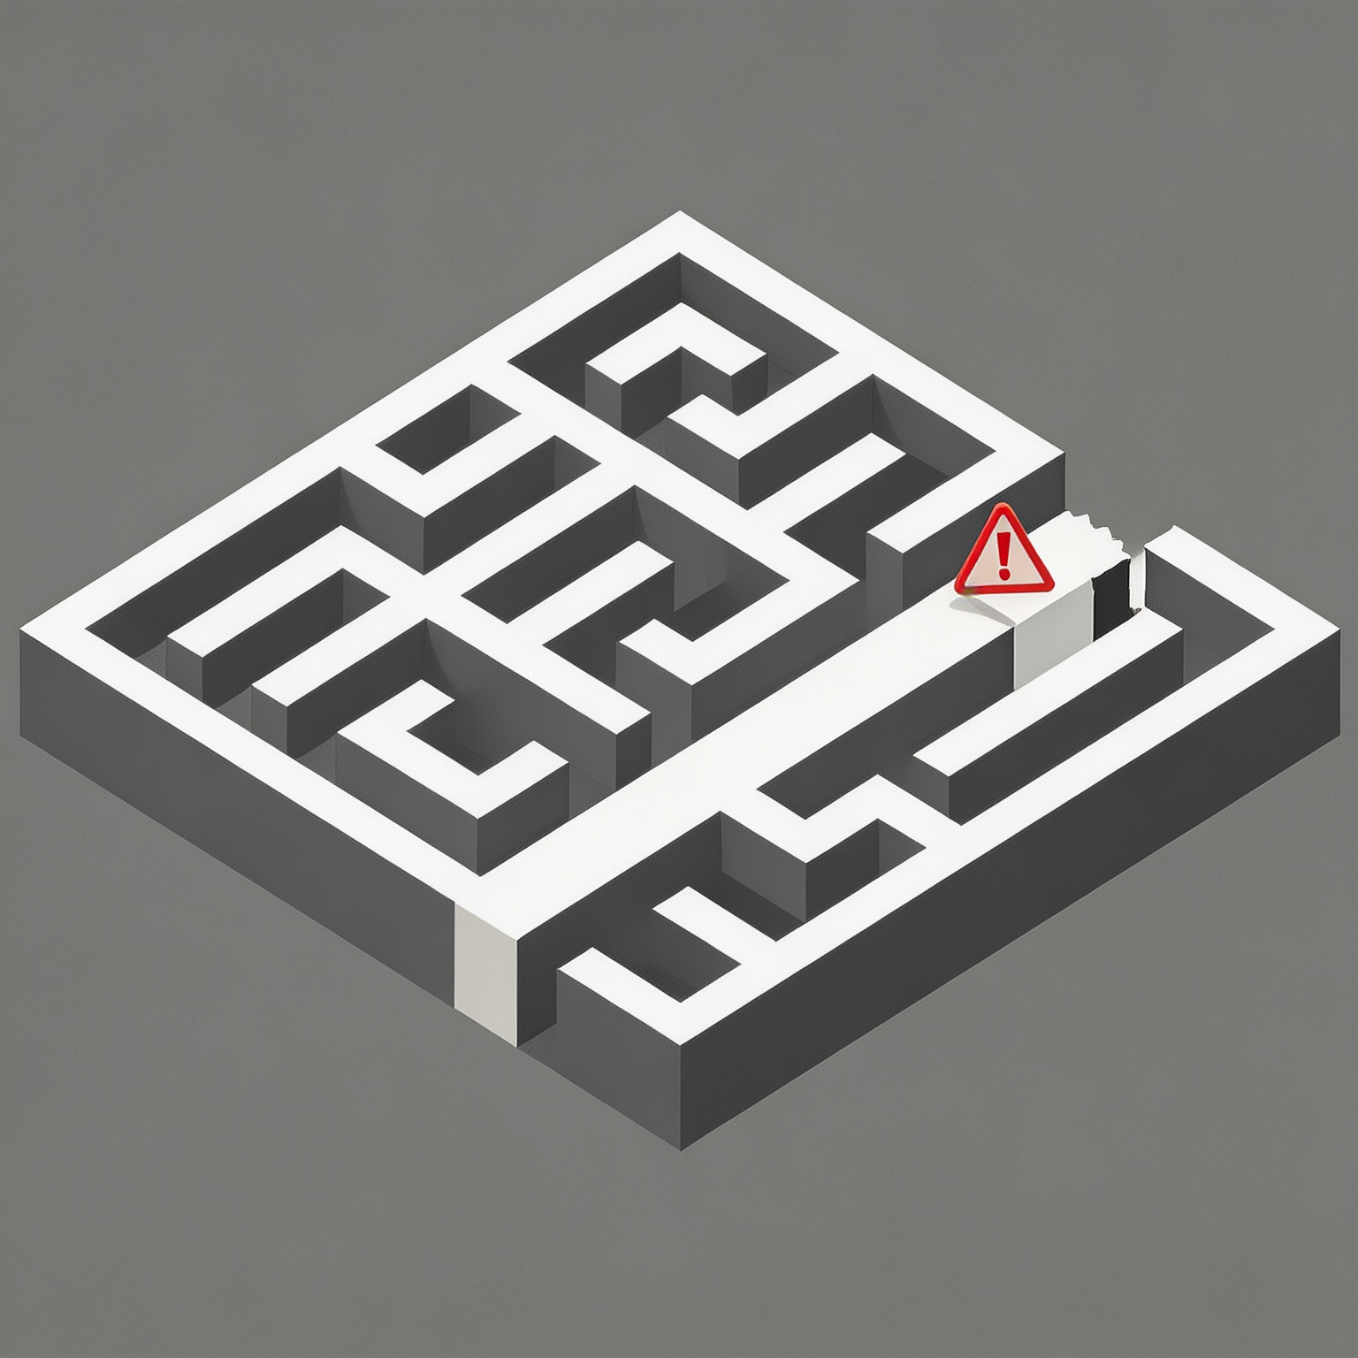
Background
01. Growing Security Challenges
02. The Dilemma of Traditional Methods
The increasing complexity and diversity of attack methods
﻿data breaches, service interruptions…
Rule-based systems have poor adaptability
Unknown attacks
Detecting Known and Unknown Malicious Traffic

Slide 3


Motivation
Supervised
✅
Known Attack
Unknown Attack
❌
Traffic Flow
Packet length
[40, 48, 48, 40, 48, 48]
Unsupervised
Known Attack
Unknown Attack
Packet direction
[1, -1, -1, 1, -1, -1]
❌
✅
Server
Client
Limitation 1: Feature representation information loss
Limitation 2: The single paradigm is weak
bidirectional traffic
undirected graphs or sequences
Supervised learning: Good at known attacks
Unsupervised learning: Good at unknown attacks
losing key temporal interaction patterns and structural dependencies

Slide 4



Idea and Contribution
Idea：DGNet (Directional Graph Network)
directed graph modeling + a hybrid learning paradigm
First work: Directional Flow Graph
A breakthrough to capture the deep structure information and time series information of the traffic at the same time.
Design: ﻿Directional Graph Isomorphism Networks (DIRGIN)
The GNN model is designed for a directional flow graph.
Build: An end-to-end Hybrid Learning Framework
Combining the advantages of supervised learning and unsupervised learning to achieve comprehensive detection.

Slide 5
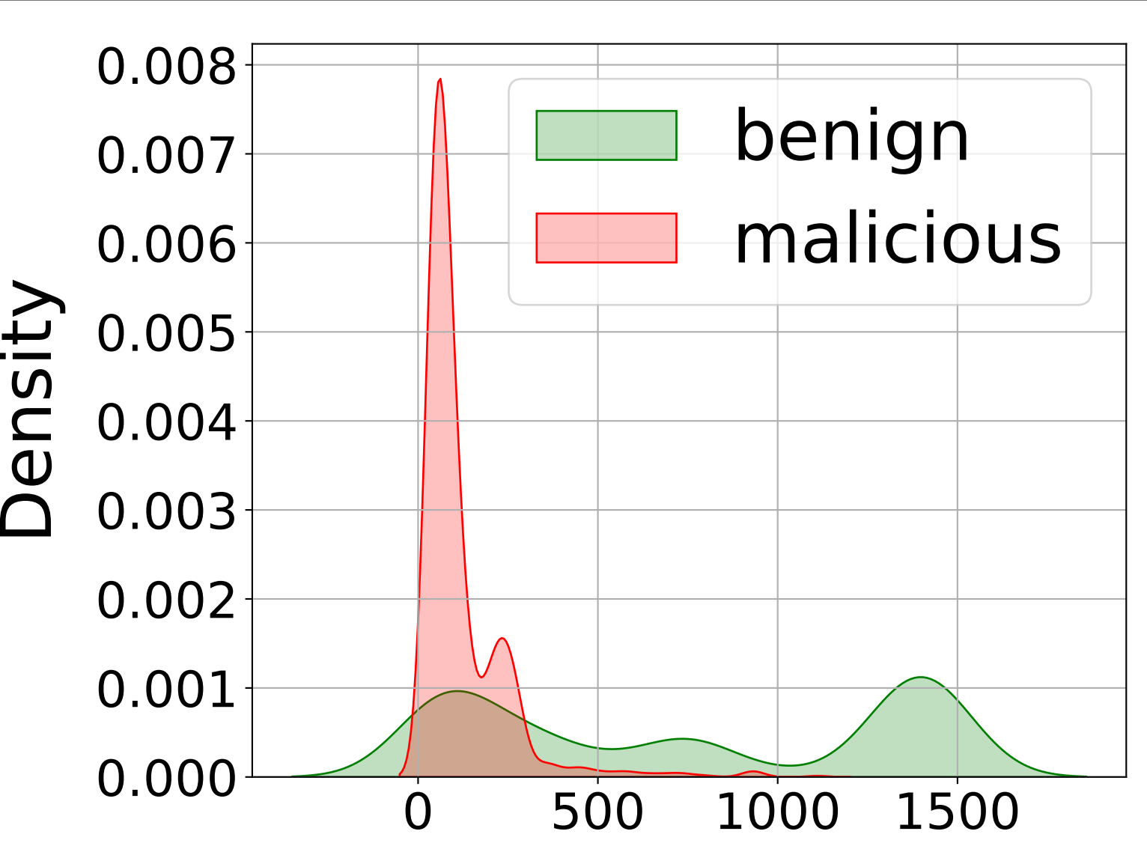
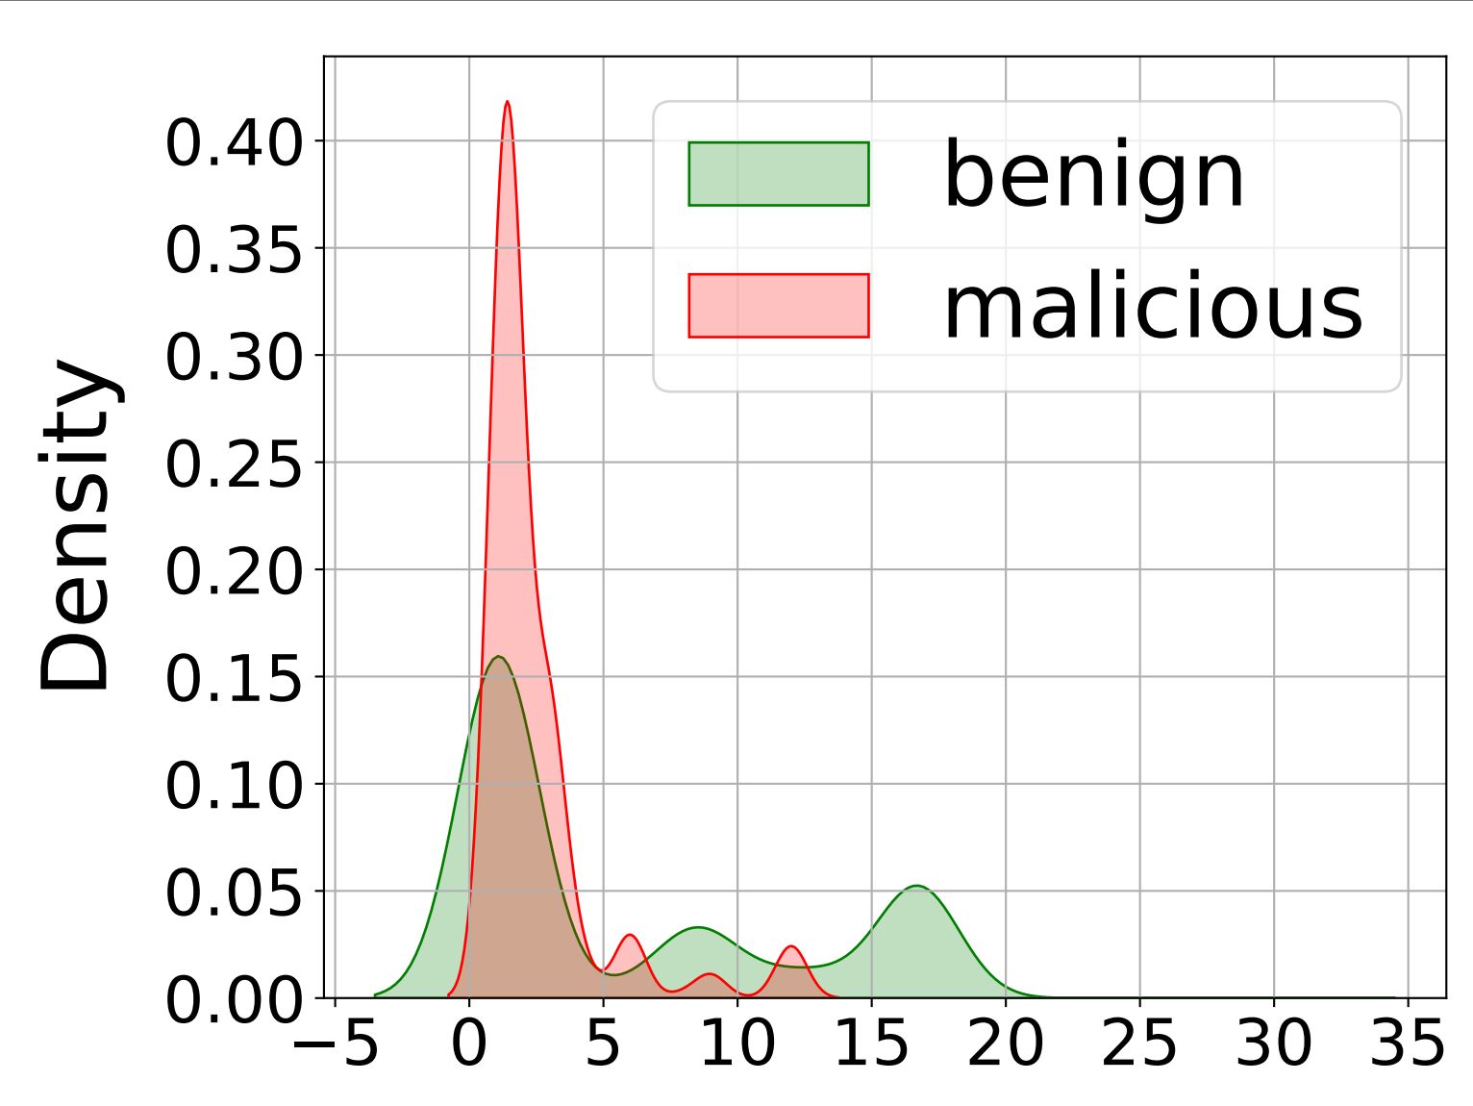
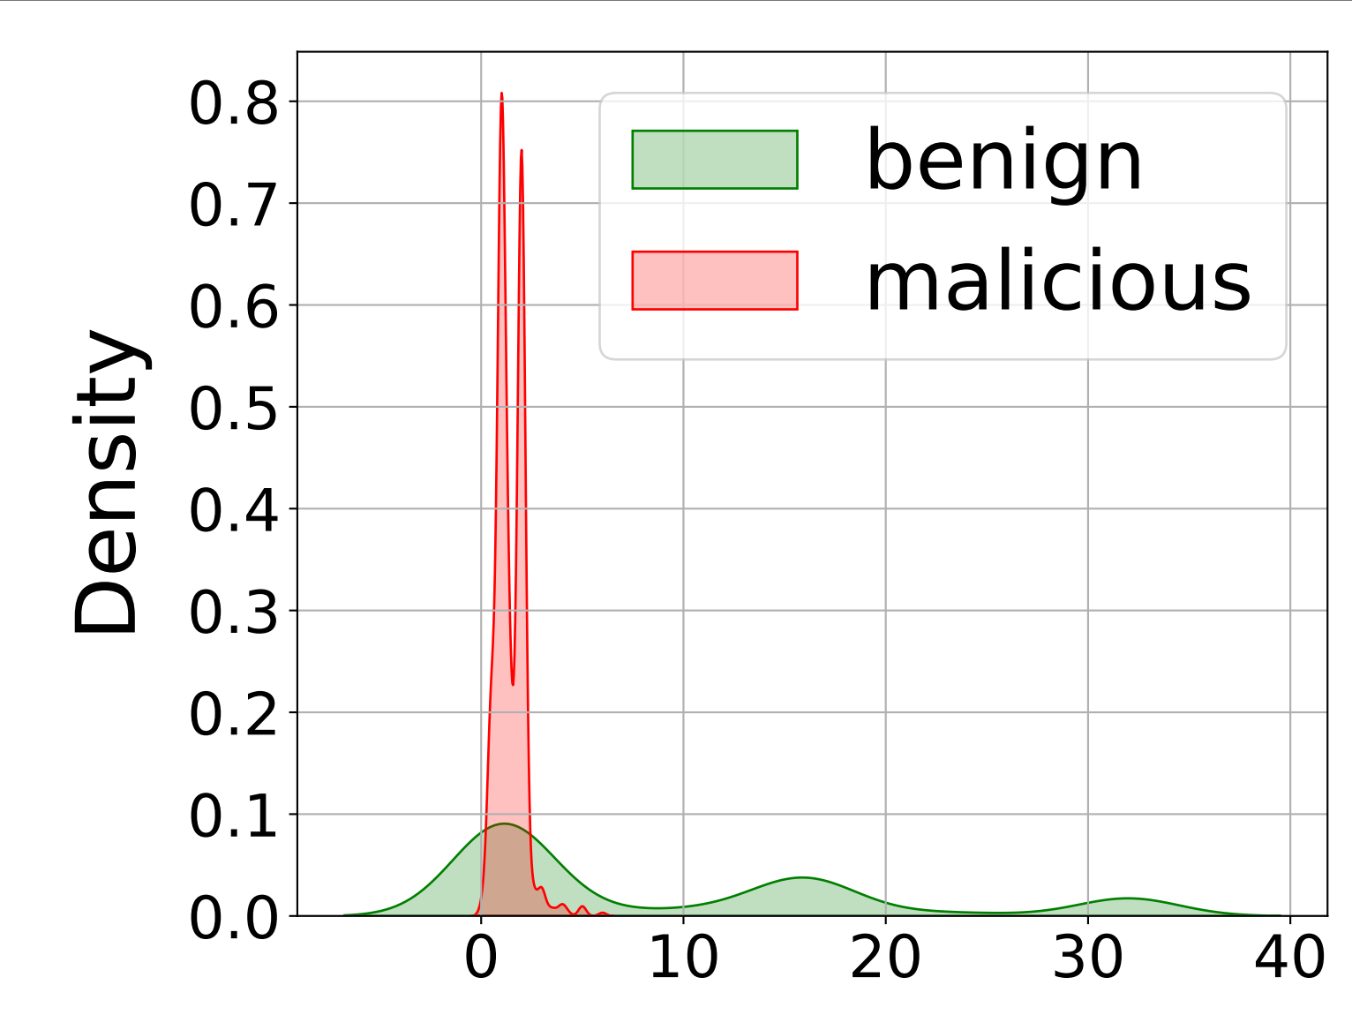
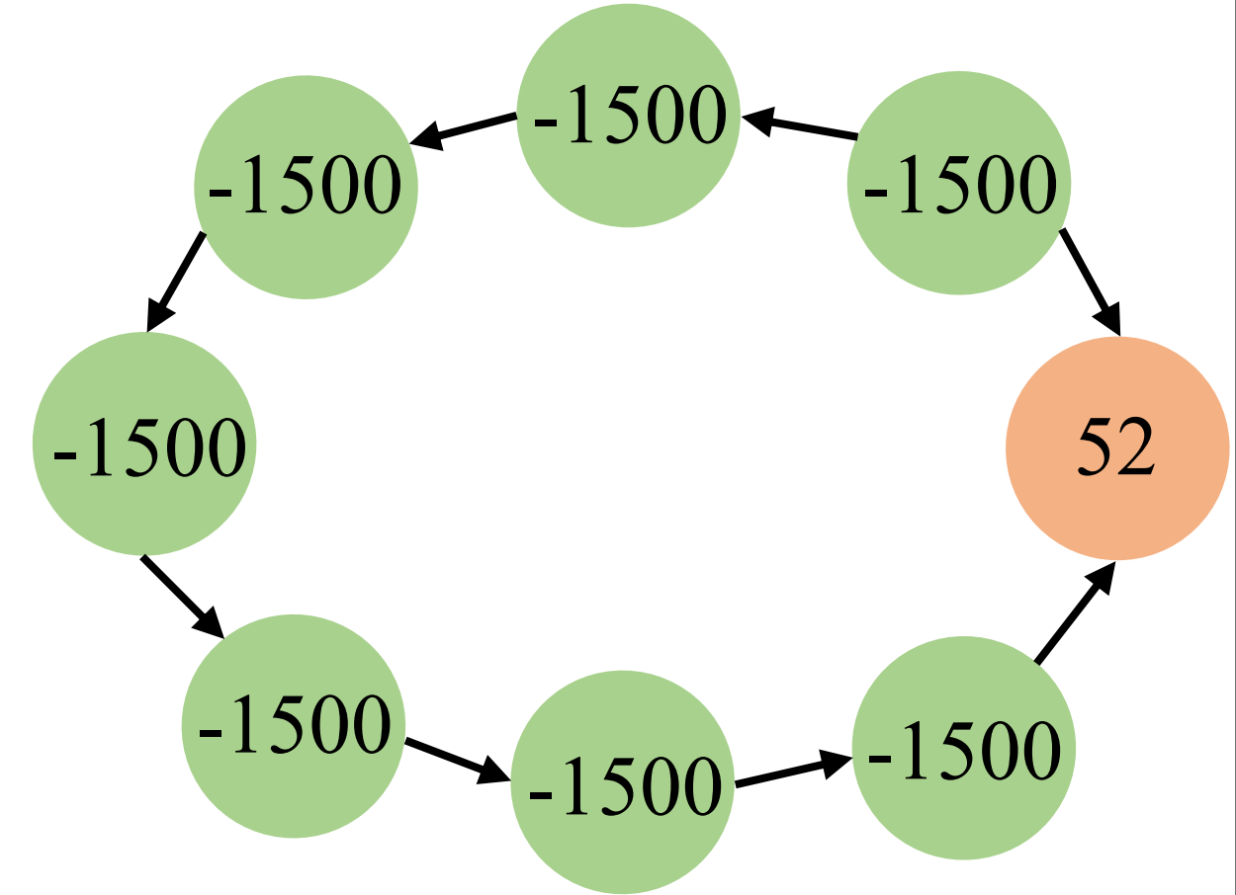
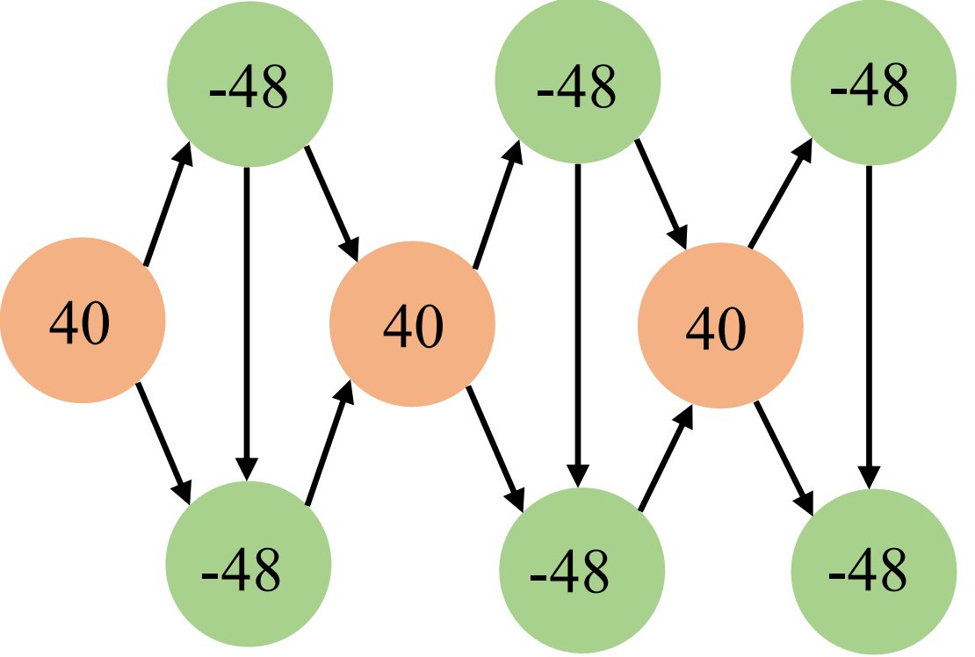
﻿Design Intuition: Traffic Pattern Differences
Packet length
Burst
﻿Down/Up Ratio
Benign
Malicious
Observation：USTC-TFC2016 dataset
Conclusion: Feasibility verification of the scheme
Examples of directional flow graphs for benign and malicious traffic. The directed graph pattern difference can effectively distinguish malicious traffic from benign traffic.
There are significant behavioral pattern differences between benign and malicious traffic in the three dimensions of the length distribution of the underlying packet interaction, burst frequency, and uplink and downlink ratio

Slide 6
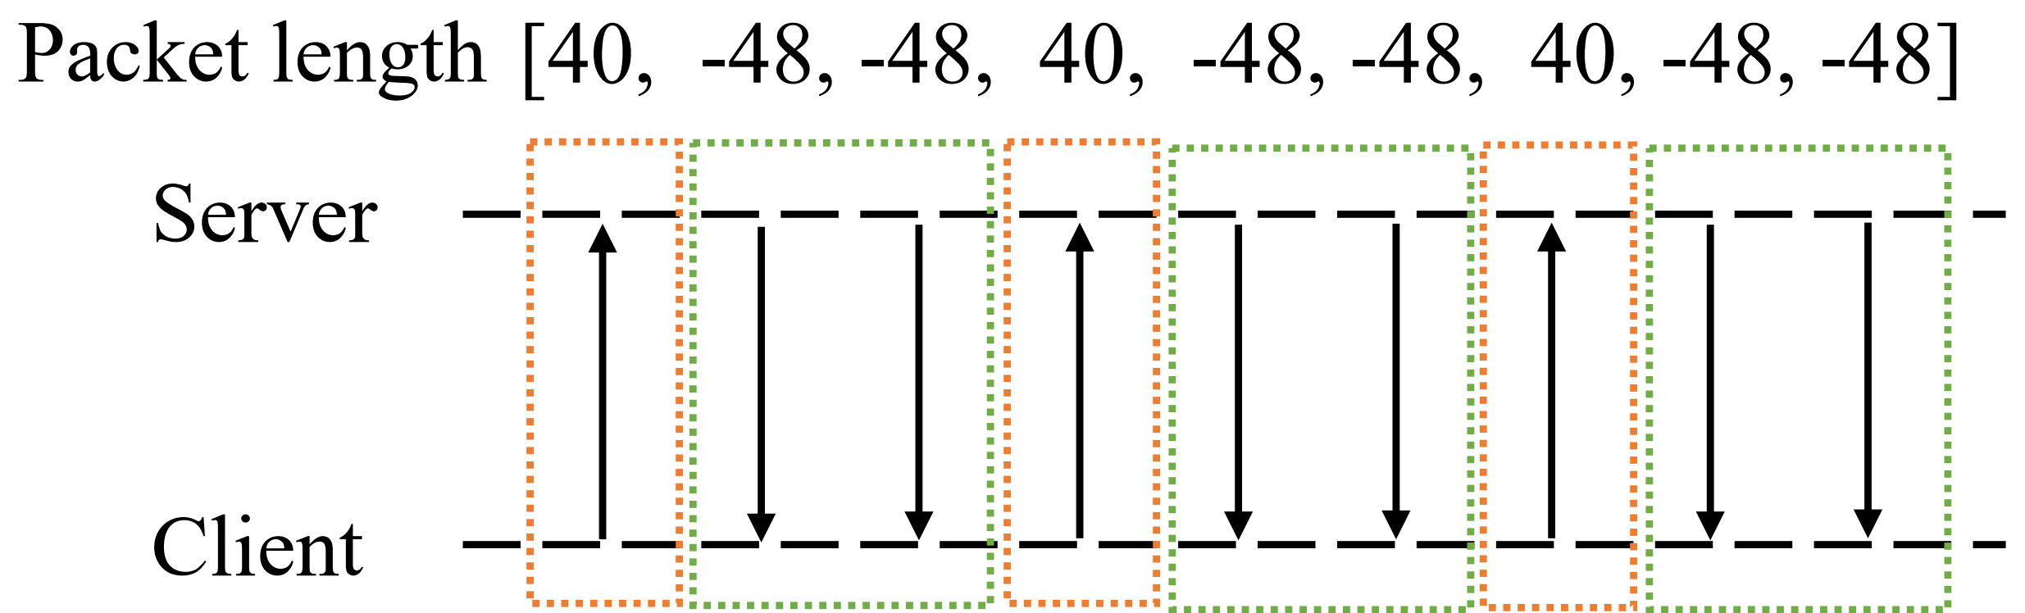


Method: Directional Flow Graph
How to build a directed flow graph?
Nodes: Data packet
Feature = packet length × direction (uplink =1, downlink =-1)
Bi-flow traffic
Edges: structured traffic sequences
Intro-Burst: sequential join;
Inter-Burst: head-to-head, tail-to-tail;
Advantage: Differentiation of behavioral patterns
It preserves the order and direction information of data packets, and can effectively distinguish the completely different bidirectional interaction behaviors.
Corresponding directional graph

Slide 7


Method: DGNet
① Supervised Learning
DIRGIN is used to train a classifier to accurately identify known attack behaviors in the system through labeled data.
② Unsupervised Learning
Copy the parameters of the DIRGIN encoder, and construct an autoencoder network to learn the deep feature patterns of benign traffic, so as to effectively find unknown attacks.
③ ﻿Inference and Detection
The supervised classification results and unsupervised reconstruction loss were combined to detect malicious traffic.

Slide 8

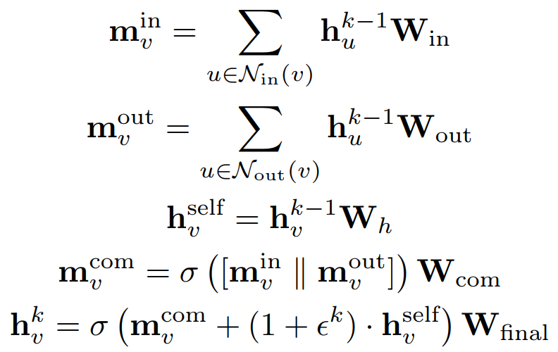




Method: DIRGIN Encoder
Why DIRGIN is needed？
Standard GNNS (such as GIN) ignore the directions of edges when dealing with directed graphs, and cannot distinguish incoming edges from outgoing edges, resulting in the loss of key interactive information such as requests and responses.
Core mechanism: Separation and aggregation of incoming and outgoing edges
Incoming edge
Outgoing edge
Information Fusion
$$m_{v}= Σ\left(h_{u}· W_{in}\right)$$
$$m_{v}= Σ\left(h_{u}· W_{out}\right)$$
The fully connected layer after concatenation
Core advantage: Accurate capture of causality
The “influencers” (incoming edges) and “influenced” (outgoing edges) of nodes are clearly distinguished.

Slide 9
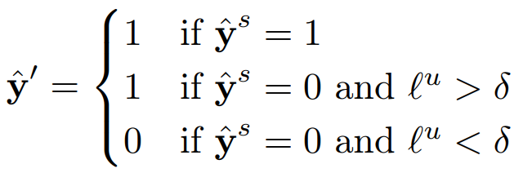
Method: Hybrid Learning and Inference
▍ Final decision logic
• If the supervised model predicts malicious, the result is directly determined to be malicious.
• If the supervised model predicts benign, the unsupervised model reconstruction loss is examined ：
-- loss> δ: unknown| loss < δ: benign
▍ Threshold δ
A Data-Driven Approach Based on Kernel Density Estimation (KDE)
The normal and malicious traffic reconstruction loss distribution bimodal valley or 95% quantile is chosen as the optimal threshold δ on the validation dataset.

Slide 10



﻿Experiment Settings
Datasets
Scenarios
Baselines
USTC-TFC2016
I: Known Attacks
📊 Supervised
FS-Net, GraphDAPP, Graph2Vec, FG-SAT
A classic malicious traffic benchmark dataset in the field of network security.
The training and testing set contains the same type of attack samples.
🔍 Unsupervised
Kitsune
CICIoT2024
II: Unknown Attacks
The large-scale dataset for IoT scenarios contains more complex attack behaviors and real network traffic characteristics.
The training and testing set contains completely different attack types.
⚖️ Hybrid
IoTArgos
🚀 Other SOTA
CVAE-EVT, ECNet

Slide 11
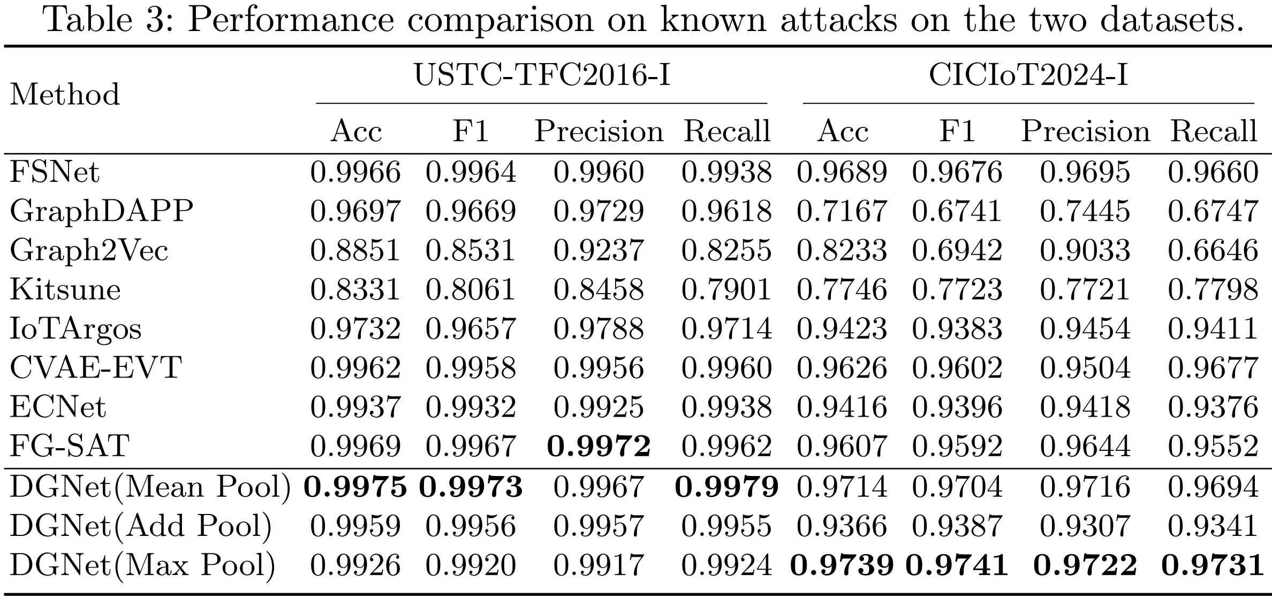


Experimental results: ﻿Known Malicious Traffic Detection
USTC-TFC2016-I
F1-Score
The benchmark attack detection scenario has a relatively canonical structure
0.9973
CICIoT2024-I
F1-Score
Complex real attack scenario
data distribution is more challenging
0.9741
The DGNet has ﻿the best results
DGNet > graph-based / sequence-based
Directed > Undirected
The direction information is effectively modeled, enabling DGNet to outperform similar graph-based baselines.

Slide 12
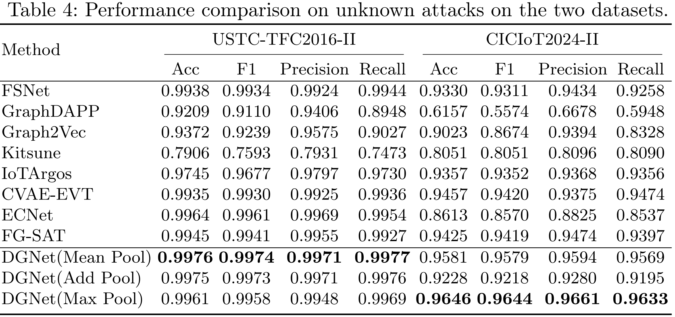
Experimental results: ﻿Unknown Malicious Traffic Detection
Excellent generalization ability
The performance degradation of DGNet is significantly lower than that of other comparison methods, demonstrating the strong robustness of the model under non-stationary data distribution.
Advantages of Hybrid Learning
It makes up for the performance deficiency of pure supervised learning on unknown samples.

Slide 13


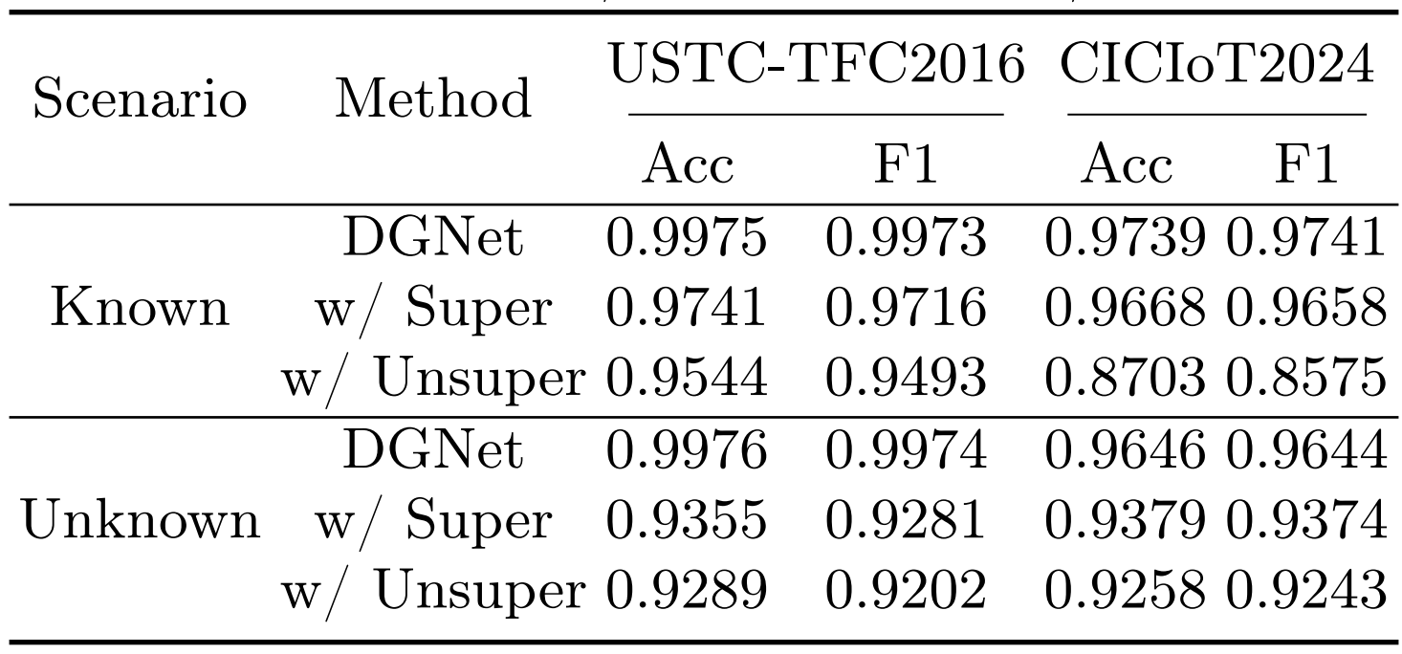
Experimental results: ﻿ablation study
w/ Super
w/ Unsuper
DGNet (Ours)
Only supervised
Only unsupervised
Supervised + unsupervised
It performs well in known attack scenarios, but decreases significantly when facing unknown attacks.
It is limited by the fuzziness of its feature representation; the overall classification accuracy is always lower than the supervised learning baseline.
It verifies the effectiveness and robustness of the hybrid architecture.
Validation of complementary
The two learning paradigms exhibit extremely strong complementarity in DGNet. 1+1 > 2

Slide 14
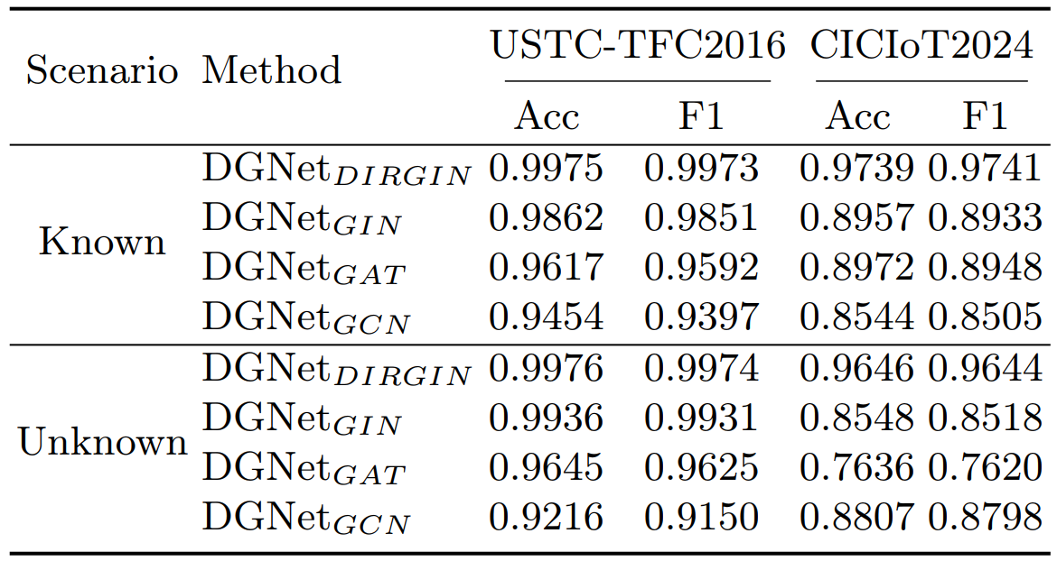
Experimental results: ﻿ablation study of GNN backbone
Only unsupervised
DIRGIN (Ours)
Dir + GIN
It performs better than other undirected GNNs.

Slide 15
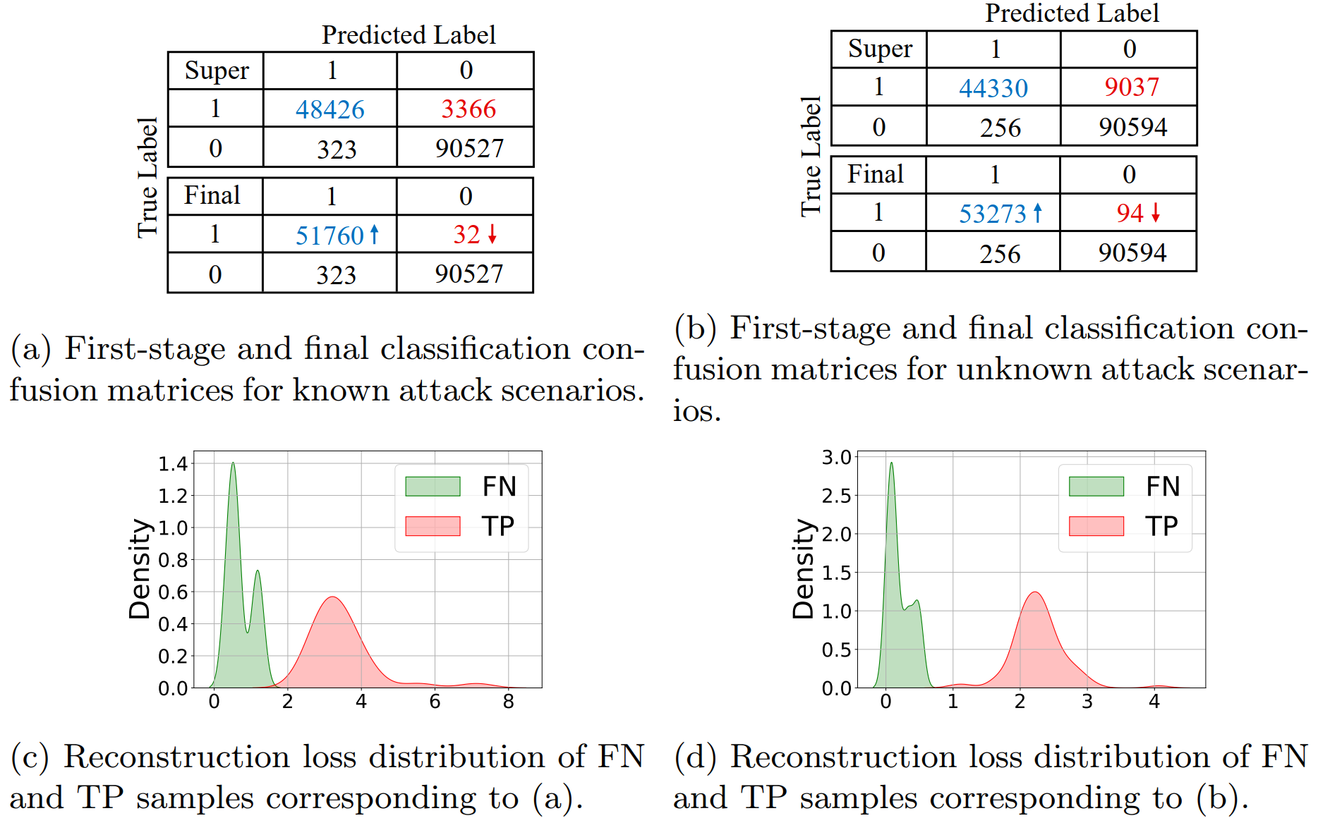
Experimental results: ﻿ Analysis of missed detection recovery
Substantial reduction in missed detections
•First step (only-super): a lot of missed attacks (FN). The model is not sensitive to some malicious samples.
•Final step (hybrid): after adding unsupervised learning, a large number of missed detections are successfully corrected.
Reconstruction Loss distribution: Characteristics of anomalous samples
The reconstruction loss for malicious samples (FN) missed by the supervised stage is significantly higher than that for benign samples, ﻿making them easier to detect.

Slide 16




Conclusion and Future Work
Conclusion
Future work
Innovative traffic representation
Model lightweight
The directional flow graph structure captures the spatial topology and time series characteristics.
Explore a more streamlined GNN architecture to adapt it to edge computing devices.
Targeted graph neural network learners
Real-time traffic detection
The DIRGIN module is designed to optimize the extraction and deep learning of edge direction information in directed graphs.
Optimize our stream-processing pipeline and model inference to achieve millisecond response times over high-speed network links.
Detection performance at the SOTA level
Combat sophisticated and covert attacks
Based on the hybrid learning framework, optimal results are achieved in both known-attack classification and unknown-attack detection tasks.
Extend the framework to deep-detection tasks for adversarial samples, encrypted traffic, and multi-stage APT attacks.

Slide 17

Thank You!
QUESTIONS & ANSWERS
CONTACT US
wuy92@chinatelecom.cn

