Slide 1
On the Design and Analysis of Data Center Network Architectures for Interconnecting Dual-Port Servers
Dawei Li and Prof. Jie Wu
Temple University

Slide 2
Outline
Introduction
Preliminaries
Maximizing the number of dual-port servers given network diameter and switch port number
SWCube
SWKautz
Related Existing architectures
On the Comparison of Various Architectures
Evaluation of SWCube and SWKautz
Conclusion

Slide 3
Introduction
The number of servers in modern and future data centers will tend to be very large.
Challenge: how to design network architectures to interconnect large numbers of servers, and also to meet the requirements of Data Center Networks (DCN).
Basic connections in a DCN:
Server-server
Server-switch (switch-server)
Switch-switch

Slide 4
Introduction
DCN architecture classification: based on whether the interconnection intelligence is put on switches or servers.
Switch-centric
Server-centric
Server-centric
More than two Network Interface Cards (NICs) are used: BCube, DCell
No more than two NICs are used: FiConn, HCN&BCN, Dpillar.

Slide 5
Introduction
Main contributions:
We propose the concept of Normalized Switch Delay (NSD), denoted by c, to unify the design and analysis of DCNs for dual-port servers.
We ask the following fundamental question: what is the maximum number of dual-port servers that any architecture can accommodate at most, given network diameter d, and switch port number n? And give an upper bound on this maximum number.
We propose two novel DCN architectures that try to achieve this upper bound. We also show that the two proposed architectures have good properties for DCNs.

Slide 6
Preliminaries
Some definitions:
A hop is a path, from one node to another node of the same kind, which consists of no other nodes of the same kind. Thus, we have switch-to-switch hops and server-to-server hops.
Server-to-server hops consist of server-to-server-direct hops and server-to-server-via-a-switch hops.
The length of a path between two servers is the number of server-to-server-direct hop(s), plus 1 + c times the number of server-to-server-via-switch hop(s) in the path.
The distance of two servers is the length of the shortest path between the two servers.
The diameter of a DCN architecture is the maximum distance among all pairs of servers.

Slide 7
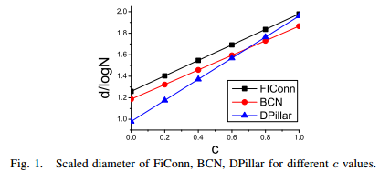
Preliminaries
A preview of the influence of NSD (c).

Slide 8
Maximizing the Number of Dual-Port Servers Given Network Diameter and Switch Port Number
Background
Moore bound: The maximum number of nodes in a graph, given diameter constraints, $d$ ,and node degree δ is :
$N≤1+δ+δ\left(δ−1\right)+…+δ{\left(δ−1\right)}^{d−1}=1+δ\sum_{i=0}^{d−1}{{(δ−1)}^{i}}$.
Illustration: any node can reach at most $δ$ other nodes within distance 1. Each of the $δ$ nodes can reach another $δ$-1 nodes within distance 2, because one degree has already been used for connecting to the original node. Extending to distance, the upper bound on the maximum number can be calculated.

Slide 9
Maximizing the Number of Dual-Port Servers Given Network Diameter and Switch Port Number
Consider a DCN architecture with dual-port servers when c = 0.

Slide 10
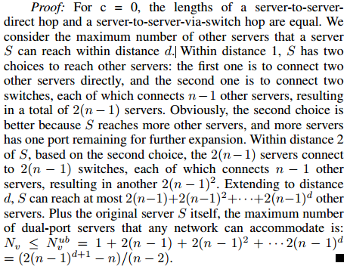
Maximizing the Number of Dual-Port Servers Given Network Diameter and Switch Port Number
Proof of Theorem 1

Slide 11
Maximizing the Number of Dual-Port Servers Given Network Diameter and Switch Port Number
when c != 0.

Slide 12
Maximizing the Number of Dual-Port Servers Given Network Diameter and Switch Port Number
The upper bound may not be achievable
Much less than $N_{v}^{ub}$=

Slide 13
Maximizing the Number of Dual-Port Servers Given Network Diameter and Switch Port Number
In traditional graphs, a $d$-dimensional $r$-ary generalized hypercube has diameter d and network order (the number of nodes in a network) $r^{d}$.
A Kautz graph with $r + 1$symbols and diameter d has network order $r^{d}+r^{d−1 }$.
These facts motivate us to design large order DCN architectures, based on the generalized hypercube and the Kautz graph.

Slide 14
SWCube
The Generalized Hypercube
A node W is represented by a k-tuple
Two nodes are connected directly by a link if and only if their addresses differ at one bit.
SWCube Construction
1.) replace the nodes in the original generalized hypercube with switches
2.) insert one server into each link that connects two switches

Slide 15
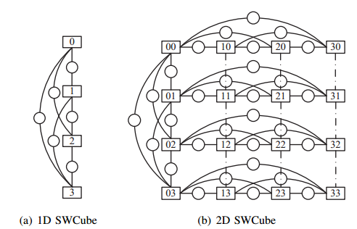
SWCube

Slide 16
SWCube
Properties
Lemma 1: The distance of two servers that are along the same dimension is at most 2.
Lemma 2: The distance of two servers that are not along the same dimension is at most k + 1.
Theorem 3: The diameter of an SWCube(r, k) is d = k+1.
Theorem 4: In terms of network diameter and switch port number, the number of servers in an SWCube(r; k) is

Slide 17
SWKautz
Kautz graph: A $k$-dimensional Kautz directed graph with $r+1$ symbols is denoted by $KA(r, k).$
The node set of $KA(r, k)$is given by all possible strings of length k where each symbol of the string is from the set $Z = \{0, 1, 2, · · · , r\}.$
Restriction: two consecutive symbols of the string are always different.
There exists a directed edge from node $W^{1}=w_{1}^{1}w_{2}^{1}…w_{k}^{1}$ to node $W^{2}=w_{1}^{2}w_{2}^{2}…w_{k}^{2}$ if and only if $W^{2}$ is a left shifted version of $W^{1}$, i.e., $w_{2}^{1}w_{3}^{1}…w_{k}^{1}=w_{1}^{2}w_{2}^{2}…w_{k−1}^{2}$, and $w_{k}^{2}≠w_{k−1}^{2}.$

Slide 18
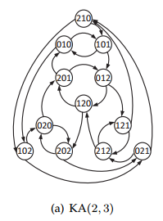
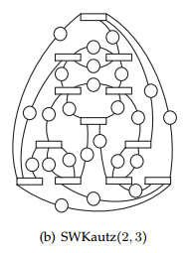
SWKautz
SWKautz construction
1.) replace each node in the original KA(n/2, k) graph with an n-port switch.
2.) remove the direction of all the edges and insert a server into each edge.

Slide 19
SWKautz
Properties
Theorem 5: The diameter of an SWKautz$(n/2, k)$ is $d = k + 1$.
Theorem 6: In terms of network diameter and switch port number n, the number of servers in an SWKautz$(n/2, k)$ is

Slide 20
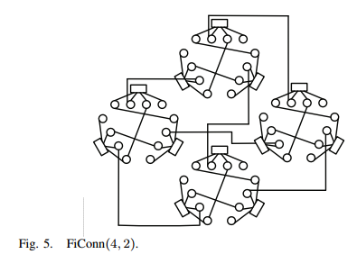
Existing architectures
FiConn

Slide 21
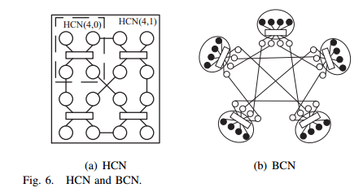
Existing architectures
HCN & BCN

Slide 22
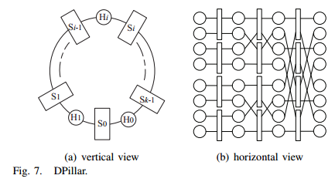
Existing architectures
DPillar

Slide 23
On the Comparison of Various Architectures
Design Flexibility
FiConn:
BCN:
Dpillar: d =
SWCube: $n = k(r − 1) = (d − 1)(r − 1),$it is only required that $d − 1$is a divisor of $n$.
SWKautz: allows the most flexible choice of network diameters because it can choose arbitrary positive integers independent of the switch port number.

Slide 24
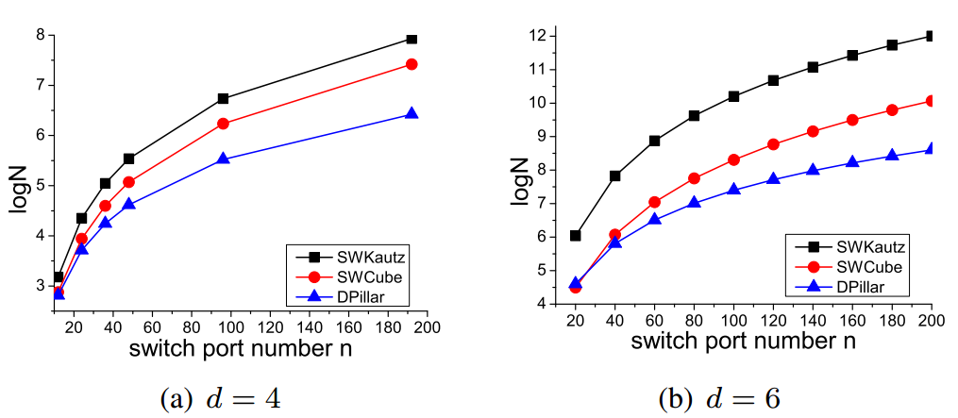
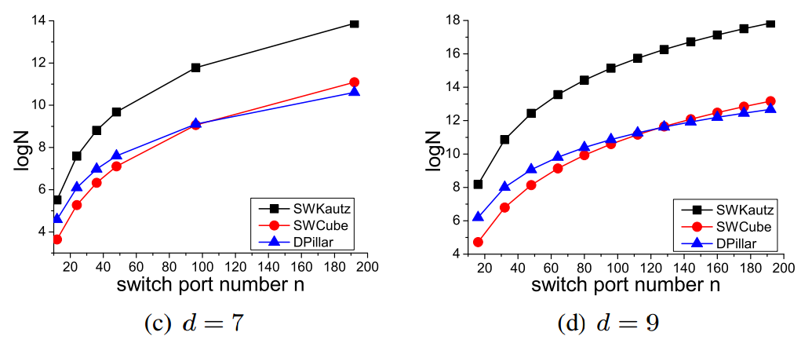
On the Comparison of Various Architectures
The Number of Servers Given d and n

Slide 25
On the Comparison of Various Architectures
Hardware Interconnection Cost per Server

Slide 26
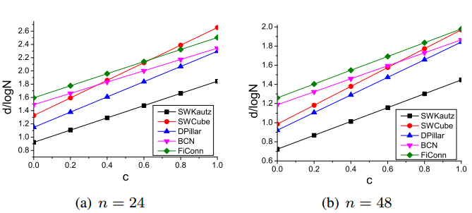
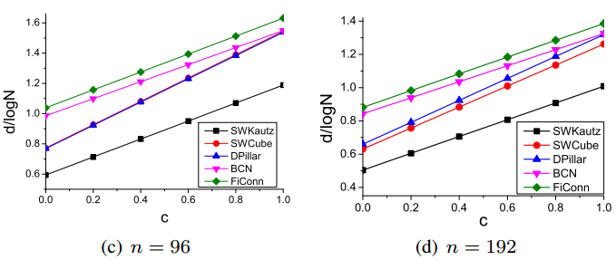
On the Comparison of Various Architectures
Influence of c on Various Architectures

Slide 27
Evaluation of SWCube and SWKautz
Routing Properties of SWCube and SWKautz
SWCube

Slide 28
Evaluation of SWCube and SWKautz
Routing Properties of SWCube and SWKautz
SWKautz
Conclusion: both SWCube and SWKautz have good fault-tolerance properties.

Slide 29
Evaluation of SWCube and SWKautz
Routing Simulation With Congestion
A time-step based simulation
All randomly generated flows are imposed on the network at the same time step, $ts$= 0.
each server can send at most one packet at each time step;
If more than one packet needs to be sent out, the packages will be queued by the First-In-First-Out (FIFO) scheme.
For SWCube, we adopt the shortest path for SWCube.
For SWKautz, we choose the long path routing algorithm.

Slide 30
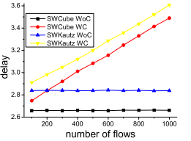
Evaluation of SWCube and SWKautz
Routing Simulation With Congestion
SWCube(13,2)
2028 servers
SWKautz(12,2)
1872 servers
Conclusion: Both SWCube and SWKautz have the capability of efficiently handling network congestion.

Slide 31
Conclusion
We propose the concept of Normalized Switch Delay (NSD), denoted by c, to unify the design and analysis of DCNs for dual-port servers.
We ask the following fundamental question: what is the maximum number of dual-port servers that any architecture can accommodate at most, given network diameter d, and switch port number n? And give an upper bound on this maximum number.
We propose two novel DCN architectures that try to achieve this upper bound. Comparisons with the existing one demonstrate various advantages. Evaluations on themselves show they have good properties for DCNs.

Slide 32
The End!
Thank you for your attention!
Questions?
dawei.li@temple.edu

