Slide 1
Cyber Security Defense: From Moving Target Defense to Cyber Deception
Jie Wu
Temple University

Slide 2
Outline
Offense vs. Defense
Cyber Deception in Offense
Deep Fake
Cyber Deception in Defense
Moving Target Defense
Challenges of Cyber Deception
Conclusions

Slide 3
1. Offense vs. Defense
The Art of War
All warfare is based on deception
Offense vs. Defense
Attack is the secret of defense
Defense is the planning of an attack
Cyber Deception
Both attacker and defender

Slide 4
2. Cyber Deception in Offense
New York Times (12/28/2020)
Designed to Deceive
Website Generated.Photos
“unique, worry-free” fake person for $2.99

Slide 5
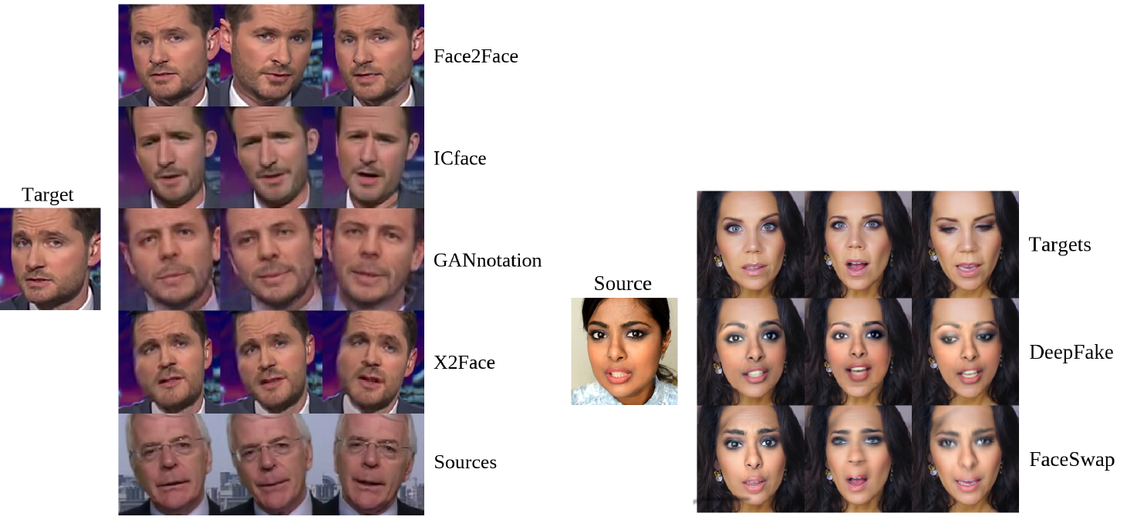
3. Deep Fake
Defend against facial forgery
Face reenactment
Face swapping
Face2Face, CVPR 2016
Architecture of deepfake defense systems
Notes:
Asymmetric advantage over attackers: defenders know more!

Slide 6
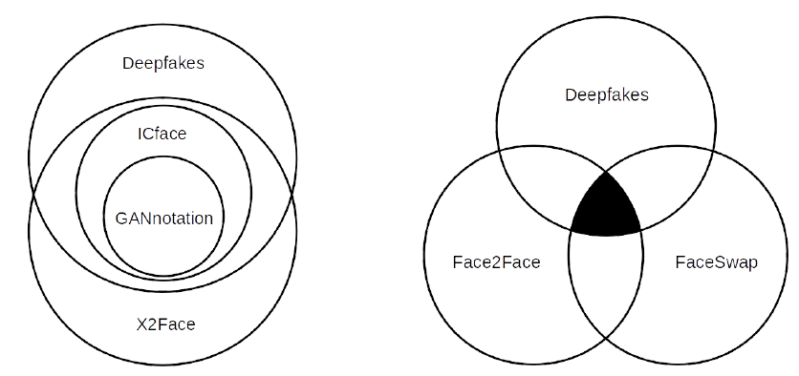
Deep Fake Detection
Limitation of current defense systems
Cannot defend against unseen attack methods
Features of different attack methods can be independent
Feature overlap among existing facial forgery techniques ^{[1]} (tested on MesoNet)
[1] J. Brockschmidt, J. Shang, and J. Wu., “On the Generality of Facial Forgery Detection”,
Proc of REUNS 2019 (Best Paper)
Notes:
Asymmetric advantage over attackers: defenders know more!

Slide 7
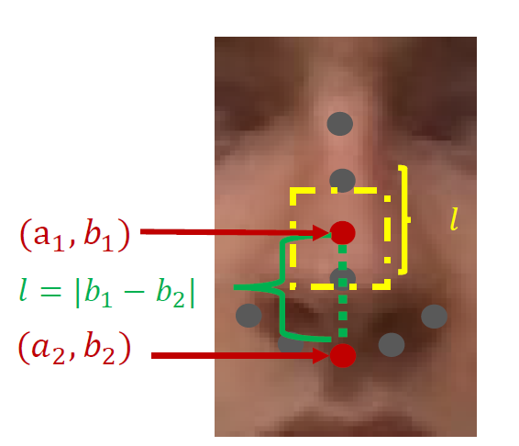
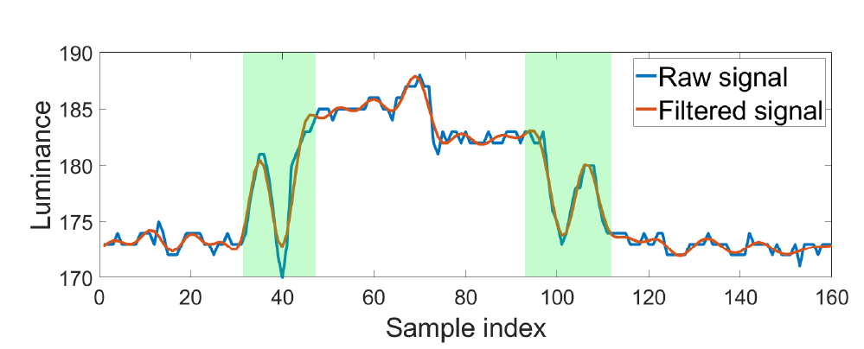
Deep Fake Detection (Cont’d)
Detection using side-channel information ^{[2]}
The screen light reflected off human faces
$$C=0.2126R+0.7152G+0.722B$$
[2] J. Shang and J. Wu, “Protecting Real-time Video Chat against Fake Facial Videos Generated by Face Reenactment”, Proc of ICDCS 2020
Notes:
where $C$ is the luminance value calculated using linear Red Green Blue (RGB) values. The coefficient of each color is assigned based on the human visual perception of brightness.

Slide 8
2. Cyber Deception in Defense
Cyber deception
Planned actions to mislead/confuse (i.e. trap) attackers
Goals
Complement detection, enhance prevention, and mitigate successful attacks
Unit and layer
Parameter, file, account, profile, …
Network, system, application, data, …
Life cycle of cyber deception
Collect knowledge of attacker
Implement deception schemes
Notes:
Concealment, camouflage, false and planted information, lies, displays, ruses, demonstrations, feints and insight
Masking, repacking and dazzling for dissimulation
Mimicking, inventing and decoying for simulation

Slide 9
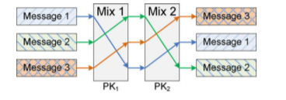
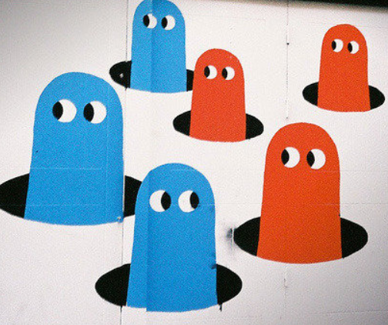
Types of Deception
Perturbation
Perturb sensitive data with noises
Mixing
Prevent linkability (mixing zone)
Obfuscation
Decoy targets and/or reveal useless info
Honey-X
Disguise honeypots as real systems
Moving target defense (MTD)
Change attack surfaces to increase
uncertainty and complexity for attackers

Slide 10
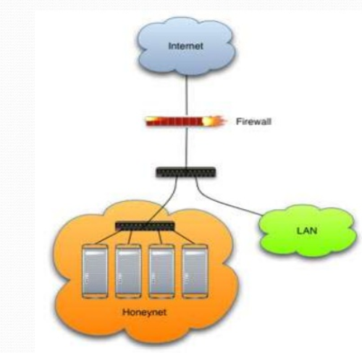
Honeypots and Honey-X
Honeypots
Bears: honey eaters
Traps
Honey-X
Honeynet: two ore more honeypots on a network
Honeyfile, honeyword, …

Slide 11
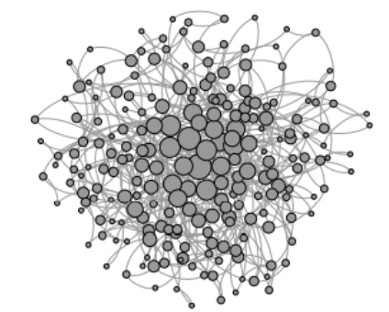
5. Moving Target Defense
Hierarchical military command chains
Network hierarchy
SDN controllers: load balance and fault tolerance

Slide 12
Self-Organizing Solutions
Local decision
P2P and simple interaction (mostly local and without sequential propagation)
Global functionality
Adaptive, robust, and scalable
Principles
P₁: Local interactions with global properties (scalability)
P₂: Minimization of maintained state (usability)
P₃: Adaptive to changes (self-healing)
P₄: Implicit coordination (efficiency)
Agility

Slide 13
MTD Applications
Connected Dominating Set (CDS)
Local decision:
backbone nodes
based on node priority (ID, degree, …)
Global properties:
Connectivity
Coverage

Slide 14
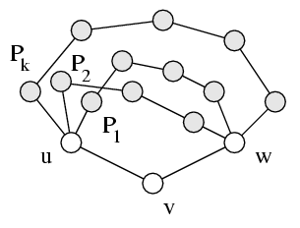
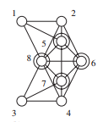
Application: Resiliency and Rotation
Redundancy: K-connected & K-dominated
Non-backbone node: K node-disjointed paths for any neighbor pairs (for multiple CDS)
Moving target defense: CDS rotation
Self Healing: How can we deal with the complexity of building a structure along with a change of topology ^{[3]}?
[3] J. Wu, “Uncovering the Useful Structures of Complex Networks in Socially-Rich and Dynamic Environments”, Proc. of IEEE ICDCS, 2017
Notes:
CIAA: Confidentiality, Integrity, Authentication, and Availability

Slide 15
4. Challenges of Cyber Deceptions
Limited Applications
Projected market to be $1B by 2020
Effectiveness
How to measure?
Game Theory and Learning
Ability of both attackers & defender

Slide 16
Limited Applications in Defense
Still limited in cyber deception, why?
Differences: cyber deception vs. deceptions in warfare
Domain: cyber vs. physical, social, …
Time: different scales, logical clock vs. physical clock (i.e., real time)
Space: virtual space vs. physical space
Speed: speed of light vs. physical space laws (e.g., movement of a tank)
Do not understand the attackers well: known vs. unknown
Know your enemies and know yourself
How to attract attackers to interact with them in cyberspace?
It is relatively easy to engage your enemies in a battle field

Slide 17
Effectiveness
Effectiveness measurement for attackers
Rate frustration in time and cost
Effectiveness measurement for systems
Time and place of attacker’s action
How much attacker’s resources are wasted (e.g. num. of packets)
How long before attacker break the system/ stop acting
How much valuable data are breached
And more…

Slide 18
Measurement
Lord Kelvin: If you cannot measure it, then we cannot improve it
Extended dependability that includes security
Mean time between security incidents (MTBSI)
Mean time to incident discovery (MTTID)
Mean time to incident recovery (MTTIR)
Performability: work completed before the next security breach
Degradation
B₁: Level 1 breach, 1,000 hrs
B₂: Level 4 breach, 5 hrs

Slide 19
Game Theory and Learning
Markov chain (MC)
Basic MC: transition probability
Semi MC: time and budget limit
Hidden MC: partially observable state (attacker/defense)
Stochastic repeated game
Learn the behavior of the attacker: learning theory
(0: healthy, 1: slightly damaged, 2: heavily damaged, 3: disabled)
Attacker
$$λ$$
0
1
2
3
Defender
$$μ$$

Slide 20
Learning: Cognitive Biases
Deception is strongly relied
on human psychology
Cognitive biases
Cultural biases
Power Distance Index (PDI)
Uncertainty Avoidance (UAI)

Slide 21
Final Thoughts
Cyber-deception: friend or foe?
Misinformation vs. disinformation
Disinformation is information that is deliberately false or misleading
Recent events in the world
Challenges
Identifying disinformation is not merely about the truth, but about referring the intent (to mislead)

Slide 22
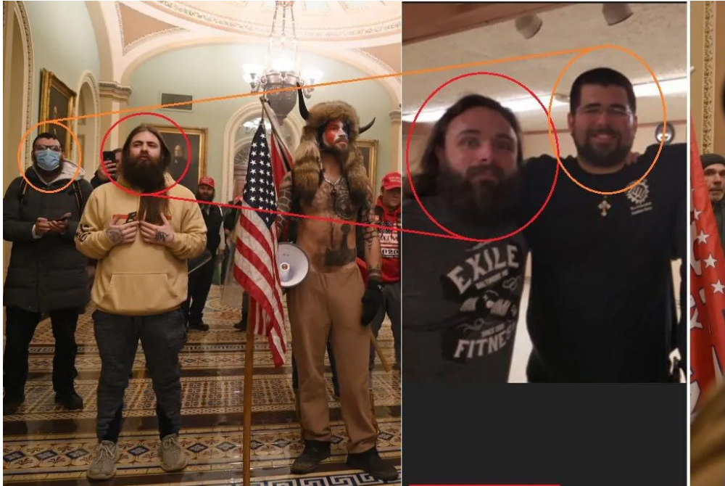
QAnon or Antifa?
An article in WeChat
US Capital Hill, 01/06/2021

Slide 23
Smarter Than You Think
Who is Smarter
Human or Computer?
Homo Dues: Man God
AI-designed software/media
Controls Homo Sapiens
Replaces human beings

Slide 24
5. Conclusions
Importance of cyber deception
Compliment to the existing security methods
Self-organized design for agility
Basic principles and challenges
Future
A better learning model for attackers/defenders
Security vs. ML
Game theoretical models
Science of security (S & P 2017)

