Slide 1
Algorithmic Solutions for Re-Balancing in Bike Sharing: Challenges and Opportunities
Jie Wu
Center for Networked Computing
Temple University
Notes:
1

Slide 2
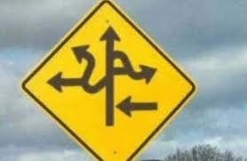
Road Map
  1. Introduction
  2. Four System Components
  3. Re-balancing Through Trucks
  4. Re-balancing Through Workers
  5. Spatial and Temporal Complexity
  6. Challenges and Opportunities
  7. Conclusion

Slide 3
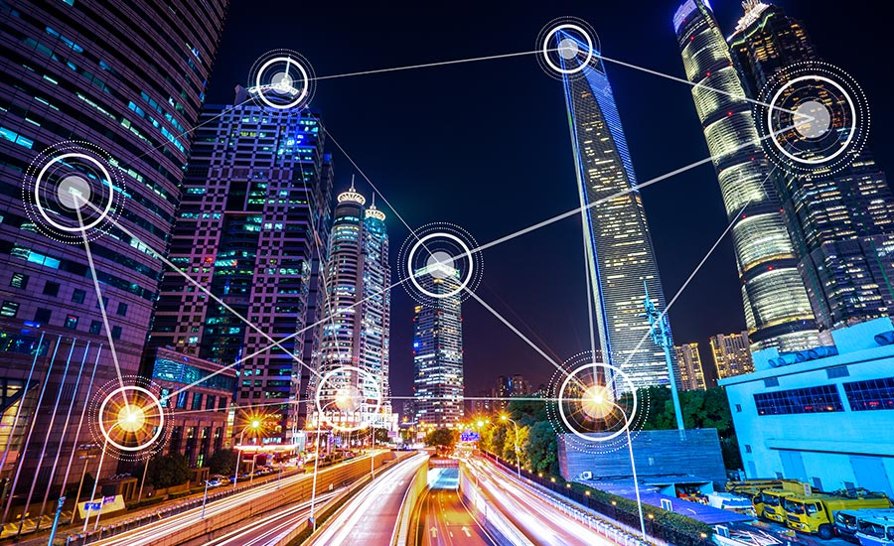
1. Introduction
  Smart City
    Collection of data
    Management of assets, resources, and services
  Scope
    Transportation
    Power plants
    Utilities
    Water supply
    Crime detection
    School
    Libraries
    Hospitals
    …
Notes:
Data buckets for TeraSort

Slide 4
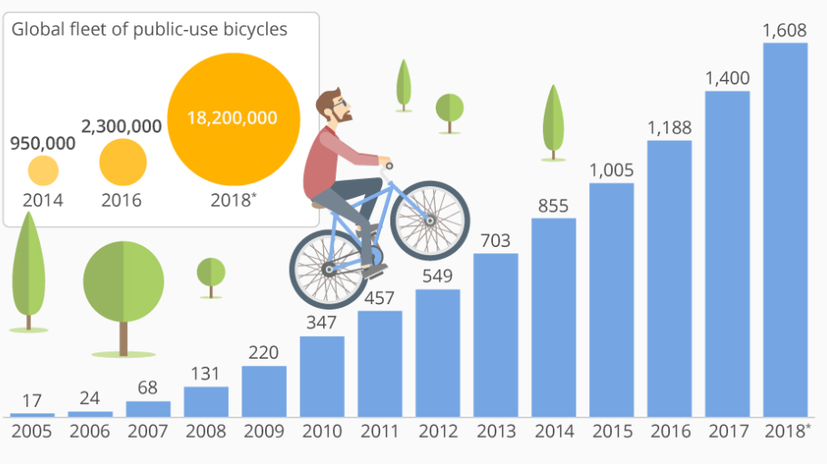
Bike Sharing System (BSS)
  BSS
    First/last mile connection
    Rent-Ride-Return
    > 1600 BSSs in > 50 countries
  Benefits
    Healthy lifestyle
    Green transportation
    40% of BSS users drive less
Notes:
Data buckets for TeraSort

Slide 5
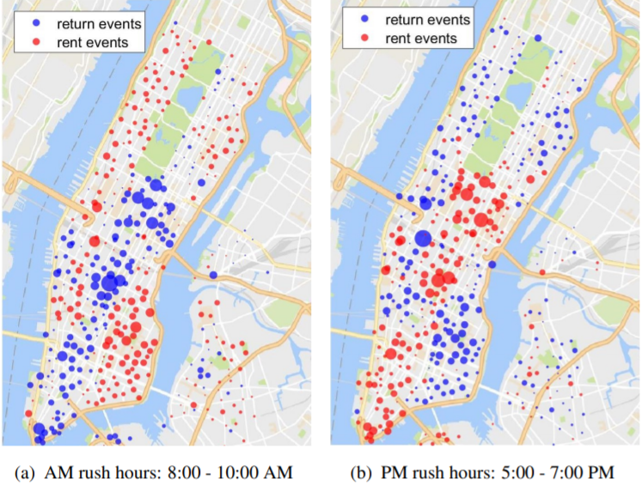
Unbalanced Usage in BSS
  Unbalanced usage
    Time
    Space
  Capacity
    Underflow (full stations)
    Overflow (empty stations)
Notes:
Data buckets for TeraSort

Slide 6
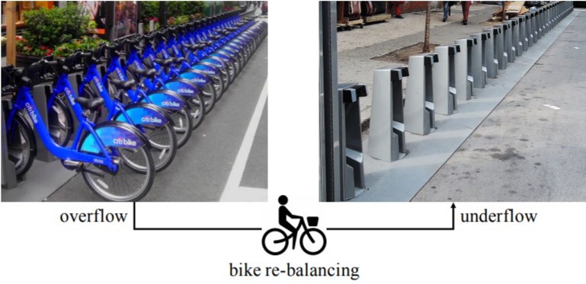
Re-Balancing in BSS
Dock BSS
Citi Bike (NYC), Indego (Philly),
and GoBike (Bay Area), …
BikeMi (Milan), Bubi (Budapest)
Dock-less BSS
ofo and Mobike (in China)
U-Bicycle and OV-fiets (Europe)
LimeBike and JUMP (US)
Re-balancing
Via truck
Via worker
Notes:
Data buckets for TeraSort

Slide 7
2. Four System Components
1. System design
Station number, location,
capacity, and bike number
Facility location problem: area
best for placing a station?
2. System prediction
Mobility modeling
Traffic prediction
3. System balancing
Dedicated truck service
Incentive-based worker
recruitment
Route planning and scheduling
4. Trip advisor
User guidance
Re-balance via suggestions

Slide 8
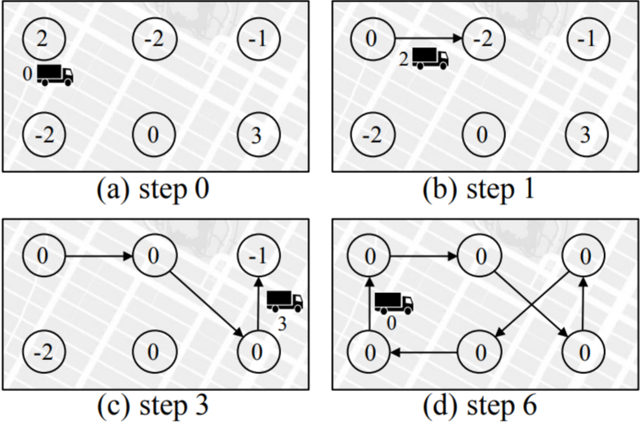
3. Re-balancing Through Trucks
Hamiltonian circle
Trucks move around stations
to pick-up/drop-off bikes
Notation
+m: overflow by m
-m: underflow by m
l: truck capacity
-l ≤ m ≤ l
Legitimate circle
Alternating positive pieces and
negative pieces s.t. capacity l

Slide 9
MATCH and GREED Methods
Assumptions
Predefined Hamiltonian cycle
Piece length limit: l’
MATCH method
l’: l/2, complexity: O(n³), bound: 6.5
Min-weight perfect matching:
pos., neg., and zero pieces
Visit each pair following the
seq. in the cycle
(1, 3, 7, 8, 4, 5, 6, 9, 2, 10, 1)

Slide 10
MATCH and GREED Methods
Assumptions
Predefined Hamiltonian cycle
Piece length limit: l’
GREED method
l’: l, complexity: O(n²)
Alternating pos. and neg.
following the cycle
(1, 2, 5, 6, 7, 8, 3, 4, 9, 10, 1)

Slide 11
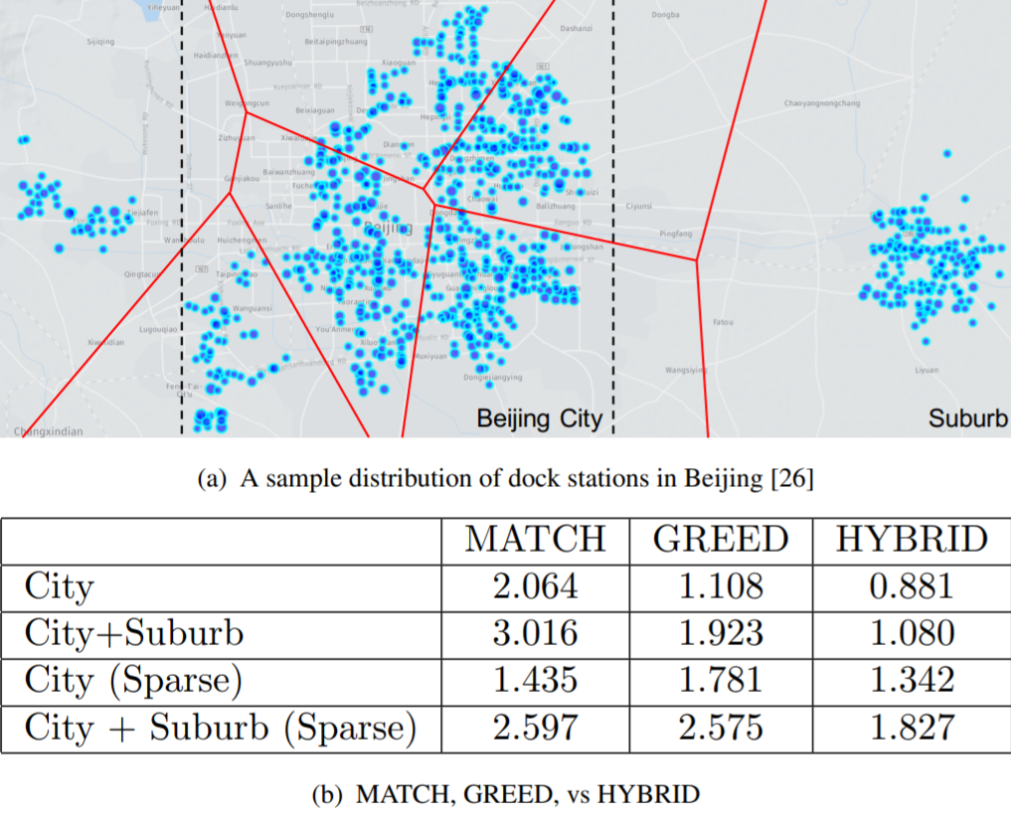
HYBRID Methods
MATCH
Sparse mode (primary)
Small geo-area (secondary)
GREED
Dense model (primary)
Large geo area (secondary)
HYBRID
Two-level hierarchy
MATCH for intra-cluster
GREED for inter-cluster
M. Charikar et al, Algorithms for capacitated vehicle routing, SIAM, 2001
Y. Duan, J. Wu, and H. Zheng, A greedy approach for vehicle routing, IEEE GLOBECOM, 2018

Slide 12
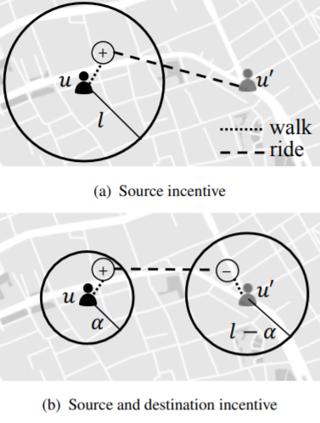
4. Re-balancing Through Workers
Through incentive
Workers are BSS users
Overflow: + and underflow: -
Monetary award prop.to distance
Dock-less incentive
Source detour bounded by l
Extensions with detour at both
source and destination
Y. Duan and J. Wu, Optimizaing Rebalance Scheme for Dock-less Bike Sharing Systems with Adaptive User Incentive, IEEE MDM, 2019

Slide 13
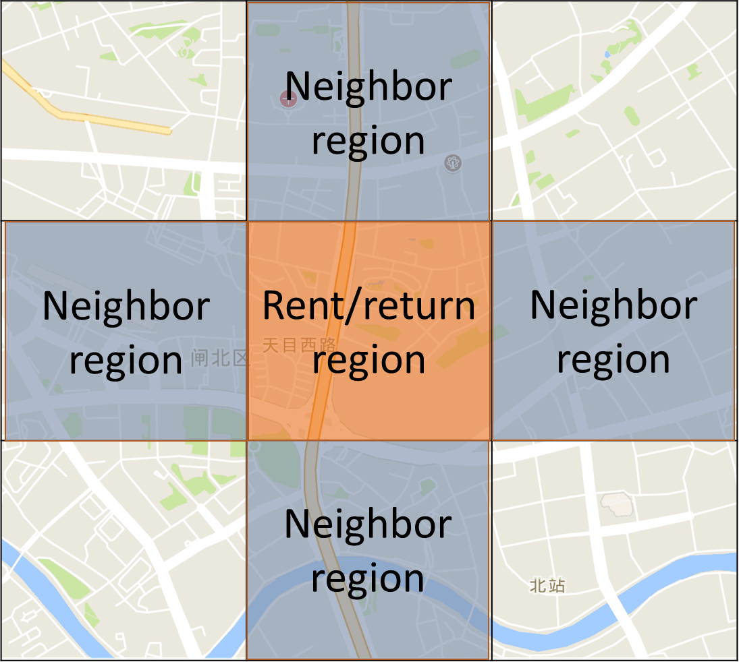
Incentive Simulation
Cost of detour $δ$
0 in original rent/return region
$ηδ^{2}$ in neighbor regions
    +$∞$ otherwise
Incentive
Learn optimal prizing from
usage dynamics
Higher rent (return) incentive
in overflow (underflow) regions
Mobike trace data

Slide 14





A Global Incentive Approach
Incentive
For both dock and dock-less
Deal with multiple workers
3-D perfect matching
  Match overflow station with
  underflow station
  Match users with a station pair
$$+$$
$$−$$
o
u
s
d
$$+$$
$$−$$
o'
u'
Y. Duan and J. Wu, Optimizing the crowdsourcing-based bike rebalancing scheme, IEEE ICDCS, 2019

Slide 15
  Approximation
3-approximation
Proof sketch:
Optimality of the two rounds of matching
Triangle inequality
Combining

Slide 16
5. Spatial and Temporal Complexity
Traffic dynamic: NYC Citi Bike dataset
weekdays
weekends
Notes:
Equal-cost multi-path routing (ECMP)

Slide 17
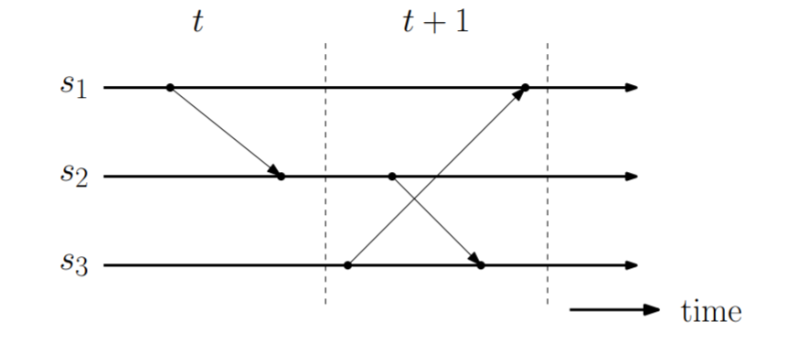
Time-Space View
Global state
Local state
Transition state
Cut: an event goes across
two slices
View
Horizontal line
  Status of local station
Vertical dotted line (slice)
  Time period between two
  slices
Slanted arrow
  Re-balancing event

Slide 18
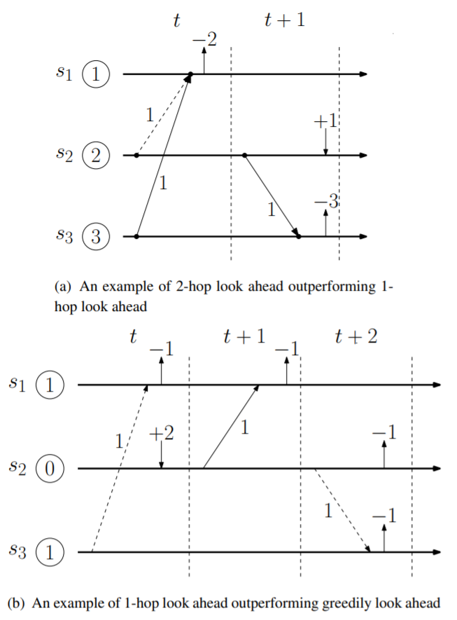
Frequency Reduction via Look-Ahead
K-hop look ahead
Once done in the current slice,
it can last at least k hops
Greedily look ahead
Uses look-ahead data to make a
target move so that the target
configuration can last the longest
Greedily look and act ahead
Cut ahead in any of next k slices
(instead of just the current slice)

Slide 19
Spatial and Temporal Domain Simulation
Spatial domain
On a single time slot
Given rebalance targets
Minimize worker detour
(BB: Branch & Bound , LS: Local Search, TRM: 2-Round Matching)
Temporal domain
Over multiple time slots
Minimize bike usage
(1-LA: 1-hop, 2-LA: 2-hop, GLA: Greedily)

Slide 20
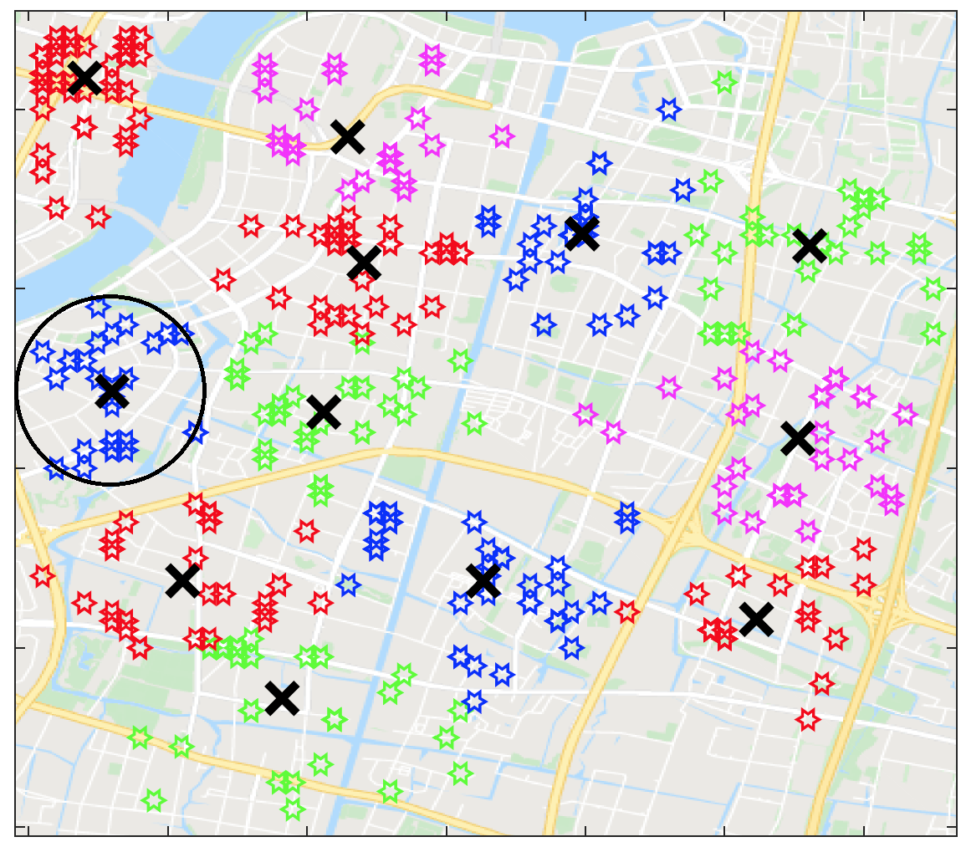
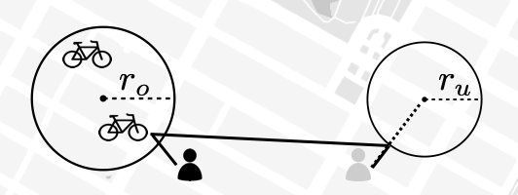
Extension to Dock-less Scenario
Virtual stations (VS)
Mesh grid
K-means
Density-Based Clustering
Rebalancing VS
Pick-up
  nearest in starting VS
Drop-off
  nearest in destination VS
Mobike Shanghai Dataset (08/01/16-08/31/16)

Slide 21
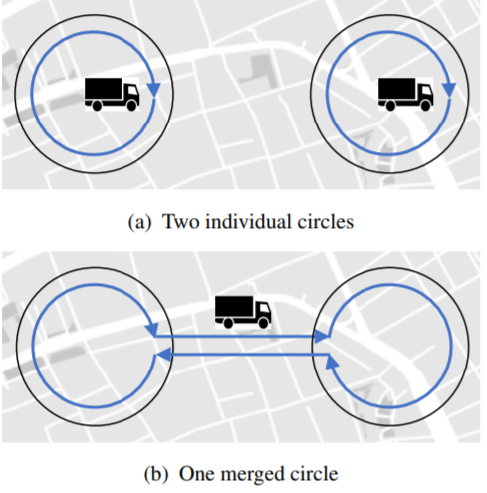
6. Challenges and Opportunities
Model extensions
Models with “cut”
Capacities for trucks and workers
Scalable design
Geometric partitioning
Clustering (k-means)
Other models
Bike recycling
Usage balance
Pricing (mechanism design)

Slide 22
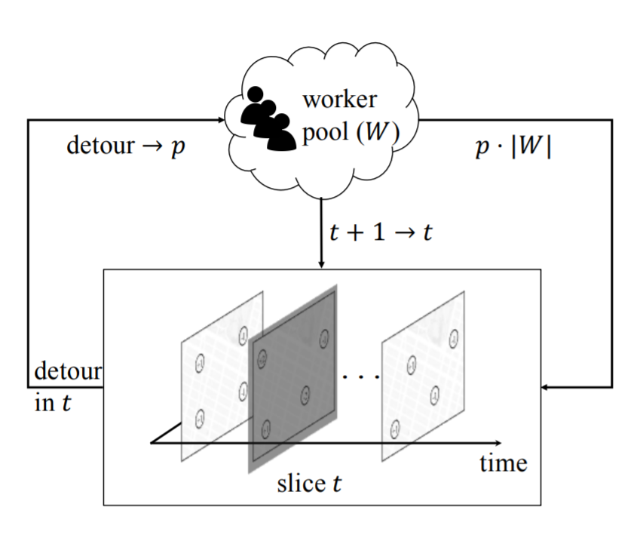
Challenges and Opportunities (Cont’d)
Gaming and Incentive
Stakelberg game
  BBS operators and workers
Nash equilibrium
  Subgames between homo-/hetero
  workers
Incentive
  Reinforcement incentive

Slide 23
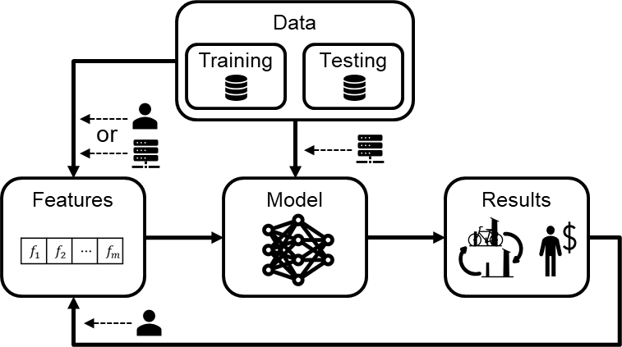
Challenges and Opportunities (Cont’d)
ML with data analytics
Effectiveness
  With the support of a large data set
  Challenges: biased samples, data
  sparsity, data missing
Explainable AI
  Hybrid approaches
Robustness
  Performance deviation due to the data
  perturbation

Slide 24
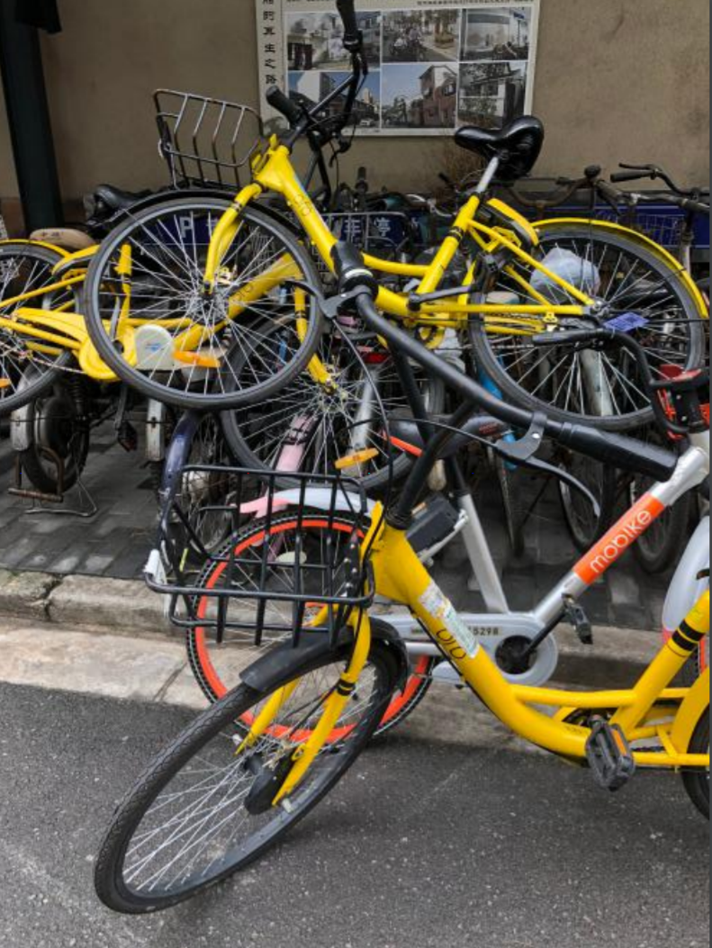
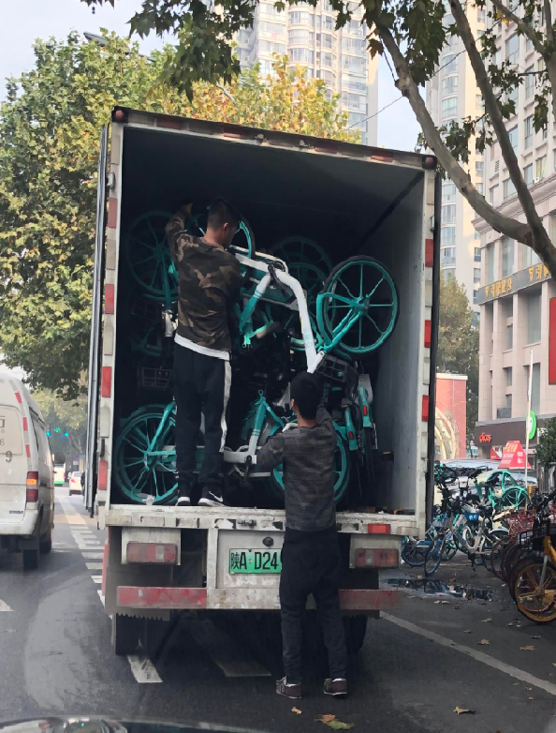
Challenges and Opportunities (Cont’d)
  Dock vs. dock-less BSS
  Flexibility
  Manageability
Trends
  Dock-less BSSs have appeared largely in US
  Ofo, the largest dock-less BSS in China, suffered financially

Slide 25
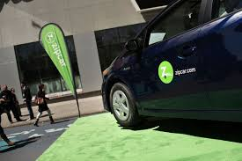
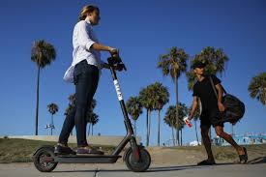
A Bigger Picture: Classification
Active transportation
Fixed (subway, bus, auto-shuttle)
On-demand (taxi, Uber, DiDi, Lift)
Hybrid (restricted on-demand)
Passive transportation
ZipCar (first/last ten-mile)
Bike/e-bike (first/last mile)
Scooter/e-scooter (first/last mile)

Slide 26
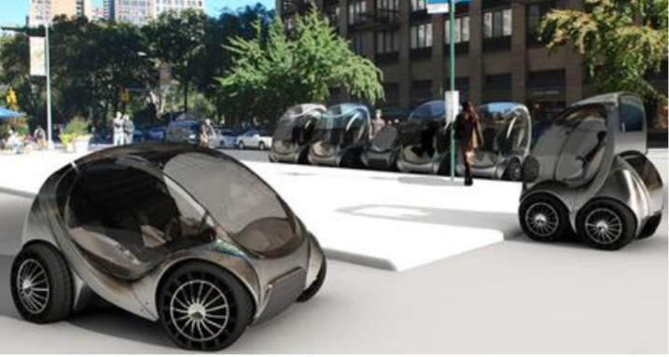
A Bigger Picture: Future of BSSs
Future
E-bike or two-wheeled e-scooters
Disappearing dock-less BSS in US
Policy
Shared responsibility
  Credit systems
Safety and regulation
  Sidewalk, bike lanes, and car lanes
  Scooter: sidewalk or bike lane?
  How about the folded-mini cars (in
  MIT’s CityCar Project)?

Slide 27
7. Conclusions
Bike Sharing Systems (BSSs)
  Bike re-balancing issue
Solutions
  Algorithmic solutions
  ML solutions with data analytics
Future of BSSs
  Policies and regulations
  Role in a smart-city ecosystem

