Slide 1
Android-Stego: A Novel Service Provider Imperceptible MMS Steganography Technique Robust to Message Loss
Temple University
College of Science and Technology
Computer and Information Sciences
Presenter: Lei Chen
Authors: Avinash Srinivasan, Jie Wu, and Justin Shi Temple University Computer and Information Sciences
Philadelphia – USA

Slide 2
Presentation Roadmap
Background
Steganography 101
Android-Stego
Overview, Salient Features, Process
Implementation
Robust to Operator Manipulation
Conclusion

Slide 3
Background
Information hiding (IH) –
extensively researched for over two decades
Steganography –
one type of IH
yet to be fully explored on smartphones over cellular carrier networks
Smartphones –
epitome of ubiquitous and pervasive computing
continue being the locus of one-device-for-all-needs
make steganography an easily accessible CC channel.

Slide 4
Steganography 101

Slide 5
The practice of concealing messages or information within other non-secret text or data.
Simple embedding techniques –
data are often hidden through the use of mathematical techniques
imperceptible to the naked eye
Sophisticated embedding techniques –
degradation in quality
payload change are perceptible

Slide 6
Steganography + Encryption
problem just got harder…..rather lot harder
Message encryption –
substantially harder to detect, extract, and recover message.
harder to use entropy-based statistical analysis
all encrypted data have very high entropy
7.5 - 8.0 bits-per-byte

Slide 7
Steganography drawbacks
Broad techniques have remained unchanged
Offer limited number of possibilities and algorithms

Slide 8
Steganography – Key Requirements
Cover file should be popular – its usage should not in itself be considered an anomaly.
AndroidStego meets this requirement.
Resultant modifications to the cover file should be imperceptible to a third-party
AndroidStego meets this requirement.

Slide 9
Android-Stego Prototype

Slide 10
Assumptions and Threat Model
Alice (sender) and Bob (receiver) use a PKI-based digital certificate for mutual authentication.
Alice and Bob can negotiate a shared session key spontaneously over an unsecured communication channel.
Unsecured channel is a channel that is vulnerable to sniffing/monitoring by – service provider, attacker, etc.

Slide 11
Process Overview
Splitting and encoding a secret message on the sender side
can be multi-part depending on message size; operator restrictions
Encoded secret message successfully traverses the cellular networks
transparent to network restrictions and operator manipulations
Decoding the received secret message on the receiver side
reassembly necessary if it is a multi-part message

Slide 12
Android-Stego Implementation
Insertion of a secret message into a single instance of the cover file is upper bound by the imperceptibility threshold (T_{imp}) to modifications.
AndroidStego meets this requirement by incorporating:
multi-part, segmented, and distributed capabilities into the LSB encoding algorithm.
can hide arbitrary binary data of arbitrary length – additional cover file instances are used if the secret message size > T_{imp}

Slide 13
Prototype is features:
robust to message loss resulting from cellular operator manipulations of MMS messages.
a segmented and distributed implementation built with LSB as the core encoding technique.
Prototype implementation-
real world working prototype – custom LSB implementation
modular, built with existing Android APIs
new features can be easily introduced, making it more capable in hiding, as well as robust to detection

Slide 14
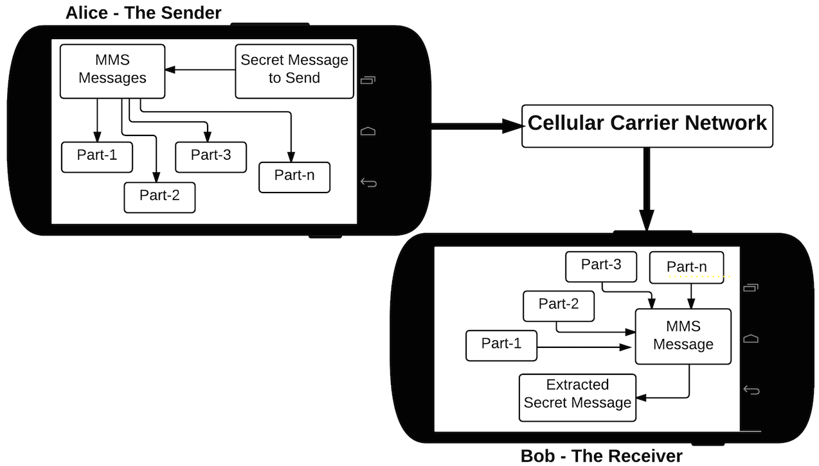
Generating MMS Stego
2
1
4
5
3
6
7
8

Slide 15
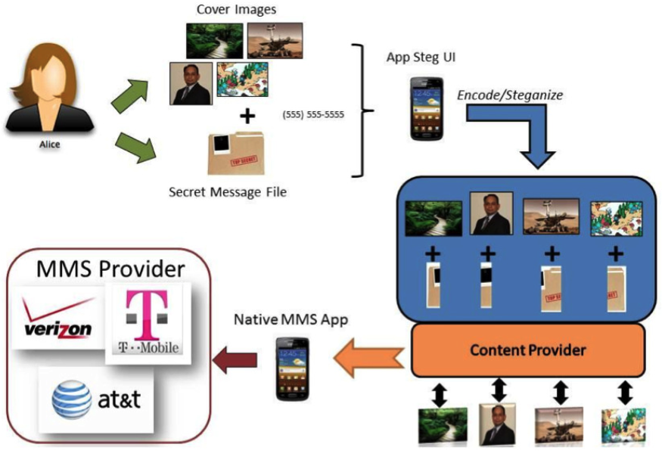
Embedding Secret Message
1
3
4
2
5
8
6
7

Slide 16
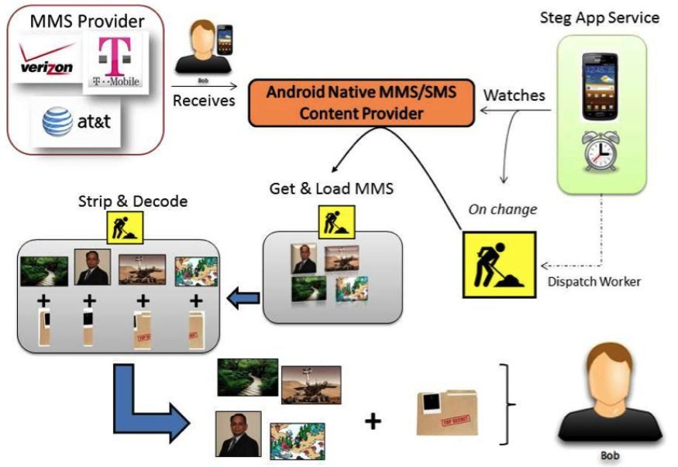
Extracting Secret Message
2
3
1
5
6
4
9
7
8

Slide 17
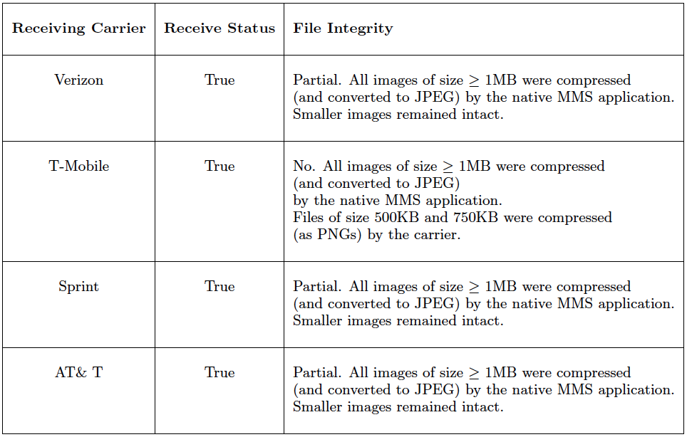
Table 2: Summary of cellular carrier restriction on in-coming MMS message size for four major cellular service providers in North America.

Slide 18
Conclusion(s)
Smartphones will increasingly be the locus of one-device-for-all-needs.
Steganography most easily accessible alternative for covert communication over smartphones.
Built a real-world working prototype – robust to cellular operator manipulations of MMS messages – results of of our prototype’s survival over four major cellular operators in North America has been analyzed and presented.

